Slide 1

TweetAnd
Android Application
Ali Al-Qalaf

Slide 2



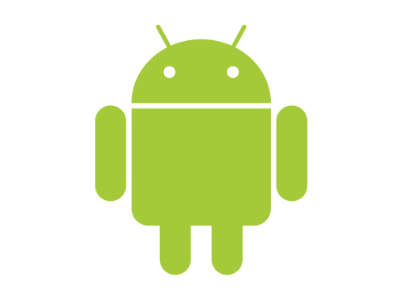


Technologies
Java.
Twitter API(user_timeline).
Google Gson.
Sql lite.
Android.

Slide 3



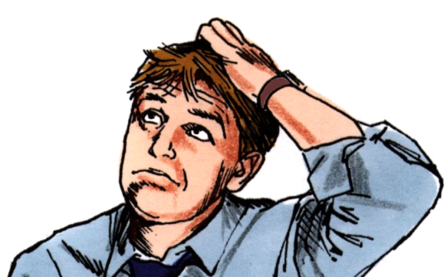

TweetAnd
Where Is Phone
android
I’m Here

