Slide 1

Interpretable Machine Learning (IML) Methods: Classification and Solutions for Transparent Models
9/12/2024
Alireza Ghaffar Tehrani,
Data Science Department
Notes:
Good morning,
Thank you for having me here. Today, I am discussing an aspect of modern AI —Interpretable Machine Learning, or IML for short. This is important as it bridges the gap between advanced ML techniques and real-world applications where trust, transparency, and understanding matter.
ML has great potential for improving products, processes, and research. But computers usually do not explain their predictions which is a barrier to the adoption of ML.
Complex AI models can sometimes act as black boxes as we don't know what's going on inside. While their decisions can impact industries, governance, and our daily lives, the reasoning behind these decisions isn't always clear. This is where IML comes into play. IML seeks to make these decisions transparent, understandable, and trustworthy.
I will focus on classification methods within IML and discuss various solutions that have been proposed to enhance the transparency of predictive models.

Slide 2
Agenda
Introduction to IML
Categories of IML Methods
Interpretable Methods in Supervised Learning
Interpretable Methods in Unsupervised Learning
Sample Examples
Challenges and Future Directions
Q&A
IML Methods: Classification and Solutions for Transparent Models
PAGE 2
Notes:
This is what we are going to cover together.
First I will provide you with an introduction to IML, Then we will see some categories of IML methods. We will follow with some IML methods in Supervised & Unsupervised paradigms.
Then we move on to some sample examples.
Toward the end, we'll discuss the challenges and future directions in this field, and point to some of the ongoing research and developments, and of course Q&A.

Slide 3
Introduction to IML
What is IML & why is it important?
IML Methods: Classification and Solutions for Transparent Models
PAGE 3
Notes:
So what is IML & why is it important?

Slide 4
Introduction to IML
What is Interpretability in Machine Learning?
Introduction to Interpretability
Explanation of Terms Interpretability and explainability
Practical Importance
IML Methods: Classification and Solutions for Transparent Models
PAGE 4
Notes:
Before we get into the details, it’s important to address the foundational question: what do we mean when we talk about interpretability in ML? Is it just about understanding models, or is it something broader?
Defining interpretability mathematically is challenging. The concept broadly relates to human’s ability to understand and trust the decisions made by ML models. It is all about how clearly we as humans can comprehend the reasons behind a model’s predictions or decisions.
Interpretability, is used interchangeably with explainability in this presentation. however, there is a nuanced technical distinction which lies in the depth and focus of the understanding process: interpretability is about the clarity of the decision-making process within the model, while explainability involves techniques to help humans understand and trust the model's outputs, even if the model's internal workings are complex. So interpretability focuses more on making our models transparent while explainability is about ensuring that these models can be understood by humans without needing complex explanations.
So the higher the interpretability, the easier it is to comprehend the decisions. Understanding this can help us build models that are not only effective but also align with ethical standards and public accountability. This is crucial, especially in applications involving critical decisions that affect people’s lives.

Slide 5
Introduction to IML
Definitions:
Miller (2017): "Interpretability is the extent to which an observer can comprehend the reasons behind a decision made by a model."
Kim, Khanna, and Koyejo (2016): "Interpretability is the extent to which a human can understand and consistently anticipate a model’s output."
Doshi-Velez and Kim: "Interpretability is the ability to explain or to present in understandable terms to a human."
Gilpin et al.: "Interpretability involves an ability to describe the internals of a system in a way that is understandable to humans, which varies depending on the target audience."
Lipton: "Interpretability is the ability to provide understandable explanations of how the model works or an explanation of why the model makes certain decisions."
Ribeiro et al.: "Interpretability is the degree to which an observer can understand the reasons behind a decision."
IML Methods: Classification and Solutions for Transparent Models
PAGE 5
Notes:
Here I have gathered some definitions of interpretability. Notice the recurring keywords across these definitions: comprehensibility, predictability, and the ability to explain or justify decisions made by models which is the same as what we discussed so far.
[These perspectives highlight a common understanding—that interpretability involves how easily a human can understand the workings and outcomes of a model.]

Slide 6
Introduction to IML
A Comprehensive Definition of IML
Interpretability refers to the extent to which a human can comprehend not only the decisions made by a model but also the underlying reasoning and causality that lead to these decisions. This involves clarity in the presentation of a model's processes and results, enabling straightforward insights into its operational mechanisms and justifications for its outputs.
IML Methods: Classification and Solutions for Transparent Models
PAGE 6
Notes:
Building on these definitions, we provide a deeper and more descriptive definition of IML. It’s not just about making the model’s decisions understandable but also about revealing the underlying reasons and causality behind these decisions. This ensures both the outcomes and the processes leading to them are clear, which brings trust and facilitates validation of the model’s behavior. So we extend the traditional framework of interpretability to emphasize its necessity for transparent and verifiable ML applications.

Slide 7
Introduction to IML
Significance of IML
The “What” vs. The “Why”
IML in Practice
Critical Domains for Interpretability
Beyond the Practical
Quick note: Transparency vs. Interpretability
IML Methods: Classification and Solutions for Transparent Models
PAGE 7
Notes:
You might ask "why not just trust the model's output? Why is it necessary to understand the underlying decisions it makes?"
The answer lies in the distinction between the 'what' and the 'why' of ML predictions. The "WHY" is exactly IML. Sometimes prediction alone does not fully address the complexity of the problem, we must also comprehend how the model arrived at its conclusion—the 'why'.
This particularly becomes critical in domains where decisions directly impact human lives, such as healthcare, the judiciary, and financial services, since we need to ensure that automated decisions are transparent and justifiable.
We could also think of other philosophical and ethical reasons including issues of fairness, accountability, and the prevention of bias.
Before continuing, let's note a crucial distinction between Transparency versus IML. Transparency is related to our understanding of how an algorithm models data to make decisions. It's about recognizing what the algorithm can learn and how it structures its learning process. For instance, algorithms like the least squares method for linear models are considered highly transparent due to their straightforward computational mechanics compared to neural networks. So generally Algorithm Transparency answers the question of “How does the algorithm create the model?”
On the other hand, Interpretability extends beyond mere transparency. It involves not only how the model is constructed but also explaining the specific reasons behind individual decisions made by the model.

Slide 8
Categories of IML Methods
What are the different paradigms in IML?
IML Methods: Classification and Solutions for Transparent Models
PAGE 8
Notes:
Here we explore the various categories of IML methods, which are essential for understanding how models make their decisions.

Slide 9
Categories of IML Methods
Model-specific(White-box) vs. Model-agnostic (Black-box)
Intrinsic vs. Post-hoc
Global vs. Local
IML Methods: Classification and Solutions for Transparent Models
PAGE 9
Notes:
Model-specific methods, often referred to as 'white-box' approaches, leverage internal model structures, like the weights of linear regression, to provide insights. This intrinsic approach ensures that interpretability is built directly into the model. In contrast, model-agnostic methods, or 'black-box' approaches, apply universally across different models regardless of their internal workings or parameters. These methods simulate changes in input to observe how predictions change, so they offer flexibility and robustness in interpreting various ML models.
Intrinsic interpretability is embedded in simpler, more transparent models such as decision trees or sparse linear models. These models are inherently easier to understand due to their straightforward structures. Post-hoc methods, on the other hand, are applied after a model is trained. They are designed to explain complex models whose inner workings are not immediately transparent, by analyzing how changes in input features affect outputs.
Global interpretability provides an overview of how a model makes decisions across all instances, often asking, "How does the model behave overall?" It's concerned with the aggregate insights across a wide range of data points. Local interpretability focuses on individual predictions, seeking to answer, "Why did the model make this specific decision for this particular instance?"

Slide 10
Human-friendly Interpretations
Attributes of Effective Explanations
Contrastive and Abnormal Insights in ML
Principles of Brevity, Fidelity, and Generalizability
IML Methods: Classification and Solutions for Transparent Models
PAGE 10
Notes:
We can come back to this slide if we have some extra time!
Why are certain explanations considered more effective, and how can these principles be applied to ML interpretations?" Let's explore the key attributes that make explanations effective in human contexts and adapt these for use in IML models.
Contrastive Nature: Humans prefer explanations that not only address the occurrence of an event but contrast it with a scenario where the event might not have occurred. In machine learning, effective interpretability tools, like LIME, provide contrastive explanations that highlight the differences that led to a particular prediction.
Focus on Abnormalities: In our everyday understanding, explanations often focus on abnormal or unexpected causes. Similarly, in machine learning, features that are atypical yet influential in a model’s prediction need to be highlighted to give meaningful insights.
Brevity and Selectiveness: Good explanations are typically concise and focused, providing just a few key reasons. This aligns with the approach taken by tools like LIME, which simplifies the complexity of models by offering the most decisive reasons behind a prediction.
Truthfulness and Fidelity: Just as explanations in social contexts are valued for their truthfulness, interpretable machine learning models strive for fidelity, ensuring that the explanations accurately reflect the model's behavior.
Consistency with Existing Beliefs: While challenging, aligning machine learning explanations with prior human beliefs is crucial for acceptance and trust, though it must be balanced with the need to avoid compromising on model accuracy.
Generalizability: Lastly, a good explanation should be applicable in a general sense, supported by frequent instances within the data. This makes the explanation not only robust but also more likely to be valid across different scenarios.

Slide 11
IML in Supervised Methods
Global & Local
IML Methods: Classification and Solutions for Transparent Models
PAGE 11
Notes:
Interpretable methods in supervised learning are essential for understanding and validating the decisions made by ML models. These methods can be broadly classified
into global and local approaches which were discussed before.

Slide 12
IML in Supervised Methods
Global Methods
Coefficients in Linear or Additive Models
Tree-Based Feature Importance
Backpropagation-Based Feature Attribution
Local Methods
LIME (Local Interpretable Model-agnostic Explanations)
SHAP (SHapley Additive exPlanations)
Saliency Maps
IML Methods: Classification and Solutions for Transparent Models
PAGE 12
Notes:
Global methods offer insights into the model as a whole. For instance:
1. Coefficients in linear or additive models are fundamental to understanding how these models make predictions.
In a linear model (including linear & logistic regression), the relationship between the input features and the output is expressed as a linear equation, where each input feature is multiplied by a coefficient, and the sum of these products yields the predicted output. This straightforward relationship allows for easy interpretation of how each feature influences the prediction by observing the coefficients' sign or magnitude.
Additive models extend the concept of linear models by allowing for non-linear relationships between the input features and the output while maintaining interpretability. These models, such as GAMs (Generalized Additive Models), express the output as a sum of functions of the input features. Each function represents the effect of an individual feature, allowing for a more flexible model that can capture complex patterns in the data while still being interpretable. The key advantage of additive models is their ability to capture non-linear relationships
while preserving interpretability.
2. Tree-based models, such as decision trees, and ensemble methods like random forests, provide powerful tools for feature importance analysis which is one of the key IML
features of these models. Feature importance provides insights into which variables are most influential in making predictions. These models inherently offer interpretability by
allowing users to examine the tree’s structure and understand how decisions are made based on the features.
3. Feature attribution methods play a critical role in understanding how individual features contribute to the predictions made by ML models, especially in neural
networks. Backpropagation-based feature attribution techniques leverage the backpropagation algorithm to trace and quantify the influence of input features on the model’s
output. This approach helps interpret complex models by providing insights into the decision-making process, making them more transparent and trustworthy.
[While training neural networks, the backpropagation algorithm adjusts the weights by propagating the error gradient backward through the network. This same mechanism can be used to determine the contribution of each input feature to a specific output. The core idea is to compute the output’s gradient with respect to the input features, which indicates how changes in the input affect the prediction.]
On the other side, Local methods focus on specific instances or predictions:
1. LIME is a popular technique used to interpret the predictions of ML models. LIME explains individual predictions by approximating the complex model locally with an interpretable one. This method is extremely useful when dealing with black-box models where understanding the decision-making process is crucial.
LIME works by perturbing the input data and observing the changes in the predictions. It then fits a simple, interpretable model (such as a linear model) to these perturbed data
points to approximate the behavior of the complex model in the vicinity of the instance being explained.
[The core idea of LIME is to generate local surrogate models that are interpretable and can mimic the behavior of the complex model for a specific instance. The steps involved
in LIME are as follows:
1. Perturbation 2. Prediction 3. Weighting 4. Surrogate Model 5. Explanation]
2. SHAP (SHapley Additive exPlanations) allocates each feature's contribution to a particular prediction, derived from cooperative game theory, providing a fair distribution of contributions among features.
3. Saliency maps are a technique used primarily in the field of deep learning, particularly with convolutional neural networks (CNNs) applied to image data. They help to visualize which parts of an input image influence the neural network's output by highlighting the most important pixels or regions that contribute to a decision.

Slide 13
IML in Unsupervised Methods
Global & Local
IML Methods: Classification and Solutions for Transparent Models
PAGE 13
Notes:
Unsupervised learning methods, while often more challenging to interpret than supervised learning models, also benefit from interpretability techniques. These methods can be divided
into global and local approaches, similar to those in supervised learning.

Slide 14
IML in Unsupervised Methods
Global Methods
Principal Component Analysis (PCA)
Spectral Embedding (Laplacian Eigenmaps)
Local Methods
Local Embedding
Locally Linear Embedding (LLE)
Neighborhood Embedding Methods
t-Distributed Stochastic Neighbor Embedding (t-SNE)
Uniform Manifold Approximation and Projection (UMAP)
IML Methods: Classification and Solutions for Transparent Models
PAGE 14
Notes:
In unsupervised learning, the interpretability of methods often revolves around understanding the structure and distribution of data without predefined labels.
Principal Component Analysis (PCA) and spectral embedding are two prominent global methods for interpreting unsupervised learning models.
1. PCA is a fundamental technique in unsupervised learning used to reduce the dimensionality of data while preserving as much variance as possible. It is widely used for its ability to simplify complex datasets, making them more interpretable.
PCA transforms the original variables of a dataset into a new set of variables, the principal components, which are orthogonal and ordered by the amount of variance they
capture from the data.
[The first principal component captures the most variance, the second the second most, and so on. This transformation makes the data more interpretable
by highlighting the directions of maximum variability, which often correspond to the most important underlying structure in the data.]
2. Spectral embedding methods are also techniques used to represent high-dimensional data in a lower-dimensional space while preserving the intrinsic structure of the data. Spectral embedding also known as Laplacian Eigenmaps works by leveraging the eigenvalues and eigenvectors of a similarity or affinity matrix constructed from the data.
For Local methods, we have:
Local embedding techniques also aim to represent high-dimensional data in a lower-dimensional space. Locally Linear Embedding (LLE) is a widely used method for local embedding. LLE operates by linearizing the local neighborhoods of data points and preserving these linear relationships in the lower-dimensional space.
Neighborhood embedding methods are essential for visualizing and interpreting the local structure of high-dimensional data. These methods focus on maintaining the relative
distances between data points within their local neighborhoods when projecting them into a lower-dimensional space. Two prominent neighborhood embedding techniques are t-Distributed Stochastic Neighbor Embedding (t-SNE) and Uniform Manifold Approximation and Projection (UMAP).

Slide 15
Sample Examples
Wine Quality dataset
IML Methods: Classification and Solutions for Transparent Models
PAGE 15
Notes:
Here I built a model for the Wine Quality dataset using various ML algorithms and evaluate their performance. I also used Explainable AI (XAI) libraries like LIME and SHAP in Python to gain insights into how the model is making its predictions. The Wine Quality dataset contains information about various physicochemical properties of different types of wines and their quality ratings. The aim is to predict the quality of wine based on its chemical properties.

Slide 16
Sample Example
Performed Steps
Load the dataset
Exploratory Data Analysis (EDA)
Data Preprocessing
Feature Selection
Model Building
Model Evaluation
Interpretability using LIME and SHAP
IML Methods: Classification and Solutions for Transparent Models
PAGE 16
Notes:
I performed the following steps:
1. Load the dataset
2. checked the shape of the dataset, the column names, the data types, and also missing values
We realized that the dataset contains around 7000 rows and 13 columns. The columns represent the various chemical properties of the wines, including fixed acidity, volatile acidity, citric acid, residual sugar, chlorides, free sulfur dioxide, total sulfur dioxide, density, pH, sulphates, alcohol, quality, and type. All columns except the 'type' column are numerical.
we also checked the distribution of the quality ratings in the dataset and realized We can see that the majority of wines in the dataset have a quality rating of 5 or 6.
then split the dataset into training and testing sets
Before building the model, we performed feature selection to select the most important features. We used the Recursive Feature Elimination (RFE) method with a Random Forest classifier.
We realized that the most important features for predicting the quality of wine was 'total sulfur dioxide', 'alcohol', 'quality', and 'type_red'.
We then used the Random Forest classifier as it performed well in the feature selection step.
then evaluated the performance of the model on the testing set using the mean squared error (MSE) and R-squared score.
We could see that the model has an MSE of 0.36 and an R-squared score of 47%, which indicates that it is not performing very well. So we used LIME and SHAP to gain insights into how the model is making its predictions and see if we can improve its performance.

Slide 17
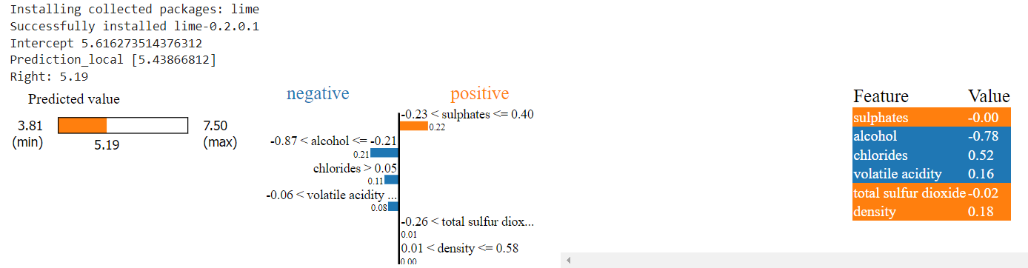
Sample Example
Interpretability using LIME
IML Methods: Classification and Solutions for Transparent Models
PAGE 16
Notes:
The LIME explanation shows that the model predicts a wine quality of 5.19 for the given input. The most important features for this prediction are sulphates, alcohol, and chlorides. The values of these features are also shown, along with their contributions to the prediction.

Slide 18
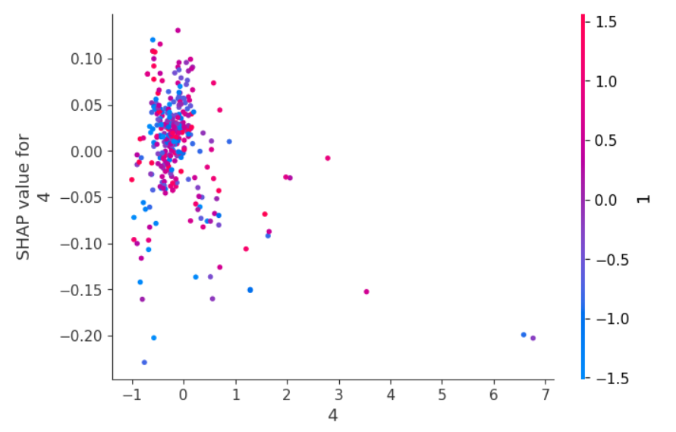
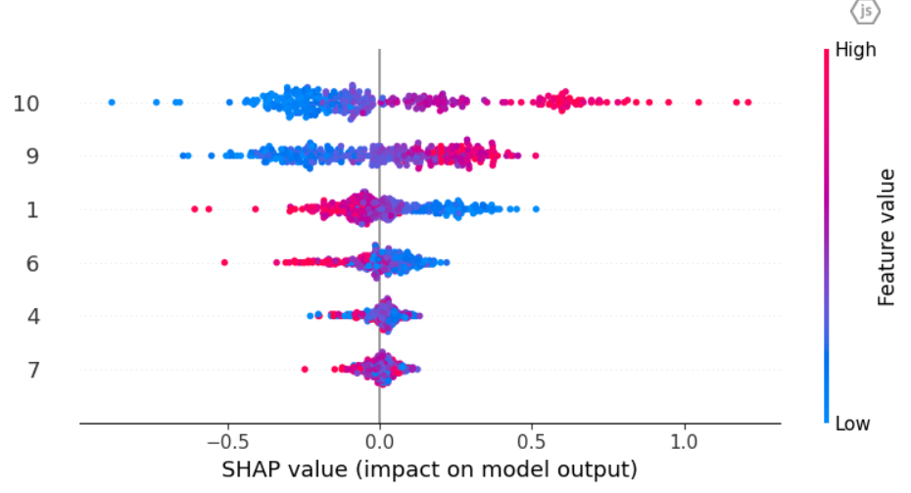
Sample Example
Interpretability using SHAP
IML Methods: Classification and Solutions for Transparent Models
PAGE 16
Notes:
The SHAP waterfall plot shows the contributions of each feature to the prediction of the first test instance. We can see that the most important features are sulphates, alcohol, and chlorides, which is consistent with the LIME explanation.
So here we built a model for the wine quality dataset using Random Forest regression. We also performed feature selection and evaluated the performance of the model on the testing set. Finally, we used LIME and SHAP to gain insights into how the model is making its predictions and identified the most important features. We can use these insights to improve the performance of the model in future iterations.

Slide 19
Challenges and Future Directions
IML Methods: Classification and Solutions for Transparent Models
PAGE 17
Notes:
IML has made significant progresses in recent years, but several challenges remain that prevent its common adoption and effectiveness.

Slide 20
Challenges and Future Directions
Current Challenges
Gaps in the Literature
Potential Research Directions
Development of Hybrid Models
Standardization of Interpretability Metrics
Scalability Improvements
Domain-Specific Interpretability
Interdisciplinary Approaches
IML Methods: Classification and Solutions for Transparent Models
PAGE 18
Notes:
One of the primary challenges in IML is achieving a balance between model complexity and interpretability. Complex models such as deep neural networks often provide higher predictive accuracy but are difficult to interpret.
Another significant challenge is the lack of a universally accepted definition of interpretability.
Moreover, the field faces issues related to the scalability of interpretability techniques. Many current methods are computationally intensive and do not scale well with large
datasets or complex models
Several gaps in the existing literature need to be addressed to advance the field of IML. Firstly, there is a need for more robust theoretical foundations for interpretability methods.
Many existing techniques are empirical and lack a strong theoretical backbone, which can weaken their reliability and generalizability.
There are also some potential Research Directions for instance:
1. Combining interpretable and complex models in a hybrid approach
2. Establishing universally accepted definitions and metrics for interpretability
3. Enhancing the scalability of interpretability techniques to handle large datasets and complex models
4. Conducting more research on domain-specific interpretability techniques tailored to the unique needs and challenges of different fields
5. Exploring the interplay between interpretability and
other critical aspects such as fairness and privacy requires interdisciplinary collaboration

Slide 21
References
Zhi-Hua Zhou. Machine Learning. Springer Singapore, Singapore, 2021.
Christoph Molnar. Interpretable machine learning: a guide for making black box models explainable. Christoph Molnar, Munich, Germany, second edition edition, 2022.
Ethem Alpaydin. Machine learning. The MIT Press essential knowledge series. The
MIT Press, Cambridge, Massachusetts, revised and updated edition edition, 2021.
Doshi-Velez, Finale, and Been Kim. "Towards a rigorous science of interpretable machine learning." arXiv Preprint arXiv:1702.08608. (2017).
Gilpin, Leilani H., et al. "Explaining explanations: An overview of interpretability of machine learning." 2018 IEEE 5th International Conference on Data Science and Advanced Analytics (DSAA). IEEE, 2018.
Lipton, Zachary C. "The mythos of model interpretability." Queue 16.3 (2018): 31-57.
Miller, Tim. "Explanation in artificial intelligence: Insights from the social sciences." arXiv Preprint arXiv:1706.07269. (2017).
Kim, Been, Rajiv Khanna, and Oluwasanmi O. Koyejo. "Examples are not enough, learn to criticize! Criticism for interpretability." Advances in Neural Information Processing Systems (2016).
Rudin, Cynthia. "Stop explaining black box machine learning models for high stakes decisions and use interpretable models instead." Nature Machine Intelligence 1.5 (2019): 206-215.
IML Methods: Classification and Solutions for Transparent Models
PAGE 18
Notes:
One of the primary challenges in IML is achieving a balance between model complexity and interpretability. Complex models such as deep neural networks often provide higher predictive accuracy but are difficult to interpret.
Another significant challenge is the lack of a universally accepted definition of interpretability.
Moreover, the field faces issues related to the scalability of interpretability techniques. Many current methods are computationally intensive and do not scale well with large
datasets or complex models
Several gaps in the existing literature need to be addressed to advance the field of IML. Firstly, there is a need for more robust theoretical foundations for interpretability methods.
Many existing techniques are empirical and lack a strong theoretical backbone, which can weaken their reliability and generalizability.
There are also some potential Research Directions for instance:
1. Combining interpretable and complex models in a hybrid approach
2. Establishing universally accepted definitions and metrics for interpretability
3. Enhancing the scalability of interpretability techniques to handle large datasets and complex models
4. Conducting more research on domain-specific interpretability techniques tailored to the unique needs and challenges of different fields
5. Exploring the interplay between interpretability and
other critical aspects such as fairness and privacy requires interdisciplinary collaboration

Slide 22
Q&A
IML Methods: Classification and Solutions for Transparent Models
PAGE 19
Notes:
Thank you for your attention. I welcome any questions or clarifications you might have.
19

Slide 23
Thank you!
IML Methods: Classification and Solutions for Transparent Models
PAGE 20
Notes:
Thank you for your attention. I welcome any questions or clarifications you might have.
20

Slide 24

PRESENTATION TITLE
PAGE 21

