Slide 1
L&N KITCHEN
Menu Website
Upgrade Proposal
Live Grill category screenshots · phased roadmap · fixed investment of ₦1,850,000
Prepared for L&N Kitchen leadership · August 2026

Slide 2
Agenda
• Live product walkthrough — customer (mobile, Grill category) & admin dashboard
• Where we are today and the upgrade opportunity
• Proposed vision and upgrade pillars
• Phased delivery roadmap
• Fixed cost breakdown — ₦1,850,000
• Expected outcomes and recommended next steps
L&N Kitchen · Menu Website Upgrade Proposal · 2/14

Slide 3
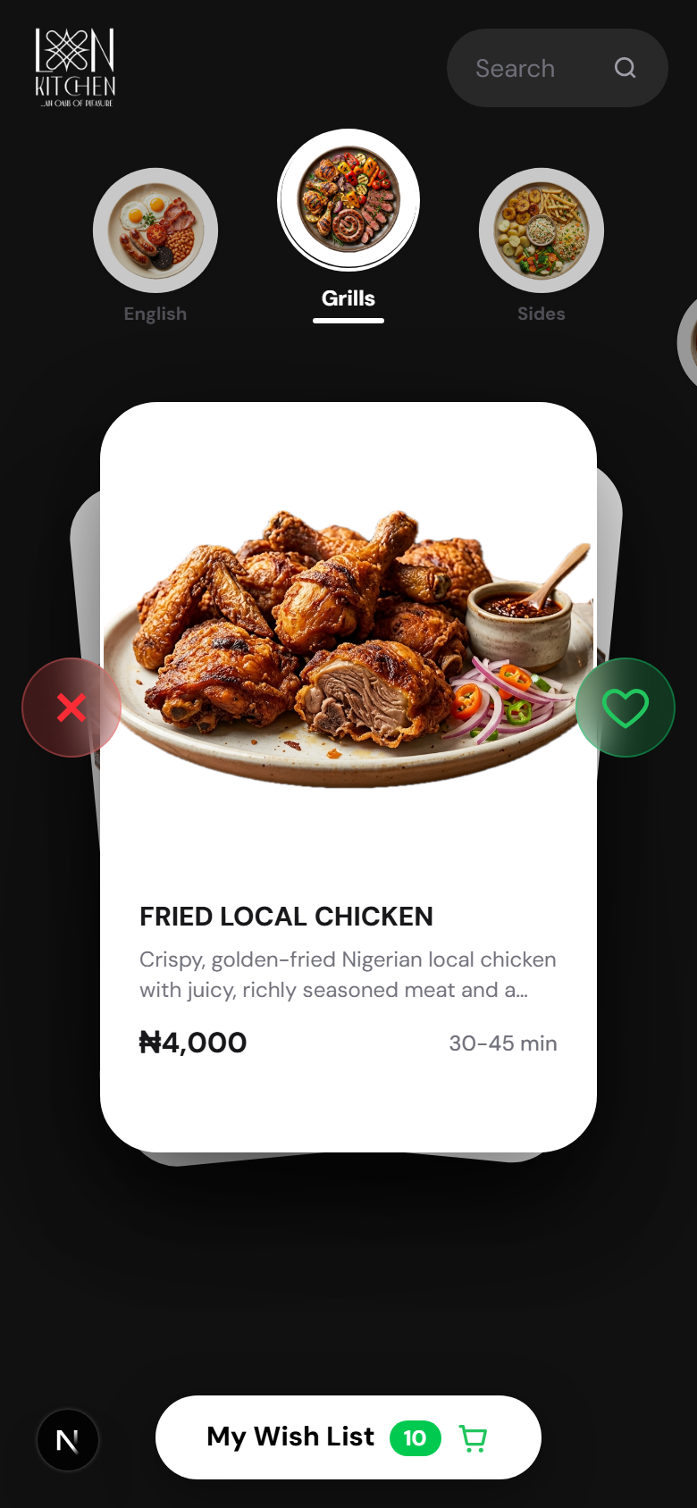
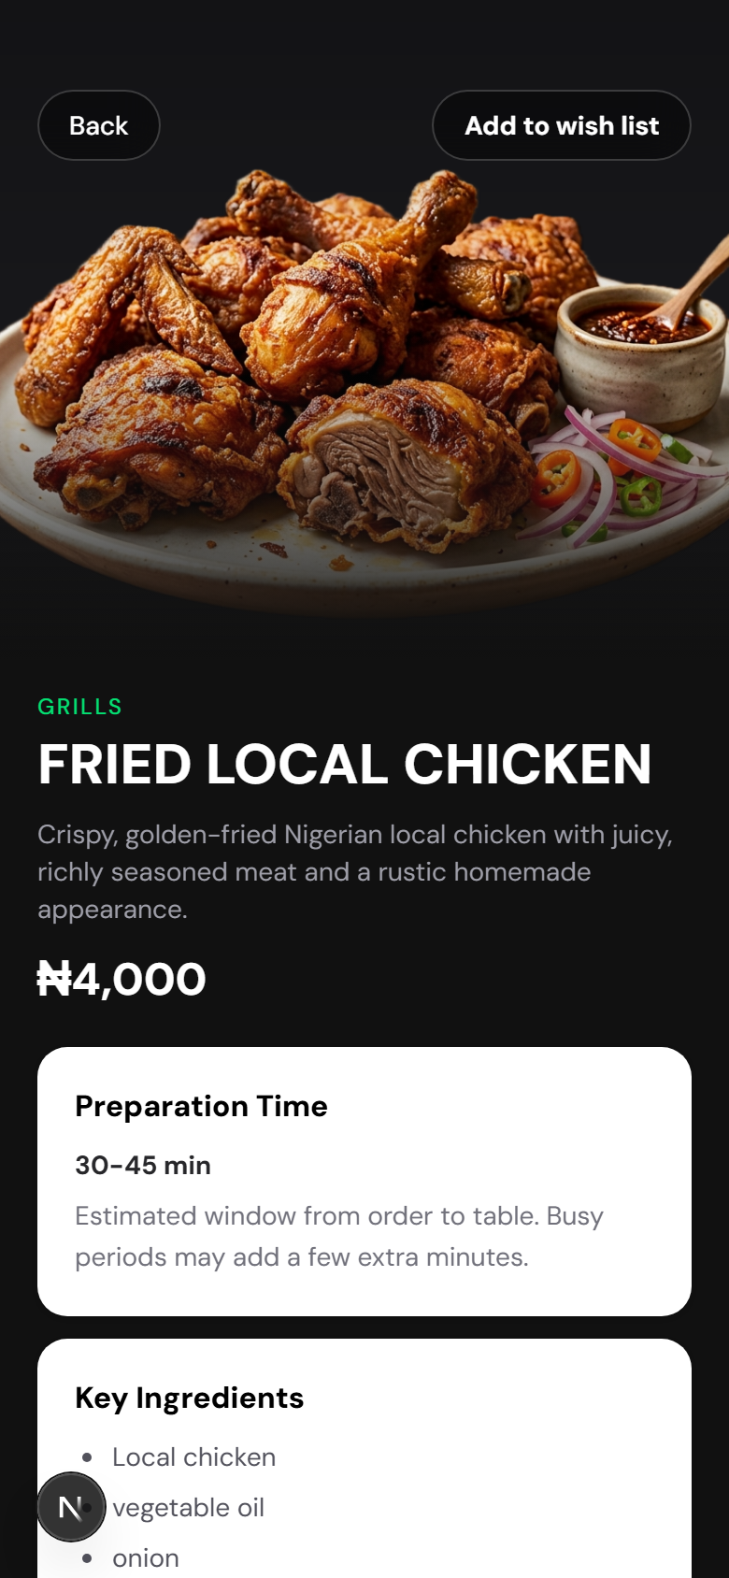
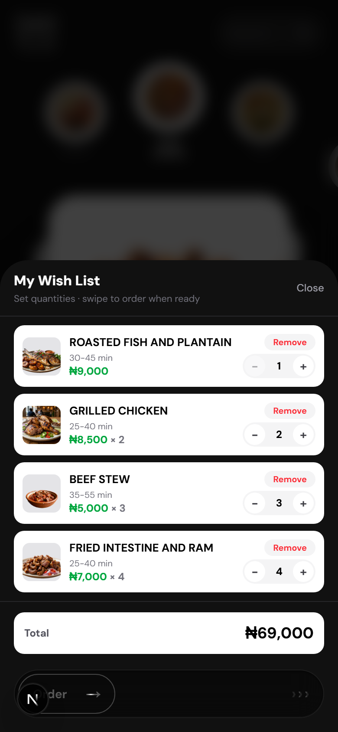
Customer experience (mobile)
Grill category · swipe deck, dish detail, wish list
Swipe menu — Grill
Dish detail
Wish list
L&N Kitchen · Menu Website Upgrade Proposal · 3/14

Slide 4
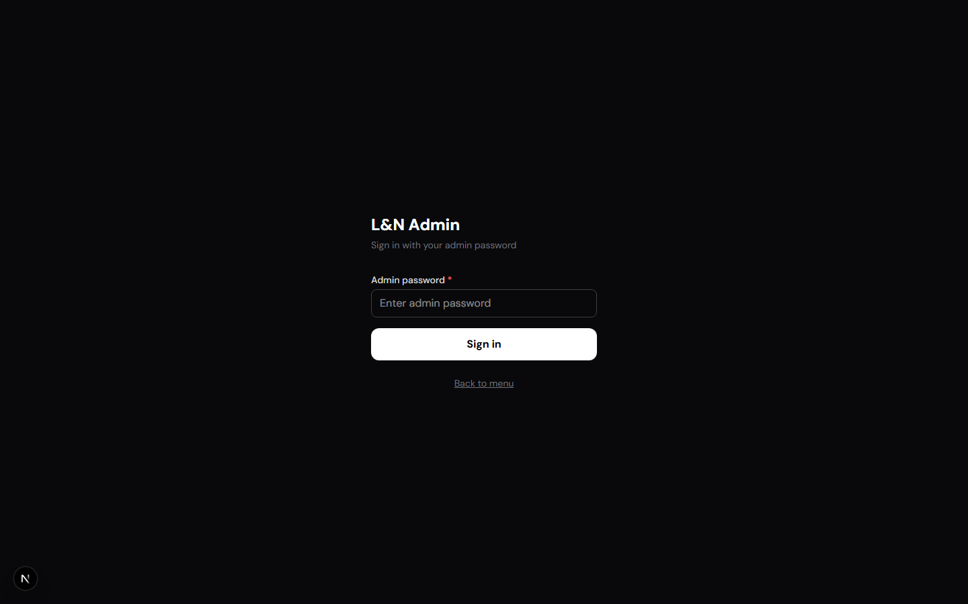
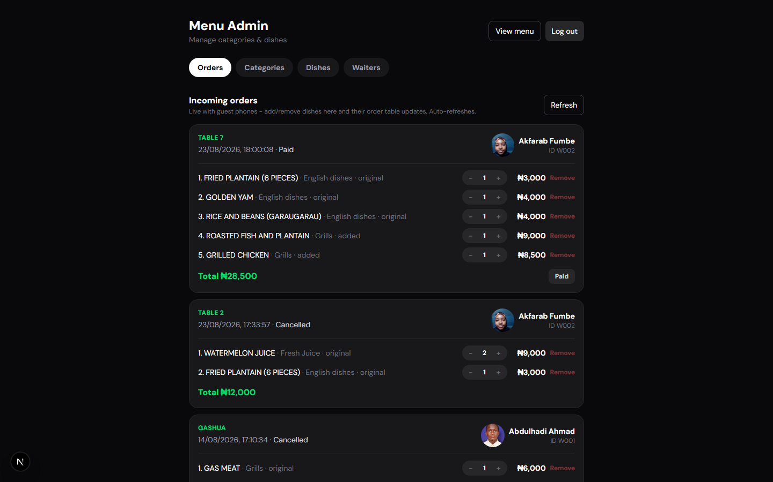
Admin — login & live orders
Secure sign-in and live order control with Mark paid
Admin login
Orders dashboard
L&N Kitchen · Menu Website Upgrade Proposal · 4/14

Slide 5
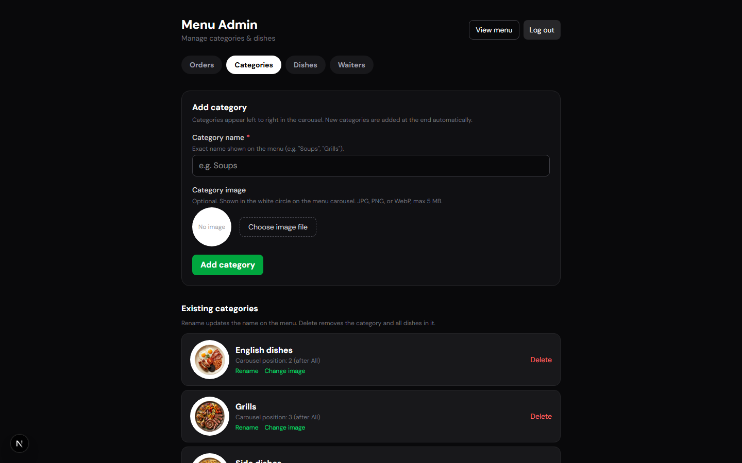
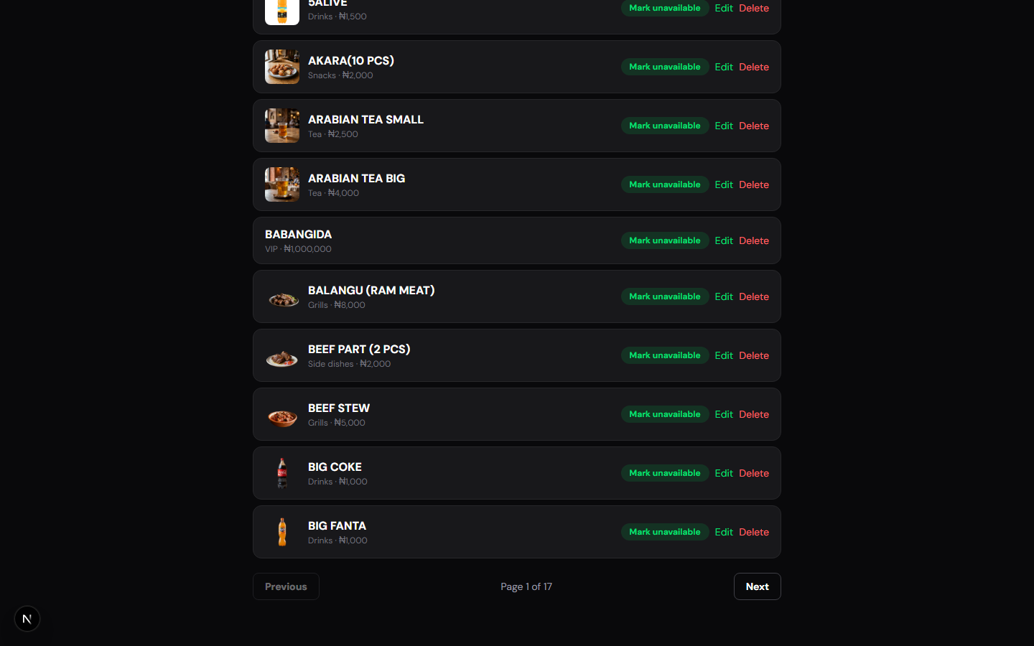
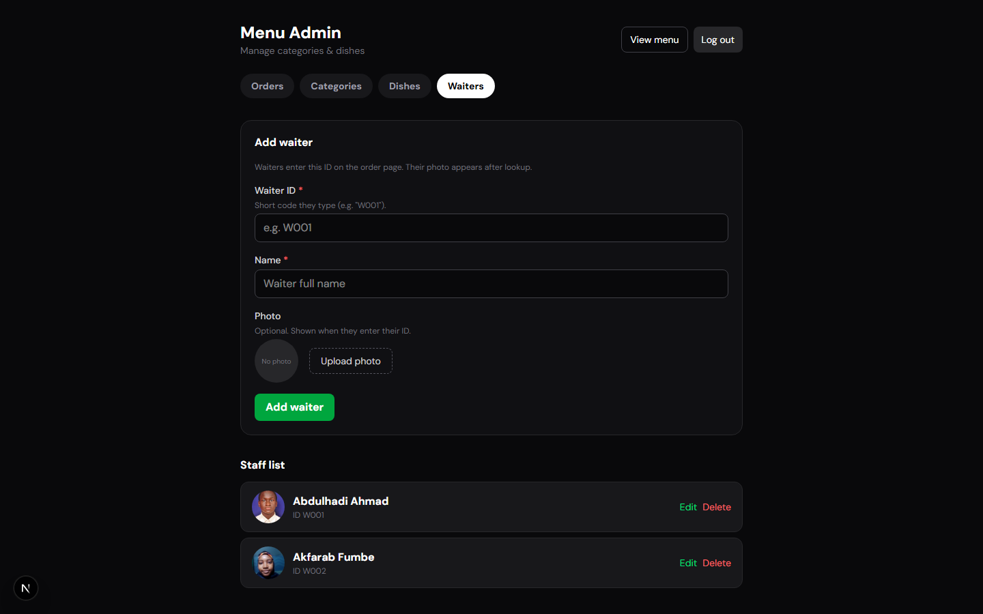
Admin — menu & staff CMS
Categories, dishes, and waiter profiles
Categories
Dishes
Waiters
L&N Kitchen · Menu Website Upgrade Proposal · 5/14

Slide 6
Current state
Already live in the L&N Kitchen system
Guest menu
Floor operations
Admin control
Mobile swipe card deck
Category carousel & search
Wish list + trash restore
Dish detail & allergens
QR share for waiter pickup
Live sync after assign
Session reset after payment
Waiter scans guest QR
Table / lounge capture
Assign to admin (one-shot)
Order image download
Staff ID waiter profiles
Orders dashboard
Accept / mark paid
Edit live order items
Categories & dishes CMS
Availability toggles
Waiter management
L&N Kitchen · Menu Website Upgrade Proposal · 6/14

Slide 7
Opportunity & vision
• Turn the in-venue phone menu into a branded L&N web destination
• Reduce paper / chat-order mistakes with one source of truth
• Give kitchen and lounge shared live status from guest → paid
• Use order data for bestsellers, peak hours, and staff insight
• North star: digital hospitality that feels as curated as the food
L&N Kitchen · Menu Website Upgrade Proposal · 7/14

Slide 8
Upgrade pillars
01 Brand & web
02 Guest journey
03 Ops excellence
04 Growth
Public landing + menu site
SEO / share previews
Desktop-friendly browse
Story & atmosphere
Table join via QR
Multi-guest shared order
Status timeline
Receipts & feedback
Kitchen display (KDS)
Printer / alerts
Shift reports
Role permissions
Promos & set menus
VIP / lounge packages
Analytics dashboard
Loyalty hooks
L&N Kitchen · Menu Website Upgrade Proposal · 8/14

Slide 9
Phased roadmap
Everything below is covered by the ₦1,850,000 package
Phase 1 — Polish
Weeks 1–3
Phase 2 — Shared dining
Weeks 4–7
Phase 3 — Kitchen
Weeks 8–12
Phase 4 — Growth
Weeks 12–14
• Public brand landing
• Desktop menu browse
• Status UX clarity
• Analytics basics
• Multi-guest table order
• Guest status timeline
• Waiter alerts
• Dietary filters
• Kitchen display
• Print / notify hooks
• Roles & audit
• Shift reports
• Promos & set menus
• VIP packages
• Loyalty hooks
• SEO polish
L&N Kitchen · Menu Website Upgrade Proposal · 9/14

Slide 10
Cost breakdown — ₦1,850,000
Fixed package investment (One Million, Eight Hundred and Fifty Thousand Naira)
Workstream
Amount (NGN)
Share
UX / UI design & brand landing page
₦300,000
16%
Public website + desktop menu browse
₦350,000
19%
Guest journey upgrades (shared order, status, filters)
₦400,000
22%
Waiter & kitchen ops (KDS, alerts, roles, reports)
₦450,000
24%
Analytics, staff training & 30-day support
₦200,000
11%
Project contingency & QA buffer
₦150,000
8%
TOTAL PACKAGE
₦1,850,000
Includes delivery of Phases 1–4 in the roadmap. Hosting / domain billed separately if not already covered.
L&N Kitchen · Menu Website Upgrade Proposal · 10/14

Slide 11
Suggested payment schedule
Tied to delivery milestones within ₦1,850,000
On kickoff · 40%
Phase 1–2 demo · 30%
Phase 3–4 handoff · 30%
₦740,000
Brand assets collected, Phase 1 starts
₦555,000
Public site + shared dining live
₦555,000
Kitchen ops + growth features + training
L&N Kitchen · Menu Website Upgrade Proposal · 11/14

Slide 12
Expected business outcomes
Faster turns
Fewer errors
Higher attach
Clearer orders and paid resets reduce dead time between guests
One digital source of truth vs handwritten or chat tickets
Upsell-ready UI for VIP, sides, and set experiences
Brand lift
Staff clarity
Insight
A website that feels like L&N — not a generic PDF menu
Waiters and admin share the same live order state
Know what sells, when, and which tables convert wish lists
L&N Kitchen · Menu Website Upgrade Proposal · 12/14

Slide 13
Recommended next steps
Approve package
Confirm ₦1,850,000 scope and preferred payment schedule
1
Brand workshop
Logo, photos, hours, location, VIP / lounge story
2
Kick off Phase 1
Public site + desktop browse — first visible upgrade
3
Pilot on floor
Train waiters; capture friction notes for Phase 2–3
4
L&N Kitchen · Menu Website Upgrade Proposal · 13/14

Slide 14
L&N KITCHEN
Let’s make the menu feel like
the oasis guests already love.
Fixed investment: ₦1,850,000 · Phases 1–4 included · Ready to kick off on approval

