Slide 1
NYSE Analysis

Slide 2
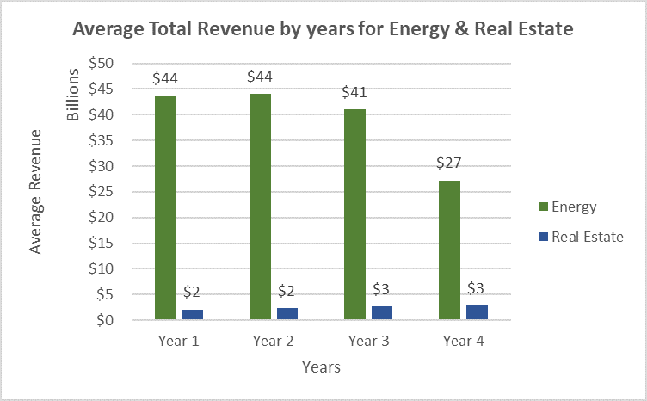
Does the Energy sector have total revenue similar to the Real Estate sector ?
Here is a column chart for the average total revenue by years for energy & real estate sectors.
based on the figure we can clearly conclude that there is a big difference between the average for both sector in all four years.
The average for the energy sector in the four years is between 25 to 45 billions. while the average for the real estate sector is between 2 to 3 billions approximately.

Slide 3
Additional Details
The median for the energy sector is $11,777,257,500
while the median for the real estate is $2,088,012,500 . It looks like that 50% of the companies in the energy sector have a higher total revenue on average than 50% of the companies categorized under the real estate Sector.
The standard deviation for the energy sector is also much higher with $79,864,818,250. while the real estate sector is $1,998,872,108 . There's a higher variability of Total Revenues in the energy sector compared to the real estate.
and finally , the range for the energy sector is $450,327,296,000
and for the real estate sector $10,446,414,000 . It looks like companies in the energy sector have more significant variability in the total revenues they receive because their range is more spread out.

Slide 4
Thank you

