Slide 1
INTRODUCTION
MATHEMATICS…

Slide 2
Objectives
By the end of this session you will understand…
The Mathematical Formalization of Data and its Relationships
The Role of Mathematics in Data Science
By the end of this session you will have…
Drawn the graph of several functions by hand
From Data Points
From Formulae

Slide 3
What is Mathematics?
A language about order
Informal
Contextual
Concise
Arbitrary
Communicative
Order
Objective: statements about order may be true or false independent of any person
Relative: statements are relative to / expressed with a measurement system

Slide 4
Why learn Mathematics?
Analyse Data
Find Relationships
Find Best Estimates
Description
How is the data distributed?
What is the mean profit?
What is its shape?
How disperse are profits?
Where do observations cluster?
Do we profit from all age groups?
Inference
Prediction
What value should I expect?
When will I make the most profit?
Causal Analysis
Does changing X necessarily change Y?
Do people who eat organic food live longer because they eat the food?

Slide 5
What Mathematics do I need to know?
Data Analysis
Variables: To describe Data
Functions: To describe Relationships
Descriptive Statistics: To describe the structure of Data
Data Science
Inferential Statistics: To Predict and Conclude
Probability: To Simulate and Interpret Data
Linear Algebra: To Describe, Process and Interpret Data
Machine Learning & Artificial Intelligence
Calculus: To Find Unknown Relationships using Changes in Known Relationships

Slide 6
Data
Structured Data
Tabular aka. Data Frame
Rows and Columns
Correlation
Association between Columns
Columns
Variables, Features, Covariates
Rows
Observations, Examples, Cases

Slide 7


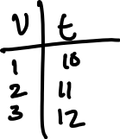

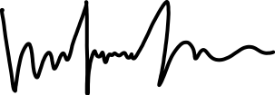
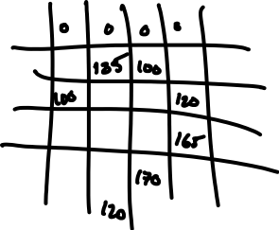

Structuring Unstructured Data
Images
Audio

Slide 8









Variables
A variable may take any value in a set/domain
A variable with an index is a particular observation
A variable without an index means “any value in the domain”
A continuous variable lies on a number line with a value at any location, eg. 1.1, 1.0001, 1.11
A discrete variable has only one of a fixed number of values, eg. 1, 2, 3

Slide 9
Observations
A (random) variable can take any value in its allowed domain
However we may not observe particular values, or observe some more than others
The frequency of observations for a given variable is its distribution
You can also interpret the distribution as how probable it to observe a particular value (hence a probability distribution)

Slide 10





Relationships between Variables
We need a formal description of relationships between variables
A function is a mathematical relationship between two or more variables
Which describes how to transform one variable so that it becomes the other
Age | Purchases/Year
15 | 0
18 | 3
… | …
60 | 7

Slide 11








Functions vs. Algorithms
An algorithm describes a sequences of actions to perform
A mathematical function describes the relationship between two (or more) variables
For any given mathematical relationship there are many (very different) algorithms which could calculate values
To calculate requires an algorithm. Mathematics merely expresses.. It is possible to exp[ress relationships for which no algorithm exists (eg., a sum of all the real numbers).

Slide 12
Generating Data from Functions
To draw a function or better understand what it describes we need to run some data through it

Slide 13

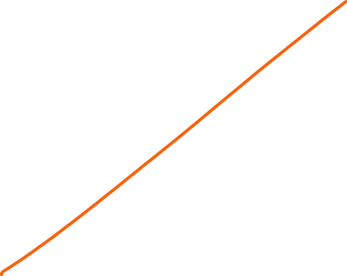
Plotting Data
An axis line represents the range of values each variable may take
A dot represents an observation at a particular pair of variable values
A line connecting the dots represents the relationship between the variables for all possible values they may take
eg., the line says

Slide 14





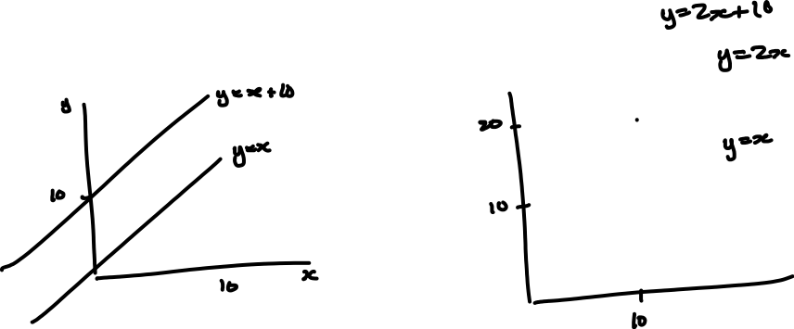

Interpreting Plots

Slide 15
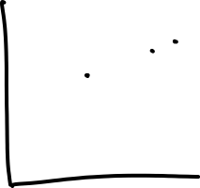






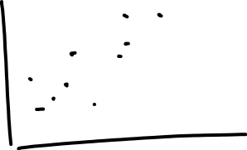


Finding Functions from Data
Guess a line (ie., guess a value for the slope, a, and the intercept, b)
Calculate the error for each point (distance from observation yi to the prediction using the line y^i)
Move the line around until the total error is minimized
The TOTAL error considers the distance from EVERY point which has the effect of dragging the line to a place where each point is “balanced” with respect to the others

Slide 16







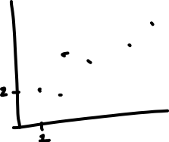
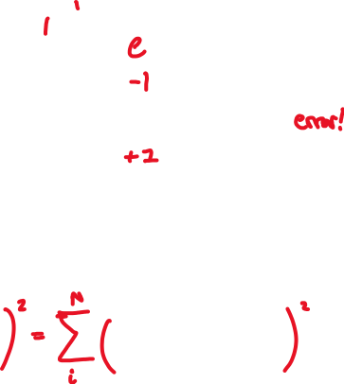



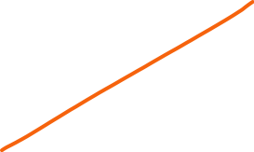



Linear Regression

Slide 17



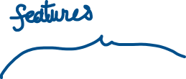



Notation in Machine Learning
In machine learning we are typically trying to infer the relationship between some “input” variables to an output.
The convention is to call the known or observed features X
And the target variable Y
Formulae relate some Xs to some Ys
To distinguish the column a subscript is used
Since we rarely talk about specific observations (we are relating variables)
A row index is not usually needed
When present it is sometimes given as a superscript

Slide 18













Notation in Machine Learning: Greek
Greek letters provide a different alphabet which is useful for conveying information
Eg., constants (terms which only ever have one value, not a range) may be written in greek

Slide 19
Summary
Mathematics communications relationships between variables
Variables may take on any value in a given set
Functions

