Slide 1

ALPHA RESEARCH REPORT
Seven signals.
One research
discipline.
The hypotheses, ablations and test results
behind the submitted pool.
HYPOTHESIS / FALSIFICATION / EVIDENCE
01 / 23
Notes:
[0:00–0:20] Thanks for having me. Over the next twenty minutes or so I'll walk through the seven alphas I submitted, one at a time, three slides each: the economic idea and how the signal is built in code, the tests that tell us whether the mechanism is real, and the slow-run results with the PnL. Five are price, volume and event signals; the last two are accounting-based. I want to put the emphasis on how each was found and tested, not on selling the numbers. Four of the seven sit within 0.004 of the bar, and I'll be upfront about that.
SOURCE SLIDE CONTENT (for reference)
Alpha Research Report
The hypotheses, ablations and test results behind the submitted pool

Slide 2

ALPHA RESEARCH
01 / CLOSING PRESSURE
IDEA
Closing pressure reverses overnight.
THE ECONOMIC IDEA
Index funds, ETFs and benchmarked managers care when they trade. One-sided closing flow pushes the print.
CONSTRUCTION
push = close / vwap_last_hour - 1
alpha = -push
THE PREDICTION
Liquidity providers demand an overnight concession. Two-sided flow returns next morning; the push unwinds.
Why the last-hour VWAP?
A robust reference price: where the last hour’s volume actually traded.
The test that matters
Is this closing-auction pressure, or ordinary short-term reversal?
Closing imbalance
Next morning
Bogousslavsky & Muravyev (2023) · schematic illustration; construction shown as pseudocode
02 / 23
Notes:
[0:20–1:50] Factor one, closing pressure. A big and growing share of US volume trades at the close, and most of it isn't informed: index funds and ETFs have to trade at the closing price to track their benchmark, benchmarked managers trade there to minimize tracking error, leveraged ETFs rebalance mechanically in the direction of the day. These traders care about when, not price. So when closing flow leans one way, it pushes the print away from value. Whoever takes the other side holds that inventory overnight, the riskiest time to hold it, so they demand a concession. The next morning normal two-sided flow returns and it unwinds. Bogousslavsky and Muravyev document this. The construction is two lines. "push" is how far the close sits from the last hour's VWAP. VWAP is where the last hour's volume actually traded, so it's a robust reference price; the close is the auction print. The alpha is minus push: short the stocks pushed up into the close, long the ones pushed down. It's a dimensionless ratio, so no ranking or winsorizing is needed, and the platform demeans it within industry. The interesting part is how I know this isn't just short-term reversal, so the tests come before the results.
SOURCE SLIDE CONTENT (for reference)
FACTOR 1 OF 7 · CLOSING PRESSURE
Closing pressure reverses overnight
Economic motivation
Index funds, ETFs, and benchmarked managers trade at the close: they care when they trade, not at what price.
One-sided closing flow pushes the print; liquidity providers want a concession to carry it overnight.
Two-sided flow returns next morning and the push unwinds (Bogousslavsky & Muravyev 2023).
Prediction: a close above where the last hour actually traded falls back the next day.
Construction
# how far the close sits from where
# the last hour's volume traded
push = close / vwap_last_hour - 1
alpha = -push
vwap_last_hour: a robust reference price, where the last hour's volume actually traded
2

Slide 3
ALPHA RESEARCH
01 / CLOSING PRESSURE
ABLATIONS
The late-day push carries the signal.
ret1 ≈ (vwap_lh / prev_close − 1) + (close / vwap_lh − 1)
TRADE EACH PART AS REVERSAL
One-day delay: 0.08 → 0.02
Rest of the day
0.005
Rapid decay fits an overnight unwind. The same delay leaves −ret5 intact.
Whole day (−ret1)
0.025
PnL correlation: 0.17 / 0.05
Versus −ret1 and −ret5; the two reversal baselines correlate 0.65.
Late-day push
0.079
Rejected a higher-IR version
Last-hour close stopped varying after 2011. Its 0.10 slow IR came from 2008–10; VWAP restored coverage.
Fast-mode IR unless stated · same stocks, days and universe · original data-field failure disclosed
03 / 23
Notes:
[1:50–3:00] The obvious objection: the close-versus-VWAP move is part of the daily return, and short-term reversal is a known factor. So I split the day's return into two pieces that add up to ret1: the move from yesterday's close to the last-hour VWAP, and the late-day push from VWAP to the close. Same stocks, same days, same universe; they differ only in when the move happened. If this were generic reversal, the rest-of-day piece, which carries most of the variance, should reverse at least as strongly. It scores 0.005. The late push scores 0.079. Plain minus ret1 scores 0.025 because it mixes the predictive slice with a large unpredictive one. That's what the mechanism predicts and generic reversal doesn't. Two supporting checks. A one-day delay kills it, 0.08 to 0.02, consistent with an overnight unwind, while minus ret5 loses nothing from the same delay, so fast decay isn't a platform property. And PnL correlation with the reversal baselines is only 0.17 and 0.05. The process point is in orange. My first version used the last-hour closing price and scored 0.10 in slow mode, which would have passed. But the number-of-stocks tab showed the field stops varying after 2011, so all the IR came from 2008–10. I rejected it. VWAP measures the same thing and covers the full sample. And one honest miss: the mechanism also predicts a stronger effect with abnormal closing volume, and that interaction was neutral, so I don't claim it.
SOURCE SLIDE CONTENT (for reference)
FACTOR 1 · ABLATIONS (Fast Mode)
Is it just reversal? Let’s split the day
ret1 ≈ (vwap_lh / prev_close − 1) + (close / vwap_lh − 1)
Fast-mode IR when each part is traded as reversal
Rest of the day
0.005
Whole day (−ret1)
0.025
Late-day push
0.079
Delay one day: 0.08 → 0.02
Unwinds overnight, as a liquidity premium should. −ret5 loses nothing from the same delay.
PnL corr: 0.17 / 0.05
with −ret1 and −ret5, which correlate 0.65 with each other.
Caveat: using VWAP
The first version (IR 0.10) used the last-hour close price, which stops varying after 2011. All its IR came from 2008–10. Rejected; VWAP fixed it.
3

Slide 4
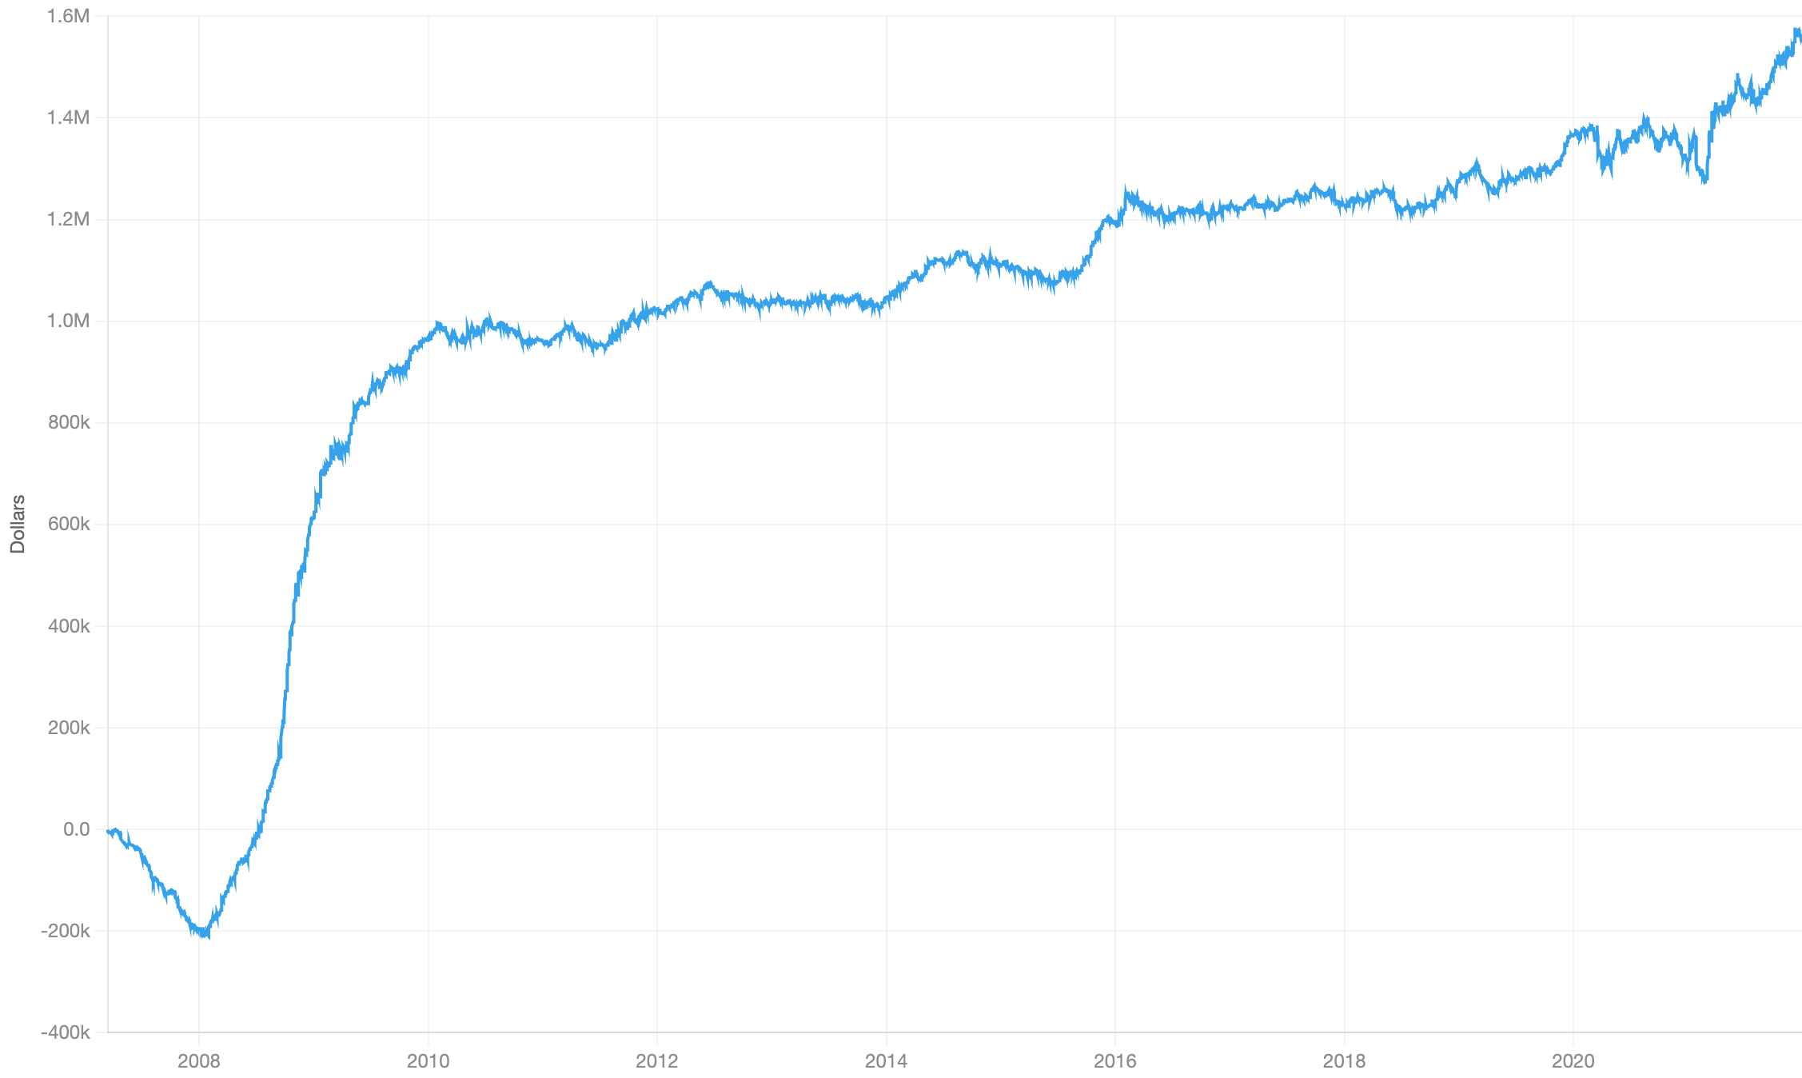
ALPHA RESEARCH
01 / CLOSING PRESSURE
SLOW RUN
A strong result. A concentrated crisis gain.
CUMULATIVE PNL / PLATFORM DOLLARS
DAILY IR
2007: ≈ −200k | 2010–21: ≈ +600k
0.091
t ≈ 5.5 · t ≈ IR × √days
SLOW-RUN METRIC
VALUE
Turnover
1.26
IR / √TVR
0.081
Return (platform)
0.107
Max drawdown
21.7
Stocks per side
776 × 773
Liq / LiqN
241 / 105
≈45% of total PnL came in Q4 2008–mid 2009.
Above the 25% episode rule.
2007–21 · original platform PnL image · episode shares are approximate readings from the chart
04 / 23
Notes:
[3:00–3:30] The slow run. IR 0.091, t about 5.5, the joint-highest of the seven, at turnover 1.26, which is high but expected for a one-day liquidity premium. Full book, 776 stocks a side. The PnL is where I have to be upfront. It lost about 200 thousand through 2007, then made roughly 45% of its total between late 2008 and mid 2009, when liquidity was scarcest and the concession for carrying closing imbalances overnight was largest. That breaks my own rule that no single episode carries more than a quarter. What reassures me is that it isn't only a crisis bet: from 2010 to 2021 it earns roughly another 600 thousand with no long flat stretch. A 2010–21 subperiod IR is the number I'd report next.
Slide interpretation: 2007 lost about 200k. From 2010–21, about +600k with no long flat stretch.
Visible caveat: Concentration — Exceeds the pre-set 25% episode rule; a 2010–21 subperiod IR is the next check.
SOURCE SLIDE CONTENT (for reference)
FACTOR 1 · CLOSING PRESSURE
Slow run results
2007: ≈ −200k. Q4 2008 – mid 2009: ≈ 45% of the total,
2010–21: steady, ≈ +600k with no long flat stretch.
4
Slow run, 2007–21 | Value
IR | 0.091
t ≈ IR × √days | 5.5
Turnover | 1.26
IR/√TVR | 0.081
Return | 0.107
Max drawdown | 21.7
Stocks per side | 776 × 773
Liq / LiqN | 241 / 105

Slide 5

ALPHA RESEARCH
02 / JUMP CONTINUATION
IDEA
The sign flipped. The hypothesis changed.
01 / REJECTED: LOTTERY SKEW
Predicted high skew → low returns. The observed sign ran the other way, and strengthened with controls.
CONSTRUCTION
rs = ½(skew_first_hour +
skew_last_hour)
vol = ts_std(ret1, 20)
trd = log ts_mean(trades_lh, 20)
hr = rank(ts_mean(hourly_rank, 5))
alpha = cs_factorneut(
ts_mean(rs, 5),
[ret5, vol, log mktcap, trd, hr])
02 / REJECTED: JUMP UNDERREACTION
Predicted weeks of drift and a small-cap effect. Both written predictions failed.
03 / PROPOSED: SPLIT-ORDER FLOW
Parent orders worked over days leave sharp, one-sided minutes. Skew acts as a signed-jump proxy.
Shape of moves, after removing their direction.
Parent order
Child orders
Amaya et al. (2015); Jiang & Zhu (2017); Chordia & Subrahmanyam (2004) · order-flow proxy is an inference
05 / 23
Notes:
[3:30–4:50] Factor two is the one where the data overruled me, and I'll show the whole path because a sign flip is exactly where data-mining hides. I started from Amaya et al.: high realized skewness predicts low returns, because investors overpay for lottery stocks. In this universe the sign came out the opposite way, and adding controls for reversal, volatility, size and trade count made it more negative, not less. My guess is that the lottery effect lives in small retail-heavy stocks, and in the top 1000 a one-minute jump is mostly order flow. So I flipped it, but under a new card with predictions written first. Jump underreaction, Jiang and Zhu, predicts weeks of drift concentrated in low-attention small caps. Both failed: the five-day-delayed signal is zero, and large caps are twice as strong as small. My pre-set rule for that outcome was to relabel it as order-flow pressure. Institutions split a parent order over days; each aggressive child order produces a sharp minute; the skewness of 61 one-minute returns is dominated by the largest one or two minutes, so it's effectively a signed jump. That proxy is my inference, and the footer says so. The code on the right: rs is the average of first-hour and last-hour skewness of one-minute returns, my signed-jump proxy. I average it over five days, then neutralize it cross-sectionally against five controls: weekly return, so it isn't reversal; 20-day volatility; size; the log of last-hour trade count; and hr, a rank of the stock's recent hourly returns, which removes the direction of the moves. What's left is the shape of the moves, not their direction.
SOURCE SLIDE CONTENT (for reference)
FACTOR 2 OF 7 · JUMP CONTINUATION
Intraday jumps continue: a sign that came out backwards
Rejected
Lottery skew (Amaya et al. 2015) predicts high skew → low returns. Sign came out opposite, and stronger with controls.
Rejected
Jump underreaction (Jiang & Zhu 2017) predicts weeks of drift, mostly in small caps. Both predictions, written down first, failed.
Proposed
Split-order flow (Chordia & Subrahmanyam 2004): a parent order worked over days leaves sharp one-sided minutes. Skew of 61 one-minute returns ≈ a signed jump.
# skew of 61 one-minute returns
rs = ½(skew_first_hour + skew_last_hour)
vol = ts_std(ret1, 20)
trd = log ts_mean(trades_last_hour, 20)
hr = rank(ts_mean(hourly-return rank, 5))
alpha = cs_factorneut(ts_mean(rs, 5),
[ret5, vol, log mktcap, trd, hr])
5

Slide 6
ALPHA RESEARCH
02 / JUMP CONTINUATION
ABLATIONS
Shape matters. Weeks of drift do not.
CONTROLS STRENGTHEN IT
DECAY: DAYS, NOT WEEKS
LARGE CAPS CARRY IT
Raw skew
0.060
Same day
0.087
Larger half
0.080
− ret5, vol, size, trades
0.080
Delayed 1 day
0.035
Smaller half
0.035
− hourly direction
0.087
Delayed 5 days
−0.003
Consistent with institutional order pressure
finishing over a few days.
Open issue
PnL is flat from 2017 to mid-2019. Execution changes or crowding are untested explanations.
Fast-mode IR · adding controls, imposing delays and splitting the universe test distinct predictions
06 / 23
Notes:
[4:50–5:50] Three ablations, and each tested a prediction. Left: adding controls made the signal stronger, 0.06 to 0.08 to 0.087. Artifacts usually weaken when you control for things; this one strengthened. The last control removes the direction of the hourly returns, and IR went up. So it's not "stocks that rose in the last hour keep rising", it's "stocks whose moves came in sharp one-sided bursts keep going". Middle: decay. About 40% survives a one-day delay and nothing survives five days. That rules out weeks-long underreaction and fits parent orders finishing over a few days. It's also more persistent than Factor 1, which keeps only about a quarter after one day. Right: the large-cap half is more than twice as strong, which is where institutional flow is concentrated, and the opposite of the limited-attention prediction. Also, daily-return skew shows the same sign with a totally different construction, so it isn't a quirk of the hourly field. The open issue, which I'd flag in any review: the PnL is flat from 2017 to mid-2019. Possible causes are better execution algorithms hiding child orders, or crowding. I haven't tested either.
SOURCE SLIDE CONTENT (for reference)
FACTOR 2 · ABLATIONS
Shape not direction, days not weeks
Controls make it stronger
Raw skew
0.060
- ret5, vol, size, trades
0.080
- hourly-return direction
0.087
It decays in 1–3 days
Same day
0.087
Delayed 1 day
0.035
Delayed 5 days
−0.003
Large caps carry it
Larger half by market cap
0.080
Smaller half
0.035
6

Slide 7
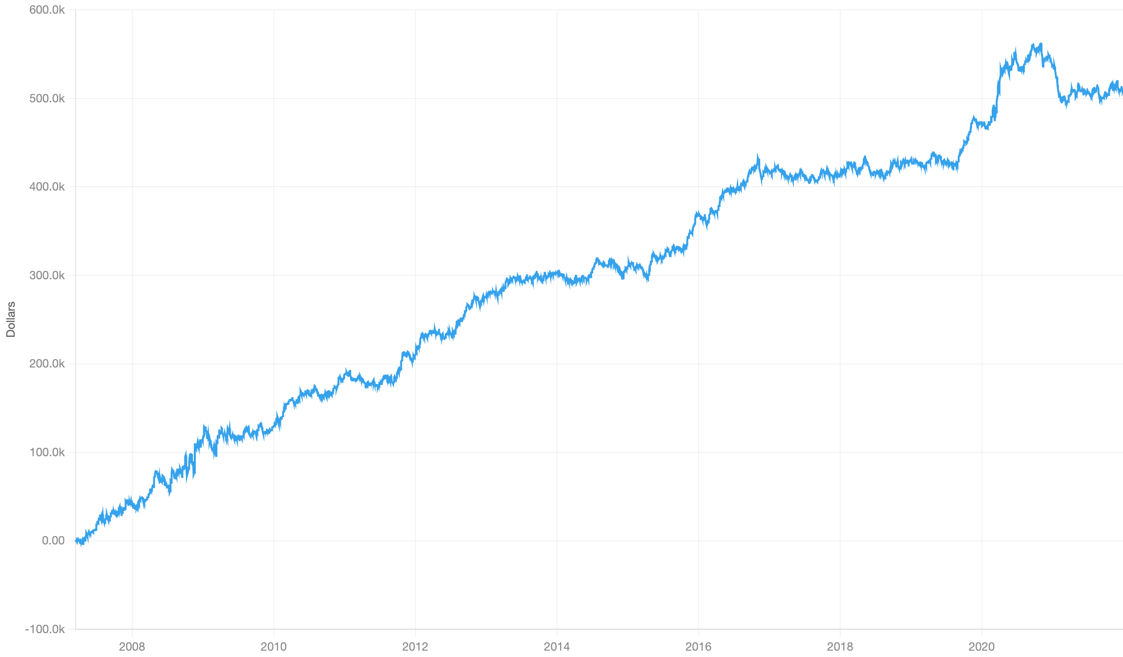
ALPHA RESEARCH
02 / JUMP CONTINUATION
SLOW RUN
Steady to 2016. Then a flat stretch.
CUMULATIVE PNL / PLATFORM DOLLARS
DAILY IR
2020 adds ≈15%; no episode above 25%.
0.073
t ≈ 4.4 · t ≈ IR × √days
SLOW-RUN METRIC
VALUE
Turnover
0.70
IR / √TVR
0.088
Return (platform)
0.034
Max drawdown
7.0
Stocks per side
776 × 773
Liq / LiqN
572 / 239
2017–mid 2019 is the main unresolved flat period.
0.003 above the IR bar.
2007–21 · original platform PnL image · episode shares are approximate readings from the chart
07 / 23
Notes:
[5:50–6:20] Slow IR 0.073, a thin margin, but t about 4.4 on a full book and the lowest drawdown of the seven, 7.0. Turnover 0.70. The PnL rises steadily to late 2016, then goes flat from 2017 to mid 2019, and 2020 adds about 15% of the total. No single episode is over a quarter, so it passes my concentration rule, but the flat stretch is its main open issue. Possible causes are execution algorithms getting better at hiding child orders, or crowding. Untested.
Slide interpretation: 2020 adds about 15%; no single episode exceeds one quarter.
Visible caveat: Thin margin — IR 0.073, with the lowest drawdown among the seven.
SOURCE SLIDE CONTENT (for reference)
FACTOR 2 · JUMP CONTINUATION
Slow run results
Rises steadily to late 2016, then flat 2017 – mid 2019
2020 adds ≈ 15%; no single episode over ¼.
7
Slow run, 2007–21 | Value
IR | 0.073
t ≈ IR × √days | 4.4
Turnover | 0.70
IR/√TVR | 0.088
Return (platform) | 0.034
Max drawdown | 7.0
Stocks per side | 776 × 773
Liq / LiqN | 572 / 239

Slide 8

ALPHA RESEARCH
03 / PEER DIFFUSION
IDEA
Peer news travels through the trading day.
THE ECONOMIC IDEA
News about related firms reaches the laggard slowly. Trade peers’ moves with the stock’s own return removed.
CONSTRUCTION
day5 = ts_sum(close / open - 1, 5)
# A: top 50 peers, past 252 days
pRaw = peers on raw ret1
pRes = peers on subindustry-net ret1
sA = β × mean(day5 over pRaw)
sB = β × mean(day5 over pRes)
# remove own ret5, ret1; neutralize
# B: industry leaders
lead = cap-weighted industry ret20
s2 = neut(lead × (2-rank(mktcap)),
[ret5, ret20])
alpha = zmean(zmean(sA, sB), s2)
TWO PROXIES FOR RELATED FIRMS
A: top co-movers, re-picked annually.
B: cap-weighted industry leaders.
Use daytime returns to isolate the peer news.
Peer news
Related firms
Equal z-score weights; no tuning.
Hou (2007); Cohen & Frazzini (2008); Wang (2025) · peers chosen using past-year data only
08 / 23
Notes:
[6:20–7:50] Factor three, peer information diffusion. The idea is well documented: news about a firm's customers, suppliers or competitors is also news about the firm, but investors specialize and have limited attention, so the related stock catches up slowly. Hou shows it within industries, Cohen and Frazzini along customer links. So the trade is the gap: peers have moved, the stock hasn't, with its own recent return removed so this isn't reversal in disguise. The refinement comes from Wang 2025: only the peers' daytime moves carry the information. Their overnight moves are retail reactions at the open that reverse during the day. The code. The catalog has no link data, so I infer "related" two independent ways. Part A: day5 is each stock's five-day open-to-close return, the daytime part only. Once a year, using the past 252 days, I pick each stock's 50 strongest co-movers twice: once on raw returns, once on returns with the subindustry move removed. Peers are fixed for the next year, so there's no look-ahead. The signal is the stock's beta to its peer portfolio times the peers' average daytime return; then I remove the stock's own ret5 and ret1 and demean within subindustry. Part B is Hou's industry leaders: the cap-weighted industry 20-day return, scaled up for smaller stocks by the 2 minus size-rank term, with own returns removed. The final line averages the z-scores with equal weights that I never tuned.
SOURCE SLIDE CONTENT (for reference)
FACTOR 3 OF 7 · PEER DIFFUSION
Peers' daytime news diffuses slowly
Economic motivation
News about one firm is news about related firms. With limited attention, the laggard catches up slowly (Hou 2007; Cohen & Frazzini 2008).
Trade the gap: peers have moved, the stock hasn't. Its own recent return is removed.
Wang (2025): only peers' daytime moves predict. Their overnight moves are retail noise that reverses intraday.
No link data, so "related" is inferred two ways: co-movement (A) and industry leaders (B).
Construction
# A · co-movers, re-picked yearly from past 252 days
day5 = ts_sum(close / open - 1, 5)
pRaw = top 50 co-movers on ret1
pRes = top 50 co-movers on ret1 net of subindustry
sA = β · mean(day5 over pRaw)
sB = β · mean(day5 over pRes)
# own ret5, ret1 removed; subindustry-neutral
# B · industry leaders (Hou 2007)
lead = cap-weighted industry ret20
s2 = neut(lead · (2 − rank(mktcap)), [ret5, ret20])
alpha = zmean(zmean(sA, sB), s2)
Peers chosen on past-year data only · β = the stock's beta to its peer portfolio
8

Slide 9
ALPHA RESEARCH
03 / PEER DIFFUSION
ABLATIONS
The signal survives two placebos.
WHICH HALF OF THE PEER RETURN?
LINKED PEERS OR SHARED FACTORS?
Close-to-close
0.051
Co-moving peers
0.042
Daytime only
0.063
Size-matched placebo
0.020
Overnight placebo
0.010
Industry leaders
+ correlation peers
+ second peer set
Daytime peer returns
0.047
0.071
0.077
0.091
Replacement rule met
Beat 0.077 IR and 0.094 IR/√TVR. The daytime version achieved 0.091 and 0.109.
Top panels: fast-mode IR · bottom: slow-mode development path · swap rule registered before the replacement run
09 / 23
Notes:
[7:50–9:00] Two placebos. Left: I split the peers' return into its daytime and overnight halves, holding everything else fixed. Wang's mechanism makes a sharp prediction: the daytime half should beat close-to-close, and the overnight half should be about zero. That's what happened: 0.063 versus 0.051, and the overnight placebo is 0.01. The improvement arrives together with the noise half going to zero, which is the mechanism, not luck. Right: same construction, but "peers" are the 50 stocks nearest in size instead of the 50 most correlated. IR halves. It isn't zero, because similar-size stocks share factor exposures, but most of the signal needs genuinely co-moving peers. Bottom: how it was built, in slow mode. Industry leaders alone were a near miss at 0.047. Adding correlation peers gave 0.071. The two proxies correlate only 0.29, and the gain matches the diversification arithmetic, root of 2 over 1 plus rho, about 1.25. A second peer set gave 0.077, which was submitted. The daytime refinement was registered as a replacement with a swap rule: beat 0.077 IR and 0.094 IR per root turnover. It got 0.091 and 0.109, so it replaced its parent. In all, about fourteen runs led here, and every step had a reason written down first; none was a parameter sweep.
SOURCE SLIDE CONTENT (for reference)
FACTOR 3 · ABLATIONS
Two placebos, one built-in prediction
Which half of the peer return? (fast)
Close-to-close
0.051
Daytime only
0.063
Overnight (placebo)
0.01
Linked peers or shared factors?
Co-moving peers
0.042
Size-matched (placebo)
0.02
How it was built, slow-mode IR: each step had a written reason before it ran
Industry leaders alone
0.047
+ correlation peers
0.071
+ second peer set
0.077
Daytime peer returns
0.091
The daytime version replaced its parent in the pool under a swap rule set in advance (beat 0.077 IR and 0.094 IR/√TVR)
9

Slide 10
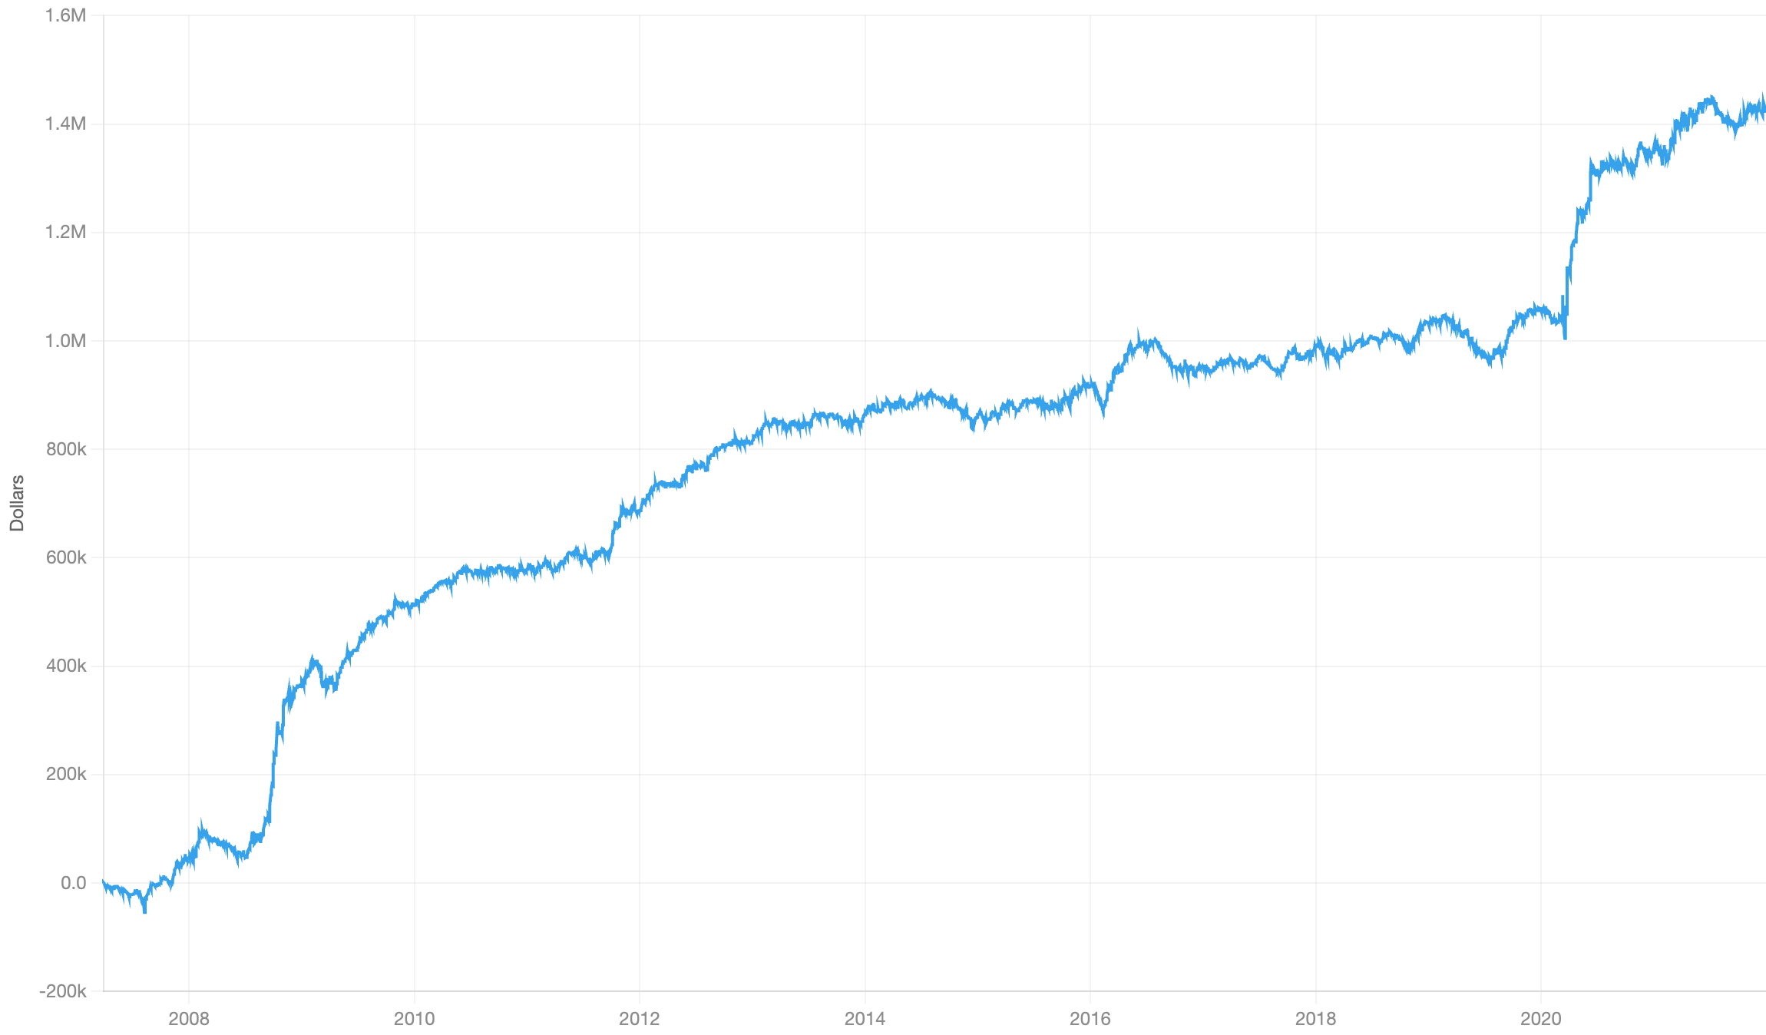
ALPHA RESEARCH
03 / PEER DIFFUSION
SLOW RUN
Calm-year gains, plus crisis rebounds.
CUMULATIVE PNL / PLATFORM DOLLARS
DAILY IR
2009–16: steady gains | 2020 rebound: ≈21%
0.091
t ≈ 5.5 · t ≈ IR × √days
SLOW-RUN METRIC
VALUE
Turnover
0.69
IR / √TVR
0.109
Return (platform)
0.098
Max drawdown
8.5
Stocks per side
785 × 764
Liq / LiqN
704 / 332
Largest episode ≈21%; nearly flat mid-2016–Feb 2020.
Best price-based IR / √TVR.
2007–21 · original platform PnL image · episode shares are approximate readings from the chart
10 / 23
Notes:
[9:00–9:30] Slow IR 0.091, t about 5.5, with turnover 0.69, so IR per root turnover is 0.109, the best of the five price-based factors. Drawdown 8.5 on a full book. The PnL passes my concentration rule: the largest single episode, late 2008 to mid 2009, is about 21%, and it earns steadily from 2009 to 2016 without any crisis. Like Factor 2 it's nearly flat from mid 2016 to early 2020, and the 2020 rebound adds another 21%. My reading is that catch-up profits scale with the size of peer moves and how stretched attention is, and both peak in crisis rebounds. This is the factor I trust most.
Slide interpretation: Steady 2009–16. The 2020 rebound adds about 21%.
Visible caveat: Strength — IR/√TVR is the best of the five price-based factors.
SOURCE SLIDE CONTENT (for reference)
FACTOR 3 · PEER DIFFUSION
Slow run results
Largest episode ≈ 21% (Q4 2008 – mid 2009); steady 2009–16.
Flat mid 2016 – Feb 2020; the 2020 rebound adds ≈ 21%.
10
Slow run, 2007–21 | Value
IR | 0.091
t ≈ IR × √days | 5.5
Turnover | 0.69
IR/√TVR | 0.109
Return (platform) | 0.098
Max drawdown | 8.5
Stocks per side | 785 × 764
Liq / LiqN | 704 / 332

Slide 11

ALPHA RESEARCH
04 / LIQUIDITY COMPOSITE
IDEA
Three small effects. Different clocks.
S1 / FIRST-HOUR CONTINUATION
About a week
CONSTRUCTION
Split orders recur at the same time of day. Alone: slow IR 0.054.
s1 = neut(ts_mean(ret_first_hour, 5),
[ret5, ret1, vol, log mktcap,
mean closing push])
s2 = -ret5 as of T-4
# held T-4…T-2; NaN off-window
s3 = zmean(-cv20(log(high/low)),
-cv20(hourly σ))
alpha = zmean(zmean(s1, s2), s3)
S2 / MONTH-END REVERSAL
Three days a month
Settlement-driven selling reverses. Alone: 0.039; ≈0.10 per active day.
S3 / RANGE-SHOCK VOL-OF-VOL
About a month
Underperformance after a large-range day. Alone: slow IR 0.031; loses in crashes.
T = last trading day · cv20 = 20-day std / mean
Heston, Korajczyk & Sadka (2010); Etula et al. (2020) · weights fixed before the hedge’s slow result
11 / 23
Notes:
[9:30–10:50] Factor four is a composite, and the interesting part is why it's built the way it is. Three effects, each a near miss alone. s1, first-hour continuation: institutions working split orders tend to trade at the same time of day, so a stock pushed in the morning keeps getting pushed the next mornings. Heston, Korajczyk and Sadka. Slow IR 0.054 alone. I found this as a placebo that beat its main signal: I was testing overnight sentiment, the first-hour control won, so it became its own idea. In code it's the five-day mean of the first-hour return, with weekly and daily return, volatility, size and the recent closing push all removed, so it isn't reversal or Factor 1. s2, the month-end "dash for cash" from Etula et al.: pension and mutual funds sell before the last settlement date of the month to meet payouts, the selling is uninformed, and it reverses. The code takes minus the five-day return as of four days before month-end and holds it for three days; it's empty the rest of the month. So 0.039 overall, but about 0.10 per active day. s3, vol-of-vol: the 20-day coefficient of variation of the daily high-low range and of hourly volatility, with a minus sign. I'll describe it honestly on the next slide: it's really underperformance after one big non-earnings range day. Alone 0.031. Its role here is as a hedge. The final line is a nested equal-weight z-score average, with weights fixed before I saw the hedge's slow result.
SOURCE SLIDE CONTENT (for reference)
FACTOR 4 OF 7 · LIQUIDITY COMPOSITE
Three small effects combined
s1 · First-hour continuation
About a week
Split orders trade at the same time each day, so morning pressure repeats (Heston, Korajczyk & Sadka 2010).
Alone: slow IR 0.054
s2 · Month-end settlement reversal
3 days a month
Funds sell before the last settlement date to raise cash; the selling is uninformed and reverses (Etula et al. 2020).
Alone: 0.039, ≈ 0.10 per active day
s3 · Range-shock vol-of-vol
About a month · the hedge
After one large range day, a stock lags for weeks. Loses in crashes, earns in calm years.
Alone: slow IR 0.031
s1 = neut(ts_mean(ret_first_hour, 5),
[ret5, ret1, vol, log mktcap, mean closing push])
s2 = −ret5 as of T−4, held T−4…T−2 before month-end
s3 = zmean(−cv20(log(high / low)), −cv20(hourly σ))
# cv20 = 20-day std / 20-day mean; s2 is NaN off-window
alpha = zmean(zmean(s1, s2), s3)
# equal weights, fixed before the hedge's slow result
9 data variables · 796 stocks per side · T = last trading day of the month
11

Slide 12
ALPHA RESEARCH
04 / LIQUIDITY COMPOSITE
ABLATIONS
A hedge helps. Concentration remains.
PART
FALSIFICATION
RESULT
WHY ADD THE THIRD LEG?
Month-end
Same trade 10 days earlier
0.004 vs 0.039
45% → 35%
First hour
Delay for a week
Keeps ≈60%
Share of PnL from
Q4 2008–mid 2009
First hour
Last hour instead
Opposite sign
Vol-of-vol
Volatility level alone
0.00
Vol-of-vol
Drop recent earnings
Keeps 0.03
Still above the 25% rule
Vol-of-vol
Drop top range day
0.035 → 0.01
The hedge loses in crashes and earns in calm years. It improves timing but does not solve concentration.
Vol-of-vol
Delay 20 days
0.035 → 0.01
Honest label: short-horizon underperformance
after a non-earnings range shock.
Fast IR for falsification tests · first-hour delay corrected to “keeps ≈60%”, consistent with script and factor write-up
12 / 23
Notes:
[10:50–12:10] Left: each part had to pass its own falsification. The month-end trade shifted ten days earlier is 0.004 against 0.039, so it's tied to the settlement deadline, not ordinary weekly reversal. The first-hour effect keeps 60% after skipping a week, which fits a slow periodic pattern, and the last hour has the opposite sign, so it's morning-specific. The vol-of-vol tests are where I had to change my story. The volatility level alone is zero, so it's not the low-vol anomaly, and removing recent earnings keeps most of it, so it's not the earnings cycle. But removing the single largest range day kills it, and a 20-day delay kills it. So it's not a persistent ambiguity premium. The honest label is short-horizon underperformance after a one-day range shock. Right: why combine at all. The first two parts together reached 0.070 but almost half the PnL came from one episode, late 2008 to mid 2009. My pre-set rule was that no episode carries more than a quarter, so I didn't submit it. I then searched specifically for a partner that loses in crashes. Gross profitability and volume commonality both earned in the crisis, so they failed. Vol-of-vol lost in both crashes. Before running, I estimated the combined IR at 0.071 assuming uncorrelated parts; it came out exactly 0.071. Crisis share fell from 45 to about 35%, still above my own rule. I disclose that. It was accepted because this is a research exercise; in production it would block submission.
SOURCE SLIDE CONTENT (for reference)
FACTOR 4 · ABLATIONS AND THE REASON FOR THE COMPOSITE
Falsify each part, combine for timing
Falsification tests (fast IR)
Shaded rows confirm a one-day range shock not from the earnings day that fades within a month.
Why combine: PnL timing
The first two parts alone hit 0.070 but took ≈ 45% of PnL in rebound from Q4 2008 to mid–2009. The vol-of-vol part loses in both crashes but increases steadily in calm years.
Crisis Share: 45% → 35%
12
Part | Test | Result
Month-end | Same trade 10 days earlier | 0.004 vs 0.039
First hour | Delay for a week | Loses ≈ 60%
First hour | Last hour instead | Opposite sign
Vol-of-vol | Volatility level alone | 0.00
Vol-of-vol | Drop recent earnings | Keeps 0.03
Vol-of-vol | Drop the top range day | 0.035 → 0.01
Vol-of-vol | Delay 20 days | 0.035 → 0.01
EDITORIAL CORRECTION: first-hour delay keeps ≈60%, per C53 factor write-up and presentation script; original slide said loses ≈60%.

Slide 13
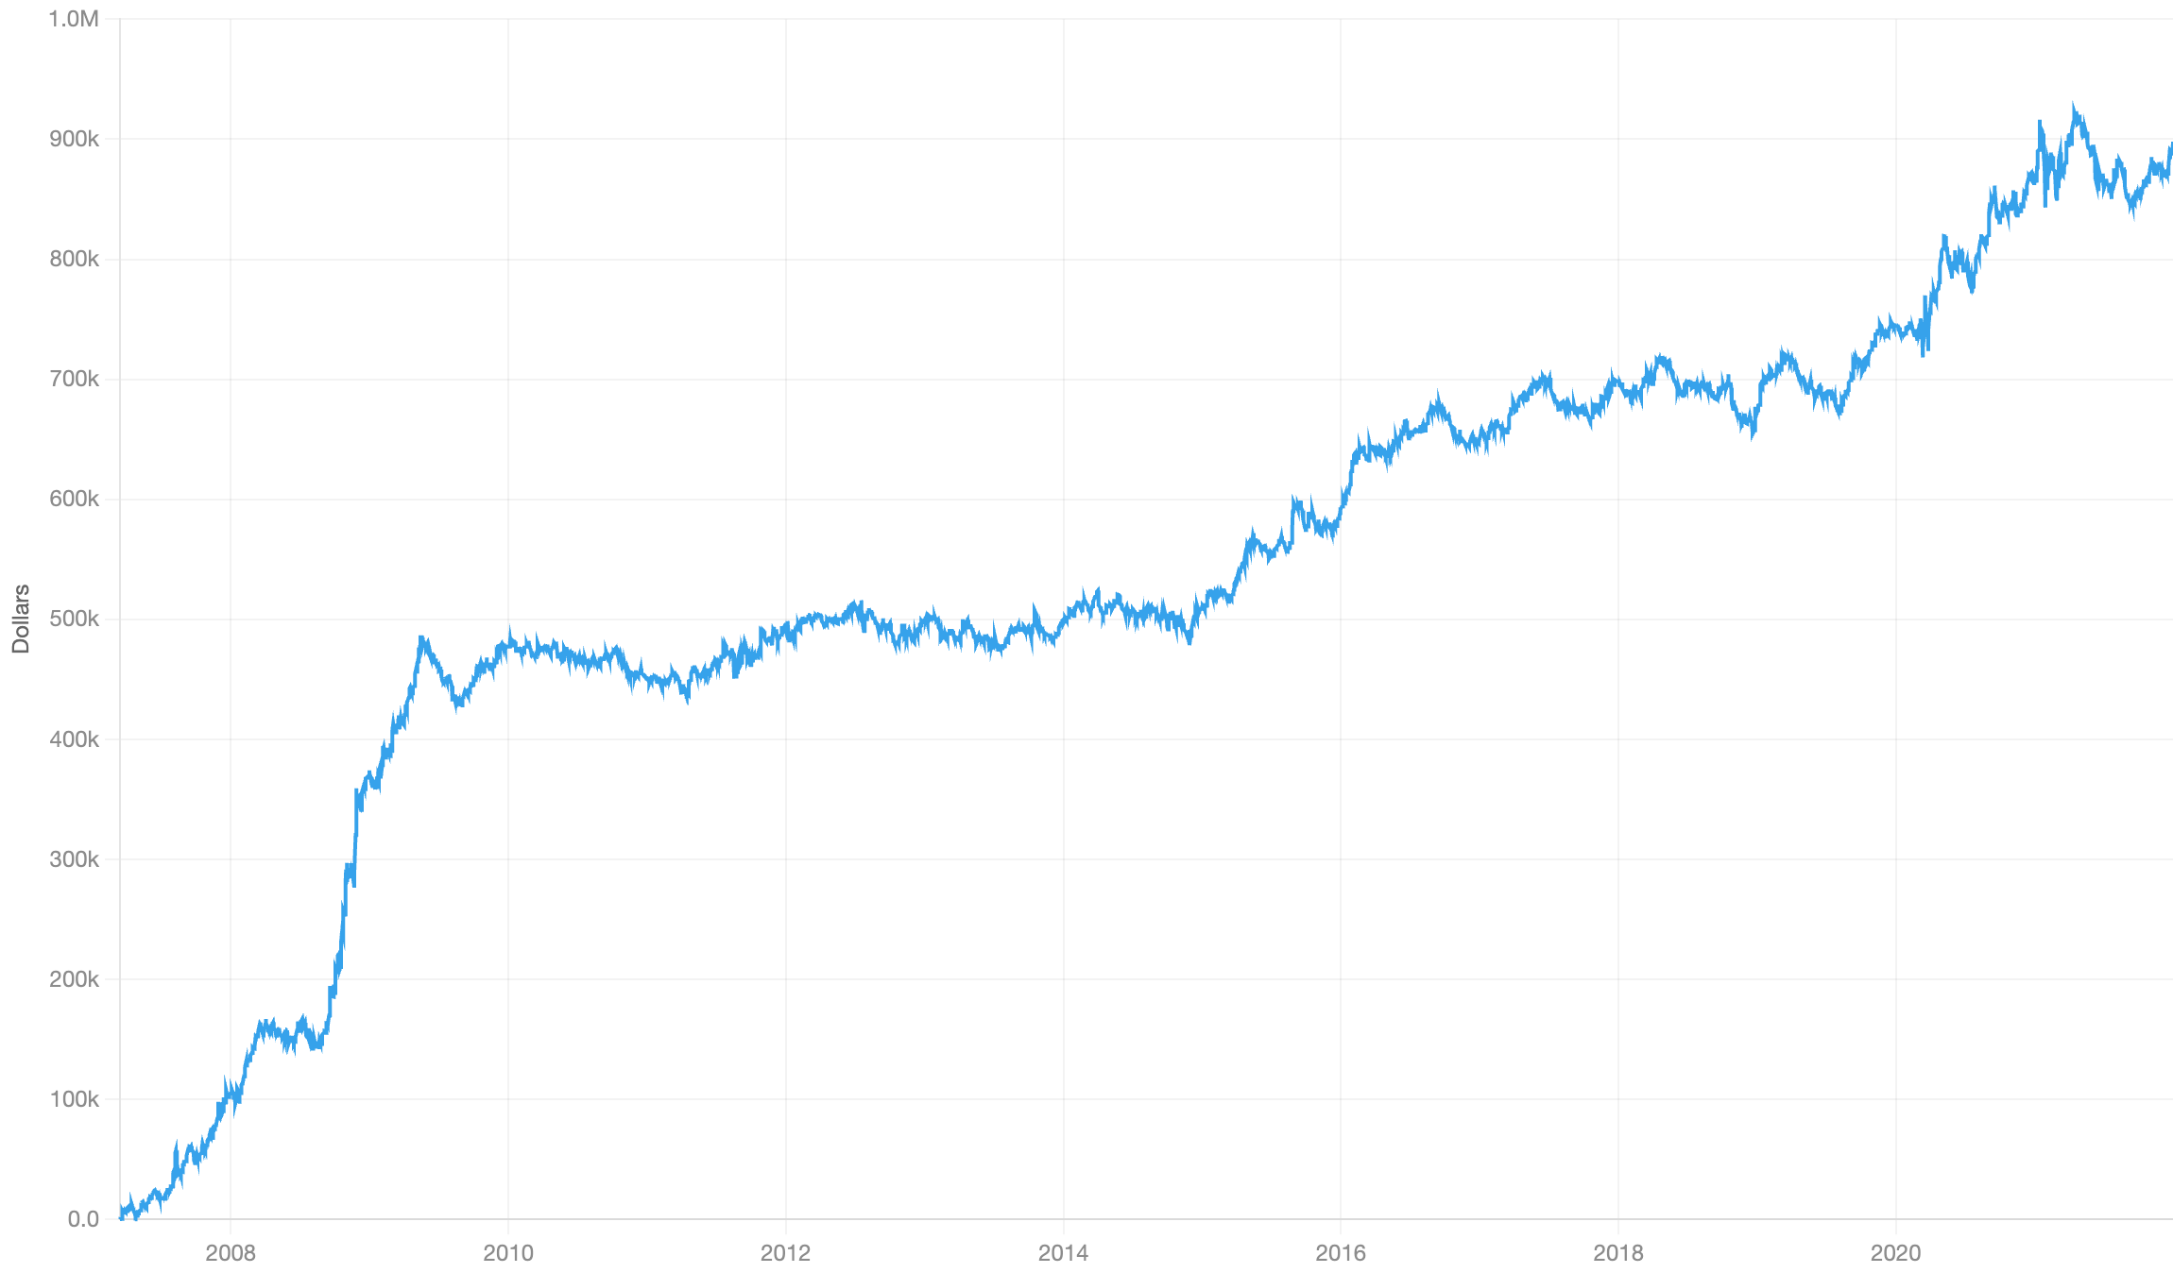
ALPHA RESEARCH
04 / LIQUIDITY COMPOSITE
SLOW RUN
Less crisis exposure, still above the rule.
CUMULATIVE PNL / PLATFORM DOLLARS
DAILY IR
The hedge largely removes the March 2020 spike.
0.071
t ≈ 4.3 · t ≈ IR × √days
SLOW-RUN METRIC
VALUE
Turnover
0.53
IR / √TVR
0.097
Return (platform)
0.061
Max drawdown
8.0
Stocks per side
796 × 753
Liq / LiqN
630 / 230
≈35% crisis share; 2010–15 is nearly flat.
Concentration remains a blocker.
2007–21 · original platform PnL image · episode shares are approximate readings from the chart
13 / 23
Notes:
[12:10–12:40] Slow IR 0.071, thin margin, t about 4.3. Turnover 0.53 and drawdown 8.0. The PnL shows what the hedge did and didn't do. Late 2008 to mid 2009 is still about 35% of the total, down from 45% without the hedge leg, so it's still over my own quarter rule, and I disclose that. The March 2020 spike that the first two legs had is mostly gone. The weak stretch is 2010 to 2015, which is nearly flat. In a production review this concentration would block it; for this exercise it was accepted with the disclosure.
Slide interpretation: The March 2020 spike from the first two legs is mostly gone.
Visible caveat: Production caveat — Concentration would block production submission; accepted for the exercise with disclosure.
SOURCE SLIDE CONTENT (for reference)
FACTOR 4 · LIQUIDITY COMPOSITE
Slow run results
13
Slow run, 2007–21 | Value
IR | 0.071
t ≈ IR × √days | 4.3
Turnover | 0.53
IR/√TVR | 0.097
Return (platform) | 0.061
Max drawdown | 8.0
Stocks per side | 796 × 753
Liq / LiqN | 630 / 230

Slide 14

ALPHA RESEARCH
05 / EARNINGS CYCLE
IDEA
One event. Two different trades.
BEFORE / DAYS −5 TO −1
AFTER / DAYS +1 TO +10
Liquidity gets expensive.
The reaction drifts.
Inventory risk rises before the release. Liquidity providers demand larger concessions.
Prices continue in the direction of the news. Freeze the reaction, then hold it.
CONSTRUCTION
CONSTRUCTION
tdu = trading days to next earnings
pre = -ret1 if 1 ≤ tdu ≤ 5
# NaN outside the window
ds = trading days since earnings
R3 = 3-day daytime return / σ60
post = R3 at ds=1, held ds=1…10
~56 stocks per side
Pre-earnings leg
~128 different stocks
Post-earnings leg
So & Wang (2014); Jiang, Li & Wang (2021) · disjoint windows, equal per-stock z-score weights
14 / 23
Notes:
[12:40–14:00] Factor five trades the earnings cycle, and its origin is the best example of a lucky diagnostic. I started with the earnings-announcement premium, and my event-window signals produced no output at all. Calibration runs showed why: the platform median-centers per industry, so any alpha made only of zeros and ones vanishes, and a two-valued alpha loses its majority side. While debugging, I filled the window with minus ret1 just to count stocks, and that "diagnostic" scored 0.080, against 0.025 for minus ret1 on all stocks. That matched So and Wang 2014: before earnings, inventory risk is at its peak because a big move in an unknown direction is coming, so liquidity providers demand larger concessions, and attention brings in uninformed flow. Short-term reversals are several times larger in that window. That's the left box: "pre" is minus the daily return, only for stocks one to five trading days before their announcement, and empty otherwise. On its own it was in my pool first, but with only 56 stocks a side. So in the last round I added the other side of the event: after the announcement, prices underreact and drift in the direction of the reaction, Jiang, Li and Wang 2021. That's the right box: "post" takes the three-day daytime reaction around the announcement, scaled by pre-event volatility, freezes it the day after, and holds it for ten days. The windows never overlap, so the second leg fills the idle book with different stocks; the last line just averages their z-scores. I'll show what that does to the book after the tests.
SOURCE SLIDE CONTENT (for reference)
FACTOR 5 OF 7 · EARNINGS CYCLE
Both sides of the earnings announcement
Days −5 to −1: liquidity gets expensive
Reversal · ~56 stocks a day
Inventory risk peaks before the release, so liquidity providers demand bigger concessions (So & Wang 2014).
tdu = trading days to next earnings
pre = −ret1 if 1 ≤ tdu ≤ 5, else NaN
Days +1 to +10: the reaction drifts
Drift · ~128 different stocks a day
Prices keep drifting in the direction of the news for days (Jiang, Li & Wang 2021).
ds = trading days since the announcement
R3 = 3-day daytime return (close/open) / σ60
post = R3 frozen at ds = 1, held 1 ≤ ds ≤ 10
alpha = zmean(pre, post) # equal per-stock z-weights; the windows never overlap
14

Slide 15
ALPHA RESEARCH
05 / EARNINGS CYCLE
ABLATIONS
A weaker second leg buys breadth.
PRE: DOSE–RESPONSE
POST: A FAILED GATE
SLOW RUN
PRE ONLY
FACTOR 5
Days 1–5 before
0.08
Daytime reaction
0.03
IR
0.078
0.070
Days 6–10 before
0.04
Overnight placebo
0.03
Turnover
1.53
0.77
IR / √TVR
0.063
0.080
Outside window
0.02
Held days 31–40
0.01
Max DD
57.5
22.2
Stocks / side
56
183
Placebo = main.
Relabel as ordinary
post-earnings drift.
LiqN
3
22
IR dips ≈10%; IR/√TVR rises 27%
Turnover halves, drawdown falls, the book triples, and capacity grows about sevenfold.
Ablations: fast IR · comparison: slow run · composite run was exploratory: pre-set after-leg trigger of 0.04 was not met
15 / 23
Notes:
[14:00–15:20] Left, the pre-announcement leg. The mechanism says the effect should grow as the announcement approaches, because inventory risk does. Days one to five give 0.08, days six to ten 0.04, outside the window 0.02, a clean dose-response. Two robustness checks: the earnings-date field could leak the actual date, so I rebuilt the window from the previous announcement plus about 60 trading days, which only uses past information; it still qualifies in slow mode at 0.072. And a one-day delay keeps 0.07, so it isn't bid-ask bounce, unlike Factor 1. Middle, the after-leg, and this is a failure I want to show. I tried to carry over the project's most reliable pattern, daytime is information and overnight is noise. The placebo, the overnight gap, drifted exactly as much as the daytime move. My gate said the placebo had to be at most half the main signal, so the daytime mechanism was rejected and the leg relabelled as ordinary post-earnings drift. The timing placebo, days 31 to 40, is about zero, so it's event-tied. Right: the direct comparison with the pre-earnings leg alone, which was in my pool before Factor 5 replaced it. Same code for that leg. IR dips about 10%, 0.078 to 0.070, because the new leg is weaker per stock. But turnover halves, drawdown falls from 57.5 to 22.2, the book goes from 56 to 183 stocks a side, and capacity grows about seven times. Per unit of turnover it's 27% better. And the gain isn't fitted: because the legs hold different stocks, I predicted the combination from its parts before running it, IR 0.069 and turnover 0.79, and got 0.070 and 0.77. One irregularity, disclosed in the footer: the composite had a pre-set trigger of 0.04 for the after-leg, which wasn't met, and it was run anyway as an exploratory run with unchanged code.
SOURCE SLIDE CONTENT (for reference)
FACTOR 5 · ABLATIONS
A stronger leg and a weaker leg for more breadth
Before-leg: dose-response
−ret1, days 1–5 before
0.08
Days 6–10 before
0.04
Outside the window
0.02
After-leg: a failed gate
Daytime reaction
0.03
Overnight (placebo)
0.03
Held days 31–40
0.01
Placebo = main, so it's plain post-earnings drift.
Pre-earnings leg alone vs Factor 5
Same pre-earnings code. IR dips 10%; everything else improves, and IR/√TVR rises 27%.
15
Slow run | Pre only | Factor 5
IR | 0.078 | 0.070
Turnover | 1.53 | 0.77
IR/√TVR | 0.063 | 0.080
Max drawdown | 57.5 | 22.2
Stocks per side | 56 | 183
Capacity (LiqN) | 3 | 22

Slide 16
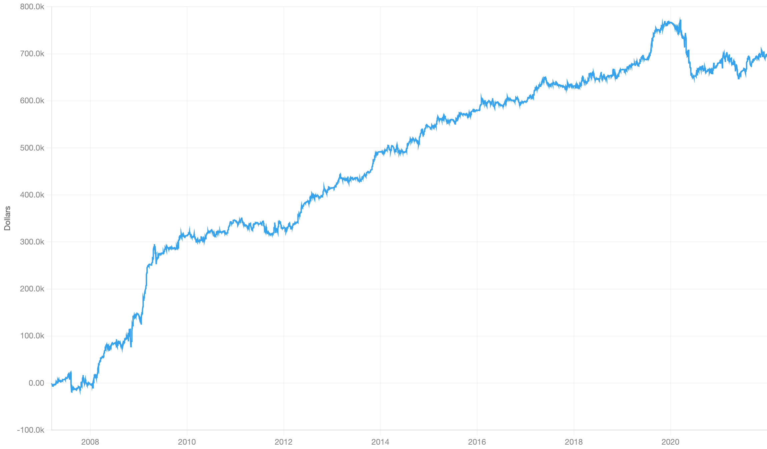
ALPHA RESEARCH
05 / EARNINGS CYCLE
SLOW RUN
More breadth. An unresolved 2020 loss.
CUMULATIVE PNL / PLATFORM DOLLARS
DAILY IR
Steady 2012–16; 2020 weakness is unexplained.
0.070
t ≈ 4.3 · t ≈ IR × √days
SLOW-RUN METRIC
VALUE
Turnover
0.77
IR / √TVR
0.080
Return (platform)
0.083
Max drawdown
22.2
Stocks per side
183 × 184
Liq / LiqN
59 / 22
Crisis share ≈29%; 2020 loses ≈17% of total PnL.
Exactly on the 0.070 IR bar.
2007–21 · original platform PnL image · episode shares are approximate readings from the chart
16 / 23
Notes:
[15:20–15:50] Slow IR exactly on the bar, 0.070, t about 4.3, turnover 0.77. The book is 183 stocks a side, three times the pre-earnings leg alone, and capacity is the smallest of the seven because it only holds stocks in earnings windows. Two things in the PnL to flag. Late 2008 to mid 2009 is about 29% of the total, over my quarter rule. And 2020 lost about 17% of the total, inherited from the pre-announcement leg. That one is a puzzle, since reversal generally did well in 2020; my untested guess is that pre-announcement moves were unusually informative during COVID, with guidance withdrawals. The steady part is 2012 to 2016.
Slide interpretation: Steady 2012–16. The 2020 loss is inherited from the pre-earnings leg.
Visible caveat: Exactly on the bar — IR 0.070, with the smallest capacity of the seven.
SOURCE SLIDE CONTENT (for reference)
FACTOR 5 · EARNINGS CYCLE
Slow run results
Q4 2008 – mid 2009 ≈ 29%
2020 ≈ −17%, from the pre-earnings leg; steady 2012–16.
16
Slow run, 2007–21 | Value
IR | 0.070
t ≈ IR × √days | 4.3
Turnover | 0.77
IR/√TVR | 0.080
Return (platform) | 0.083
Max drawdown | 22.2
Stocks per side | 183 × 184
Liq / LiqN | 59 / 22

Slide 17

ALPHA RESEARCH
06 / INVESTMENT & EARNINGS QUALITY
IDEA
Six accounting signals. One investment thesis.
The market misreads how firms invest — and how real their earnings are.
LEG / SIGN
ECONOMIC READING
CONSTRUCTION
R&D yield (+)
Expensed R&D hides value
s1 = rank(R&D_expense / mktcap)
s2 = rank(operating_income_growth)
s3 = -rank(inventory_growth)
s4 = -rank(goodwill / total_assets)
s5 = -rank(63-day share growth)
s6 = rank(income_tax / total_assets)
alpha = cs_factorneut(
zmean(s1, …, s6),
[log mktcap, r250])
Operating growth (+)
Fundamental momentum
Inventory growth (−)
Build-ups signal weak demand
Goodwill / assets (−)
Acquirers overpay
Share issuance (−)
Firms issue when overvalued
Tax / assets (+)
Tax income is harder to manage
z-scores clipped at ±3; average the legs available for each stock. Remove size and 12-month return.
Chan et al. (2001); Novy-Marx (2015); Thomas & Zhang (2002); Gu & Lev (2011); Pontiff & Woodgate (2008); Lev & Nissim (2004)
17 / 23
Notes:
[15:50–17:20] Factor six is the first of two fundamental factors, and a change of method. For most of the project single fundamentals looked dead here: value was about zero, ROE and ROA about zero, gross profitability 0.03. So I switched to screening batches of one-line accounting signals, with the gates and the combination rule written down before each batch ran. The idea that survived is one idea measured six ways: the market misreads what a firm's accounts say about how it invests and how real its earnings are. Firms whose spending is expensed, R&D, are underpriced, because the expense depresses reported earnings. Firms that grow by buying other firms, which shows up as goodwill, by issuing shares, or by piling up inventory are overpriced. And firms with high taxable profitability, and growing operating income, are underpriced, because taxable income is harder to manage than book income. Each leg is a published anomaly with a stated sign. The code is six ranked one-liners, one per leg, read straight off the 8-K fields. The legs are z-scored, clipped at plus or minus three so no single leg takes over, and averaged over whichever legs a stock has. Then the whole thing is neutralized against size and the 12-month return, because R&D yield and low goodwill lean toward small stocks and recent losers, and I don't want those tilts. Four of the legs are investment measures and two are profitability measures, so it's close in spirit to the q-factor model, plus an intangibles leg.
SOURCE SLIDE CONTENT (for reference)
FACTOR 6 OF 7 · INVESTMENT AND EARNINGS QUALITY
Six accounting signals of how a firm invests
One idea: the market misreads what the accounts say about how a firm invests and how real its earnings are. Each leg is a documented anomaly; the combination and the selection rule are mine.
Construction
s1 = rank(R&D_expense / mktcap)
s2 = rank(operating_income_growth)
s3 = -rank(inventory_growth)
s4 = -rank(goodwill / total_assets)
s5 = -rank(63-day growth in shares)
s6 = rank(income_tax / total_assets)
r250 = close / ts_delay(close, 250) - 1
alpha = cs_factorneut(zmean(s1, …, s6),
[log mktcap, r250])
# zmean: z-scores clipped at ±3,
# averaged over the legs a stock has
17
Leg (sign) | Reading (source)
s1 R&D yield (+) | Expensed R&D hides value (Chan et al. 2001)
s2 Operating growth (+) | Fundamental momentum (Novy-Marx 2015)
s3 Inventory growth (−) | Build-ups signal weak demand (Thomas & Zhang 2002)
s4 Goodwill / assets (−) | Acquirers overpay with rich stock (Gu & Lev 2011)
s5 Share issuance (−) | Firms issue when overvalued (Pontiff & Woodgate 2008)
s6 Tax / assets (+) | Taxable income is hard to manage (Lev & Nissim 2004)

Slide 18
ALPHA RESEARCH
06 / INVESTMENT & EARNINGS QUALITY
ABLATIONS
Screen by rule. Then test each leg.
EACH LEG ALONE: ABOUT HALF THE BAR
CONFOUND / TIMING TEST
IR
READING
R&D yield
0.043
R&D: remove size & 12-m return
0.03
Survives
− Goodwill
0.040
Size placebo within R&D firms
0.01
Not size
Operating growth
0.036
− Share issuance
0.030
Inventory: remove op. growth
0.03
Specific
Tax / assets
0.030
Op. growth: remove 12-m return
−0.03
Price-linked
− Inventory growth
0.028
Op. growth / inventory: delay 63d
0.00 / 0.01
Priced in
First 4-leg composite
Drop dead leg + controls
Six legs, pre-set rule
0.058
0.059
0.082
Next test: leave operating growth out. Selection from a screen implies likely out-of-sample decay.
Fast-mode IR for standalone legs and confounds · slow-mode IR for composites · 36 one-line fundamentals screened
18 / 23
Notes:
[17:20–18:30] Left: each leg alone earns 0.03 to 0.04, about half the bar. Those are the survivors of 36 one-line fundamentals across two batches, with a shortlist gate of 0.03 set before the runs. Whole families were absent here: every value yield, ROE and leverage came out at about zero. Right: each leg had to pass its own checks. R&D survives removing size and the 12-month return, and the placebo, small stocks among R&D firms, is 0.01, so it isn't a size effect. The inventory leg survives removing operating growth, so it's inventory-specific, not just "low growth". The orange row is the honest one: operating growth with the 12-month return removed goes to minus 0.03. So that leg's standalone IR is growth confirmed by the price trend. Inside the composite, which is itself neutralized on the 12-month return, its contribution is probably small, and a leave-one-out without it is my first open item. And a 63-day delay takes the fresh legs to zero: they're priced within a quarter of the filing. Bottom: how it was built. The first four-leg composite was 0.058 slow. Its ablations showed one leg, gross profitability, added nothing, and that removing size and momentum tilts helped slightly. Those findings went into a new pre-registered composite before the second batch reported, and the legs were chosen mechanically: add in IR order if the correlation with every leg already in is below 0.5. Before running I estimated 0.065 to 0.08. Slow mode gave 0.082. The residual risk is that the legs are the best of a screen, so I'd expect some decay out of sample.
SOURCE SLIDE CONTENT (for reference)
FACTOR 6 · ABLATIONS (FAST-MODE IR)
Screened by rule, then each leg tested
Each leg alone is half the bar
R&D yield
0.043
−Goodwill
0.04
Operating growth
0.036
−Share issuance
0.03
Tax / assets
0.03
−Inventory growth
0.028
Confounds and timing
First 4-leg composite · slow
0.058
Drop dead leg + size/12-m control
0.059
6 legs by pre-set rule · slow
0.082
18
Test | IR | Reading
R&D, size and 12-m return removed | 0.03 | Survives
Placebo: small stocks among R&D firms | 0.01 | Not a size effect
Inventory, op. growth removed | 0.03 | Inventory-specific
Op. growth, 12-m return removed | −0.03 | Rides the price trend
Op. growth / inventory, 63-day delay | 0.00 / 0.01 | Priced in a quarter

Slide 19
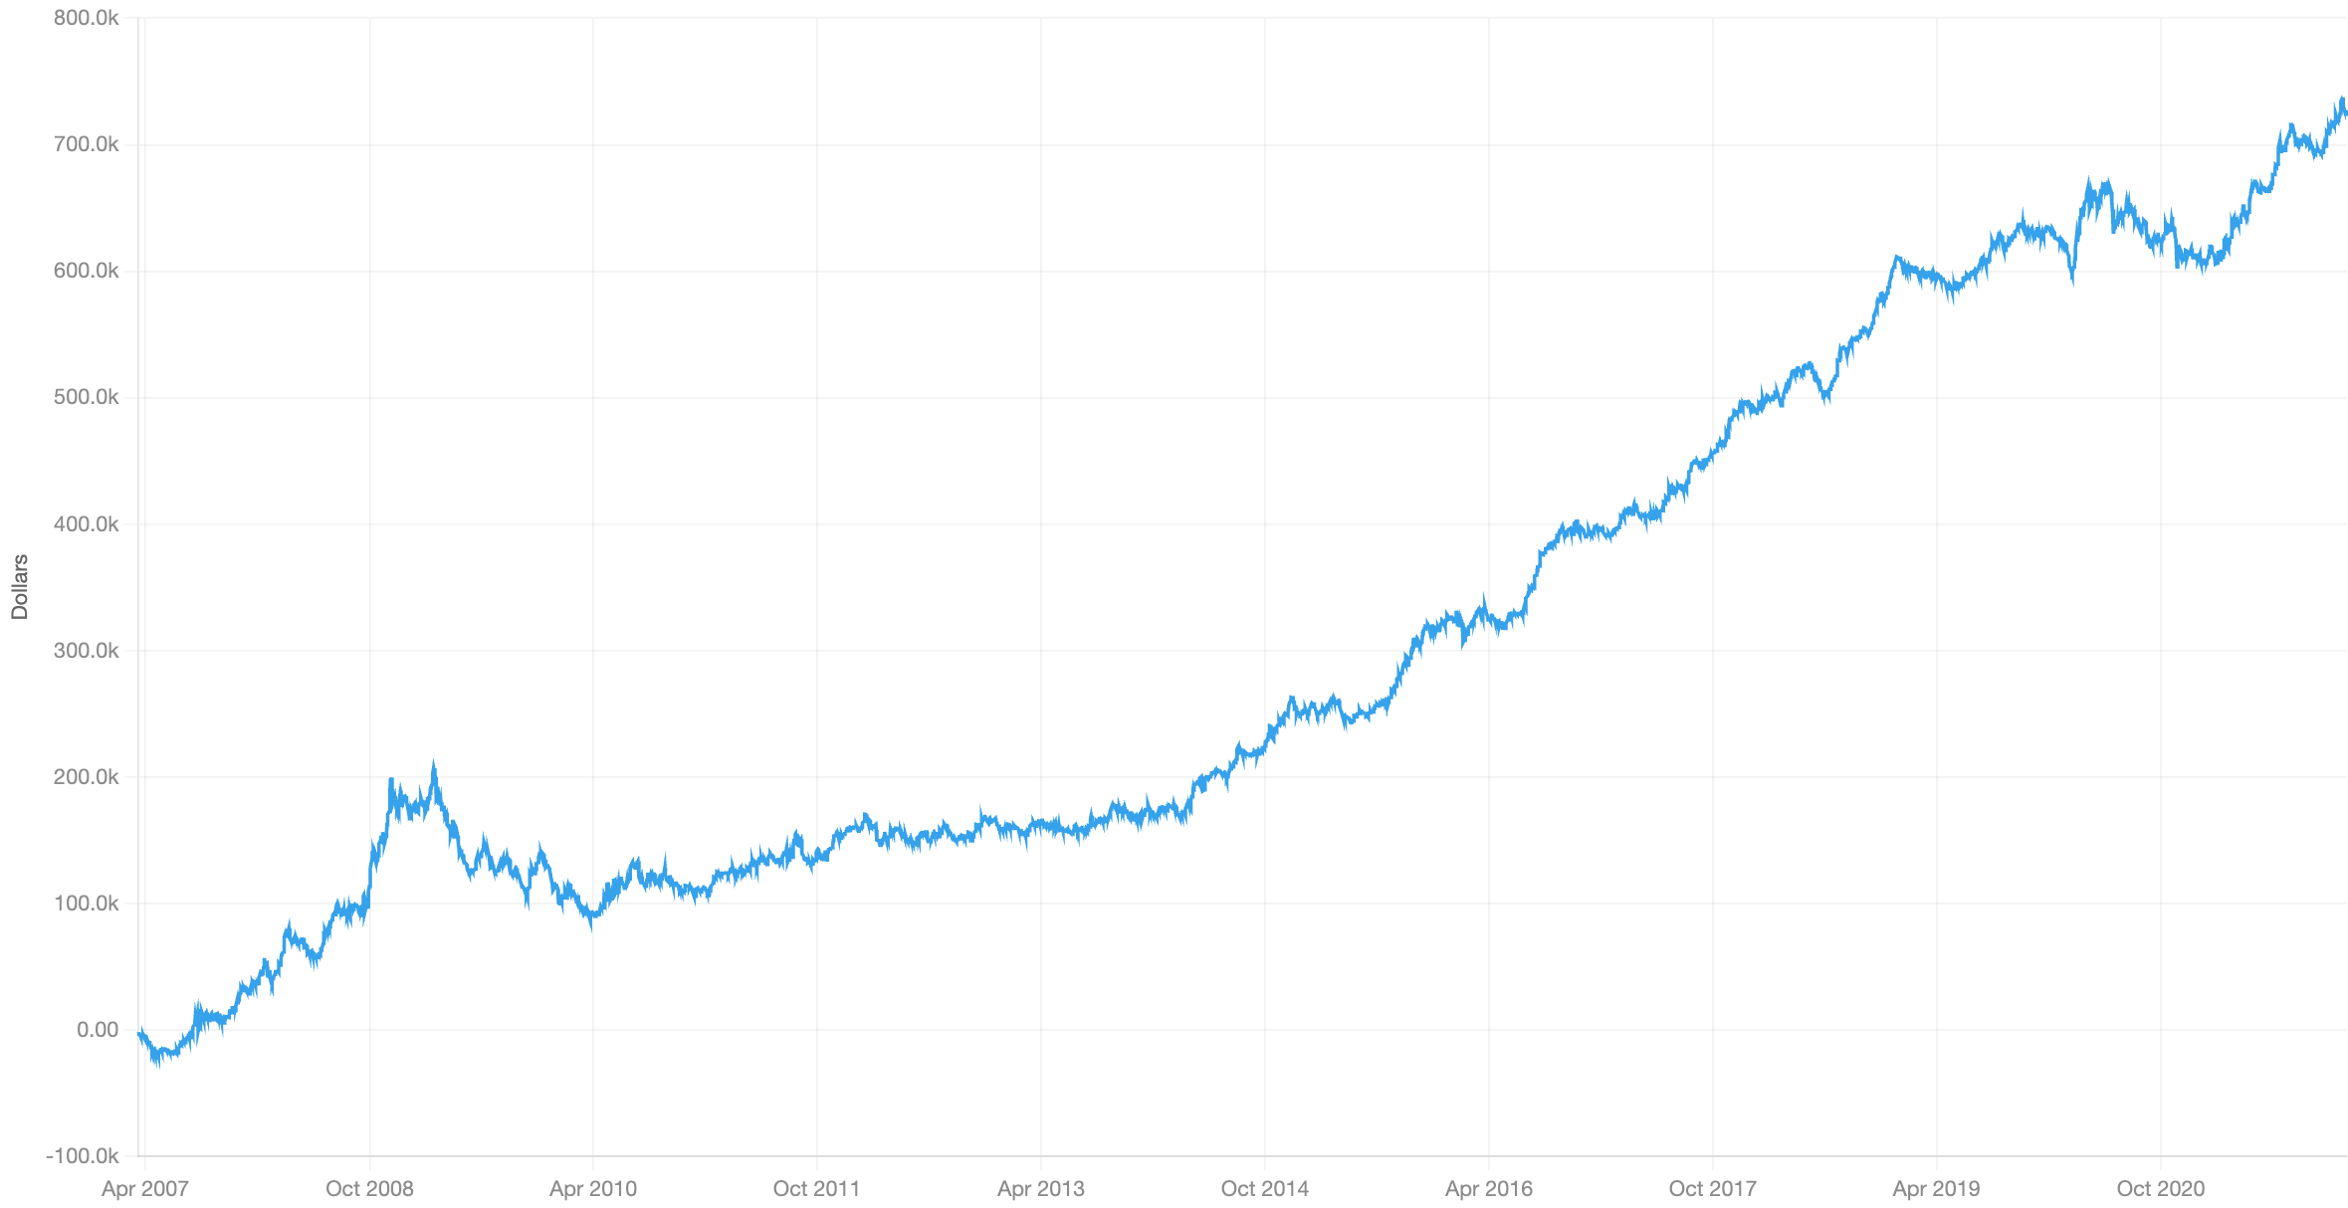
ALPHA RESEARCH
06 / INVESTMENT & EARNINGS QUALITY
SLOW RUN
The diversifier earns in calm years.
CUMULATIVE PNL / PLATFORM DOLLARS
DAILY IR
Weak spots: 2009 junk rally; flat 2011–13.
0.082
t ≈ 5.0 · t ≈ IR × √days
SLOW-RUN METRIC
VALUE
Turnover
0.054
IR / √TVR
0.354
Return (platform)
0.049
Max drawdown
11.9
Stocks per side
651 × 631
Liq / LiqN
694 / 379
≈75% of PnL earned in 2010–19; crisis share ≈4%.
Lowest turnover in the pool.
2007–21 · original platform PnL image · episode shares are approximate readings from the chart
19 / 23
Notes:
[18:30–19:00] Slow IR 0.082, t about 5.0, with turnover 0.054, the lowest of the seven, so IR per root turnover is 0.354. Drawdown 11.9 on a broad book of about 650 a side. The PnL is the reverse of the price-based factors. The crisis window is only about 4% net: it spiked in December 2008 and gave it back. About 75% of the PnL is earned from 2010 to 2019, exactly when Factors 1, 4 and 5 are flat. The weak spots are the 2009 junk rally and 2011 to 2013, which is when quality and investment factors are known to lose, as low-quality stocks rebound. Its PnL correlation with the others is at most 0.21 in absolute value, and that one is negative, with Factor 3. So it's the best diversifier in the set.
Slide interpretation: Weak spots: the 2009 junk rally and flat 2011–13. Correlations with others at most 0.21 in absolute value.
Visible caveat: Diversification — The largest correlation is negative, with Factor 3.
SOURCE SLIDE CONTENT (for reference)
FACTOR 6 · INVESTMENT AND EARNINGS QUALITY
Slow run results
Q4 2008 – mid 2009 ≈ 4% net; ≈ 75% of the PnL earned 2010–19.
Weak spots: the 2009 junk rally and a flat 2011–13.
19
Slow run, 2007–21 | Value
IR | 0.082
t ≈ IR × √days | 5.0
Turnover | 0.054
IR/√TVR | 0.354
Return (platform) | 0.049
Max drawdown | 11.9
Stocks per side | 651 × 631
Liq / LiqN | 694 / 379

Slide 20

ALPHA RESEARCH
07 / OVER-EXPANSION
IDEA
Over-expansion has two channels.
CAPITAL / BALANCE-SHEET BLOAT
Net operating assets accumulate when accounting earnings outrun free cash flow. Short high NOA.
CONSTRUCTION
r250 = close / delay(close,250) - 1
op_assets = total_assets - cash
op_liabs = total_liabs - total_debt
noa = (op_assets-op_liabs) / assets
emp = ttm_eps × shsout / ni_per_emp
sA = -rank(noa)
sH = neut(-rank(emp/emp_1y_ago-1),
[log mktcap, r250])
alpha = cs_factorneut(
zmean(sA, sH), [log mktcap, r250])
LABOR / HIRING
Fast hiring predicts low returns. Here headcount is inferred; much of the leg is earnings growth the price has not confirmed.
Leg correlation: −0.17
Capital
Labor
Use NOA alone when hiring is missing. Clip each leg’s z-score at ±3.
Hirshleifer, Hou, Teoh & Zhang (2004); Belo, Lin & Bazdresch (2014) · inferred headcount, profitable firms only
20 / 23
Notes:
[19:00–20:30] Factor seven, over-expansion. One idea with two channels: firms that expand aggressively earn lower returns. There are two complementary reasons. The investment-based one, q-theory: firms expand most when their cost of capital is low, so expansion signals low expected returns. Hou, Xue and Zhang show their investment factor absorbs this. The behavioral one: investors anchor on reported earnings and overlook that earnings have outrun cash, and the gap piles up on the balance sheet. The capital channel is net operating assets, Hirshleifer, Hou, Teoh and Zhang 2004. In the code: operating assets are total assets minus cash, operating liabilities are total liabilities minus debt, and NOA is the difference scaled by assets. It's a stock variable: the cumulative excess of accounting earnings over free cash flow. Short high NOA. The labor channel is hiring, Belo, Lin and Bazdresch 2014. The catalog has no headcount, so I infer it: trailing EPS times shares gives net income, divided by net income per employee gives employees, for profitable firms only. The signal is minus the annual growth in that headcount, with size and the 12-month return removed. I'll be upfront about this leg on the next slide: most of it turns out to be earnings growth that the price hasn't confirmed, not clean hiring. The two legs correlate minus 0.17, which fits the two-channel reading: asset-heavy firms expand through the balance sheet, asset-light firms by hiring. The last line averages the clipped z-scores and removes size and the 12-month return once more, as in Factor 6.
SOURCE SLIDE CONTENT (for reference)
FACTOR 7 OF 7 · OVER-EXPANSION
Firms that over-expand underperform
Firms expand most when their cost of capital is low (q-theory), and investors anchor on earnings that have outrun cash. Two channels:
sA · Capital: balance-sheet bloat
Net operating assets accumulate when accounting earnings outrun free cash flow (Hirshleifer, Hou, Teoh & Zhang 2004).
sH · Labor: hiring
Fast hiring predicts low returns (Belo, Lin & Bazdresch 2014). Headcount is inferred, and most of this leg is earnings growth the price hasn't confirmed.
The legs correlate −0.17: asset-heavy firms bloat, asset-light firms hire.
Construction
r250 = close / ts_delay(close, 250) - 1
op_assets = total_assets - cash
op_liabs = total_liabilities - total_debt
noa = (op_assets - op_liabs) / total_assets
emp = ttm_eps · shsout / ni_per_employee
# inferred headcount; profitable firms only
sA = -rank(noa)
sH = neut(-rank(emp / emp_1y_ago - 1),
[log mktcap, r250])
alpha = cs_factorneut(zmean(sA, sH),
[log mktcap, r250])
9 data variables · zmean clips each leg's z-score at ±3 · uses NOA alone where the hiring leg is missing
20

Slide 21
ALPHA RESEARCH
07 / OVER-EXPANSION
ABLATIONS
NOA is robust. Hiring is a mixed proxy.
NOA WORKS AS A NET FIGURE
HIRING-LEG VERSION
IR
SHARE
NOA
0.05
As built
0.07
—
Financing-side NOA
0.05
Earnings piece alone
0.06
≈85%
Long-term NOA
0.05
Earnings growth removed
0.04
≈57% left
NOA ex-goodwill
0.04
NOA level / change removed
0.061
≈87%
Operating liabilities
−0.01
Factor 6 growth legs removed
0.05
≈71%
NOA holds in slow mode (0.05), after controls (0.05), and at a 63-day delay (0.06).
Honest label: hiring / price-unconfirmed earnings growth.
NOA alone
Hiring alone
Both, equal weight
0.050
0.069
0.074
Pre-run estimate: 0.08–0.09. The result came in below it; the hiring leg covers profitable firms only.
Top panels: fast-mode IR · bottom: slow-mode combination · primary NOA version and equal weights fixed before the composite
21 / 23
Notes:
[20:30–21:40] Left, the NOA leg. Hirshleifer et al.'s point is that NOA is cumulative accruals, so it should work only as the net figure, not through any single account. That's what the anatomy runs show: measured from the financing side, or long-term only, or without goodwill, it stays at 0.04 to 0.05. Operating liabilities alone are about zero, and so were cash and working capital. It also holds in slow mode, with size and the 12-month return removed, and with a 63-day delay, so it's a slow characteristic, not a filing-day effect. Right, the hiring leg, and this is a disclosure. Because headcount is inferred from net income divided by net income per employee, its growth is roughly earnings growth minus growth in income per employee. My leakage checks failed: the earnings piece alone carries about 85% of the leg, and removing earnings growth leaves about 57%. So the honest label is hiring plus price-unconfirmed earnings growth. Two checks did pass: removing NOA's level and change keeps 87%, so it's a separate channel from the other leg, and removing Factor 6's growth and issuance legs keeps 71%, so it isn't Factor 6 again. Bottom: NOA alone was 0.05, hiring alone 0.069, one thousandth short of the bar, and I didn't tune it. The two-leg combination was registered before any composite run, with plain NOA locked as the primary version. My estimate was 0.08 to 0.09; it came in below that, at 0.074, most likely because the hiring leg only covers profitable firms, so much of the book is NOA alone.
SOURCE SLIDE CONTENT (for reference)
FACTOR 7 · ABLATIONS (FAST-MODE IR)
What each leg really measures
NOA works only as the net figure
NOA
0.05
Financing-side NOA
0.05
Long-term NOA
0.05
NOA ex-goodwill
0.04
Operating liabilities only
−0.01
Holds slow (0.05), with size and 12-m return removed (0.05), and delayed 63 days (0.06).
What the hiring leg carries
Honest label: hiring / price-unconfirmed earnings growth.
NOA alone · slow
0.05
+
Hiring alone · slow
0.069
Both, equal weight · slow
0.074
Two-leg design registered before any composite run · pre-run estimate 0.08–0.09, came in below it (the hiring leg covers only profitable firms)
21
Version | IR | Share of the leg
Hiring leg as built | 0.07 | —
Earnings piece alone | 0.06 | ≈ 85%
Earnings growth removed | 0.04 | ≈ 57% left
NOA level and change removed | 0.061 | ≈ 87%: own channel
Factor 6's growth legs removed | 0.05 | ≈ 71%: not Factor 6

Slide 22
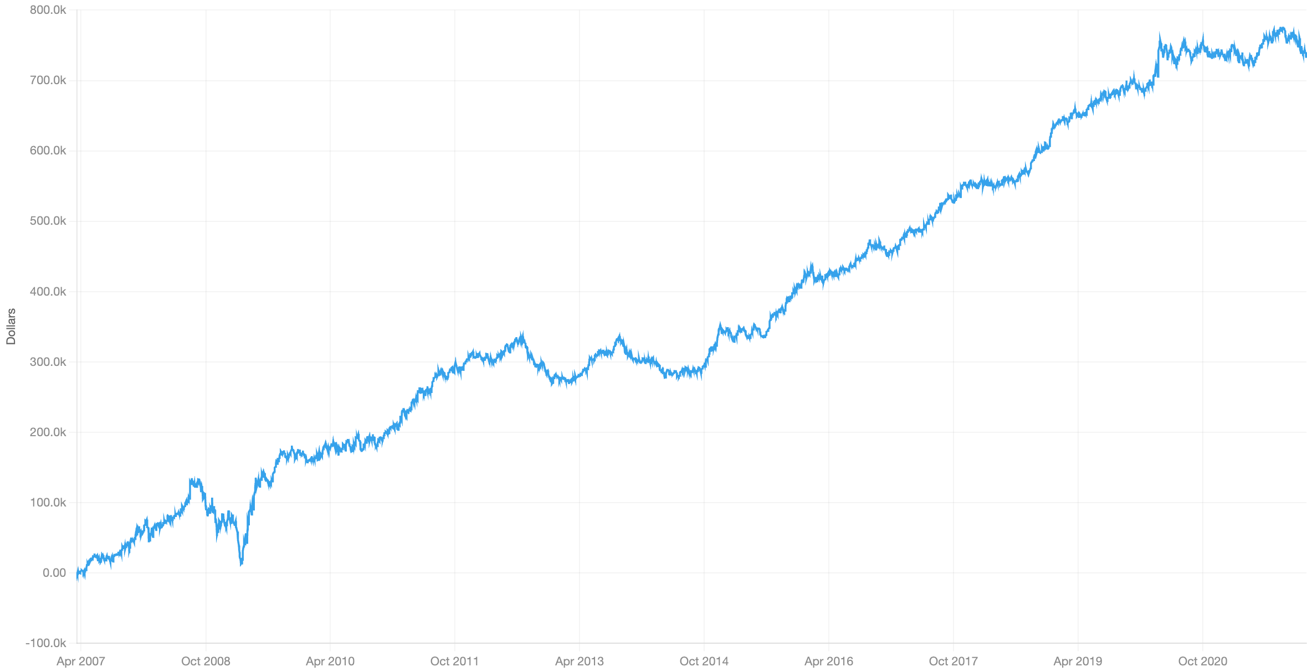
ALPHA RESEARCH
07 / OVER-EXPANSION
SLOW RUN
Steady growth. Almost no crisis share.
CUMULATIVE PNL / PLATFORM DOLLARS
DAILY IR
Q4 2008 dip recovered; weak 2012–14; flat since mid-2020.
0.074
t ≈ 4.5 · t ≈ IR × √days
SLOW-RUN METRIC
VALUE
Turnover
0.056
IR / √TVR
0.313
Return (platform)
0.052
Max drawdown
12.8
Stocks per side
475 × 458
Liq / LiqN
503 / 309
≈71% of PnL earned in 2010–19; crisis share ≈1%.
Pool correlations ≤0.14.
2007–21 · original platform PnL image · episode shares are approximate readings from the chart
22 / 23
Notes:
[21:40–22:10] Slow IR 0.074, t about 4.5, so 0.004 over the bar. Turnover 0.056 and drawdown 12.8; the book is smaller than Factor 6's, about 475 a side, because the hiring leg covers only profitable firms. The PnL earns steadily with almost no crisis share: late 2008 to mid 2009 is about 1% net. It had its steepest drawdown in Q4 2008 and recovered within months, then about 71% of the PnL comes from 2010 to 2019. Its shape differs from Factor 6: Factor 6 lost in the 2009 junk rally, Factor 7 rebounded then, which fits their low correlation of 0.14 even though both are fundamental. The weak spots are 2012 to 2014, and it has made no new money since the March 2020 jump. Its correlation with every other factor is at most 0.14.
Slide interpretation: Q4 2008 dip recovered. Weak 2012–14; flat since mid-2020. Correlation with every other factor at most 0.14.
Visible caveat: Thin margin — IR is 0.004 above the bar; hiring coverage limits breadth.
SOURCE SLIDE CONTENT (for reference)
FACTOR 7 · OVER-EXPANSION · SLOW-RUN RESULTS
Steady growth with almost no crisis share
Q4 2008 – mid 2009 ≈ 1% net; ≈ 71% of the PnL earned 2010–19.
Weak spots: a sharp Q4 2008 dip (recovered), 2012–14, flat since mid 2020.
Slow mode, lookback 300 · cumulative PnL from the platform · shares read off the chart, approximate
22
Slow run, 2007–21 | Value
IR | 0.074
t ≈ IR × √days | 4.5
Turnover | 0.056
IR/√TVR | 0.313
Return (platform) | 0.052
Max drawdown | 12.8
Stocks per side | 475 × 458
Liq / LiqN | 503 / 309

Slide 23
ALPHA RESEARCH / DISCUSSION
Thank you.
The evidence.
The limitations.
The next tests.
SEVEN SIGNALS. ONE RESEARCH DISCIPLINE.
23 / 23
Notes:
[22:10] Thank you. Happy to take questions.
SOURCE SLIDE CONTENT (for reference)
Thank you!

