Slide 1

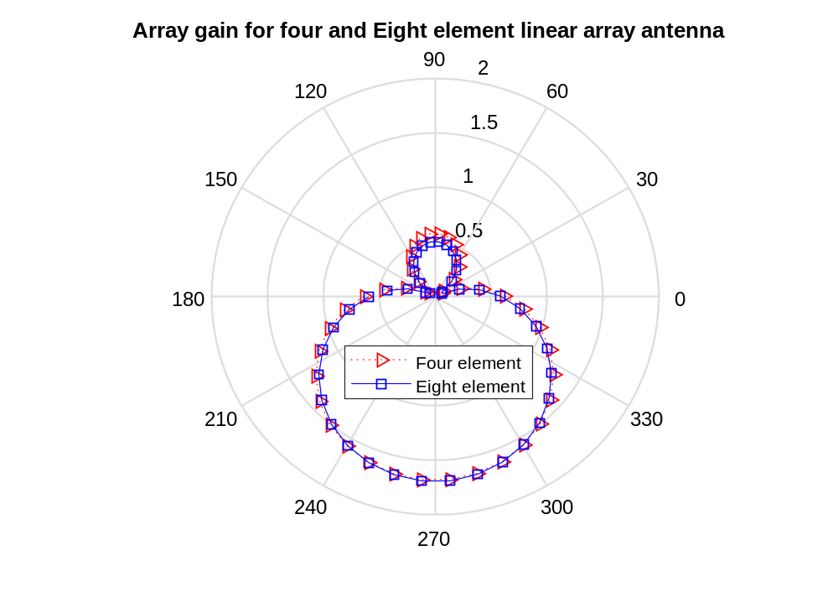
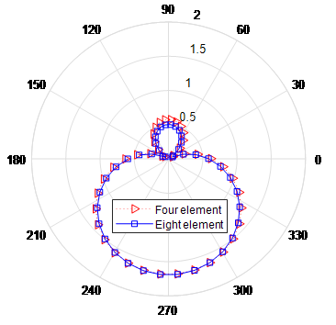
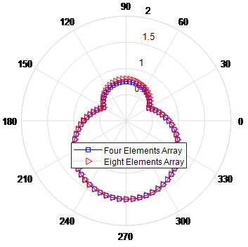
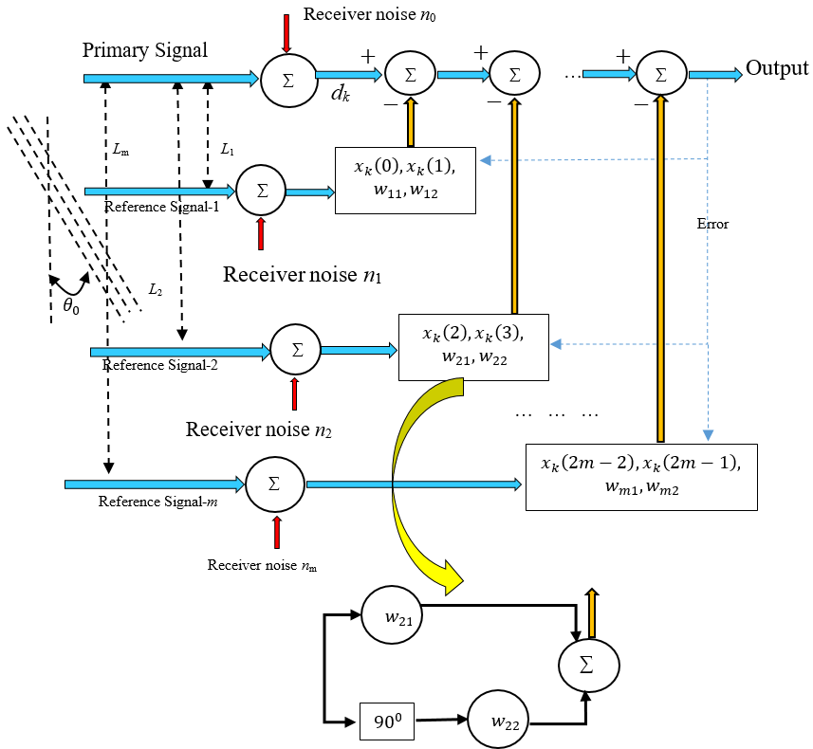
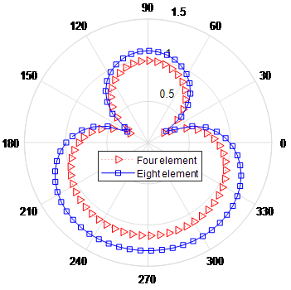
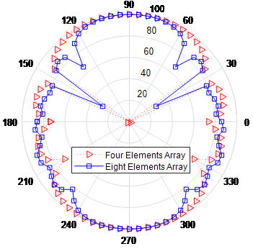
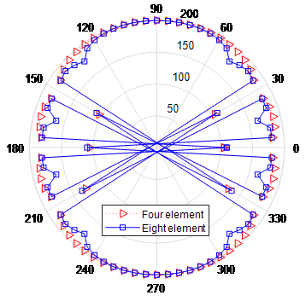
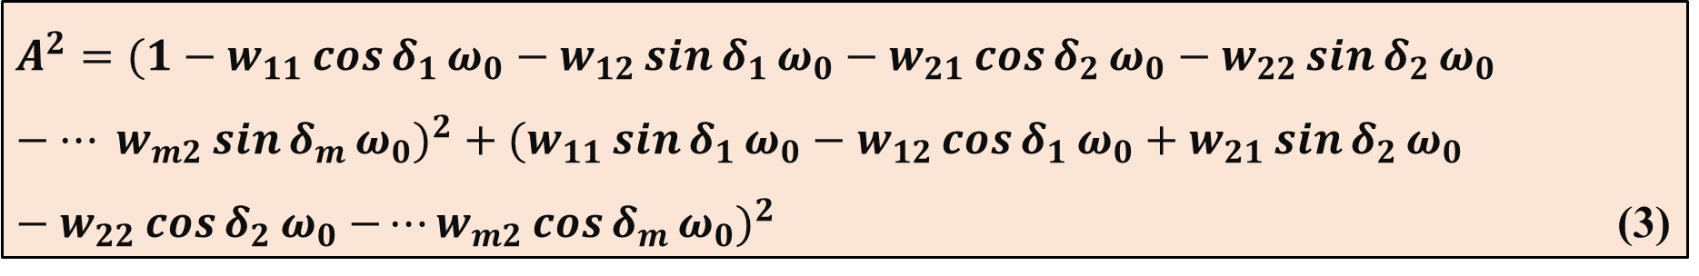
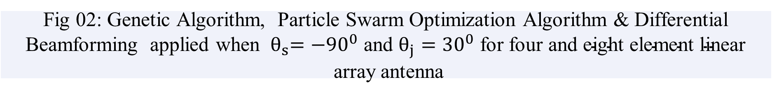
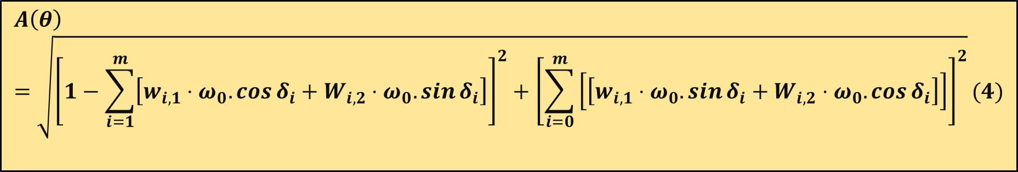
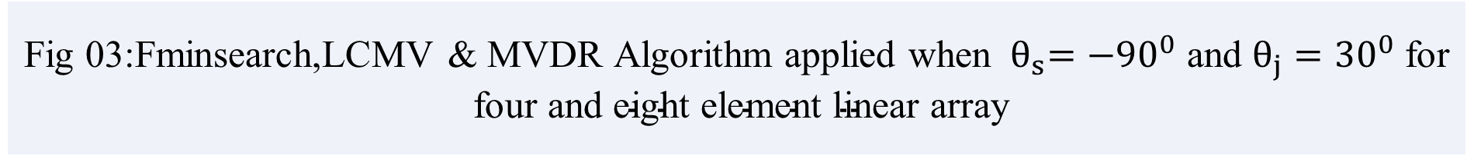
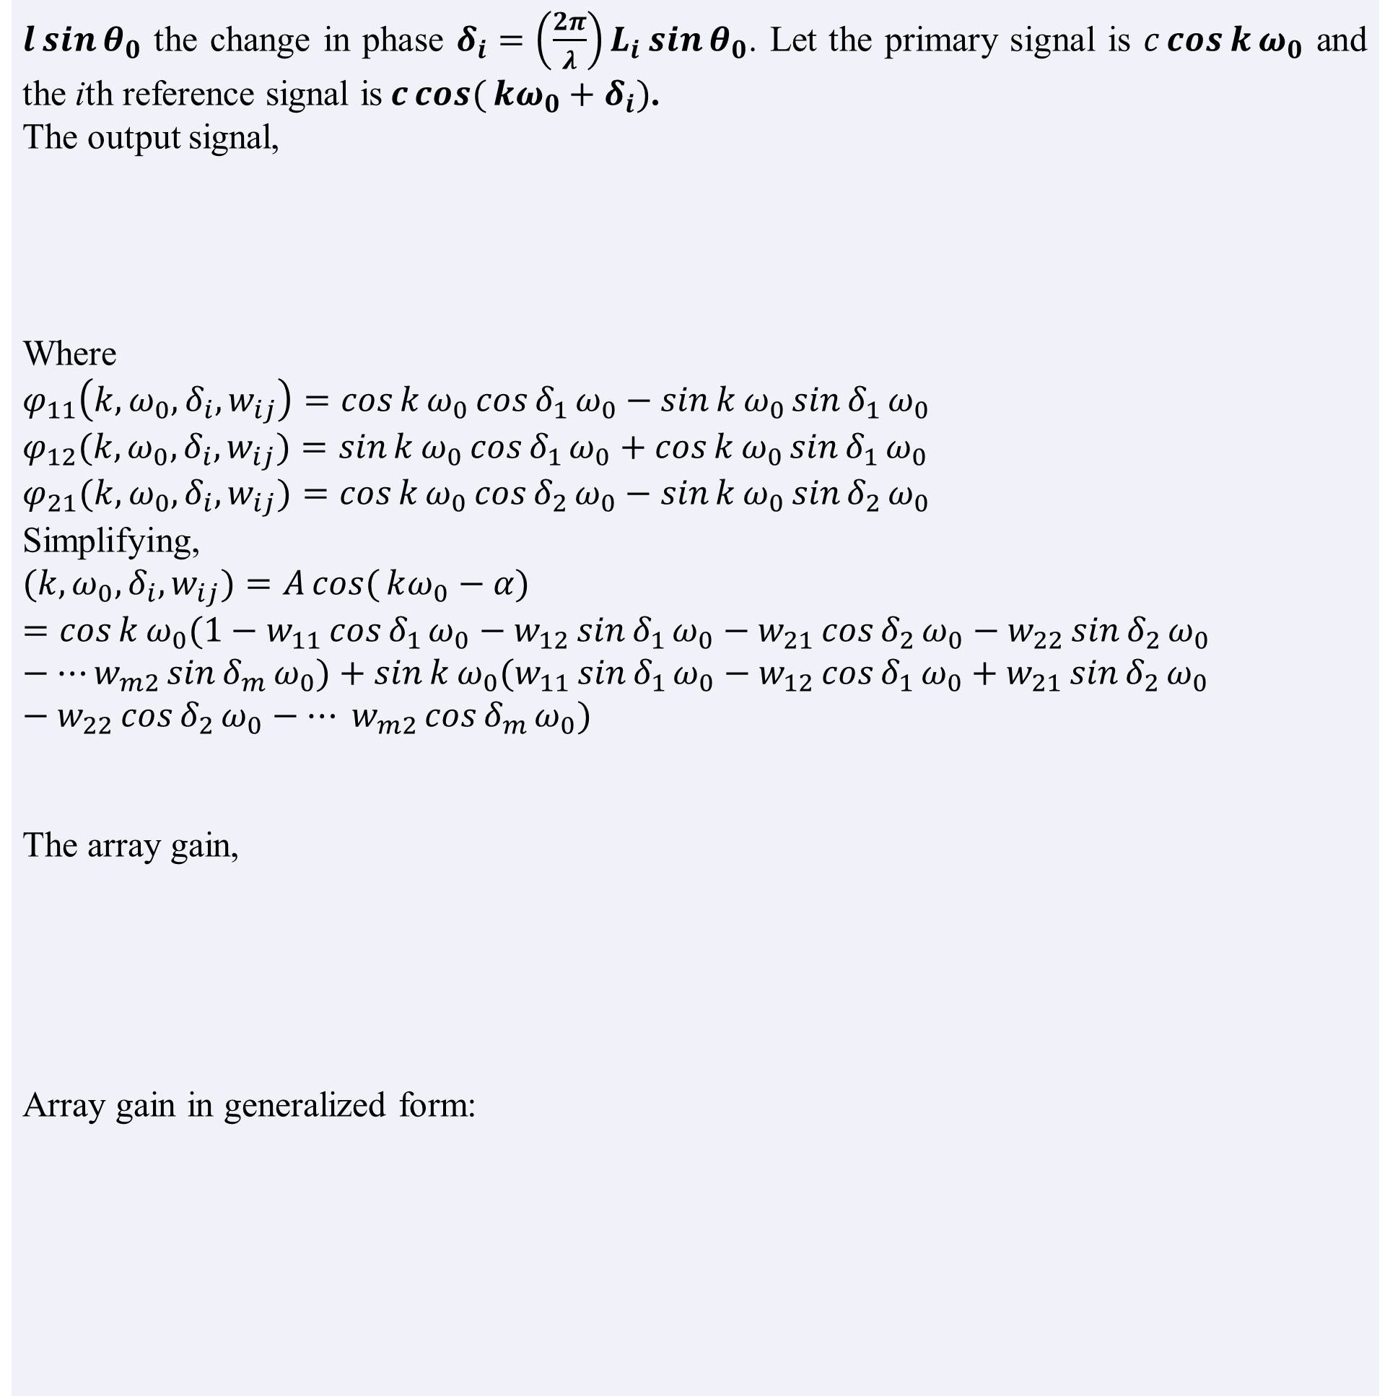
Adaptive Beamforming of Linear Array Antenna System using Particle Swarm Optimization and Genetic Algorithm
Exam Roll: 202180 & 202182
Department of Computer Science & Engineering,
Jahangirnagar University
1. Abstract
$l\sin{θ_{0}}$ the change in phase $δ_{i}=\left(\frac{2π}{λ}\right)L_{i}\sin{θ_{0}}$. Let the primary signal is $c\cos{k}ω_{0}$ and the ith reference signal is$c\cos{(}kω_{0}+δ_{i})$.
The output signal,
Where
$$φ_{11}\left(k,ω_{0},δ_{i}, w_{ij}\right)=\cos{k}ω_{0}\cos{δ_{1}}ω_{0}−\sin{k}ω_{0}\sin{δ_{1}}ω_{0}$$
$$φ_{12}(k,ω_{0},δ_{i}, w_{ij})=\sin{k}ω_{0}\cos{δ_{1}}ω_{0}+\cos{k}ω_{0}\sin{δ_{1}}ω_{0}$$
$$φ_{21}(k,ω_{0},δ_{i}, w_{ij})=cos{k}ω_{0}\cos{δ_{2}}ω_{0}−\sin{k}ω_{0}\sin{δ_{2}}ω_{0}$$
Simplifying,
$$(k,ω_{0},δ_{i}, w_{ij})=A\cos{(}kω_{0}−α)=\cos{k}ω_{0}(1−w_{11}\cos{δ_{1}}ω_{0}−w_{12}\sin{δ_{1}}ω_{0}−w_{21}\cos{δ_{2}}ω_{0}−w_{22}\sin{δ_{2}}ω_{0}−⋯w_{m2}\sin{δ_{m}}ω_{0})+\sin{k}ω_{0}(w_{11}\sin{δ_{1}}ω_{0}−w_{12}\cos{δ_{1}}ω_{0}+w_{21}\sin{δ_{2}}ω_{0}−w_{22}\cos{δ_{2}}ω_{0}−⋯ w_{m2}\cos{δ_{m}}ω_{0})$$
The array gain,
Array gain in generalized form:
One of the main features of 5G communication networks is the use of massive MIMO technology with adaptive beamforming. This research focuses on using a linear array antenna
to manage unwanted signals like jamming, interference and noise. At the same time, it enhances signal strength towards the desired user or device.The main challenge was optimizing the weights of the antenna elements. To address this, adaptive algorithms like LCMV and RLS were used.To simplify the process, we applied two soft computing methods : Particle Swarm Optimization (PSO) and Genetic Algorithm (GA). The beamforming weights and radiation patterns were evaluated for cancelling the unwanted signal and enhancing the desired signal. The results were compared with existing algorithms and showed closely matched outcomes.
$\left(k,ω_{0},δ_{i}, w_{ij}\right)=\cos{k}ω_{0}−{w_{11}φ}_{11}\left(k,ω_{0},δ_{i}, w_{ij}\right)−{w_{12}φ}_{12}\left(k,ω_{0},δ_{i}, w_{ij}\right)−⋯ ⋯ ⋯−{w_{m2}φ}_{m2}\left(k,ω_{0},δ_{i}, w_{ij}\right)$ (1)
2. Introduction
Adaptive beamforming is an adaptive technique by which we can transmit or detect the desired signal from the direction of arrival of signal. Signal may come from any direction but we have to tune the antenna to extract the target signal at the same time the interference from other direction has to be eliminated. Principal component of an adaptive beam former is an adaptive filter consists of two parts, a digital filter with adjustable coefficients and adaptive algorithm which is used to adjust the coefficients of the filter. In this research work GA and PSO will also be applied to perform the same work.
$=\cos{k}ω_{0}A\cos{α}+\sin{k}ω_{0}A\sin{α}$ (2)
$A^{2}=(1−w_{11}\cos{δ_{1}}ω_{0}−w_{12}\sin{δ_{1}}ω_{0}−w_{21}\cos{δ_{2}}ω_{0}−w_{22}\sin{δ_{2}}ω_{0}−⋯ w_{m2}\sin{δ_{m}}ω_{0})^{2}+(w_{11}\sin{δ_{1}}ω_{0}−w_{12}\cos{δ_{1}}ω_{0}+w_{21}\sin{δ_{2}}ω_{0}−w_{22}\cos{δ_{2}}ω_{0}{−⋯w_{m2}\cos{δ_{m}}ω_{0})}^{2}$ (3)
3. Literature Review
PSO outperforms in optimizing the amplitude and position of antenna elements to improve the performance of beamforming and antenna array synthesis as compared by the authors in [1] while the authors in [2] have shown how Genetic Algorithm(GA) enhances load balancing among antenna elements. Massive MIMO-OFDM combined with a genetic algorithm (GA) used in [3] improves signal quality by improving the signal-to-interference noise ratio (SINR),reducing bit error rate (BER), and lowering power consumption, all of which contribute to better service quality.Particle Swarm Optimization (PSO) excels in optimizing signal strength and minimizing interference as proposed by the authors in [4].
$$A\left(θ\right)=\sqrt{{\left[1−\sum_{i=1}^{m}{\left[w_{i,1}⋅ω_{0}.\cos{δ_{i}}+W_{i,2}⋅ω_{0}.\sin{δ_{i}}\right]}\right]}^{2}+{\left[\sum_{i=0}^{m}{\left[\left[w_{i,1}⋅ω_{0}.\sin{δ_{i}}+W_{i,2}⋅ω_{0}.\cos{δ_{i}}\right]\right]}\right]}^{2}}(4)$$
5. Results
4. Methodology
The basic architecture of AAS with adaptive beamforming technique is shown in fig. 01. Different types of adaptive algorithm are used in adaptive beamforming which transmits or receives the desired signal from a particular direction of arrival at the same time reject the unwanted signal of particular direction .
Fig 02: Genetic Algorithm, Particle Swarm Optimization Algorithm & Differential Beamforming applied when ${ θ}_{s}={−90}^{0} \text{and} θ_{j}={30}^{0} \text{for} \text{four} \text{and} \text{eight} \text{element} \text{linear} \text{array}$ antenna
Fig 03:Fminsearch,LCMV & MVDR Algorithm applied when ${{ θ}_{s}=−90}^{0} \text{and} θ_{j}={30}^{0} \text{for} \text{four} \text{and} \text{eight} \text{element} \text{linear} \text{array}$
6. References
[1] A. Durmus, R. Kurban, and E. Karakose, “A comparison of swarm-based optimization algorithms in linear antenna array synthesis,” Journal of Computational Electronics, vol. 20, pp. 1–12, August 2021.
[2] J. Andr´es V´asquez-Peralvo, J. Querol, F. Ort´ız, J. Luis Gonz´alez Rios, E. Lagunas,L. Manuel Garc´es-Socorr´as, J. Carlos Merlano Duncan, M. O. K. Mendonc¸a, andS. Chatzinotas, “Multibeam beamforming for direct radiating arrays in satellite communications using genetic algorithm,” IEEE Open Journal of the Communications Society, vol. 5, pp. 2343–2357, 2024.
[3] M. B. D. Kadhiravan and B. Ramsugesh, “Ga based adaptive beamforming in high-interference environments for xg networks,” Irish Interdisciplinary Journal of Sciences Research (IIJSR), vol. 4, pp. 48–54, 2020.
[4] L. Hou, Y. Liu, X. Ma, Y. Li, S. Na, and M. Jin, “Particle swarm optimization inspired low-complexity beamforming for mmwave massive mimo systems,” in 2020 IEEE Wireless Communications and Networking Conference (WCNC), 2020,pp. 1–6.
Fig 01: The basic architecture of adaptive beamforming
If the wave-front makes an angle $θ_{0}$ with the vertical axis then for path difference of
Ddddd

Slide 2
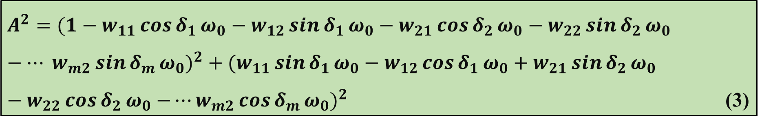
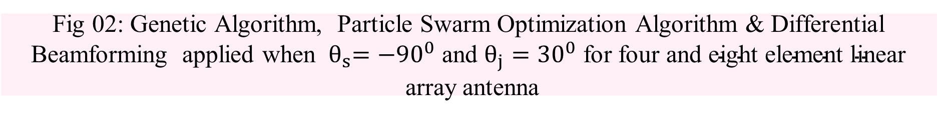
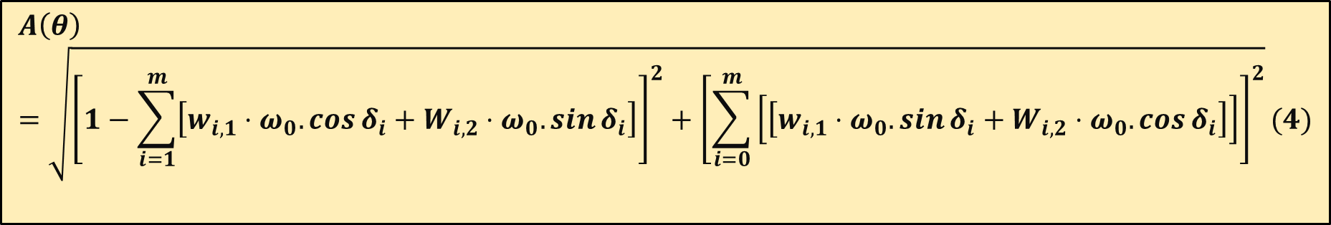
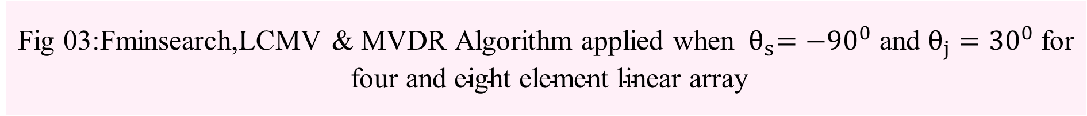
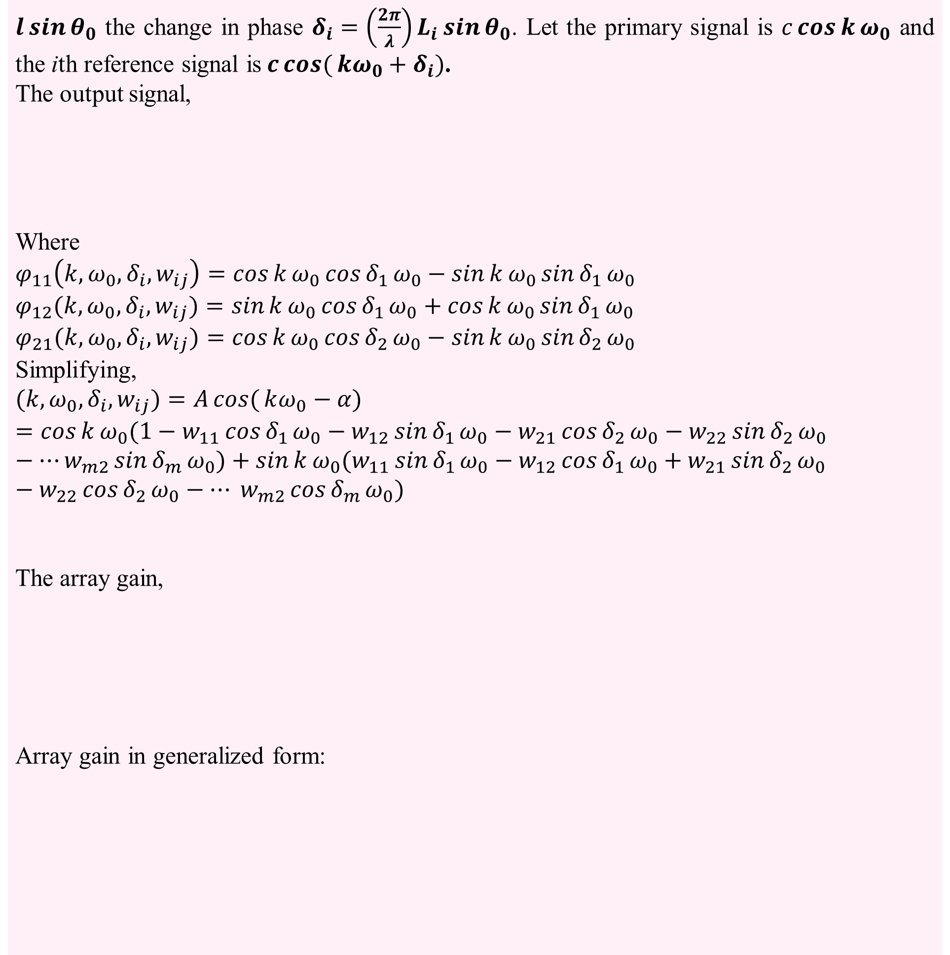
Adaptive Beamforming of Linear Array Antenna System using Particle Swarm Optimization and Genetic Algorithm
Exam Roll: 202180 & 202182
Department of Computer Science & Engineering,
Jahangirnagar University
1. Abstract
$l\sin{θ_{0}}$ the change in phase $δ_{i}=\left(\frac{2π}{λ}\right)L_{i}\sin{θ_{0}}$. Let the primary signal is $c\cos{k}ω_{0}$ and the ith reference signal is$c\cos{(}kω_{0}+δ_{i})$.
The output signal,
Where
$$φ_{11}\left(k,ω_{0},δ_{i}, w_{ij}\right)=\cos{k}ω_{0}\cos{δ_{1}}ω_{0}−\sin{k}ω_{0}\sin{δ_{1}}ω_{0}$$
$$φ_{12}(k,ω_{0},δ_{i}, w_{ij})=\sin{k}ω_{0}\cos{δ_{1}}ω_{0}+\cos{k}ω_{0}\sin{δ_{1}}ω_{0}$$
$$φ_{21}(k,ω_{0},δ_{i}, w_{ij})=cos{k}ω_{0}\cos{δ_{2}}ω_{0}−\sin{k}ω_{0}\sin{δ_{2}}ω_{0}$$
Simplifying,
$$(k,ω_{0},δ_{i}, w_{ij})=A\cos{(}kω_{0}−α)=\cos{k}ω_{0}(1−w_{11}\cos{δ_{1}}ω_{0}−w_{12}\sin{δ_{1}}ω_{0}−w_{21}\cos{δ_{2}}ω_{0}−w_{22}\sin{δ_{2}}ω_{0}−⋯w_{m2}\sin{δ_{m}}ω_{0})+\sin{k}ω_{0}(w_{11}\sin{δ_{1}}ω_{0}−w_{12}\cos{δ_{1}}ω_{0}+w_{21}\sin{δ_{2}}ω_{0}−w_{22}\cos{δ_{2}}ω_{0}−⋯ w_{m2}\cos{δ_{m}}ω_{0})$$
The array gain,
Array gain in generalized form:
One of the main features of 5G communication networks is the use of massive MIMO technology with adaptive beamforming. This research focuses on using a linear array antenna
to manage unwanted signals like jamming, interference and noise. At the same time, it enhances signal strength towards the desired user or device.The main challenge was optimizing the weights of the antenna elements. To address this, adaptive algorithms like LCMV and RLS were used.To simplify the process, we applied two soft computing methods : Particle Swarm Optimization (PSO) and Genetic Algorithm (GA). The beamforming weights and radiation patterns were evaluated for cancelling the unwanted signal and enhancing the desired signal. The results were compared with existing algorithms and showed closely matched outcomes.
$\left(k,ω_{0},δ_{i}, w_{ij}\right)=\cos{k}ω_{0}−{w_{11}φ}_{11}\left(k,ω_{0},δ_{i}, w_{ij}\right)−{w_{12}φ}_{12}\left(k,ω_{0},δ_{i}, w_{ij}\right)−⋯ ⋯ ⋯−{w_{m2}φ}_{m2}\left(k,ω_{0},δ_{i}, w_{ij}\right)$ (1)
2. Introduction
Adaptive beamforming is an adaptive technique by which we can transmit or detect the desired signal from the direction of arrival of signal. Signal may come from any direction but we have to tune the antenna to extract the target signal at the same time the interference from other direction has to be eliminated. Principal component of an adaptive beam former is an adaptive filter consists of two parts, a digital filter with adjustable coefficients and adaptive algorithm which is used to adjust the coefficients of the filter. In this research work GA and PSO will also be applied to perform the same work.
$=\cos{k}ω_{0}A\cos{α}+\sin{k}ω_{0}A\sin{α}$ (2)
$A^{2}=(1−w_{11}\cos{δ_{1}}ω_{0}−w_{12}\sin{δ_{1}}ω_{0}−w_{21}\cos{δ_{2}}ω_{0}−w_{22}\sin{δ_{2}}ω_{0}−⋯ w_{m2}\sin{δ_{m}}ω_{0})^{2}+(w_{11}\sin{δ_{1}}ω_{0}−w_{12}\cos{δ_{1}}ω_{0}+w_{21}\sin{δ_{2}}ω_{0}−w_{22}\cos{δ_{2}}ω_{0}{−⋯w_{m2}\cos{δ_{m}}ω_{0})}^{2}$ (3)
3. Literature Review
PSO outperforms in optimizing the amplitude and position of antenna elements to improve the performance of beamforming and antenna array synthesis as compared by the authors in [1] while the authors in [2] have shown how Genetic Algorithm(GA) enhances load balancing among antenna elements. Massive MIMO-OFDM combined with a genetic algorithm (GA) used in [3] improves signal quality by improving the signal-to-interference noise ratio (SINR),reducing bit error rate (BER), and lowering power consumption, all of which contribute to better service quality.Particle Swarm Optimization (PSO) excels in optimizing signal strength and minimizing interference as proposed by the authors in [4].
$$A\left(θ\right)=\sqrt{{\left[1−\sum_{i=1}^{m}{\left[w_{i,1}⋅ω_{0}.\cos{δ_{i}}+W_{i,2}⋅ω_{0}.\sin{δ_{i}}\right]}\right]}^{2}+{\left[\sum_{i=0}^{m}{\left[\left[w_{i,1}⋅ω_{0}.\sin{δ_{i}}+W_{i,2}⋅ω_{0}.\cos{δ_{i}}\right]\right]}\right]}^{2}}(4)$$
5. Results
4. Methodology
The basic architecture of AAS with adaptive beamforming technique is shown in fig. 01. Different types of adaptive algorithm are used in adaptive beamforming which transmits or receives the desired signal from a particular direction of arrival at the same time reject the unwanted signal of particular direction .
Fig 02: Genetic Algorithm, Particle Swarm Optimization Algorithm & Differential Beamforming applied when ${ θ}_{s}={−90}^{0} \text{and} θ_{j}={30}^{0} \text{for} \text{four} \text{and} \text{eight} \text{element} \text{linear} \text{array}$ antenna
Fig 03:Fminsearch,LCMV & MVDR Algorithm applied when ${{ θ}_{s}=−90}^{0} \text{and} θ_{j}={30}^{0} \text{for} \text{four} \text{and} \text{eight} \text{element} \text{linear} \text{array}$
6. References
[1] A. Durmus, R. Kurban, and E. Karakose, “A comparison of swarm-based optimization algorithms in linear antenna array synthesis,” Journal of Computational Electronics, vol. 20, pp. 1–12, August 2021.
[2] J. Andr´es V´asquez-Peralvo, J. Querol, F. Ort´ız, J. Luis Gonz´alez Rios, E. Lagunas,L. Manuel Garc´es-Socorr´as, J. Carlos Merlano Duncan, M. O. K. Mendonc¸a, andS. Chatzinotas, “Multibeam beamforming for direct radiating arrays in satellite communications using genetic algorithm,” IEEE Open Journal of the Communications Society, vol. 5, pp. 2343–2357, 2024.
[3] M. B. D. Kadhiravan and B. Ramsugesh, “Ga based adaptive beamforming in high-interference environments for xg networks,” Irish Interdisciplinary Journal of Sciences Research (IIJSR), vol. 4, pp. 48–54, 2020.
[4] L. Hou, Y. Liu, X. Ma, Y. Li, S. Na, and M. Jin, “Particle swarm optimization inspired low-complexity beamforming for mmwave massive mimo systems,” in 2020 IEEE Wireless Communications and Networking Conference (WCNC), 2020,pp. 1–6.
Fig 01: The basic architecture of adaptive beamforming
If the wave-front makes an angle $θ_{0}$ with the vertical axis then for path difference of
Ddddd

