Slide 1
Heaps
Chapter 9

Slide 2
Heaps
The root of a heap is guaranteed to hold largest node in tree
Smaller values can be on either right or left sub-tree
The tree is complete or nearly complete
Key value of each node is >= to key value in each descendent
Often implemented in an array, because locations of sub-trees and parents can be easily calculated

Slide 3
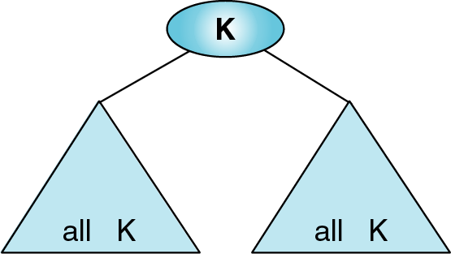
≤
≤
Figure 9-1

Slide 4
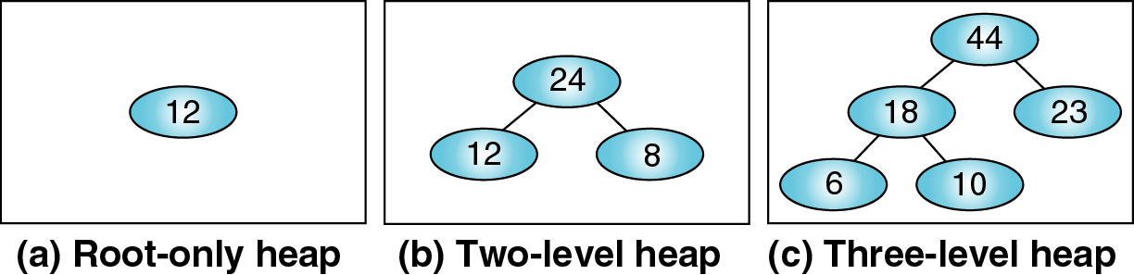
Figure 9-2 Heap trees

Slide 5
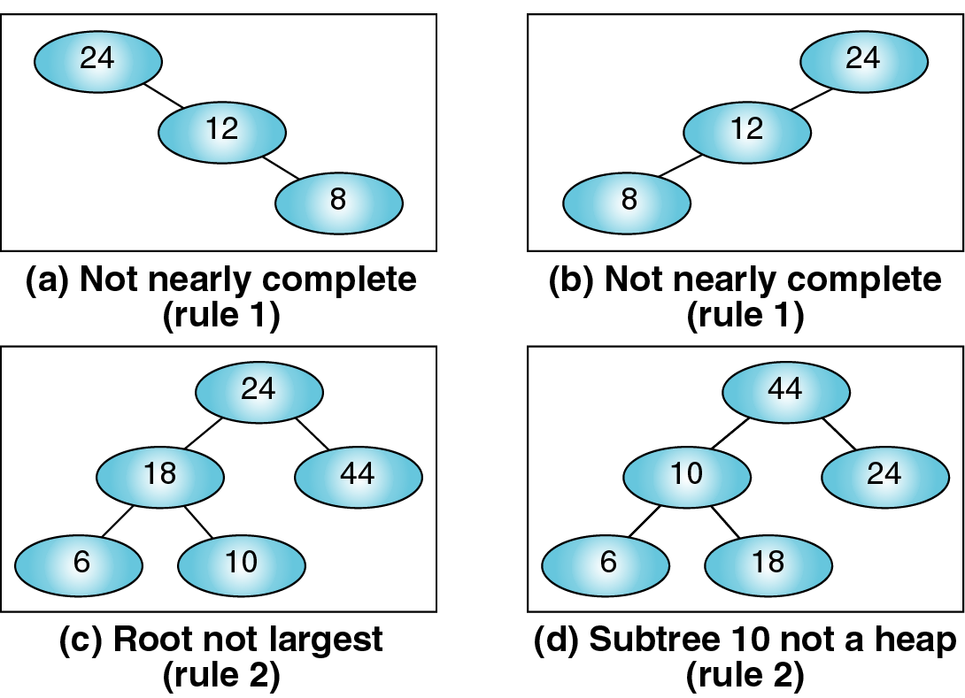
Figure 9-3 Invalid heaps

Slide 6
Basic Heap Algorithms
Two operations are performed on a heap:
  Insert a node
  Delete a node
Basic operations require:
  Reheap Up
  Reheap Down

Slide 7
Reheap Up
The reheap up algorithm repairs a binary tree that satisfies the heap property without the last element
Last element is floated up the tree until it is in the correct location in the tree
Elements are floated up by comparing itself to the parent nodes, and exchanging values with parent nodes if it is greater than parent node values

Slide 8
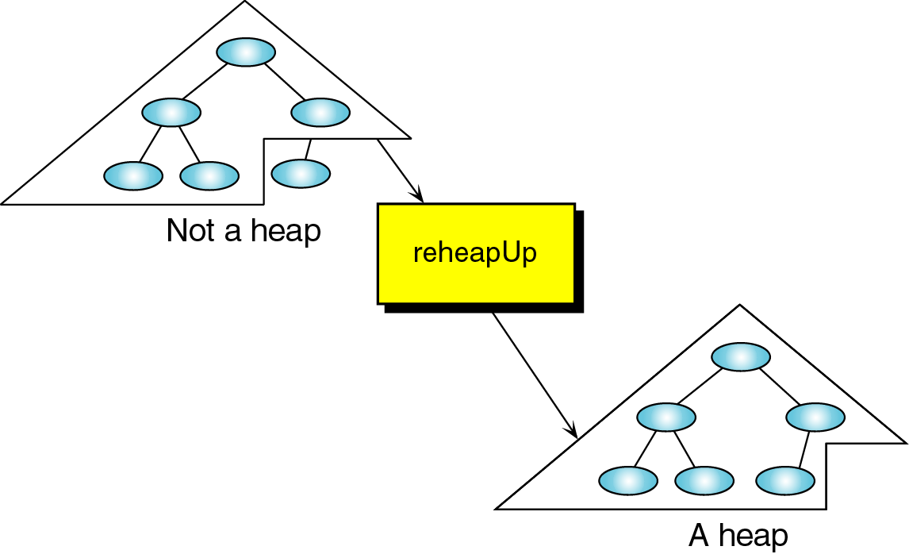
Figure 9-4

Slide 9
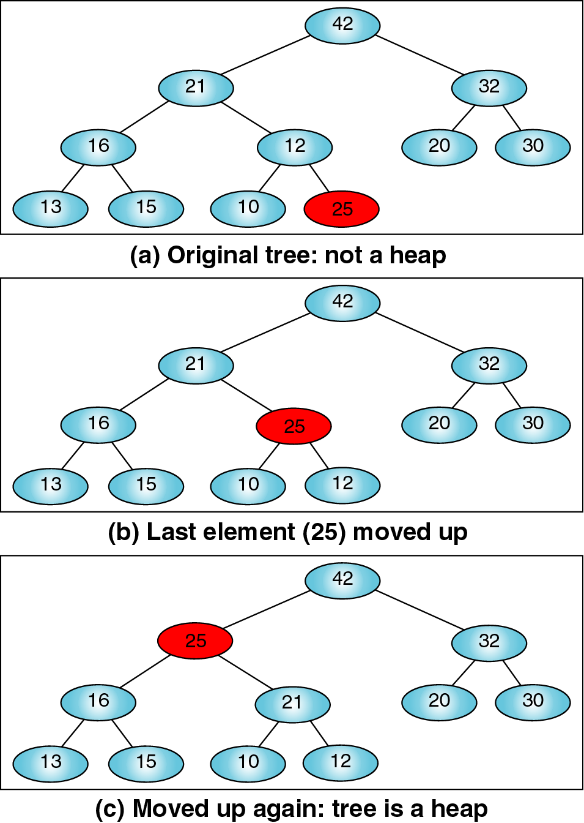
Figure 9-5

Slide 10
Reheap Down
The reheap down algorithm repairs a binary tree that satisfies the heap property except for the root node
Root element moves down the tree until it is in the correct location of the tree
Root is moved by comparing its values with those of the child nodes; if the root value is smaller than the child node’s value, the root and child node values are exchanged

Slide 11
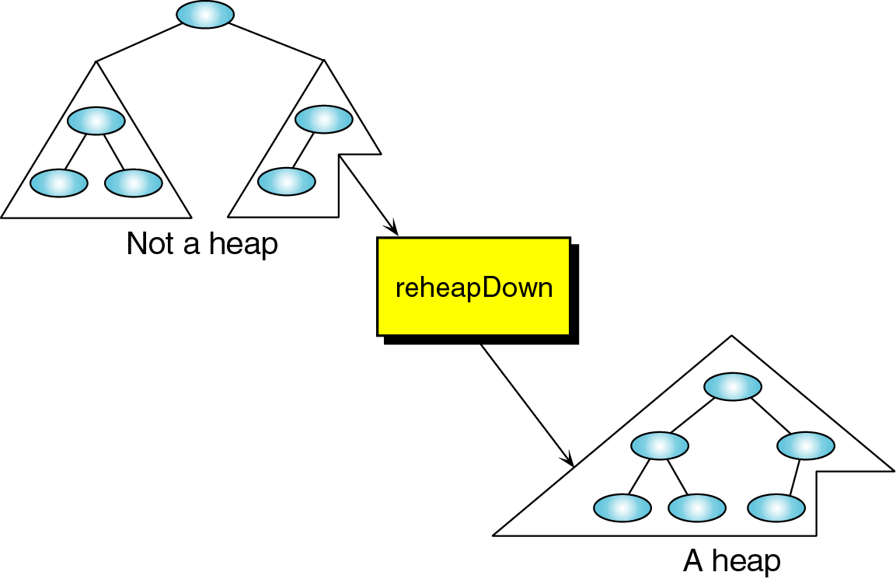
Figure 9-6 reheapDown operation

Slide 12
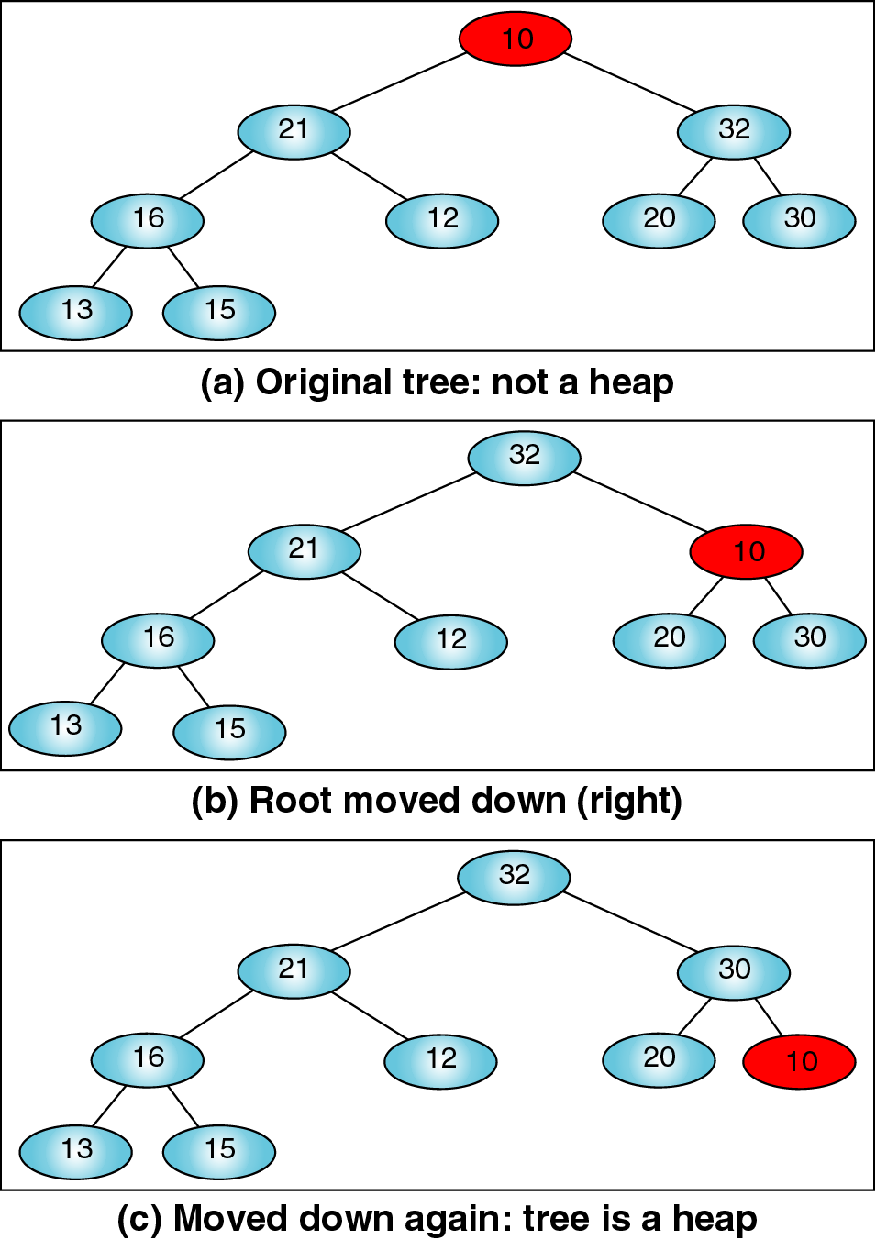
Figure 9-7 reheapDown

Slide 13
Heap Data Structure
The relationship between a node and its children can be calculated:
  Child nodes of a node located at index i
    left child: 2i + 1
    right child: 2i + 2
  Parent of a node located at index i is located at lower limit of [(i – 1)/2]
  Given index for left child j, its right sibling, if any, is found at j + 1; given right child index k, its left sibling is at k – 1
  Given size n of a complete heap, the location of first leaf is lower limit of [n/2]; given location of first leaf element, the location of last non-leaf element is 1 less

Slide 14
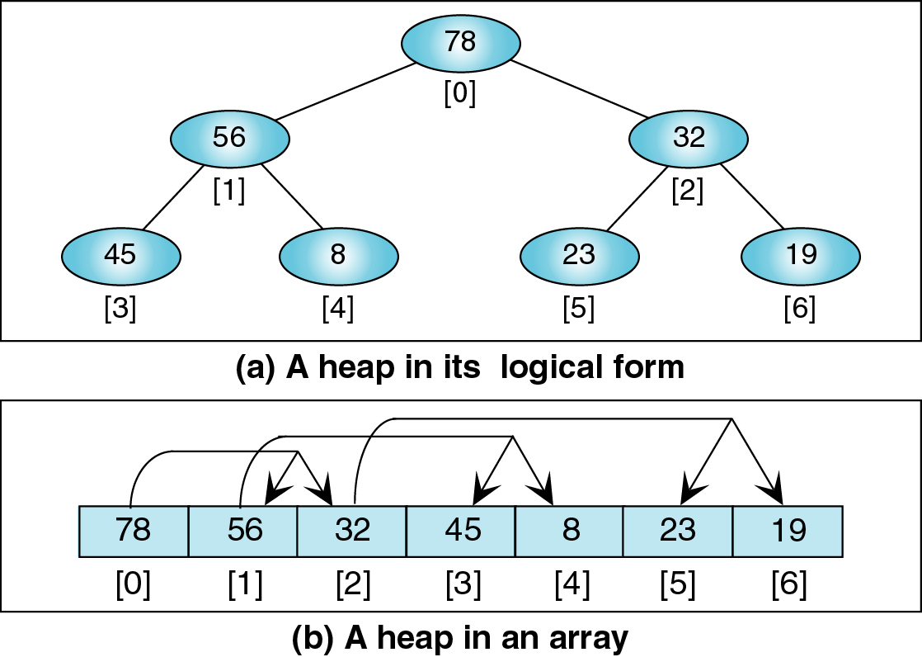
Figure 9-8 Heaps in arrays

Slide 15
Heap Algorithms
Heaps can be built by inserting elements into an empty array, or by rearranging data from an existing array
Reheap Up: Recursively move node up the tree
Reheap Down: Recursively move node down the tree
Build Heap: Re-arrange data into a heap
Insert Heap: Put data into existing heap
Delete Heap: Remove root node from heap

Slide 16
Algorithm 9-1 reheapUp
algorithm reheapUp (ref heap <array>, val newNode <index>)
  if (newNode not zero)
    parent = (newNode – 1) / 2
    if (heap[newNode].key > heap[parent].key)
      swap (heap, newNode, parent)
      reheapUp (heap, parent)
    end if
  end if
  return
end reheapUp

Slide 17
Algorithm 9-2 reheapDown
algorithm reheapDown (ref heap <array>, val root <index>, val last <index>)
1. if (root * 2 + 1 <= last)
  There is at least one child
  1.leftKey = heap[root * 2 + 1].data.key
  2.if (root * 2 + 2 <= last)
    1.rightKey = heap[root * 2 + 2].data.key) // right child exists
  3. else
    1. rightKey = lowKey // no right child
  4.end if
  5. if (leftKey > rightKey)
    1. largeChildKey = leftKey
    2.largeChildIndex = root * 2 + 1 // Calculate left child index
  6.else
    1.largeChildKey = rightKey
    2.largeChildIndex = root * 2 + 2 // Calculate right child index
  7.end if
  swap and recursively fix if root < larger subtree
  8.if (heap[root].data.key < largeChildKey)
    1.swap (heap, root, largeChildIndex)
    2.reheapDown (heap, largeChildIndex, last)
  9.end if
2.end if
3.return
end reheapDown

Slide 18
Build Heap
Given an array of elements in random order, rearrange data so each node in heap is greater than its children
Array is divided into two parts:
  Left part is a heap
  Right part is data to be inserted into heap
Insert algorithm uses reheap up to insert next element into heap, and moves divider one position to the right

Slide 19
Algorithm 9-3 buildHeap
algorithm buildHeap (ref heap <array>, val size <integer>)
1.walker = 1
2. loop (walker < size)
      1. reheapUp (heap, walker)
      2. walker = walker + 1
3.end loop
4. return
end buildHeap

Slide 20
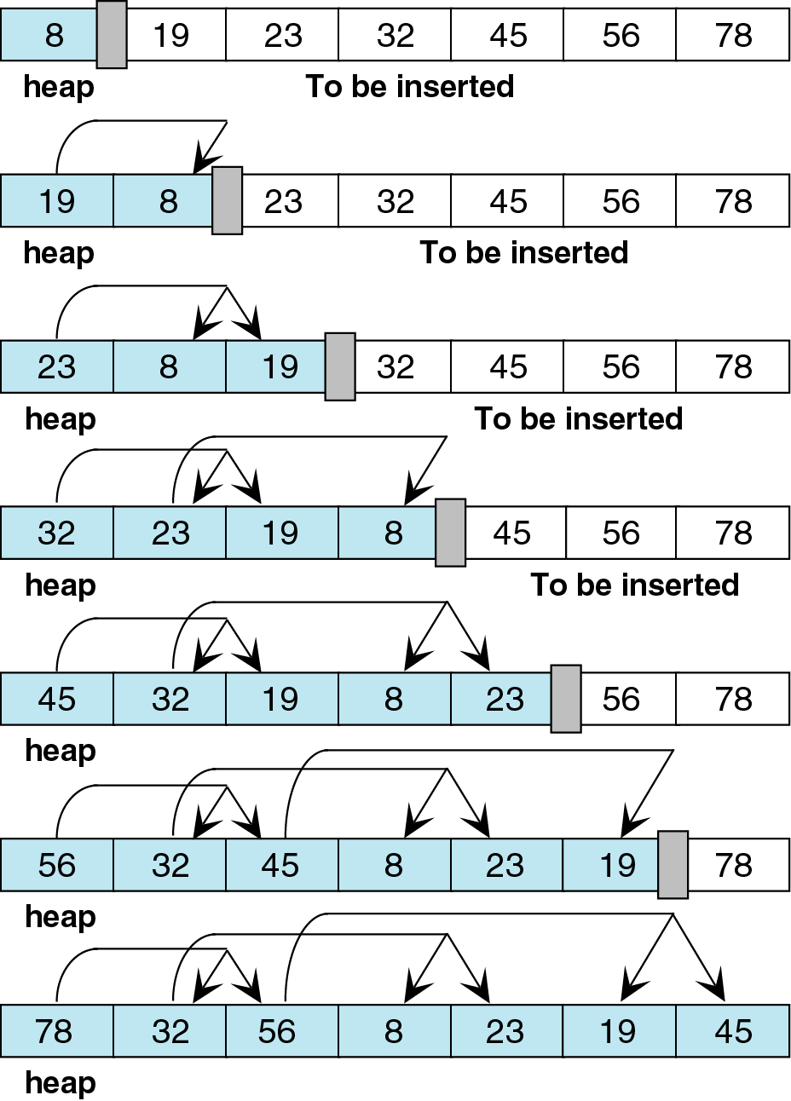
Figure 9-9 Building a heap

Slide 21
Insert Heap
As long as there's room in the array, we can insert
Locate first empty leaf in array
Move data to first empty leaf, and reheap up

Slide 22
Algorithm 9-4 insertHeap
algorithm insertHeap (ref heap <array of dataType>, ref last <index>,
val data <dataType>)
1. if (heap full)
  1.return false // No room to insert
2. end if
3. last = last + 1 // Locate first empty leaf
4. heap[last] = data // Move data to first empty leaf
5. reheapUp (heap, last)
6. return true
end insertHeap

Slide 23
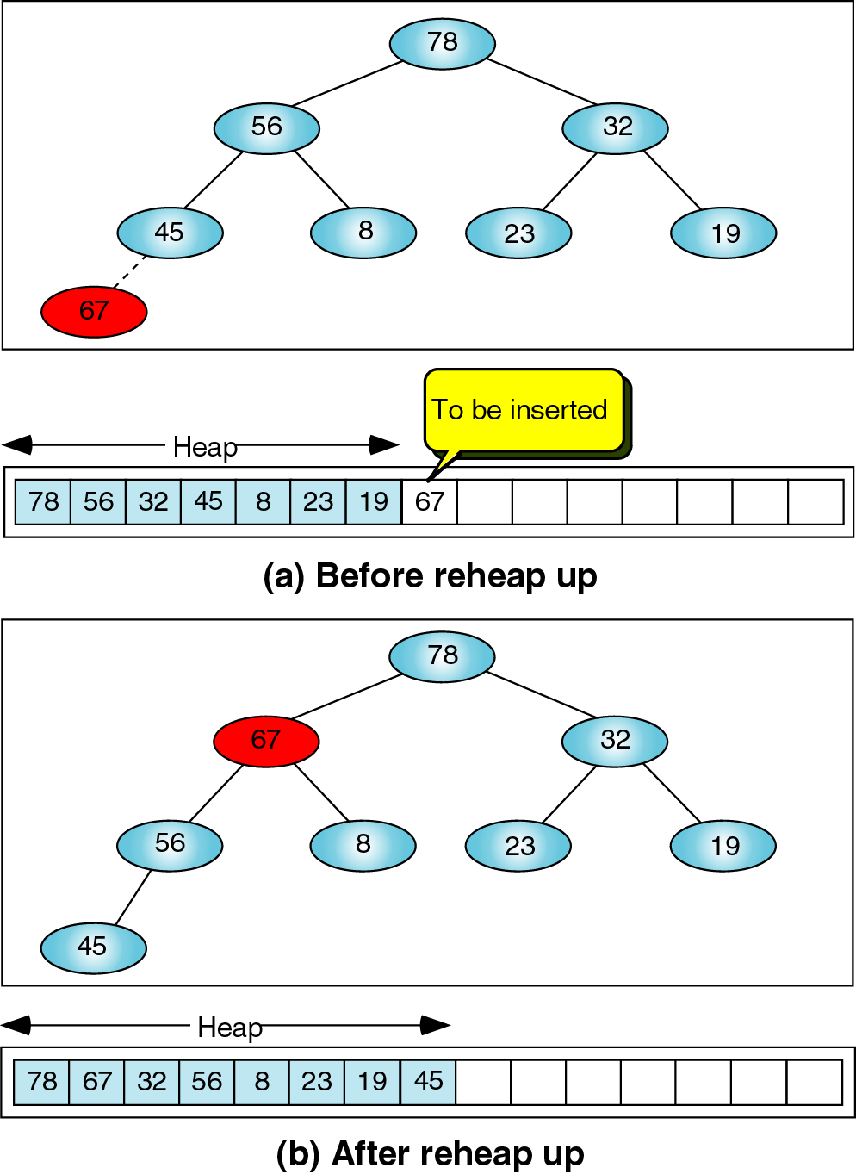
Figure 9-10 Insert node

Slide 24
Delete Heap
Deletes root node from heap
Heap is re-established by moving last heap node to the root, and calling reheap down
Data from root is returned to calling algorithm

Slide 25
Algorithm 9-5 deleteHeap node
algorithm deleteHeap (ref heap <array of dataType>, ref last <index>,
ref dataOut <dataType>)
1. if (heap empty)
  1.return false // Can't delete empty heap
2. end if
3. dataOut = heap[0] // Return node data
4. heap[0] = heap[last] // Move last node to heap node
5. last = last – 1
6. reheapDown (heap, 0, last)
7. return true
end deleteHeap

Slide 26
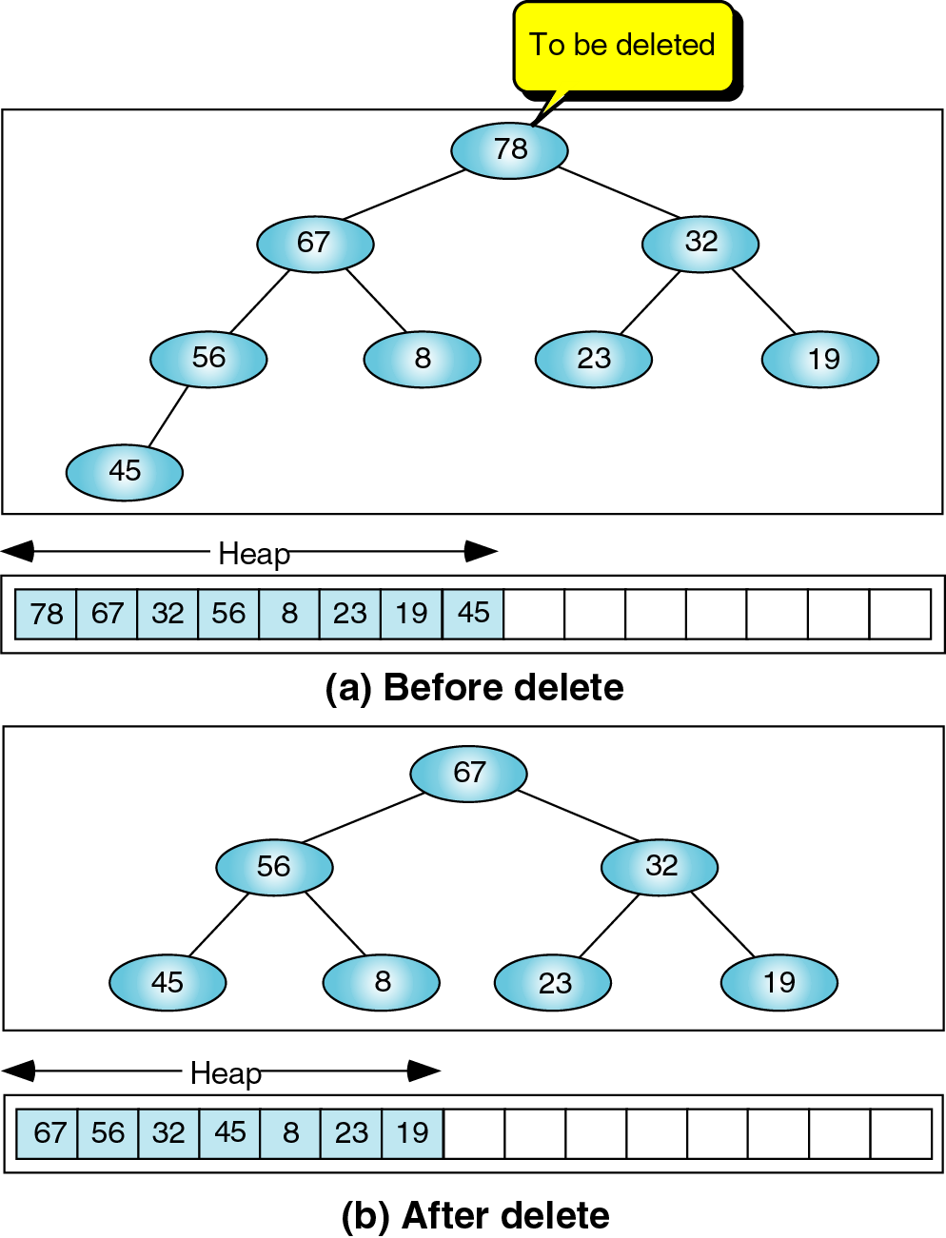
Figure 9-11 deleteHeap node

Slide 27
Heap Applications
Three common applications of heaps:
  Selection: Pick k^{th} largest (or smallest) element
  Priority queue: enforce service priority in a queue
  Sorting (covered in Chapter 11)

Slide 28
Selection
Goal is to select k^{th} largest (or smallest) item in an unsorted list
Using a heap (without sorting):
  Create a heap from unsorted list
  Exclude k - 1 elements from heap; put each element to be excluded into the end of array, and decrease heap size by 1
  k^{th} element can be selected from top of heap
  Reconstruct heap (use reheapUp) by including elements in the end of array

Slide 29
Algorithm 9-6
algorithm selectK (ref heap <array>, val k <integer>, ref heapLast <index>)
1. if (k > heapLast + 1)
  1. return 0 // Item not in heap
2. end if
3. i = 1
4. origHeapSize = heapLast + 1 // Save original heap size
5. loop (i < k) // Delete k – 1 items from heap
  1. temp = heap[0]
  2. deleteHeap (heap, heapLast, dataOut)
  Put deleted item in end of array
  3.heap[heapLast + 1] = temp
  4. i = i + 1
6. end loop
Desired element is now at top of heap
7. holdOut = heap[0]
Reconstruct heap
8. loop (heapLast < origHeapSize) // Include deleted items
  1. heapLast = heapLast + 1
  2. reheapUp (heap, heapLast) // Similar to buildHeap
9. end loop
10. return holdOut // Return desired element
end selectK

Slide 30
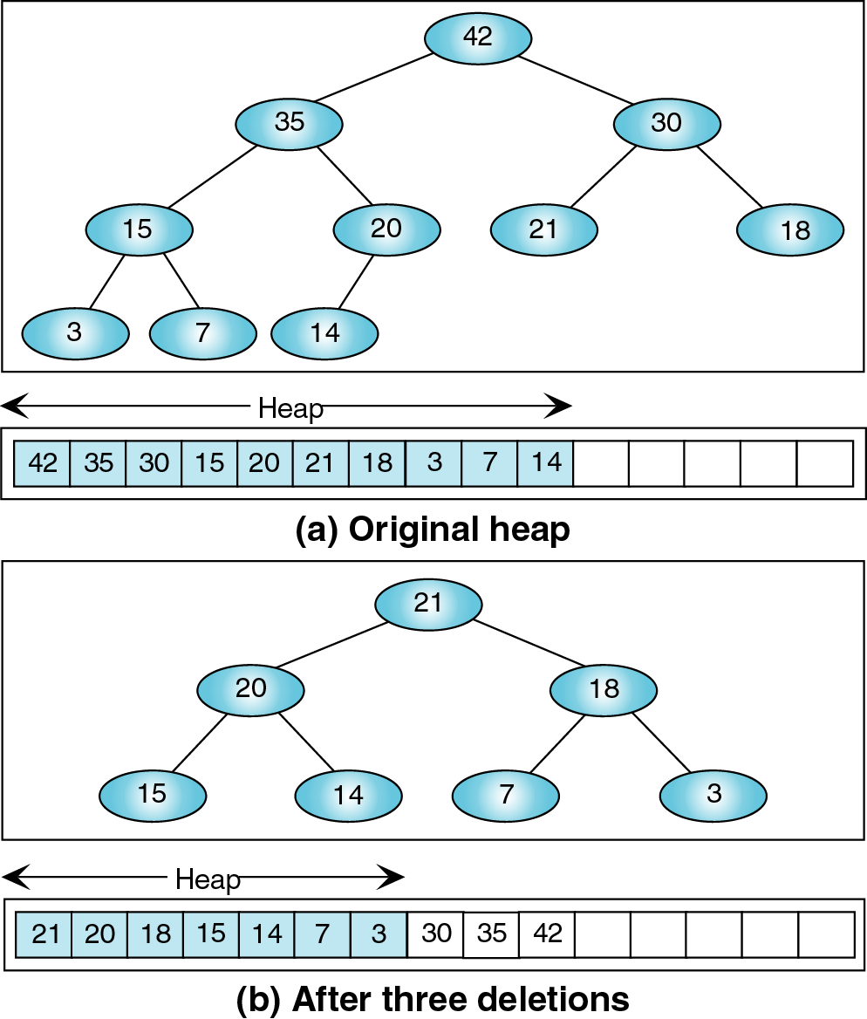
Figure 9-12 Heap selection

Slide 31
Priority Queues
Events entering priority queues are assigned a priority number to determine its relative position to other enqueued events
New event enters at first empty leaf of heap
Highest priority event rises to top of heap, and is processed next; low priority events remain low in the heap
Keys are constructed using encoded priority numbers

Slide 32
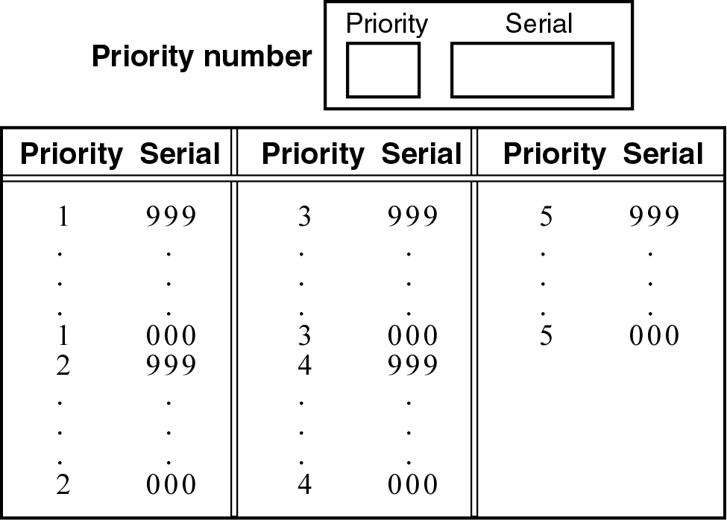
Figure 9-13 Priority queue priority numbers

Slide 33
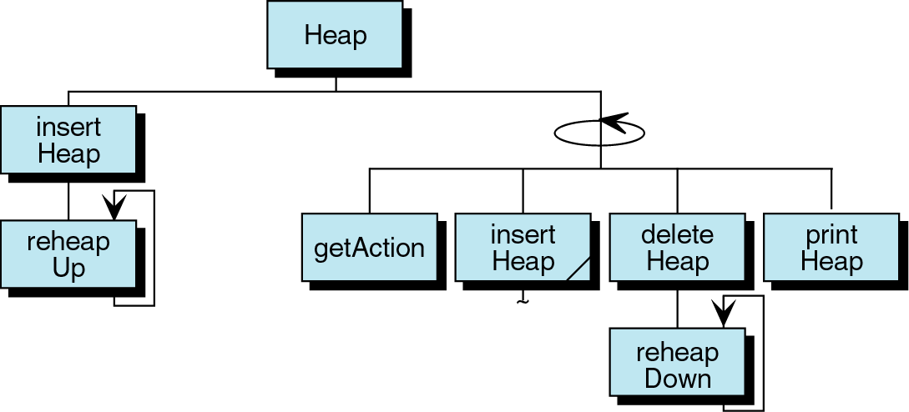
Figure 9-14 Heap program design

