Slide 1

Data Structures Using C++ 2E
Chapter 11
Binary Trees and AVL-Trees

Slide 2
Objectives
Learn about binary trees
Explore various binary tree traversal algorithms
Learn how to organize data in a binary search tree
Discover how to insert and delete items in a binary search tree
Data Structures Using C++ 2E

Slide 3
Objectives (cont’d.)
Explore nonrecursive binary tree traversal algorithms
Learn about AVL (height-balanced) trees
Learn about B-trees
Data Structures Using C++ 2E

Slide 4
Binary Trees
Definition: a binary tree, T, is either empty or such that
  T has a special node called the root node
  T has two sets of nodes, L_{T} and R_{T}, called the left subtree and right subtree of T, respectively
  L_{T} and R_{T} are binary trees
Can be shown pictorially
  Parent, left child, right child
Node represented as a circle
  Circle labeled by the node
Data Structures Using C++ 2E

Slide 5
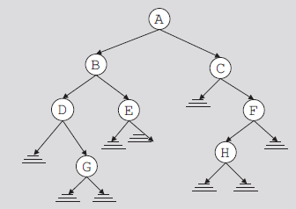
Binary Trees (cont’d.)
Root node drawn at the top
  Left child of the root node (if any)
    Drawn below and to the left of the root node
  Right child of the root node (if any)
    Drawn below and to the right of the root node
Directed edge (directed branch): arrow
FIGURE 11-1 Binary tree
Data Structures Using C++ 2E

Slide 6
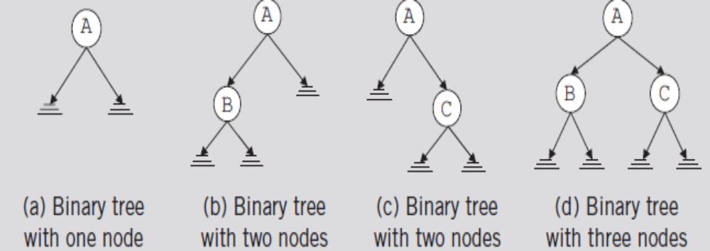
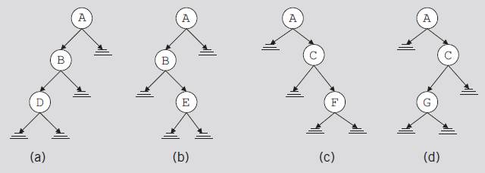
Binary Trees (cont’d.)
FIGURE 11-2 Binary tree with one, two, or three nodes
FIGURE 11-3 Various binary trees with three nodes
Data Structures Using C++ 2E

Slide 7
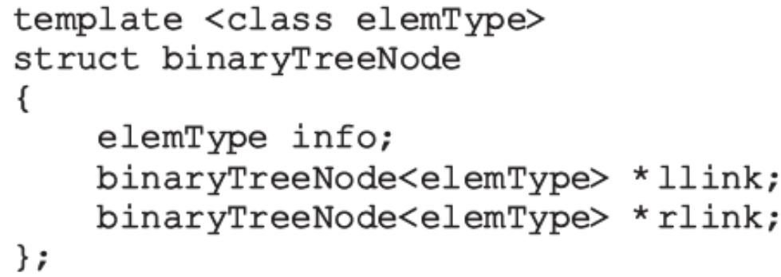
Binary Trees (cont’d.)
Every node in a binary tree
  Has at most two children
struct defining node of a binary tree
  For each node
    The data stored in info
    A pointer to the left child stored in llink
    A pointer to the right child stored in rlink
Data Structures Using C++ 2E

Slide 8
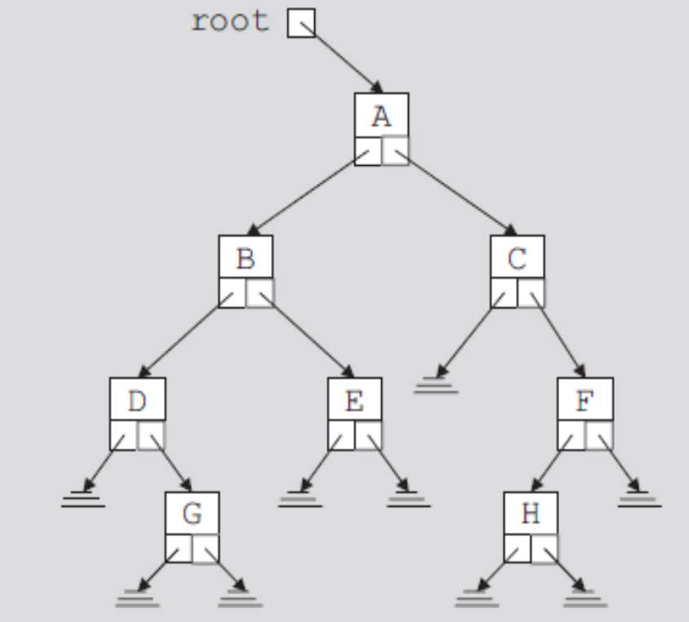
Binary Trees (cont’d.)
Pointer to root node is stored outside the binary tree
  In pointer variable called the root
    Of type binaryTreeNode
FIGURE 11-4 Binary tree
Data Structures Using C++ 2E

Slide 9
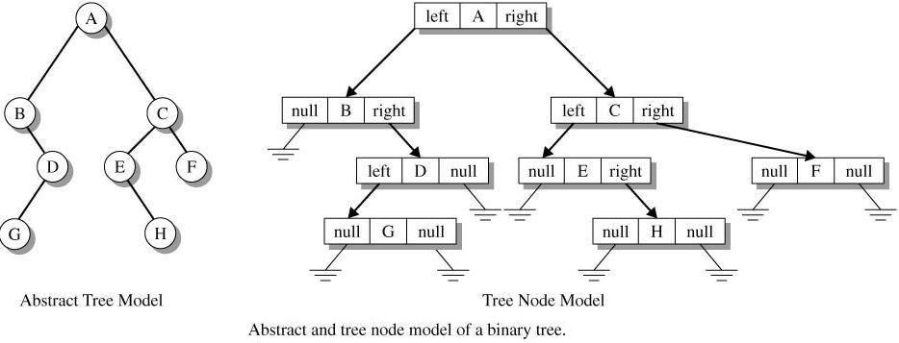

Slide 10
Binary Trees (cont’d.)
Level of a node
  Number of branches on the path
Height of a binary tree
  Number of nodes on the longest path from the root to a leaf
  See code on page 604
Root: (A) level 0 is parent for B, C
Leaves : G, E, H
Tree Height = 4
D is on level 2
FIGURE 11-1 Binary tree
Data Structures Using C++ 2E

Slide 11
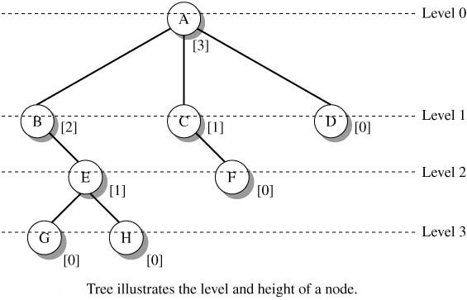

Slide 12
Binary Tree Traversal
Must start with the root, and then
  Visit the node first or
  Visit the subtrees first
Three different traversals
  Inorder
  Preorder
  Postorder
Data Structures Using C++ 2E

Slide 13
Binary Tree Traversal (cont’d.)
Inorder traversal
  Traverse the left subtree
  Visit the node
  Traverse the right subtree
Preorder traversal
  Visit the node
  Traverse the left subtree
  Traverse the right subtree
D G B E A C H F
FIGURE 11-1 Binary tree
A B D G E C F H
Data Structures Using C++ 2E

Slide 14
Binary Tree Traversal (cont’d.)
Postorder traversal
  Traverse the left subtree
  Traverse the right subtree
  Visit the node
Each traversal algorithm: recursive
Listing of nodes
  Inorder sequence
  Preorder sequence
  Postorder sequence
G D E B H F C A
FIGURE 11-1 Binary tree
Data Structures Using C++ 2E

Slide 15
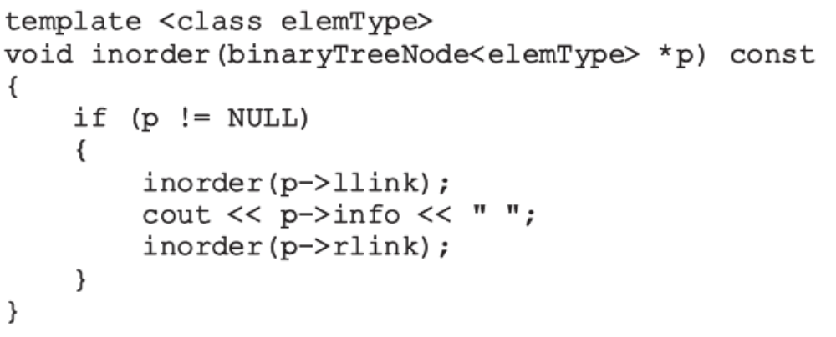
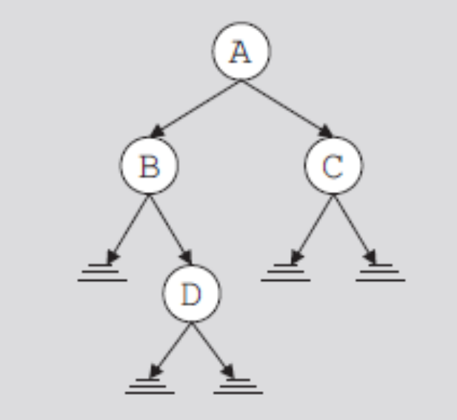
Binary Tree Traversal (cont’d.)
FIGURE 11-5 Binary tree
for an inorder traversal
Data Structures Using C++ 2E

Slide 16
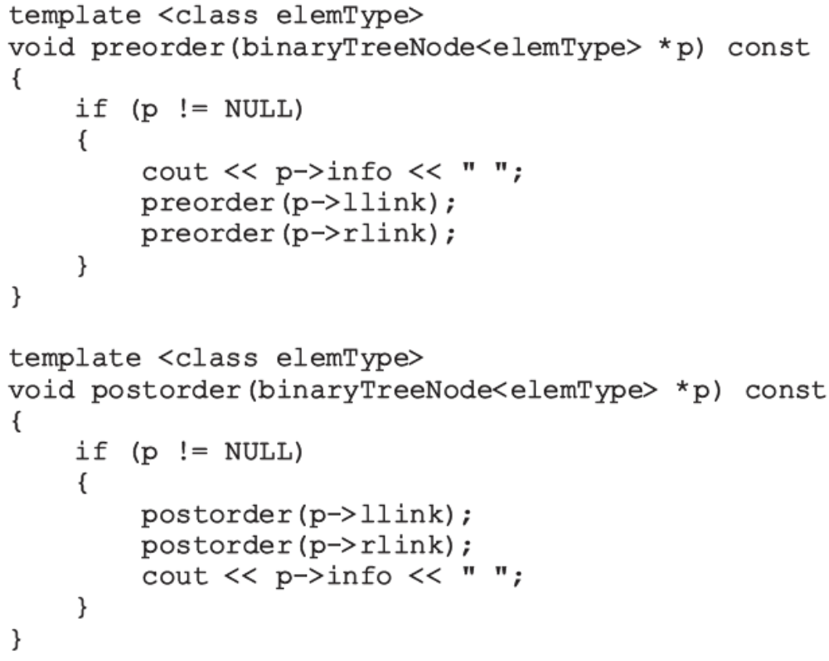
Binary Tree Traversal (cont’d.)
Functions to implement the preorder and postorder traversals
Data Structures Using C++ 2E

Slide 17
Implementing Binary Trees
Operations typically performed on a binary tree
  Determine if binary tree is empty
  Search binary tree for a particular item
  Insert an item in the binary tree
  Delete an item from the binary tree
  Find the height of the binary tree
  Find the number of nodes in the binary tree
  Find the number of leaves in the binary tree
  Traverse the binary tree
  Copy the binary tree
Data Structures Using C++ 2E

Slide 18
Implementing Binary Trees (cont’d.)
class binaryTreeType
  Specifies basic operations to implement a binary tree
  See code on page 609
    Contains statement to overload the assignment operator, copy constructor, destructor
    Contains several member functions that are private members of the class
Binary tree empty if root is NULL
  See isEmpty function on page 611
Data Structures Using C++ 2E

Slide 19
Implementing Binary Trees (cont’d.)
Default constructor
  Initializes binary tree to an empty state
  See code on page 612
Other functions for binary trees
  See code on pages 612-613
Functions: copyTree, destroy, destroyTree
  See code on page 614
Copy constructor, destructor, and overloaded assignment operator
  See code on page 615
Data Structures Using C++ 2E

Slide 20
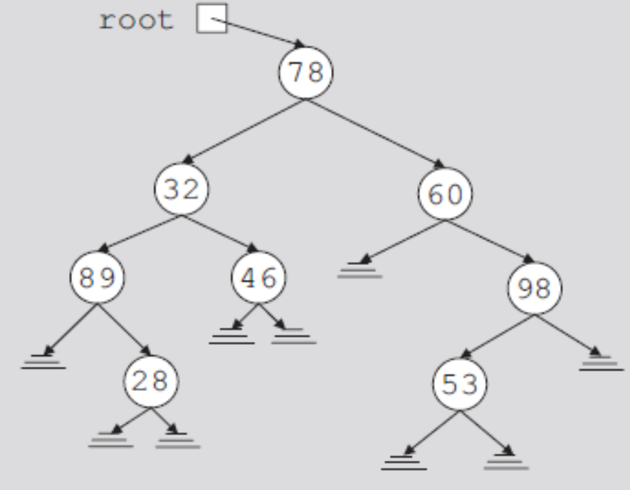
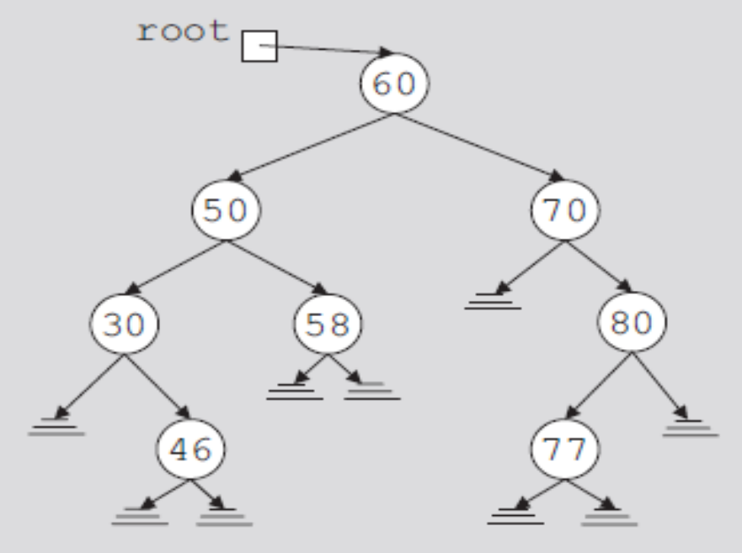
Binary Search Trees
Data in each node
  Larger than the data in its left child
  Smaller than the data in its right child
FIGURE 11-7 Binary search tree
FIGURE 11-6 Arbitrary binary tree
Data Structures Using C++ 2E

Slide 21
50 60 77 33 26 45 80 65
50
33
60
26
45
77
65
80

Slide 22
How to Delete 80
50
33
60
26
45
77
80
20
48
46

Slide 23
How to Delete 77
50
33
60
26
45
77
80
20
48
46

Slide 24
How to Delete 50
Search for the previous number that precedes 50
50
33
60
26
45
77
80
20
48
46

Slide 25
How to Delete 50
Replace 50 with 48
48
33
60
26
45
77
80
20
48
46

Slide 26
How to Delete 50
Replace 50 with 48
48
Now delete the original 48
33
60
26
45
77
80
20
48
46

Slide 27
Binary Search Trees (cont’d.)
A binary search tree, T, is either empty or the following is true:
  T has a special node called the root node
  T has two sets of nodes, L_{T} and R_{T} , called the left subtree and right subtree of T, respectively
  The key in the root node is larger than every key in the left subtree and smaller than every key in the right subtree
  L_{T} and R_{T} are binary search trees
Data Structures Using C++ 2E

Slide 28
Binary Search Trees (cont’d.)
Operations performed on a binary search tree
  Search the binary search tree for a particular item
  Insert an item in the binary search tree
  Delete an item from the binary search tree
  Find the height of the binary search tree
  Find the number of nodes in the binary search tree
  Find the number of leaves in the binary search tree
  Traverse the binary search tree
  Copy the binary search tree
Data Structures Using C++ 2E

Slide 29
Binary Search Trees (cont’d.)
Every binary search tree is a binary tree
Height of a binary search tree
  Determined the same way as the height of a binary tree
Operations to find number of nodes, number of leaves, to do inorder, preorder, postorder traversals of a binary search tree
  Same as those for a binary tree
    Can inherit functions
Data Structures Using C++ 2E

Slide 30
Binary Search Trees (cont’d.)
class bSearchTreeType
  Illustrates basic operations to implement a binary search tree
  See code on page 618
Function search
Function insert
Function delete
Data Structures Using C++ 2E

Slide 31
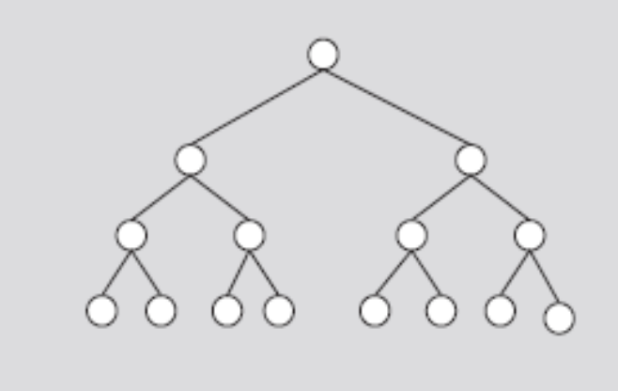
AVL (Height-Balanced) Trees
AVL tree (height-balanced tree)
  Resulting binary search is nearly balanced
Perfectly balanced binary tree
  Heights of left and right subtrees of the root: equal
  Left and right subtrees of the root are perfectly balanced binary trees
FIGURE 11-12 Perfectly balanced binary tree
Data Structures Using C++ 2E

Slide 32
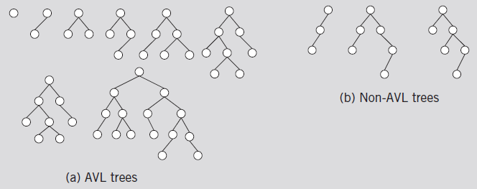
AVL (Height-Balanced) Trees (cont’d.)
An AVL tree (or height-balanced tree) is a binary search tree such that
  The heights of the left and right subtrees of the root differ by at most one
  The left and right subtrees of the root are AVL trees
FIGURE 11-13 AVL and non-AVL trees
Data Structures Using C++ 2E

Slide 33
AVL tree
Height of a node
The height of a leaf is 1. The height of a null pointer is zero.
The height of an internal node is the maximum height of its children plus 1

Slide 34
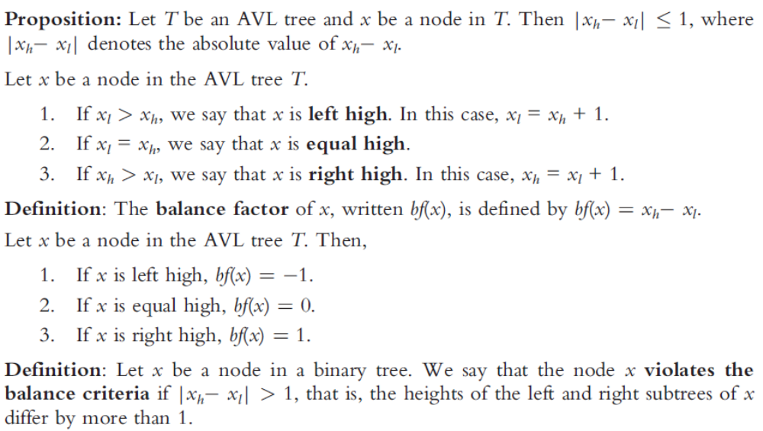
AVL (Height-Balanced) Trees (cont’d.)
Data Structures Using C++ 2E

Slide 35
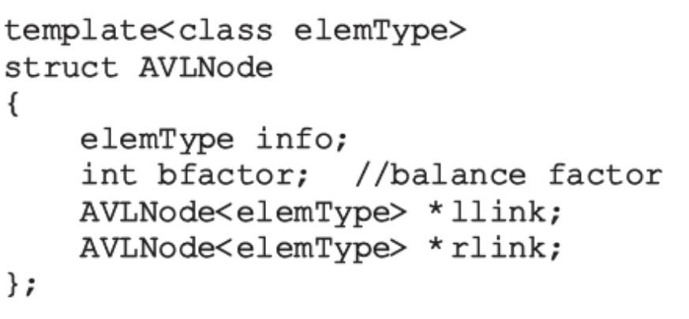
AVL (Height-Balanced) Trees (cont’d.)
Definition of a node in the AVL tree
Data Structures Using C++ 2E

Slide 36
AVL (Height-Balanced) Trees (cont’d.)
AVL binary search tree search algorithm
  Same as for a binary search tree
  Other operations on AVL trees
    Implemented exactly the same way as binary trees
  Item insertion and deletion operations on AVL trees
    Somewhat different from binary search trees operations
Data Structures Using C++ 2E

Slide 37
Insertion
First search the tree and find the place where the new item is to be inserted
  Can search using algorithm similar to search algorithm designed for binary search trees
  If the item is already in tree
    Search ends at a nonempty subtree
    Duplicates are not allowed
  If item is not in AVL tree
    Search ends at an empty subtree; insert the item there
After inserting new item in the tree
  Resulting tree might not be an AVL tree
Data Structures Using C++ 2E

Slide 38
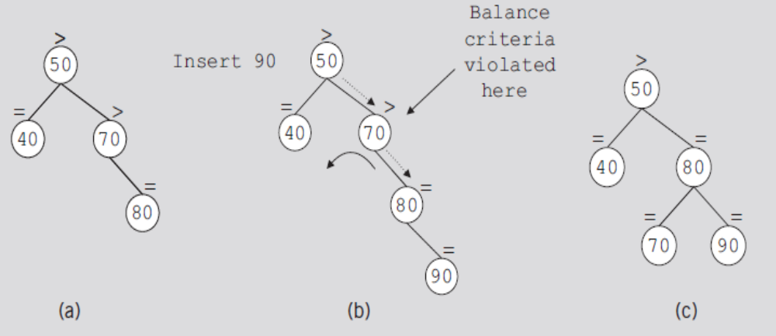
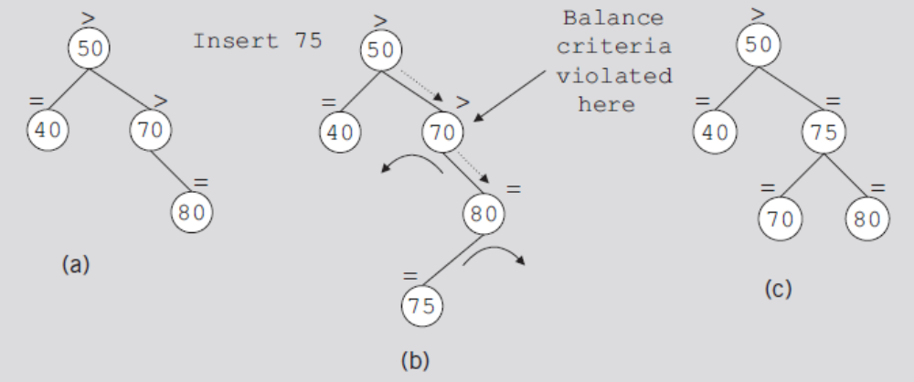
Insertion (cont’d.)
FIGURE 11-14 AVL tree before and after inserting 90
FIGURE 11-15 AVL tree before and after inserting 75
Data Structures Using C++ 2E

Slide 39
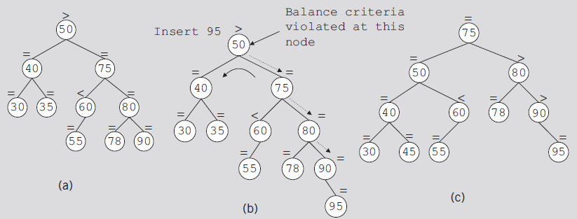
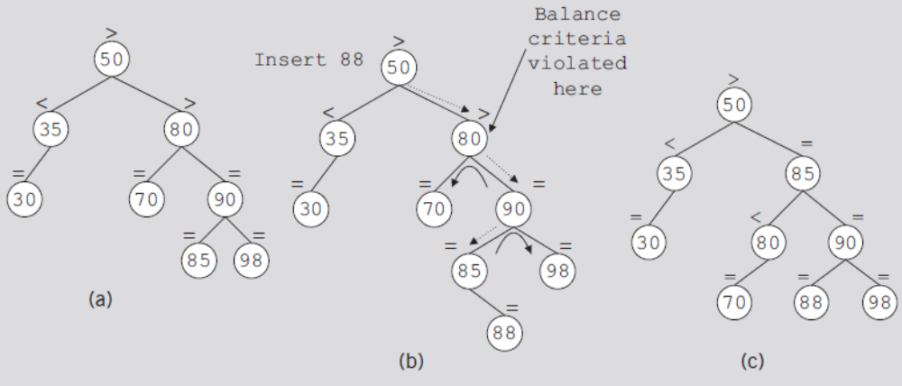
Insertion (cont’d.)
FIGURE 11-16 AVL tree before and after inserting 95
FIGURE 11-17 AVL tree before and after inserting 88
Data Structures Using C++ 2E

Slide 40
AVL Tree Rotations
Rotating tree: reconstruction procedure
Left rotation and right rotation
Suppose that the rotation occurs at node x
  Left rotation: certain nodes from the right subtree of x move to its left subtree; the root of the right subtree of x becomes the new root of the reconstructed subtree
  Right rotation at x: certain nodes from the left subtree of x move to its right subtree; the root of the left subtree of x becomes the new root of the reconstructed subtree
Data Structures Using C++ 2E

Slide 41
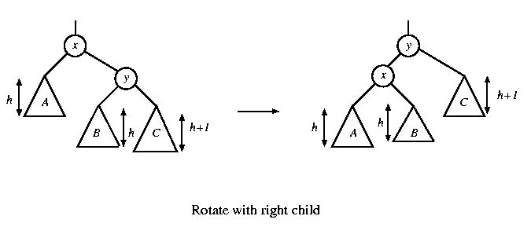
Single rotation
The new key is inserted in the subtree C.
The AVL-property is violated at x.
Single rotation takes O(1) time.
Insertion takes O(log N) time.

Slide 42
x
AVL Tree
5
5
y
8
C
3
3
8
1
4
B
1
4
A
0.8
Insert 0.8
3
5
1
After rotation
4
8
0.8

Slide 43
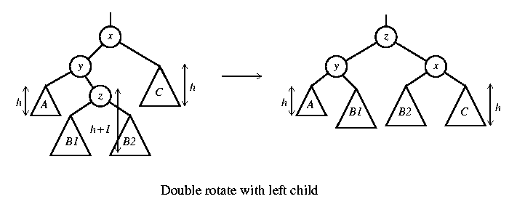
Double rotation
The new key is inserted in the subtree B1 or B2.
The AVL-property is violated at x.
x-y-z forms a zig-zag shape
also called left-right rotate

Slide 44
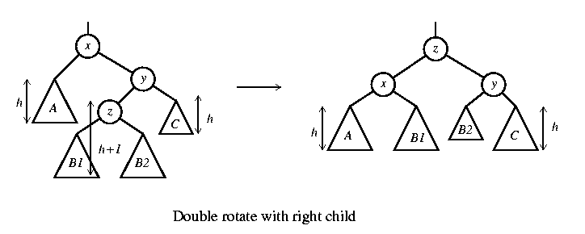
Double rotation
The new key is inserted in the subtree B1 or B2.
The AVL-property is violated at x.
also called right-left rotate

Slide 45
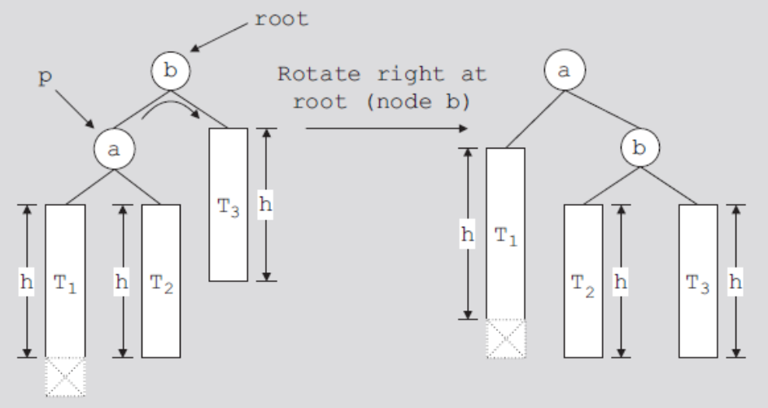
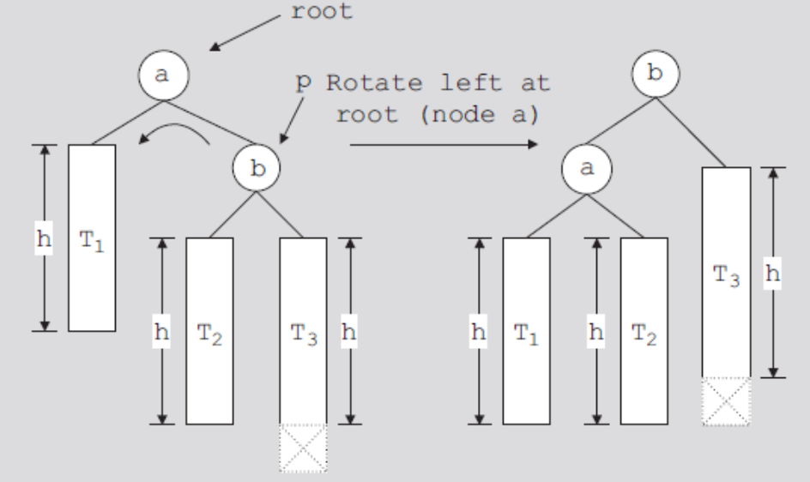
FIGURE 11-18 Right rotation at b
FIGURE 11-19 Left rotation at a
Data Structures Using C++ 2E

Slide 46
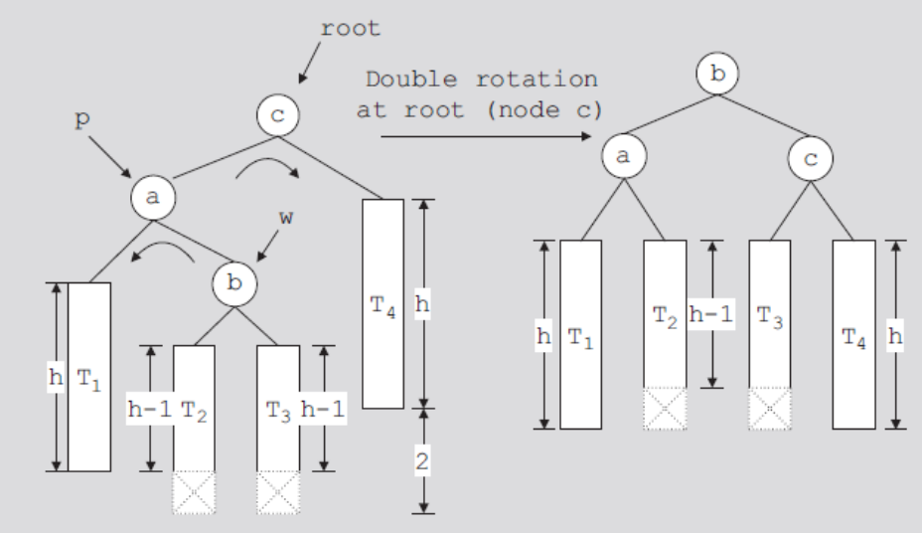
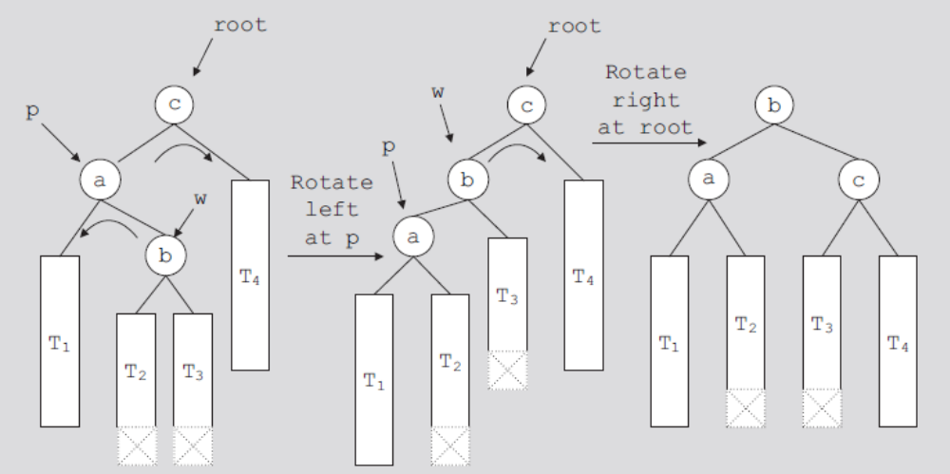
FIGURE 11-20 Double rotation: First rotate left at a and then right at c
FIGURE 11-21 Left rotation at a followed by a right rotation at c
Data Structures Using C++ 2E

Slide 47
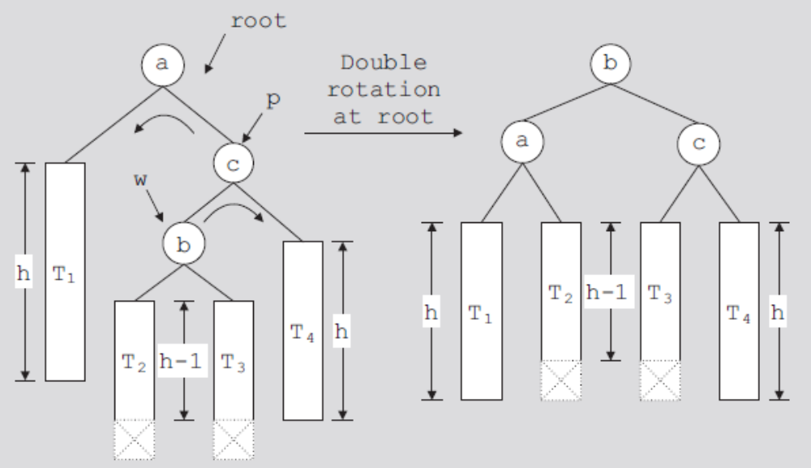
AVL Tree Rotations (cont’d.)
FIGURE 11-22 Double rotation: First rotate right at c,
then rotate left at a
Data Structures Using C++ 2E

Slide 48
x
5
AVL Tree
5
C
y
8
3
3
8
A
1
4
z
1
4
B
3.5
Insert 3.5
4
5
3
3.5
8
After Rotation
1

Slide 49
An Extended Example
Insert 3,2,1,4,5,6,7, 16,15,14
Single rotation
3
2
3
3
2
1
Fig 1
2
3
Fig 4
Fig 2
2
1
2
Single rotation
Fig 3
1
1
3
3
Fig 5
Fig 6
4
4
5

Slide 50
Insert 3,2,1,4,5,6,7, 16,15,14
2
2
Single rotation
1
4
1
4
3
5
3
5
Fig 8
Fig 7
6
4
4
Single rotation
2
5
2
5
1
3
6
1
3
6
4
Fig 9
Fig 10
7
2
6
1
3
7
5
Fig 11

Slide 51
Insert 3,2,1,4,5,6,7, 16,15,14
4
2
6
1
3
7
5
16
Fig 12
4
Double rotation
4
2
6
2
6
1
3
7
1
3
15
5
16
5
16
Fig 13
7
15
Fig 14

Slide 52
Insert 3,2,1,4,5,6,7, 16,15,14
4
4
Double rotation
2
6
2
7
15
1
3
15
1
3
5
6
16
7
5
14
16
Fig 15
14
Fig 16

Slide 53
AVL Tree Rotations (cont’d.)
Steps describing the function insertIntoAVL
  Create node and copy item to be inserted into the newly created node
  Search the tree and find the place for the new node in the tree
  Insert new node in the tree
  Backtrack the path, which was constructed to find the place for the new node in the tree, to the root node
    If necessary, adjust balance factors of the nodes, or reconstruct the tree at a node on the path
Data Structures Using C++ 2E

Slide 54
40 30 20 60 50 80 15 28 25
40
30
20
Data Structures Using C++ 2E

Slide 55
40 30 20 60 50 80 15 28 25
30
20
40
60
50
Data Structures Using C++ 2E

Slide 56
40 30 20 60 50 80 15 28 25
30
20
40
50
60
Data Structures Using C++ 2E

Slide 57
40 30 20 60 50 80 15 28 25
30
20
50
40
60
80
Data Structures Using C++ 2E

Slide 58
40 30 20 60 50 80 15 28 25
50
30
60
20
40
80
15
28
25
Data Structures Using C++ 2E

Slide 59
40 30 20 60 50 80 15 28 25
50
30
60
28
40
80
20
15
25
Data Structures Using C++ 2E

Slide 60
40 30 20 60 50 80 15 28 25
50
28
60
20
30
80
15
25
40
Data Structures Using C++ 2E

Slide 61
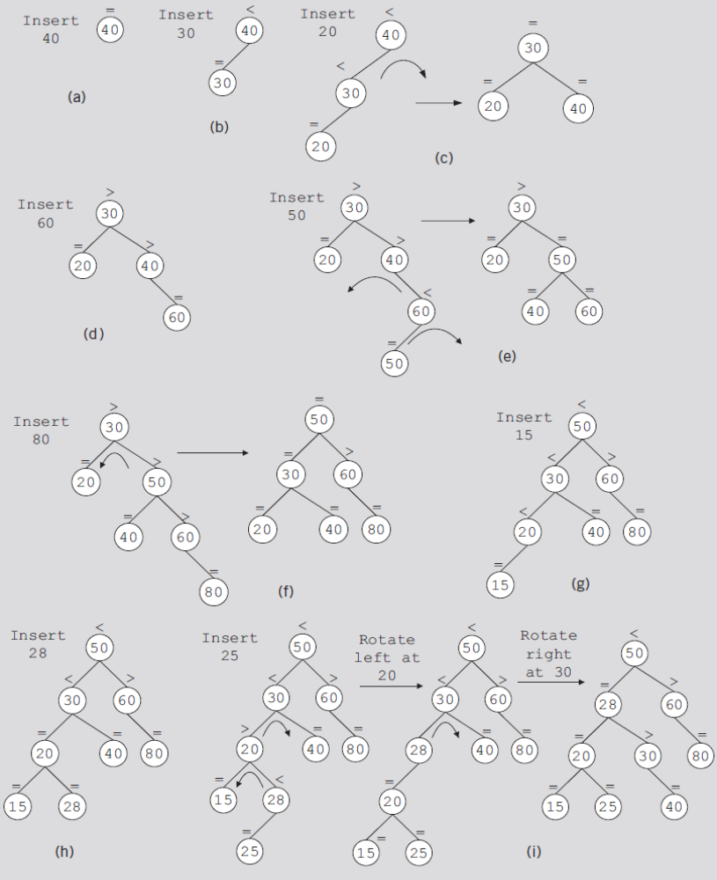
FIGURE 11-23 Item insertion into an initially empty AVL tree
Data Structures Using C++ 2E

Slide 62
Deletion from AVL Trees
Four cases
  Case 1: The node to be deleted is a leaf
  Case 2: The node to be deleted has no right child, that is, its right subtree is empty
  Case 3: The node to be deleted has no left child, that is, its left subtree is empty
  Case 4: The node to be deleted has a left child and a right child
Cases 1–3
  Easier to handle than Case 4
Data Structures Using C++ 2E

Slide 63
Delete 40
50
28
60
Still AVL
20
30
80
15
25
40
Data Structures Using C++ 2E

Slide 64
Delete 30
50
28
60
20
30
80
15
25
Data Structures Using C++ 2E

Slide 65
Delete 30
50
20
60
15
28
80
25
Data Structures Using C++ 2E

Slide 66
Another example Delete 30
50
28
60
20
30
80
25
Data Structures Using C++ 2E

Slide 67
Another example Delete 30
50
28
60
25
80
20
Data Structures Using C++ 2E

Slide 68
Another example Delete 30
50
25
60
20
28
80
Data Structures Using C++ 2E

