Slide 1

Functional Maps: A Flexible Representation of Maps Between Shapes
By M. Ovsjanikov, M Ben-Chen, J. Solomon, A Butscher & L. Guidas
Oral presentation
Paumier Nicolas & This Alexandre
Object recognition and computer vision

Slide 2
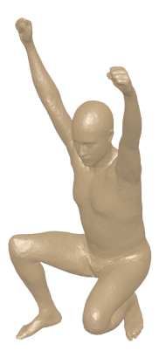
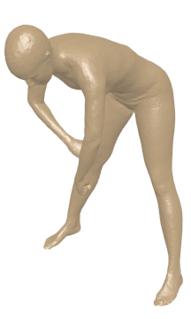
Shape matching
T

Slide 3
Background
0 | 0 | 0 | 0 | 0 | 0 | 0 | 1
0 | 1 | 0 | 0 | 0 | 0 | 0 | 0
0 | 0 | 0 | 1 | 0 | 0 | 0 | 0
0 | 0 | 0 | 0 | 0 | 1 | 0 | 0
1 | 0 | 0 | 0 | 0 | 0 | 0 | 0
0 | 0 | 0 | 0 | 1 | 0 | 0 | 0
0 | 0 | 1 | 0 | 0 | 0 | 0 | 0
0 | 0 | 0 | 0 | 0 | 0 | 1 | 0
Point to point correspondences
Optimization on all the possible permutation
=> Find a set of landmark (specific points) and interpolate to find a dense set of correspondences

Slide 4
Goals
Generalization of the notion of map : map between functions
Compact representation : Laplace-Beltrami operator
Natural constraints become linear :

Slide 5
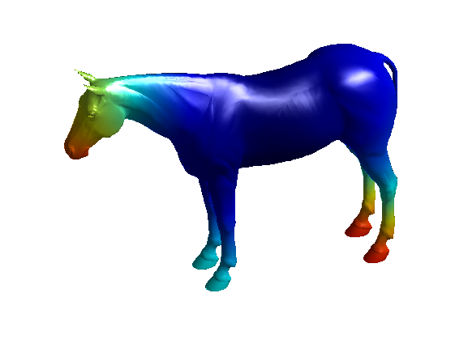
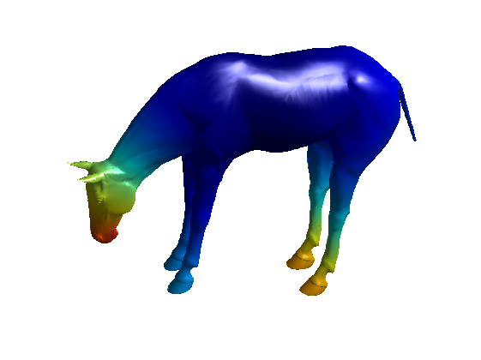
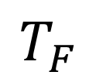



Théorie de la représentation fonctionnelle - Alex
T
M
N
$$T_{F}$$
$$f :M →ℝ$$
$$g :N →ℝ$$
$$g= T_{F}\left(f\right)=f o T^{−1}$$

Slide 6


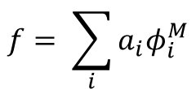


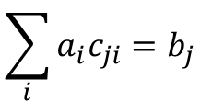

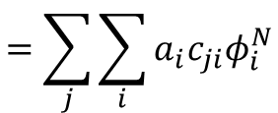

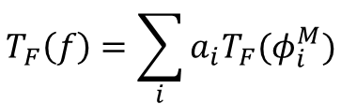

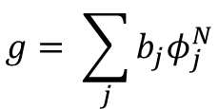
Matrice du changement de base - Alex
$$f :M →ℝ$$
$$g :N →ℝ$$
${\{φ}^{M}\}$ basis for fonctions on M
${\{φ}^{N}\}$ basis for fonctions on N
$$f= \sum_{i}{a_{i}φ_{i}^{M}}$$
$$T_{F}\left(f\right)=\sum_{i}{a_{i}{T_{F}(φ}_{i}^{M})}$$
$$=\sum_{j}{\sum_{i}{a_{i}{c_{ji}φ}_{i}^{N}}}$$
$$g= \sum_{j}{b_{j}φ_{j}^{N}}$$
$$\sum_{i}{a_{i}c_{ji}=b_{j}}$$
Matrix notation : $Ca=b$

Slide 7
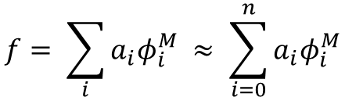
Bases ? - Alex
Natural choice : set of indicator functions on each vertex
Huge w.r.t the number of vertices
Laplace-Beltrami eigenfunctions
Orthogonal basis for functions
Low frequency to High frequency
Compactness (Natural functions are approximated using a small number of basis elements)
$$f= \sum_{i}{a_{i}φ_{i}^{M} ≈ \sum_{i=0}^{n}{a_{i}φ_{i}^{M}}}$$

Slide 8
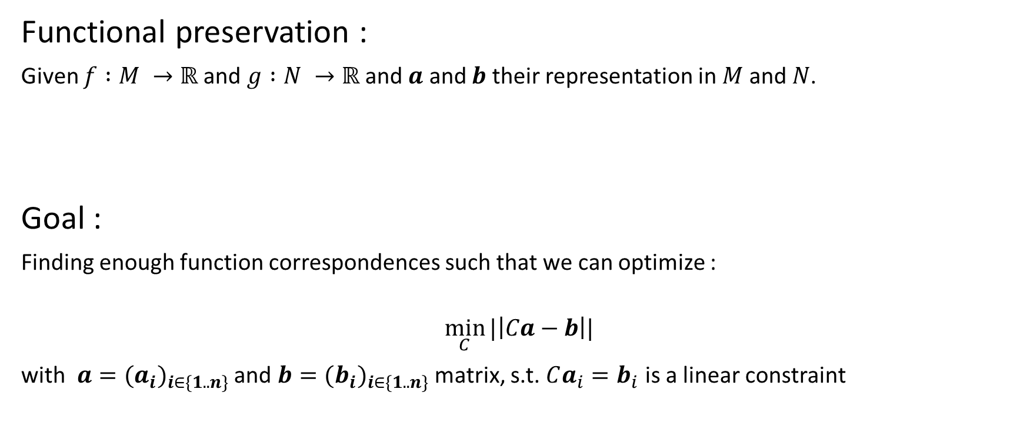

Recover matrix $C$
Functional preservation :
Given $f :M →ℝ$and $g :N →ℝ$and $a$ and $b$ their representation in $M$ and $N$.
Goal :
Finding enough function correspondences such that we can optimize :
$$\min_{C}{|\left|Ca−b\right||}$$
with $a={(a_{i})}_{i∈\{1..n\}}$ and $b={(b_{i})}_{i∈\{1..n\}}$ matrix, s.t. $Ca_{i}=b_{i}$ is a linear constraint
New linear constraint for the matrix $C$: $Ca=b$

Slide 9
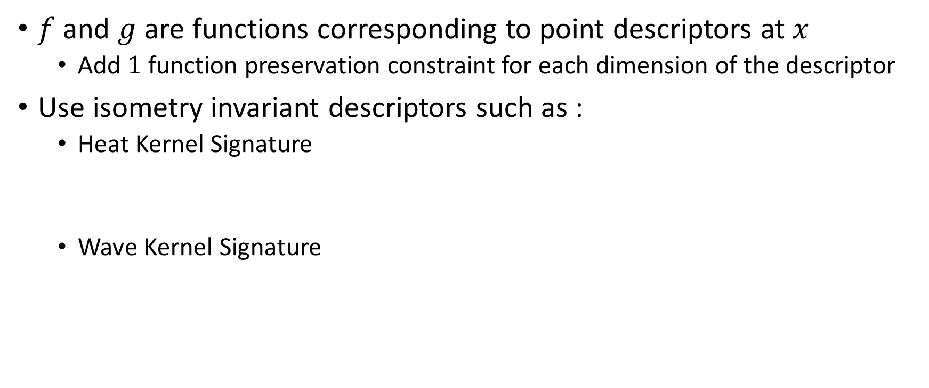
Constraints : Descriptor preservation
$f$ and $g$ are functions corresponding to point descriptors at $x$
Add $1$ function preservation constraint for each dimension of the descriptor
Use isometry invariant descriptors such as :
Heat Kernel Signature
Wave Kernel Signature

Slide 10
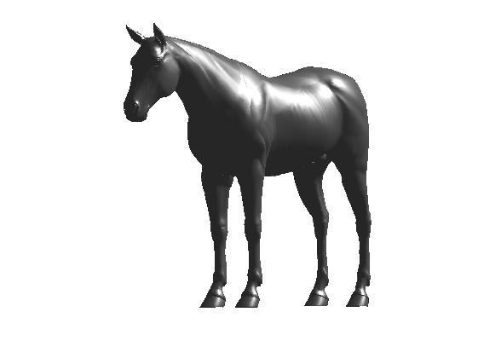
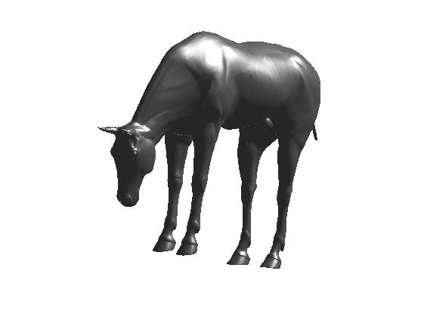
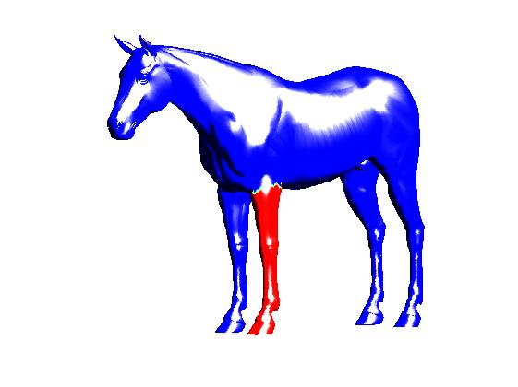
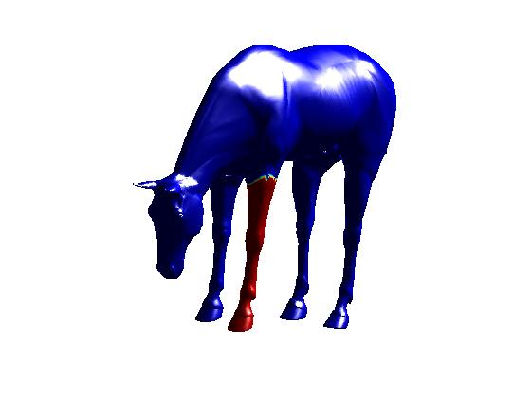


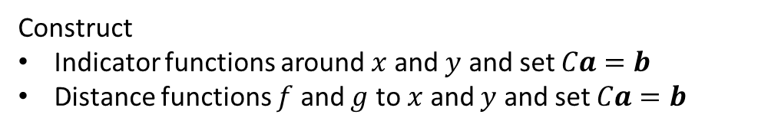
Constraints : Landmark & Segmentation correspondences
Landmark point correspondences :
Segment correspondences :
$$x$$
Construct
Indicator functions around $x$ and $y$ and set $Ca=b$
Distance functions $f$ and $g$ to $x$ and $y$ and set $Ca=b$
$$y$$
Construct linear constraints exactly like for landmark but for a part of the shapes : add more constraints than few landmark point
Need to pre-segment shape and match corresponding segments

Slide 11
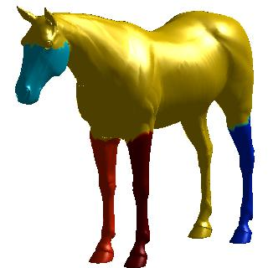
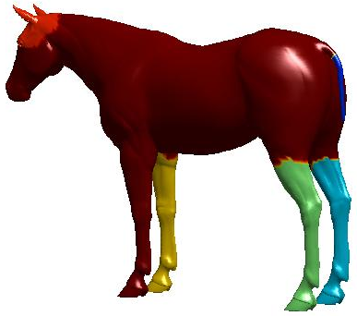
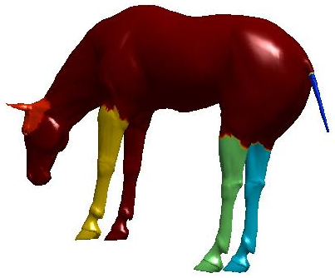
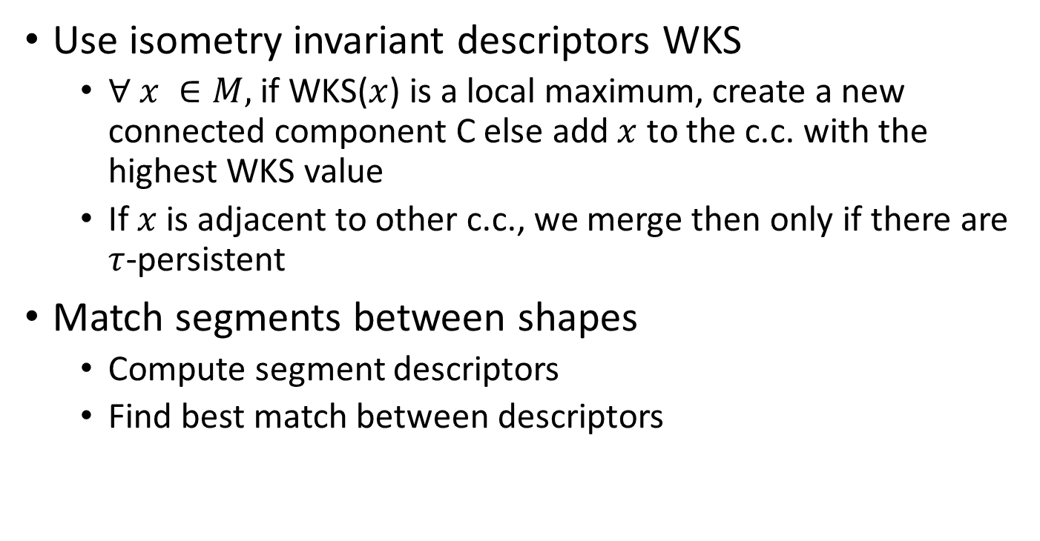
Segmentation of the shape : Skraba & al
Use isometry invariant descriptors WKS
$∀ x ∈M,$ if WKS($x$) is a local maximum, create a new connected component C else add $x$ to the c.c. with the highest WKS value
If $x$ is adjacent to other c.c., we merge then only if there are $τ$-persistent
Match segments between shapes
Compute segment descriptors
Find best match between descriptors

Slide 12
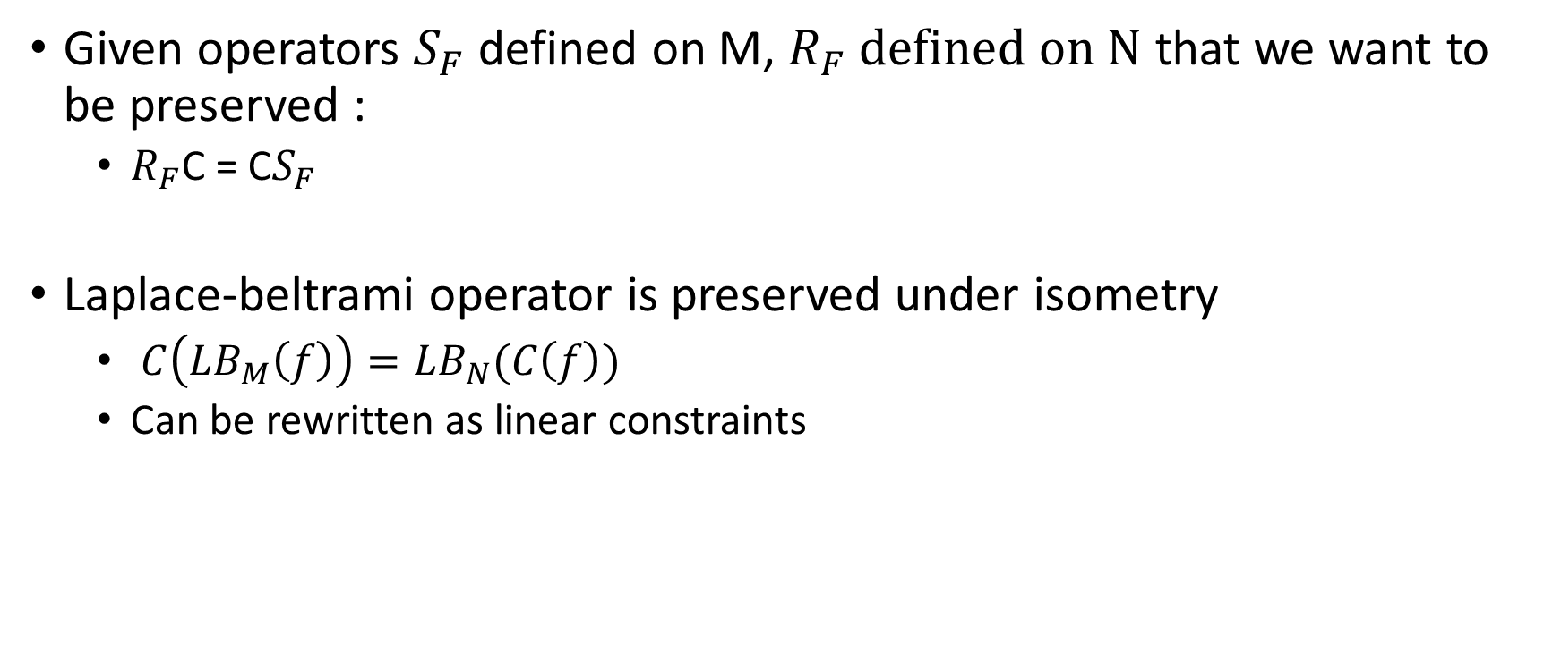
Contraintes operator commutativity - Alex
Given operators $S_{F}$ defined on M, $R_{F} defined on N$ that we want to be preserved :
$R_{F}$C = C$S_{F}$
Laplace-beltrami operator is preserved under isometry
$C\left({LB}_{M}\left(f\right)\right)={LB}_{N}(C\left(f\right))$
Can be rewritten as linear constraints

Slide 13
Refinement + conversion P2P - Alex

Slide 14
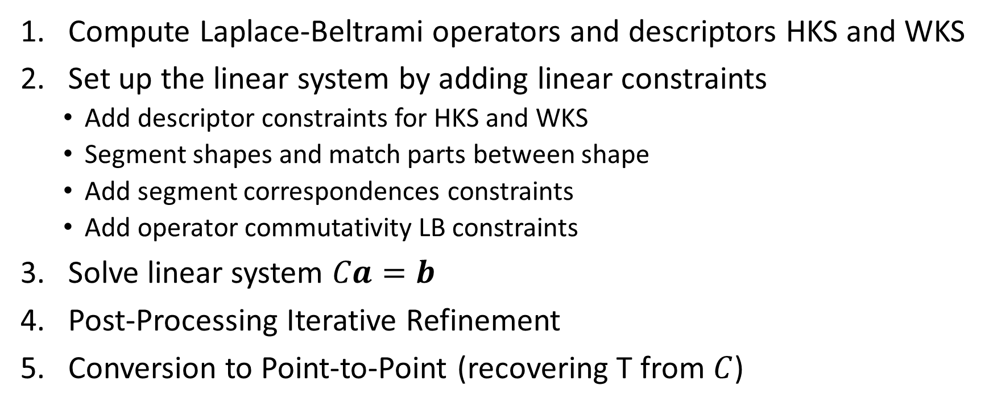
Recap and implementation
Compute Laplace-Beltrami operators and descriptors HKS and WKS
Set up the linear system by adding linear constraints
Add descriptor constraints for HKS and WKS
Segment shapes and match parts between shape
Add segment correspondences constraints
Add operator commutativity LB constraints
Solve linear system $Ca=b$
Post-Processing Iterative Refinement
Conversion to Point-to-Point (recovering T from $C$)

Slide 15
Resultats préliminaires – Descripteurs - Alex

Slide 16
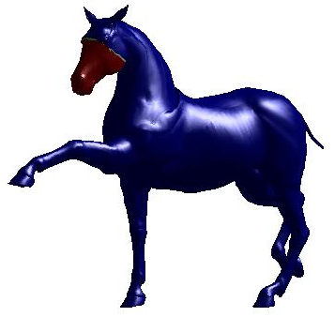
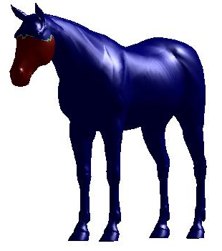
Preliminary results – Segment Transfer

Slide 17
Application - Alex
Composition de mapping
Inversion de mapping
Segmentation transfer
Use of ICSM (expliquer 1=>2=>3=>1 = ID

