Slide 1

Functional Maps: A Flexible Representation of Maps Between Shapes
By M. Ovsjanikov, M Ben-Chen, J. Solomon, A Butscher & L. Guidas
Oral presentation
Paumier Nicolas & This Alexandre
Object recognition and computer vision

Slide 2
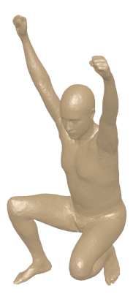
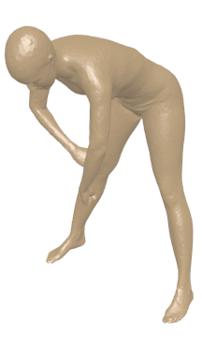
Shape matching
T

Slide 3
Background
0 | 0 | 0 | 0 | 0 | 0 | 0 | 1
0 | 1 | 0 | 0 | 0 | 0 | 0 | 0
0 | 0 | 0 | 1 | 0 | 0 | 0 | 0
0 | 0 | 0 | 0 | 0 | 1 | 0 | 0
1 | 0 | 0 | 0 | 0 | 0 | 0 | 0
0 | 0 | 0 | 0 | 1 | 0 | 0 | 0
0 | 0 | 1 | 0 | 0 | 0 | 0 | 0
0 | 0 | 0 | 0 | 0 | 0 | 1 | 0
Point to point correspondences
Optimization on all the possible permutation
=> Find a set of landmark (specific points) and interpolate to find a dense set of correspondences

Slide 4
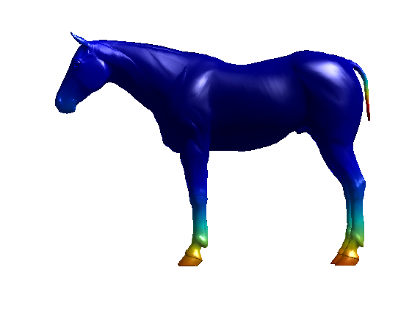
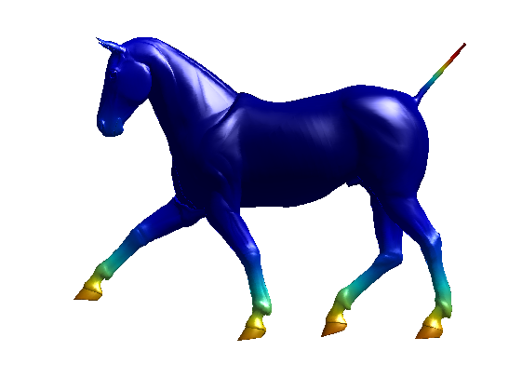
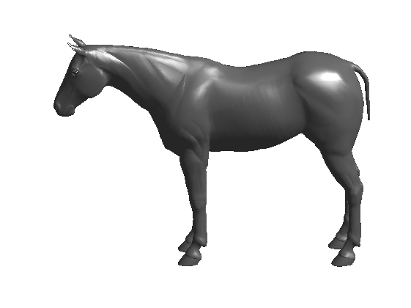
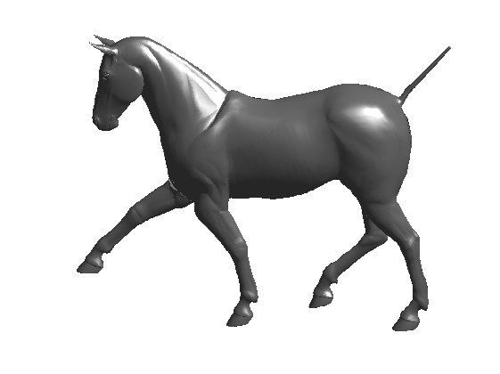



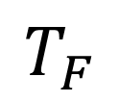
Functional representation
T
M
N
$$T_{F}$$
$$f :M →ℝ$$
$$g :N →ℝ$$
$$g= T_{F}\left(f\right)=f o T^{−1}$$

Slide 5
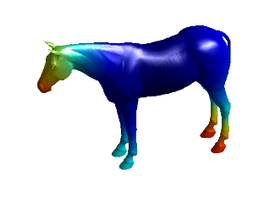
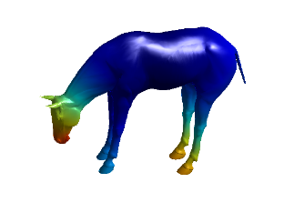
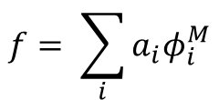


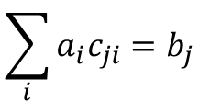

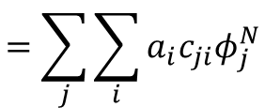

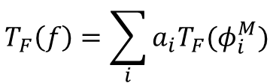

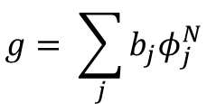
Matrix of change of basis
$$f :M →ℝ$$
$$g :N →ℝ$$
${\{φ}^{M}\}$ basis for fonctions on M
${\{φ}^{N}\}$ basis for fonctions on N
$$f= \sum_{i}{a_{i}φ_{i}^{M}}$$
$$T_{F}\left(f\right)=\sum_{i}{a_{i}{T_{F}(φ}_{i}^{M})}$$
$$=\sum_{j}{\sum_{i}{a_{i}{c_{ji}φ}_{j}^{N}}}$$
$$g= \sum_{j}{b_{j}φ_{j}^{N}}$$
$$\sum_{i}{a_{i}c_{ji}=b_{j}}$$
Matrix notation : $Ca=b$

Slide 6
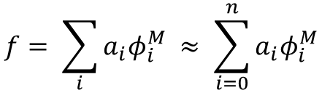
Choice of basis
Natural choice : set of indicator functions on each vertex
Huge w.r.t the number of vertices
Laplace-Beltrami eigenfunctions
Orthogonal basis for functions
Low frequency to High frequency
Compactness (Natural functions are approximated using a small number of basis elements)
$$f= \sum_{i}{a_{i}φ_{i}^{M} ≈ \sum_{i=0}^{n}{a_{i}φ_{i}^{M}}}$$

Slide 7

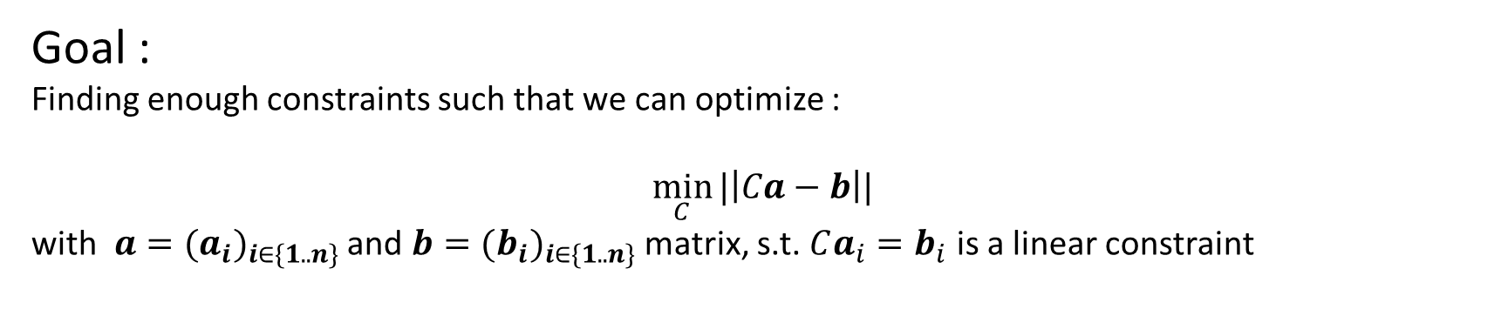

Recover matrix $C$
Functional preservation :
Given $f :M →ℝ$and $g :N →ℝ$and $a$ and $b$ their representation.
New linear constraint for the matrix $C$: $Ca=b$
Goal :
Finding enough constraints such that we can optimize :
$$\min_{C}{|\left|Ca−b\right||}$$
with $a={(a_{i})}_{i∈\{1..n\}}$ and $b={(b_{i})}_{i∈\{1..n\}}$ matrix, s.t. $Ca_{i}=b_{i}$ is a linear constraint

Slide 8
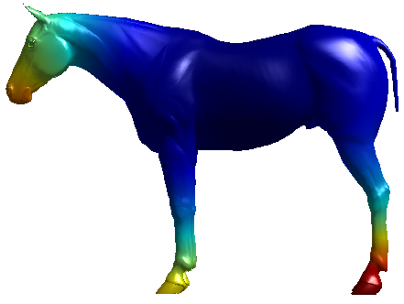
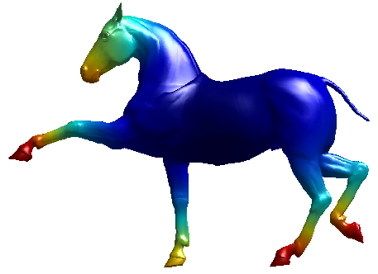
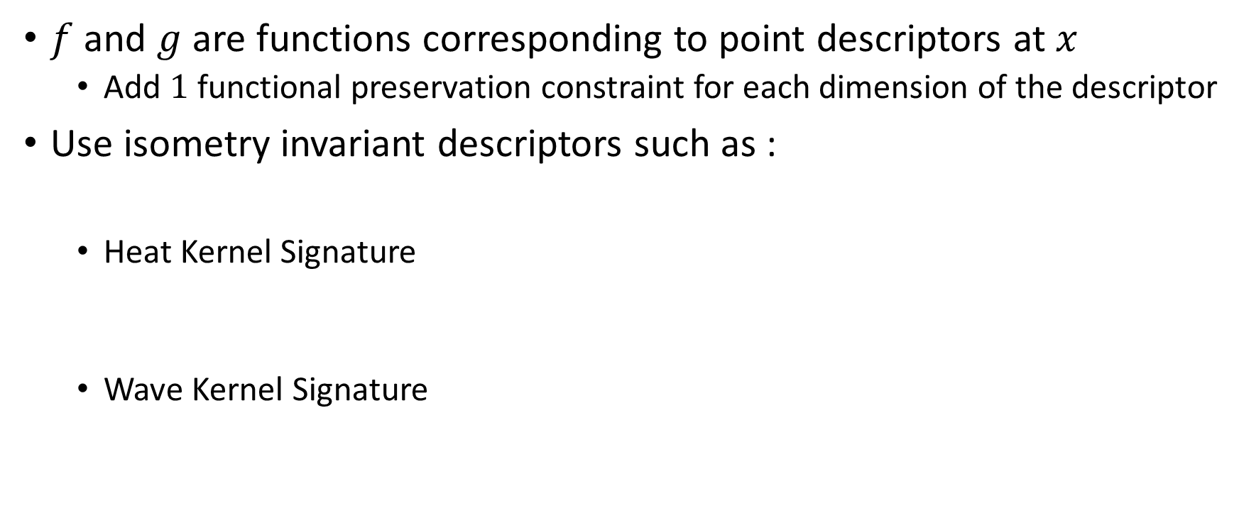
Constraints : Descriptor preservation
$f$ and $g$ are functions corresponding to point descriptors at $x$
Add $1$ functional preservation constraint for each dimension of the descriptor
Use isometry invariant descriptors such as :
Heat Kernel Signature
Wave Kernel Signature
Notes:
HKS : curvature of x at scale t
WKS : average probability of a particul to be at a specific location at different scale energy e

Slide 9
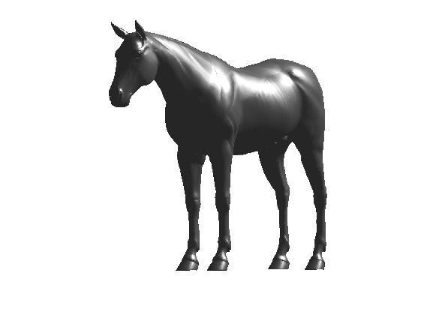
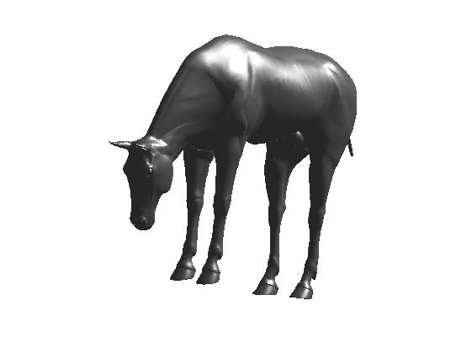
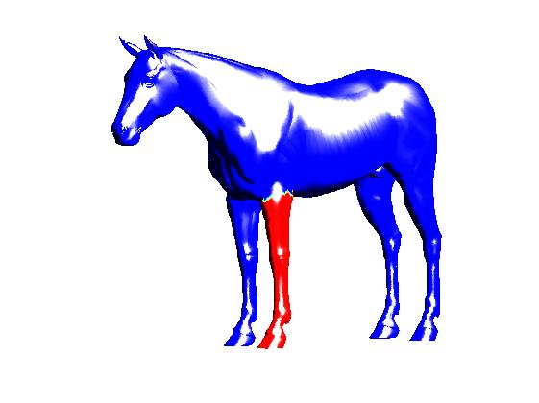
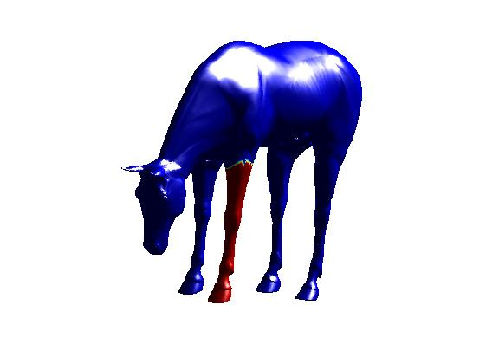


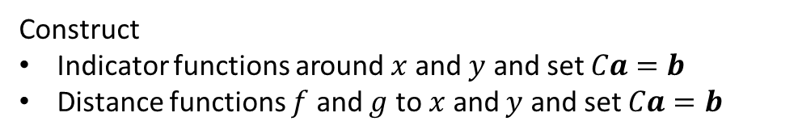
Constraints : Landmark & Segmentation correspondences
Landmark point correspondences :
Segment correspondences :
$$x$$
Construct
Indicator functions around $x$ and $y$ and set $Ca=b$
Distance functions $f$ and $g$ to $x$ and $y$ and set $Ca=b$
$$y$$
Construct linear constraints exactly like for landmark but for a part of the shapes : add more constraints than few landmark point
Need to pre-segment shape and match corresponding segments

Slide 10
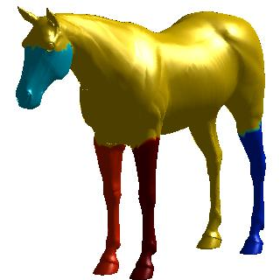
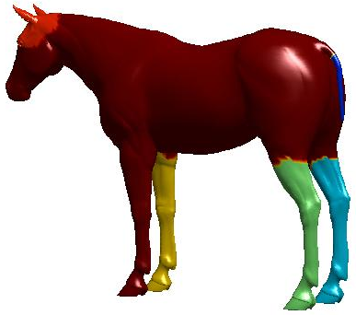
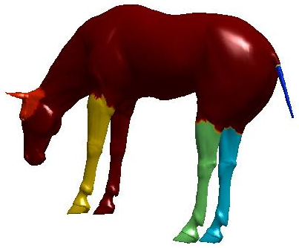
Segmentation of the shape : Skraba & al
Compute connected component based on isometry invariant descriptors WKS
Match segments between shapes
Compute segment descriptors
Find best match between descriptors

Slide 11
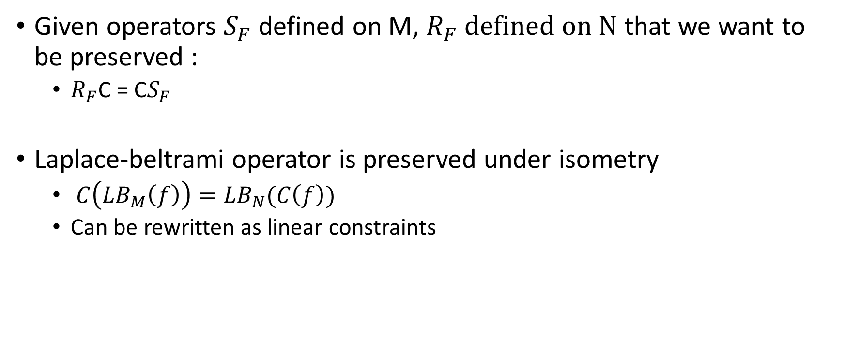
Contrainsts : Operator Commutativity
Given operators $S_{F}$ defined on M, $R_{F} defined on N$ that we want to be preserved :
$R_{F}$C = C$S_{F}$
Laplace-beltrami operator is preserved under isometry
$C\left({LB}_{M}\left(f\right)\right)={LB}_{N}(C\left(f\right))$
Can be rewritten as linear constraints

Slide 12
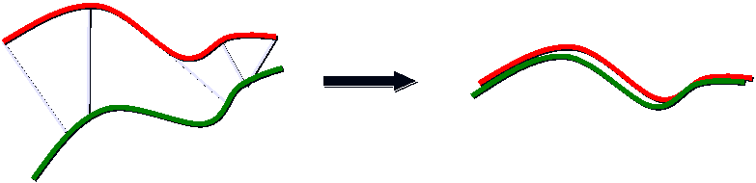
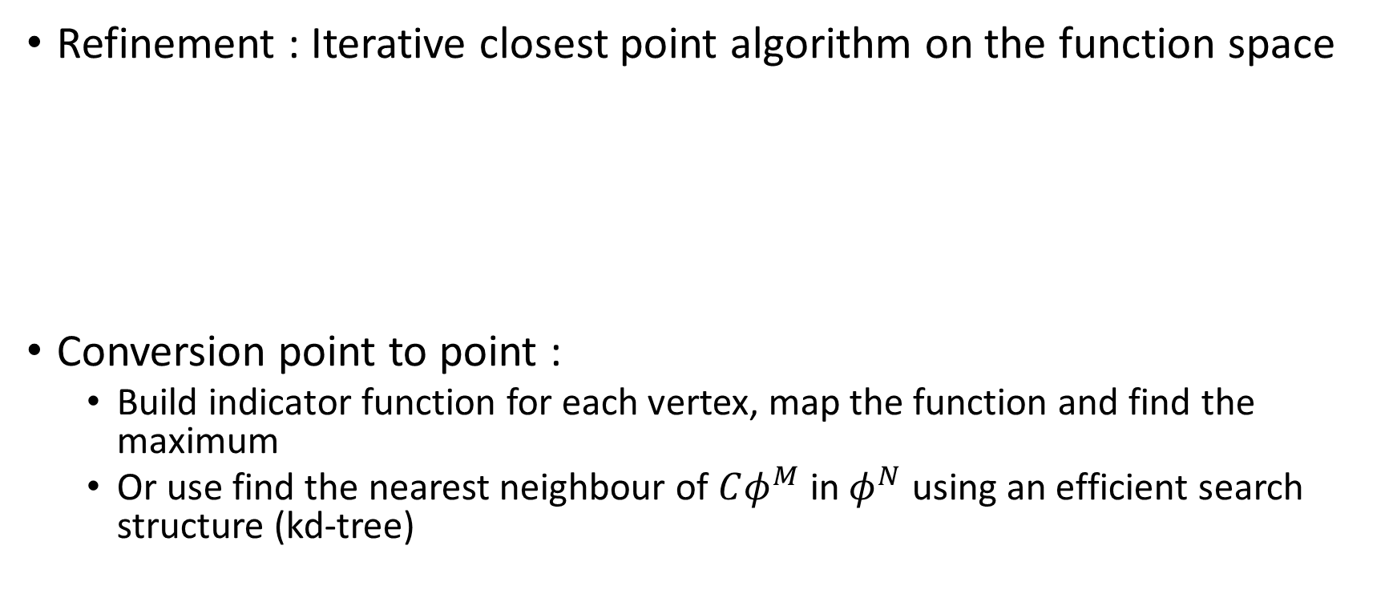


Refinement and conversion to point to point
Refinement : Iterative closest point algorithm on the function space
Conversion point to point :
Build indicator function for each vertex, map the function and find the maximum
Or use find the nearest neighbour of $Cφ^{M}$ in $φ^{N}$ using an efficient search structure (kd-tree)
$$Cφ^{M}$$
$$φ^{N}$$

Slide 13
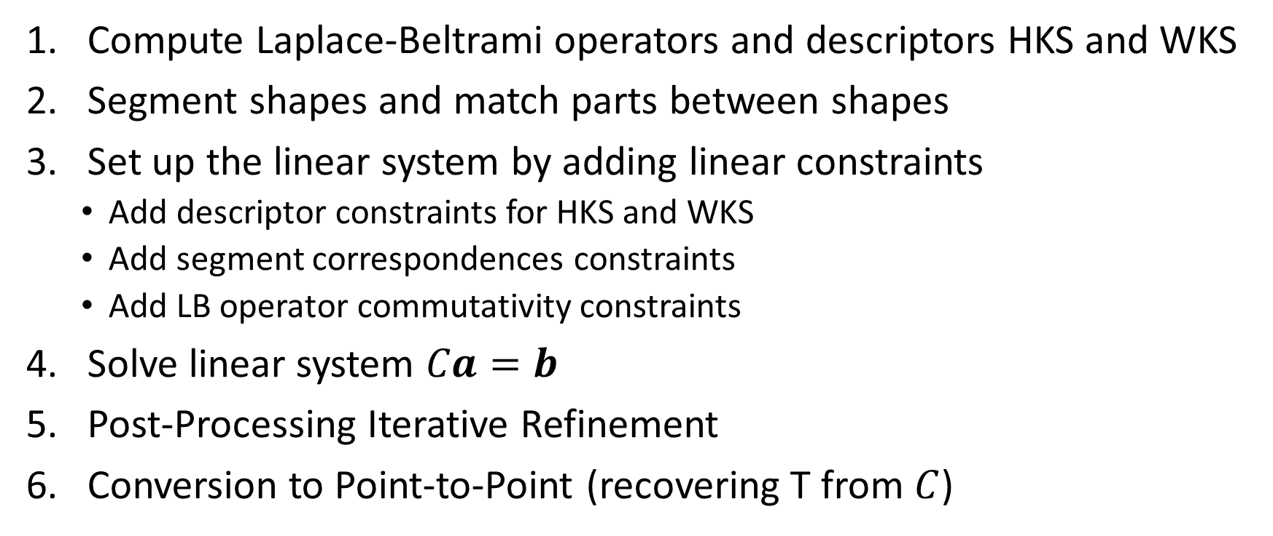
Recap and implementation
Compute Laplace-Beltrami operators and descriptors HKS and WKS
Segment shapes and match parts between shapes
Set up the linear system by adding linear constraints
Add descriptor constraints for HKS and WKS
Add segment correspondences constraints
Add LB operator commutativity constraints
Solve linear system $Ca=b$
Post-Processing Iterative Refinement
Conversion to Point-to-Point (recovering T from $C$)

Slide 14
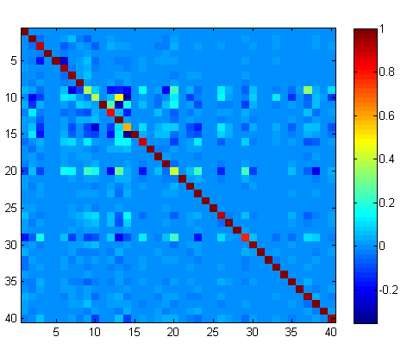
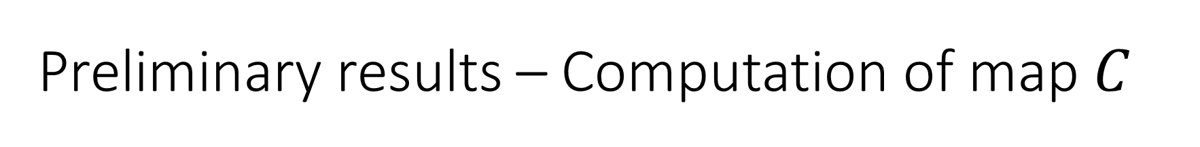

Preliminary results – Computation of map $C$
Map computed with 40 eigenfunctions with
HKS preservation constraints
WKS preservation constraints
One segment preservation constraint (tail)
LB operator commutativity constraints
$$C$$

Slide 15
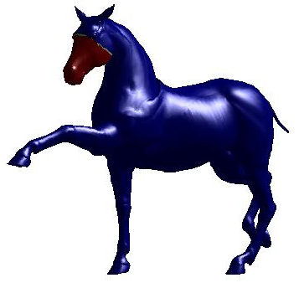
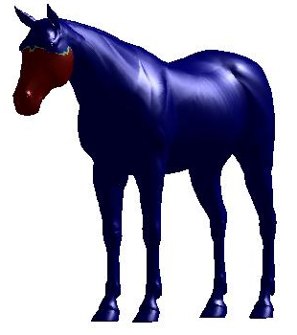
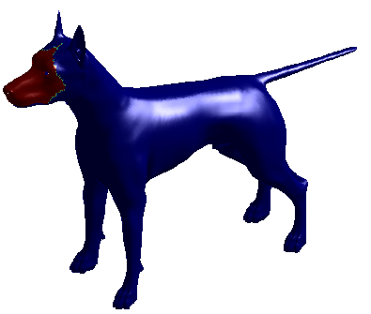
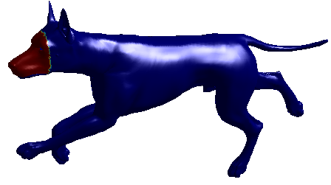
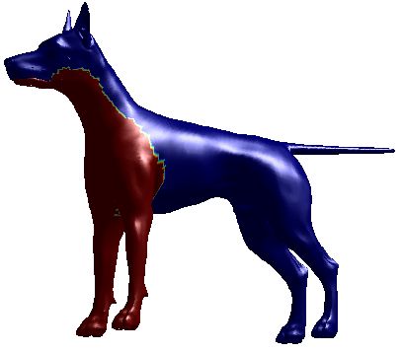
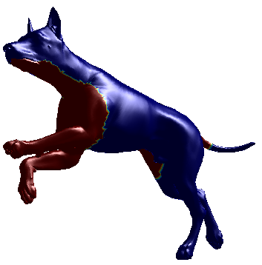
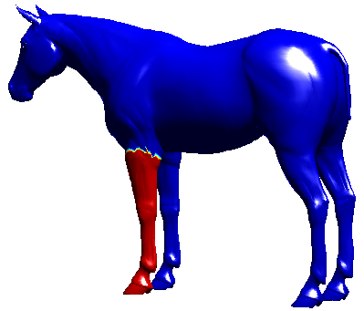
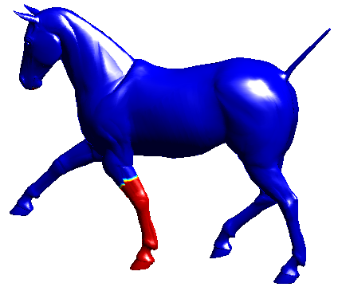
Preliminary results – Segmentation Transfer
Notes:
Define indicator function on segmented part then transfer this function to N and keep highest responses

Slide 16
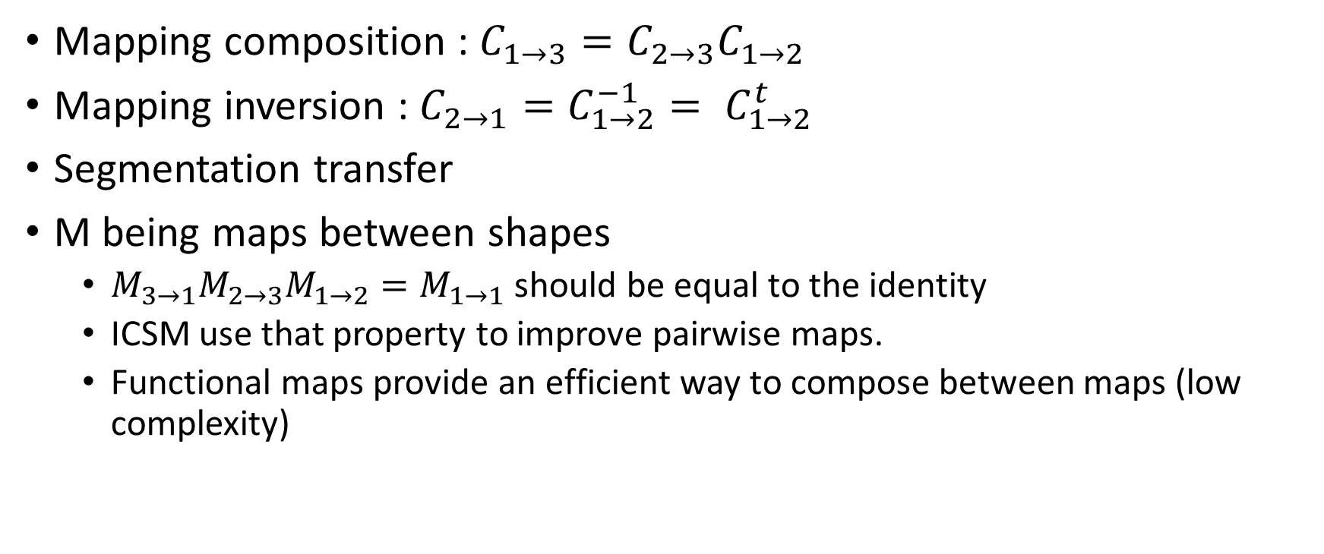
More applications and properties
Mapping composition : $C_{1→3}=C_{2→3}C_{1→2}$
Mapping inversion : $C_{2→1}=C_{1→2}^{−1}= C_{1→2}^{t}$
Segmentation transfer
M being maps between shapes
$M_{3→1}M_{2→3}M_{1→2}=M_{1→1}$ should be equal to the identity
ICSM use that property to improve pairwise maps.
Functional maps provide an efficient way to compose between maps (low complexity)

Slide 17
Current and further work
LB operator, HKS and WKS were provided
What we did until now :
Linear constraints for
descriptor preservation
Segment preservation constraints
Operator commutativity constraints
We also implemented the persistence based segmentation algorithm
Test on segmentation transfer
What’s next :
Refinement using ICP
Implementing the conversion to get the point to point mapping
More qualitative and quantitative tests

Slide 18
Questions ?

