Slide 2
Topic & context - Nico

Slide 3
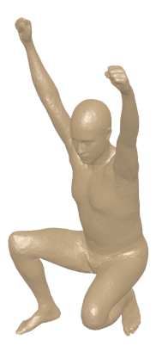
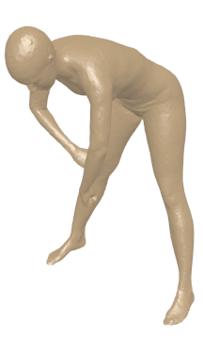
Background
0 | 0 | 0 | 0 | 0 | 0 | 0 | 1
0 | 1 | 0 | 0 | 0 | 0 | 0 | 0
0 | 0 | 0 | 1 | 0 | 0 | 0 | 0
0 | 0 | 0 | 0 | 0 | 1 | 0 | 0
1 | 0 | 0 | 0 | 0 | 0 | 0 | 0
0 | 0 | 0 | 0 | 1 | 0 | 0 | 0
0 | 0 | 1 | 0 | 0 | 0 | 0 | 0
0 | 0 | 0 | 0 | 0 | 0 | 1 | 0
Point to point correspondences
Optimization on all the possible permutation
=> Find a set of landmark (specific points) and interpolate to find a dense set of correspondences

Slide 4
Résumé et objectifs - Nico

Slide 5
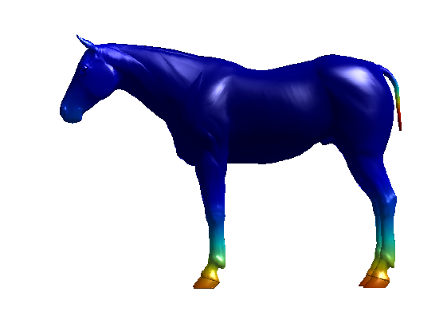
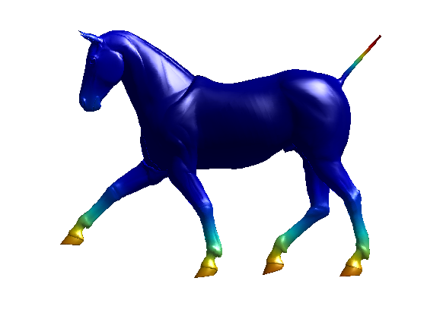
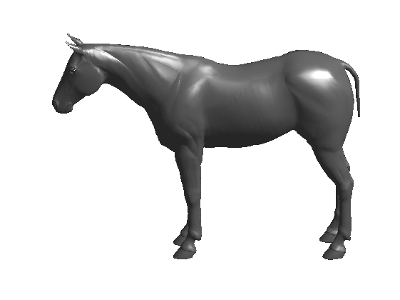
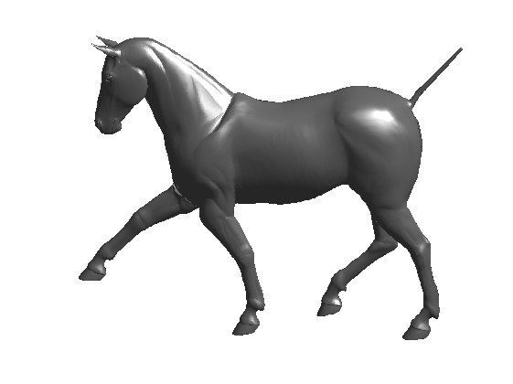



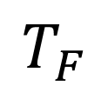
Théorie de la représentation fonctionnelle - Alex
T
M
N
$$T_{F}$$
$$f :M →ℝ$$
$$g :N →ℝ$$
$$g= T_{F}\left(f\right)=f o T^{−1}$$

Slide 6
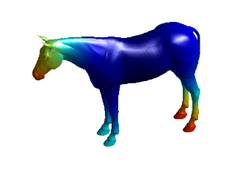
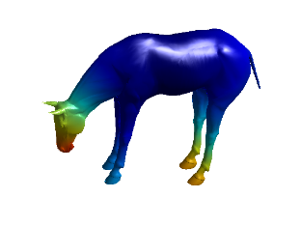
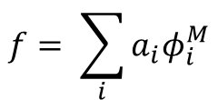


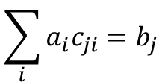

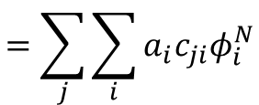

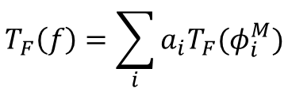

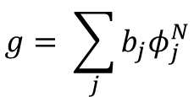
Matrice du changement de base - Alex
$$f :M →ℝ$$
$$g :N →ℝ$$
${\{φ}^{M}\}$ basis for fonctions on M
${\{φ}^{N}\}$ basis for fonctions on N
$$f= \sum_{i}{a_{i}φ_{i}^{M}}$$
$$T_{F}\left(f\right)=\sum_{i}{a_{i}{T_{F}(φ}_{i}^{M})}$$
$$=\sum_{j}{\sum_{i}{a_{i}{c_{ji}φ}_{i}^{N}}}$$
$$g= \sum_{j}{b_{j}φ_{j}^{N}}$$
$$\sum_{i}{a_{i}c_{ji}=b_{j}}$$
Matrix notation : $Ca=b$

Slide 7
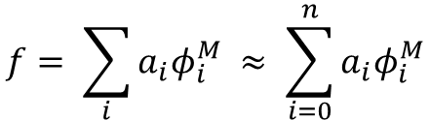
Bases ? - Alex
Natural choice : set of indicator functions on each vertex
Huge w.r.t the number of vertices
Laplace-Beltrami eigenfunctions
Orthogonal basis for functions
Low frequency to High frequency
Compactness (Natural functions are approximated using a small number of basis elements)
$$f= \sum_{i}{a_{i}φ_{i}^{M} ≈ \sum_{i=0}^{n}{a_{i}φ_{i}^{M}}}$$

Slide 8
Comment obtenir C ? - Nico
Ca = b
Contraintes linéaires = système linéaire permettant de trouver C

Slide 9
Contraintes de préservation de fonctions - Nico
Descriptor invariants par iso

Slide 10
Contraintes de préservation de fonctions - Nico
landmark

Slide 11
Contraintes de préservation de fonctions - Nico
segment

Slide 12
Skraba & al - Nico

Slide 13
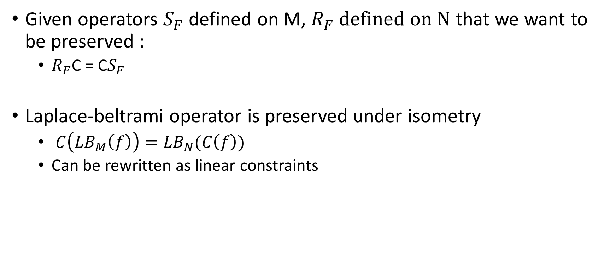
Contraintes operator commutativity - Alex
Given operators $S_{F}$ defined on M, $R_{F} defined on N$ that we want to be preserved :
$R_{F}$C = C$S_{F}$
Laplace-beltrami operator is preserved under isometry
$C\left({LB}_{M}\left(f\right)\right)={LB}_{N}(C\left(f\right))$
Can be rewritten as linear constraints

Slide 14
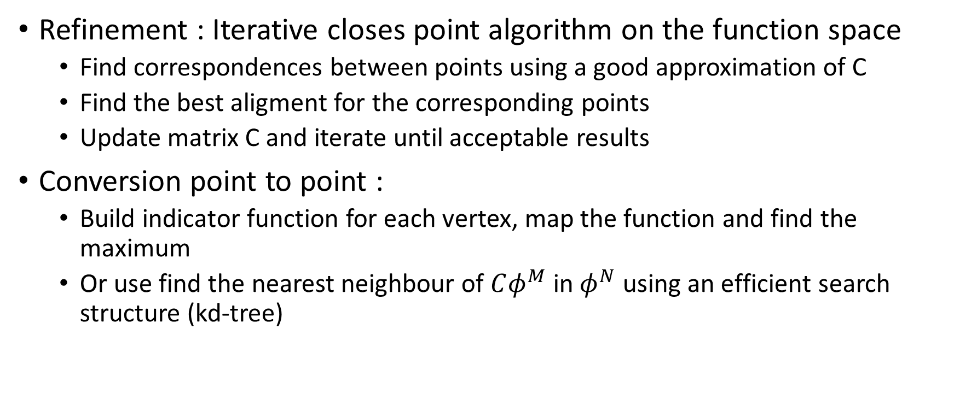
Refinement + conversion P2P - Alex
Refinement : Iterative closes point algorithm on the function space
Find correspondences between points using a good approximation of C
Find the best aligment for the corresponding points
Update matrix C and iterate until acceptable results
Conversion point to point :
Build indicator function for each vertex, map the function and find the maximum
Or use find the nearest neighbour of $Cφ^{M}$ in $φ^{N}$ using an efficient search structure (kd-tree)

Slide 15
Recap sur l’algo – implementation - Nico
Creation du système linéaire
Fonctions pour descriptor preservation HKS,WKS
Segmentation
Operator commutativity LB
Solve linear system
(+Refinement (ICP))
(+P2P correspondances)

Slide 16
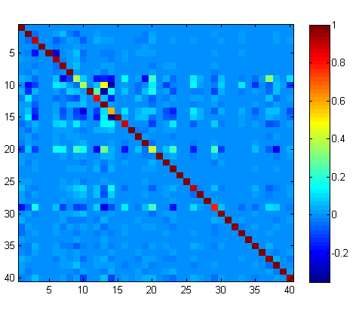
Preliminary results – Computation of map C
Map computed with 40 eigenfunctions with
HKS preservation constraints
WKS preservation constraints
One segment preservation constraint (tail)
LB operator commutativity constraints

Slide 17
Resultats préliminaires – Segment - Nico

Slide 18
Resultats préliminaires – Transfert de segment - Nico

Slide 19
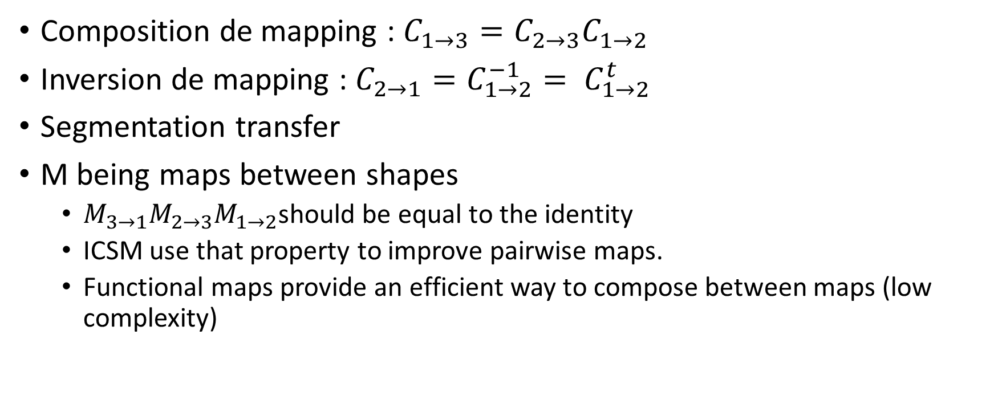
Application - Alex
Composition de mapping : $C_{1→3}=C_{2→3}C_{1→2}$
Inversion de mapping : $C_{2→1}=C_{1→2}^{−1}= C_{1→2}^{t}$
Segmentation transfer
M being maps between shapes
$M_{3→1}M_{2→3}M_{1→2}$should be equal to the identity
ICSM use that property to improve pairwise maps.
Functional maps provide an efficient way to compose between maps (low complexity)

