Slide 1
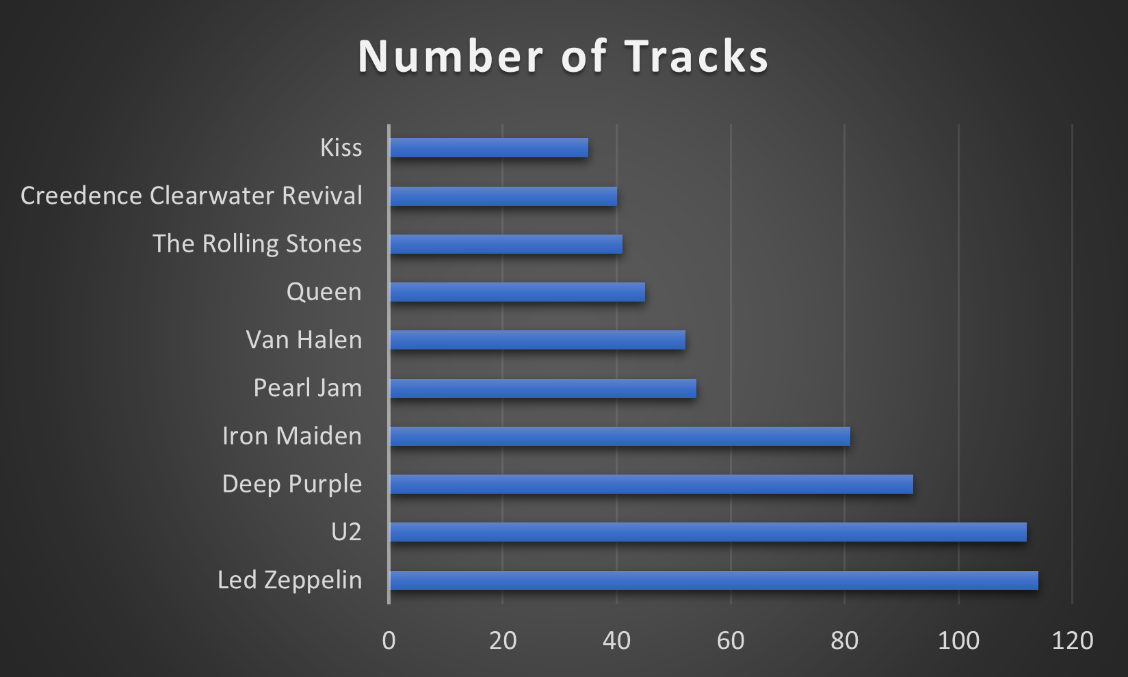
Top 10 Artis With Most Rock Tracks
<visualization>
We can see from the chart that the Artist with most Rock tracks published is Led Zeppelin. U2 is noticeably close with a couple of tracks less.
Artists
Tracks

Slide 2
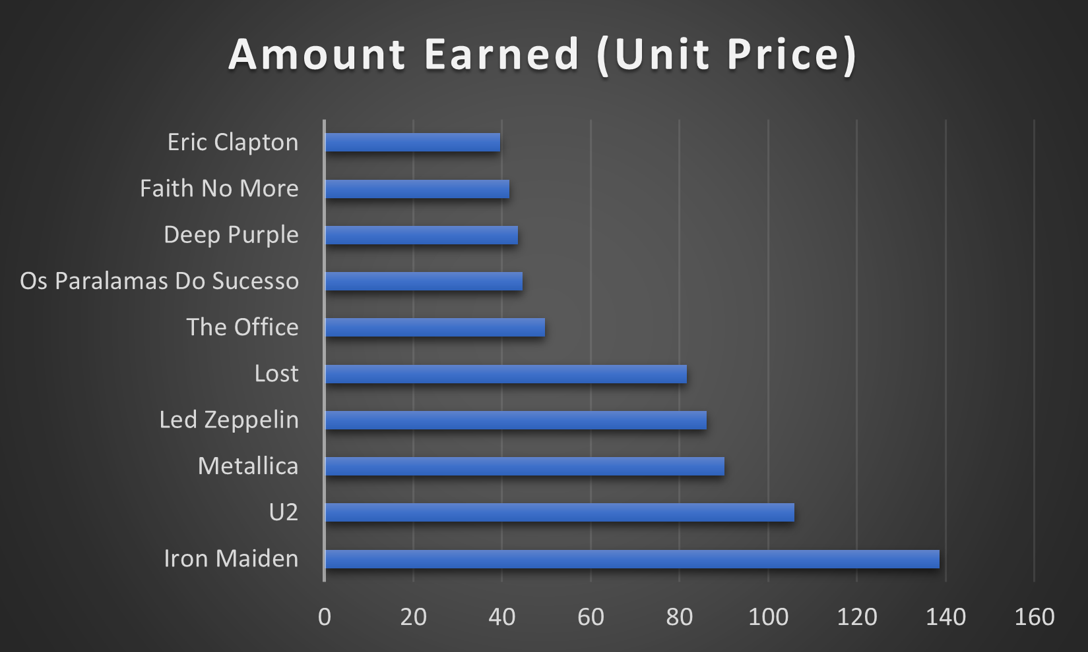
Top 10 Artists With Most Income
<visualization>
Acourding to our InvoiceLines inputs, the artist that earned the most is Iron maiden, While the Artist the earned the least is Eric Clapton. U2 is second with a difference of around 40 Unit price.
Artists
Amount Earned

Slide 3
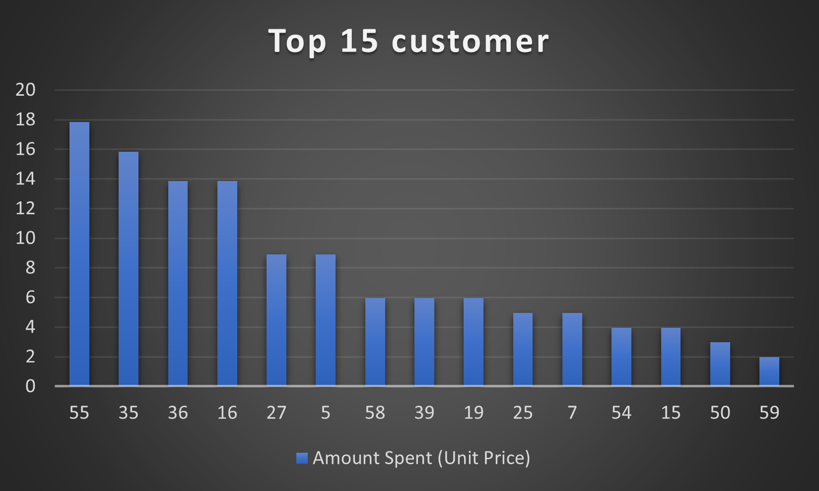
Top 15 Customers Spending on Iron Maiden
<visualization>
The chart shows that customer with ID 55 spend the most on Iron Maiden.
Customer ID

Slide 4
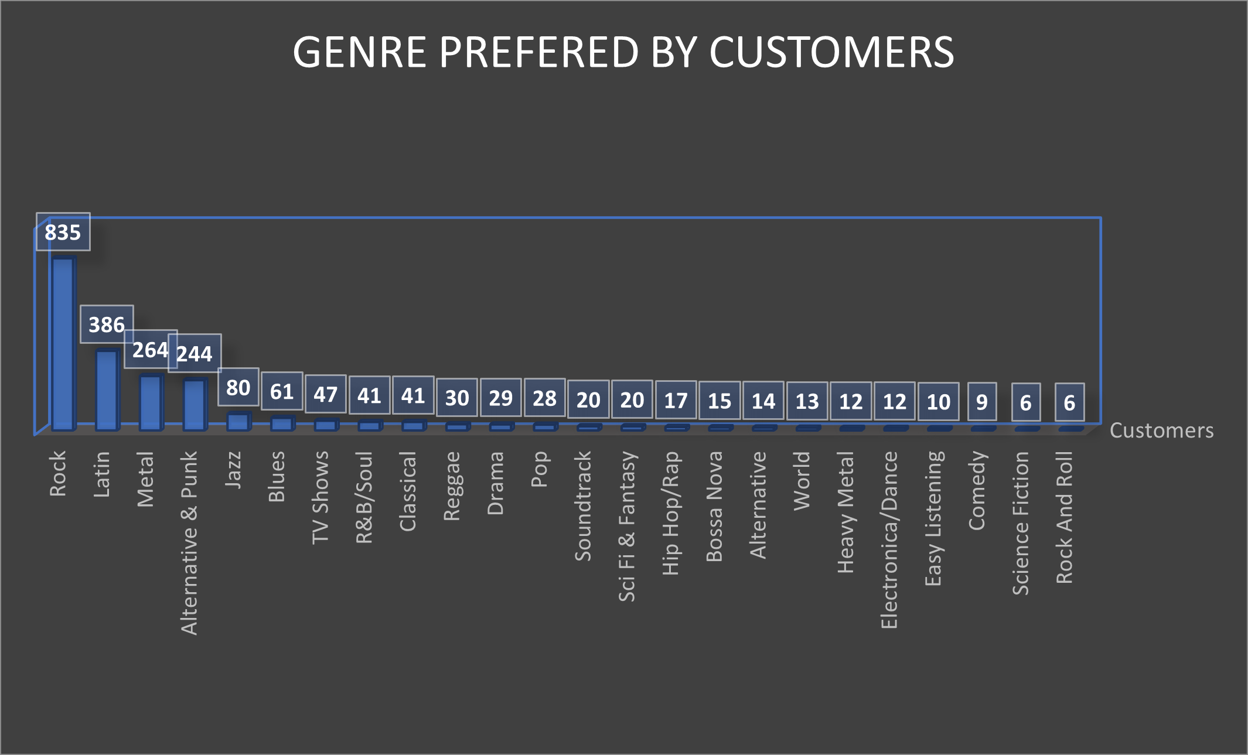
Amoutn of Customers per Each Genre
The chart shows that Rock is the top prefered genre, with Latin after it. The diffrence between Rock and Latin is quite huge arround 500 customers.
<visualization>
Genre

