Slide 1



Transport Over IP
รศ.ดร. อนันต์ ผลเพม
Asso. Prof. Anan Phonphoem, Ph.D.
anan.p@ku.ac.th http://www.cpe.ku.ac.th/~anan Computer Engineering Department Kasetsart University, Bangkok, Thailand

Slide 2
Outline
Transport Layer
Transport Layer
User Datagram Protocol (UDP)
Transmission Control Protocol (TCP)
Stream Control Transmission Protocol
(SCTP)
Real-Time Transport Protocol (RTP)

Slide 3
TCP/IP protocol Suite
Application
TCP | UDP
IP
Datalink
Physical

Slide 4





TCP/IP protocol Suite
Application
Application
Transport
Transport
Network
Network
Network
Data Link Physical
Data
Data
Data Link
Phy
Phy
Physical
Notes:
สองด้านซ้ายขวาไม่จำเป็นต้อง Implement network เดียวกัน
Transport วิ่งข้ามตัวกลางเลย แต่ปัจจุบันอาจไม่จริงแล้วก็ได้

Slide 5
Issues in Network Layer
No/Little error detection
No attempt to correct
Retransmission
Connectionless
No handshaking
No verification
No flow control

Slide 6
Transport Protocol
Set of rules
for exchange control message / data
End-to-End
Application may by-pass Transport Protocol
build functions on top of IP
reduce overhead
application runs on switch/router that has
no Transport Layer

Slide 7
Transport Protocols
User Datagram Protocol (UDP)
Transmission Control Protocol (TCP)
Stream Control Transmission Protocol (SCTP)
Real-Time Transport Protocol (RTP)

Slide 8
Ports and Addresses
IP address is the end point of identifier
source / destination
On same machine (same IP)
needs identifier for each application
multiple applications (e.g. 3 Ftp sessions)
“Port”
16-bit number (65,536 ports) for each IP

Slide 9
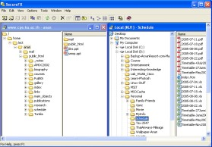

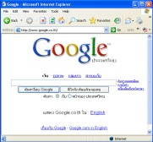
Ports and Addresses
Unique connection identifier [source IP] + [source port] [dest. IP] + [dest. port]
Web #1 [158.108.1.2:80]
Web #2 [158.108.1.2:8080]
Ftp [158.108.1.2:20]
IP address: 158.108.1.2

Slide 10
Ports and Addresses
Known destination IP
Concern Issues
destination port ?
listen port ?
IANA divides ports into three ranges
well-known ports
registered ports
dynamic / private ports

Slide 11
Well-known ports
■ 1 – 1023
Used by server applications
Use with restricted privileges (root)
Assigned by IANA

Slide 12
Well-known ports: Examples
Port Number | Description
80 | WWW
25 | SMTP
23 | Telnet
22 | SSH
21 | ftp-control
20 | ftp-data
161 | SNMP

Slide 13
Registered Ports
■ 1024 – 49,151
Used for server applications
Allow client to make contact
Registered with IANA (for uniqueness)
On most systems, registered ports can be
used by ordinary users
Ex. 8080: HTTP alternate
commonly used for Web proxy and caching server
or for running a Web server as a non-root user

Slide 14
Registered Ports: Examples
Port Number | Description
1188 | hp-webadmin | HP Web Admin
1376 | ibm-pps | IBM Person to Person Software
1381 | apple-licman | Apple Network License Manager
1741 | cisco-net-mgmt | Cisco network managment

Slide 15
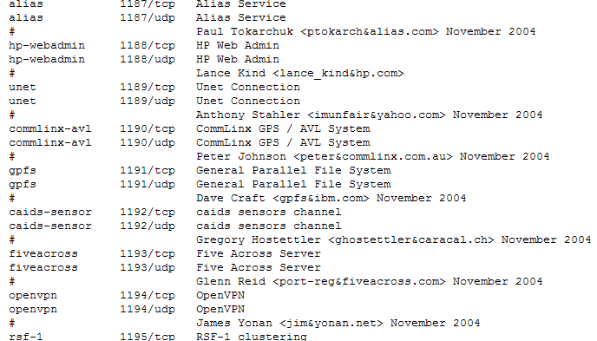
Example from
http://www.iana.org/assignments/port-numbers

Slide 16
Dynamic / Private ports
■ 49,152 – 65,535
Ephemeral ports (one day, temporary)
as-needed basis
freed up when done

Slide 17

Ephemeral
Nature
“An ephemeral waterbody is a wetland, spring, stream, river, pond or lake that only exists for a short period following precipitation or snowmelt.”
Bio
“Many plants are adapted to an ephemeral lifestyle, in which they spend most of the year or longer as seeds before conditions are right for a brief period of growth and reproduction.”
Staircase Falls in Yosemite National Park only flows after heavy rainfall or snowmelt
From http://en.wikipedia.org/wiki/Ephemeral

Slide 18
Ephemeral
Network
“In computer networking technology, an ephemeral port is a TCP, UDP or SCTP port which is dynamically assigned to a client application for a short period of time (the duration of time the application is running).”
“This is in contrast to the "well known" ports which are typically statically assigned to a specific application or service.”
From http://en.wikipedia.org/wiki/Ephemeral

Slide 19
Dynamic / Private ports
■ 49,152 – 65,535
Ephemeral ports (one day, temporary)
as-needed basis
freed up when done
Assigned by local machine
Not register with IANA
Never used for destination port at start
used by initiator as the return add.

Slide 20
Connection-Oriented Transport
Advantages
easy to communicate (if receiver is there!)
verify the real receiver
agree on some protocols
error correction
Disadvantages
heavyweight protocol
sophisticated implementation (keep state)
consume high bandwidth for management
TCP

Slide 21
Connectionless Transport
Datagram approach
Advantages
rapid data transfer
no connection setup
no need for connection maintenances
Disadvantages
not reliable (or fail)
out of order packets
application more complex (takes precautions)
UDP

Slide 22

Outline
■
Transport Layer
User Datagram Protocol (UDP)
Transmission Control Protocol (TCP)
Stream Control Transmission Protocol
(SCTP)
Real-Time Transport Protocol (RTP)
User Datagram Protocol (UDP)

Slide 23
User Datagram Protocol (UDP)
Characteristics
No error detection/recovery
No flow control
No checking for existing of destination
Simple services
Very useful protocol

Slide 24
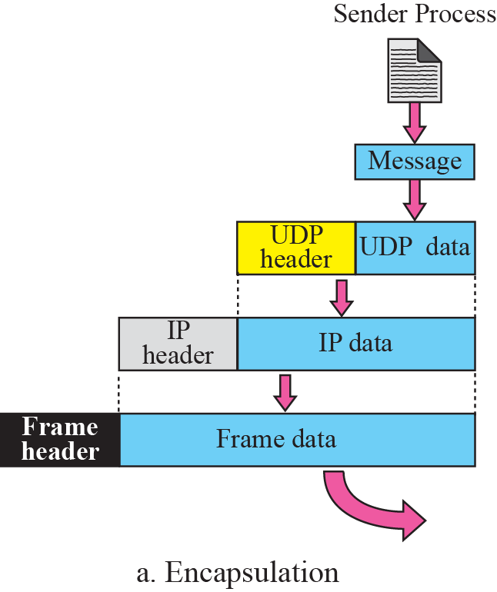
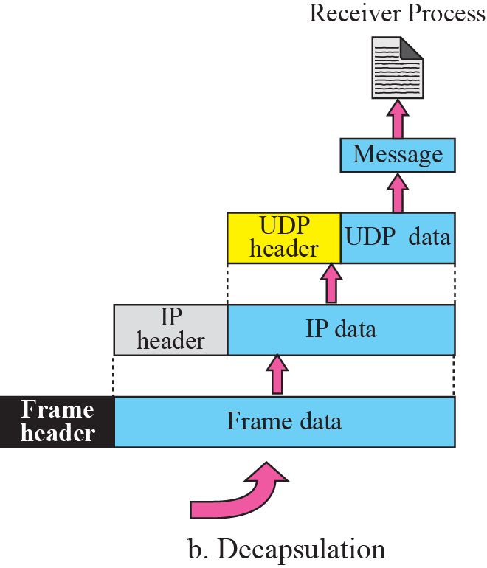
UDP Encapsulation

Slide 25
UDP Basic Functions
provide basic functions above raw IP
Destination port – to specific application
Source port – for send back info
Data integrity verification – checksum
Data reassembly – segmented packets

Slide 26
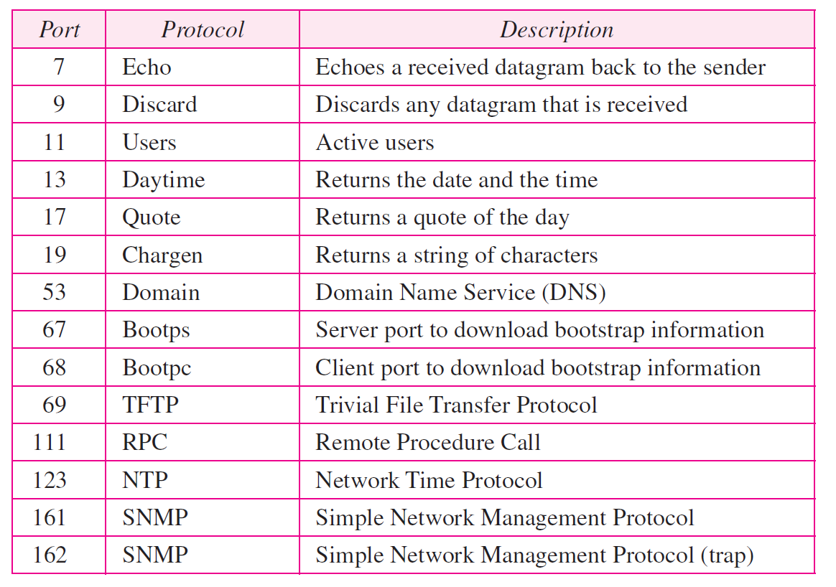
UDP well-known ports

Slide 27
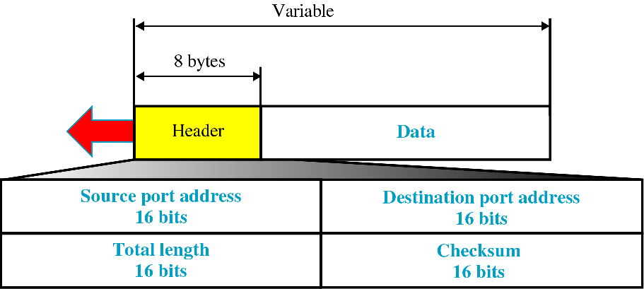
UDP Message Format
Total length = UDP header+ Payload ≤ 2¹⁶ bytes

Slide 28





UDP Message Fragmentation
UDP Header
UDP Header
DataData
Transport Layer
IP Layer
IP Header
Payload
IP Header
Data

Slide 29
UDP Checksum
Why needed it ?
Data link already provided CRC
No corrupted frame accepted
Connectionless !
loss packets due to route
Sender can choose not to use – set to 0
Optional
performance issue
Notes:
ทำไมต้องทำ crcอีกอ่ะในเมื่อ datalinkก็ทำแล้วละเอียดด้วย
เพราะบางทีข้อมูลหายได้ connectionless เลยอาจมีการเช็คด้วย หรือถ้าเซ็ต0ก็คือไม่ต้องเช็คเลย

Slide 30
UDP Checksum
Compare to other checksums
different – UDP pseudo header
same – 16-bit one’s complement
At sender
create pseudo header
Add zero to checksum field
calculating checksum of pseudo header + regular header + message
discard pseudo header when finished
Notes:
การทำงาน
สร้าง สูโดมาแล้ว set 0 ก่อน

Slide 31
UDP Checksum
At receiver
create pseudo header
save received checksum
change checksum to zero
calculating checksum (pseudeo+regular
header+message)
compare the calculate and save value

Slide 32
Why Pseudo Header is needed?
UDP Header
Only source/destination ports in the header
No Destination IP Address
IP Header contains IP add.
Reduce size of UDP Header
Need to check for correct destination
Notes:
UDP มีแต่portนะไม่มี IP

Slide 33
UDP Pseudo Header
0
31
Source IPv4 Address
Destination IPv4 Address
rsev (0) 8 bits | Protocol Type (UDP = 17) | UDP Length 16 bits
Source Port 16 bits |  | Destination Port 16 bits | UDP header
UDP Datagram Length 16 bits |  | UDP checksum 16 bits
Data
Pseudoheader
Notes:
สร้างหัวเทียมขึ้นมาแล้วรวมกับ header แล้วคำนวนใหเสร็จแล้วโยนทิ้งไปแล้วส่งตัวล่างไปทำให้ไม่หนักหัว
ขอกลับก็ทำเช่นกัน ทำให้ไม่ต้องใส่ ip

Slide 34
UDP Checksum
If error found
discard packet
responsibility of application
IPv6
Pseudo header is v6
checksum is mandatory
Notes:
Error ก็ทิ้งไปดิ

Slide 35
Protocols that use UDP
TFTP (trivial FTP)
BOOTP (for diskless station)
Network Time Protocol (NTP)
need basic delivery and checksum
Network File System (NFS)
need low overhead
Link Management Protocol (LMP)
original use raw IP (has its own error process)
move to UDP (preserve scarce IP protocol identifier)
Label Distribution Protocol (LDP)
need to support multicast and broadcast
discovery mechanism

Slide 36
UDP Lite
Ultra-lightweight version
Codecs for voice / video
good at handle error in data streams
need UDP not to discard damage packets (RF error message) based on checksum
remove checksum for better performance
UDP Lite applies checksum to part of packet
Sensitive part (e.g. address ; not payload)
whole packet sensitive ➔ regular UDP packet
Notes:
เป็นไปได้มั้ยให้มันเบากว่านั้นอีก UDP Lite โคตรๆเบา

Slide 37
UDP Lite Header
Source Port 16 bits | Destination Port 16 bits
UDP Datagram Length 16 bits | UDP checksum 16 bits
regular UDP header
Source Port 16 bits | Destination Port 16 bits
Checksum Coverage Field 16 bits | UDP Lite checksum 16 bits
UDP Lite header
Checksum Coverage Field
16 bits
UDP checksum
16 bits
# of bytes in UDP header that included in the checksum 0 = all bytes not included
UDP datagram Length = same as regular UDP

