Slide 1



Kasetsart IPv6
2016
รศ.ดร. อนันต์ ผลเพม
Asso. Prof. Anan Phonphoem, Ph.D.
anan.p@ku.ac.th http://www.cpe.ku.ac.th/~anan Computer Engineering Department Kasetsart University, Bangkok, Thailand
1

Slide 2
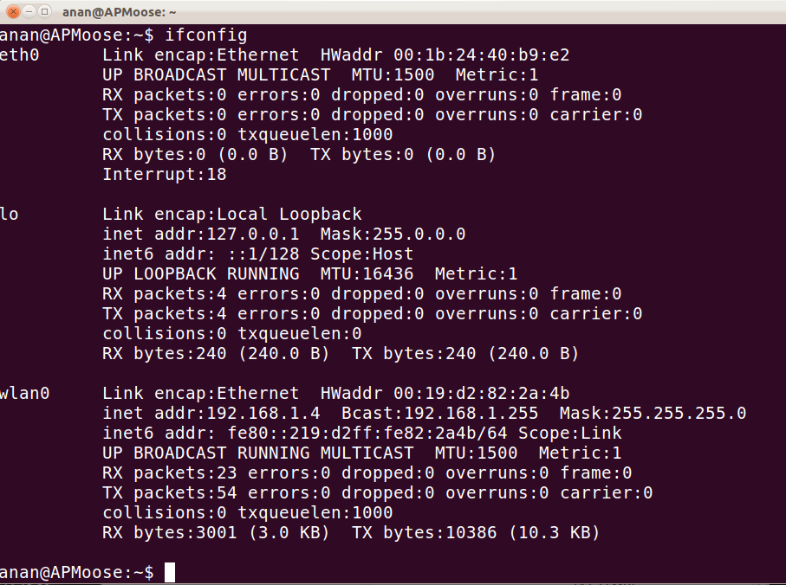
No IPv6 service available
1

Slide 3
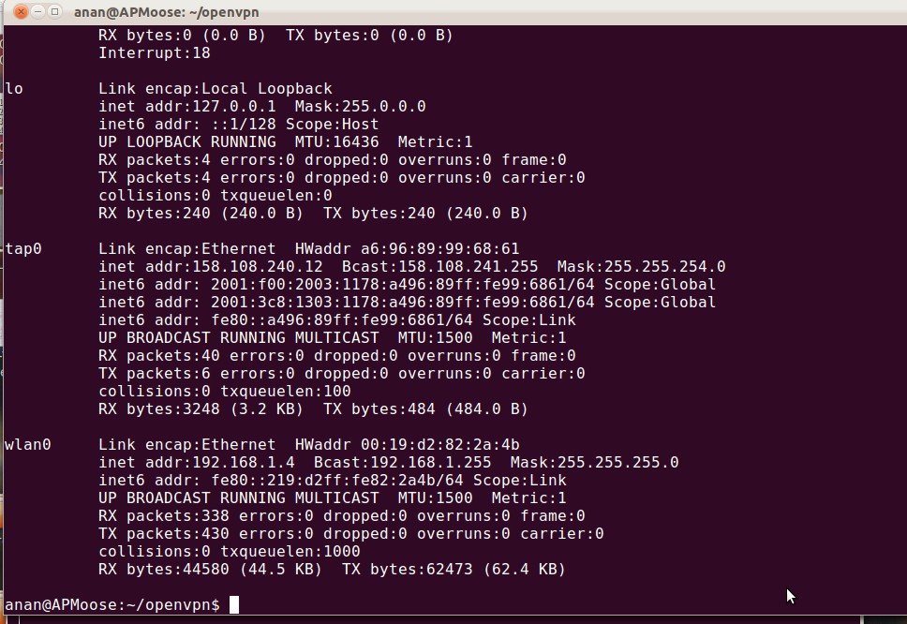
Received IPv6 prefix
1

Slide 4
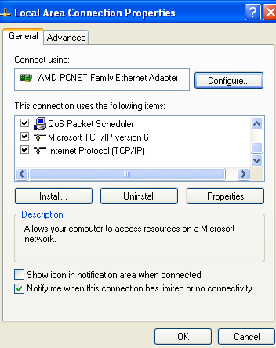
IPv6 installed (in WinXP)
1

Slide 5
Kasetsart IPv6 Address
C:\Documents and Settings\Moose> ipconfig /all
Windows IP Configuration
Host Name . . . . . . . . . . . . : moose-a083b5288 Primary Dns Suffix . . . . . . . :
Node Type . . . . . . . . . . . . : Unknown
IP Routing Enabled. . . . . . . . : No
WINS Proxy Enabled. . . . . . . . : No DNS Suffix Search List. . . . . . : ku.ac.th
Ethernet adapter Wireless Network Connection: Connection-specific DNS Suffix . : ku.ac.th
Description . . . . . . . . . . . : ORiNOCO PC Card (5 volt)
Physical Address. . . . . . . . . : 00-02-2D-B6-40-A3
Dhcp Enabled. . . . . . . . . . . : Yes
Autoconfiguration Enabled . . . . : Yes

Slide 6
Kasetsart IPv6 Address
IP Address. . . . . . . . . . . . : 158.108.133.73
Subnet Mask . . . . . . . . . . . : 255.255.248.0
Nectec : local only
IP Address. . . . . . . . . . . . : 2001:f00:2003:1164:b8e0:fc4f:9259:58a1
IP Address. . . . . . . . . . . . : 2001:f00:2003:1164:202:2dff:feb6:40a3
IP Address. . . . . . . . . . . . : 2001:3c8:1303:1164:b8e0:fc4f:9259:58a1
IP Address. . . . . . . . . . . . : 2001:3c8:1303:1164:202:2dff:feb6:40a3
IP Address. . . . . . . . . . . . : fe80::202:2dff:feb6:40a3%4
Default Gateway . . . . . . . . . : 158.108.128.1
Uninet : Route
fe80::215:c7ff:fee3:e000%4 DHCP Server . . . . . . . . . . . : 158.108.2.70
DNS Servers . . . . . . . . . . . : 158.108.2.67
Zone_ID
Address%Zone_ID
158.108.2.70
158.108.4.249
fec0:0:0:ffff::1%2 fec0:0:0:ffff::2%2 fec0:0:0:ffff::3%2
Link Local Address
Lease Obtained. . . . . . . . . . : Thursday, December 21, 2006 8:28:11AM
Lease Expires . . . . . . . . . . : Thursday, December 21, 2006 10:28:11AM
6

Slide 7
Kasetsart IPv6 Address
202:2dff:feb6:40a3
Physical Address. . . . . . . . . : 00-02-2d-b6-40-a3
202:2d
ff:fe
b6:40a3

Slide 8
Kasetsart IPv6 Address
Ethernet adapter MyTap:
Media State . . . . . . . . . . . : Media disconnected
Description . . . . . . . . . . . : TAP-Win32 Adapter V8
Physical Address. . . . . . . . . : 00-FF-21-8D-4A-E5
Ethernet adapter Local Area Connection:
Media State . . . . . . . . . . . : Media disconnected Description . . . . . . . . . . . : VIA Rhine II Fast Ethernet
Adapter
Physical Address. . . . . . . . . : 00-40-45-1C-1E-EC

Slide 9
Kasetsart IPv6 Address
Tunnel adapter Teredo Tunneling Pseudo-Interface:
Connection-specific DNS Suffix . :
Description . . . . . . . . . . . : Teredo Tunneling Pseudo-Interface Physical Address. . . . . . . . . : FF-FF-FF-FF-FF-FF-FF-FF
Dhcp Enabled. . . . . . . . . . . : No
IP Address. . . . . . . . . . . . : fe80::5445:5245:444f%7
Default Gateway . . . . . . . . . :
NetBIOS over Tcpip. . . . . . . . : Disabled

Slide 10
Kasetsart IPv6 Address
Tunnel adapter Automatic Tunneling Pseudo-Interface:
Connection-specific DNS Suffix . : ku.ac.th
Description . . . . . . . . . . . : Automatic Tunneling Pseudo-Interface
Physical Address. . . . . . . . . : 9E-6C-85-49
Dhcp Enabled. . . . . . . . . . . : No
IP Address. . . . . . . . . . . . : fe80::5efe:158.108.133.73%2
Default Gateway . . . . . . . . . :
DNS Servers . . . . . . . . . . . : fec0:0:0:ffff::1%2
fec0:0:0:ffff::2%2
fec0:0:0:ffff::3%2 NetBIOS over Tcpip. . . . . . . . : Disabled

Slide 11


IPv6 Address Allocation
 | Organization | APNIC prefixes | Services
1 | NECTEC/ThaiSarn | 2001:f00::/32 | Native, dual stack, 6to4 relay, IPv6 tunnel broker
2 | UniNet | 2001:3c8::/32 | Dual stack
3 | CAT Telecom | 2001:c38::/32 | Native, 6to4 tunnel
4 | TOT | 2001:ec0::/32 | Testing, plan for commercial DSLv6
5 | Internet Thailand | 2001:c00::/32 | Dual stack ready, few customers
6 | CS-Loxinfo | 2404:b0::/32 | Testing
7 | True Internet | 2001:fb0::/32 | Testing, 6to4 relay
8 | AIS | 2001:44c8::/32 | Testing
… | …many more… | … | … 11

