Slide 1



IPv6
2016
รศ.ดร. อนันต์ ผลเพม
Asso. Prof. Anan Phonphoem, Ph.D.
anan.p@ku.ac.th http://www.cpe.ku.ac.th/~anan Computer Engineering Department Kasetsart University, Bangkok, Thailand

Slide 2
Outline
IP Address Management
Rationale for IPv6
IPv6 Addresses

Slide 3
IP Address Management

Slide 4
Abbreviation
 | Full Name
ICANN | Internet Corporation for Assigned Names and Numbers
IANA | Internet Assigned Numbers Authority a department of ICANN responsible for allocation of globally unique names and no.
RIR | Regional Internet Registries
APNIC | Asia Pacific Network Information Center
ARIN | American Registry for Internet Numbers
RIPE NCC | Réseaux IP Européens Network Coordination Centre Europe, Middle East and parts of Central Asia
Notes:
ควรจำได้

Slide 5
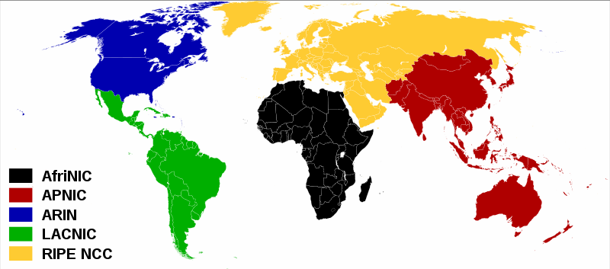
RIR World Map
http://en.wikipedia.org/wiki/IPv4_address_exhaustion

Slide 6


The early years: 1981 – 1992
IANA: Internet Assigned Numbers Authority

Slide 7
Global Routing Table: ’88 - ’92
9000
8000
7000
6000
5000
4000
3000
2000
1000
0
ก.ค.- ม.ค.- ก.ค.- ม.ค.- ก.ค.- ม.ค.- ก.ค.- ม.ค.- ก.ค.-
88 89 89 90 90 91 91 92 92

Slide 8
Global Routing Table: ’88 - ’92
100000
90000
80000
70000
60000
50000
40000
30000
20000
10000
0
Jan-89
Jan-90
Jan-91
Jan-92
Jan-93
Jan-94
Jan-95
Jan-96

Slide 9
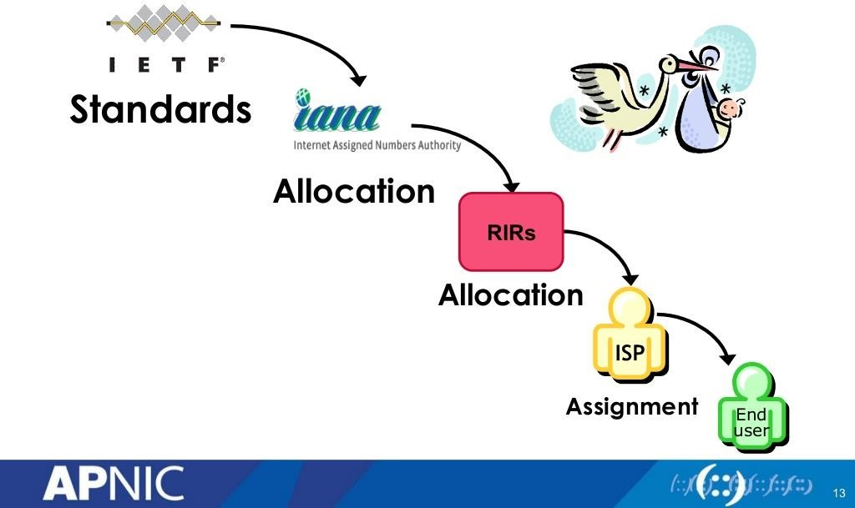
Where do IP addresses come from?

Slide 10
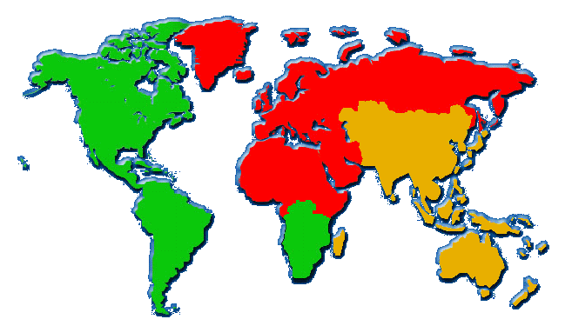



APNIC: Asia Pacific Network Info Center
ARIN: American Registry for Internet Numbers RIPE: Europe
“It has become clear that … these problems are likely to become critical within the next one to three years.” (RFC1366)
“…it is [now] desirable to consider delegating the registration function to an
organization in each of those geographic areas.” (RFC 1338)
10

Slide 11
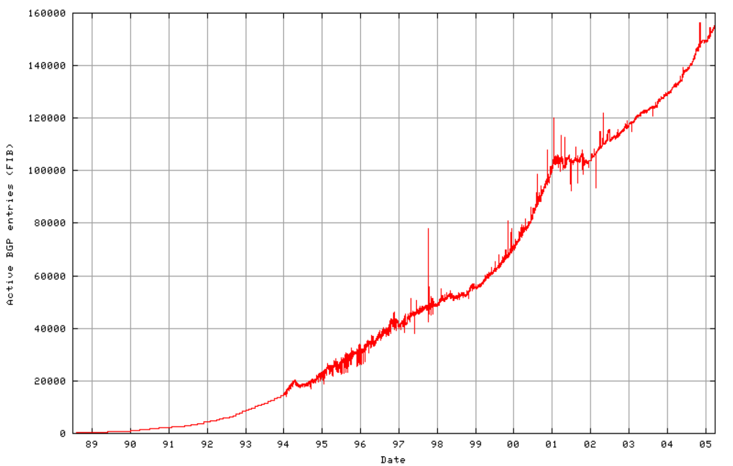
Global routing table
Sustainable growth?
“Dot-Com” boom
Projected routing table growth without CIDR
CIDR
deployment
http://bgp.potaroo.net/as1221/bgp-active.html
Notes:
BGP คือชื่อของ Routing protocol ตัวนึง การโตของ Routing table จะมหาศาล

Slide 12
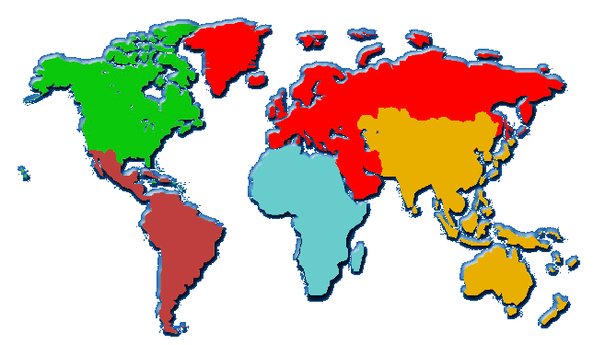





Recent years: 2002 – 2005
2004:
Establishment of the
Number Resource Organization

Slide 13
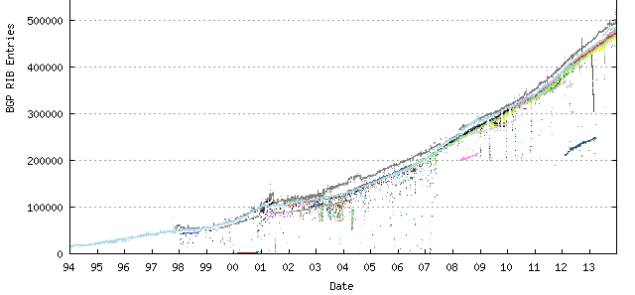
Growth of the BGP Table
1994 to Present (2013)
http://bgp.potaroo.net/
Note: Routing Information Base (RIB), also known as IP Routing Table
Forwarding Information Base (FIB), also known as IP forwarding table

Slide 14
Rationale for IPv6

Slide 15

Future of the Internet
Notes:
Internet OVERLOAD!!

Slide 16
What is wrong with IPv4 ?
Internet growth
New applications – Real time app
Network Changes
Need for corporations
Notes:
Space มีขนาดเล็ก
มีRealTimeApp ทำให้ต้องใช้ Internetสูง
รูปแบบ Network เปลี่ยนไป

Slide 17
IPv4 Exhaustion
“ Early this morning, the Asia Pacific Network Information
Centre (APNIC) announced that it had been allocated two
/8 address blocks from the Internet Assigned Numbers Authority (IANA). Those two blocks, 39/8 and 106/8, were the last unallocated blocks in the IANA free pool of IPv4 address available to Regional Internet Registries (RIR). With the allocation, the final days of IPv4 have moved closer as the number of available addresses that can be allocated will dwindle. “
Last of the IPv4 Addresses Allocated
By Sean Michael Kerner | Feb 1, 2011
http://www.enterprisenetworkingplanet.com/news/article.php/ 3923031/Last-of-the-IPv4-Addresses-Allocated.htm

Slide 18

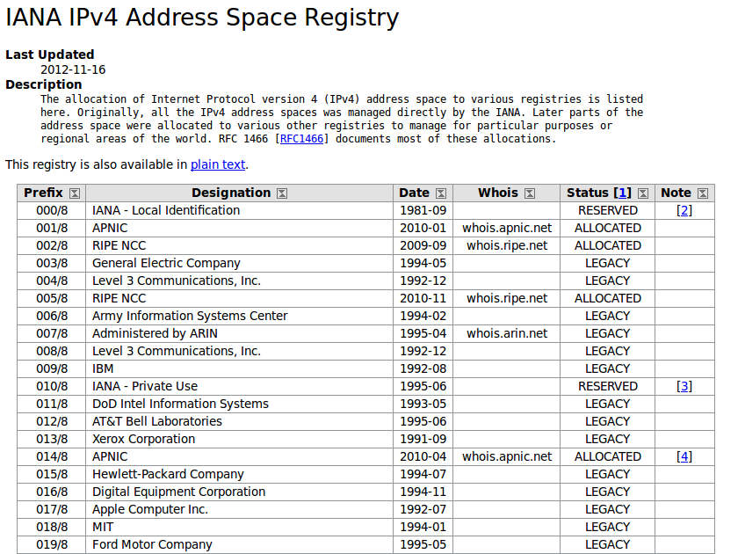
IPv4 assignment
http://www.iana.org/assignments/ipv4-address-space/ipv4-address-space.xml

Slide 19

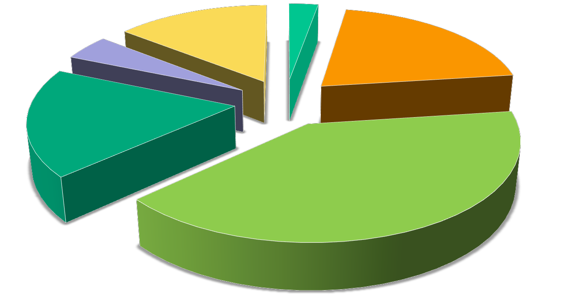
IPv4 Resource Allocations
Date: 11 Dec 2013
http://bgp.potaroo.net/iso3166/v4cc.html
AFRINIC
3%
LACNIC 5%
IANA 14%
APNIC 20%
RIPENCC 18%
ARIN
40%
APNIC: Asia Pacific Network Info Center
ARIN: American Registry for Internet Numbers RIPE: Europe
19

Slide 20
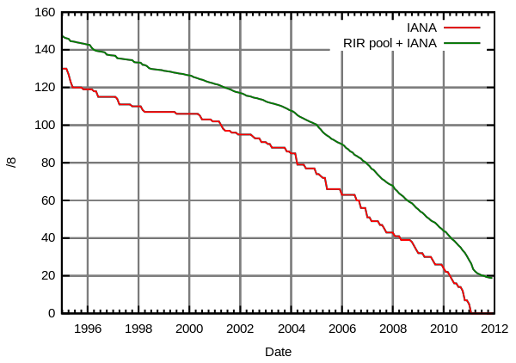
IPv4 Free/8

Slide 21




IPv6 Vision
Internet for 10 Billion nodes
Always-on Identity
Auto-Configure
Always-on Security privacy
Mobile
Notes:
ต้องเปิดตลอด
ออโต้คอนฟิค
Mobile
Secure

Slide 22
Rationale for IPv6
IPv4 address space consumption
Now ~10 years free space remaining
Unused addresses reclaimed
projection ≠ reality ➔ depleted!
Loss of “end to end” connectivity
Widespread use of NAT due to ISP policies
and marketing
Additional complexity and performance degradation
Notes:
ปัญหาของNAT คือ End to End คือไม่รู้ว่าเป็นใคร

Slide 23
The NAT
The Internet
ISP
61.100.0.0/16
61.100.32.0/25
61.100.32.128
R
NAT*
61.100.32.1 ..2
..3 ..4
10.0.0.1 ..2 ..3 ..4
*AKA(also known as) home router, ICS, firewall

Slide 24



The NAT “Problem”
Phone
Network
Internet
NAT
61.100.32.128
PABX
10 4567 9876
?
10.0.0.1
Extn 10
Notes:
ต่อจากในออกนอกไม่มีปัญหา แต่ถ้าข้างนอกต่อเข้ามามีปัญหาไม่รู้ว่าเป็นใคร

Slide 25
NAT implications
Breaks end-to-end network model
Some applications cannot work through NATs
Breaks end-end security (IPsec)
Requires application-level gateway (ALG)
new application is not NAT-aware, ALG device must
be upgraded
ALGs are slow and do not scale
Merging of separate private networks is
difficult
Due to address clashes
See RFC2993
Architectural Implications of NAT

Slide 26
IPv6 Deployment

Slide 27
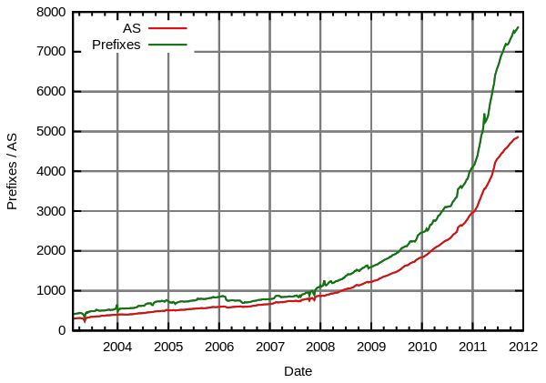
#of IPv6 prefixes and AS
http://en.wikipedia.org/wiki/IPv6_deployment
Notes:
AS = autonomus system
ชื่อโดเมน ku.ac.th
หมายเลข IP Class B 158.108.x.x
Autonomous System Number AS9411
จำนวน Host ที่รีจิสเตอร์ใน DNS ของ ku 4800 โฮส
จำนวน Sub-domain ภายใต้ 158.108.x.x 55 sub-domain
จำนวนเซิร์ฟเวอร์บริการ www ในเครือข่าย 40 เซิร์ฟเวอ

Slide 28
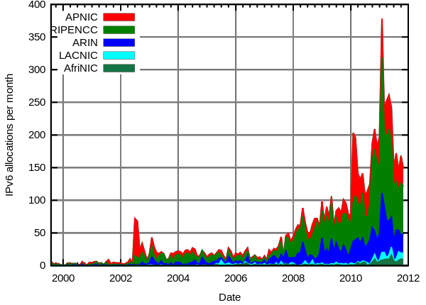
Monthly IPv6 allocations per RIR
http://en.wikipedia.org/wiki/IPv6_deployment

Slide 29
IPv6 Users by Country
Date: 11 Dec 2013
http://bgp.potaroo.net/iso3166/v6dcc.html
Index | ISO-3166 Code | Internet Users | V6 Use ratio ▴ | V6 Users (Est) | Population | Country
1 | CH | 6,544,418 | 12.48% | 816,867 | 7,681,242 | Switzerland
2 | RO | 9,710,357 | 11.16% | 1,083,365 | 22,058,968 | Romania
3 | LU | 470,292 | 10.12% | 47,607 | 517,430 | Luxembourg
4 | DE | 68,153,649 | 6.86% | 4,677,521 | 82,112,831 | Germany
5 | BE | 8,152,741 | 6.30% | 513,802 | 10,452,233 | Belgium
6 | JP | 99,409,750 | 5.98% | 5,949,484 | 125,755,535 | Japan
7 | US | 249,622,663 | 5.89% | 14,697,957 | 320,604,500 | United States of America
8 | EU | - | 5.82% | - | - | European Union
9 | PE | 11,208,101 | 5.61% | 629,291 | 31,133,616 | Peru
10 | FR | 51,908,383 | 5.41% | 2,809,229 | 65,227,926 | France
11 | SG | 3,436,691 | 3.90% | 133,939 | 4,840,411 | Singapore
12 | FJ | 280,841 | 3.46% | 9,726 | 1,003,005 | Fiji
13 | CZ | 7,415,962 | 2.45% | 181,599 | 10,163,030 | Czech Republic
14 | NO | 4,444,303 | 1.87% | 83,211 | 4,729,492 | Norway
15 | CN | 518,047,719 | 1.50% | 7,776,569 | 1,352,605,013 | China
16 | HK | 5,203,449 | 1.46% | 75,778 | 7,206,994 | Hong Kong
17 | TW | 16,697,956 | 1.33% | 221,294 | 23,191,606 | Taiwan
24 | MY | 16,892,749 | 0.77% | 129,788 | 27,693,032 | Malaysia
29 | CA | 28,793,186 | 0.40% | 115,063 | 34,690,586 | Canada
41 | TH | 16,063,362 | 0.21% | 33,615 | 67,777,901 | Thailand
29

Slide 30
Features of IPv6

Slide 31
IPv6 feature summary
Increased size of address space
Header simplification
Extended Address Hierarchy
Auto-configuration / Renumbering
QoS (Integrated/Differentiated services
IPSec (As for IPv4)
Notes:
Size เยอะขึ้น
ทำให้ Headerง่ายชึ้น

Slide 32



IPv6 addressing model
Unicast
Single interface
Anycast
Any one of several
Multicast
All of a group of interfaces
Replaces IPv4 “broadcast”
See RFC 3513
32
Notes:
คล้ายๆ IPV4 แต่เพิ่ม Anycast

Slide 33
Anycast
Assigned to more than one interface
Nodes must know that the add. is anycast add.
Addresses are from the unicast address
space
In a region, where anycast is used, each member must have its own entry in the routing table
Note: now used only for (identify) routers
Notes:
ใครก็ได้ในกลุ่มนั้นๆสามารถ ตอบแทนได้ทันที

Slide 34
IPv4 vs IPv6
IPv4: 32 bits
2³² addresses
= 4,294,967,296 addresses
= 4 billion addresses
IPv6: 128 bits
2¹²⁸ addresses?
= 340,282,366,920,938,463,463,374,607,431,770,000,000
= 340 billion billion billion billion addresses?
No, due to IPv6 address structure…

Slide 35
IPv6 header
IPv6 header is simpler than IPv4
IPv4: 14 fields, variable length (20 bytes +)
IPv6: 8 fields, fixed length (40 bytes)
Header fields eliminated in IPv6
Header Length
Identification
Flag
Fragmentation Offset
Checksum
Header fields enhanced in IPv6
Traffic Class
Flow Label
Notes:
Ipv6มีแค่ 8 field และ fix length 40 byteจะไม่มีการมา++ไรทั้งนั้น

Slide 36
IPv6 transition
Dual stack hosts
Two TCP/IP stacks co-exists on one host
Supporting IPv4 and IPv6
Client uses whichever protocol it wishes
Notes:
ต้องเตรียมพร้อมการย้ายจากv4
โดยการใช้ dual stacks คือสามารถใช้ได้ทั้งคู่

Slide 37


IPv6 transition
?
?
www.apnic.net
IPv4
Application
TCP/UDP
IPv4 | IPv6
Link
IPv6

Slide 38


IPv6 transition
IPv6 tunnel over IPv4
IPv4
Network
tunnel
IPv6
IPv6
IPv4 Header
IPv6 Header
Data
IPv6 Header
Data
IPv6 Header |  | Data
Notes:
จะพยายามส่งv6ข้าม v4ไปเลยโดยใช้เทคนิค encapsulation

Slide 39
IPv6 Addressing

Slide 40
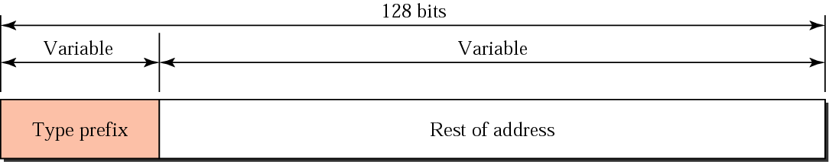
Address Structure

Slide 41
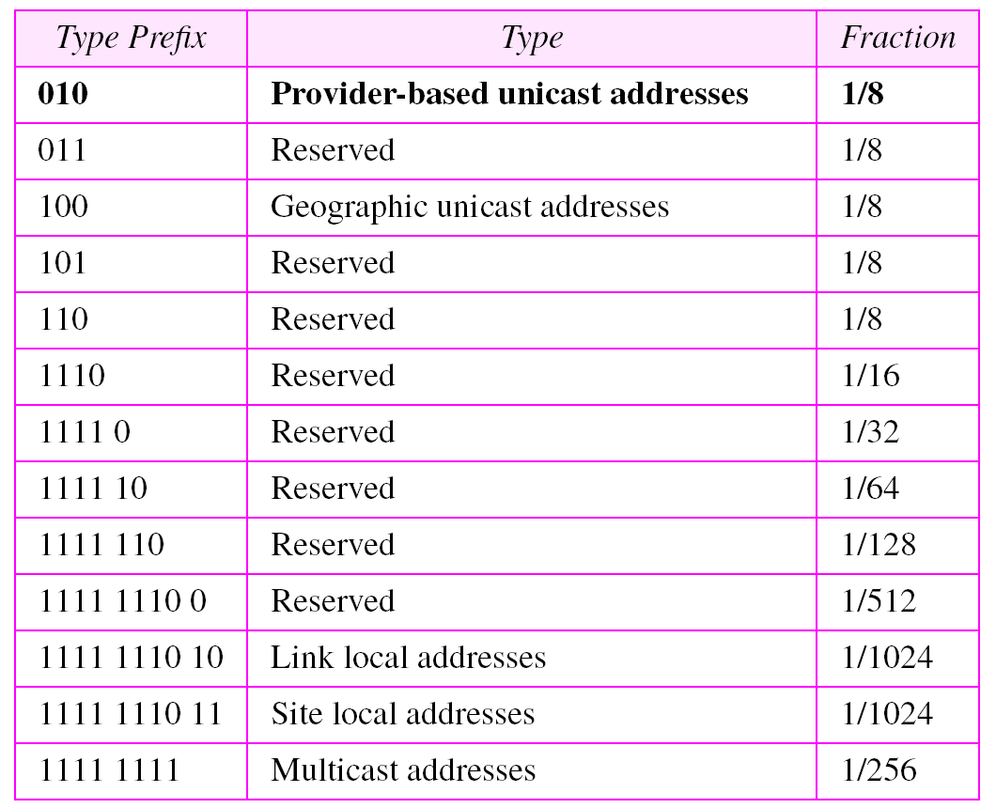
Prefix Type

Slide 42
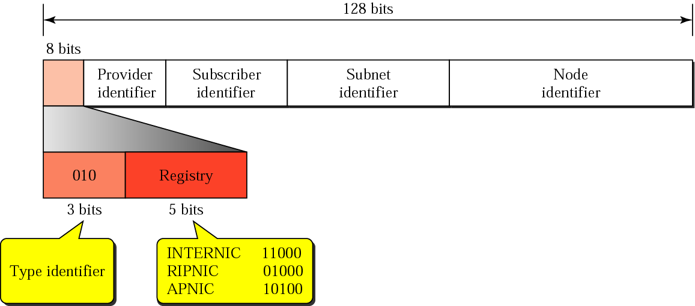
Provider-Based Unicast Address
Type ID
Registry ID
Notes:
ip แยกตามโซน

Slide 43
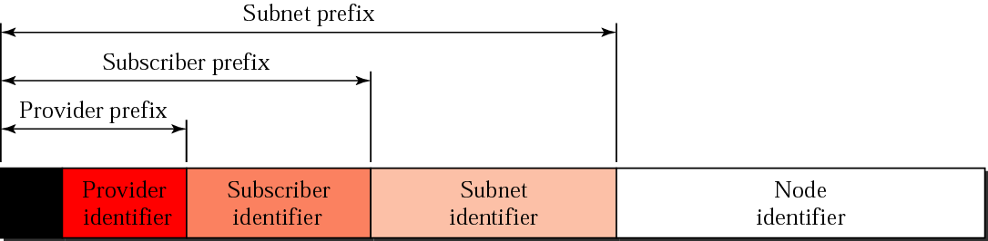
Address Hierarchy

Slide 44
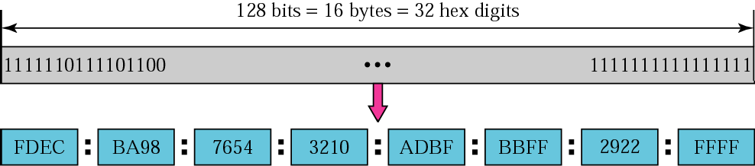
IPv6 address format
8 groups of 4 hexadecimal digits
Each group represents 16 bits
Separator is “:”
Case-independent
Notes:
ตัวเล็กตัวใหญ่ใช้ได้หมด

Slide 45
IPv6 address format
2001:0DA8:E800:0000:0260:3EFF:FE47:0001
2001:0DA8:E800:0000:0260:3EFF:FE47:0001
2001:DA8:E800:0:260:3EFF:FE47:1
2001:0DA8:E800:0000:0000:0000:0000:0001
2001:0DA8:E800:0000:0000:0000:0000:0001
2001:DA8:E800::1
Notes:
การย่อ 0
:: = 0 ทั้งแถบ
มีโคล่อนๆมากกว่า1ที่ไม่ได้

Slide 46
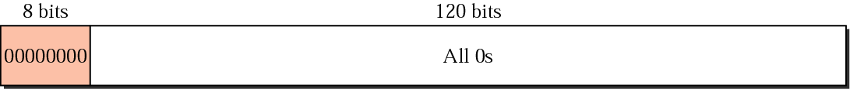
Special Address
Unspecified address
0:0:0:0:0:0:0:0 ➔ ::
Source add. (when own add. is unknown)

Slide 47
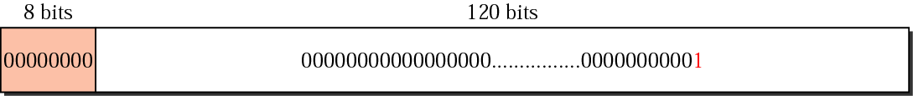
Special Address
Loopback address 0:0:0:0:0:0:0:1 ➔ ::1 For testing
Datagram is delivered to local machine
Notes:
ลูปแบ็ก ::1

Slide 48
Transition IPv4 → IPv6
2 Formats
Compatible Address
(v6host → v4net → v6host)
Mapped Address
(v6host → v6net → v4host)
Notes:
แปลงจาก v4->v6 หรือกลับกัน

Slide 49
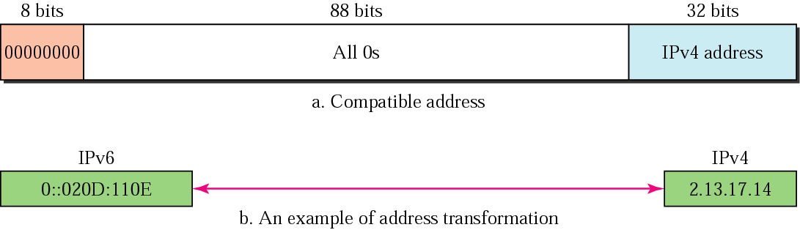
Compatible Address
(v6host → v4net → v6host)
Notes:
แมปได้ตรงๆ

Slide 50
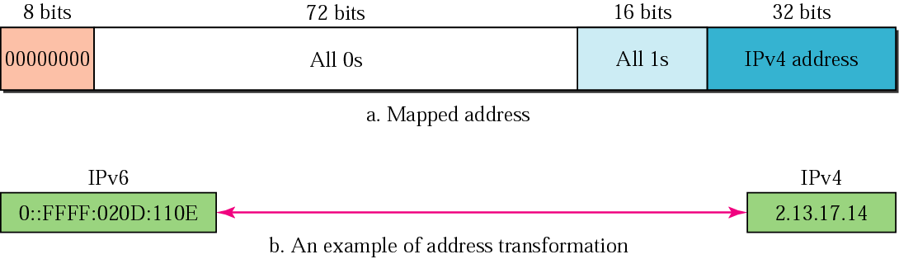
Mapped Address
(v6host → v6net → v4host)
Notes:
ต่างจากกันตรงมี 16bits 1s ด้วย

Slide 51
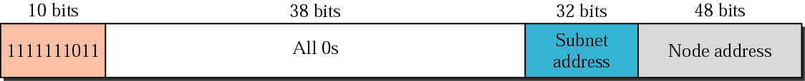
Local Address:
Site Local Address
Scope of an entire site (organization)
No public prefix required
Allow addressing within an organization
Not forward to outside (public Internet)
Similar to Private IPv4
Prefix FEC0::/10
Note: Start address with FExx:
Notes:
เปิดมาแล้วมี address ได้เลย 48 bit คือ Mac address ทำให้Uniqueเลยเปิดคอมปุปแล้วมี IP ได้เลยโดยไม่ต้องไปขอใคร
Prefix คือ FEC0::/10 มันคือ site local address ใช้ใน organization

Slide 52
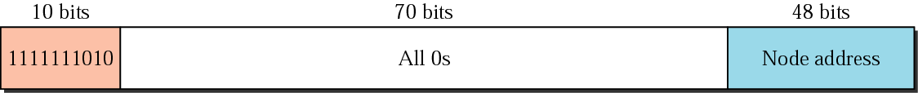
Local Address:
Link Local Address
Smaller scope than Site Local Add
Refer only to a particular physical link
Routers will not forward datagram using Link Local Add at all, not even within the organization
IPv6 Neighbor Discovery (ND)
Prefix FE80::/10
Note: Start address with FExx:
Notes:
เริ่มต้างกันนะเริ่มด้วยFExx: แล้วก็ไม่มี SubnetAddress จะไม่บอกไปทั่ว แต่จะเป็นลิ้งๆเดียวที่ต่ออยู่
Prefix FE80::/10

Slide 53
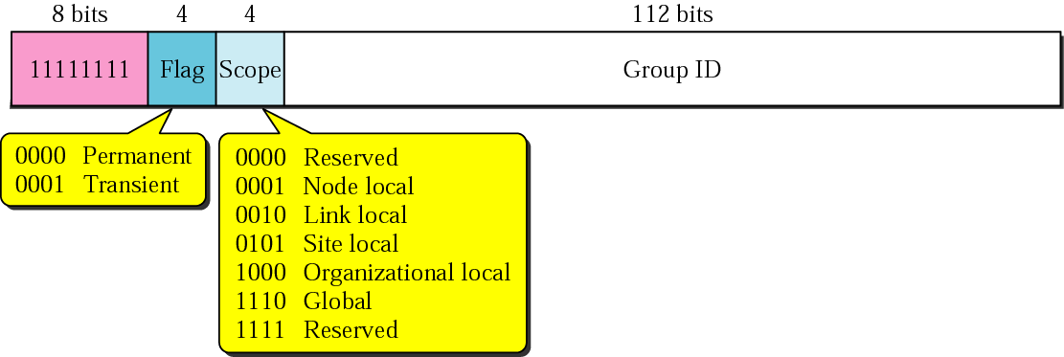
Multicast Address
Note: Start address with FFxx:
53
Notes:
FFxx = Multicast

Slide 54
Multicast
Multicast (and Anycast) built in from the Beginning
Scope more well-defined – 4 bit integer
Doesn’t influence well-defined groups
Value | Scope
0 | Reserved
1 | Node Local
2 | Link Local
5 | Site Local
8 | Organization Local
E | Global Local
F | Reserved

Slide 55
Multicast
A Few Well-Defined Groups
Note all begin with ff, the multicast addresses
Much of IGMP is from IPv4, but is in ICMP now
Value | Scope
FF02::0 | Reserved
FF02::1 | All Nodes Address
FF02::2 | All Routers Address
FF02::4 | DVMRP Routers
FF02::5 | OSPF
FF02::6 | OSPF Designated Routers
FF02::9 | RIP Routers
FF02::D | All PIM Routers

Slide 56
Obtain IP Address
Prefix 4C00::/80
+
Link Address
00:A0:C9:1E:A5:B6
=
IPv6 Address 4C00::00A0:C9:1E:A5:B6
Router Adv.
Notes:
การสร้างมาซึ่งไอพี Router ประกาศมาก่อน 4C00::/80 ก็เอา Prefix ยัดหน้า Link address ได้เลย ก็จะได้เป็นของตัวเองง่ายๆ

Slide 57
Obtain IP Address
DHCP
server
00:A0:C9:1E:A5:B6
DHCP Request
DHCP Response
4c00::00:A0:C9:1E:A5:B6
Notes:
หรือ DHCP request ไปแล้วก็รอกลับมาโดนโดนยัดหน้าให้

Slide 58
Packet Format

Slide 59
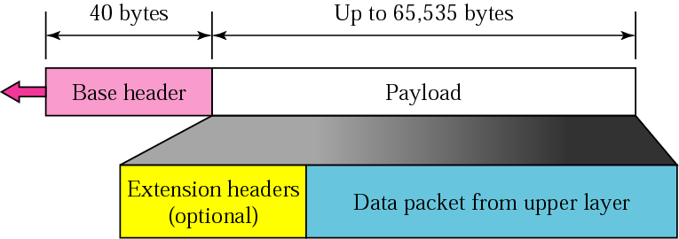
Structure of IPv6 Datagram
Base Header is fixed
40 Octets long
Options are in an extension header
Several extension headers
Notes:
Based Header จะ = 40 เสมอ

Slide 60
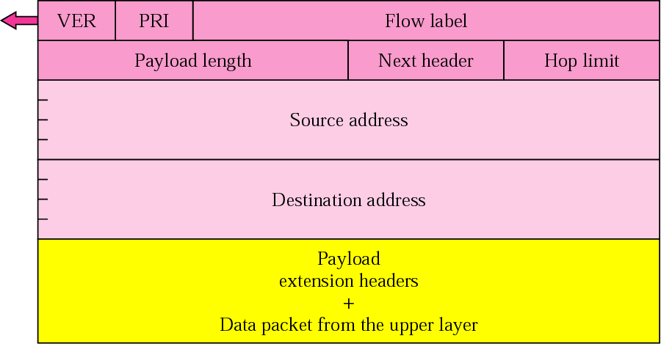
IPv6 Header

Slide 61
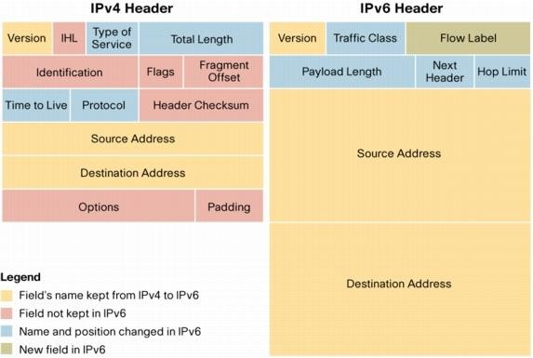
Basic Headers
http://www.cisco.com/en/US/technologies/tk648/tk872/technologies_white_paper0900aecd8054d37d.html
Notes:
Ipv6 Source des 128 bit เลยโคตรใหญ่ แต่ Header จะเล็กลงมาก

Slide 62
Basic Headers (Fields)
Version (4 bits) – only field to keep same position & name
Class (8 bits) – new field
Flow Label (20 bits) – new field
Payload Length (16 bits) – length of data, slightly different from total length
Next Header (8 bits) – type of the next header, new idea
Hop Limit (8 bits) – was time-to-live, renamed
Source address (128 bits)
Destination address (128 bits)

Slide 63
Header Simplification
Fixed length of all fields, not like old options field
Remove Header Checksum – rely on checksums at other layers
No hop-by-hop fragmentation – fragment offset
irrelevant – MTU discovery
Add extension headers – next header type (sort of a protocol type, or replacement for options)
Basic Principle: Routers along the way should do minimal processing
Notes:
ความง่ายขึ้น
Fix length
ถ้ามันพลาดช่างมันดิ
จะไม่มีการเกิดแบ่งข้อมูลอีกแล้วทำให้ไม่เกิด Fragment
มีการเพิ่ม Extension header
อ่านให้น้อยที่สุด อะไรไม่จำเป็นโยน extension

Slide 64
Extension Headers
How do we know whether or not we have an upper layer header, or an extension header?
Both are combined into header types
Notes:
แล้วรู้ได้ยังไงว่ามันมีextensionรึเปล่า

Slide 65
Header Types
Look in packet for Next Header
Can be Extension Header
Can be something like ICMP, TCP, UDP, or
other normal types
Notes:
เลยมี Header Types ให้เพื่อบอกว่าต่อไปเป็น Type อะไร

Slide 66
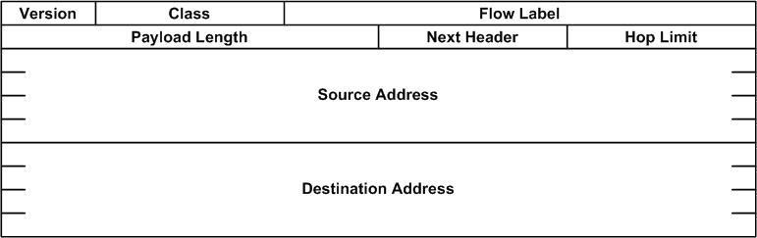
Header Type
(Next Header)
คา่ | รหสยอ่ | ชนิด
0 | HBH | Hop-by-Hop Options Header
6 | TCP | Tranmission Control Protocol
17 | UDP | User Datagram Protocol
43 | RH | Routing Header
44 | FH | Fragmentation Header
45 | IDRP | Inter-Domain Routing Protocol
51 | AH | Authentication Header
52 | ESP | Encrypted Security Payload
59 | Null | No Next Header
Notes:
ถ้านอกจาก 6 กับ 17 แสดงว่ามี extension header แล้ว

Slide 67


Extension Headers Types
Base Header | Extensions | TCP/UDP | Data
Routing Header (RH-43)
Fragmentation Header (FH-44)
Hop-by-Hop Options Header (HBH-0)
Destinations Options Header (60)
Authentication Header (AH-51)
Encrypted Security Payload Header (ESP-52)

Slide 68
Extension Headers:
1. Routing Header (RH-43)
Version | Traffic class |  |  | Flow Label
Payload Length |  |  |  |  | Next Hdr : 43 |  | Hop Limit
Source Address
Destination Address
Next Hdr : 6 |  | Hdr Len | Other fields
Routing
Notes:
Next header -> 43 แปลว่าตัวถัดไปเป็น Routing header
Next header -> 6 คือ TCP คือตัว ถัด ถัด ไปอีก
เทคนิกพวกนี้สรุปแล้วคือ Linked-list

Slide 69
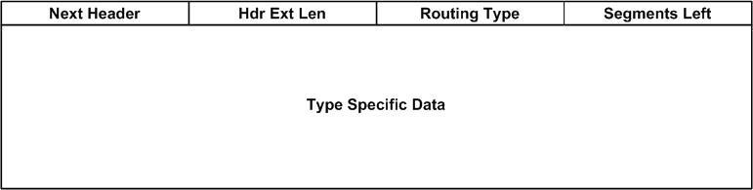
Extension Headers
General Routing Header

Slide 70
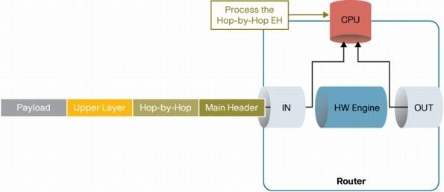
Forwarding IPv6 Packets
with the Hop-by-Hop Extension Header
The Hop-by-Hop Extension Header is the ONLY EH that MUST be
fully processed by all network devices
http://www.cisco.com/en/US/technologies/tk648/tk872/technologies_white_paper0900aecd8054d37d.html
Notes:
HBH เป็นประเภทเดียวที่จะถูกส่งไป cpu ประมวลผลเลยแล้วส่งออก
แต่ถ้าไม่ใช่ มันจะไม่ส่งไป cpu แต่จะส่งออกไปเลย เพราะ V6 ต้องส่งให้ไวที่สุด โดยจะยกเว้นให้ HBH อันเดียวเท่านั้น

Slide 71
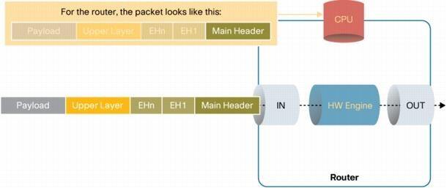
Forwarding IPv6 Packets
with the other Extension Headers
Network devices are not required to process any of the other IPv6 extension headers when simply forwarding the traffic
http://www.cisco.com/en/US/technologies/tk648/tk872/technologies_white_paper0900aecd8054d37d.html

Slide 72
Extension Headers:
2. Fragmentation Header (FH-44)
“I thought we don’t fragment?”
Can do at the sending host
Insert fragment headers

Slide 73
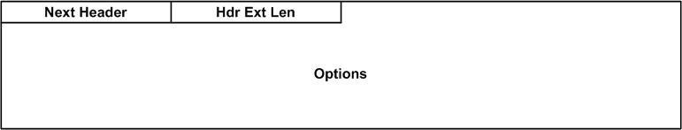
Extension Headers
Options Headers in General
The usual next header and length
Any options that might be defined

Slide 74
Extension Headers:
3. Hop-by-Hop Extension Header (HBH-0)
The usual format of an options header
An example is the jumbo packet
Payload length encoded
Can’t be less than 65,535
Can’t be used with fragmentation header

Slide 75
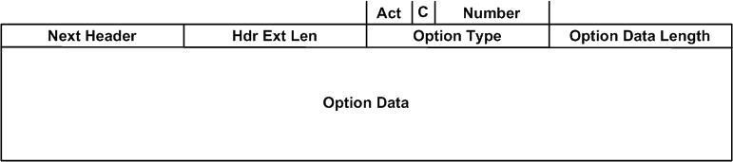
Extension Headers:
Destinations Options Header(60)
Act – The Action to take if unknown option
00 – Skip Over
01 – Discard, no ICMP report
10 – Discard, send ICMP report even if multicast
11 – Discard, send ICMP report only if unicast
C – Can change in route
Number is the option number itself

Slide 76
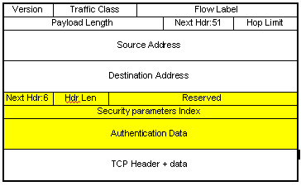
Extension Headers:
5. Authentication Header (AH-51)

Slide 77
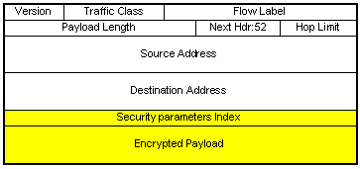
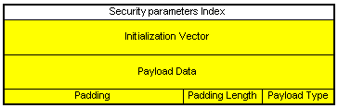
Extension Headers:
6. Encryption Header (ESP-52)

Slide 78
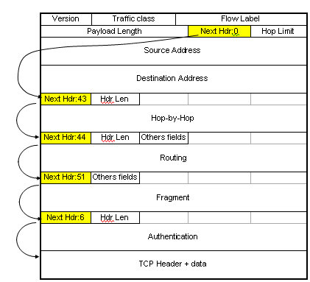
Address Chain

Slide 79
Extension Header Order
Hop-by-Hop options Header
Destination options Header (1)
Routing Header
Fragment Header
Authentication Header
Destination Options Header (2)
Upper Layer Header, e.g. TCP, UDP

Slide 80
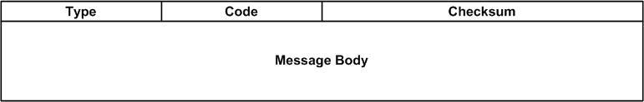
ICMP
Completely Changed – note new header type
Now includes IGMP
Types organized as follows
1 – 4 Error messages
■ 128 – 129 Ping
130 – 132 Group membership
133 – 137 Neighbor discovery
General Format

Slide 81


ICMP
Type | Description
1 | Destination Unreachable
2 | Packet Too Big
3 | Time Exceeded
4 | Parameter Problem
128 | Echo Request
129 | Echo Reply
130 | Group Membership Query
131 | Group Membership Report
134 | Router Advertisement

Slide 82
ICMP
Error Messages (Types 1 – 4): Examples
Destination Unreachable
Code 0 – No route to destination
Code 1 – Can’t get to destination for admin. reasons
Code 2 – Address unreachable
Code 3 – Port Unreachable
Packet Too Big
Code 0, Parameter is set to MTU of next hop
Allows for MTU determination

Slide 83
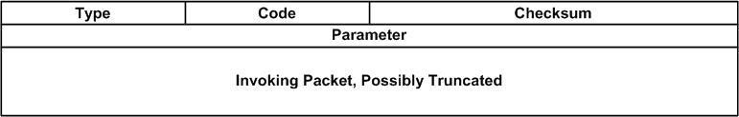
ICMP General Format

Slide 84
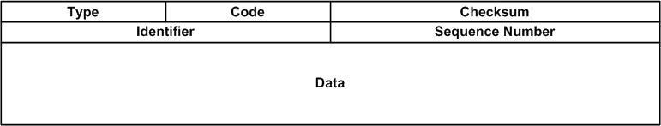
ICMP
Ping
Similar to IPv4
Echo Request, set code to 0
Echo Reply sent back
General Format

Slide 85
Changes from IPv4 to IPv6
Expanded addressing capabilities
Header format simplification
Improved support for extensions and options
Flow labeling capability
Authentication and privacy capabilities
Notes:
สรุป ข้อเปลี่ยนแปลง
-Expanded address
-ทำให้ง่ายง จาก 14 field -> 8
-มีการใส่เป็น extesion แทน
-มีflow label
ขมี autth

Slide 86
IPv6 Address Structure

Slide 87


IPv6 address structure
/0 /64
Topological Interface
/128
128
bits
Infrastructure
Site
/0
/48
/64
ISP |  |  |  |  | Customer
Infrastructure
/0 /32
Current ISP allocation (min) is /32
Providing 2¹⁶ = 65,536 customer site addresses
ISP allocation can be larger and can increase
Each site address is /48
Providing 2¹⁶ = 65,536 subnet addresses
/48
Notes:
Isp ที่ไปขอจะได้ site 2^16 แต่ละไซด์ได้อีก 2^16 ดูรูปๆ v
มี128 แบ่งให้ 64 แล้วแบ่งให้ 48 แล้วเครื่องเราใช้/48

Slide 88

IPv6 – ISP addressing
Every ISP receives a /32 (or more)
Providing 65,536 site addresses (/48)
/32
/32
/32

Slide 89

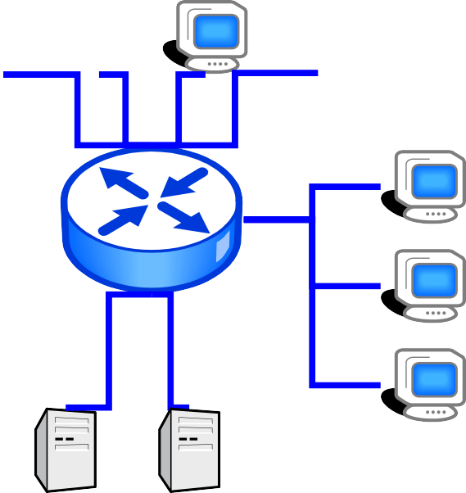


IPv6 – Site addressing
Every “site” receives a /48
Providing 65,536 /64 (LAN) addresses

Slide 90




IPv6 – LAN addressing
Every LAN segment receives a /64
Providing 2⁶⁴ interface addresses per LAN
/64

Slide 91
IPv6 – Device addressing
Every device interface receives a /128
May be EUI-64 (derived from interface MAC address), random number (RFC 3041), autoconfiguration, or manual configuration
/128
/128
/128
/128

Slide 92
References
“Tutorial - IPv6 Address Management” by Paul Wilson,
Director General, APNIC
“IPv6 Tutorial/Workshop” by Rick Summerhill, Great Plains Network, and Dale Finkelson, U of Nebraska at Lincoln
“IPv6 21st Century Internet” by IPv6 Forum
“IPv6 Education and Deployment Efforts in Japan” by
Takashi Arano, NTT Communications

