Slide 1



Routing II
รศ.ดร. อนันต์ ผลเพ่ม
Asso. Prof. Anan Phonphoem, Ph.D.
anan.p@ku.ac.th http://www.cpe.ku.ac.th/~anan Computer Engineering Department Kasetsart University, Bangkok, Thailand

Slide 2
Outline
Intermediate-System to Intermediate- System (IS-IS)
Border Gateway Protocol (BGP)
IPv6 Routing

Slide 3
IS-IS
Intermediate-System to Intermediate-System
(IS-IS)
Integrated IS-IS (Support both TCP/IP and Connectionless Network Protocol: CLNP)
Link State routing protocol
Terminology
End systems (ES) → Host
Intermediate System (IS) → Router

Slide 4
Timeline OSPF and IS-IS
1985 | Originated by DEC phase V
1987 | IS-IS (from DEC) selected by ANSI as OSI intradomain protocol (CLNP only)
1988 | OSPF work begins, loosely based on IS-IS
1989 | OSPF v.1 RFC published IS-IS becomes ISO proposed standard
1990-1991 | Dual-mode IS-IS RFC published; OSPF v.2 RFC published
1992 | Most run OSPF (Very few deploy IS-IS)
1994 | Large ISPs need an IGP; IS-IS is recommended
1995 | ISPs begin deployment of IS-IS (popular)
1996-1998 | many ISPs switch from OSPF to IS-IS
1998-2000 | many extensions for both protocols
http://www.nanog.org
4

Slide 5
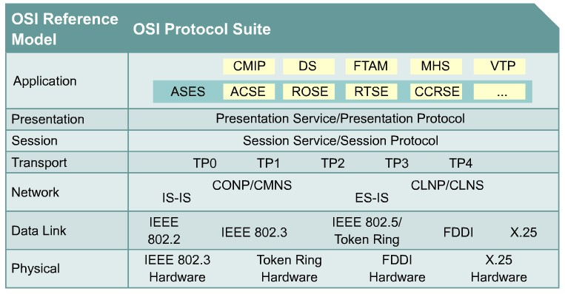
OSI: Two Network Services, Two Network Protocols

Slide 6
OSI: Two Network Services,
Two Network Protocols
CMNS (Connection Mode Network Service)
Requires establishment of a path @transport layer
CONP (Connection-Oriented Network Protocol)
CLNS (Connectionless Network Service)
Datagram support, No circuit establishment
CLNP (Connectionless Network Protocol)

Slide 7
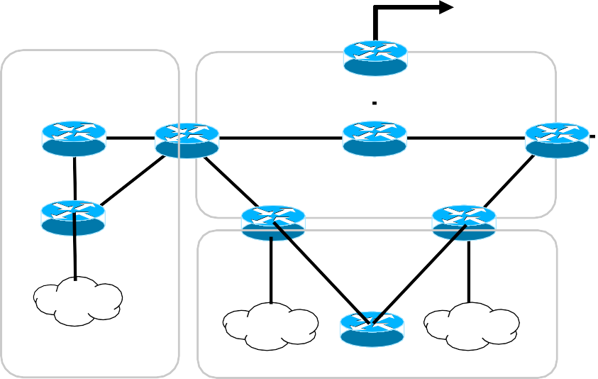
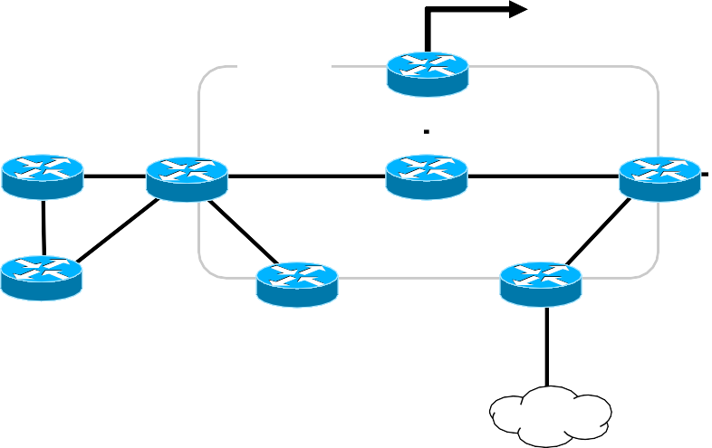
IS-IS Routers
เชอ่่ืื มไปยงัั ระบบอ
พน้ื ท่ี 1
พน้ื ท่ี 1
พื้นที่1
พน้ื ท่ี 0
พน้ื ท่ี 0
Level 1 IS (L1 IS, router)
Analogous to OSPF Internal non-backbone router (Totally Stubby)
Responsible for routing to End System (ES) inside an area.
Level 2 IS (L2 IS, router)
พน้ื ท่ี 0
R1
R7
R2
R3
R4
R5 R6
R8
N8
R9
N5
N6
พน้ื ท่ี 2
พน้ื ท่ี 2
พน้ื ท่ี 2
Analogous to OSPF Internal Backbone router
Responsible for routing between areas
Level 1 and 2 IS (L1-L2 IS, router)
Analogous to OSPF Area Border Router (ABR router)
Participate in both L1 intra-area routing and L2 inter-area routing.
Notes:
Level ต่างกัน คือคนละประเภท มีสามรูปแบบ ใน ไอซิสจะต้องทำตัวเป็น1in3นี้แหละ
L1เป็นstub จะคุยกันกับ l1 เท่านั้น
L2 เป็นเหมือนกับrouterที่ไว้ต้อข้าม area
L1&L2

Slide 8
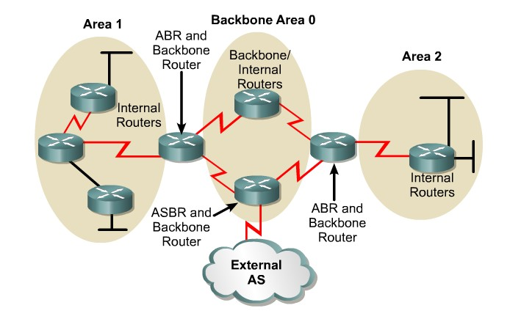
OSPF Area
ABR: Area Border Router
ASBR: Autonomous System Border Router
8
Notes:
Area 0 คือ Backbone

Slide 9






IS-IS Area
AS 193
L1 Area 2
L1/L2
L1 Area 1
L1/L2
L1/L2
L1/L2
L1 Area 3
AS 23
L2 Area 0
Like ABR
in OSPF
AS 44
Notes:
L1/L2 คือชนิด L1/L2 คุยทั้งในและนอก Area
L2ก็L2ไงคุยแต่ใน area 0 Backbone
L1ก็L1ไงอย่าโง่ดิ คุยได้แต่ข้างใน

Slide 10
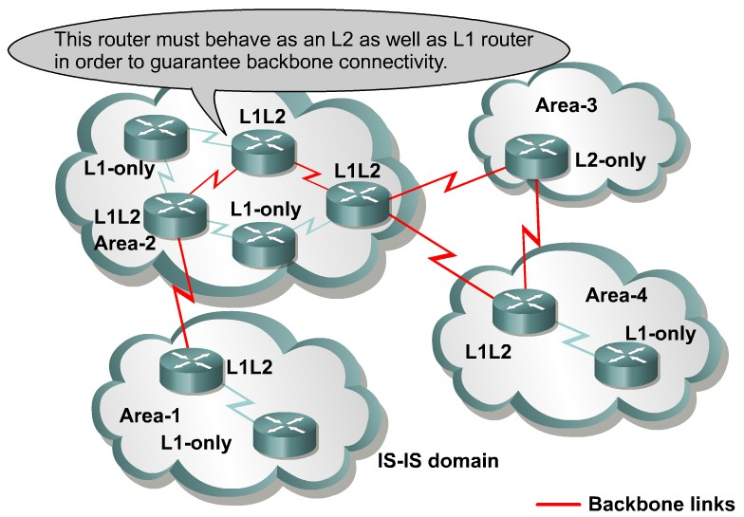
IS-IS Area
Notes:
เป็นหน้าที่ทำให้ดูง่ายขึ้น อย่าง Area-3 เอาไว้ต่อกับข้างนอกอย่างเดียวเลยเป็น L2
อย่างแรกต้อง Identify ให้ได้ L1 L2 L1/L2

Slide 11
Data Encapsulation & Addressing
IS-IS messages are not carried in IP datagrams
Message called Protocol Data Units (PDU)
Encapsulated directly in Data Link Layer frames
SNPA (Subnetwork Point of Attachment)
→ Data Link Address
Notes:
ไอซิสเหมาะกับipv6

Slide 12
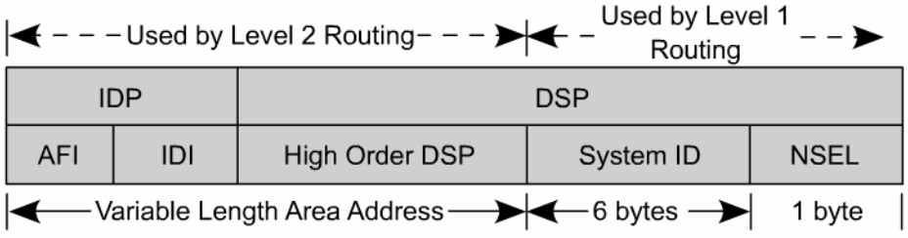
IS-IS address format
NSAP
Hierarchical Address
IDP: Initial Domain Part
DSP: Domain Specific Part
OSI network layer addressing is done through
the NSAP (Network Service Access Point)
Represented in hexadecimal (up to 40 hex digits)

Slide 13
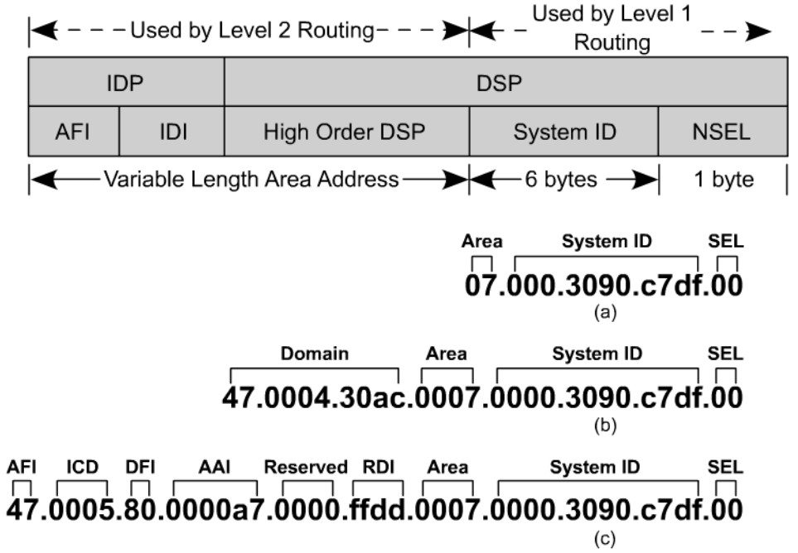
IS-IS address format
L2
L1
Variable Length Add.
Cisco format: Area – System ID – NSEL (always 00 on ISs) 49.0001.2222.2222.2222.00
Notes:
รูปแบบของ Address ไอซิส

Slide 14
NSAPs – Cisco Format
NSAP
Area – System ID – NSEL
49.0001.2222.2222.2222.00
Area
Add. starting with 49 (AFI=49) are considered private IP add.
Routed by IS-IS
Should not be advertised to other CLNS networks (outside this IS-IS domain)
Additional 2 bytes (HODSP) added for the area ID
All routers in the same are must have the same area add.

Slide 15
NSAPs – Cisco Format
NSAP
Area – System ID – NSEL
49.0001.2222.2222.2222.00
System ID
Same no. of bytes throughout the domain. Cisco fixes@ 6 bytes.
Customary can be
MAC address from the router
IP address of loopback interface
■ 192.168.111.3 -> 192.168.111.003 -> 1921.6811.1003
Each device (IS and ES) must have a unique System ID within the area.

Slide 16
NSAPs – Cisco Format
NSAP
Area – System ID – NSEL
49.0001.2222.2222.2222.00
NSEL (NSAP Selector)
NSEL is a service identifier like port or socket in TCP/IP.
Not used in routing decisions.
NSEL = 00 means the device itself (the network level address)
The NSAP with a NSEL = 00
◉ is known as a Network Entity Title (NET)
Notes:
สรุปเลย คือแยกเป็นสามส่วน Area System ID NSEL โดยFix NSEL ไว้

Slide 17
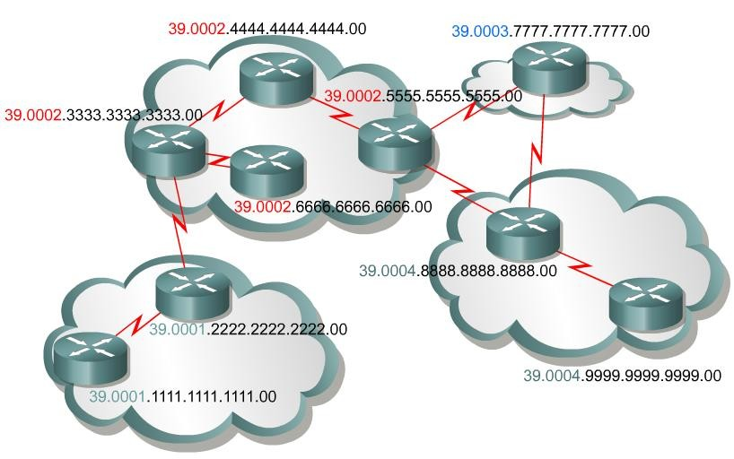
NSAP (NETs)
Example: NSAP 39.0002.aaaa.bbbb.cccc.00
Area ID is 39.0002
System ID is aaaa.bbbb.cccc (4444.4444.4444)
NSAP selector byte is 00
Notes:
39.0002 คือArea ใน39.0002
aaaa.bbbb.cccc คือเลขข้างใน แล้วตามท้ายด้วย 00เสมอ

Slide 18
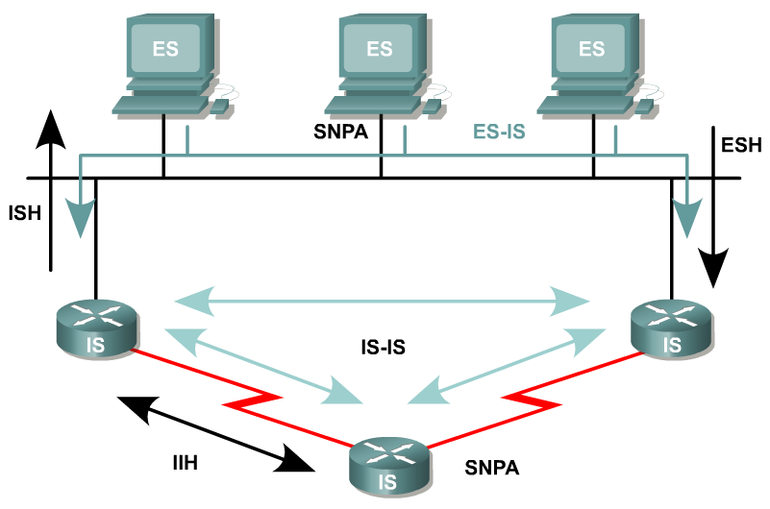
Network Representation
Broadcast
Point-to-Point
In OSI, only two main types of physical links:
Broadcast: usually LANs
Nonbroadcast: Point-to-Point, Multipoint, and dynamically
established links (WAN links)
Thus, IS-IS supports only
Broadcast (LAN) and Point-to-Point (for all other media)

Slide 19
Hello Message
To establish adjacencies with other routers (ISs) and ESs
Uses Hello PDUs.
3-type of Hello PDUs:
ESH, sent by ES to an IS
ISH, sent by IS to an ES
IIH, used between two ISs (normally transmitted every 10 seconds)
Notes:
End system จะมีรูปแบบการคุยที่ต่างๆกันไป

Slide 20




Synchronization and Update Process
If PSNP not received, resends LSP
LSP: Link State PDU
PSNP: Partial Sequence Number PDU
Notes:
พอขาดกะจะเชื่อมไปอีกอัน ถ้าไม่ได้รับก็ resend

Slide 21
IS-IS Routing Process
Divided into four stages:
Update process
Decision -- Uses Dijkstra’s algorithm to
build a SPT (Shortest Path Tree)
Forwarding -- forwarding table
Receive

Slide 22
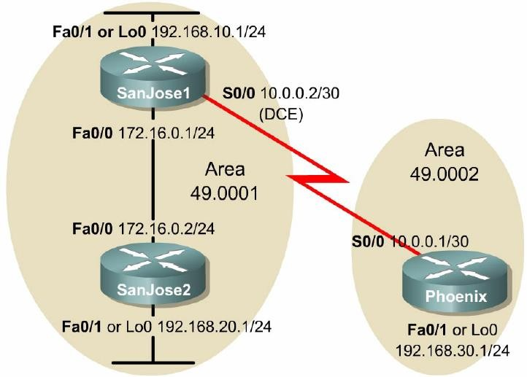
Example: IP route @ SanJose1
L1/L2
SanJose1#show ip route
Gateway of last resort is not set
i L2 192.168.30.0/24 [115/20] via 10.0.0.1, Serial0/0
C
192.168.10.0/24 is directly connected, FastEthernet0/1 172.16.0.0/24 is subnetted, 1 subnets
C
172.16.0.0 is directly connected, FastEthernet0/0
i L1 192.168.20.0/24 [115/20] via 172.16.0.2, FastEthernet0/0
10.0.0.0/30 is subnetted, 1 subnets
C
10.0.0.0 is directly connected, Serial0/0
Notes:
ช่วงนี้หลุดๆนะ ในข้อสอบให้มาแล้วให้เขียน routing table หรือให้วาดรูป
จะได้เป็น I L1 หรือ L2 ขึ้นมา

Slide 23
Example: IP route @ SanJose2
L1/L2
SanJose2#show ip route
Gateway of last resort is 172.16.0.1 to network
0.0.0.0
i | L1 | 192.168.10.0/24 [115/20] via 172.16.0.1, FastEthernet0/0
 |  | 172.16.0.0/24 is subnetted, 1 subnets
C C |  | 172.16.0.0 is directly connected, FastEthernet0/0 192.168.20.0/24 is directly connected, FastEthernet0/1 10.0.0.0/30 is subnetted, 1 subnets
i | L1 | 10.0.0.0 [115/20] via 172.16.0.1, FastEthernet0/0
i*L1 0.0.0.0/0 [115/10] via 172.16.0.1, FastEthernet0/0
Notes:
การset default route บรรทัดสุดท้ายให้ไปที่ 172.16.0.1
ต่อให้มาจาก Areaอื่นแต่ถ้าต้องผ่านในareaตัวเองกอ่นก็จะเป็น L1

Slide 24
Example: IP route @ Phoenix
L1/L2
Phoenix#show ip route
Gateway of last resort is not set
C
192.168.30.0/24 is directly connected, FastEthernet0/1
i L2 192.168.10.0/24 [115/20] via 10.0.0.2, Serial0/0
172.16.0.0/24 is subnetted, 1 subnets
i L2
172.16.0.0 [115/20] via 10.0.0.2, Serial0/0
i L2 192.168.20.0/24 [115/30] via 10.0.0.2, Serial0/0
10.0.0.0/30 is subnetted, 1 subnets
C
10.0.0.0 is directly connected, Serial0/0
24

