Slide 1



Multiprotocol Label Switching
(MPLS)
รศ.ดร. อนันต์ ผลเพ่ม
Asso. Prof. Anan Phonphoem, Ph.D.
anan.p@ku.ac.th http://www.cpe.ku.ac.th/~anan Computer Engineering Department Kasetsart University, Bangkok, Thailand
1
Notes:
ไปฟังทั้งสไลด์เลย

Slide 2
Outline
Motivation
MPLS Basics
Operation
Protocol Stack Architecture
Advantages and Disadvantages
2

Slide 3
Motivation
IP
ATM
MPLS positioning
3

Slide 4
Internet Protocol (IP)
IP is here and everywhere
De facto protocol for global Internet
Disadvantages
connectionless (e.g. no QoS)
independent forwarding decisions based on IP
large IP header (at least 20 bytes)
routing in Network Layer (Slower than Switching)
Usually shortest path (not concern other metrics)
4
Notes:
Routing ใน network layer ช้ากว่า switching

Slide 5
Asynchronous Transfer Mode
(ATM)
5

Slide 6
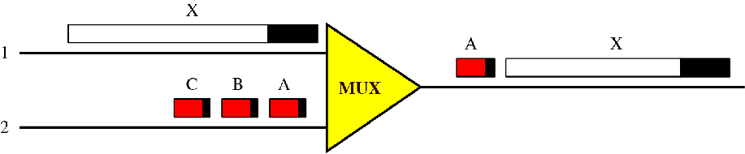
Packet Sizes in the Network
traffic unpredictable
Slow and expensive
Delay variation
6
Notes:
เรื่อง packet size เป็นหลัก มันไม่มีทางการันตีได้เลยว่าจะส่งไม่ส่ง
เป็นหลักการของ ATM Traffic ที่ช้าหลากๆหลายทำไงให้มันเท่าๆกันหมด
Jitter = delay variation

Slide 7
Voice Transmission
If introduce large packet size for voice
Cannot tolerate long delay, large jitter
Echo problem
echo cancellation does not work (long delay)
To support voice
Small packet
fixed-size packet
Called “Cell” ➔ ATM cell
7
Notes:
ถ้ามีความยาว5วิ 10นาที 1ชัว่โมงเงี้ยแปลว่ามัน vary ขนาดมากๆเลยเกิดปัญหา

Slide 8
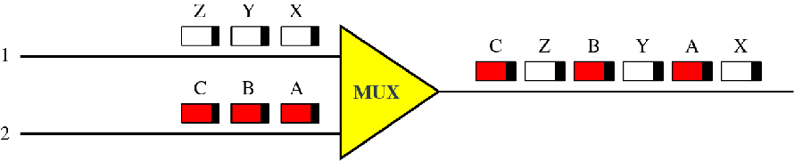
Multiplexing using cells
Advantages of cells
Fair delay
high speed and cheap (switching and multiplexing -> HW)
8
Notes:
เลยทำการ fix size เป็น cellทำให้แบ่งกันไปได้
เร็วเพราะไม่ต้องอ่าน packet size เลยเพราะ size fix อยู่แล้ว

Slide 9
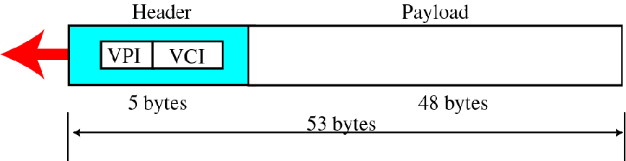
An ATM cell
VPI: Virtual Path Identifier VCI: Virtual Circuit Identifier
9
Notes:
Header เลยเหลือนิดเดียวด้วย fix size 53 B
ในหัวก็เลยมีแค่ VPI VCI

Slide 10
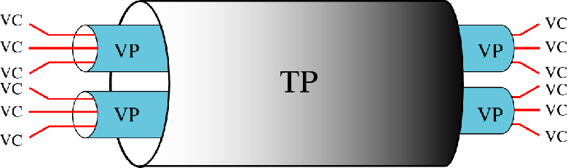
TP, VPs, and VCs
TP: Transmission Path VP: Virtual Path
VC: Virtual Circuit
10 of 39
Notes:
TP>VP>VC แต่ทั้งหมดทั้งมวลนี้คือ Virtual circuit

Slide 11
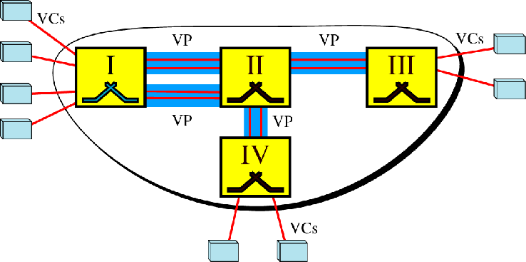
Examples of VPs and VCs
11 of 39
Notes:
ที่ปลายทาง switch VC ที่กลางทาง switch VP อย่างเดียว

Slide 12
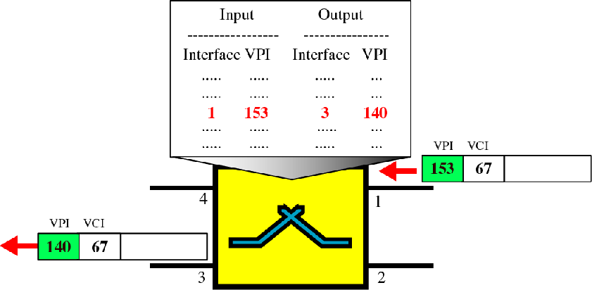
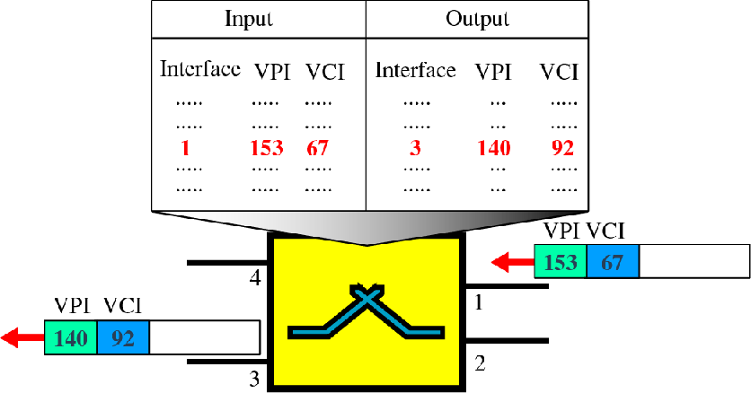
ATM Switching
Forwarding Table
VP switch (use only VPI)
* Most switches
VPC switch (use both VPIs and VCIs)
* Boundaries switches

Slide 13
Connection oriented (Supports QoS)
ATM
Fast packet switching
fixed length packets (cells)
Integration of different traffic types
voice, data, video
Disadvantages
Complex
Expensive
Not widely adopted
Notes:
ข้อเสียคือถ้าไฟล์ใหญ่ๆมันส่งได้ทีละนิดเลยต้องส่งเยอะ
ATM จากไป

Slide 14




MPLS Positioning
Combine the forwarding algorithm used
in ATM with IP
Packet Forwarding
Hybrid
Virtual Circuit Switching
IP
MPLS
ATM
Notes:
MPLS เป็น hybrid

Slide 15
MPLS Overview
Switch data according to its Label (tag)
look up in table
determine next hop
substitute new label
Do not pay attention to
network and transport protocols
➔ Multiprotocol
Switching for IP and non-IP
Signaling protocol based on IP
Notes:
ดู LABEL เอาเลยแล้ว Switching แทนทำให้โคตรไว ไม่สนใจ transport layer ทำหน้าที่แค่แปะหัวไรมา ตบไปทางนั้นเลย

Slide 16
Outline
Motivation
MPLS Basics
Operation
Protocol Stack Architecture
Advantages and Disadvantages

Slide 17
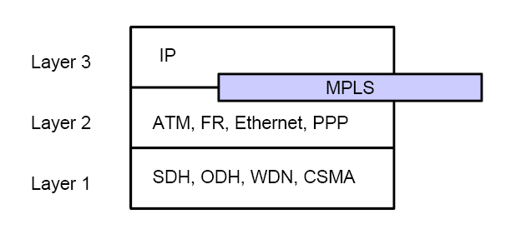

MPLS in the protocol stack
Between Layer 2 and Layer 3
MPLS
SDH: Synchronous Digital Hierarchy (optical fiber)
Notes:
MPLS อยู่ล่าง layer 3 ทำใหsupport ได้หลายตัวมากๆ

Slide 18
MPLS Characteristics
Flow Management
Independent of L2 and L3 protocols
Maps IP-addresses to fixed length labels
Interfaces to existing routing protocols (RSVP, OSPF)
Supports ATM, Frame-Relay and Ethernet
RSVP: Resource Reservation Protocol

Slide 19
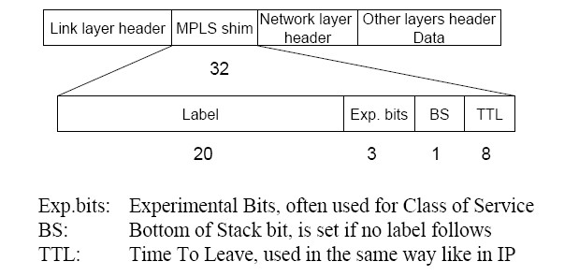
Label
Generic label format
bits
Shim: A thin, often tapered piece of material, such as wood, stone,
or metal, used to fill gaps, make something level, or adjust something to fit properly.
…http://www.thefreedictionary.com/
19
Notes:
Shim คือแทรกระหว่างหัว ethernet กับหัว IP ขนาด 32but

Slide 20
Label Distribution
Not specify a single method for label
distribution
Routing support for label exchange
BGP and RSVP can piggyback the label information
IETF defines signal and management
label distribution protocol (LDP)
Extension of LDP protocol
support explicit routing based on QoS

Slide 21
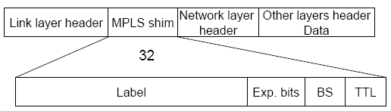


Label Insertion
Data Link Frame
IEEE 802 MAC Frame
ATM Cell
Frame Relay Frame
Notes:
ก็แทรกไปก่อน IP Header ได้หมดเลยลองรับ multi protocol

Slide 22
MPLS Terminology
LDP: Label Distribution Protocol
LSP: Label Switched Path
FEC: Forwarding Equivalence Class
LSR: Label Switching Router
LER: Label Edge Router

Slide 23
Label Edge Router (LER)
Edge of an MPLS network
Assigns and removes packet labels
Support multiple ports
frame relay
ATM
Ethernet
etc.
Notes:
ตัวที่ขอบทำหน้าที่แปะtagหรือถอดtag support ไรก็ได้

Slide 24
Label Switching Router (LSR)
High speed router in the core on an
MPLS network
ATM switches can be used as LSR
no hardware modification
label switching is equivalent to VP and VC
switching
Notes:
ตัวตรงกลางทำไย ไม่ต้องแปะเปอะไรละทำหน้าที่ switching อย่างเดียวคล้ายๆ atmอย่างเดียว ดูแทกแล้วโยนๆ

Slide 25
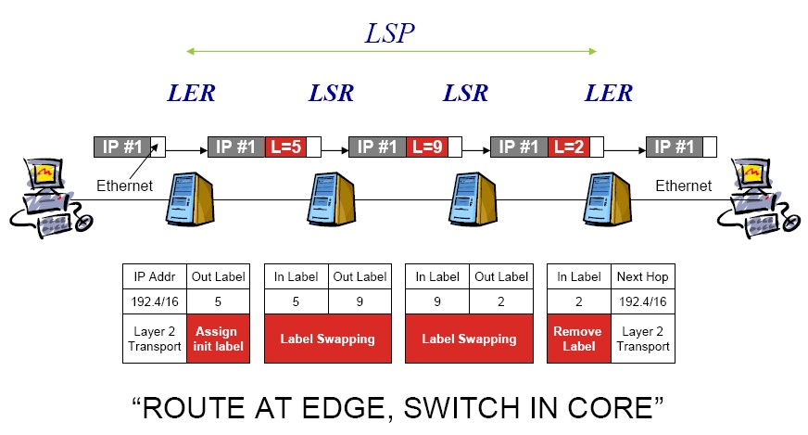
LER and LSR Position
(Label Switched Path)
Notes:
วิ่งเข้ามาด้วย IP ตัวที่ขอบก็แปะ label ก็ส่งให้เพื่อน ตัวกลางๆ ตัวที่รับก็อ่านแล้วก็ส่งๆ โคตรไว

Slide 26
Forward Equivalence Class (FEC)
Represent group of packets
share same requirements for their transport
Packet Assignment
assignment to each packet
only one time at entry point
Notes:
ข้าม

Slide 27
Label-Switched Path (LSP)
A path is established before the data
transmission starts
A path is a representation of a Forward
Equivalence Class (FEC)
Notes:
ข้าม

Slide 28
LSP Setup
Hop-by-hop routing
each LSR independently selects next hop for a given FEC
Explicit routing
similar to source routing
(sender specify the route of the packet)
ingress LSR specifies the list of nodes through
which the packet traverses
LSP setup for an FEC is unidirectional
return traffic must use another LSP
Notes:
การ setup path ใช้ hopBhop routing ก่อน

Slide 29
Label Distribution Protocol (LDP)
Application layer protocol
for label binding distribution info to LSRs
map FECs to labels (create LSP)
LDP sessions are established between LDP peers in the MPLS network
(not necessarily adjacent).
Sometimes employs OSPF or BGP
Notes:
ข้าม

Slide 30
LDP message types
Discovery messages
announce/maintain the presence of an LSR
Session messages
establish/maintain/terminate sessions between
LDP peers
Advertisement messages
create, change, and delete label mappings for
FECs
Notification messages
provide advisory info and signal error information
Notes:
ข้าม

Slide 31
Outline
Motivation
MPLS Basics
Operation
Protocol Stack Architecture
Advantages and Disadvantages
Notes:
ข้าม

Slide 32
Route at Edge, Switch in Core
IP
IP #L1
IP #L2
IP #L3
IP
IP Forwarding
LABEL SWITCHING
IP Forwarding

Slide 33
MPLS: How does it work?
UDP-Hello
UDP-Hello
TCP-open
TIME
Initialization(s)
Label request
IP
#L2
Label mapping
33
Notes:
วิธีการคือ UDP hello
TCP connection
แล้วก็แลกเปลี่ยน label

Slide 34
MPLS Operation
Five Steps
label creation and distribution
table creation at each router
label-switched path creation
label insertion/table lookup
packet forwarding

Slide 35
Step 1 :Label creation and distribution
First, routers bind a label to a specific FEC
Then build their tables
Using LDP
downstream routers initiate the distribution of labels and the label/FEC binding
negotiate traffic-related characteristics and MPLS
capabilities
A reliable and ordered transport protocol should be used for the signaling protocol

Slide 36
Step 2: Table creation
On receipt of label bindings each LSR creates
entries in the label information base (LIB)
Table specifies the mapping between a label and an FEC
mapping between the input port and input label table to the output port and output label table
entries are updated whenever renegotiation of
label bindings occurs

Slide 37
Example of
Label Information Base (LIB) Table
Input Port | Incoming Port Label | Output Port | Outgoing Port Label
1 | 3 | 3 | 6
2 | 9 | 1 | 7
Notes:
ตัวอย่าง LIB

Slide 38
MPLS Label Distribution
Intf In | Label In |  |  | Dest | Intf Out | Label Out
3 |  | 0.50 |  | 47.1 | 1 |  | 0.40
Intf In | Label In |  |  | Dest | Intf Out
3 |  | 0.40 |  | 47.1 | 1
1
47.1
Intf In | Dest | Intf Out | Label Out
3 | 47.1 | 1 |  | 0.50
Request: 47.1
3
3
2
1
Mapping: 0.40
1
2
47.3
3
47.2
2
Notes:
สีเหลืองคือ เบอที่ถูก assignแล้วก็เลยสร้างตารางกันปุปปัปเลยได้เลยสุดท้าย packet ต้นทางเลยแปะหัว 0.50 ไปทำให้เร็ว

Slide 39
Label Switched Path (LSP)
Intf In | Label In |  |  | Dest | Intf Out | Label Out
3 |  | 0.50 |  | 47.1 | 1 |  | 0.40
Intf In | Label In |  |  | Dest | Intf Out
3 |  | 0.40 |  | 47.1 | 1
1 47
IP 47.1.1.1 .1
3
Intf In | Dest | Intf Out | Label Out
3 | 47.1 | 1 |  | 0.50
1
2
1
3
2
47.2
47.3 3
IP 47.1.1.1
2
Notes:
Ip จะหมดความหมายไปก็ดู tagอย่างเดียวแล้วไปได้เลย

Slide 40
Step 3: Label switched path creation
LSPs are created in the reverse direction to the creation of entries in the LIBs.

Slide 41



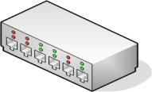
MPLS Example
LER 2
LSR 3
Destination
Source
LER 1
LER 3
LSR 2
LSR 1
LER 4

Slide 42
Step 4: Label insertion/table-lookup
First router (LER1) uses LIB table to find the next hop and request a label for the specific FEC
Subsequent routers just use the label to find the next hop
Once the packet reaches the egress LSR (LER3), the label is removed and the packet is supplied to the destination

Slide 43
Step 5: Packet forwarding
For first time packet
LER1 may not have any labels
(In IP) find the longest add match for next hop
Let LSR1 be the next hop for LER1.
LER1 will initiate a label request toward LSR1
This request will propagate through the
network (green lines)
Notes:
ส่ง rebel ไป

Slide 44
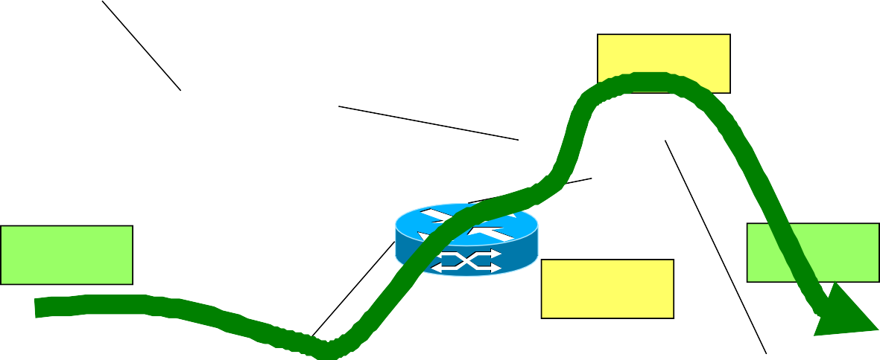
MPLS Operation Example
LER 2
LSR 3
Destination
Source
LER 1
LER 3
LSR 2
LSR 1
Label Request
LER 4

Slide 45
Step 5 (cont.)
Label downstream (LER3 →LSR→ … → LER1)
The LSP setup (blue lines) uses LDP or any other signaling protocol.
LER1 will insert the label and forward the packet to LSR1
Notes:
โยนdata

Slide 46
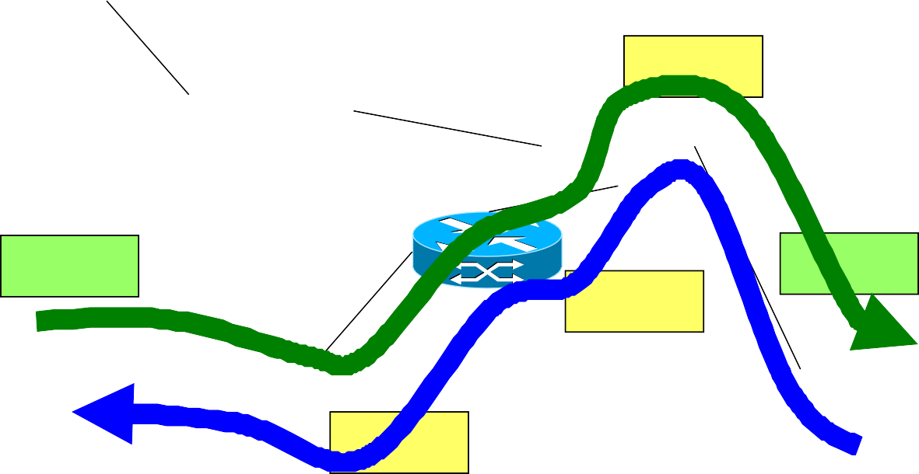
MPLS Operation Example
LER 2
LSR 3
Destination
Source
LER 1
LER 3
LSR 2
LSR 1
Label Request Label Distribution
LER 4

Slide 47
Step 5 (cont.)
Each subsequent LSR (LSR2,LSR3)
examine label in received packet
replace it with outgoing label
forward it
When reaches LER4, label is removed
leave MPLS domain and deliver to the destination
Actual data path followed by the packet is the red line

Slide 48
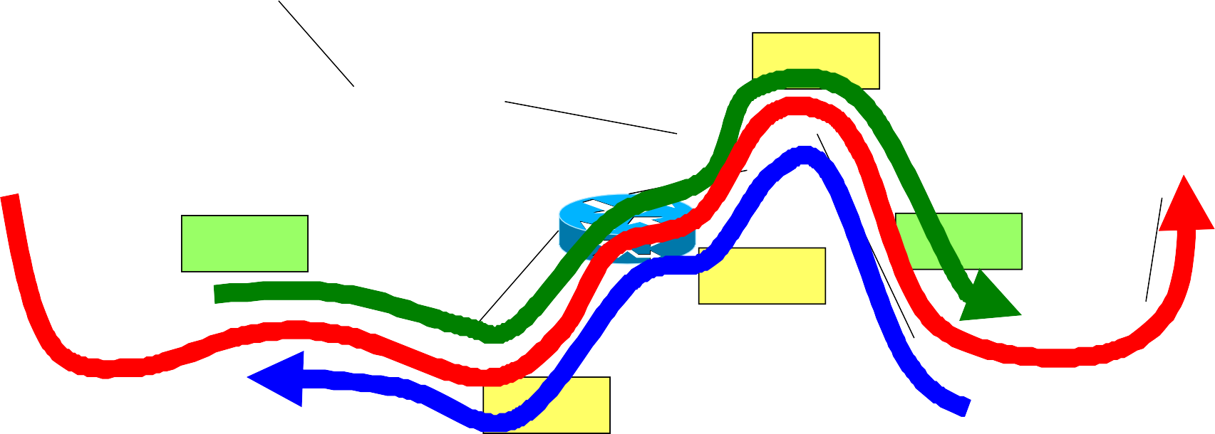
MPLS Operation Example
LER 2
LSR 3
Destination
Source
LER 1
LER 3
LSR 2
LSR 1
Label Request Label Distribution Data Flow
LER 4

Slide 49
Tunneling in MPLS
Control the entire path of a packet without explicitly specifying the intermediate routers.
Creating tunnels through the intermediary routers that can span multiple segments.
MPLS based VPNs.

Slide 50
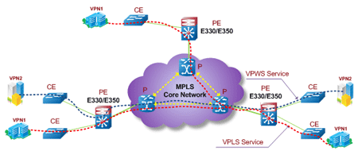
MPLS network application (MPLS L2 VPN)
customer edge (CE) routers provider edge (PE) routers
http://www.centecnetworks.com/en/SolutionList.asp?ID=77

Slide 51
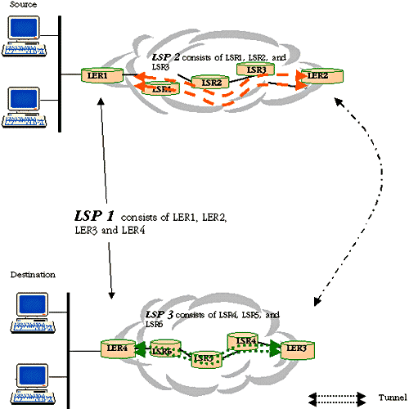
Tunneling in MPLS

Slide 52
Outline
Motivation
MPLS Basics
Operation
Protocol Stack Architecture
Advantages and Disadvantages

Slide 53
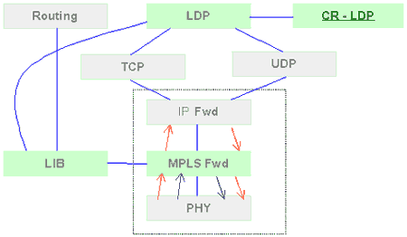
MPLS Protocol Stack Architecture

Slide 54
Outline
Motivation
Basics
Operation
Protocol Stack Architecture
Advantages and Disadvantages

Slide 55
MPLS Advantages
Improves packet-forwarding
performance in the network
Supports QoS and CoS for service
differentiation
Supports network scalability
Integrates IP and ATM in the network
Builds interoperable networks
Notes:
ข้อดีเร็วขึ้นแน่นอน support service หลากหลาย

Slide 56
MPLS Disadvantages
An additional layer is added
The router has to understand MPLS
Notes:
ข้อเสียคือต้องเพิ่ม labelที่แปะไปนิดนึง และ routerต้องใหม่ๆหน่อย

Slide 57
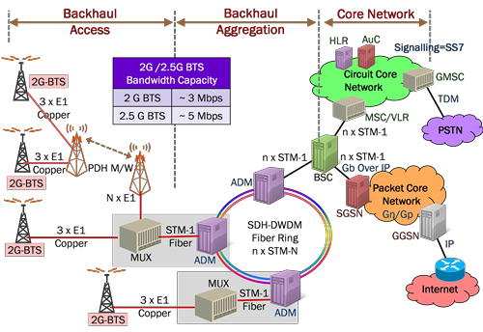
Transport Network in Legacy 2G/2.5G
http://lteuniversity.com/get_trained/expert_opinion1/b/skrishnamurthy/archive/2013/04/01/why-ethernet-backhaul.aspx

Slide 58
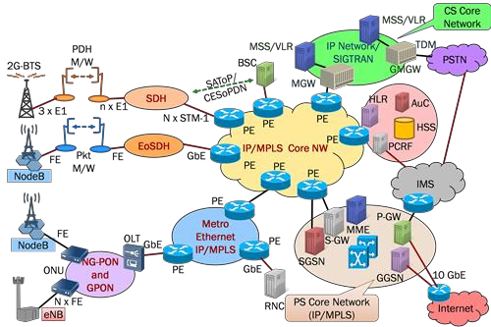
Unified Backhaul and Core Network in
2G/2.5G/3G/4G Networks
customer edge (CE) routers provider edge (PE) routers
customer edge (CE) routers
http://lteuniversity.com/get_trained/expert_opinion1/b/skrishnamurthy/archive/2013/04/01/why-ethernet-backhaul.aspx

Slide 59
References
“MPLS Introduction”, Yun Teng, Dept. of Computer
Science, UMBC
“MPLS Tutorial and Operational Experiences”, Peter Ashwood-Smith, Bilel Jamoussi, October, 1999

