Slide 1


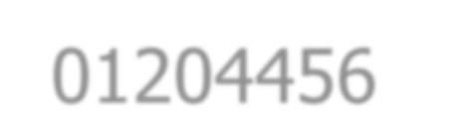







01204456 Social Networks Data Mining
Department of Computer Engineering Faculty of Engineering, Kasetsart University Bangkok, Thailand.

Slide 2

Outline
Modeling
Direct Opinion
Comparative Opinion
Opinion Spam
Notes:
มีแบบแสดงความคิดเห็นโดยตรงกับแบบเปรียบเทียบ

Slide 3

Fact vs. Opinion
2 main types of textual information:
Fact: objective expressions about entities
Opinion: subjective expressions of people’s sentiments toward entities
However, factual statements can imply opinions too.
e.g., (implicit opinion) The earphone broke in two days.
Most current textual information processing
Work with factual information
e.g., web search, text mining
Important of opinionated information, e.g.,
Individual needs to make a decision.
Organization needs to find feedback of products.
Notes:
Fact คือลักษณะที่เป็นข้อเท็จจริงมีตัวตนเวลากล่าวถึงเป็นแบบรูปธรรม
Opinion คือเป็นการแสดงข้อความที่เป็นนามธรรม
แต่บางทีอาจเป็นรูปประโยคที่แฝงข้อคิดเห็นได้

Slide 4

Definition
“Computational study of opinions, sentiments, and emotions expressed in text”
Notes:
ความรู้สึกหรืออารมณ์ที่แสดงออกมาทางข้อความเพิ่อให้รู้ได้ว่าข้อความนั้นๆมีความรู้สึกหรืออารมณ์อย่างไร

Slide 5

Why Opinion Mining Now?
In the past,
Individuals: ask for opinions from friends and families
Businesses: conduct polls, surveys, and focus groups
User-generated media: online word-of-mouth
A huge volume of opinionated text on the Web
i.e., Internet forums, discussion groups, and blogs
No longer limited to (individuals) one’s circle of friends or (businesses) small scale surveys, tiny focus groups
Notes:
ข้อความบางข้อความที่เป็น word of mouth มีปริมาณมากๆ จึงเป็นเหตุให้เกิด Opinion minning
พูดง่ายๆคือพยายามจะสร้าง tool มาช่วยประมวลผลข้อความจาก social mediaที่มีปริมาณมากๆ

Slide 6

An Example Review
“(1) I bought an iPhone a few days ago. (2) It was such a nice phone. (3) The touch screen was really cool. (4) The voice quality was clear too. (5) Although the battery life was not long, that is ok for me. (6) However, my mother was mad with me as I did not tell her before I bought the phone. (7) She also thought the phone was too expensive, and wanted me to return it to the shop. …”
What do we see?
Opinions: positive (2-5) and negative (6-7)
Targets of opinions: iPhone, touch screen, voice quality, battery life, me, and price (2-7, respectively)
Opinion holders: I (2-5) and my mother (6-7)

Slide 7

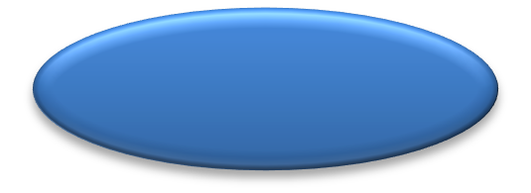

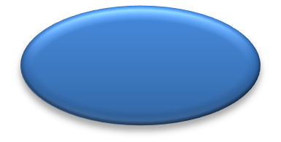
Target Object
Definition (object): An object o is a product, person, event, organization, or topic.
– A hierarchy of components, sub-components, and so on, associated with their sets of attributes
Canon S500 {picture quality, size, appearance, …}
Lens
{…} …
Battery
{battery life, size, …}
– Use the term features to represent both components and attributes
An opinion can be expressed on any node or attribute of the node.
Notes:
Object ในที่นี้มองได้หลายแบบ อาจจะเป็นproduct คนเหตุการณ์ห่าไรก็ได้ ซึ่ง object จะมีโครงส้รางเป็น hierachy โดนจะมี components sub-components ต่างๆย่อยลงไป

Slide 8

Types of Opinion
Direct opinion
Directly express opinion on some target objects (e.g., products, events, topics, persons, …)
e.g., the picture quality of this camera is great.
Comparative opinion
Express a relation of similarities or differences between two or more objects
e.g., car x is cheaper than car y.
Notes:
ชนิดของข้อคิดเห็นมีสองแบบคือ direct คือแสดงความคิดเห็นโดยตรงเลยว่ามันดีไม่ดียังไงตรงๆ Comparative เป็นการนำตัวนึงไปเทียบตัวนึง

Slide 9






Slide 10

Modeling
A quintuple
(o_{j}, f_{jk}, so_{ijkl}, h_{i}, t_{l})
where
o_{j} is a target object.
f_{jk} is a feature of the object o_{j}.
so_{ijkl} is the sentiment value of the opinion of the opinion holder h_{i}
on feature f_{jk} of object o_{j} at time t_{l}.
Can be positive, negative, neutral, or a more granular rating
h_{i} is an opinion holder.
t_{l} is the time when the opinion is expressed.
10
Notes:
Model ของ Direct Opinion
Oj คือ target fjk คือ feature ที่jของ objectที่kของOj
Soijkl เป็นsentiment value คือค่าความคิดเห็นโดยคนที่ hi เวลา tl อาจเป็นความเห็นแบบไหนก็ได้แต่ต้องระบุด้วยว่าใครเมื่อไหร่

Slide 11

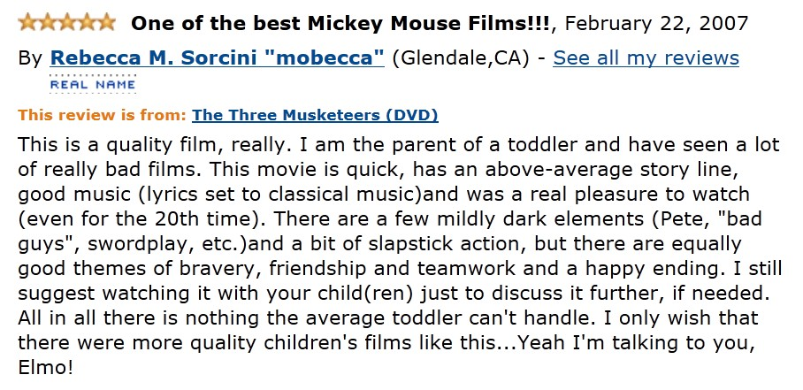



(o_{j}, f_{jk}, so_{ijkl}, h_{i}, t_{l})
t_{l}
h_{i}
o_{j}
this is a quality film.
this movie is quick
… has an above-average story line
… has good music
… was a real pleasure to watch
(o_{j}, film, positive, h_{i}, t_{l}) (o_{j}, film, positive, h_{i}, t_{l})
(o_{j}, story line, positive, h_{i}, t_{l}) (o_{j}, music, positive, h_{i}, t_{l}) (o_{j}, film, positive, h_{i}, t_{l})

Slide 12

Levels of Opinion Mining
Document-level sentiment classification
Sentence-level subjectivity classification
Feature-based sentiment analysis
Notes:
ทำทั้งหมดแล้วสรุปให้ได้ว่ามันดีหรือไม่ดี
แล้วค่อยมองลึกลงไปเรื่อยๆ
แล้วในขั้นที่3คือให้ระบบมองทุกๆreview แล้วให้ระบบสรุปว่าคนเขามีความเห็นต่อระบบอย่างไร

Slide 13



Document-Level Classification
Classify a document (e.g., review) based on the overall sentiment expressed by a opinion holder
Classes: positive or negative (and neutral)
In the model, (o_{j}, f_{jk}, so_{ijkl}, h_{i}, t_{l}),
Assume a document d focuses on a single object o_{j} (or o_{j} = f_{jk}) and contains opinion from a single opinion holder h_{i}.
The assumption holds for customer reviews, but may not hold a forum and blog post.
Notes:
ระดับบนสุดที่เป็นdocument level บอกได้ไหมว่า+ - 0 โดยให้ Oj= Fjk

Slide 14


Sentence-Level Classification
Perform two sub-tasks:
Subjectivity classification: subjective or objective sentence
Objective: e.g., I bought an iPhone a few days ago.
Subjective: e.g., It is such a nice phone.
Sentiment classification: positive or negative for the subjective sentence
Positive: e.g., It is such a nice phone.
However,
Subjective sentence ≠ only positive or negative opinion
e.g., I think he came yesterday.
Objective sentence ≠ no opinion
e.g., The earphone broke in two days. (implicit negative opinion)
Notes:
Sentense มีกระบวน สองประการ
1ต้องแยกให้ได้ก่อนว่าเป็น Objective หรือ Subjective sentence พอวิเคราะห์ได้แล้วก็สนใจเฉพาะ Subjective
2.นำมาทำเป็นSentiment classification ดูว่าเป็น positive หรือ negative
อย่างไรก็ตาม Subjective != Opinion เสมอไป อาจเป็นแค่การเสนอความคิดเฉยๆ ความแนะนำโง่ๆ
แต่ถ้าพบว่าเป็น Objective sentence ไม่ได้มีความหมายแฝงของการแสดงความคิดเห็นอยู่

Slide 15


Feature-based Sentiment Analysis
Sentiment classification at both document and sentence levels are not sufficient since
A positive opinion on an object does not mean that the opinion holder likes everything.
A negative opinion on an object also does not mean …
They do not tell what people like and/or dislike.
Notes:
Object หนึ่งๆอาจจะมีบางส่วนที่ดีหรือบางส่วนที่ไม่ดีก็ได้ เลยสร้างระบบจากทุกๆreview แล้ว review บางส่วนๆแยกไปเลย

Slide 16




Feature-based Opinion Summary
“(1) I bought an iPhone a few days ago. (2) It was such a nice phone. (3) The touch screen was really cool. (4) The voice quality was clear too. (5) Although the battery life was not long, that is ok for me. (6) However, my mother was mad with me as I did not tell her before I bought the phone. (7) She also thought the phone was too expensive, and wanted me to return it to the shop. …”
Feature1: touch screen
Positive: 212
The touch screen was really cool.
The touch screen was so easy to use and can do amazing things.
– …
Negative: 6
The screen is easily scratched.
I have a lot of difficulty in removing finger marks from the touch screen.
– …
Feature2: battery life
…

Slide 17


















Visualization
Summary of reviews
Cell Phone 1
+
–
voice screen battery size weight
Comparison of reviews
Cell Phone 1
Cell Phone 2
+
–
Notes:
นำสิ่งที่เราสรุปได้มามะกี้มาทำ visualizationได้

Slide 18
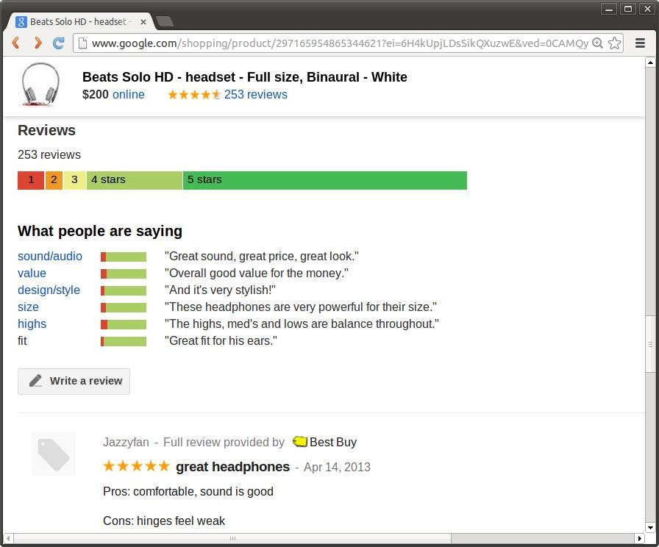
Example: Google Product Search

Slide 19

















Sentiment Analysis is Challenging!
“This past Saturday, I bought a Nokia phone and my girlfriend bought a Motorola phone with Bluetooth. We called each other when we got home. The voice on my phone was not so clear, worse than my previous phone. The battery life was long. My girlfriend was quite happy with her phone. I wanted a phone with good sound quality. So my purchase was a real disappointment. I returned the phone yesterday.”

Slide 20
Sentiment Analysis is not just ONE Problem!
Natural language processing
The model (o_{j}, f_{jk}, so_{ijkl}, h_{i}, t_{l}),
➔ Named entity extraction (and more)
➔ Information extraction
➔ Sentiment determination
➔ Information/data extraction
➔ Data extraction
A target object o_{j}
A feature f_{jk}
Sentiment so_{ijkl}
An opinion holder h_{i}
The time t_{l}
Co-reference resolution
Relation extraction
Synonym match
– e.g. voice = sound quality
All of them are not an easily solved problem!
20
Notes:
เป็นกระบวนการหาความสัมพันธ์ระหว่างประโยคปัจจุบันกับประโยคถัดๆไป

Slide 21


Co-reference Resolution
Different from the traditional one
Important to resolve objects and features
e.g., “I bought a Canon S500 camera yesterday. It looked beautiful. I took a few photos last night. They were amazing.”
it ➔ Canon S500 they ➔ photos

Slide 22

Identify Opinion Orientation
For each feature,
Identify the sentiment or opinion orientation expressed by a reviewer
Almost all approaches make use of opinion words and phrases. However,
Some opinion words have context independent orientations.
e.g., great
Some opinion words have context dependent orientations.
e.g., small
Machine learning methods for sentiment classification at the sentence level are also applicable.
Notes:
โดยปรกติแล้วทุกๆประโยคต้องหา feature ให้ได้โดยหาแบบPositive หรือ Negative โดยหาคำๆนึง เรียกว่า Opinion words / phareses
โดยบางอันอาจดูได้เลยไม่ต้องดูรูปประโยคเรียก context independent แต่อีกแบบคือ context dependent

Slide 23

Basic Opinion Rules
Neg → Negative Pos → Positive
Negation Neg → Positive Negation Pos → Negative
Desired value range → Positive
The phone has a good screen.
The phone has not a good screen, but …
This drug causes low blood pressure.
Below or above the desired value range → Negative
4. Decreased Neg → Positive Decreased Pos → Negative
My pain has disappeared after taking the drug.
Increased Neg → Negative Increased Pos → Positive
5. Consume resource → Negative Produce resource → Positive Consume waste → Positive Produce waste → Negative
This product gain a lot of money.

Slide 24



Slide 25
Types of Comparative Relations
Gradable:
Non-equal gradable: relations of the type greater or less than
e.g., Quality of camera A is better than that of camera B.
Equative: relations of the type equal to
e.g., Camera A and camera B both are light.
Superlative: relations of the type greater or less than all others
e.g., Camera A is the cheapest camera available in market.
Non-gradable: relations that compare features
e.g., Coke tastes differently from Pepsi.
Notes:
แบ่งออกเป็น สอง แบบ โดยอันแรกคือแบบที่สามารถบอกระดับได้แบ่งเป็นสามประเภทย่อย 1 ระดับที่ไม่เท่ากัน 2 เท่ากัน 3.นับเป็นอันที่สุดในตลาด
แบบที่สองไม่สามารถบอกระดับได้

Slide 26
Modeling
(o₁, o₂, F, po, h, t)
where
o₁ and o₂ are the object sets being compared (with respect to order of the objects).
F is the shared features of the objects o₁ and o₂.
po is the preferred object set of the opinion holder h.
Not positive or negative opinion
h is an opinion holder.
t is the time when the comparative opinion is expressed.

Slide 27




Slide 28

Types of Opinion Spam
Untruthful opinion (fake)
Hype spam: write undeserving positive reviews for some target objects in order to promote them
Defaming spam: write unfair or malicious negative reviews for some target objects to damage their reputations
Opinion on brands only
Do not comment on the specific products supposed to review, but comment on the brands
e.g., I hate HP. I never buy any of their products.
Non-opinion
Advertisements
Irrelevant texts containing no opinions
Notes:
ข้อคิดเห็นที่เป็นเท็จ hype spam เขียนเกินจริง หรือ defaming spam เขียนด่าไอสัส
Onbrand คือชอบก็ชอบไม่ชอบก็ไม่ชอบ brandนั้น ไม่ถือเป็นความเห็น
Non-opinion คือขยะ สวะ รกโลก ตั้ม

Slide 29
Spam Reviews vs. Product Quality
 | Positive Spam Review | Negative Spam Review
Good Quality Product | (a) | (b)
Average Quality Product | (c) | (d)
Bad Quality Product | (e) | (f)

Slide 30

Spam Strategy
Jindal and Liu (2008) found a large number of duplicate and near-duplicate reviews of products from the site amazon.com
Divide into four groups
Duplicate from the same userid on the same product
Duplicate from different userids on the same product
Duplicate from the same userid on different products
Duplicate from different userids on different products
Group (1) may be mistaken clicking the submit button multiple times.
Groups (2-4) are treated as untruthful opinions.
30
Notes:
แบ่งเป็น 4 กรุ้ป เพราะพบพวกที่ยกขึ้นมา
1 อาจผิดพลาดเอง 234 spam

Slide 31

Some Tentative Results
Negative outlier reviews tend to be heavily spammed.
Top-ranked reviewers are more likely to be spammers.
Spam reviews can get good helpful feedbacks and non- spam reviews can get bad feedbacks.
Notes:
คนที่เป็น Negative thinking มากๆ มีโอกาสเป็นSpammer สูง

Slide 32
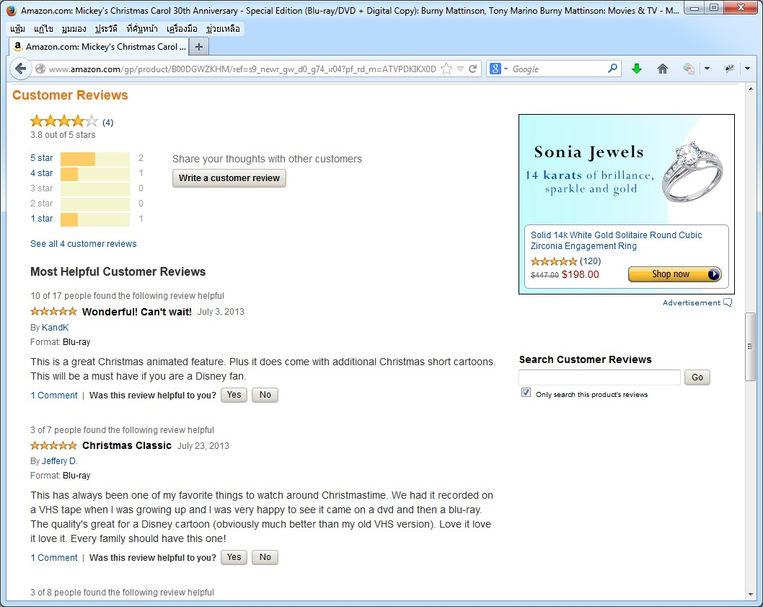
Example of Opinion Spam Fighting

Slide 33

References
G. Qiu, B. Liu, J. Bu, and C. Chen. “Expanding Domain Sentiment Lexicon through Double Propagation”, in Proc. of the 21st International Joint Conference on Artificial Intelligence, 2009.
N. Jindal and B. Liu. “Opinion Spam and Analysis”, in Proc. of the Conference on Web Search and Web Data Mining, 2008.

Slide 34


