Slide 1


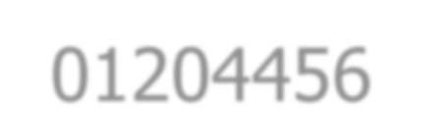







01204456 Social Networks Data Mining
Department of Computer Engineering Faculty of Engineering, Kasetsart University Bangkok, Thailand.

Slide 2

Outline
Small-World Phenomenon
Milgram’s experiment
Properties
Average path length
Clustering coefficient
Models
Watts-Strogatz (short paths & clustering)
Kleinberg (geograhic)

Slide 3









Small-World Phenomenon
“We are all linked by short chains of acquaintances.”
6
5
4
Six degrees of separation
3
2
1
YOU

Slide 4
Small-World Phenomenon
A famous experiment conducted by Milgram (1967)
Subjects were asked to send a chain letter to his acquaintance in order to reach a target person.
The average path length is around 5.5
Verified on a planetary-scale IM network of 180 million users (Leskovec and Horvitz 2008)
The average path length is 6.6
Notes:
จดหมายลูกโซ่

Slide 5



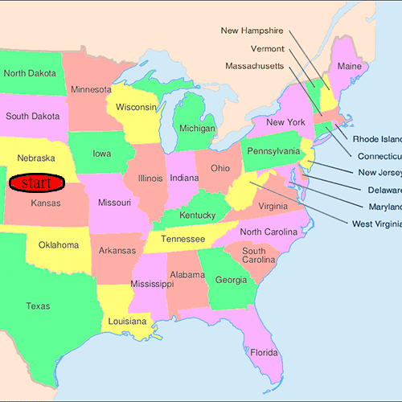
Milgram’s Experiment
Study the probability that two randomly selected people would know each other
Goal:
Examine the average path length between any 2 persons in social network
Setup:
Starting points – participating persons in Omaha town (Nebraska) and in Wichita town (Kansas)
Ending points – Researcher in Harvard in Boston town (Massachusetts)
Instructions:
Given a target individual, pass the message (a letter chain) to a person you correspond with who is closest to the target
Notes:
การทดลองคือไปเลือกอาสาสมัตรมาแล้วเลือกโหนดปลายทางที่นึง ต้องการให้คนต้นทางส่งไปหาปลายทางโดยไม่รู้จักกัน โดยส่งไป200ฉบับถึงแค่20%

Slide 6
Milgram’s Experiment
Study the probability that two randomly selected people would know each other
Procedure:
Participating person sent it directly if he know that target person
Otherwise, forward it to his acquaintance in other city whom should know
Average path length had been examined
Outcome:
20% of initiated chains reached target average length is around five and a half
No. of Completed Chains
12
10
8
6
4
2
0
44 chains in total
0 2 4 6 8 10 12
Chain Length

Slide 7

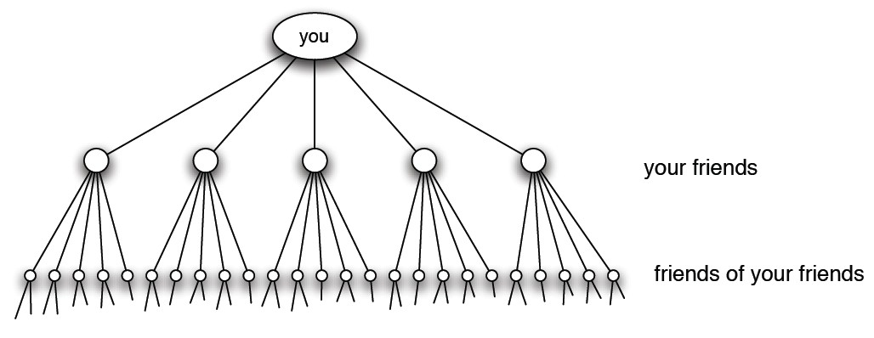
Structure in Random Networks
Suppose everybody has 100 friends distributed randomly in the world population
Pure exponential growth produces a small world
In 6 hops, you can reach 100⁶ people.
i.e., a million million > 6,000 million (world pop.)
There is nothing mathematically wrong with this reason.
Notes:
ตามทฤษฏีแล้วแบบนี้เป็ฯไปได้คือเชื่อมได้100^6คน

Slide 8


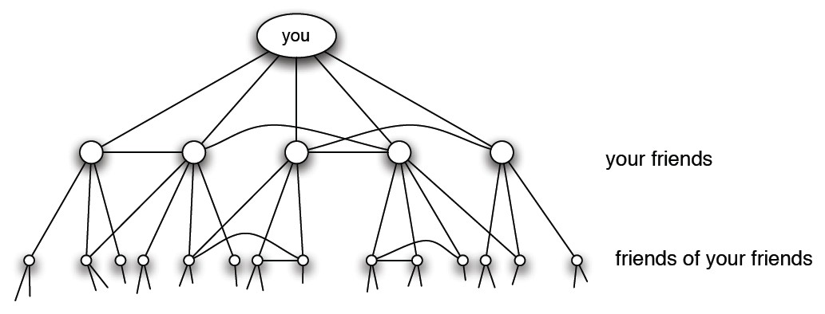
Structure in Social Networks
But, the real social networks tend to be clustered.
– i.e., if A and B are two individuals with a common friend, it is much more likely that they themselves are friends.
Triadic closure reduces the growth rate
– The number of friends you reaching in few steps could be much smaller.
Notes:
แต่ความเป็นจริงแล้วได้แบบนี้

Slide 9

Small-World Properties
Average path length
⇨ Short path
Clustering coefficient
⇨ High clustering

Slide 10
Transitivity and Triadic Closure
Transitivity:
If A is connected to B and B is connected to C, what is the probability that A is connected to C?
My friends’ friends are likely to be my friends.
Triadic closure:
If two person have a friend in common, then there is an increased likelihood that they will become friends themselves at some point in the future.
?
A
C
A
C
close the triangle
B
B
10
Notes:
Trasitive คือเพื่อนของเพื่อนคือเพื่อน เอเพื่อนบี บีเพื่อนซี เอเพื่อนซี
Triadic Closure เปลี่ยนมุมองบีเพื่อนเอ บีเพื่อนซี เอเพื่อนซี

Slide 11






Clustering
Global clustering coefficient
Measure the clustering in the whole network
Often, called transitivity
_{C =} 3×number of triangles number of connected triples
3
triangle = {{1,2,3}}
connected triples = {{2-1-3},{1-2-3},{1-3-2}}
1
2
Notes:
ความเป็นกลุ่มก้อน

Slide 12





Example: Global Clustering
triangle = {{1,2,3},{2,3,4}} connected triples
= {{2-1-3},
{1-2-3},{1-2-4},{3-2-4},
{1-3-2},{1-3-4},{2-3-4},
{2-4-3}}
3
4
1
2
_{C =} 3×2 ₌ 3
8 4
Notes:
3*2(สามเหลี่ยม2อัน)/8(คือที่ไม่ใช้เส้นเดียวกัน) = 3/4

Slide 13








Clustering
Local clustering coefficient
Measure the density of connections among one’s friends
i.e., the fraction pairs of neighbors of the node that are themselves connected
i
Notes:
จะพิจารณาโหนดใดโหนดหนึ่งเป็นศูนย์กลาง

Slide 14

Local Clustering Coefficient
Given G=(V,E), let
N_{i} be the set of neighborhood of node v_{i}
k_{i} be the number of neighbors (degrees) of node v_{i}, i.e., |N_{i}|
For a directed network,
₌ |{e_{jk}:v_{j},v_{k}∈N_{i},e_{jk}∈E}|
C
i
k (k –1)
i i
For an undirected network,
₌ |{e_{jk}:v_{j},v_{k}∈N_{i},e_{jk}∈E}|
C
i
k (k –1)/2
i i

Slide 15








Example: Local Clustering
What is the clustering coefficient
7
of node 1?
number of 1’s friends = 4
⇨ {2, 3, 4, 5}
number of edges between 1’s friends = 1
⇨ {e₃₄}
number of possible between 1’s
2
6
3
1
5
4
friends = (⁴) = 6
2
⇨ {e₂₃, e₂₄, e₂₅, e₃₄, e₃₅, e₄₅}
1
6
C₁ =
Notes:
หาว่าโหนดเบอหนึ่งมีlocalclustเท่าไหร่ เพื่อนเบอ1มีสี่ตัว เพื่อนเบอ1มีเส้นเชื่อมหากันกี่เส้น เส้นเดียวคือสามสี่ แล้วเพื่อนเบอหนึ่งมีเส้นเชื่อมที่เป็นไปได้กี่เส้น หกเส้น(สีแดง) ดังนั้นก็คือ 1/6 ป_

Slide 16








Local Clustering Coefficient
Average over all n nodes
C = ¹ ∑C
n
i
i
7
2
C | = | ¹/₇(C₁+C₂+C₃+C₄+C₅+C₆+C₇)
 | = = | ¹/₇(¹/₆+0+1+1+0+0+0) 0.31
6
3
1
5
4

Slide 17
Recap: Modeling the Phenomenon
Goals:
Why should there exist short chains of acquaintances linking together arbitrary pairs of strangers?
Why should arbitrary pairs of strangers be able to find
short chains of acquaintance that link them together?
Models:
Random networks
Watts-Strogatz model
Kleinberg model

Slide 18





Slide 19










Random Networks
A random network G=(n,p):
n is total number of nodes
p is a probability for connecting each pair of nodes independently
i
p
j

Slide 20












Average Path Length
Suppose node has k neighbors distributed randomly
Consider at distance l
Let n be total number of nodes
n = k^{l}
Average path length:
~ log(n)
l
random
log(k)
l
20

Slide 21








Clustering Coefficient
i
p
j
Consider each node i:
Has k neighbors
The number of edges connecting between its neighbors is p(^{k})
2
– The total number of possible edges is (^{k})
2
– Thus, the clustering coefficient of i is c_{i} = p(^{k})/(^{k}) = p
2 2
Average clustering coefficient
k_{/n}
^{C}random
= p =
Notes:
♥♥

Slide 22





Random VS. Real-World Networks
Average path length
^{l}network
^{≈ l}random
= O(log n)
Clustering coefficient
^{C}network
^{>> C}random

Slide 23
Random VS. Real-World Networks
Comparisons with random network used to determine whether real-world network is small-world
Network | Size | ^{l}actual | ^{l}random |  | ^{C}actual | ^{C}random
Film actors | 225,226 | 3.65 | 2.99 |  | 0.79 | 0.00027
MEDLINE co- authorship | 1,520,251 | 4.6 | 4.91 |  | 0.56 | 1.8×10^{–4}
E.Coli substrate graph | 282 | 2.9 ≈ | 3.04 |  | 0.32 > | > 0.026
C.Elegans | 282 | 2.65 | 2.25 |  | 0.28 | 0.05
Notes:
ตัว Random Network ไม่สามารถอธิบายNetworkจริได้เพราะค่าCต่างกันมากๆ

Slide 24












Slide 25



Watts-Strogatz (WS) Model
Watts & Strogatz (1998)
Create a model for small-world networks (low l and high C)
Interpolate between regular and random networks:
rewiring procedure
edges are divide into local and long-range contacts
Notes:
ให้ค่า Average Path สั้นแต่ Cสูง

Slide 26

Regular Network Topologies
STAR
TREE
GRID
BUS
RING

Slide 27


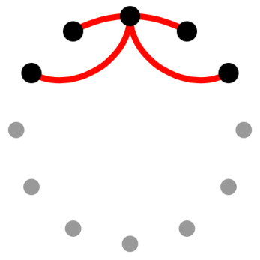
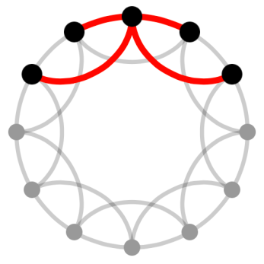
Watts-Strogatz Model
Start with a k-regular ring lattice
Support n=12 nodes, each has k=4 neighbors
Create a ring of n nodes
Each node is connected to its k nearest neighbors
Like so…
n=12
k=4

Slide 28
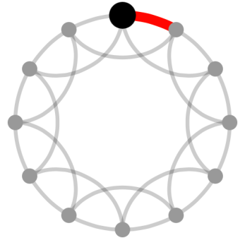
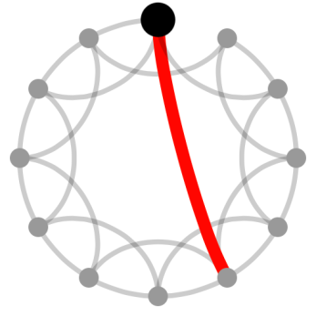
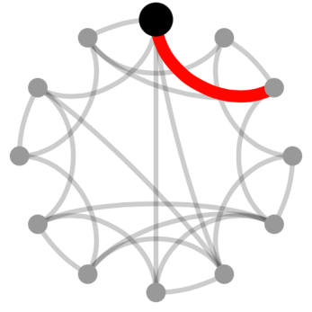
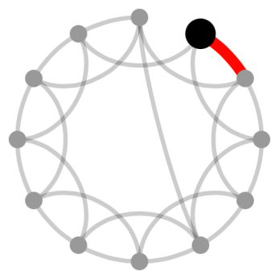
Watts-Strogatz Model
Rewire each edge: disallow self and multiple edges
1. Choose a node, and the edge to its nearest
clockwise neighbor
2. With probability
β, reconnect this edge to a node chosen randomly
4. Next, consider the edge connecting to the
second-nearest neighbor clockwise
3. Repeat this process by moving clockwise
around the ring
Notes:
ข้อกำหนด ห้ามเชื่อมตัวมันเอง และ ห้ามมีMultipleedge คือไม่มีเส้นเชื่อมไปยังจุดๆเดียวหลายเส้น โดยพิจารณาเส้นเชื่อมทีละเส้นแล้วพิจารณาว่าควรจะเปลี่ยนหรือไม่ โดยค่าProb เบต้า ยิ่งเยอะยิ่งมีโอกาสเปลี่ยนไปเส้นอื่น

Slide 29

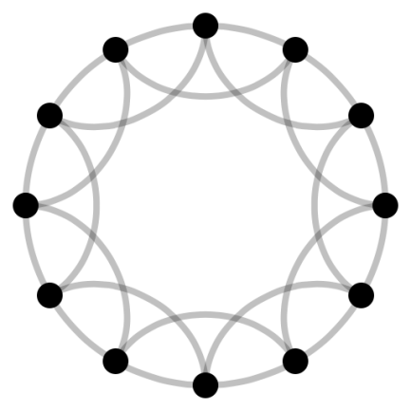
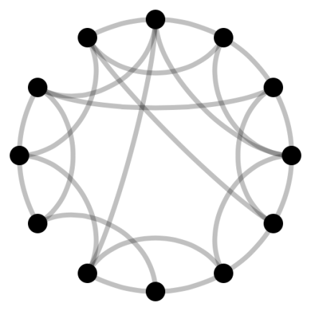
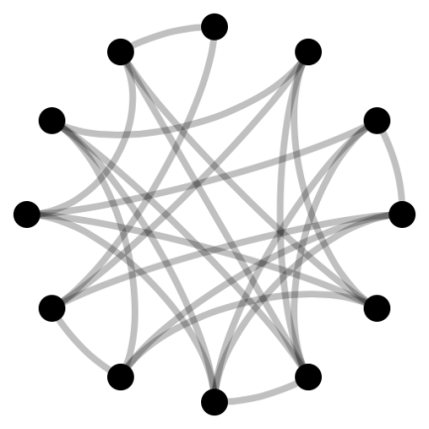
Rewiring of Links
Tune a graph between regular (β=0) and random (β=1)
For β=0, unchanged
At β=0.15,
increasingly disordered
At β=1,
rewired randomly
β
Notes:
สรป เบต้าศูนย์ จะไม่มีเส้นเชื่อมเปลี่ยน ถ้าเบต้าหนึ่งคือrandomnetwork

Slide 30

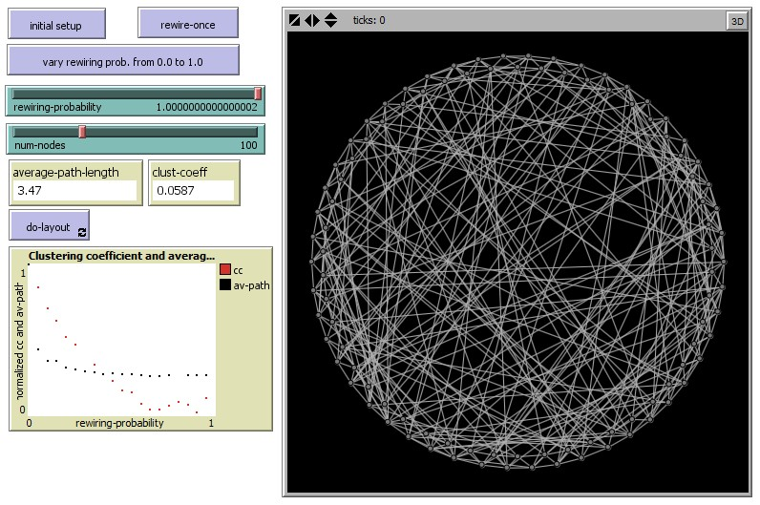
Watts-Strogatz Model
Observe average path length and clustering coefficient
SmallWorldWS.nlogo
30

Slide 31
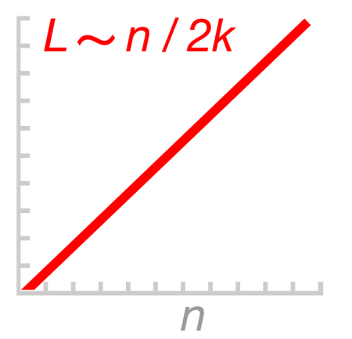
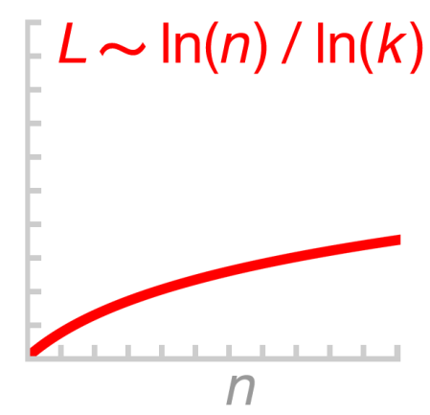
Average Path Length
At β=0, the regular lattice is a large world where l grows linearly with n.
~ n
l
regular
2k
At β=1, the random network is a small world where l
grows only logarithmically with n.
~ log(n)
l
random
log(k)

Slide 32
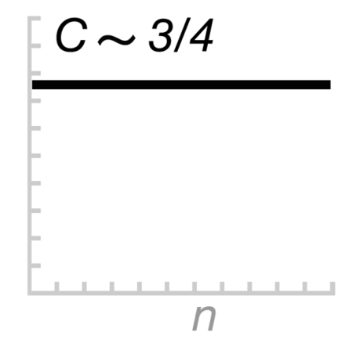
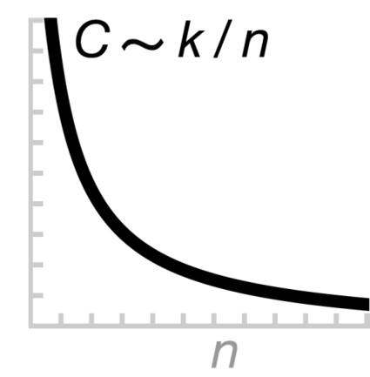
Clustering Coefficient
At β=0, the regular lattice is a highly clustered.
₌ 3(k–2) ~ 3
4(k–1) 4
C
regular
At β=1, the random network is a poorly clustered.
~ k
C
random
n

Slide 33


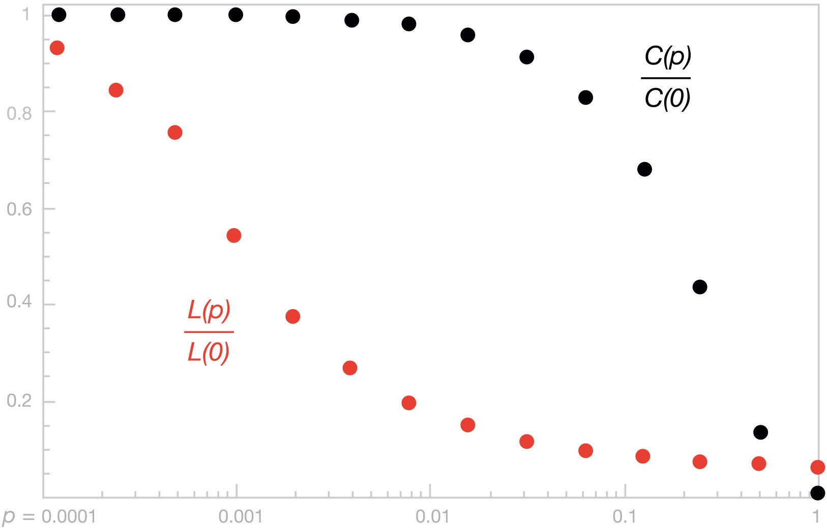
What happens in between?
Average path length & clustering coefficient as rewiring
C(β)
C(0)
l(β)
l(0)
β
1% of links rewired
10% of links rewired

Slide 34


