Slide 1

VoiceSens
A VOICE BIOMETRIC AUTHENTICATION SOLUTION USING WATSON

Slide 2

CONTENT
WHY VOICE BIOMETRICS
COMPETITOR ANALYSIS
FUTURE WORK
ARCHITECTURE USED
DEMO

Slide 3









WHY VOICE BIOMETRICS
Password based Authentication
49% of the users say that authentication is time consuming
67% of mobile users reset their passwords at least once a month
85% of users are dissatisfied with current authentication techniques
Voice Biometric Authentication
80% faster authentication
$15 Mill average saving over 3 year period
90% prefer Voice Biometric over the status quo
Notes:
<div>Icons made by <a href="https://www.flaticon.com/authors/eucalyp" title="Eucalyp">Eucalyp</a> from <a href="https://www.flaticon.com/" title="Flaticon">www.flaticon.com</a> is licensed by <a href="http://creativecommons.org/licenses/by/3.0/" title="Creative Commons BY 3.0" target="_blank">CC 3.0 BY</a></div>

Slide 4



ARCITECTURE USED
User Enrollment
User Authentication
Create User Profile
Capture Voice Samples
Create Voice Prints
Voice Print Database
Voice Print Comparison
Capture Voice to Authenticate
Login to User Profile
SPEECH TO TEXT
Notes:
<div>Icons made by <a href="https://www.flaticon.com/authors/kiranshastry" title="Kiranshastry">Kiranshastry</a> from <a href="https://www.flaticon.com/" title="Flaticon">www.flaticon.com</a> is licensed by <a href="http://creativecommons.org/licenses/by/3.0/" title="Creative Commons BY 3.0" target="_blank">CC 3.0 BY</a></div>
<div>Icons made by <a href="https://www.flaticon.com/authors/smashicons" title="Smashicons">Smashicons</a> from <a href="https://www.flaticon.com/" title="Flaticon">www.flaticon.com</a> is licensed by <a href="http://creativecommons.org/licenses/by/3.0/" title="Creative Commons BY 3.0" target="_blank">CC 3.0 BY</a></div>

Slide 5

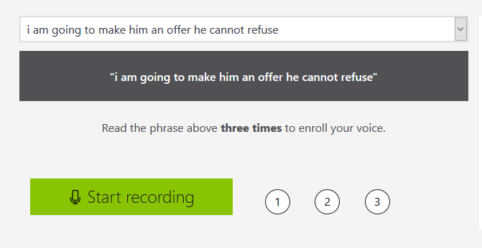

COMPETITOR ANALYSIS
Speaker Recognition
Fast and accurate solution.
Enrollment phrases are standard, making replay attacks a possibility.
API requests can be intercepted, since there is no hashing done to sign the requests and the private key is provided in the header as a plaintext.
https://azure.microsoft.com/en-us/services/cognitive-services/speaker-recognition/
Notes:
<div>Icons made by <a href="https://www.flaticon.com/authors/eucalyp" title="Eucalyp">Eucalyp</a> from <a href="https://www.flaticon.com/" title="Flaticon">www.flaticon.com</a> is licensed by <a href="http://creativecommons.org/licenses/by/3.0/" title="Creative Commons BY 3.0" target="_blank">CC 3.0 BY</a></div>

Slide 6
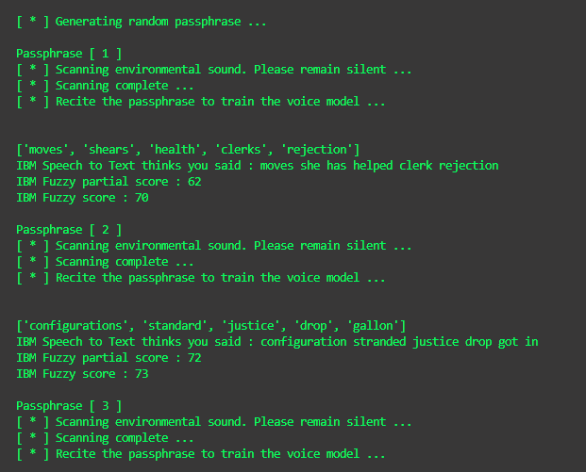

COMPETITOR ANALYSIS
Fast and accurate solution.
Enrollment phrases are randomized to prevent replay attacks from attackers.
Hashing the audio file with the clients RSA private key, to prevent man in the middle attacks.
Notes:
<div>Icons made by <a href="https://www.flaticon.com/authors/eucalyp" title="Eucalyp">Eucalyp</a> from <a href="https://www.flaticon.com/" title="Flaticon">www.flaticon.com</a> is licensed by <a href="http://creativecommons.org/licenses/by/3.0/" title="Creative Commons BY 3.0" target="_blank">CC 3.0 BY</a></div>

Slide 7
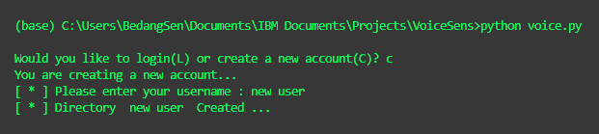
DEMO
Github Repository
Check out the VoiceSens github repository at the following link:
https://github.com/bedangSen/VoiceSens
Notes:
<div>Icons made by <a href="https://www.flaticon.com/authors/eucalyp" title="Eucalyp">Eucalyp</a> from <a href="https://www.flaticon.com/" title="Flaticon">www.flaticon.com</a> is licensed by <a href="http://creativecommons.org/licenses/by/3.0/" title="Creative Commons BY 3.0" target="_blank">CC 3.0 BY</a></div>

Slide 8
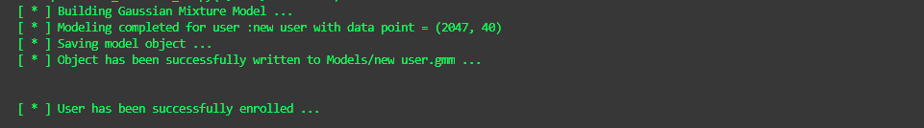
DEMO
Github Repository
Check out the VoiceSens github repository at the following link:
https://github.com/bedangSen/VoiceSens
Notes:
<div>Icons made by <a href="https://www.flaticon.com/authors/eucalyp" title="Eucalyp">Eucalyp</a> from <a href="https://www.flaticon.com/" title="Flaticon">www.flaticon.com</a> is licensed by <a href="http://creativecommons.org/licenses/by/3.0/" title="Creative Commons BY 3.0" target="_blank">CC 3.0 BY</a></div>

Slide 9
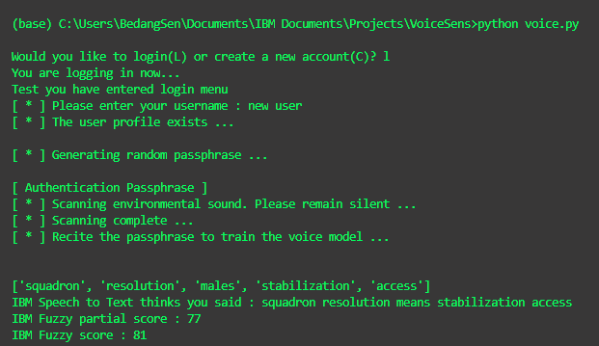
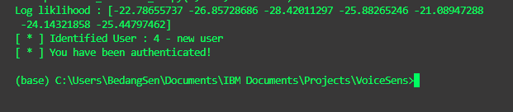
DEMO
Github Repository
Check out the VoiceSens github repository at the following link:
https://github.com/bedangSen/VoiceSens
Notes:
<div>Icons made by <a href="https://www.flaticon.com/authors/eucalyp" title="Eucalyp">Eucalyp</a> from <a href="https://www.flaticon.com/" title="Flaticon">www.flaticon.com</a> is licensed by <a href="http://creativecommons.org/licenses/by/3.0/" title="Creative Commons BY 3.0" target="_blank">CC 3.0 BY</a></div>

Slide 10


FUTURE WORK
Integrate with a web application
Hashing the files and signing it with the clients private key
Storing the User Profile models in the Object Storage
Notes:
<div>Icons made by <a href="https://www.flaticon.com/authors/eucalyp" title="Eucalyp">Eucalyp</a> from <a href="https://www.flaticon.com/" title="Flaticon">www.flaticon.com</a> is licensed by <a href="http://creativecommons.org/licenses/by/3.0/" title="Creative Commons BY 3.0" target="_blank">CC 3.0 BY</a></div>

Slide 11
REFERENCES
Practicalcryptography.com. (2018). Practical Cryptography. [online] Available at: http://practicalcryptography.com/miscellaneous/machine-learning/guide-mel-frequency-cepstral-coefficients-mfccs/ [Accessed 14 Dec. 2018].
Scikit-learn.org. (2018). 2.1. Gaussian mixture models — scikit-learn 0.20.1 documentation. [online] Available at: https://scikit-learn.org/stable/modules/mixture.html [Accessed 14 Dec. 2018].
Digital Signal Processing: Speaker Recognition Finnal Report [online] Available at: https://raw.githubusercontent.com/ppwwyyxx/speaker-recognition/master/doc/Final-Report-Complete.pdf
Notes:
<div>Icons made by <a href="https://www.flaticon.com/authors/eucalyp" title="Eucalyp">Eucalyp</a> from <a href="https://www.flaticon.com/" title="Flaticon">www.flaticon.com</a> is licensed by <a href="http://creativecommons.org/licenses/by/3.0/" title="Creative Commons BY 3.0" target="_blank">CC 3.0 BY</a></div>

