Slide 1
covid-19 re-genotyping

Slide 2
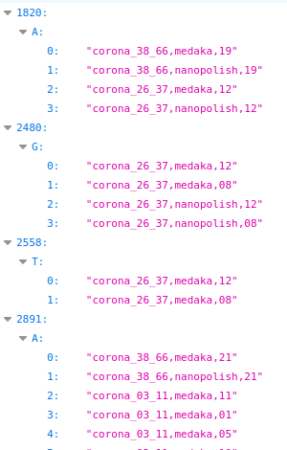
Collect interesting positions
Any VCF entry

Slide 3
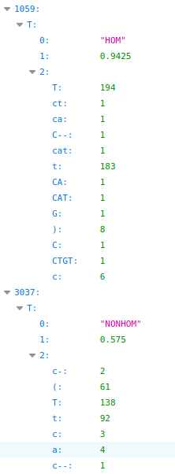
Label all variant calls for all samples
Criteria for HOM:
> 50X Coverage
> 0.85 percent of reads
or
Medaka HOM Call
Criteria for HET:
Medaka HET Call

Slide 4
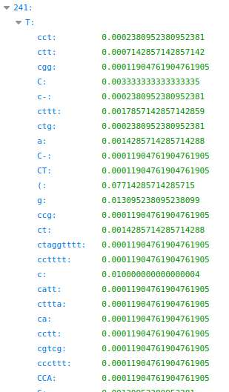
Identify HOM positions and emissions
Normalize across all samples
Divide in each sample by total reads
Divide across all samples by number of samples

Slide 5
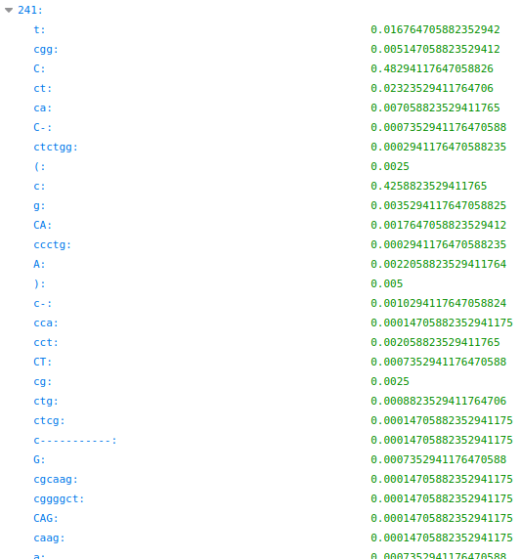
Identify reference emissions
For each HOM pos
Same normalization

Slide 6
Bayesian-esque Model
Define a set of splits ( e.g. 100:0, 50:50, 75:25, 0:100)
For each position, for each sample, for each split, calculate likelihood
Product of Poisson PMF (exp(e),obs(e)) for each emission e (e.g. observed base, deletion etc.)
Calculate exp(e) with split, for instance 50:50:
referenceEmission*totalReads*1/2 + variantEmissions*totalReads*1/2
Prior assumptions:
All splits equal likelihood,

Slide 7
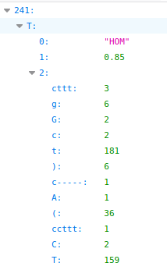
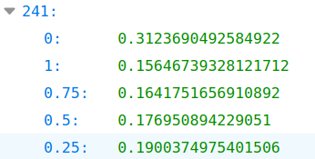
Results
- rather vague
- works only if hom samples exist
- error term handling

Slide 8
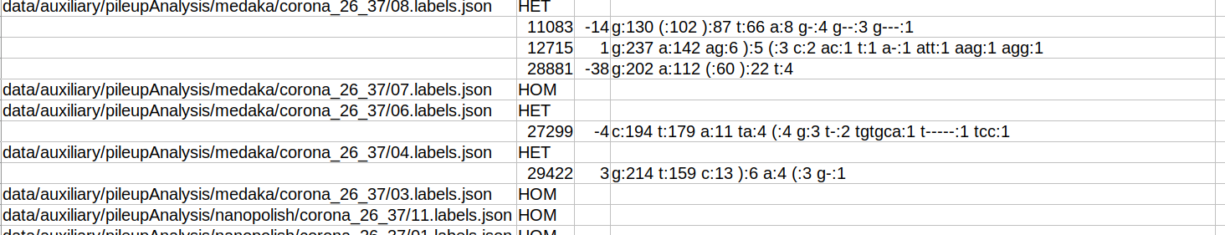
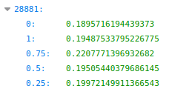
other news
Label samples as pure/mixed based on variant call labels
Posterchild 4 has only one HET call by our criteria
Posterchild 8 has only one HET call with corresponding HOMs

Slide 9
other news
03_11/03 is posterchild for pure but our method detects it as HET (medaka)

Slide 10
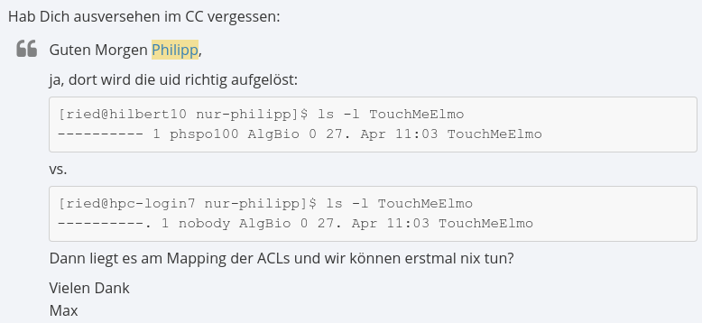
hpc

