Slide 1
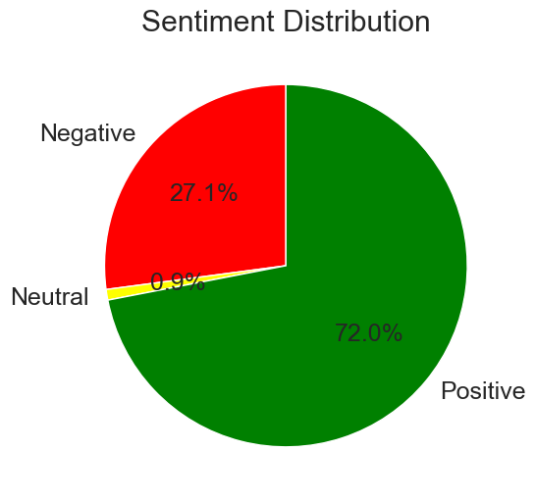
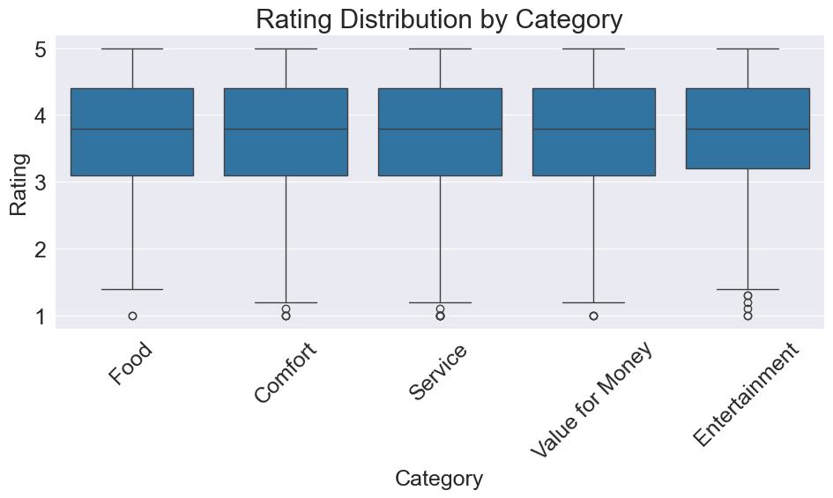
British Airways Customer Review Analysis: Key Insights & Recommendations
Data Source: 3,908 customer reviews scraped from airlinequality.com. Overall Sentiment: Predominantly positive (72%), with a significant portion of negative feedback (27%) and a small number of neutral reviews (1%). Review Length: Positive reviews are generally longer and more detailed, while neutral reviews are concise. Negative reviews fall in between. Key Themes (LDA & Word Clouds): Positive: Crew service, in-flight experience (food, entertainment), punctuality (especially London/Heathrow) and premium classes. Negative: Staff interactions, flight delays, seating, verification/check-in and baggage. Neutral: Booking, payment, cancellations and transactional aspects. Rating Distribution by Category: Overall positive ratings across all categories (Food, Comfort, Service, Value for Money, Entertainment), with medians around 4 out of 5. Entertainment shows slightly more variability with more low-end outliers.

Slide 2
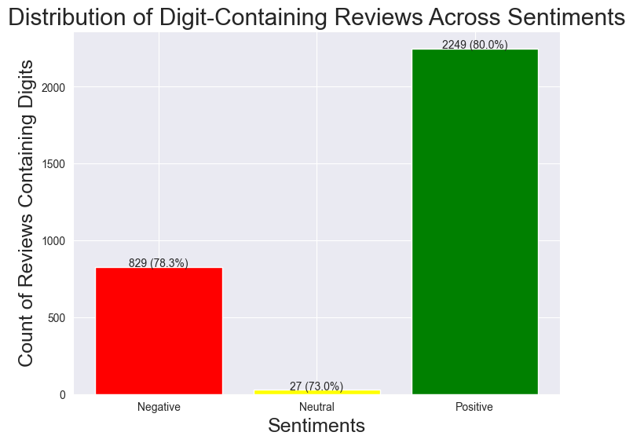
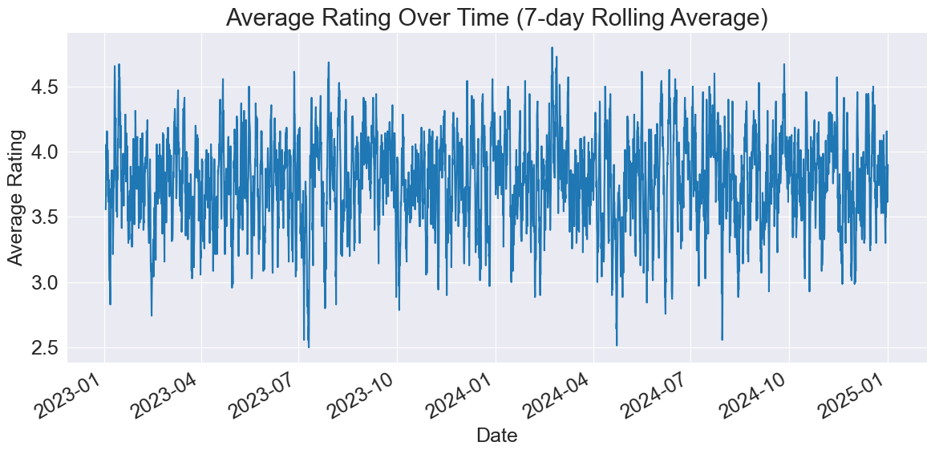
Enhancing Customer Experience: Actionable Recommendations
Leverage Strengths: Recognize high-performing staff for crew service and in-flight experience. Enhance in-flight amenities (food, entertainment, comfort). Promote punctuality on key routes. Address Pain Points: Invest in staff training on customer service and conflict resolution. Minimize flight delays and improve communication during disruptions. Optimize seating for comfort and customer satisfaction. Streamline check-in and baggage handling processes. Engage Neutral Customers: Improve transactional processes (booking, check-in) to convert neutral feedback into positive sentiment. Monitor Trends: Continuously track feedback to assess changes and identify emerging issues. Further Analysis: Conduct deeper analysis on key topics (e.g., seating, baggage) from LDA insights.

