Slide 1

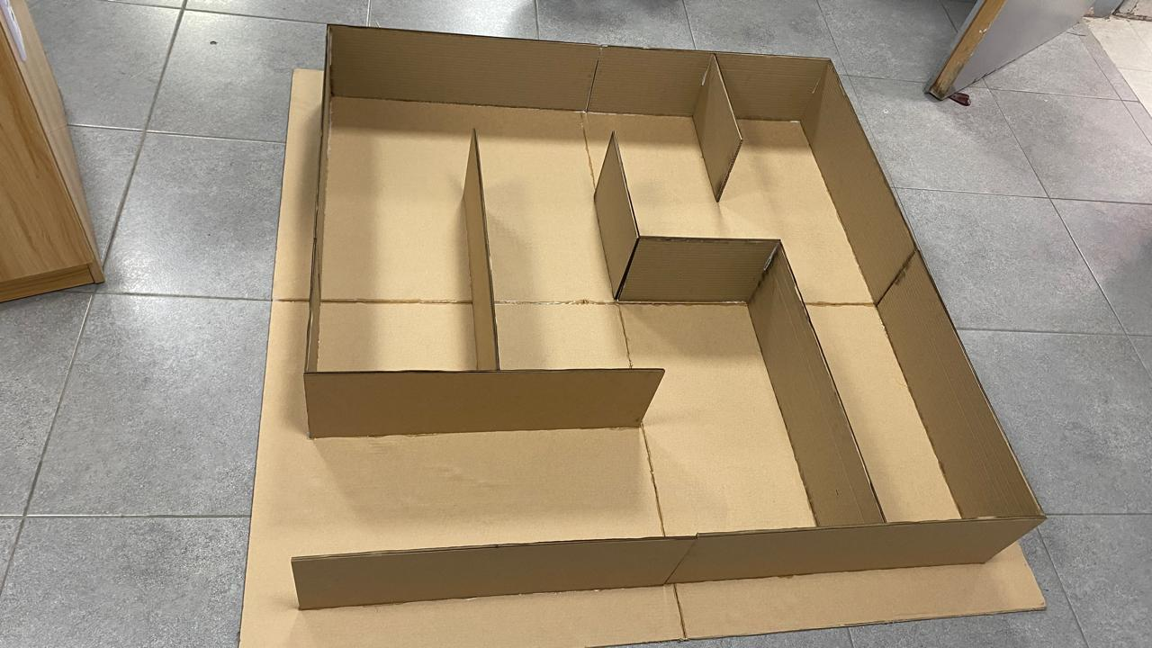
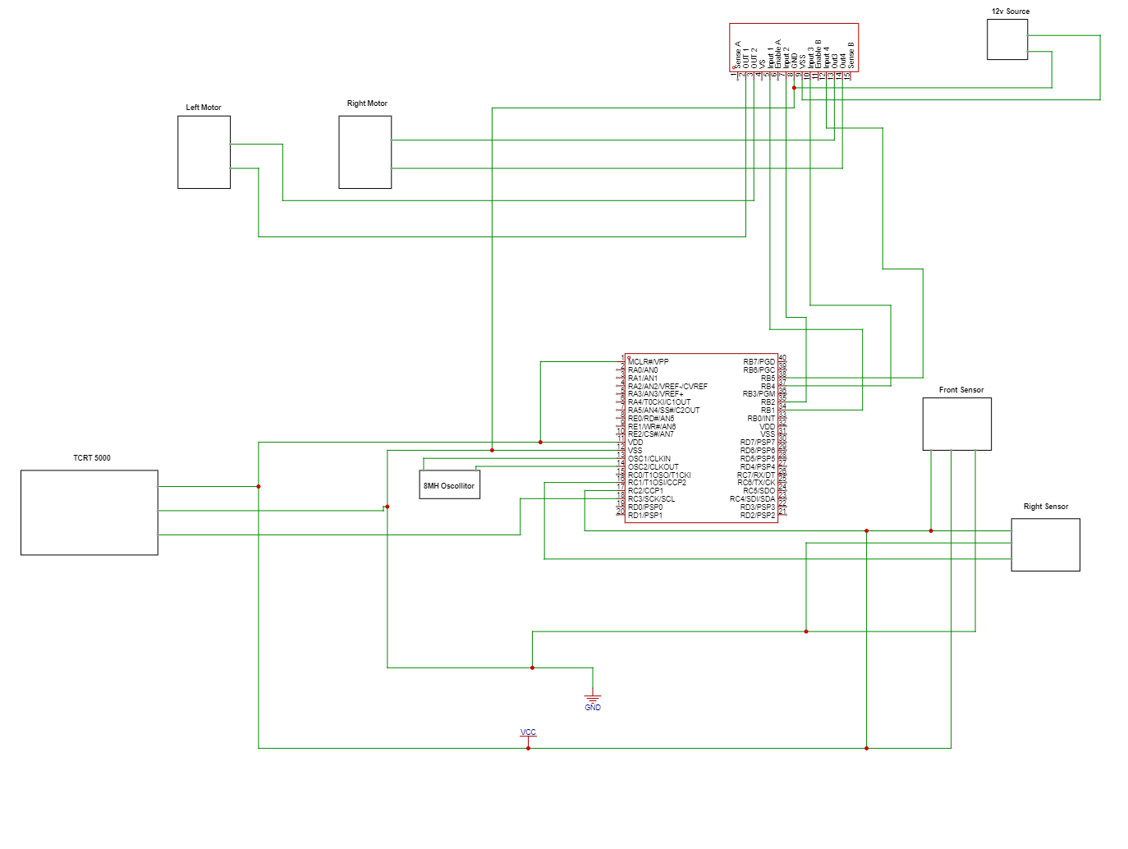
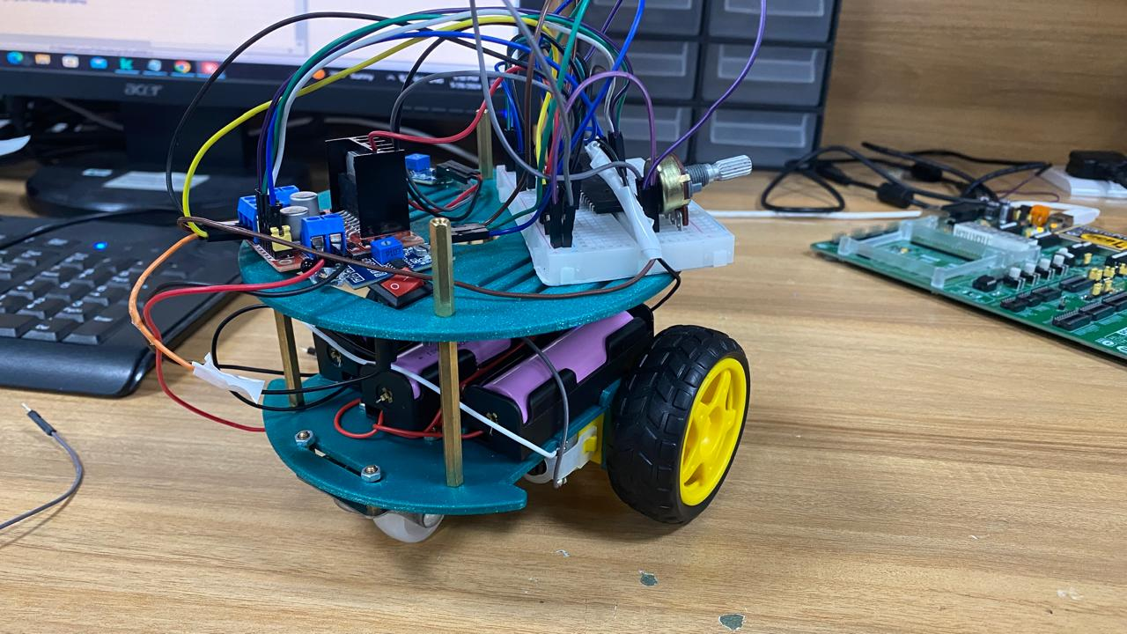
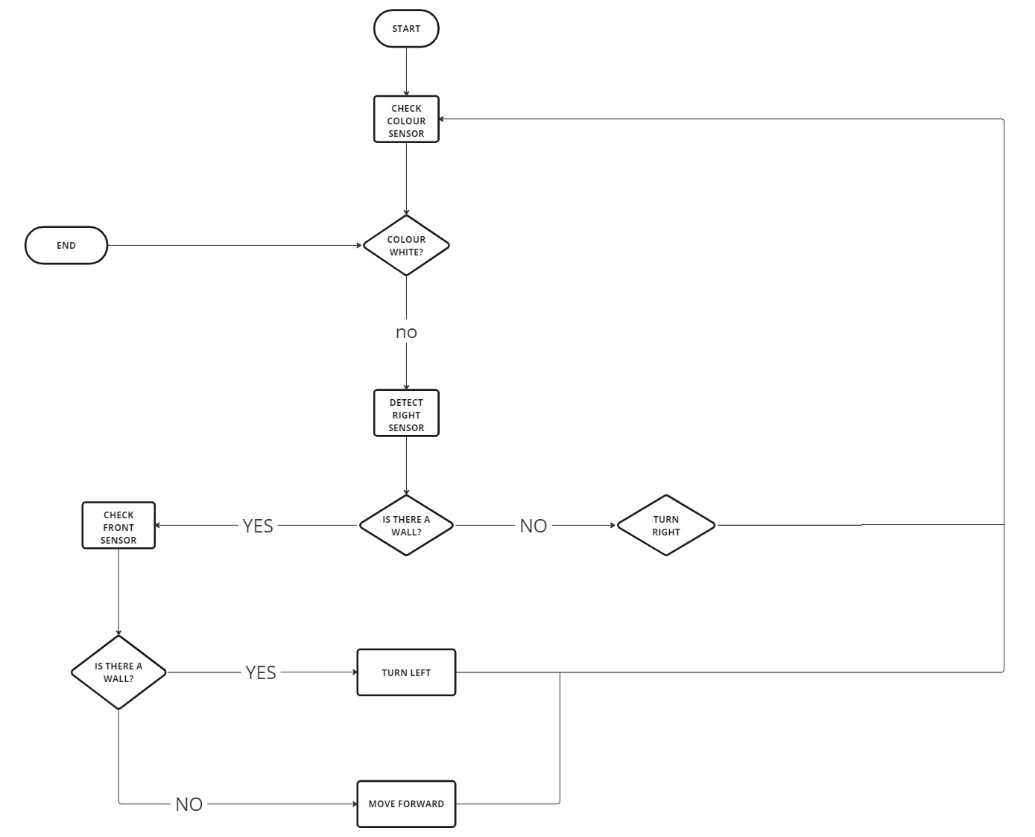
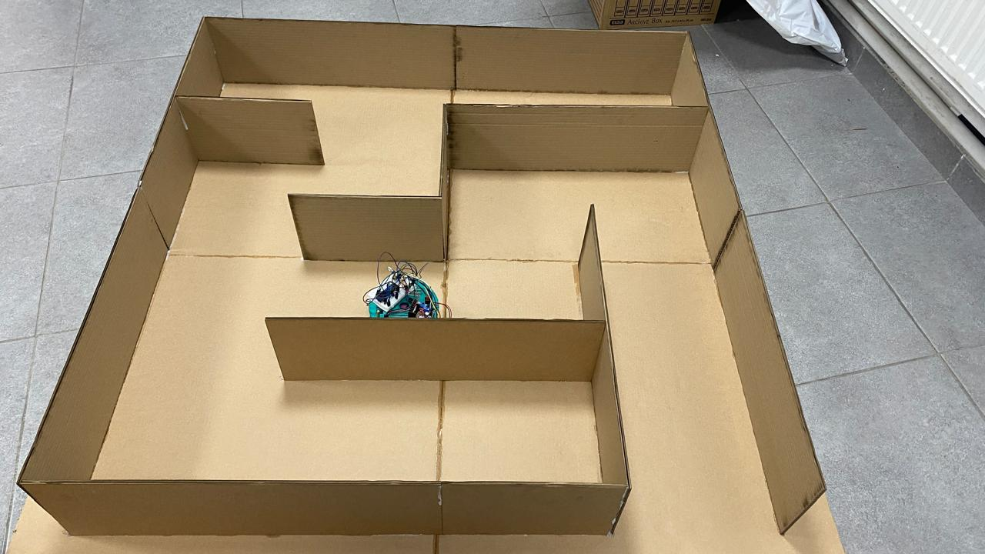
Title that hints at the underlying issue or project purpose/goal
S.AbuKhalaf, A.almaslamani, O.Aldakker
Supervisor: Dr. Belal Sababha
Embedded Systems Final Design Project, Spring 2024
King Abdullah II School of Engineering
Princess Sumaya University for Technology
Introduction
Our project centers on the development of a maze solver robot, engineered to autonomously navigate through complex mazes with precision and efficiency. Powered by the versatile PIC 16F877A microcontroller, our robot employs sophisticated navigation algorithms and sensor technologies to conquer the intricacies of maze traversal. By adhering to a meticulously crafted right-following algorithm and leveraging a digital color sensor for destination identification, our robot exemplifies the fusion of hardware and software prowess. Through meticulous design and implementation, we demonstrate the capabilities of our maze solver robot to adeptly navigate diverse maze configurations, showcasing its potential for practical applications across industries.
Results
Figure 1
Figure 2
Figure 3
Design
Hardware
Software
Conclusion
In summary, our maze solver robot project successfully solves mazes using PIC16F877A MCU. By following the right wall of the maze, the robot navigates efficiently to the end of it. The project highlights the practical application of automation in solving multiple scenarios, showcasing a simple yet effective solution.

