Slide 1



GRADUATION PROJECT
V-MOVE: VOICE-ACTIVATED WHEELCHAIR
Supervised: Dr. Saeed Alshahrani
Co-Supervised: Dr. Nayyar Ahmed Khan
Project Members :
Abdulrahmna Abdullah AL-Duaij
Fahad mathkar Alotibi

Slide 2

CONTENT
01
INTRODUCTION
02
REQUIREMENTS
03
MATERIALS AND METHODS
04
RESULTS
05
CONCLUSIONS AND FUTURE WORK

Slide 3



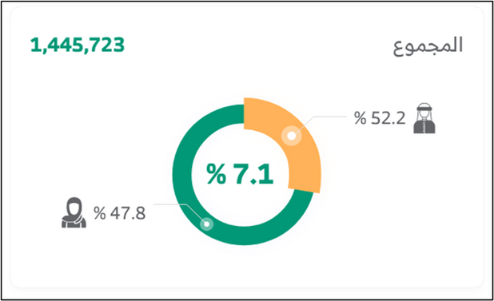

INTRODUCTION
- The rapid advancement of modern technology.
- Assistive technologies that aim to improve the lives of people with disabilities, and wheelchairs in particular stand out as a development of assistive technologies that provide independence
-The demand for wheelchairs will increase to $2.3 billion in 2027, and the World Health Organization estimates that only 5% to 15% of the 75 million people need assistive technologies.

Slide 4





REQUIREMENTS
Hardware
System & Software
Data and Contents
• Voice Data
• Sensor Data
1. Arduino UNO Board.
2. L293D Motor Shieldز
3. Bluetooth Module HC-05.
4. Ultrasonic Sensor HC-SR-04.
5. 18650 Holder and Battery.
6. DC Geared Motors.
7. Jumper Wires.
8. Caster wheel.
9. Wheel
1. Arduino Software IDE.
2. Android Application.
An application in the Android operating system written in java and C++.

Slide 5

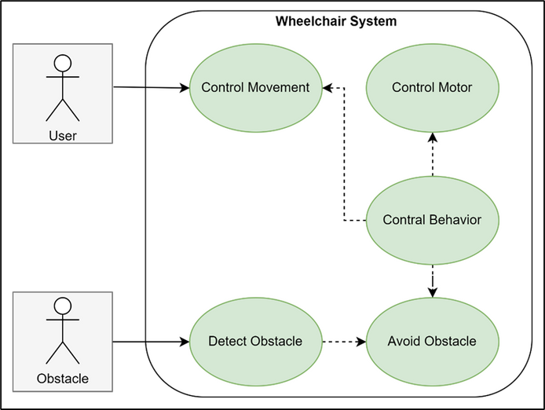
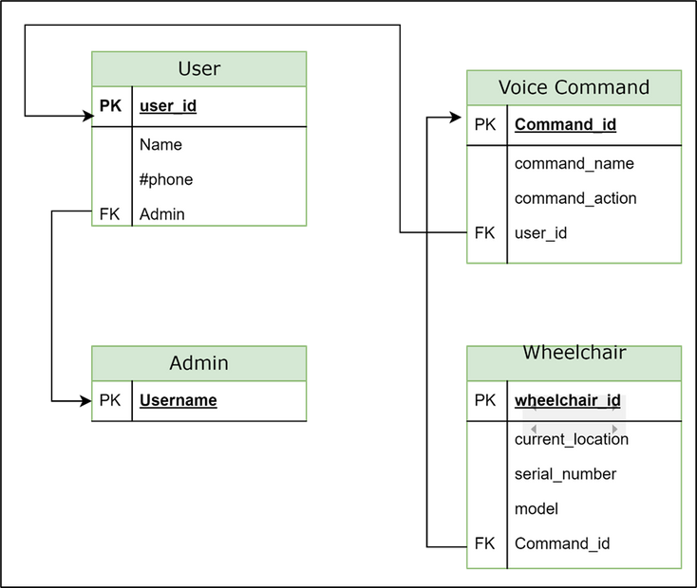
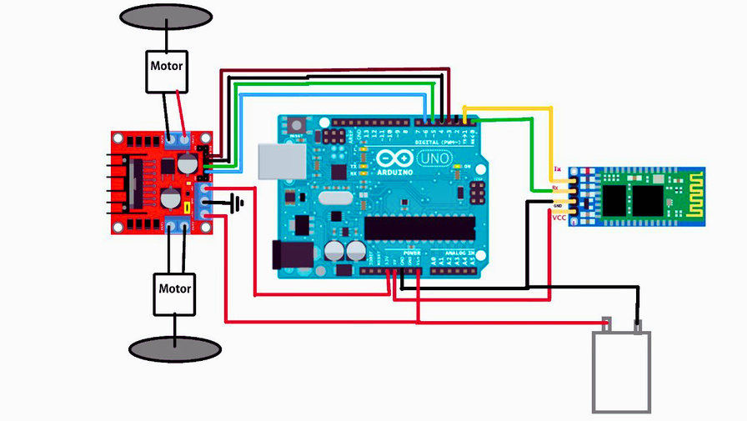
MATERIALS AND METHODS
Use Case Diagram
Database Schema
Circuit Diagram

Slide 6
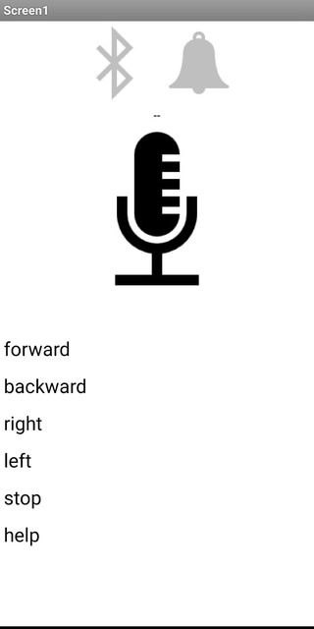
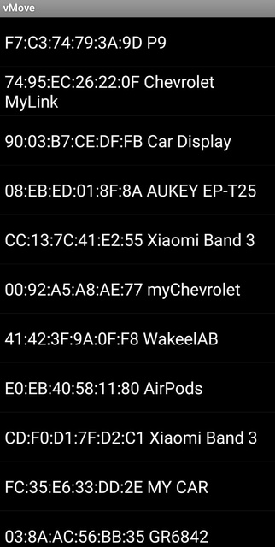

RESULTS
First, the application on the smartphone captures the voice of the operator. Then, a speech recognition software on the phone is used to convert the spoken words into textual commands. The generated textual commands are then packaged into a data format (suitable for transmission) and send via Bluetooth to the Arduino board. The Arduino program parses the received data to extract the voice commands. Based on the interpreted command, the Arduino program triggers the corresponding action. This could involve controlling the motors, activating the sensors, or performing other tasks.
Based on the interpreted command, the Arduino program triggers the corresponding action. This could involve controlling the motors, activating the sensors, or performing other tasks.
HOMEPAGE
BLUETOOTH PAGE

Slide 7
CONCLUSIONS AND FUTURE WORK
Voice-activated wheelchair control is a promising field in assistive technology, aiming to enhance user independence and accessibility.
Advancements in wireless communication (Bluetooth) and embedded systems (Arduino) have enabled innovative solutions in voice-controlled wheelchairs.
This project utilizes an Arduino Uno board and a smartphone application to enable voice control over wheelchair movement, promoting independence and accessibility for users. Future advancements may include obstacle detection sensors and expanding the voice command repertoire for a more comprehensive user experience.

Slide 8

THANK YOU

