Slide 1
HEART DISEASE PREDICTION USING MACHINE LEARNING
Group Presentation
CSE299 Section-1
North South University|2025
Group 5

Slide 2
introduction
Background:
Heart disease is a leading cause of global mortality.
Traditional diagnostic methods (e.g., manual tests, clinical evaluations) are often slow, costly, and subject to human error.
Machine learning (ML) has the potential to speed up the process and improve accuracy by analyzing large datasets and identifying complex patterns.
Previous work shows that ML techniques can optimize diagnostic performance in heart disease prediction.
Al Imran, MD. Mukzanul Alam Nishat, Khondkar Sayif Ali, Arman Hossain Nawmee, MD Araf UI Haque Dhrubo (Group 5)

Slide 3
introduction
Purpose of the Study:
This study compares four widely used supervised ML algorithms (Logistic Regression, SVM, Decision Tree, and Random Forest) for the task of binary classification in heart disease prediction.
We evaluate these models on two datasets with different distributions but the same features to assess their stability and generalizability across varied data conditions.

Slide 4
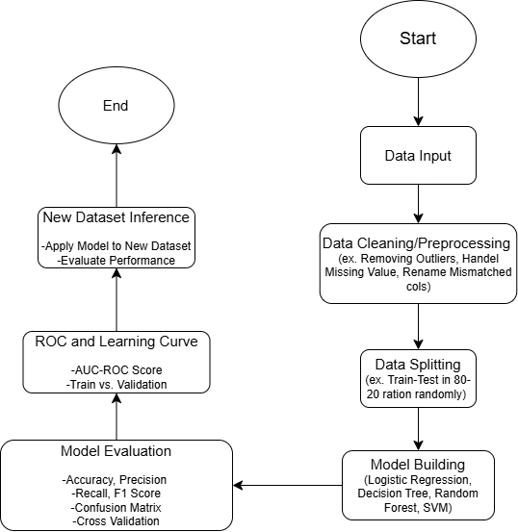
Work Flow

Slide 5
Dataset
Column Name | Meaning | Range (Dataset-1) | Range (Dataset-2)
age | Age of the patient | [20,80] | [29,77]
gender | Gender of the patient | 0 = female, 1 = male | 0 = female, 1 = male
chestpain | Type of chest pain experience | [0,3] | [0,4]
restingBP | Testing blood pressure | [94,200] | [94,200]
serumcholestorol | Serum cholesterol level | [0,602] | [126,564]
fastingbloodsugar | Fasting blood sugar level | 0 = false, 1 = true | 0 = false, 1 = true
restingrelectro | Resting electrocardiographic result | [0,2] | [0,2]
maxheartrate | Maximum heart rate achieved | [71,202] | [71,202]
exerciseangia | Exercise-induced angina | 0 = no, 1 = yes | 0 = no, 1 = yes
oldpeak | ST depression induced by exercise relative to rest | [0,6.2] | [0,6.2]
salop | Slope of the peak exercise ST segment | [0,3] | [0,3]
noofmajorvessels | Number of major vessels colored by fluoroscopy | [0,3] | [0,4]
target | 0 = No heart disease, 1 = heart disease | 0 = no, 1 = yes | 0 = no, 1 = yes

Slide 6
The models
In this project we used –
Logistic Regression
Decision Tree
Random Forrest
Support vector machine

Slide 7
Methodology
Preprocessing Steps:
Data Cleaning
Feature Engineering
Handling Class Imbalance
Modeling Process:
Split the data into training (80%) and testing (20%) sets.
using the Standard Scaler
tune hyperparameters
Evaluation
Cross-validation
Learning curves

Slide 8
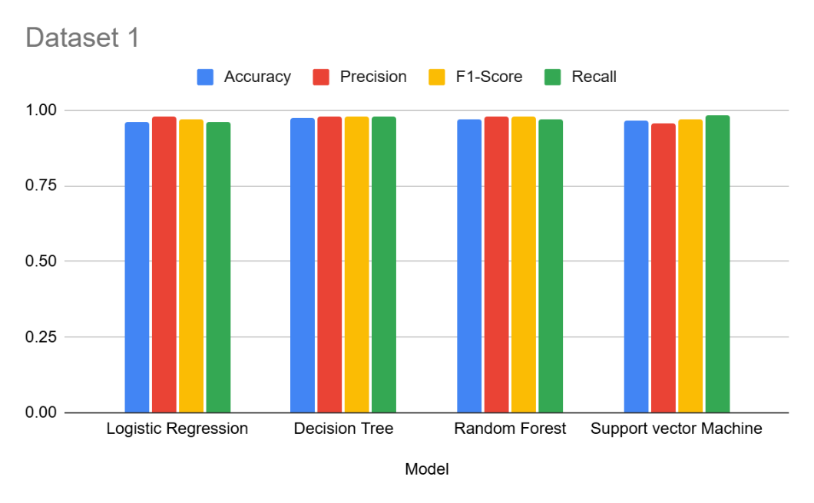
Performance of dataset 1
Model | Accuracy | Precision | F1-Score | Recall
Logistic Regression | 0.96 | 0.98 | 0.97 | 0.96
Decision Tree | 0.973 | 0.977 | 0.977 | 0.977
Random Forest | 0.97 | 0.98 | 0.98 | 0.97
Support vector Machine | 0.965 | 0.956 | 0.969 | 0.982

Slide 9
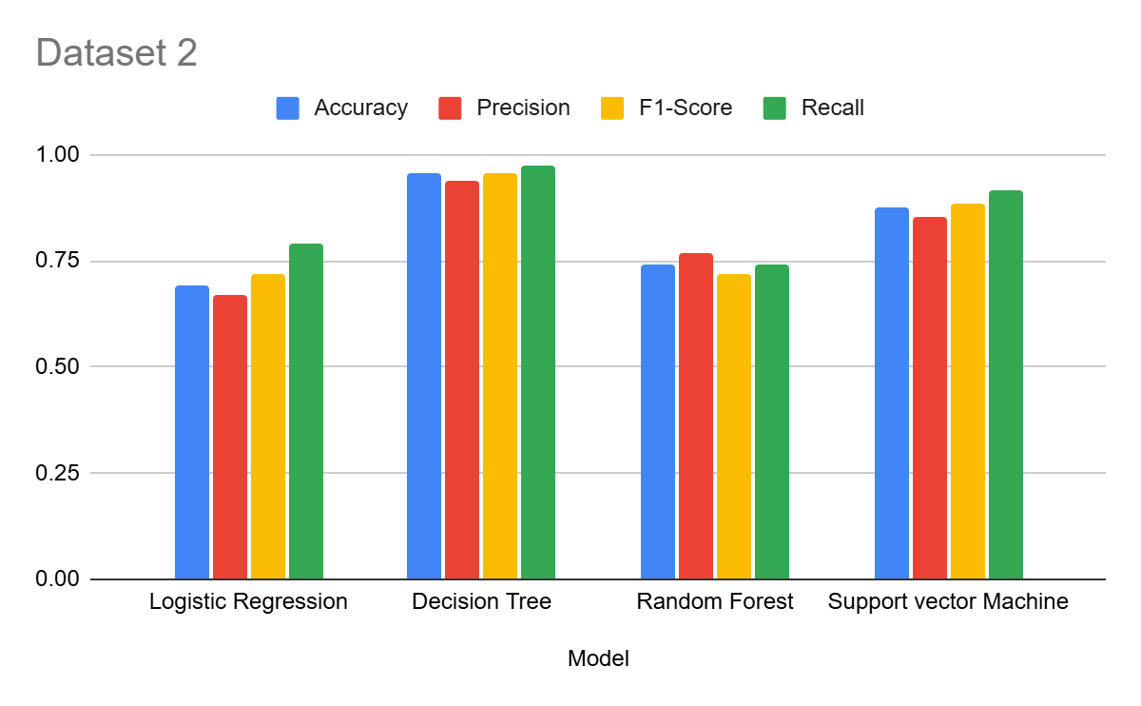
Performance of dataset 2
Model | Accuracy | Precision | F1-Score | Recall
Logistic Regression | 0.69 | 0.67 | 0.72 | 0.79
Decision Tree | 0.955 | 0.94 | 0.958 | 0.976
Random Forest | 0.74 | 0.77 | 0.72 | 0.74
Support vector Machine | 0.878 | 0.852 | 0.883 | 0.915

Slide 10
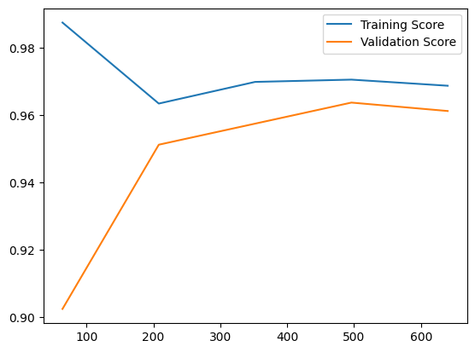
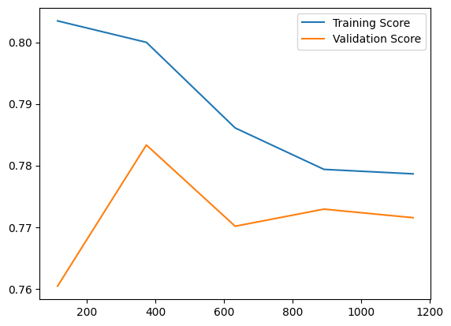
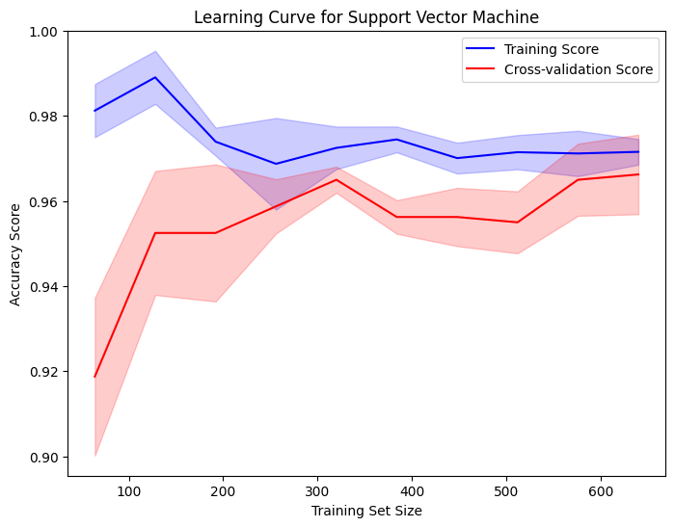
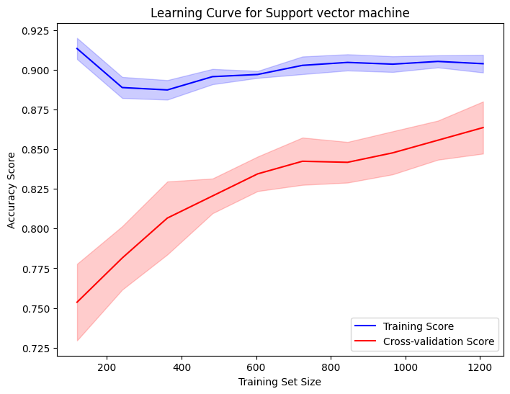
Graphical representations (Learning curve)
Logistic Regression (dataset 1 and dataset 2
SVM (dataset 1 and dataset 2)

Slide 11
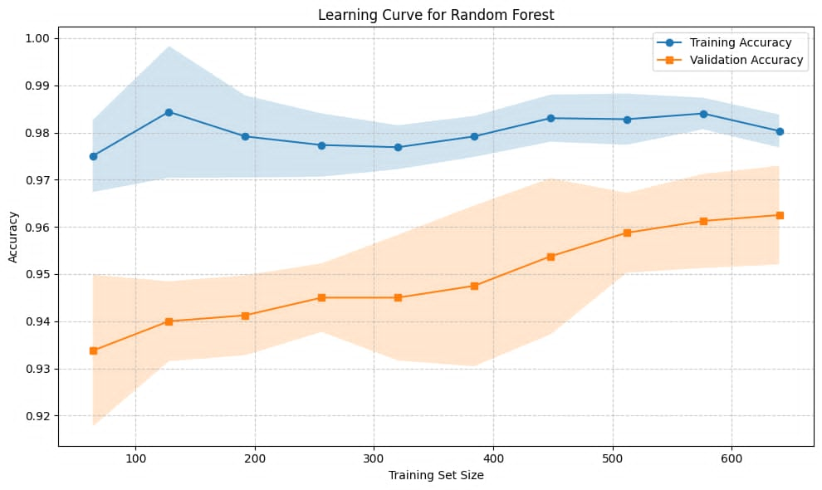
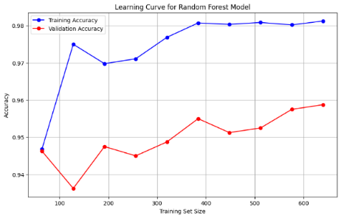
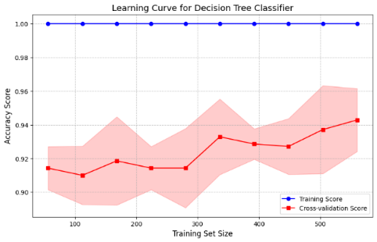
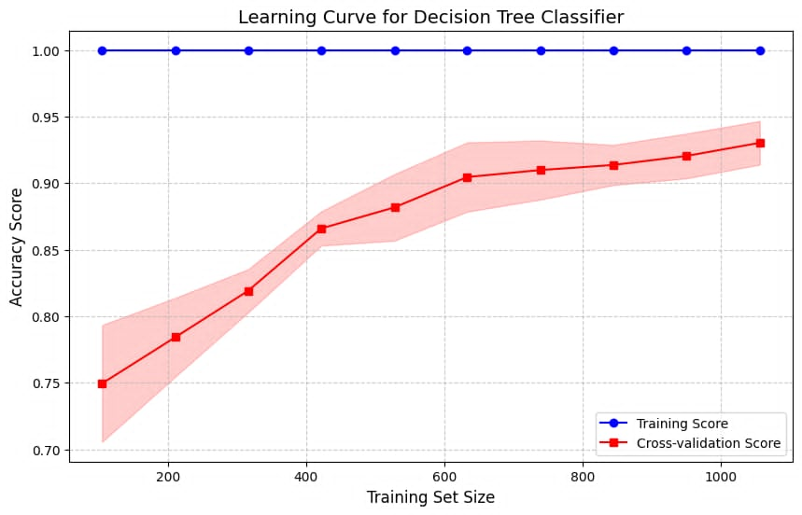
Graphical representations (Learning curve)
Random Forest (dataset 1 and dataset 2)
Decision Tree (dataset 1 and dataset 2)

Slide 12
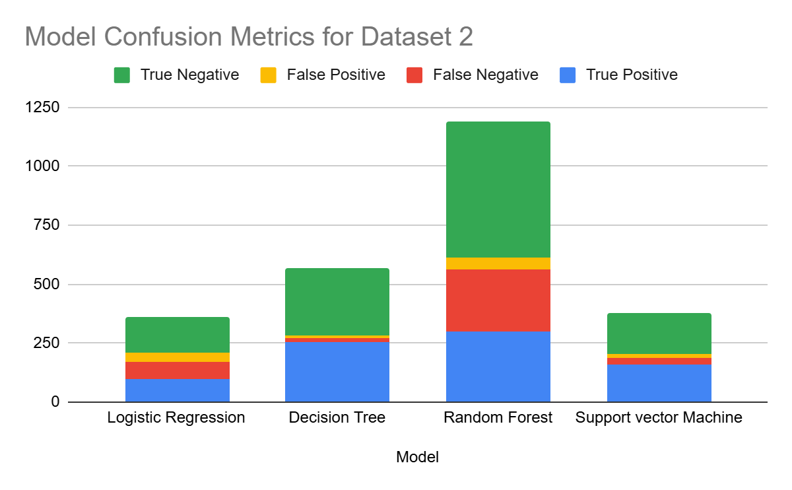
Comparison Between Models confusion Matrix
Model | True Positive | False Negative | False Positive | True Negative
Logistic Regression | 99 | 73 | 40 | 148
Decision Tree | 256 | 18 | 7 | 286
Random Forest | 298 | 263 | 51 | 578
Support vector Machine | 158 | 30 | 16 | 174

Slide 13
Limitation and Future work
Limited to tabular datasets, which restricts the model's predictive power.
Incorporating multimodal data (e.g., ECG signals, lifestyle information) could enhance performance.
Does not account for regional variations in heart disease prediction, limiting localized insights.
Future work will focus on:
- Integrating multimodal datasets to provide a more comprehensive view of patient health. - Implementing additional techniques (e.g., post-pruning or GANs) to reduce overfitting and improve model robustness.

Slide 14
Challenges
Logistic Regression and Random Forest were more sensitive to data distribution variations, showing significant performance degradation on Dataset 2.
Even performing Hyperparameter tuning did not show much improvement.
SVM was effective but not as stable as Decision Tree across datasets.

Slide 15
Conclusion
This study compared the performance of four machine learning models on heart disease prediction across two datasets.
Decision Tree emerged as the most stable and consistent model, outperforming others in terms of accuracy and generalization.
Logistic Regression and Random Forest faced challenges with data distribution and consistency.

Slide 16


