Slide 1
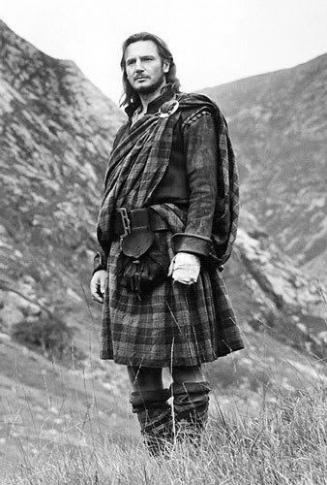
Epistemology & knowledge in Islamic legal theory & theology
Epi
Dale J. Correa, PhD | UT Austin

Slide 2
Tracing the epistemological tradition
Echoes over time and space
Al-Nasafī’s text is obviously dependent on previous scholars’ work: whose?
Al-Nasafī’s text is almost identical to that of two of his contemporaries: how? And then, why?
Future question: how did the relationship between Ḥanafī theology and legal theory develop into the theological turn of the 12th century CE?

Slide 3
Aspirations and solutions
Corpus of excerpts from three scholars on khabar (testimony)
Sentence by sentence comparison view
Aspirational: planned wireframe of website, visualization
Annotate for structure, identical terms, and shared topics
And/or topic modeling
Aspirational: across legal theory corpus, would address research question #3
Voyant Tools revealed that *excerpts* are not long enough to be effective for topic modeling

Slide 4
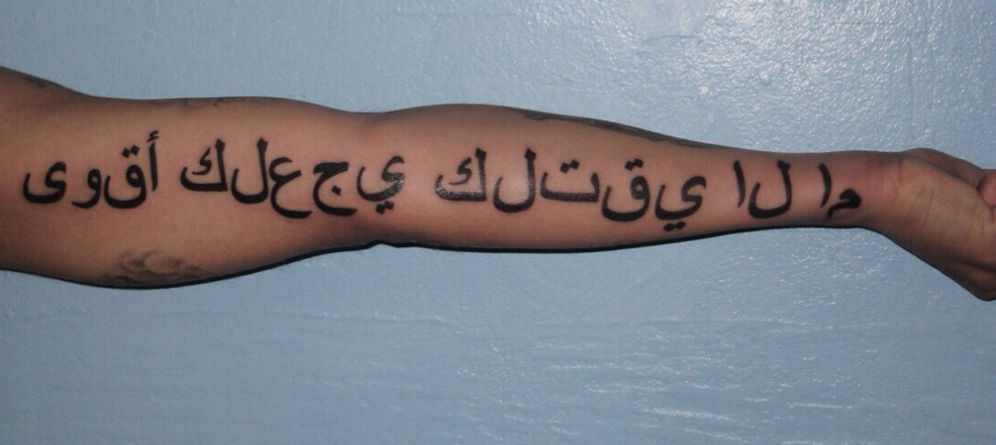
Make good choices
http://www.gettysburgcollegeitt.org/LRCblog/2014/12/when-arabic-tattoos-go-bad-or-why-you-should-talk-to-a-translator-first/

Slide 5
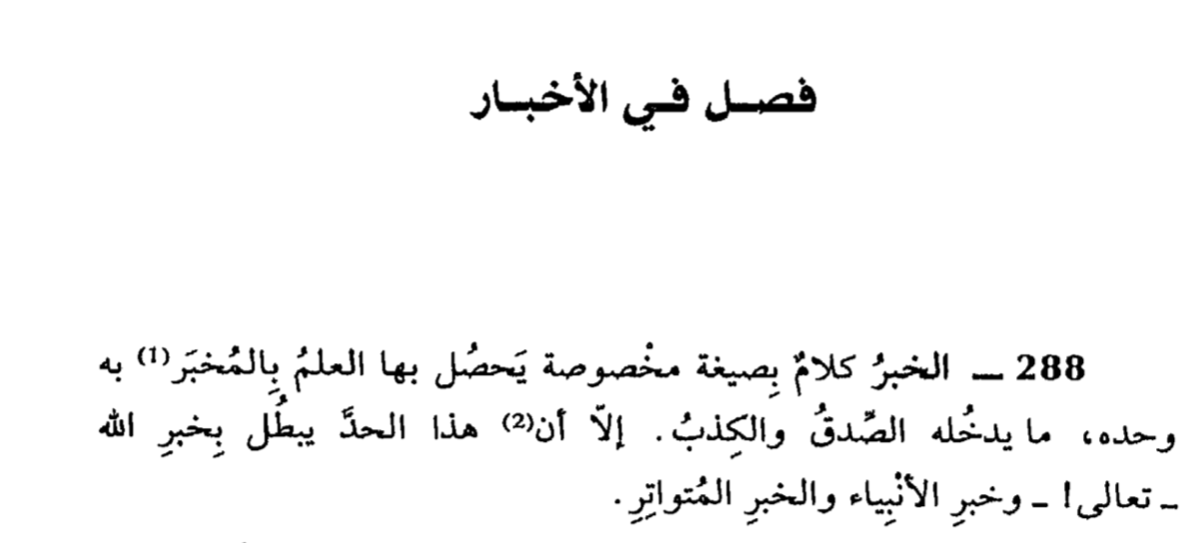
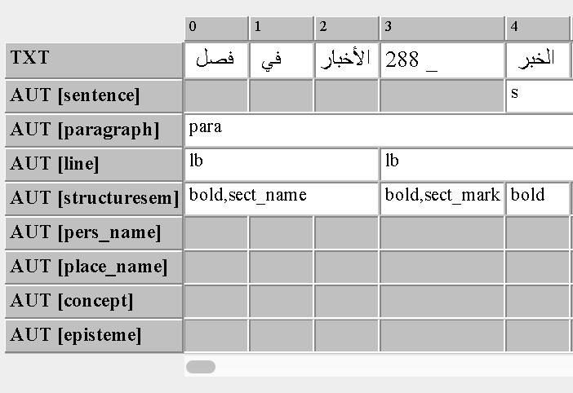
(?tools digital LTR Or) Arabic of challenges the: perspective

Slide 6
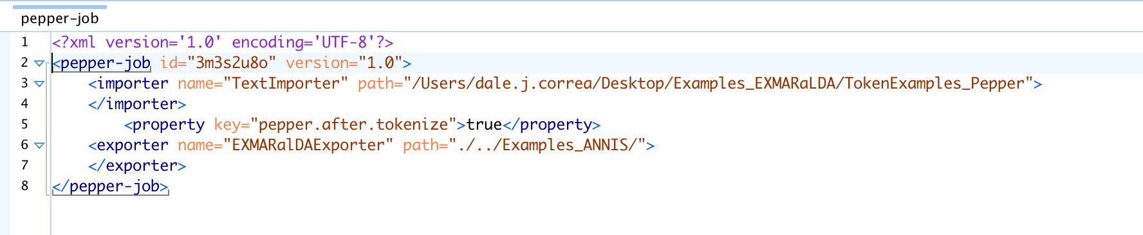
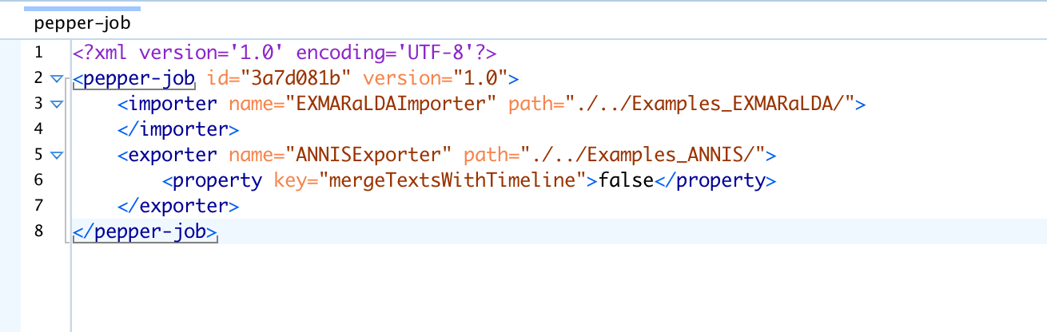
Making it work

Slide 7
ANNotation
TXT: normalized, with the exception of formatting
Sentence
Structuresem
Paragraph
Line
Pers_name
Place_name
Concept
Episteme
Def_arg
Quran

Slide 8
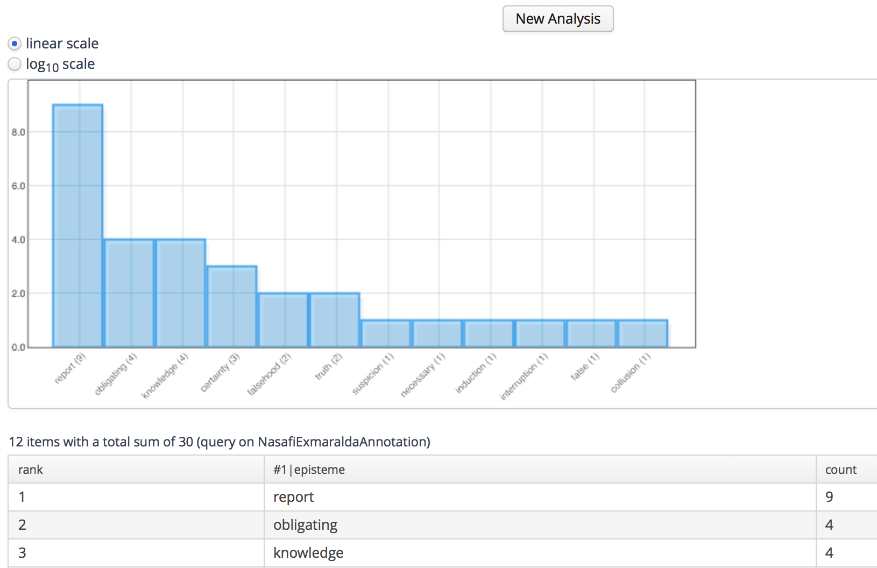
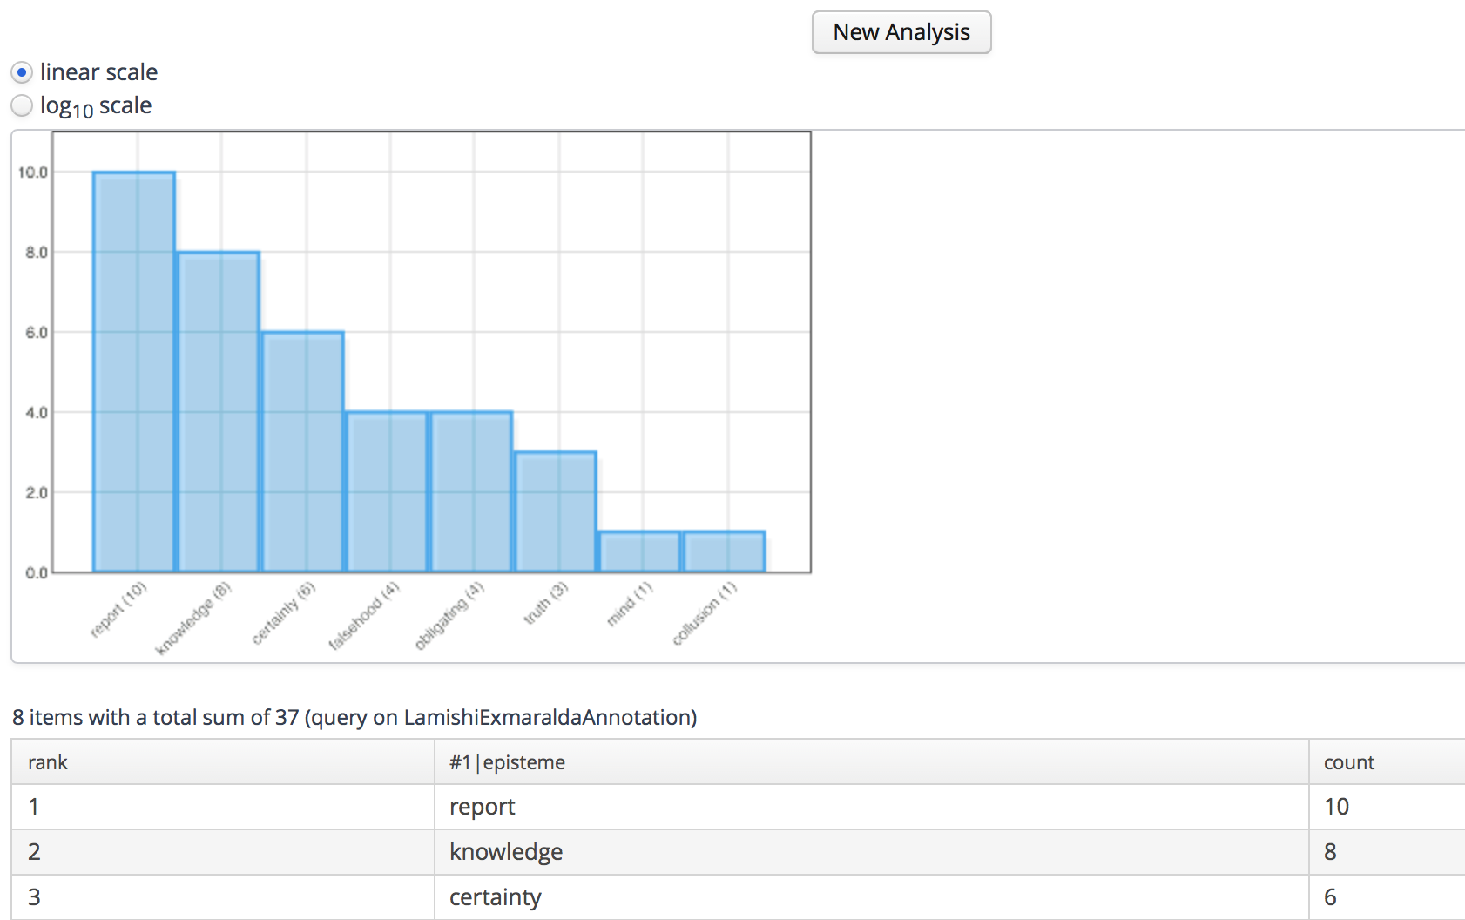
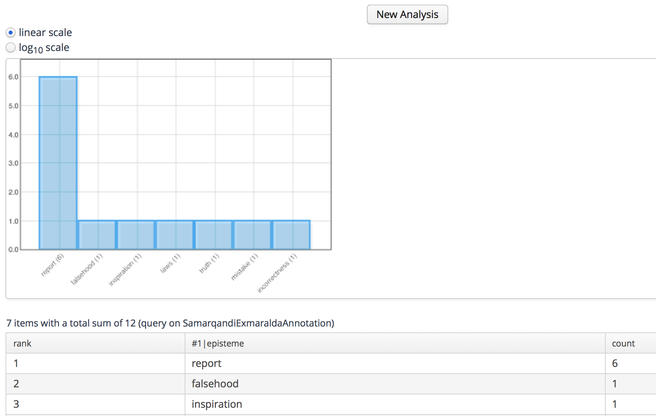
ANNIS: Episteme Frequency Analysis
Al-Nasafī
Al-Lāmishī
Al-Samarqandī

Slide 9
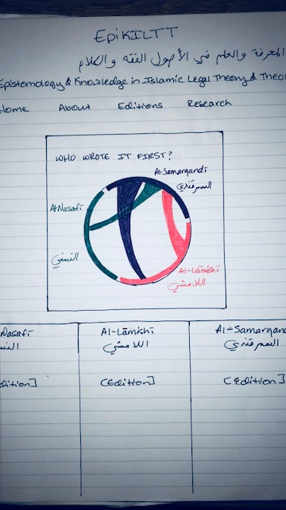
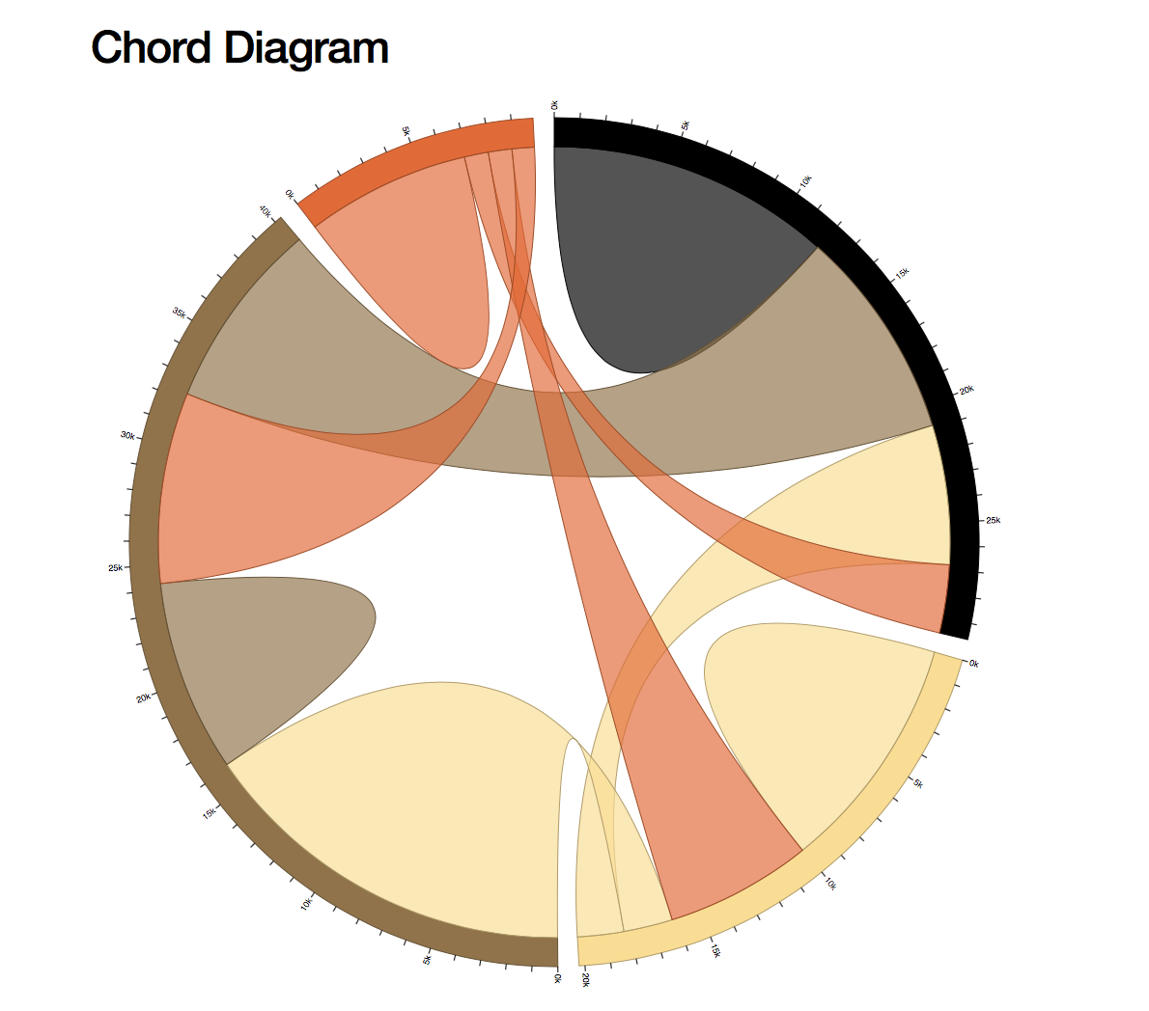
Wireframe
& Visualization
https://bl.ocks.org/mbostock/4062006

Slide 10
goals
Realities and aspirations
Build website for digital editions of these three sections on testimony
Finish digital edition of complete Nasafi text
Create corpus of Islamic legal theory texts from 8th – 12th centuries CE for topic modeling for course project and to address the following question:
How does the structure of Islamic legal theory works change over time and by school?

