Slide 1
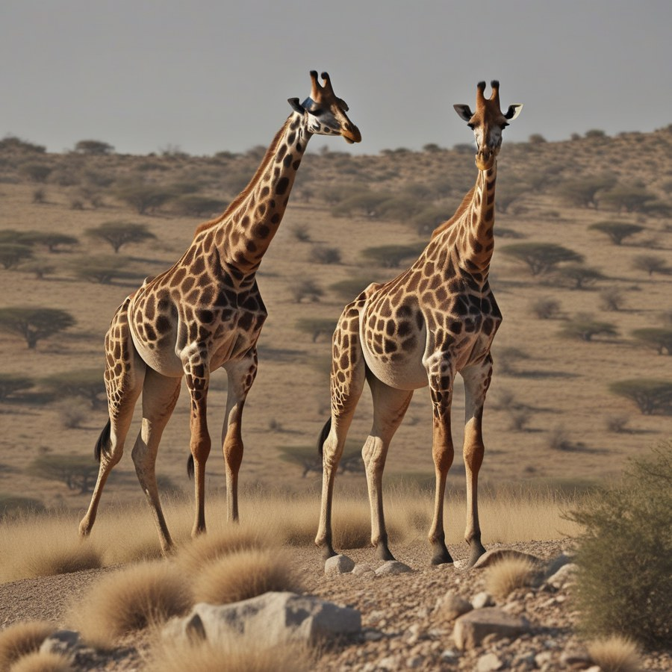
Training-free Enhancement of SDXL
FreeU · PAG · DUNE: what helps, and at what cost
[Name A] · [Name B] · [Name C]
Generative AI Technical Review · November 2026
SDXL + PAG, prompt p130
Notes:
[0:00–0:20, Speaker A] Hi, we compared ways to make a text-to-image model draw better pictures without retraining it. In eight minutes: what the methods do, how we tested them, and what we found.

Slide 2
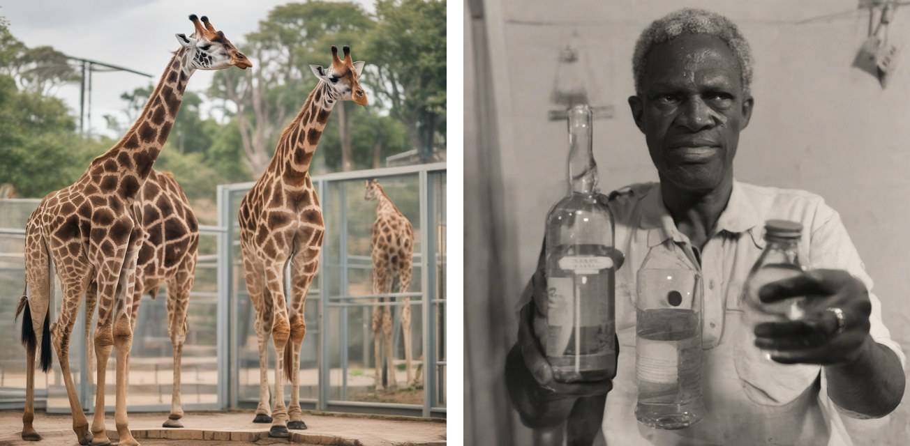
SDXL still draws broken structure
54%
of base-SDXL judgements were tagged with a structure or limb error
Retraining a 3.5B-parameter model is out of reach. Can we fix this at inference time instead?
Two giraffes with fused bodies and extra legs
“A man holding a bottle”: three bottles, tangled hands
Notes:
[0:20–0:50, Speaker A] Even a strong model like SDXL still makes structural mistakes: animals with extra legs, hands holding three bottles. In our blind study, over half of the judgements on plain SDXL flagged a structure error. Retraining is expensive, so we look at methods that only change how the model is run.

Slide 3
Where the two fixes plug in
Text prompt
Two text encoders
U-Net denoising ×30 steps
VAE decoder
1024×1024 image
Inside the U-Net, at every step
skip connections
Down blocks
Mid block
Up blocks
PAG acts here
FreeU acts here
Notes:
[0:50–1:45, Speaker A] SDXL starts from random noise in a compressed latent space. A U-Net removes the noise over thirty steps, guided by the text, and a decoder turns the result into a picture. Both methods we test plug into that U-Net loop: FreeU changes how the upsampling blocks mix their inputs; PAG adds an extra prediction at the middle block. Neither one changes the model's weights.

Slide 4
FreeU: rebalance structure and detail
The U-Net decoder mixes two signals:
Backbone features carry layout and meaning
Skip connections carry fine, high-frequency detail
When detail dominates, structure can fall apart. FreeU turns the backbone up and the skip detail down.
SDXL settings we used
Backbone ×1.3 / ×1.4
Skip detail ×0.9 / ×0.2
+3%
inference time: four multiplications per block
Notes:
[1:45–2:45, Speaker B] FreeU starts from one observation. Inside the U-Net, the main path decides the overall layout, while skip connections bring in fine detail. If the detail wins, structure suffers. FreeU simply amplifies the main path and damps the skip path. It is almost free: about three percent extra time.

Slide 5
PAG: learn from a broken prediction
1
2
3
Predict as usual
Predict again, broken
Move away from it
The model predicts the noise to remove, guided by the text.
Same step, but self-attention is replaced by the identity: the layout falls apart.
Push the sample away from the broken prediction (scale 3).
+47%
Like showing the model a deliberately bad draft and saying “not like this”.
inference time: one extra U-Net pass per step
Notes:
[2:45–4:00, Speaker C] PAG works differently. At every step it asks the model for a second prediction where self-attention is switched off, which produces a version with broken structure. It then steers the image away from that broken version. Think of it as showing the model a bad draft and saying: not like this. The price is one extra pass through the network, so about fifty percent more time.

Slide 6
Same model, prompts and seeds
150
5
1,000
3 × 60
COCO captions, 5 categories
settings incl. our DUNE reimplementation
images on one NVIDIA A40
blind four-way human rankings
How we measured
CLIPScore: does the image match the text?
Similarity to the plain SDXL image: how much did the method change it?
Time and memory per image
Humans: pick best and worst of 4 shuffled images, tag failures
Notes:
[4:00–4:50, Speaker A] To keep it fair, every setting used the same SDXL model, the same 150 COCO captions and the same random seed per prompt, so the only difference is the method. We measured text alignment with CLIPScore, how much each method changes the image, speed and memory, and ran a blind study where three of us ranked four shuffled images for sixty prompts.

Slide 7
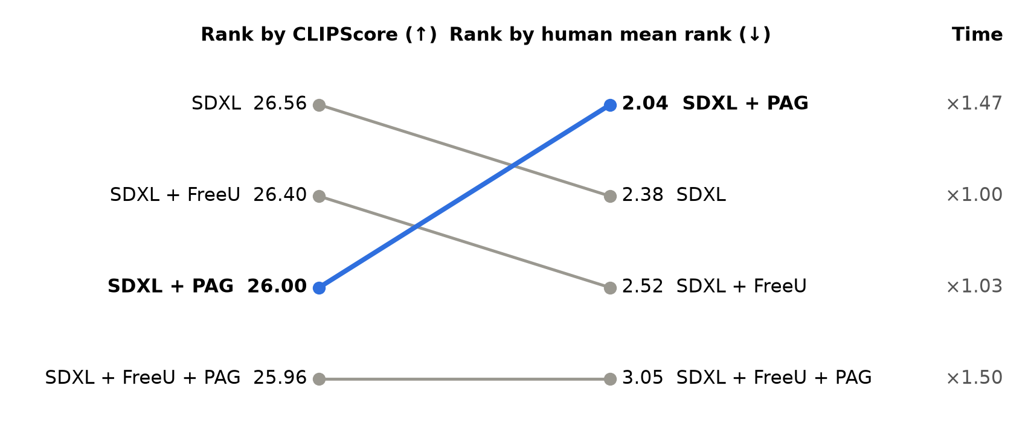
The metric and the raters disagree
CLIPScore only checks whether the named objects are present; it cannot see a fifth leg.
Notes:
[4:50–5:40, Speaker B] Here is our main finding. On the left, the automatic metric: no method beats plain SDXL, and PAG is third. On the right, human judgement: PAG comes first and is almost never picked as worst. The metric checks whether the objects in the caption are there, not whether they are drawn correctly. The cost column shows the trade-off: PAG takes about one and a half times as long.

Slide 8
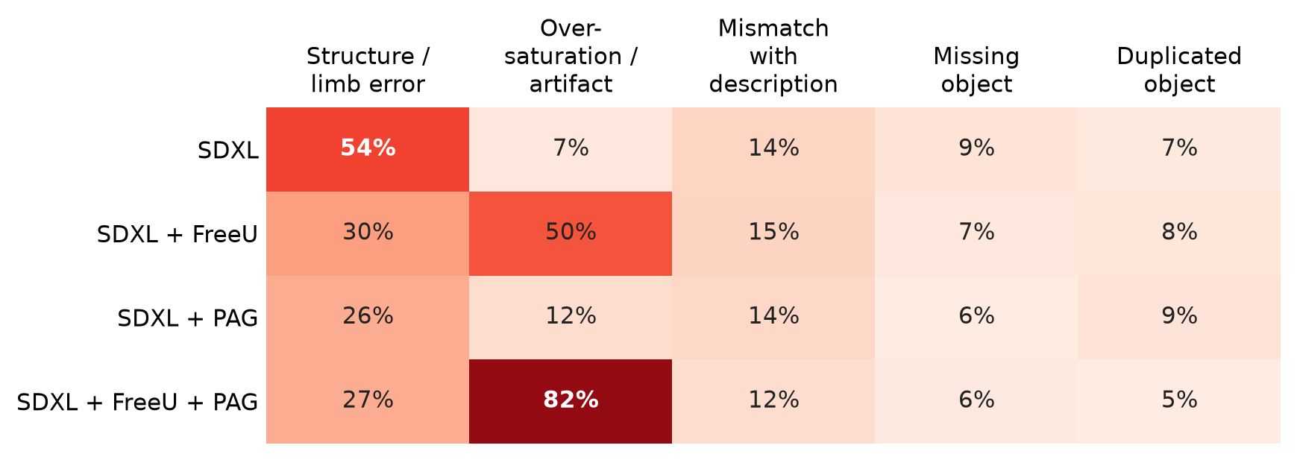
PAG fixes structure; stacking saturates
54→26%
structure errors, SDXL → PAG
7→82%
over-saturation, SDXL → FreeU + PAG
Share of judgements tagged with each failure
5%
42%
of judgements picked PAG as worst (SDXL 22%)
picked FreeU + PAG as worst
Notes:
[5:40–6:20, Speaker B] The failure tags explain the ranking. Plain SDXL's main problem is structure, flagged in 54 percent of judgements; PAG halves that. FreeU also helps structure but pushes colours too far, and stacking FreeU with PAG makes it worse: 82 percent flagged as over-saturated, and that combination is picked as worst most often.

Slide 9
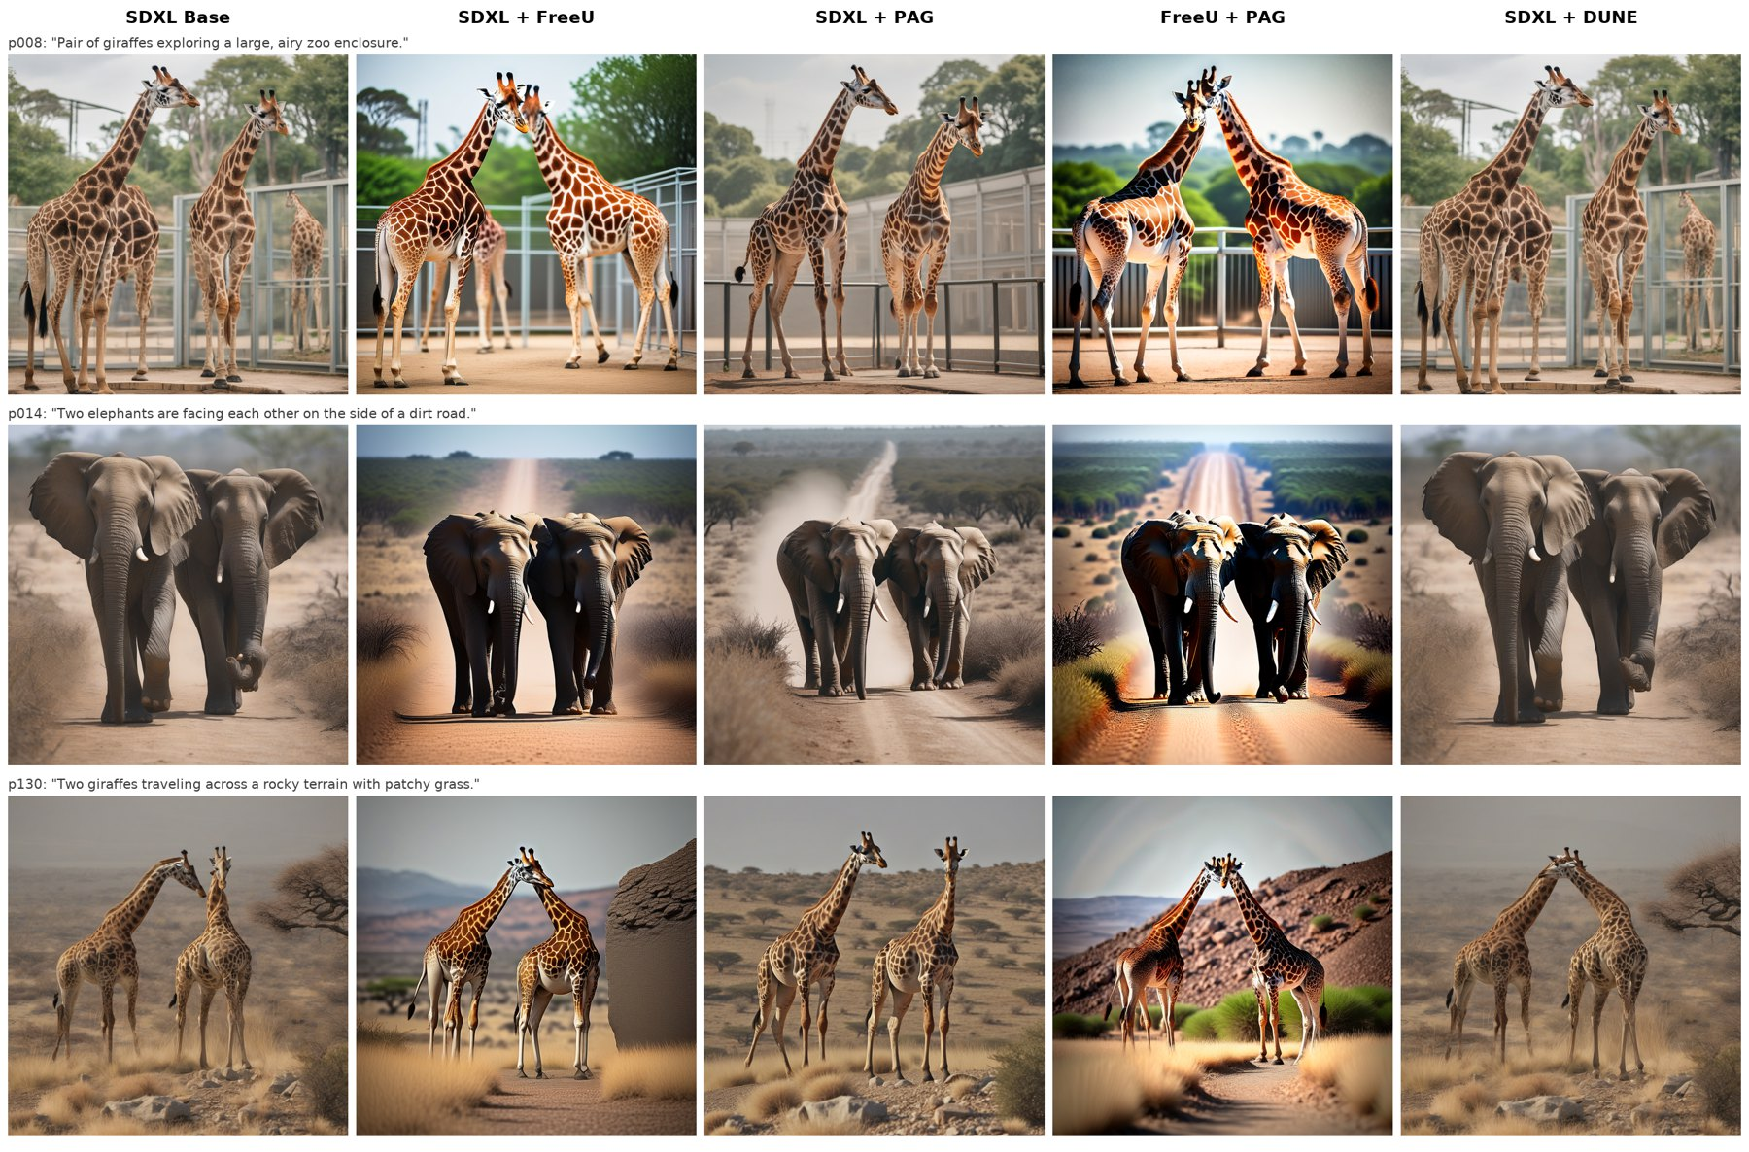
Two animals: where PAG helps most
Columns: SDXL, + FreeU, + PAG, + FreeU + PAG, + DUNE
SDXL and FreeU fuse the two giraffes and add legs
PAG separates them cleanly with natural colour
FreeU + PAG: right shapes, poster-like colour
Notes:
[6:20–6:45, Speaker C] Here is what that looks like. Two of the same animal is where SDXL struggles most: bodies merge and legs multiply. PAG keeps them apart; the combination gets the shapes right but the colours look like a poster.

Slide 10
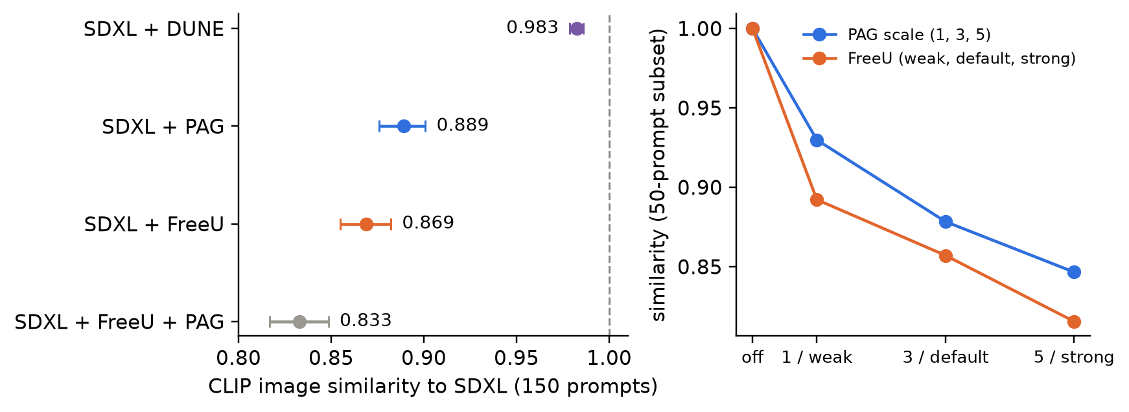
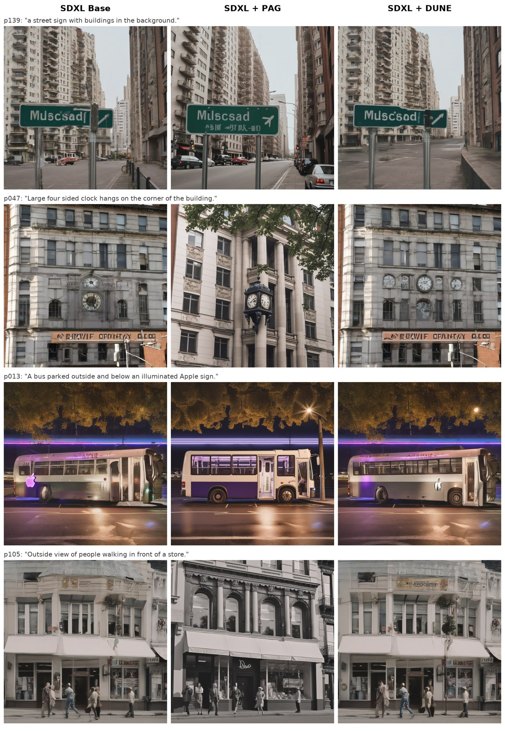
DUNE (2026): the most conservative fix
0.983
×1.00
−0.04
similarity to SDXL
inference time
CLIPScore, not significant
Notes:
[6:45–7:15, Speaker C] We also reimplemented DUNE, a 2026 method that suppresses unusual activations inside the U-Net. It is the gentlest of all: images stay 98 percent similar to plain SDXL, with no extra time and no change in CLIPScore. Even where it changes most, on the right, the edits are small and not always better: one clock became a row of clocks. We could not confirm its claimed structural gains without a human study.

Slide 11
What limits our conclusions
Few raters
Metric blind spot
Three raters, all authors, with low agreement (Fleiss' κ = 0.105). One preferred plain SDXL, another PAG.
CLIPScore misses structure, so the automatic results understate PAG.
Narrow scope
DUNE
150 short COCO captions, one sampler, 30 steps, CFG 5.
Our own reimplementation of an unreviewed preprint, rated by metrics only.
Notes:
[7:15–7:35, Speaker C] Some caveats. Only three of us rated the images and we often disagreed, so the human result is a trend. CLIPScore cannot see structure. We tested short COCO captions with one sampler. And DUNE is our own reimplementation, measured by metrics only.

Slide 12
Takeaways
Use PAG when structure matters (≈1.5× time)
Do not stack FreeU and PAG at default strengths
Do not judge these methods by CLIPScore alone
Code, prompts, ratings: github.com/AlMuM/sdxl-freeu-pag
Notes:
[7:35–8:00, Speaker C] Three takeaways. If structure matters, use PAG and budget about one and a half times the time. Do not stack FreeU and PAG at their default strengths. And do not judge these methods by CLIPScore alone. Thank you; the code and data are on GitHub.

