Slide 1
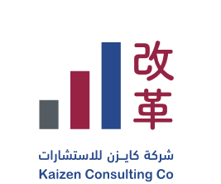
High Level Project Roadmap

Slide 2
Planning : Baseline and Gap Analysis
It will be divided in phases – Millstone during Project Implementation
Planning
Foundation & Culture Awareness
Implementation
Closing
Baseline and Gap Analysis
Manufacturing & Quality Measures
Material/ Product Flow & VSM Sample
KPI’s & Target Setting
Lean Training (Hybrid : onsite and online)
Waste Matrix to be Communicated by Company Team
Bottlenecks and Balancing
Daily Kaizen training
Reward & Recognition Program
5S+1 & Visual Management (Pilot Area)
Spaghetti Diagram Workshop .
Standardized Work SOP Training
Autonomous Maintenance
Sales Forecasting Techniques
Periodic Audits
TPM & OEE Analysis (Pilot)
Time and Motion Study
Pilot Quick Change Over QCO
Kaizen Projects & Project Charter
Skill Matrix & Training plan
Waste matrix & Loss Analysis
Planning System
Inventory Management
Quality Control System
KPI’s Dashboard
Reward & Recognition Program
Follow up Master Action Plan
Periodic Audits
Project KPI’s Review
Daily Kaizen Training Certification
Evaluate the final progress of Master Action Plan .
Rollout plan
Periodic Audits

Slide 3
Deliverables(As per TOR)
Current and Target Value Stream Maps (VSM)
Training/application and development of a 5S and Visual Management system
Training/awareness of all engineers and supervisors on all required tasks
Planning Management System (for example, but not limited to): -Production Planning Management and Production Capacity Utilization -Following up on the implementation of plans. -Key Performance Indicators including their definition and identifying those responsible for them
Increasing production flexibility and reducing the changeover time between work orders and reducing the Work In Process Inventory (Quick Changeover - QCO)

Slide 4
Deliverables(As per TOR)
Increasing the effectiveness of machines and equipment and integrating equipment maintenance into the manufacturing process and ensuring that the equipment always performs its required task and maintaining its production rate - (Improve M/C availability and setup reduction).
Standard Operating Procedures for the processes and target times for each process.
Reducing production cycle times, reducing material waste and reducing material movements or distance between them.
Organizing the workplace and creating a positive work environment.

Slide 5
Deliverables(As per TOR)
Training workers and applying Kanban techniques and partial application
Developing a comprehensive Autonomous Maintenance system and work guide
Training 4 employees to practice lean manufacturing techniques with the condition that at least 2 employee obtains a certificate from an accredited body.

Slide 6
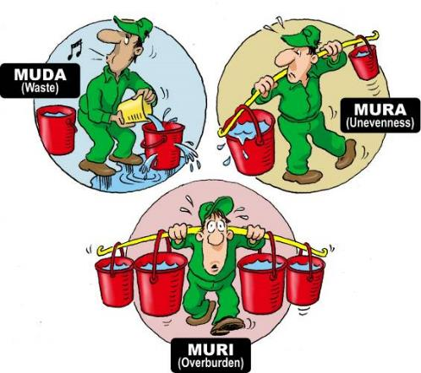
What are the enemies of learn?
Activities that do not add value
Workload that is not balanced
Work that creates a burden on the
team members or processes

Slide 7
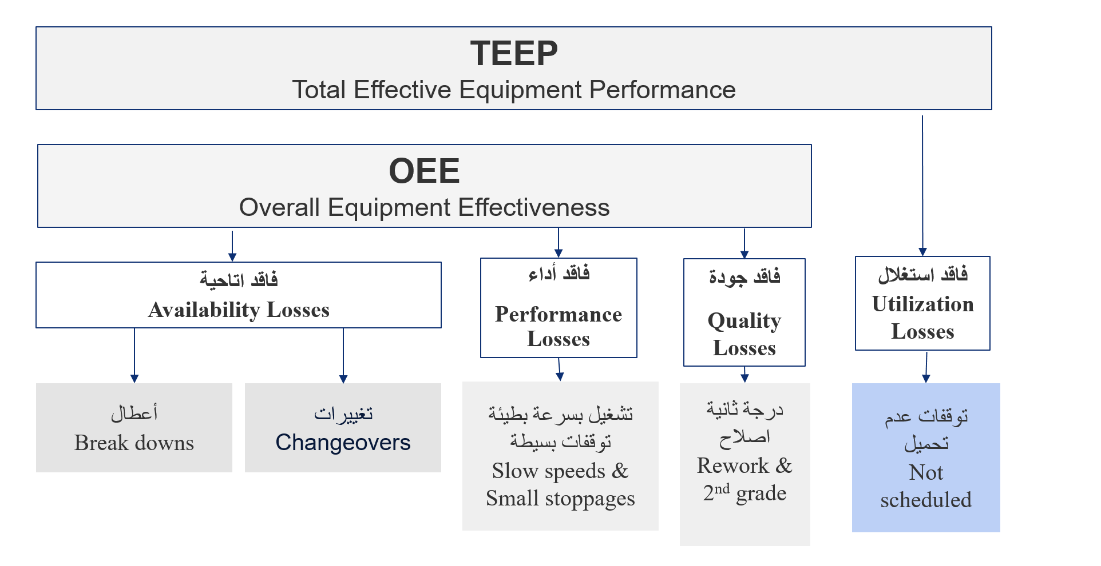
Types of Losses أنواع الفواقد

Slide 8



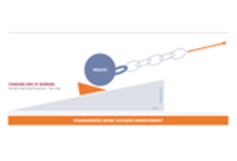

The 4 Steps of the Improvement Process
Planning phase
Executing phase
1
2
3
4
Where do we want to be?
Kaizen Strategy
Where are we now?
Gap Analysis
How we get there?
Action Plan
Arrived?
Standardize
Once we achieved our targets a new improvement cycle starts

Slide 9
Step 2: Where are we now? Gap Analysis – Process Level
Performance Matrices;
KPI’s statue: Inventory level, Cost, FTT, Delivery Performance
Transform all above into LE, How much it costs the company
Process Outcome Performance
Performance Metrics;
KPI’s statue: Inventory level, Cost, FTT, Delivery Performance
Transform all above into LE, How much it costs the company
How is the process performing over time? (Data)
Equipment Capacity
Machines performance, OEE
Constraints
Do we have any machine constraints?
What are they? (Data)
Necessary Number of Operators (if the process were stable)
Process waste, of operator per machine per shift
Direct to indirect, revenue per man
How many people were necessary? (Calculate)

Slide 10
Step 2: Where are we now? Gap Analysis – Process Level
The kaizen approach is to start with a value-stream design (VSD) exercise by building a team to work on the analysis, design, and action plan.
The intensive VSM work starts with drawing the current-state map, and having a good look at the Gemba.
The members of the project team are given a brief explanation of the VSM method, the data sheets used to record the value stream, and the icons used in the mapping process.
The mapping groups then are organized. One person will record the steps in the process, and others will find the relevant information (mainly by counting material waiting as they go through the process that has been selected for VSM analysis).
The operations that are part of the process are recorded on a process analysis sheet.
Once the current-state map has all the important data on it (and some important key performance indicators as well—e.g., defect rates and changeover times), it is complete.

Slide 11
Step 2: Where are we now? Gap Analysis – Process Level
The most important types of data are
Customer demand data (These are necessary to calculate the takt time.)
Material waiting quantities (checked on the Gemba)
Customer-service-level data (on-time delivery data)
Operations data:
Machine overall efficiency of key equipment (with a Pareto diagram detailing losses for the main machines)
Manpower efficiency (if possible, also with a Pareto diagram detailing losses)
Machine changeover times
Machine or operation opening (or working) times

Slide 12
Step 3:How we get there? Action Plan /Implementation
The next steps will be to provide basic training for the operators and supervision in all the TFM, Kaizen Change model NA Kaizen Lean tools.
One-day kaizen foundations seminar
The one-day kaizen foundations seminar is for everyone in the company, to explain the principles and concepts of kaizen.
This seminar includes some Muda awareness exercises and explains the main kaizen improvement tools.
It is also a very good opportunity to present the vision of kaizen in logistics and supply chains for the company.

Slide 13
Step 3:How we get there? Action Plan /Implementation
The purpose of the seminar is to prepare people for the challenge of implementing.
The vision is to give them an opportunity to reflect on their own attitudes toward the changes needed in everyone’s work habits.
Implement the updated action plans.
Create standards and SOPs.

Slide 14
Step 4: Are we arrived? Follow up / Kamishibai
The Leader places his Standard Work tasks on Kamishibai cards
As the tasks are being completed, he places the cards with the green part facing out
If the tasks are not completed, he places the card with the red part facing out and fills out the improvement cycle with the concern.
Plan corrective actions to achieve agreed standards continuously.

