Slide 1
Week 10, Generative AI

Slide 2
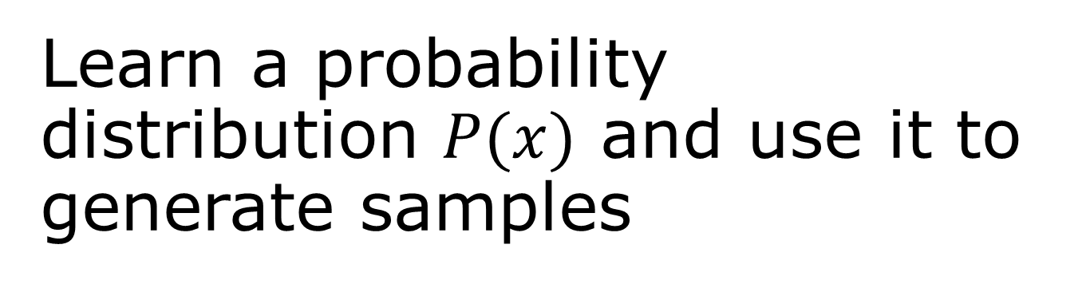
Learn a probability distribution $P(x)$ and use it to generate samples
Generative adversarial networks (GAN) – beat the real thing
Normalising flows – drive a distribution by Gaussian
Diffusion models – learn the noises

Slide 3
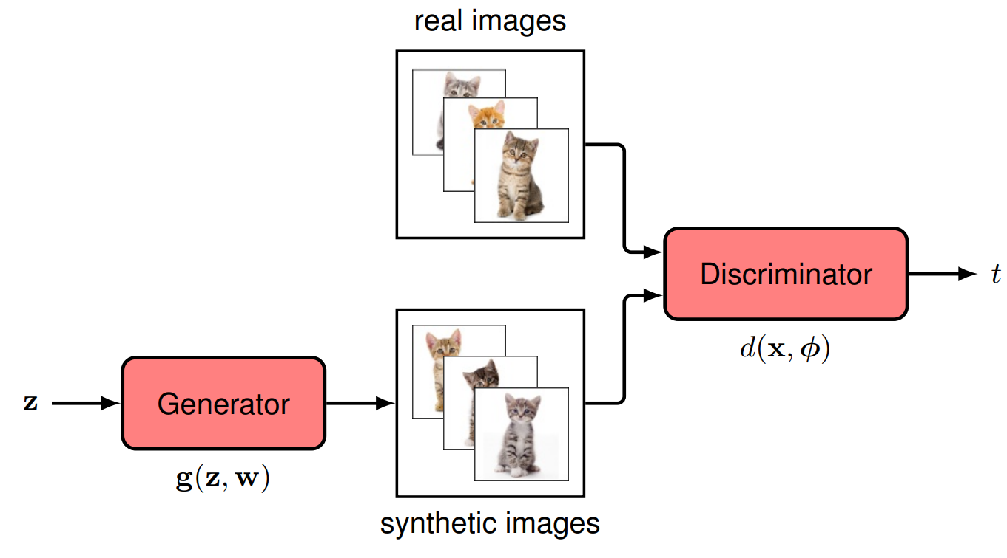
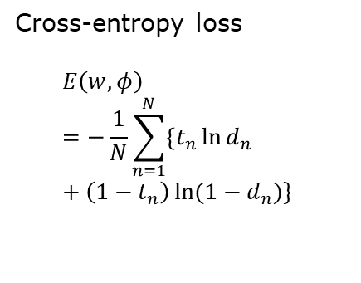
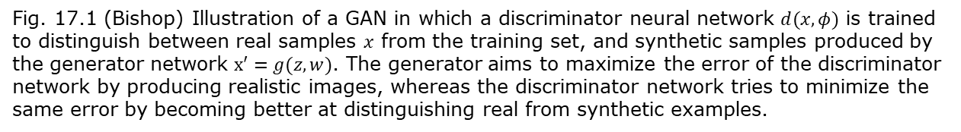




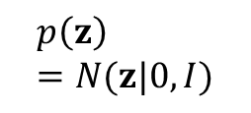

Generative Adversarial Network architecture
Cross-entropy loss
$$E\left(w,φ\right)=−\frac{1}{N}\sum_{n=1}^{N}{\left\{t_{n}\ln{d_{n}}+\left(1−t_{n}\right)\ln{(1−d_{n})}\right\}}$$
$$p_{data }(x)$$
$$x$$
$$p\left(z\right)=N(z|0,I)$$
$t=1$ real data
$t=0$ synthetic data
A logistic classifier
$$x′$$
Probability of being real data
$w,φ$:network parameters
Fig. 17.1 (Bishop) Illustration of a GAN in which a discriminator neural network $d(x,φ)$ is trained to distinguish between real samples $x$ from the training set, and synthetic samples produced by the generator network $x′=g(z,w)$. The generator aims to maximize the error of the discriminator network by producing realistic images, whereas the discriminator network tries to minimize the same error by becoming better at distinguishing real from synthetic examples.

Slide 4
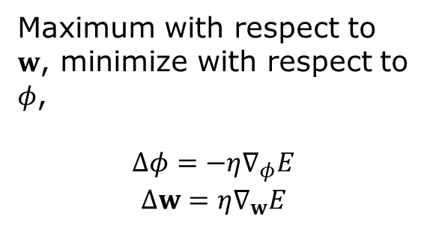





GAN training
$$E\left(w,φ\right)=−\frac{1}{N}\sum_{n=1}^{N}{\left\{t_{n}\ln{d_{n}}+\left(1−t_{n}\right)\ln{(1−d_{n})}\right\}}$$
$$d_{n}=d(x_{n},φ)$$
$$x_{n}$$
or
$t=1$ real data
$t=0$ synthetic data
$$z_{n}$$
$$x_{n}^{′}$$
Maximum with respect to $w$, minimize with respect to $φ$,
$$Δφ=−η∇_{φ}E$$
$$Δw=η∇_{w}E$$
$η$: learning rate

Slide 5

Zero-sum game in GAN
The optimization in GAN training can be expressed as
$$\max_{w}{\min_{φ}\left[−𝔼_{x∼P_{data}\left(x\right)}\log{d\left(x,φ\right)−𝔼_{z∼p\left(z\right)}\log{(1−d(g\left(z,w\right),φ)}}\right]}$$

Slide 6
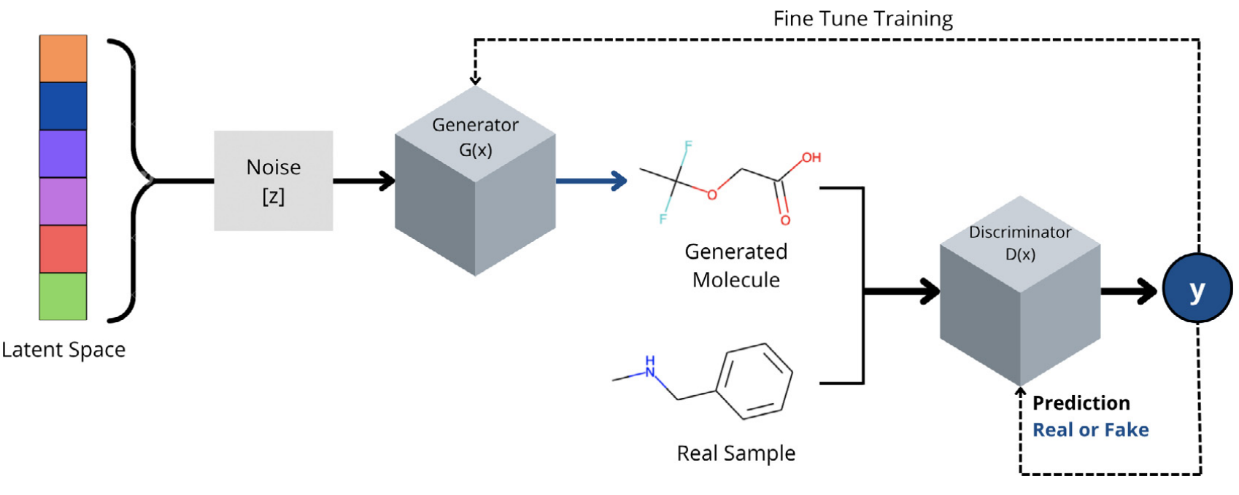
GAN for molecular discovery
From S. Tripathi, et al,
“Artificial Intelligence in the Life Science 2, 100045 (2022).
https://insilico.com/

Slide 7


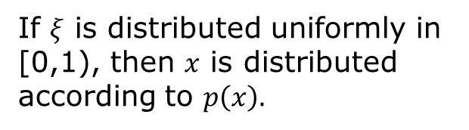

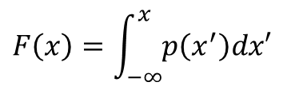
Generate arbitrary distribution in 1D
$$F\left(x\right)=\int_{−∞}^{x}{p\left(x^{′}\right)dx′}$$
$$ξ$$
$$x$$
$$x=F^{−1}(ξ)$$
If $ξ$ is distributed uniformly in [0,1), then $x$ is distributed according to $p\left(x\right).$

Slide 8
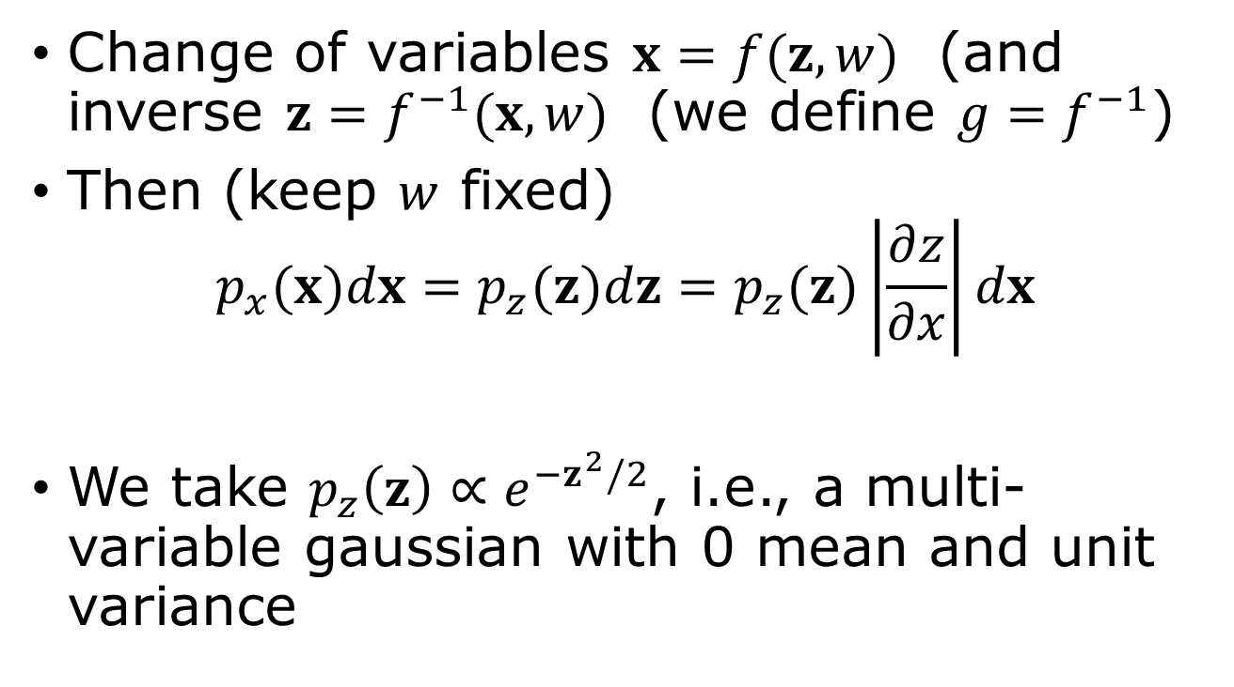
Use Gaussian to drive N-dimensional distribution
Change of variables $x=f(z,w)$ (and inverse $z=f^{−1}(x,w)$ (we define $g=f^{−1}$)
Then (keep $w$ fixed)
$$p_{x}(x)dx=p_{z}(z)dz=p_{z}(z)\left|\frac{∂z}{∂x}\right|dx$$
We take $p_{z}\left(z\right)∝e^{−z^{2}/2}$, i.e., a multi-variable gaussian with 0 mean and unit variance
Jacobian of the transform
Notes:
What is the Jacobian? It is the determinant of matrix of all the partial derivatives partial z_i /partial x_j. See next slide

Slide 9
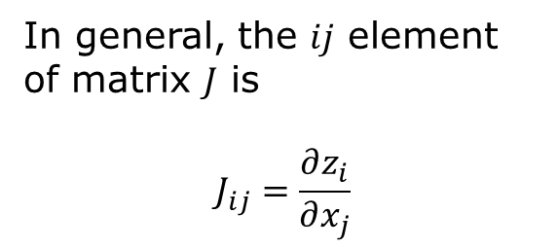
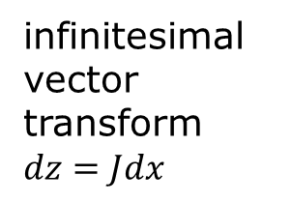
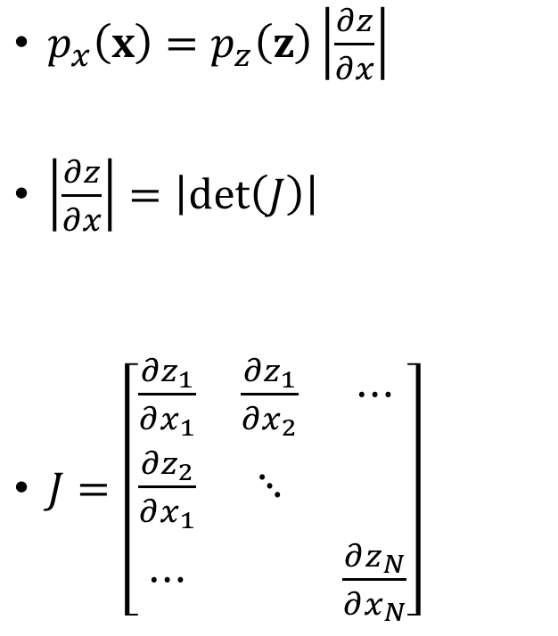
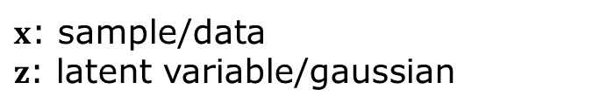
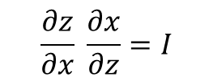
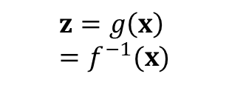
Jacobian
$x$: sample/data
$z$: latent variable/gaussian
$$z=g\left(x\right)=f^{−1}(x)$$
$p_{x}\left(x\right)=p_{z}\left(z\right)\left|\frac{∂z}{∂x}\right|$
$\left|\frac{∂z}{∂x}\right|=\left|\det\left(J\right)\right|$
$J=\left[\begin{matrix}\frac{∂z_{1}}{∂x_{1}} & \frac{∂z_{1}}{∂x_{2}} & ⋯ \\ \frac{∂z_{2}}{∂x_{1}} & ⋱ & \\ ⋯ & & \frac{∂z_{N}}{∂x_{N}}\end{matrix}\right]$
In general, the $ij$ element of matrix $J$ is
$$J_{ij}=\frac{∂z_{i}}{∂x_{j}}$$
$$\frac{∂z}{∂x} \frac{∂x}{∂z}=I$$
infinitesimal vector transform $dz=Jdx$

Slide 10

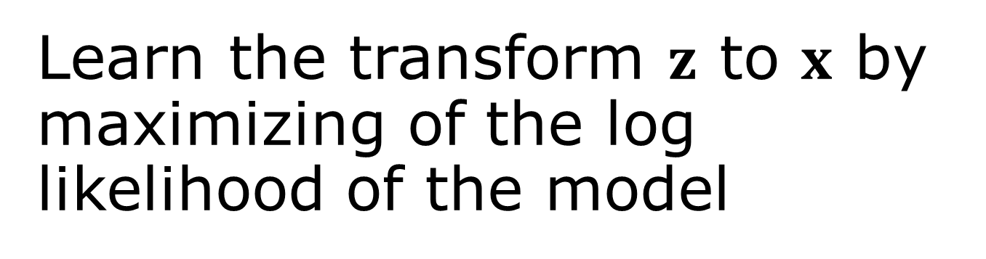

Learn the transform $z$ to $x$ by maximizing of the log likelihood of the model
$$\sum_{n=1}^{N}{\ln{p_{x}\left(x_{n} | w\right)=}}$$
$$\sum_{n=1}^{N}{\left\{−\frac{1}{2}g{\left(x_{n},w\right)}^{2}+\ln{|\det{J\left(x_{n}\right)|}}\right\}+}const$$
$x=f(z,w)$, $z=g(x,w)$

Slide 11
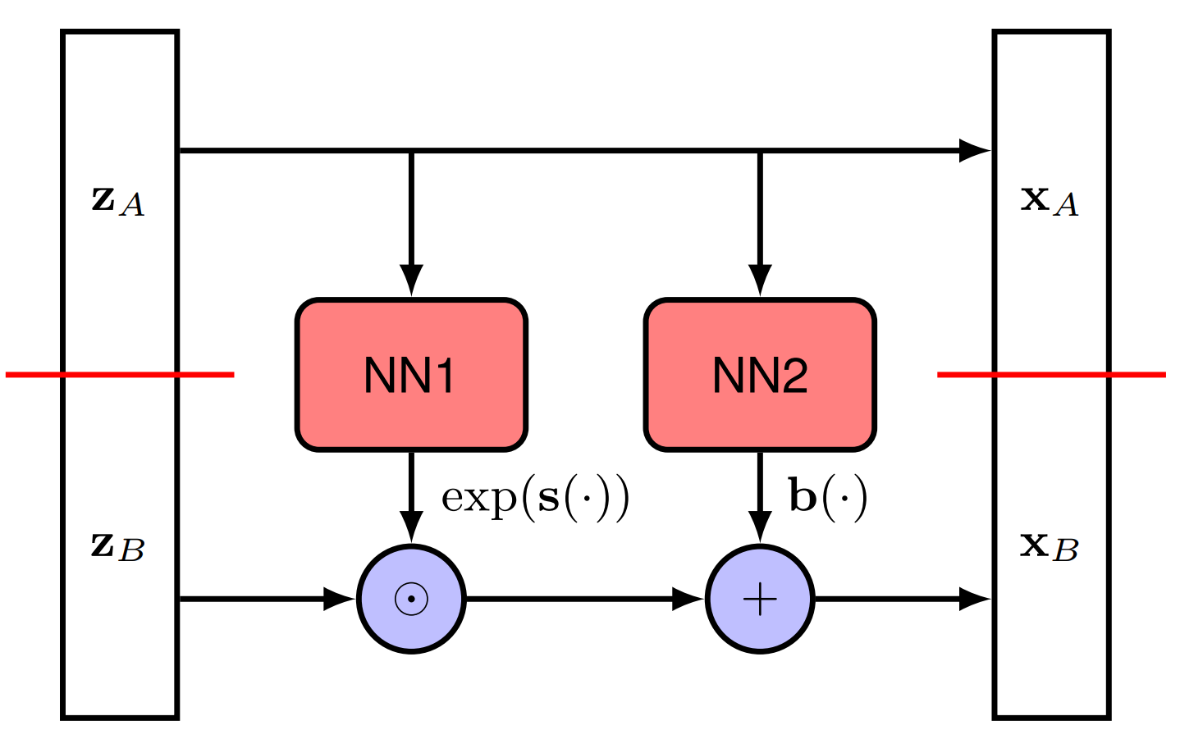

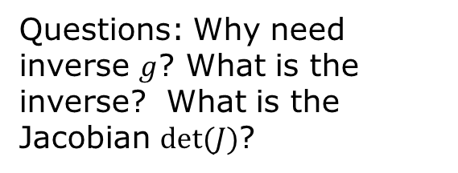
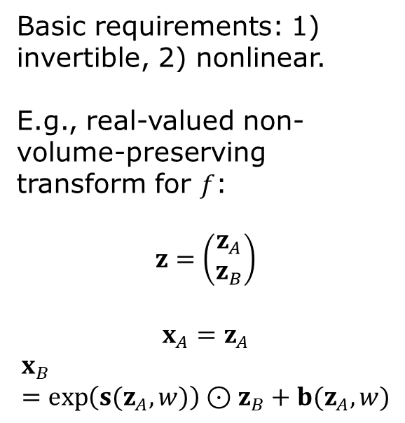
Implement the transformation $z→x$ as Neural network
Basic requirements: 1) invertible, 2) nonlinear.
E.g., real-valued non-volume-preserving transform for $f$:
$$z=\left(\begin{matrix}z_{A} \\ z_{B}\end{matrix}\right)$$
$$x_{A}=z_{A}$$
$$x_{B}=\exp\left(s(z_{A},w)\right)⊙z_{B}+b(z_{A},w)$$
Questions: Why need inverse $g$? What is the inverse? What is the Jacobian $det⁡(J)$?

Slide 12
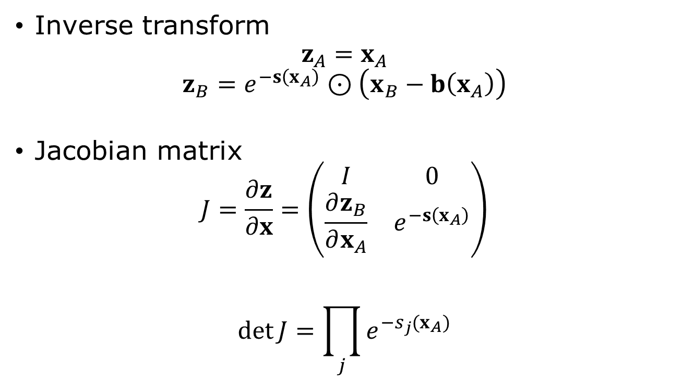
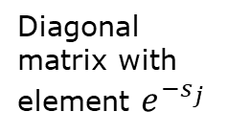
Real NVP
Inverse transform
$$z_{A}=x_{A}$$
$$z_{B}=e^{−s\left(x_{A}\right)}⊙\left(x_{B}−b\left(x_{A}\right)\right)$$
Jacobian matrix
$$J=\frac{∂z}{∂x}=\left(\begin{matrix}I & 0 \\ \frac{∂z_{B}}{∂x_{A}} & e^{−s\left(x_{A}\right)}\end{matrix}\right)$$
$$\det{J}=\prod_{j}{e^{−s_{j}(x_{A})}}$$
Diagonal matrix with element $e^{−s_{j}}$
Notes:
See also https://bjlkeng.io/posts/normalizing-flows-with-real-nvp/

Slide 13
State-of-the-art normalizing flow architecture
From arXiv:2412.06329, S. Zhai, et al.

Slide 14
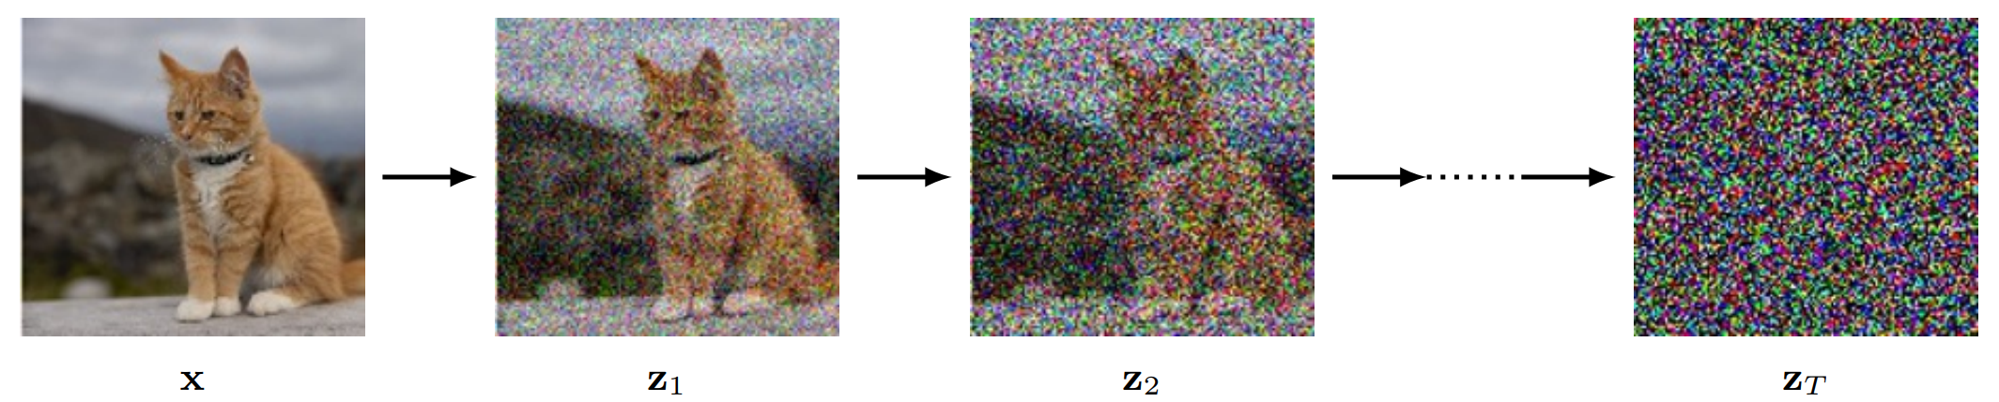
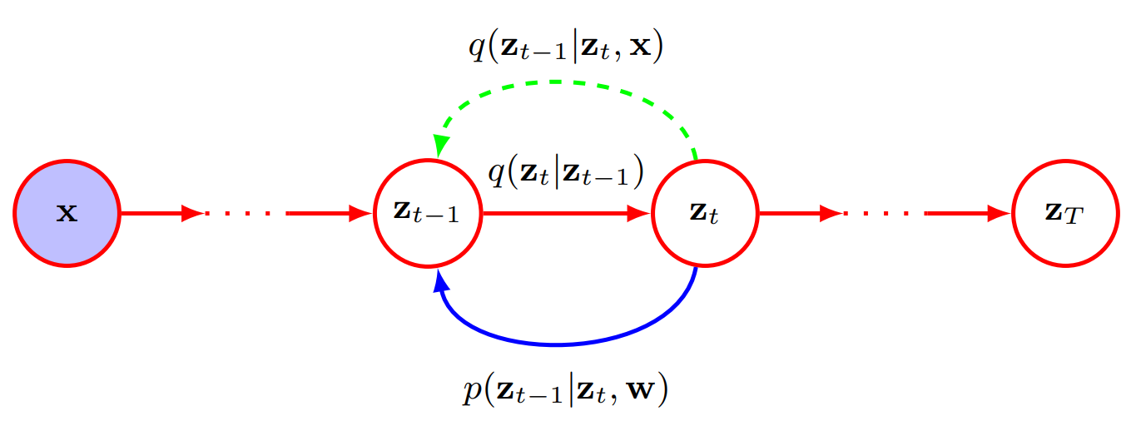


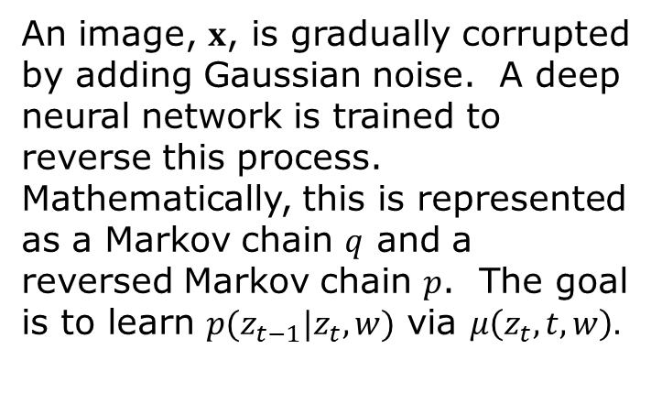
Diffusion models
$$q\left(z_{t} | z_{t−1}\right)=N(z_{t}|\sqrt{1−β_{t}} z_{t−1},β_{t}I)$$
$$p\left(z_{t−1} | z_{t},w\right)=N(z_{t−1}|μ(z_{t},t,w),β_{t}I)$$
An image, $x$, is gradually corrupted by adding Gaussian noise. A deep neural network is trained to reverse this process. Mathematically, this is represented as a Markov chain $q$ and a reversed Markov chain $p$. The goal is to learn $p(z_{t−1}|z_{t}, w)$ via $μ\left(z_{t}, t,w\right).$
$z_{t}$, $t=1,⋯, T$ are latent variables
Notes:
See books in Bishop, “Deep Learning”, Chapter 20, or S. J. D. Prince, “Understanding Deep Learning”, Chapter 18, or arXiv:2312.10393, or arXiv:2402.04384.

Slide 15
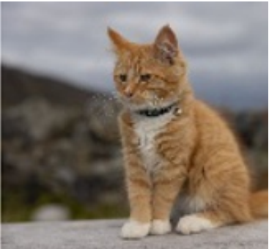
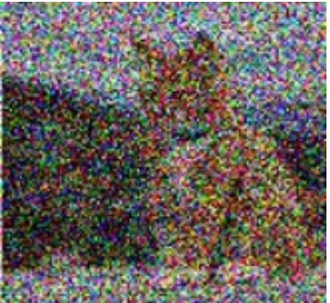

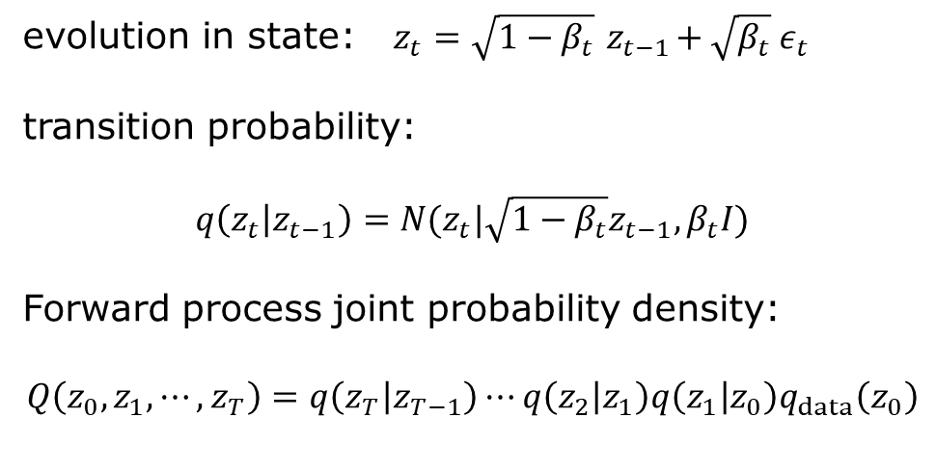











Forward Markov chain
add noise
add noise
$$z_{0}$$
$$z_{1}$$
$$z_{2}$$
…
$$z_{t−1}$$
$$z_{t}$$
…
$$z_{T}$$
$$z_{0}=x$$
$$\left\langle z_{t}\right\rangle$$
evolution in state: $z_{t}=\sqrt{1−β_{t}}{ z}_{t−1}+\sqrt{β_{t}} ε_{t}$
transition probability:
$$q\left(z_{t} | z_{t−1}\right)=N(z_{t}|\sqrt{1−β_{t}}z_{t−1},β_{t}I)$$
Forward process joint probability density:
$$Q\left(z_{0},z_{1},⋯, z_{T}\right)=q\left(z_{T} | z_{T−1}\right)⋯q\left(z_{2} | z_{1}\right)q\left(z_{1} | z_{0}\right)q_{data}\left(z_{0}\right)$$
$$var\left(z_{t}\right)$$
$$e^{−βt/2}$$
$$t$$

Slide 16
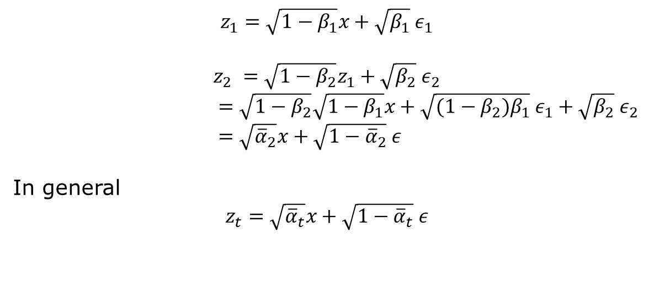
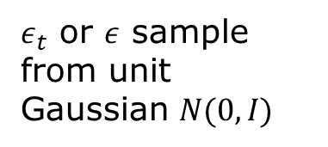


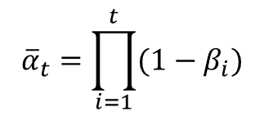
Faster update (diffusion kernel)
add noises
$$z_{0}$$
$$z_{t}$$
$${\overline{α}}_{t}=\prod_{i=1}^{t}{(1−β_{i}})$$
$$z_{0}=x$$
$$z_{1}=\sqrt{1−β_{1}}x+\sqrt{β_{1}} ε_{1}$$
$$z_{2} =\sqrt{1−β_{2}}z_{1}+\sqrt{β_{2}} ε_{2}$$
$=\sqrt{1−β_{2}}\sqrt{1−β_{1}}x+\sqrt{{(1−β_{2})β}_{1}} ε_{1}+\sqrt{β_{2}} ε_{2}$
$=\sqrt{{\overline{α}}_{2}}x+\sqrt{1−{\overline{α}}_{2}} ε$
In general
$$z_{t}=\sqrt{{\overline{α}}_{t}}x+\sqrt{1−{\overline{α}}_{t}} ε$$
$ε_{t}$ or $ε$ sample from unit Gaussian $N(0,I)$

Slide 17
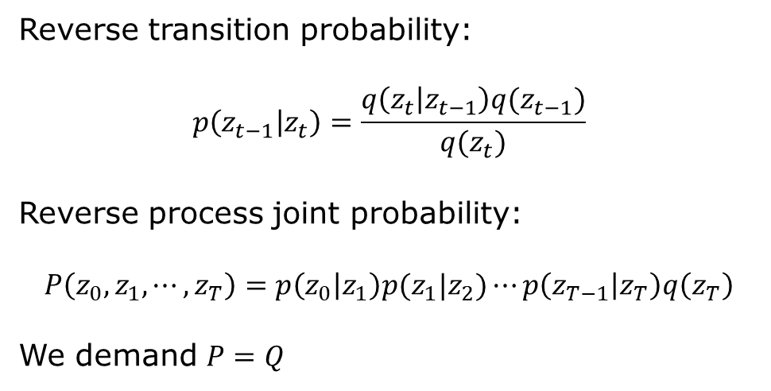
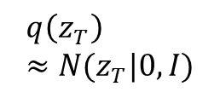
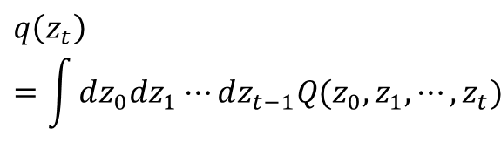
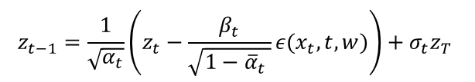
Reverse Markov chain
subtract noise
subtract noise
$$z_{0}$$
$$z_{1}$$
$$z_{2}$$
…
$$z_{t−1}$$
$$z_{t}$$
…
$$z_{T}$$
$$z_{t−1}=\frac{1}{\sqrt{α_{t}}}\left(z_{t}−\frac{β_{t}}{\sqrt{1−{\overline{α}}_{t} }}ε(x_{t},t,w)\right)+σ_{t}z_{T}$$
Reverse transition probability:
$$p\left(z_{t−1} | z_{t}\right)=\frac{q\left(z_{t} | z_{t−1}\right)q(z_{t−1})}{q(z_{t})}$$
Reverse process joint probability:
$$P\left(z_{0},z_{1},⋯, z_{T}\right)=p\left(z_{0} | z_{1}\right)p(z_{1}|z_{2})⋯p\left(z_{T−1} | z_{T}\right)q\left(z_{T}\right)$$
We demand $P=Q$
$$q\left(z_{t}\right)=\int{dz_{0}dz_{1}⋯dz_{t−1}Q(z_{0},z_{1},⋯,z_{t})}$$
$$q\left(z_{T}\right)≈N(z_{T}|0,I)$$

Slide 18
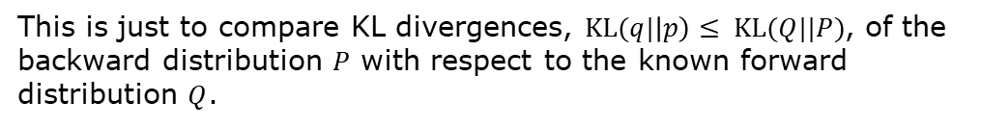
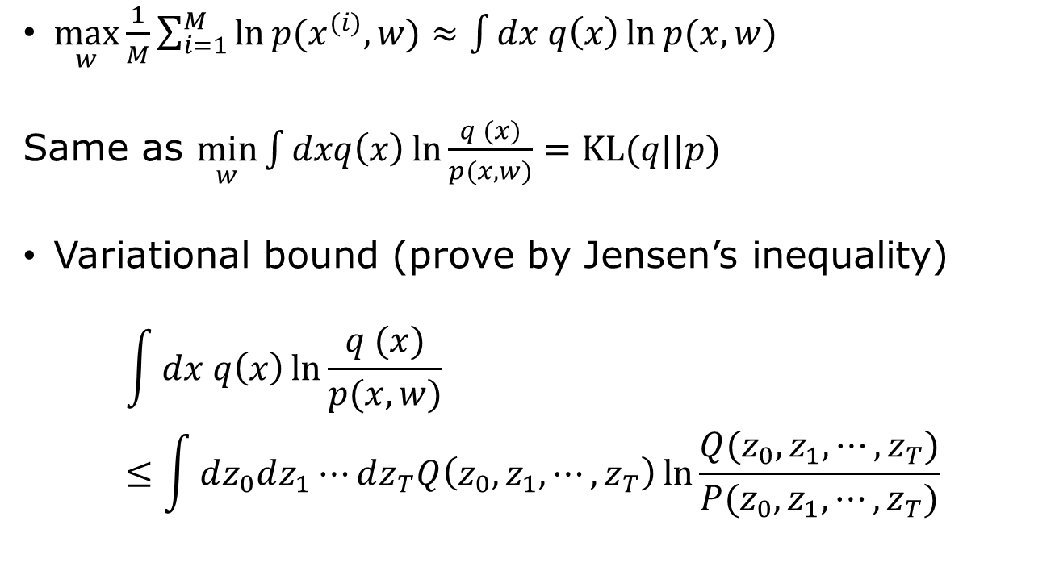


Likelihood/KL divergence
$\max_{w}{\frac{1}{M}\sum_{i=1}^{M}{\ln{p(x^{(i)},w)}}≈\int{dx q\left(x\right)\ln{p(x,w)}}}$
Same as $\min_{w}{\int{dxq\left(x\right)\ln{\frac{q (x)}{p(x,w)}}}=KL(q||p)}$
Variational bound (prove by Jensen’s inequality)
$$\int{dx q\left(x\right)\ln{\frac{q (x)}{p(x,w)}}}≤\int{dz_{0}dz_{1}⋯dz_{T}Q\left(z_{0},z_{1},⋯,z_{T}\right)\ln{\frac{Q(z_{0},z_{1},⋯, z_{T})}{P(z_{0},z_{1},⋯, z_{T})}}}$$
$$q(x)≡q_{data}(x)$$
$$z_{0}=x$$
This is just to compare KL divergences, $KL(q|\left|p\right)≤ KL(Q||P)$, of the backward distribution $P$ with respect to the known forward distribution $Q$.

Slide 19
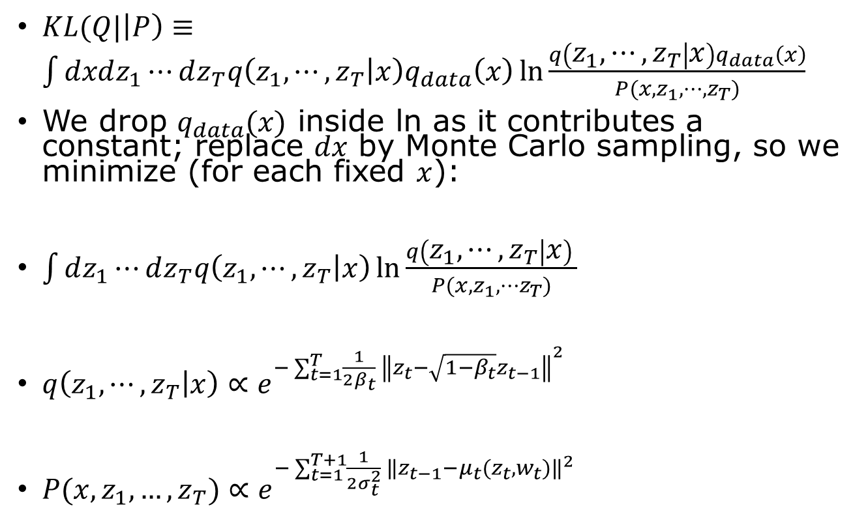



Minimizing KL($Q||P$)
$KL(Q|\left|P\right)≡\int{dxdz_{1}⋯dz_{T}q\left(z_{1},⋯, z_{T} | x\right)q_{data}\left(x\right)}\ln{\frac{q\left(z_{1}, ⋯, z_{T} | x\right)q_{data}\left(x\right)}{P(x,z_{1},⋯, z_{T})}}$
We drop $q_{data}(x)$ inside ln as it contributes a constant; replace $dx$ by Monte Carlo sampling, so we minimize (for each fixed $x$):
$\int{dz_{1}⋯dz_{T}q\left(z_{1},⋯, z_{T} | x\right)}\ln{\frac{q\left(z_{1}, ⋯, z_{T} | x\right) }{P(x,z_{1},⋯z_{T})}}$
$q\left(z_{1},⋯, z_{T} | x\right)∝e^{−\sum_{t=1}^{T}{\frac{1}{2β_{t}} {\left\|z_{t}−\sqrt{1−β_{t}}z_{t−1}\right\|}^{2} }}$
$P(x,z_{1},…, z_{T})∝e^{−\sum_{t=1}^{T+1}{\frac{1}{2σ_{t}^{2}} {\left\|z_{t−1}−{μ_{t}(z}_{t},w_{t})\right\|}^{2} }}$
$$z_{0}≡x$$
Forward is a free spring
Backward is a tethered spring
$$μ_{T+1}=0$$

Slide 20
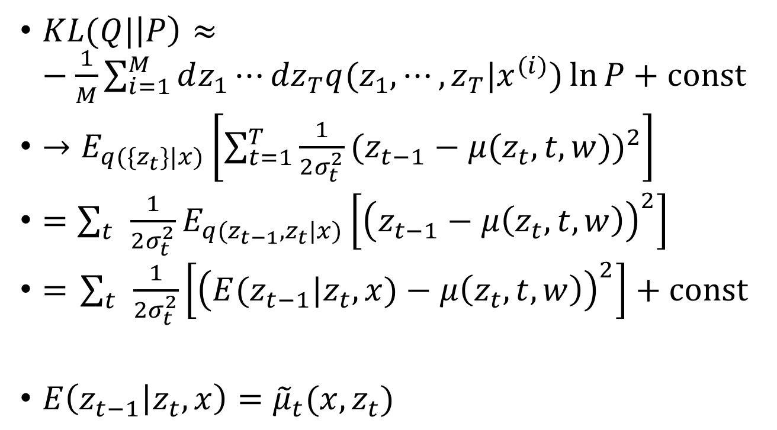
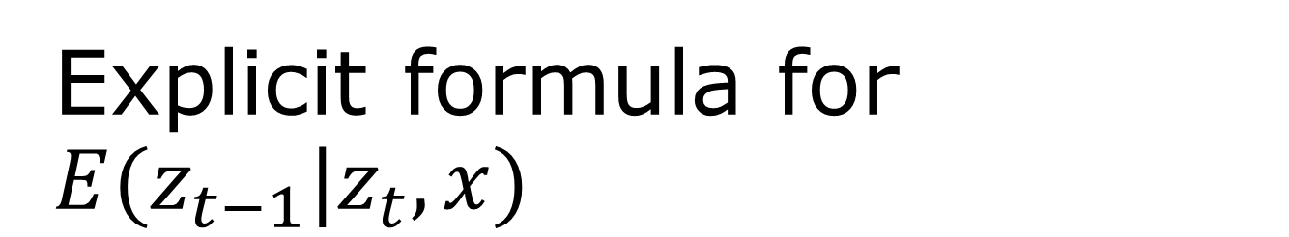
Explicit formula for $E(z_{t−1}|z_{t},x)$
$KL(Q|\left|P\right)≈−\frac{1}{M}\sum_{i=1}^{M}{dz_{1}⋯{dz}_{T}q(z_{1},⋯, z_{T}|x^{(i)})\ln{P}+const}$
$→E_{q(\{z_{t}\}|x)}\left[\sum_{t=1}^{T}{\frac{1}{2σ_{t}^{2}}}{(z_{t−1}−μ(z_{t}, t,w))}^{2}\right]$
$=\sum_{t}{\frac{1}{2σ_{t}^{2}}E_{q(z_{t−1},z_{t}|x)}\left[{\left(z_{t−1}−μ\left(z_{t},t,w\right)\right)}^{2}\right]}$
$=$ $\sum_{t}{\frac{1}{2σ_{t}^{2}}\left[{\left(E(z_{t−1}|z_{t},x)−μ\left(z_{t},t,w\right)\right)}^{2}\right]+const}$
$E\left(z_{t−1} | z_{t},x\right)={\tilde{μ}}_{t}(x,z_{t})$
can be calculated explicitly

Slide 21
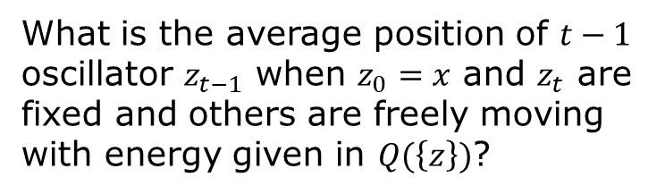


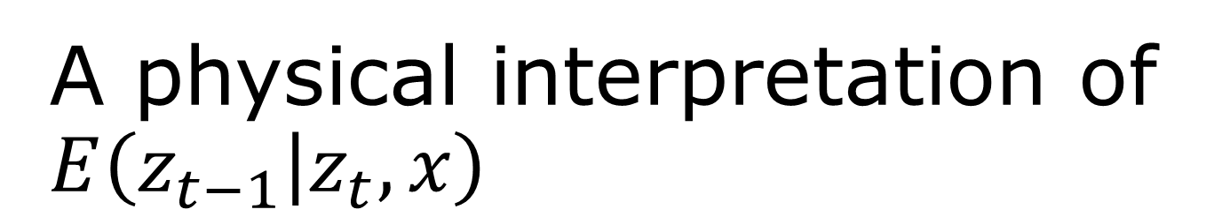




A physical interpretation of $E\left(z_{t−1} | z_{t},x\right)$
$$\left\langle z_{t−1}\right\rangle ={\tilde{μ}}_{t}=az_{0}+bz_{t}$$
$$x$$
$${ z}_{1}$$
…
$$z_{t−2}$$
$$z_{t−1}$$
$$z_{t}$$
What is the average position of $t−1$ oscillator $z_{t−1}$ when $z_{0}=x$ and $z_{t}$ are fixed and others are freely moving with energy given in $Q(\left\{z\right\})$?

Slide 22

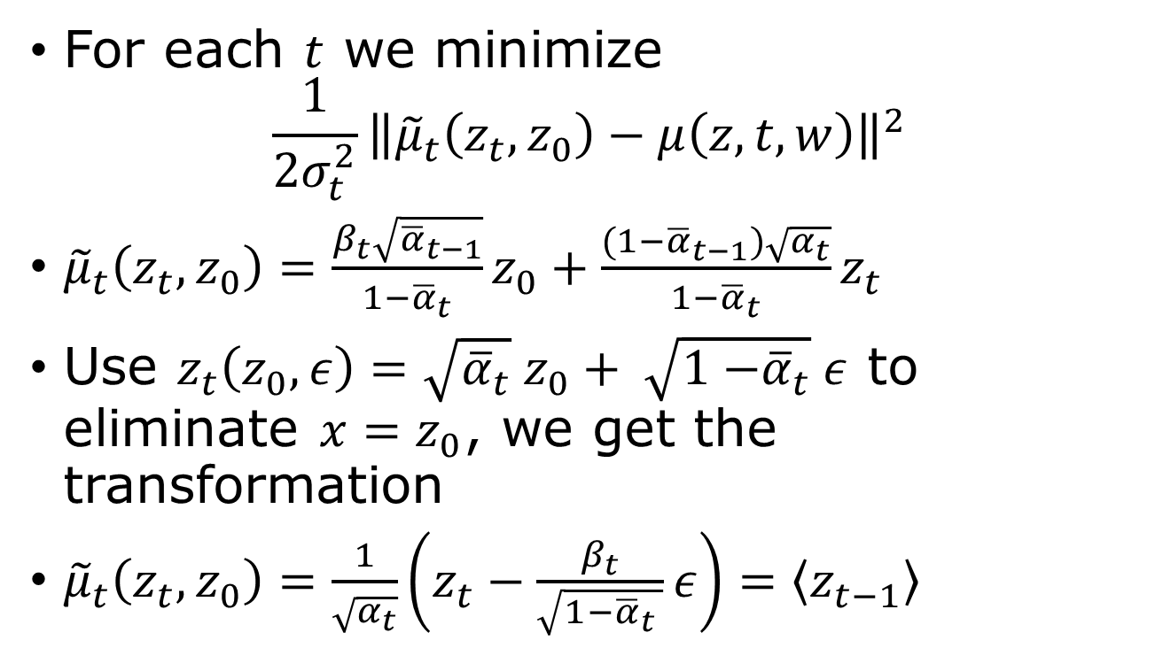
Loss function and re-parametrization
For each $t$ we minimize
$$\frac{1}{{2σ}_{t}^{2}}{\left\|{\tilde{μ}}_{t}\left(z_{t},z_{0}\right)−μ\left(z, t,w\right)\right\|}^{2}$$
${\tilde{μ}}_{t}\left(z_{t},z_{0}\right)=\frac{β_{t}\sqrt{{\overline{α}}_{t−1}}}{1−{\overline{α}}_{t}}z_{0}+\frac{(1−{\overline{α}}_{t−1})\sqrt{α_{t}}}{1−{\overline{α}}_{t}}z_{t}$
Use $z_{t}\left(z_{0},ε\right)=\sqrt{{\overline{α}}_{t}} z_{0}+ \sqrt{1{−\overline{α}}_{t}}ε$ to eliminate ${x=z}_{0}$, we get the transformation
${\tilde{μ}}_{t}\left(z_{t}, z_{0}\right)=\frac{1}{\sqrt{α_{t}}}\left(z_{t}−\frac{β_{t}}{\sqrt{1−{\overline{α}}_{t} }}ε\right)=\left\langle z_{t−1}\right\rangle$
$${\overline{α}}_{t}=α_{1}α_{2}⋯α_{t}$$

Slide 23
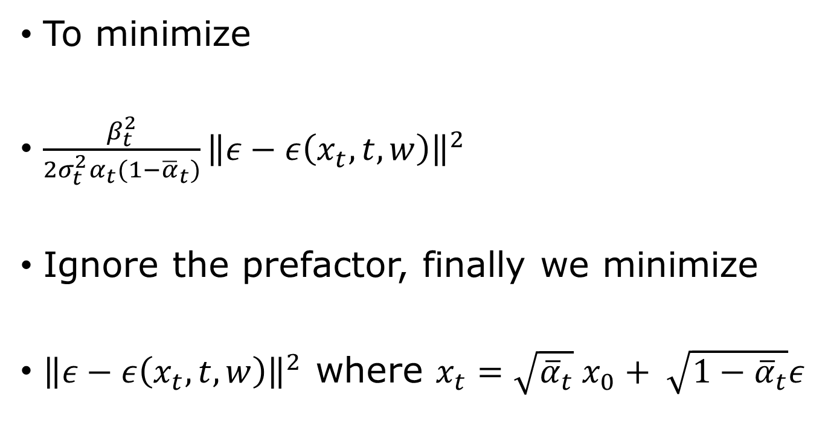
Final loss function
To minimize
$\frac{β_{t}^{2}}{2σ_{t}^{2}α_{t}(1−{\overline{α}}_{t})}{\left\|ε−ε\left(x_{t},t,w\right)\right\|}^{2}$
Ignore the prefactor, finally we minimize
${\left\|ε−ε\left(x_{t},t,w\right)\right\|}^{2}$ where $x_{t}=\sqrt{{\overline{α}}_{t}} x_{0}+ \sqrt{1−{\overline{α}}_{t}}ε$

Slide 24
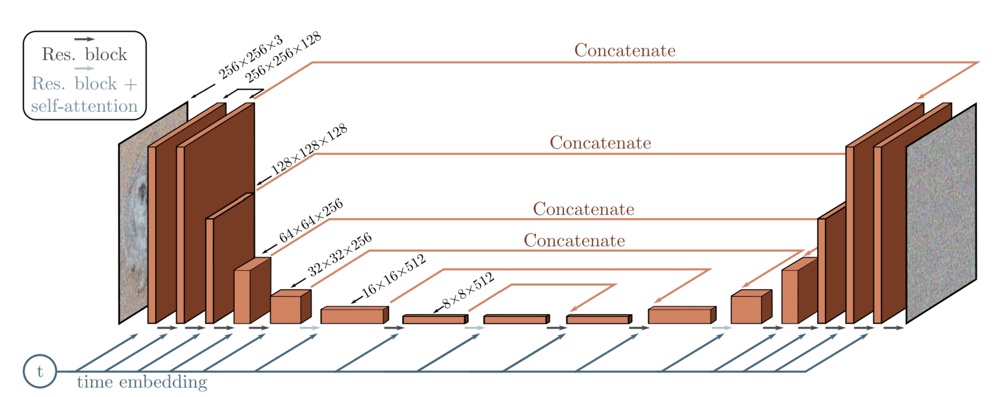

Unet to learn $ε(z_{t},t,w)$
What is “concatenate” and what is “time embedding”?
From https://learnopencv.com/denoising-diffusion-probabilistic-models/

Slide 25
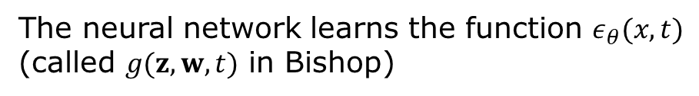

Training and sampling
The neural network learns the function $ε_{θ}(x,t)$
(called $g(z,w,t)$ in Bishop)
$$α_{t}+β_{t}=1$$
From arXiv:2006.11239, J. Ho, et al.

Slide 26


Continuous time diffusion models
for DDPM:
$$f=−\frac{1}{2}β_{t}x_{t}$$
$$g=\sqrt{β_{t}}$$
$w$: standard Wiener process
Forward move
$$dx=f\left(x,t\right)dt+g\left(t\right)dw$$
Reverse reconstruction
$$dx=\left[f\left(x,t\right)−g{\left(t\right)}^{2}∇_{x}\log{p_{t}(x)}\right]dt+g\left(t\right)dw$$
Or deterministic ODE
$dx=\left[f\left(x,t\right)−\frac{1}{2} g{\left(t\right)}^{2}∇_{x}\log{p_{t}(x)}\right]dt$
Notes:
See Y. Song, et al, https://arxiv.org/abs/2011.13456

