Slide 1
Week 11, Boltzmann Machine
Notes:
See Haykin, “Neural Networks”, 2nd ed, Chap 11.7; or Fischer and Igel. “Training Restricted
Boltzmann Machines: An Introduction,” in Pattern Recognition 47:25-39, 2014

Slide 2
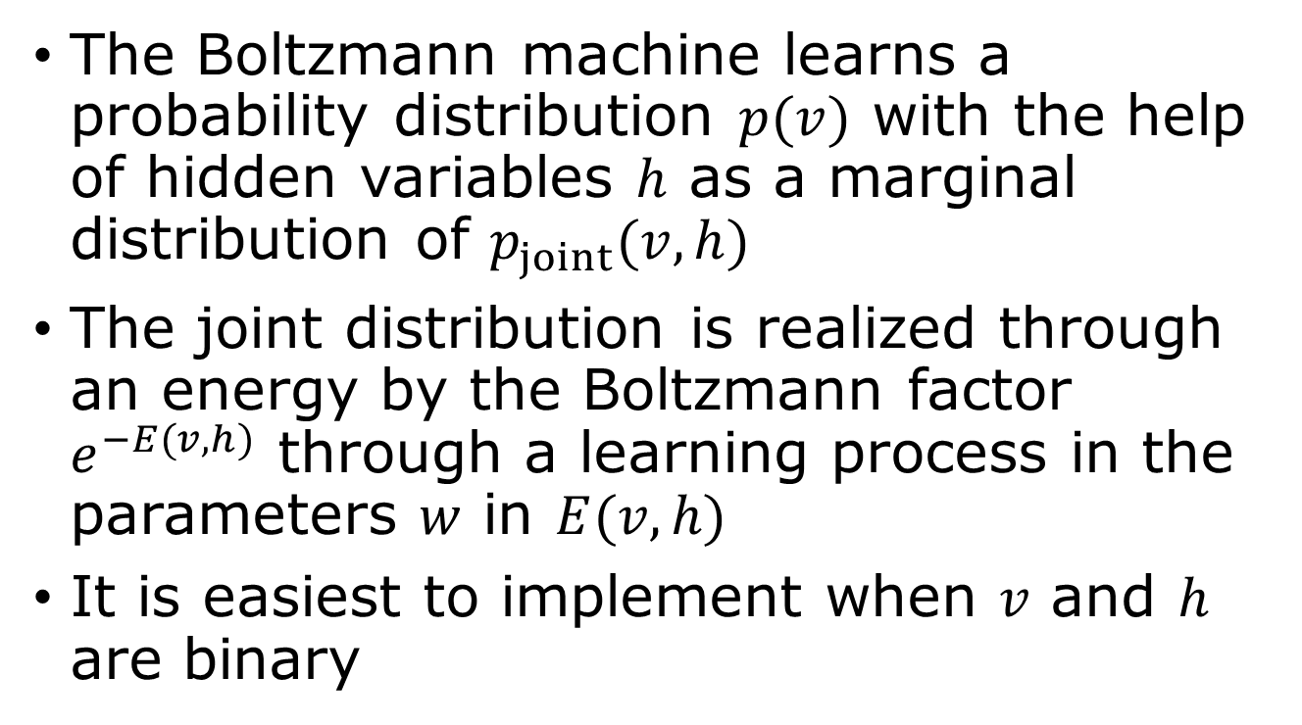
Model data distribution
The Boltzmann machine learns a probability distribution $p(v)$ with the help of hidden variables $h$ as a marginal distribution of $p_{joint}(v,h)$
The joint distribution is realized through an energy by the Boltzmann factor $e^{−E(v,h)}$ through a learning process in the parameters $w$ in $E(v,h)$
It is easiest to implement when $v$ and $h$ are binary
Notes:
See chapter 20, “Deep Learning”, Goodfollow, et al

Slide 3
What a Boltzmann machine can do?
Recommendation systems: predict user preferences by analyzing past user-item interactions, allowing for personalized recommendations on online platforms
Image recognition and processing: extract meaningful features from images and used for tasks like image denoising, reconstruction, and general pattern recognition
Natural Language processing and generative modeling

Slide 4

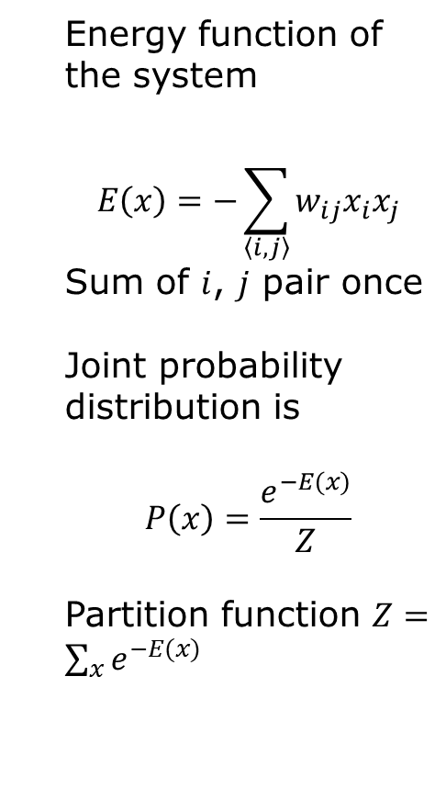





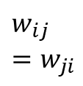

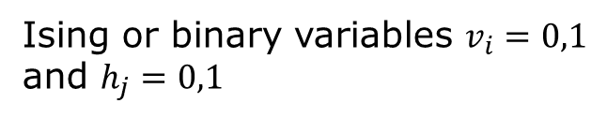


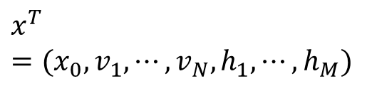
Visible and hidden units
$$x^{T}=(x_{0}, v_{1},⋯, v_{N},h_{1},⋯, h_{M})$$
Energy function of the system
$$E\left(x\right)=−\sum_{\left\langle i,j\right\rangle }{w_{ij}x_{i}x_{j}}$$
Sum of $i$, $j$ pair once
Joint probability distribution is
$$P\left(x\right)=\frac{e^{−E(x)}}{Z}$$
Partition function $Z=\sum_{x}{e^{−E(x)}}$
$$x_{0}=1$$
$${ h}_{1}$$
$${ h}_{2}$$
…
$${ h}_{j}$$
…
$${ h}_{M}$$
$$w_{ij}=w_{ji}$$
$${ v}_{1}$$
$${ v}_{2}$$
…
$${ v}_{i}$$
…
$${ v}_{N}$$
Ising or binary variables $v_{i}=0,1$ and $h_{j}=0,1$

Slide 5
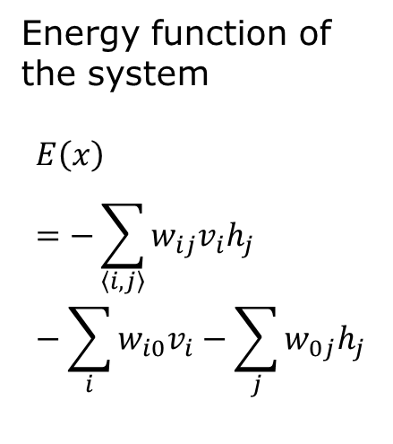

Restricted Boltzmann machine – no self-interaction
$$x^{T}=(x_{0}, v_{1},⋯, v_{N},h_{1},⋯, h_{M})$$
Energy function of the system
$$E\left(x\right)=−\sum_{\left\langle i,j\right\rangle }{w_{ij}v_{i}h_{j}}−\sum_{i}{w_{i0}v_{i}}−\sum_{j}{w_{0j}h_{j}}$$
$$x_{0}=1$$
$${ h}_{1}$$
$${ h}_{2}$$
…
$${ h}_{j}$$
…
$${ h}_{M}$$
$$w_{ij}$$
$${ v}_{1}$$
$${ v}_{2}$$
…
$${ v}_{i}$$
…
$${ v}_{N}$$
bipartite
Ising or binary variables $v_{i}=0,1$ and $h_{j}=0,1$

Slide 6

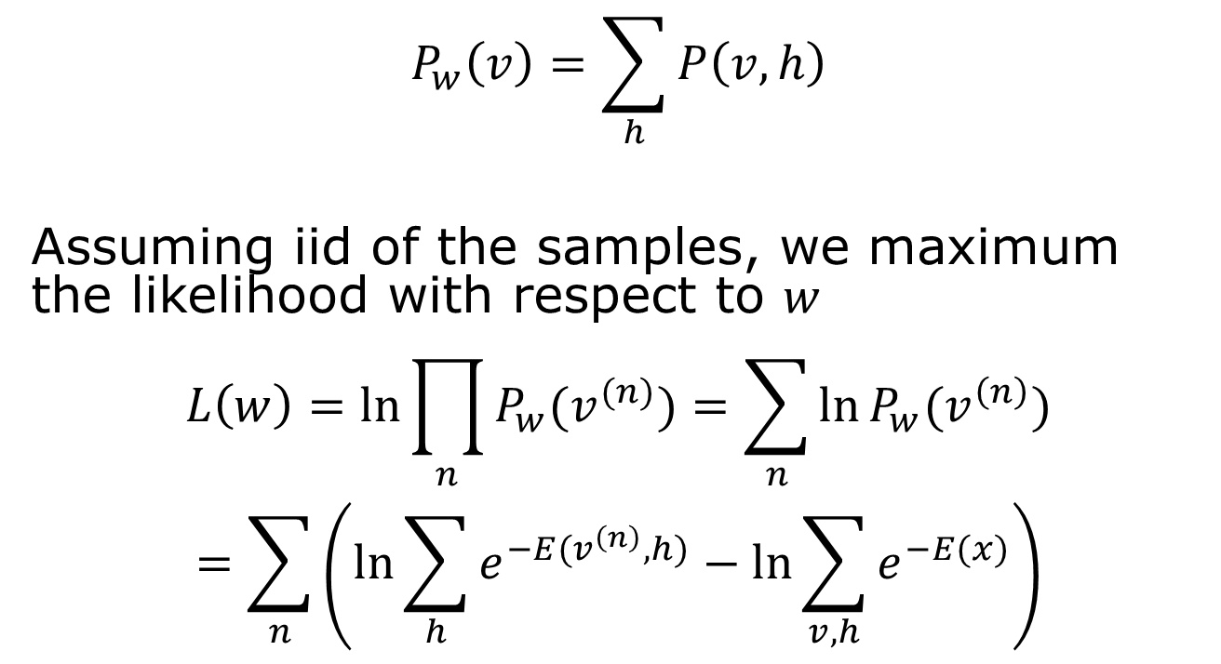
Learn sample probability from data
$$x=\left(\begin{matrix}1 \\ v \\ h\end{matrix}\right)$$
$$P_{w}\left(v\right)=\sum_{h}{P\left(v,h\right)}$$
Assuming iid of the samples, we maximum the likelihood with respect to $w$
$$L\left(w\right)=\ln{\prod_{n}{P_{w}(v^{(n)})}}=\sum_{n}{\ln{P_{w}(v^{\left(n\right)})}}$$
$$=\sum_{n}{\left(\ln{\sum_{h}{e^{−E(v^{\left(n\right)},h)}}}−\ln{\sum_{v,h}{e^{−E(x)}}}\right)}$$
By marginalization

Slide 7
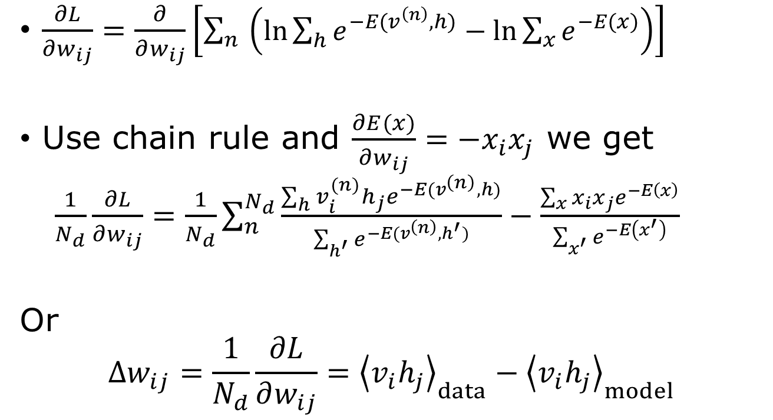
Compute gradient
$\frac{∂L}{∂w_{ij}}=\frac{∂}{∂w_{ij}}\left[\sum_{n}{\left(\ln{\sum_{h}{e^{−E(v^{\left(n\right)},h)}}}−\ln{\sum_{x}{e^{−E(x)}}}\right)}\right]$
Use chain rule and $\frac{∂E(x)}{∂w_{ij}}=−x_{i}x_{j}$ we get
$\frac{1}{N_{d}}\frac{∂L}{∂w_{ij}}=\frac{1}{N_{d}}\sum_{n}^{N_{d}}{\frac{\sum_{h}{v_{i}^{(n)}h_{j}e^{−E(v^{\left(n\right)},h)}}}{\sum_{h^{′}}{e^{−E(v^{\left(n\right)},h^{′})}}}}−\frac{\sum_{x}{{x_{i}x_{j}e}^{−E\left(x\right)}}}{\sum_{x^{′}}{e^{−E\left(x^{′}\right)}}}$
Or
$$Δw_{ij}=\frac{1}{N_{d}}\frac{∂L}{∂w_{ij}}={\left\langle v_{i}h_{j}\right\rangle }_{data}−{\left\langle v_{i}h_{j}\right\rangle }_{model}$$

Slide 8
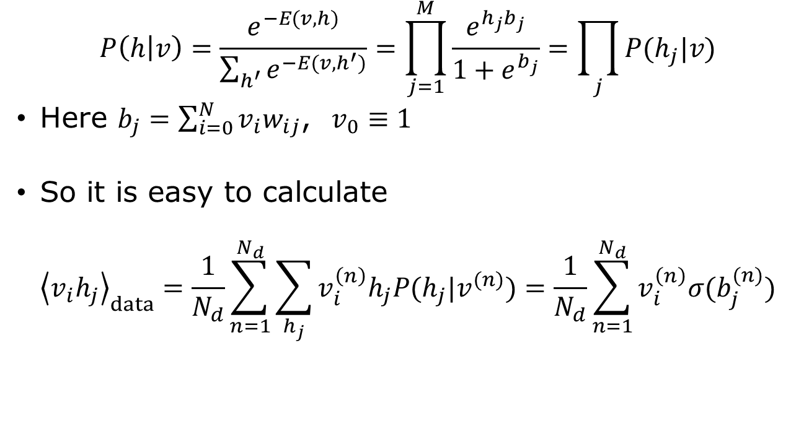
Conditional probability of h given data
$$P\left(h | v\right)=\frac{e^{−E(v,h)}}{\sum_{h^{′}}{e^{−E(v,h^{′})}}}=\prod_{j=1}^{M}{\frac{e^{{h_{j}b}_{j}}}{1+e^{b_{j}}}}=\prod_{j}{P(h_{j}|v)}$$
Here $b_{j}=\sum_{i=0}^{N}{v_{i}w_{ij}}$, $v_{0}≡1$
So it is easy to calculate
$${\left\langle v_{i}h_{j}\right\rangle }_{data}=\frac{1}{N_{d}}\sum_{n=1}^{N_{d}}{\sum_{h_{j}}{v_{i}^{\left(n\right)}h_{j}P(h_{j}|v^{(n)})}}=\frac{1}{N_{d}}\sum_{n=1}^{N_{d}}{v_{i}^{\left(n\right)}σ(b_{j}^{(n)})}$$

Slide 9
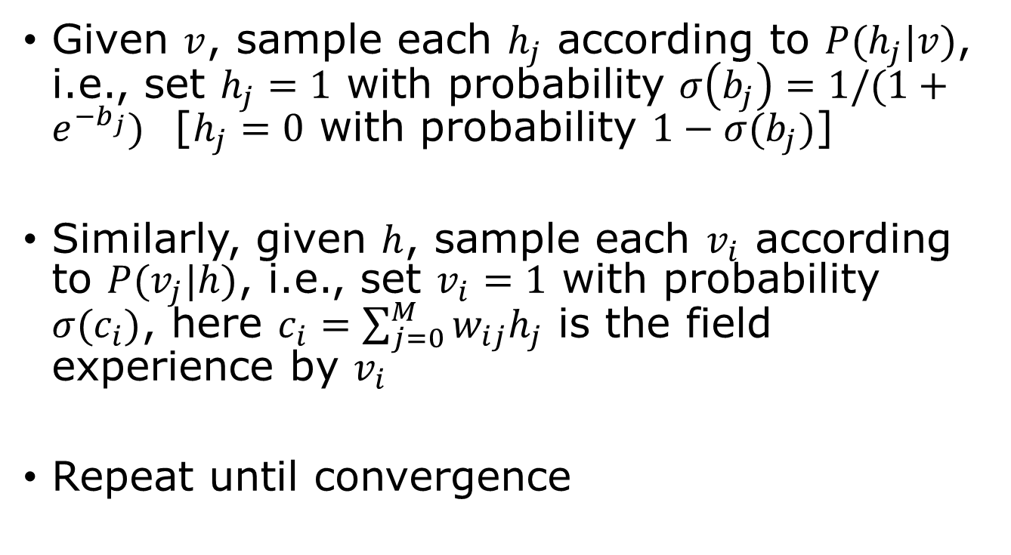
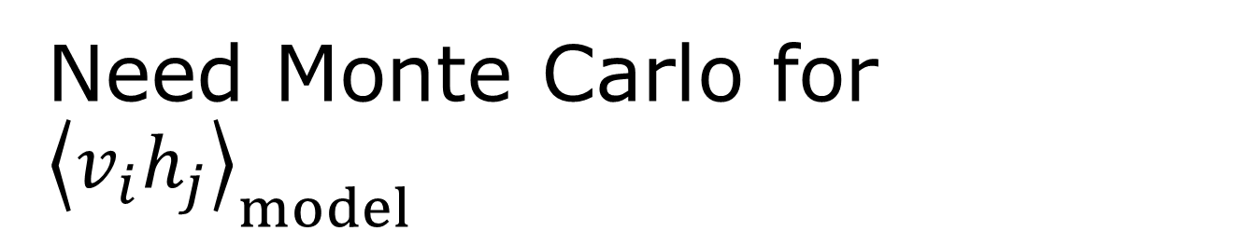
Need Monte Carlo for ${\left\langle v_{i}h_{j}\right\rangle }_{model}$
Given $v$, sample each $h_{j}$ according to $P(h_{j}|v)$, i.e., set $h_{j}=1$ with probability $σ\left(b_{j}\right)=1/(1+e^{−b_{j}})$ [$h_{j}=0$ with probability $1−σ(b_{j})$]
Similarly, given $h$, sample each $v_{i}$ according to $P(v_{j}|h)$, i.e., set $v_{i}=1$ with probability $σ(c_{i})$, here $c_{i}=\sum_{j=0}^{M}{w_{ij}h_{j}}$ is the field experience by $v_{i}$
Repeat until convergence

Slide 10
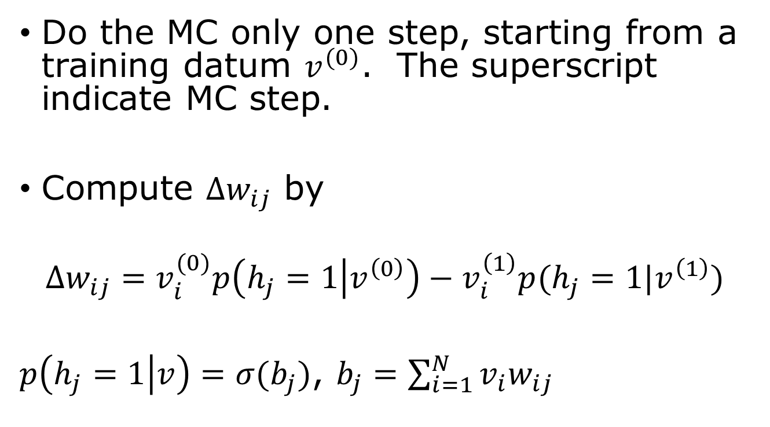
Contrastive divergence
Do the MC only one step, starting from a training datum $v^{(0)}$. The superscript indicate MC step.
Compute $Δw_{ij}$ by
$${Δw_{ij}=v}_{i}^{(0)}p\left(h_{j}=1 | v^{\left(0\right)}\right)−v_{i}^{\left(1\right)}p(h_{j}=1|v^{\left(1\right)})$$
$p\left(h_{j}=1 | v\right)=σ(b_{j})$, $b_{j}=\sum_{i=1}^{N}{v_{i}w_{ij}}$
Notes:
As usual, in machine learning, we update the weight with a learning rate, i.e., w_ij -> w_ij + eta Delta w_ij (eta small).

Slide 11
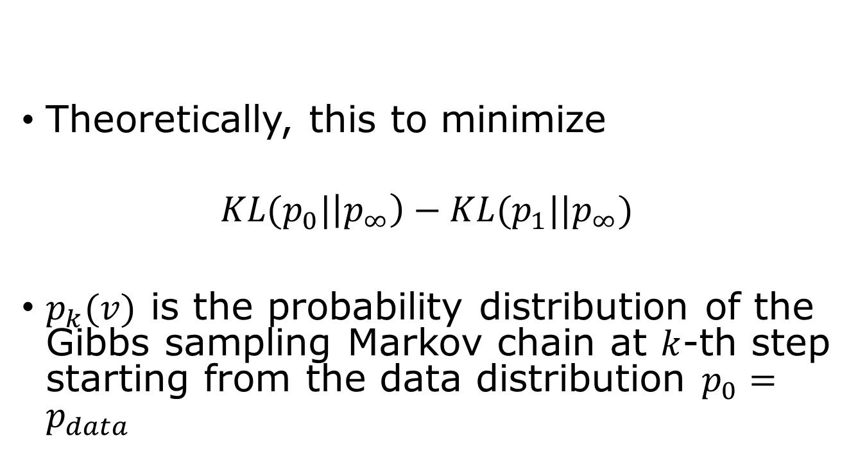
Contrastive divergence
Theoretically, this to minimize
$$KL(p_{0}|\left|p_{∞}\right)−KL(p_{1}||p_{∞})$$
$p_{k}(v)$ is the probability distribution of the Gibbs sampling Markov chain at $k$-th step starting from the data distribution $p_{0}=p_{data}$

Slide 12
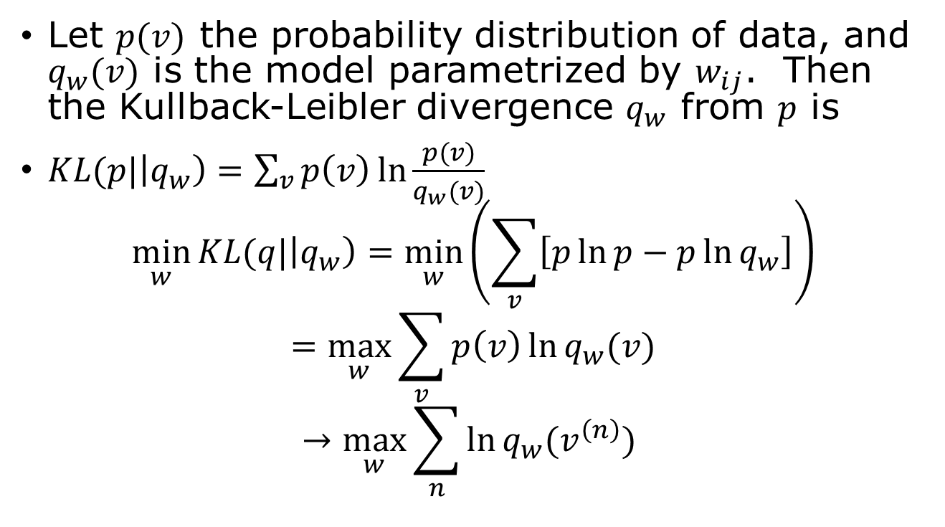
Maximising Likelihood is equivalent to minimizing KL Divergence
Let $p(v)$ the probability distribution of data, and $q_{w}(v)$ is the model parametrized by $w_{ij}$. Then the Kullback-Leibler divergence $q_{w}$ from $p$ is
$KL(p|\left|q_{w}\right)=\sum_{v}{p\left(v\right)\ln{\frac{p(v)}{q_{w}(v)}}}$
$$\min_{w}{KL(q|\left|q_{w}\right)=\min_{w}\left(\sum_{v}{\left[p\ln{p}−p\ln{q_{w}}\right]}\right)}$$
$$=\max_{w}{\sum_{v}{p\left(v\right)\ln{q_{w}(v)}}}$$
$$→\max_{w}{\sum_{n}{\ln{q_{w}(v^{\left(n\right)}) }}}$$
Replace probability average by sample average

Slide 13
Revision Suggestions
The ppt slides define the “scope” only
Focus on the relevant chapters of Bishop’s book
Memorizing formulas is unlikely to be helpful, focus on the conceptual understanding
Format of final exam: 1) multiple choices, 2) Python programming, 3,4) Bishop book style problems (mostly math)
The contents you can ignore: week 1 biological neurons, statistic sufficiency, regularization, PINN, diffusion model, and week 13 Boltzmann machine

