Slide 1
Week 2, Programming in machine learning: Python & PyTorch

Slide 2
Outline
Install Python and PyTorch
Python language fundamentals
NumPy arrays
PyTorch for machine learning/automatic differentiation
Object-oriented programming in PyTorch and torch.nn

Slide 3
Install Python/PyTorch
www.python.org
www.anaconda.com/download
Go to the download tab
Download the latest installer for your operating system (Windows, macOS, or Linux)
Follow the instructions to execute the installer
Use IDLE
Choose your OS (Windows, Mac or Linux)
Download the graphical installer
Advantage: you get jupyter notebook, numpy, as well as many other packages
Inside the Jupyter notebook do:
%pip install torch torchvision torchaudio

Slide 4
First Python Example
Running a Python script: option 1, in Command Prompt (Windows), using py hello.py (name of this file).
option 2, open the file in Python IDLE and click Run -> Run Module.
3. Press shift-enter on jupyter notebook.
# This program prints hello
#
print("hello, world!")
x = 1
y = 2
z = x + y
print(x, "+", y, "=", z)
Notes:
For Python, see for example, E. Matthes, “Python crash course”, 2nd edition. Or B. Lubanovic, “Introducing Python”. IDLE: integrated development and learning environment.

Slide 5
Data Types
Everything in Python is an “object” having an id, type, and value, as well as attributes and methods.
E.g., z.real, z.imag, z.conjugate()
booleans (True or False)
integers: 42, 1000, 2**100
floats: pi = 3.14159
complex: z = 1.0 + 2.5j
string, four ways: single quote, 'like', double quote, "open or close", or triple quotes, """this""", or '''this and that is in "a" la'''
Notes:
j is used as the complex units, you can type 1j for sqrt(-1), but not j alone.

Slide 6
Name of a Variable
The name serves as a handle to refer to the data (boolean, integer, etc)
The name is case sensitive, cannot start with a digit. Special character underscore can be used:
a, a1, A, x_result

Slide 7
Reserved words cannot be used as ordinary variables
False
None
True
and
as
assert
break
class
continue
def
del
elif
else
except
finally
for
from
global
if
import
in
is
lambda
nonlocal
not
or
pass
raise
return
try
while
with
yield
Notes:
Reserved words are also known as keywords.

Slide 8
Equal is not equal
x = 10 is not 10 = x
x = x + 1 made no sense if it is math
x = a + b OK if a and b have been defined earlier, but a+b = x is not.
In general, left side of ‘=’ refers to memory location, right side expression can be evaluated to numerical values

Slide 9
Expressions
Expressions can be formed with +, -, *, / with the usual meaning
Use parentheses ( …) for evaluation order, e.g., (a+b)*c
Special operators: // integer division, % modulus (remainder), ** exponentiation
a += b, is the same as a = a+b, etc.
Logical operators: ==, !=, <, <=, >, >=, and, or, not, in

Slide 10
Bitwise operations
|, &, ^, ~ : bitwise or, and, exclusive or, and not. <<, >>: left shift and right shift.
Examples:
5 | 1 -> 5 5 -> 101₂
5 & 1 -> 1 1 -> 001₂
5 ^ 1 -> 4
~5 -> -6
5 << 1 -> 10
5 >> 1 -> 2

Slide 11
Control Structures - loop
for j in range(0,10,1):
print(j)
n = 1
while n < 10:
print(n)
n *= 2
0, 1, 2, …, 9 are printed.
Important: indentation serves the purpose of grouping, like
{ … } pair in C, or begin/end in Pascal.
Notes:
The range(…) is an “range” object.

Slide 12
Control Structure - conditional
The colon : starts an indentation block after structure control key words, such as for, while, if, else, def etc.
Correct indentation important here.
if b > 3:
a = 1
n =1
if n < 1000:
n *= 2
else:
n = 0

Slide 13
Control Structure – break, continue, else
while True:
...
if … :
break
...
else:
...
Opposite of break is continue.

Slide 14
Structured Data Type - List
a=[1,2,3]
defines elements a[0],a[1],a[2] to be 1, 2, and 3.
y=[a,"we",3.14]
The elements do not have to be of the same type. A list can contain a list. So, y[0] is a, and y[0][0] is 1.
Index in [ ] starts from 0, just like in C.
Notes:
The C compiler cannot check if the array is out-of-bound. Fortran is much better in array processing. Python is “foolproof”.

Slide 15
List “processing” method
Slice of the list using [start:stop:step]
append() : add an item at the end
+= : combine two lists.
insert(i,item) : insert at offset i
pop() : get then delete (the last) entry
index() : find an item offset
sort() : sort the items
copy() : make a copy of the list
Use list method with the dot notation, e.g.,
a.pop( )

Slide 16
Tuples and Dictionaries
t=(1,2,3,)
defines tuple with elements 1, 2, and 3. It is the same as list except the values cannot be changed. It behaves like a constant list.
d={"A":1, "B":2, "C":3}
Dictionary consists of list of key:value pair. The value is referred to by the key, e.g., d["A"] gives 1.
Notes:
There is also data structure called set. It is a dictionary without value. See next slide. Tuple /ˈtjuːpəl/

Slide 17
Set: dictionaries without value
s={"A","B","C"}
Set operations: & set and, | set or, <=, <, subset of (proper subset of)
Using in to test membership of set.
Notes:
What is the difference between a set and list in mathematical sense?

Slide 18
Use Packages
import math
theta = 0.5*math.pi
x = math.sin(theta)
y = math.sqrt(x)
z = math.log(y)
print(theta,x,y,z)
Other standard packages or modules in Python includes cmath, os, datetime, etc.
Notes:
The import keyword loads a module; it is just another file that contains Python code.

Slide 19
Define Functions
def my_print():
'''Just say hello'''
print("Hello from my print!")
def square(x):
return (x*x)
def add(a,b):
c = a+b
return c
x = 1.0
y = 2.0
my_print()
print(square(y))
z=add(x,y)
print(x,y,z)
Docstring: Use ''' …''' to document the function, and help(name) to view the documentation.

Slide 20
Function argument types
Set default value by arg = value
Call with key words
Variable number of parameters with *arg
Variable number of keyword arguments with **karg
E.g.:
def func(a,b="0"):
def func(*a):
x = func(a=1,b="2") # key/value
Notes:
*arg passes a tuple to the function, while **arg passes a dictionary to the function.

Slide 21
Use Files
import math
filepath = "oscillator.eps"
fp = open(filepath, "w")
fp.write("%!PS Adobe 2.0\n")
# we trace the shape of an ellipse
b = 100
a = math.sqrt(2.0)*b
x = a
y = 0.0
fp.write("%f %f moveto\n" % (x,y))
fp.write("0.0 120.0 lineto stroke\n")
fp.write("closepath")
fp.close()
open(…) function returns a file object.
write(…) method is used to write to a file. Or use print(…,file=fp)
Finally, file is closed with the close(…) method.

Slide 22
Passing objects to functions
a copy of the value is passed to a function argument for number. But reference is passed for a list.
immutable mutable
def passnumber(a):
a = a + 1
print("in passnumber function, a=", a)
b = 1
passnumber(b)
print(b)
b is still 1 outside function
def listfun(mylist):
mylist[0] = 10
print("in listfunc, list=", mylist)
A = [1,2,3]
listfun(A)
print(A)
list is updated to [10,2,3]
Notes:
Ans: i is still 1, unaffected by the function call. A[0] becomes 2, because address associated with A[0] is passed to the function. For the left column, the input a is immutable, while for the right column, mylist is mutable.

Slide 23
NumPy
NumPy arrays are multi-dimensional grids with entries of the same data type.
Install with (in cmd)
pip install numpy
import numpy as np
l=[1.0,2.0,3.0]
a = np.array(l)
a[0]
np.array( ) converts list into number array.
Indexing by [0,…] not [0][0] etc.
Notes:
https://numpy.org/ is the official NumPy website which contains the complete information about it.

Slide 24
Create & change arrays
A=np.zeros(3)
B=np.zeros((3,2))
C=np.zeros((3,3),dtype=int)
Other functions that generate matrices are ones( ), eye( ), diag( ), etc.
B.flatten() # a copy of 1D data
B.reshape((2,3)) # a view of new shape
Notes:
Copy vs view, shape is given by tuple.

Slide 25
Algebra with ndarray
Element-wise +, -, *, /, if they are the same shape.
A + B; A – B; A * B; A / B
Scalar multiplication
3.0*A
Matrix multiplication
A @ B or np.matmul(A,B)
Notes:
Ndarray is a class for array, np.array( ) is a method for ndarray. An ndarray is a (usually fixed-size) multidimensional container of items of the same type and size.

Slide 26
Array functions
np.max( ), np.min( )
np.sum( )
np.transpose( ), np.trace( )
Linear algebra routines
np.linalg.solve( ), np.linalg.det( ), np.linalg.inv(), np.linalg.norm( ), etc
Random number: np.random.uniform()

Slide 27
PyTorch
Tensors (i.e., multi-dimensional arrays) with the option of computing derivatives with respect to a scalar automatically, or put them on the CPU or GPU.
Implementation of standard neural network construction/operation in torch.nn (as well as those in numpy)
Notes:
It is a good idea to go through the pytorch tutorials from https://docs.pytorch.org/tutorials/beginner/basics/intro.html

Slide 28
tensor
Each tensor has attributes .shape, .dtype, and .device
A tensor is similar to a NumPy array, but it also supports automatic differentiation and GPU computation.
Create tensor with list or ndarray
import torch
import numpy as np
data = [[1,2],[3,4]]
x_data = torch.tensor(data)
np_array = np.array(data)
x_np = torch.from_numpy(np_array)
Use as, e.g.,
x_data[0,1]

Slide 29
Create tensor and slicing
shape = (2,3,)
R_tensor = torch.rand(shape)
O_tensor = torch.ones(shape)
Z_tensor = torch.zeros(shape)
R_tensor[0] # 0th row
R_tensor[:,0] # 0th column (as 1D array)
R_tensor[:,-1] # last column
R_tensor[:,0:2] # column 0, 1

Slide 30
Tensor operations
t = torch.rand(3,3) # generate a 3x3 random tensor
y = t.T # transpose the matrix as a view
Matrix multiplication
z = t @ y or z = t.matmul(y)
Elementwise multiplication by
x = t * y
agg = t.sum() # result is 1x1 tensor
a = agg.item() # back to python float
Notes:
What is a “view”?

Slide 31
Load predefined dataset
import torch
from torch.utils.data import Dataset
from torchvision import datasets
from torchvision.transforms import ToTensor
import matplotlib.pyplot as plt
training_data = datasets.FashionMNIST(
root="data",
train=True,
download=True,
transform=ToTensor()
)
test_data = datasets.FashionMNIST(
root="data",
train=False,
download=True,
transform=ToTensor()
)

Slide 32
Visualize fashion data
labels_map = {
0: "T-Shirt",
1: "Trouser",
2: "Pullover",
3: "Dress",
4: "Coat",
5: "Sandal",
6: "Shirt",
7: "Sneaker",
8: "Bag",
9: "Ankle Boot",
}
figure = plt.figure(figsize=(8, 8))
cols, rows = 3, 3
for i in range(1, cols * rows + 1):
sample_idx = torch.randint(len(training_data), size=(1,)).item()
img, label = training_data[sample_idx]
figure.add_subplot(rows, cols, i)
plt.title(labels_map[label])
plt.axis("off")
plt.imshow(img.squeeze(), cmap="gray")
plt.show()
See the datasetMNST jupyter notebook

Slide 33

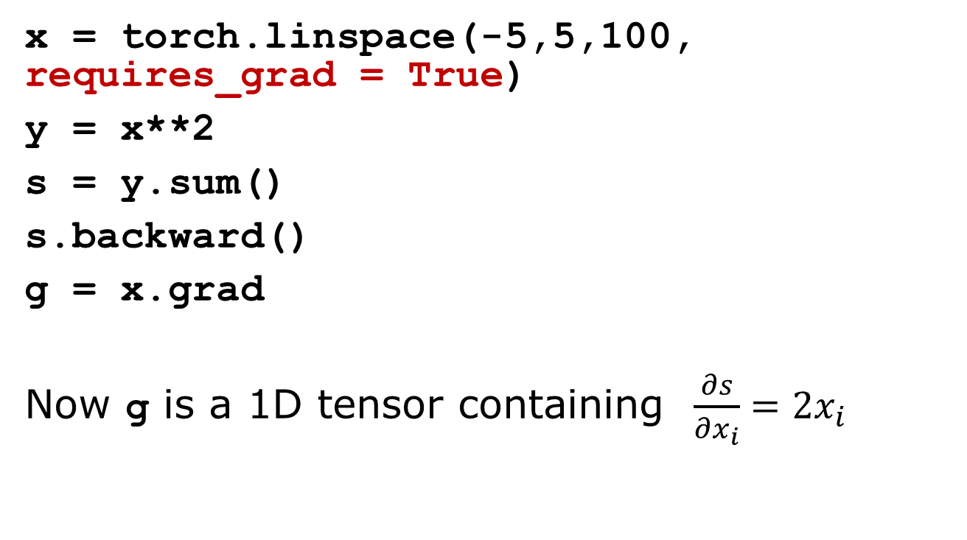
Automatic gradient computation in PyTorch
x = torch.linspace(-5,5,100, requires_grad = True)
y = x**2
s = y.sum()
s.backward()
g = x.grad
Now g is a 1D tensor containing $\frac{∂s}{∂x_{i}}=2x_{i}$
$$s=\sum_{i=0}^{99}{x_{i}^{2}}$$
plt.plot(x.detach().numpy(), y.detach().numpy(), label='y = x^2')
plt.plot(x.detach().numpy(), g.numpy(), label='dy/dx = 2x')
See autograd jupyter notebook

Slide 34







Simple 2-layer network
import torch
W1 = torch.randn(2,4,requires_grad=True)
b1 = torch.randn(4,requires_grad=True)
W2 = torch.randn(4,1,requires_grad=True)
b2 = torch.randn(1,requires_grad=True)
def forward(x):
hid = torch.matmul(x,W1) + b1
h = torch.relu(hid)
output = torch.matmul(h, W2) + b2
return output
x = torch.tensor([[1.0,2.0]])
y = forward(x)
print("y=", y)
$${ h}_{1}$$
$${ x}_{1}$$
$${ h}_{2}$$
$${ y}_{1}$$
$${ x}_{2}$$
$${ h}_{3}$$
$${ h}_{4}$$
Will implement the same using classes defined in torch.nn
Notes:
This simple 2-layer is supposed to be the same as that by torch.nn, except W is not transposed!

Slide 35
Object Oriented Programming, and class
class A:
x = "A class" # class property
def __init__(self, d):
self.data = d # attribute
def p(self): # method
print("data=", self.data)
class B(A): # inheritance/subclass
def __init__(self, d):
super().__init__(d) # call parent __init__
def p(self):
print("in B")
def __call__(…): # so that we can use as function
…
a = A("in A") # instantiation
print(a.data) # dot . access attribute, i.e. data
a.p() # .p( ) access method
b = B("pass to B")
b.p()
__call__
and forward()
in nn.Module
MRO
Notes:
MRO: method resolution order

Slide 36
Three ways to use an object
a = A(…)
a.data Access the attribute `data’ of A
a.p() Use the method `p’ of A
a(x) Use A as if A is a function (not an instantiation which calls __init__)
In PyTorch, the effect of a(x) is defined by the forward() function

Slide 37
Tensor shape, dimension, batch dimension
t = torch.rand(5,4,2)
t has dimension 3
t has the shape (5,4,2)
The batch dimension is the first dimension (size 5)

Slide 38

Use torch.nn
iterable, iterator, generator
for name, p in model.named_parameters():
print(name, p.shape)
import torch
import torch.nn as nn
class SimpleNN(nn.Module):
def __init__(self):
super().__init__()
self.hidden = nn.Linear(2,4)
self.output = nn.Linear(4,1)
def forward(self,x):
h = torch.relu(self.hidden(x))
x = self.output(h)
return x
model = SimpleNN()
x = torch.tensor([[1.0,2.0]])
y = model(x)
print("y=", y)
$${ h}_{1}$$
$${ x}_{1}$$
$${ h}_{2}$$
$${ y}_{1}$$
$${ x}_{2}$$
$${ h}_{3}$$
$${ h}_{4}$$
$$\left(h_{1},h_{2},h_{3},h_{4}\right)=relu(\left(x_{1},x_{2}\right)W_{\left(1\right)}^{T}{+b}^{\left(1\right)})$$
$$y_{1}=\left(h_{1},h_{2},h_{3},h_{4}\right)W_{(2)}^{T}+b^{(2)}$$
Notes:
Note: b is a row vector in these equations.

Slide 39

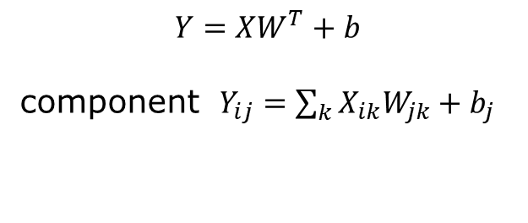
Class of torch.nn.Linear
$$Y=XW^{T}+b$$
component $Y_{ij}=\sum_{k}{X_{ik}W_{jk}}+b_{j}$
class Linear(Module):
def __init__(self,in_features,out_features):
super().__init__()
self.in_features = in_features
self.out_features = out_features
self.weight = Parameter( torch.empty((out_features,in_features)), …)
self.bias = …
def forward(self,input):
return functional.linear(input,self.weight,
self.bias)
in_features
$$X=$$
batch-size
batch processing

Slide 40
What need to know
Learn the basic Python syntax
Understand the object-oriented concepts
Know the basic concepts in PyTorch (i.e., tensors)
Be able to use the automatic differentiation in PyTorch
Can build a simple neural network using torch.nn

Slide 41
Questions & Answers
1) the difference between | and or, 2) when should we use :, 3) class, 4) object, 5) what is an instantiation? 6) attribute or property of a class, 7) method, 8) 3rd way to use an object, 9) difference between NumPy array and PyTorch tensor? 10) what is model.parameters(), 11) what does nn.Linear do?, 12) what is autograd, how to use autograd, 13) what is __call__()? relation to forward()?

