Slide 1
Week 3, Machine learning fundamentals
Notes:
Read chapter 5, Goodfellow, Bengio, and Courville, “Deep Learning”.

Slide 2
Outline
Linear models, design matrix, and the exact solution
Gradient descent method
Basics of the theory of probability
Joint distribution, conditional probability, average, variance, bias
Maximum-likelihood principle
KL divergence
Training and performance measures

Slide 3
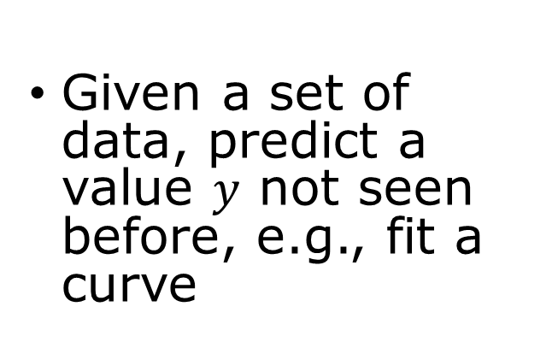
Problem to solve
Regression
Classification
Given a set of data, predict a value $y$ not seen before, e.g., fit a curve
Identify which one it is (discrete output). E.g., recognize handwritten digits
Generative AI
Learn probability distributions from data

Slide 4
Task, Performance, Experience
Task: perform a task without being explicitly programmed
Performance: how well it does (e.g., training and testing accuracy)
Experience: supervised vs unsupervised learning (generative AI); reinforcement learning

Slide 5
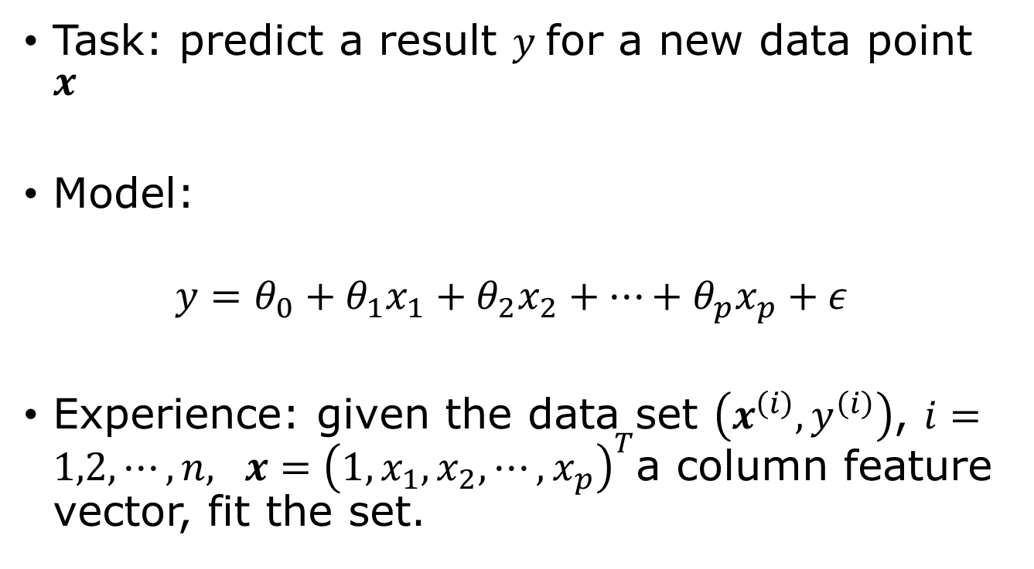
Linear regression as machine learning
Task: predict a result $y$for a new data point $x$
Model:
$$y=θ_{0}+θ_{1}x_{1}+θ_{2}x_{2}+…+θ_{p}x_{p}+ε$$
Experience: given the data set $\left(x^{\left(i\right)},y^{\left(i\right)}\right)$, $i=1,2,⋯,n,$ $x={\left(1,x_{1},x_{2},⋯, x_{p}\right)}^{T}$a column feature vector, fit the set.
random error
Notes:
The notations followed here are that of "Machine Learning", Lindholm, et al. Not that of Bishop. Linear regression can be viewed as a neural network with one linear layer and no activation function. The concepts introduced here—model, loss function, and gradient descent—carry over directly to deep learning.

Slide 6

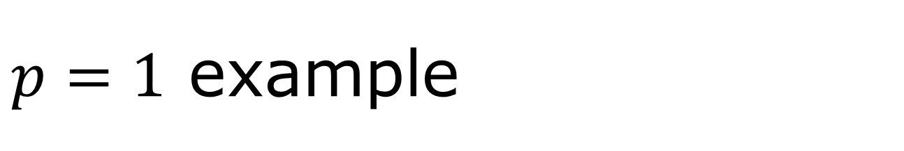
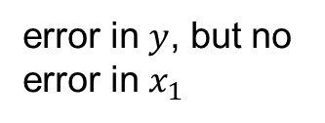


$p=1$ example
$$y$$
error in $y$, but no error in $x_{1}$
Data do not follow exactly the straight line. The basic assumption in linear regression (least squares fit) is that the deviations ε are independent Gaussian random variables with zero mean.
ε
fitting to $y=θ_{0}+θ_{1}x_{1}$
$$x_{1}$$

Slide 7
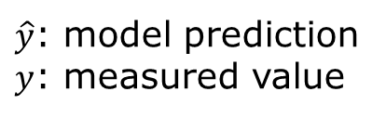
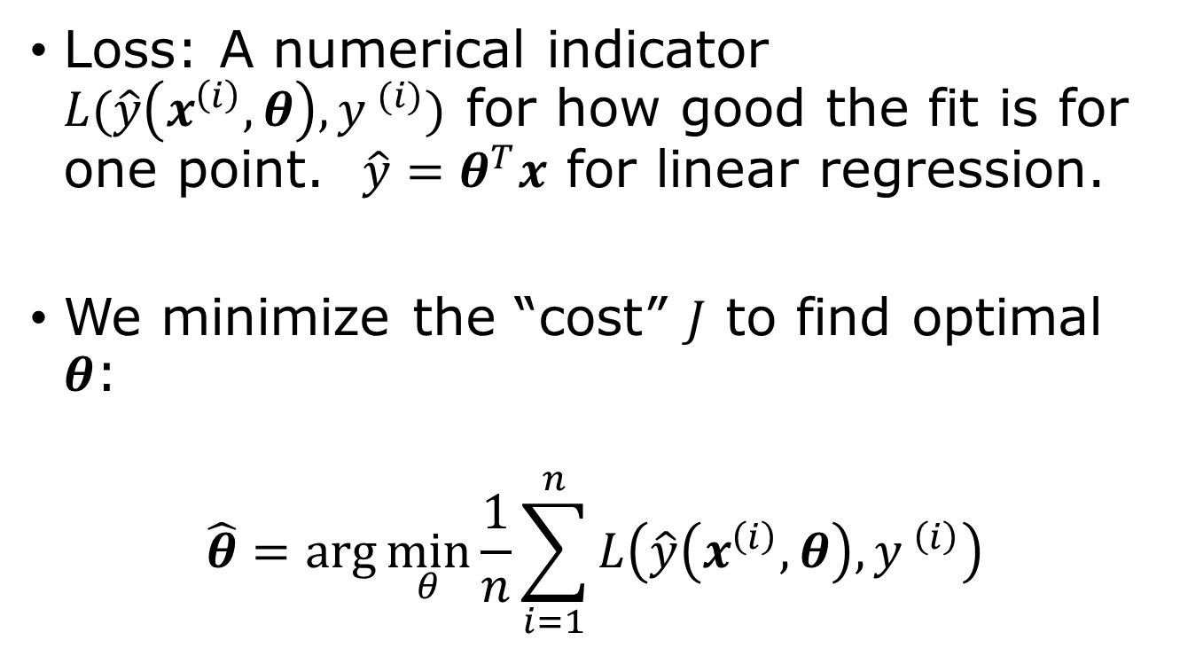

Loss function
$\hat{y}$: model prediction
$y$: measured value
Loss: A numerical indicator $L(\hat{y}\left(x^{\left(i\right)},θ\right),y^{ (i)})$ for how good the fit is for one point. $\hat{y}=θ^{T}x$ for linear regression.
We minimize the “cost” $J$ to find optimal $θ$:
$$\hat{θ}=\arg{\min_{θ}{\frac{1}{n}\sum_{i=1}^{n}{L\left(\hat{y}\left(x^{\left(i\right)},θ\right),y^{ \left(i\right)}\right)}}}$$
$$J=\frac{1}{n}\sum{L^{(i)}}$$

Slide 8
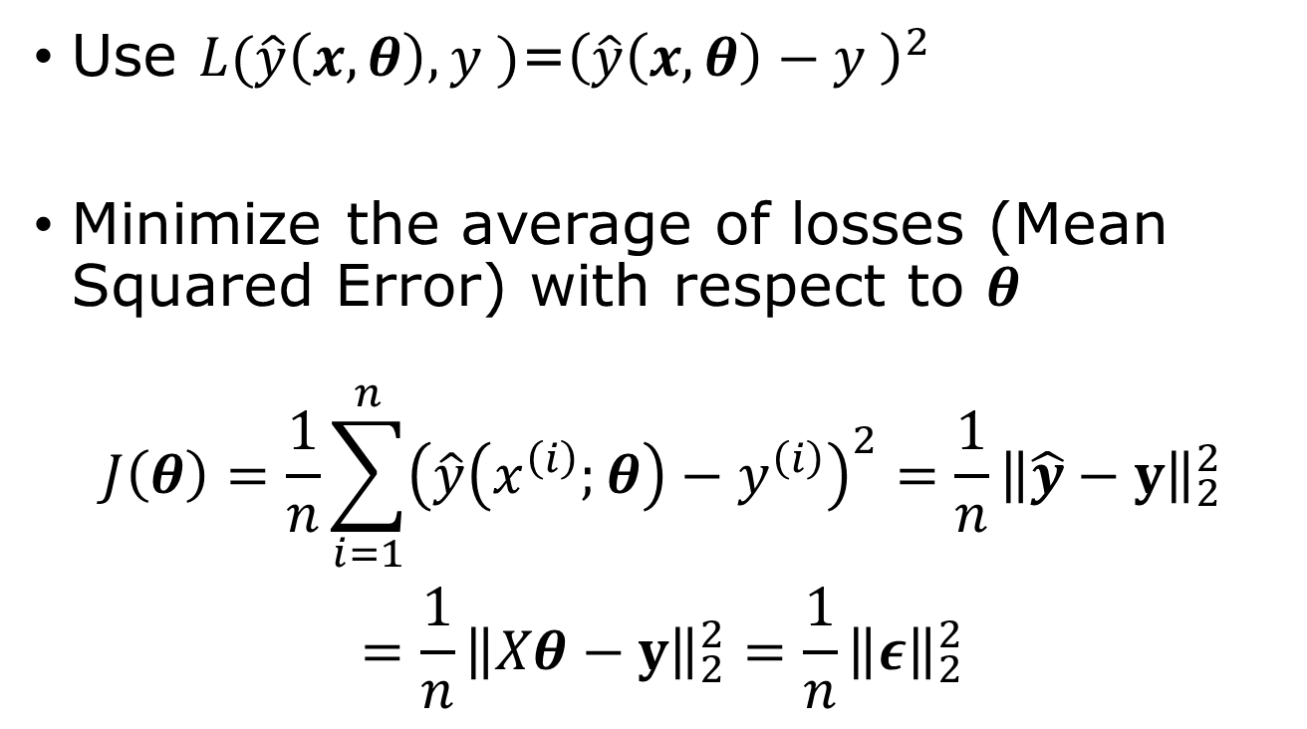
Least squares loss and exact solution
Use $L(\hat{y}\left(x,θ\right),y^{ })$=${\left(\hat{y}\left(x,θ\right)−y^{ }\right)}^{2}$
Minimize the average of losses (Mean Squared Error) with respect to $θ$
$$\begin{aligned}J\left(θ\right)=\frac{1}{n}\sum_{i=1}^{n}{{\left(\hat{y}\left(x^{\left(i\right)};θ\right)−y^{\left(i\right)}\right)}^{2}}=\frac{1}{n}{\left\|\hat{y}−y\right\|}_{2}^{2} \\ =\frac{1}{n}{\left\|Xθ−y\right\|}_{2}^{2}=\frac{1}{n}{\left\|ε\right\|}_{2}^{2}\end{aligned}$$
2-norm squared

Slide 9
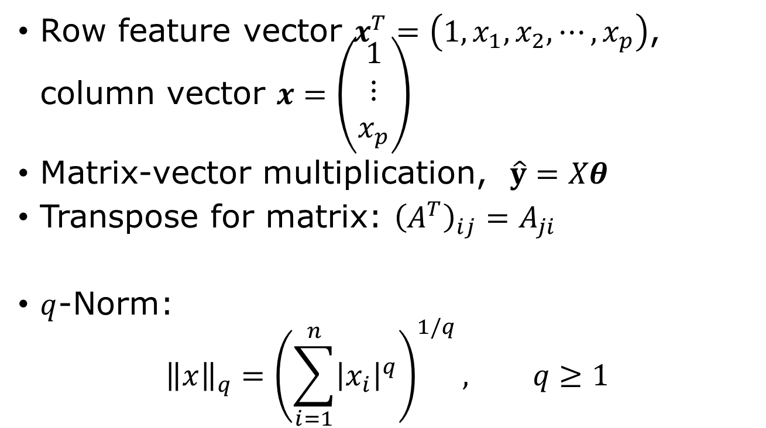
Linear algebra notations
Row feature vector $x^{T}=\left(1,x_{1},x_{2},⋯, x_{p}\right)$, column vector $x=\left(\begin{matrix}1 \\ ⋮ \\ x_{p}\end{matrix}\right)$
Matrix-vector multiplication, $\hat{y}=Xθ$
Transpose for matrix: ${\left(A^{T}\right)}_{ij}=A_{ji}$
$q$-Norm:
$${\left\|x\right\|}_{q}={\left(\sum_{i=1}^{n}{{\left|x_{i}\right|}^{q}}\right)}^{1/q}, q≥1$$

Slide 10




The design matrix $X$
feature vector
$$X=\left(\begin{matrix}1 & x_{1}^{\left(1\right)} & ⋯ & x_{p}^{\left(1\right)} \\ 1 & x_{1}^{\left(2\right)} & ⋯ & ⋯ \\ ⋯ & ⋯ & & \\ 1 & x_{1}^{(n)} & ⋯ & x_{p}^{(n)}\end{matrix}\right)$$
$$=\left(\begin{matrix}{(x^{(1)})}^{T} \\ ⋮ \\ {\left(x^{\left(n\right)}\right)}^{T}\end{matrix}\right)$$
data point
$$θ=\left(\begin{matrix}θ_{0} \\ ⋮ \\ θ_{p}\end{matrix}\right)$$
$$y=\left(\begin{matrix}y^{(1)} \\ ⋮ \\ y^{(n)}\end{matrix}\right)$$
$$Xθ=y ?$$

Slide 11



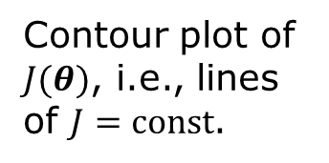
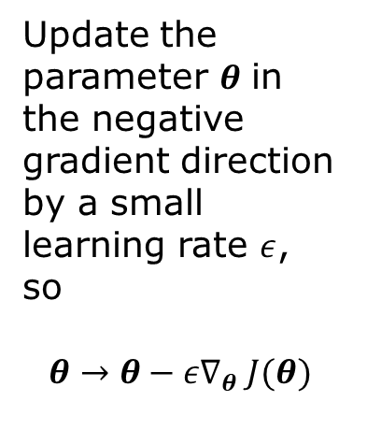
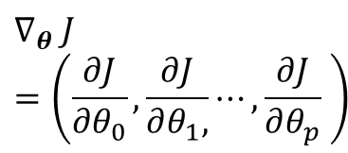
Gradient descent
$$dJ=\sum_{j}{dθ_{j}\frac{∂J}{∂θ_{j}}}$$
$$∇_{θ} J=\left(\frac{∂J}{∂θ_{0}},\frac{∂J}{∂θ_{1},}⋯,\frac{∂J}{∂θ_{p}} \right)$$
$$θ_{1}$$
Update the parameter $θ$ in the negative gradient direction by a small learning rate $ε$, so
$$θ→θ−ε∇_{θ} J(θ)$$
Contour plot of $J(θ)$, i.e., lines of $J=const$.
$$θ_{0}$$

Slide 12

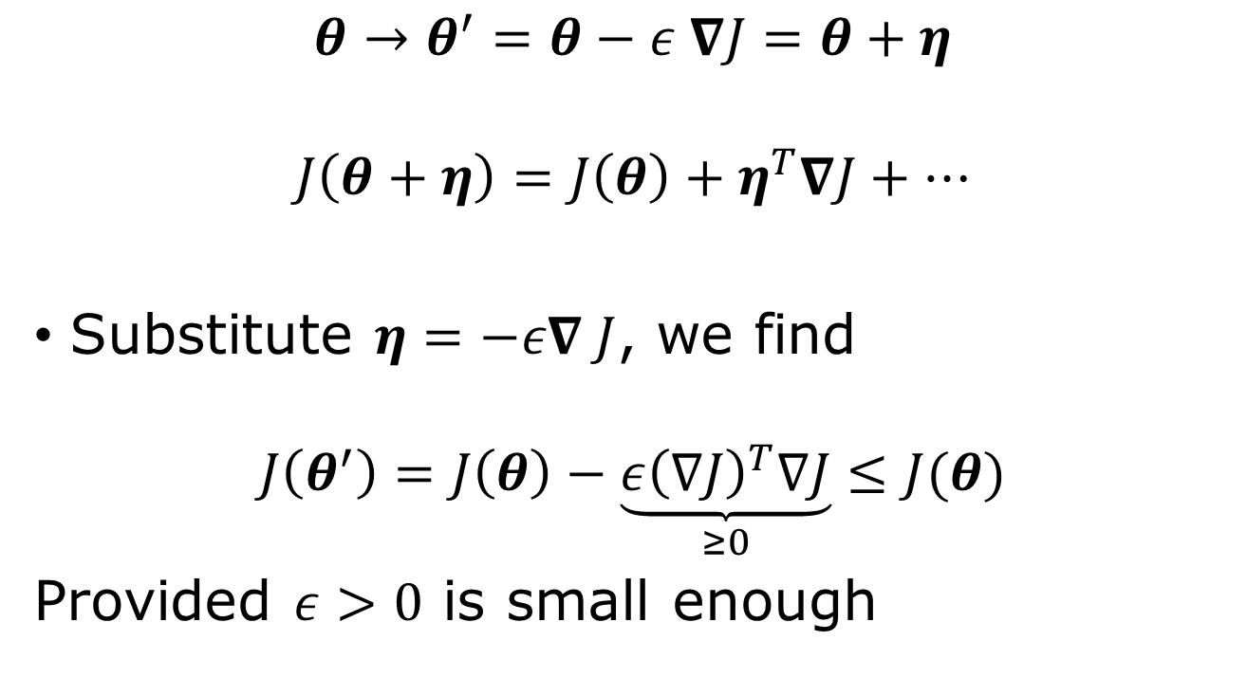
Negative gradient move lower the objective $J$
$$θ→θ^{′}=θ−ε ∇J=θ+η$$
$$J\left(θ+η\right)=J\left(θ\right)+η^{T}∇J+⋯$$
Substitute $η=−ε∇ J$, we find
$$J\left(θ^{′}\right)=J\left(θ\right)−\underset{≥0}{\underbrace{ε{\left(∇J\right)}^{T}∇J}}≤J(θ)$$
Provided $ε>0$ is small enough
Notes:
The idea is attributed to Cauchy, 1847.

Slide 13

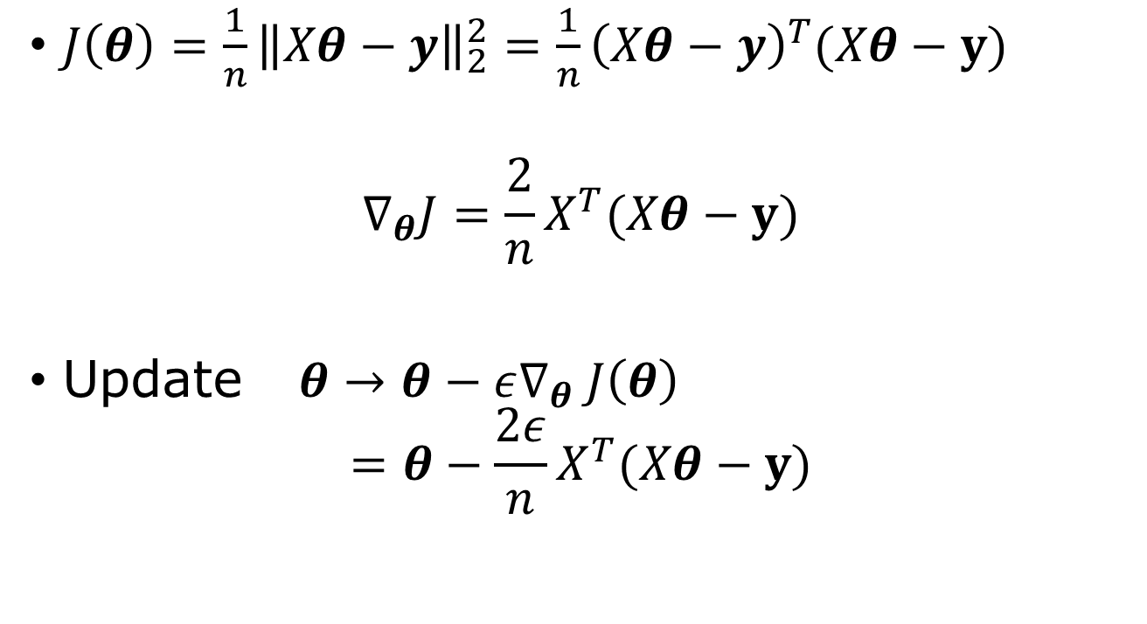
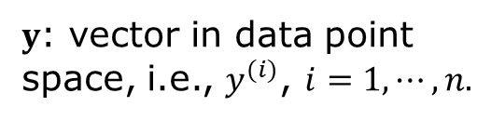

Gradient in linear regression problem
$J\left(θ\right)=\frac{1}{n}{\left\|Xθ−y\right\|}_{2}^{2}=\frac{1}{n}{\left(Xθ−y\right)}^{T}(Xθ−y)$
$$∇_{θ}J=\frac{2}{n}X^{T}(Xθ−y)$$
Update $θ→θ−ε∇_{θ} J\left(θ\right)$ $=θ−\frac{2ε}{n}X^{T}(Xθ−y)$
$$∇_{θ}=\frac{∂}{∂θ}$$
$$∇_{θ}θ^{T}=I$$
$y$: vector in data point space, i.e., $y^{(i)}$, $i=1,⋯, n.$
$$\hat{y}=Xθ$$

Slide 14

Normal equation
$∇_{θ}J=0$ at the minimum, so
$X^{T}\left(Xθ−y\right)=0$
Or
$X^{T}Xθ=X^{T}y$ $→$ $\hat{θ}={\left(X^{T}X\right)}^{−1}X^{T}y$
Moore-Penrose pseudo-inverse

Slide 15
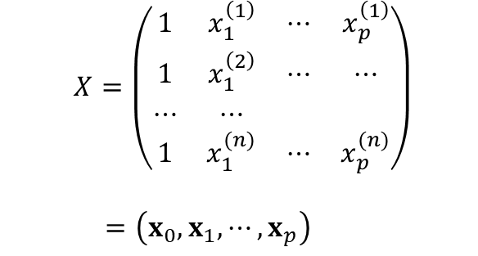
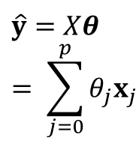
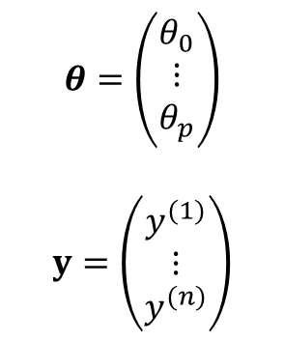




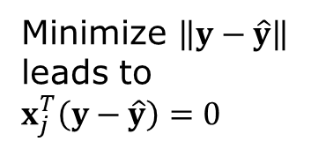
Geometric interpretation of normal solution
$$θ=\left(\begin{matrix}θ_{0} \\ ⋮ \\ θ_{p}\end{matrix}\right)$$
$$y=\left(\begin{matrix}y^{(1)} \\ ⋮ \\ y^{(n)}\end{matrix}\right)$$
$$X=\left(\begin{matrix}1 & x_{1}^{\left(1\right)} & ⋯ & x_{p}^{\left(1\right)} \\ 1 & x_{1}^{\left(2\right)} & ⋯ & ⋯ \\ ⋯ & ⋯ & & \\ 1 & x_{1}^{(n)} & ⋯ & x_{p}^{(n)}\end{matrix}\right)$$
$$=\left(x_{0},x_{1},⋯, x_{p}\right)$$
design matrix
$$y$$
$$y−\hat{y}$$
$$x_{1}$$
Minimize $\left\|y−\hat{y}\right\|$ leads to $x_{j}^{T}\left(y−\hat{y}\right)=0$
$$\hat{y}=Xθ= \sum_{j=0}^{p}{θ_{j}x_{j}}$$
$$x_{0}$$

Slide 16
Normal equation vs gradient descent
Normal equation | Gradient Descent
Exact solution | Iterative solution
Matrix inverse required | No matrix inverse
Works well for small models | Scales to millions of parameters
Rarely used in deep learning | Standard method for deep learning

Slide 17
Least-square fitting, machine learning way (code)
n = 3 # three fitting parameters
w = torch.rand((n),requires_grad=True)
def fit(x,w):
…
lr = 0.01
# loop over epochs; compute loss
loss.backward()
with torch.no_grad():
w -= lr*w.grad
w.grad.zero_()

Slide 18
Why Probability
Machine learning models are never perfect. Data contain noise and uncertainty. Probability provides a mathematical language for describing uncertainty and leads naturally to maximum-likelihood estimation.
A fundamental assumption in machine learning is that the data are generated from an underlying (possibly unknown) probability distribution.

Slide 19
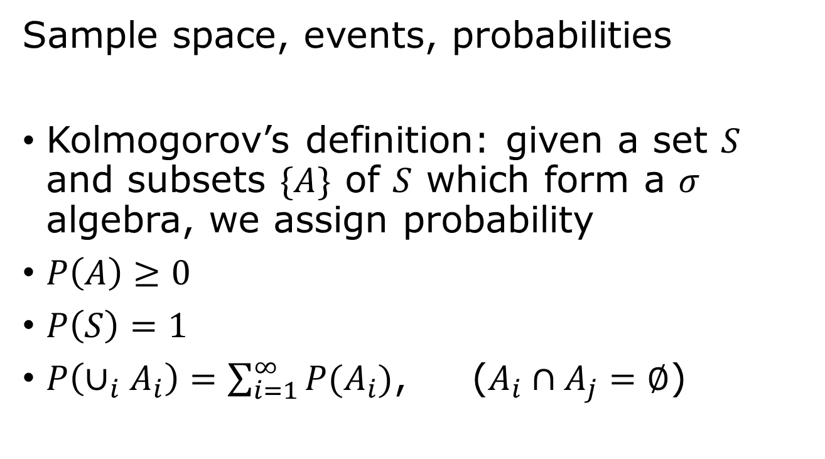
Probability
outcome
event
Sample space, events, probabilities
Kolmogorov’s definition: given a set $S$ and subsets $\{A\}$ of $S$ which form a $σ$ algebra, we assign probability
$P\left(A\right)≥0$
$P\left(S\right)=1$
$P\left(∪_{i}A_{i}\right)=\sum_{i=1}^{∞}{P(A_{i})}$, ($A_{i}∩A_{j}=∅$)
Notes:
What is a sigma algebra? The set F of subsets of S is such that 0, S is in F. If A is in F, then its complement is in F. If a sequence A_i is in F, its union is in F. The outcome of an experiment is an element of the set S, the sample space. And the event is a subset A which we assign probability.

Slide 20
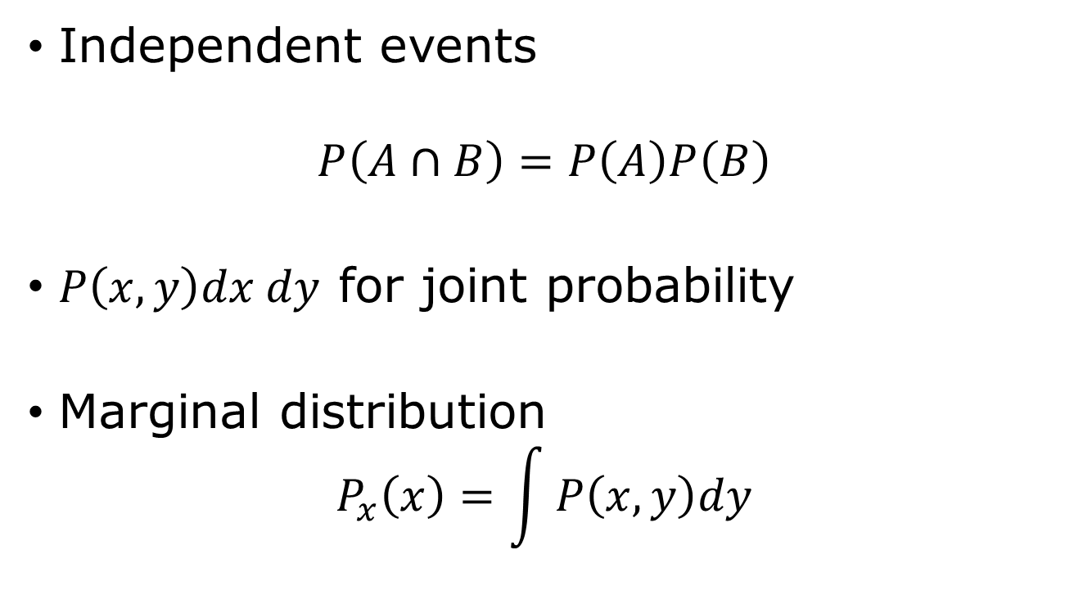
Joint distribution, marginal probability
Independent events
$$P\left(A∩B\right)=P\left(A\right)P\left(B\right)$$
$P\left(x,y\right)dx dy$ for joint probability
Marginal distribution
$$P_{x}\left(x\right)=\int{P\left(x,y\right)dy}$$
Notes:
Here we show the continuous variable case.

Slide 21
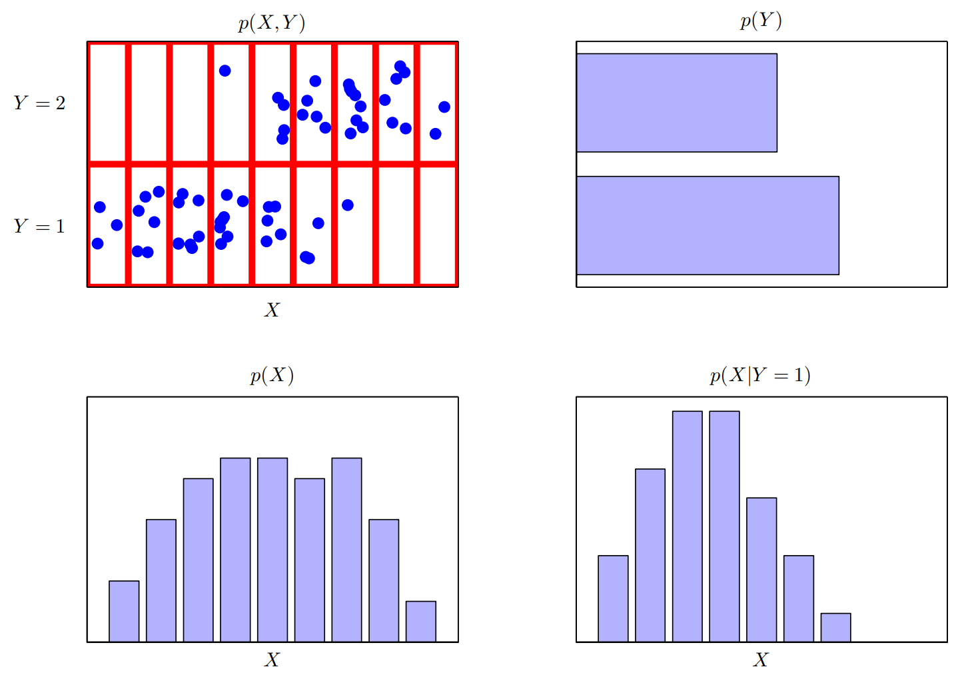
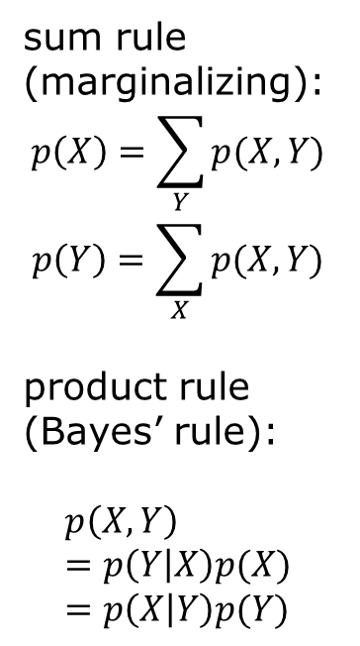
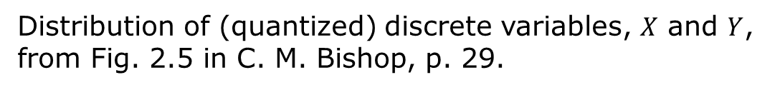
Joint, marginal, conditional distributions
sum rule (marginalizing):
$$p\left(X\right)=\sum_{Y}{p(X,Y)}$$
$$p\left(Y\right)=\sum_{X}{p(X,Y)}$$
product rule (Bayes’ rule):
$$p\left(X,Y\right)=p\left(Y | X\right)p(X)=p\left(X | Y\right)p(Y)$$
Distribution of (quantized) discrete variables, $X$ and $Y$, from Fig. 2.5 in C. M. Bishop, p. 29.

Slide 22

Conditional probability
$$P\left(A | B\right)≝ \frac{P(A∩B)}{P(B)}$$
Bayes theorem
$$P\left(B | A\right)=\frac{P(A|B) P(B)}{P(A)}$$

Slide 23
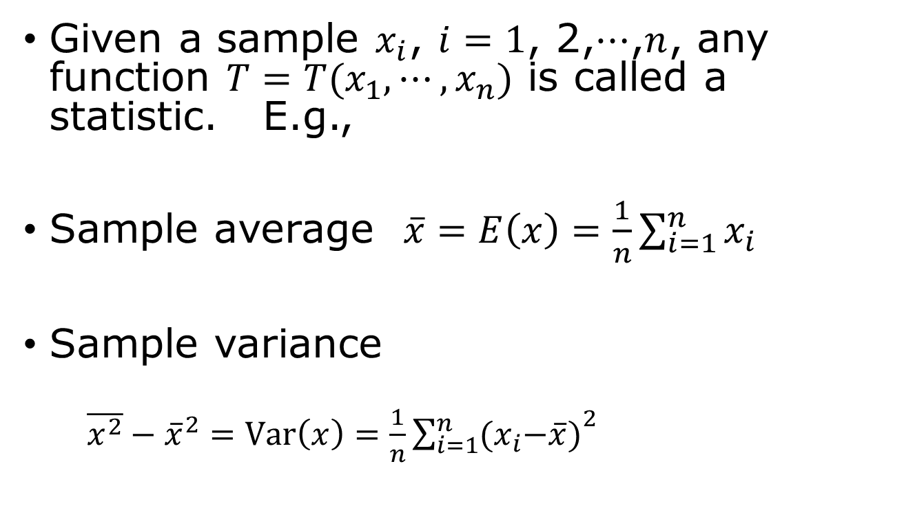
Statistic
Given a sample $x_{i}$, $i=1$, 2,$⋯$,$n$, any function $T=T(x_{1},⋯,x_{n})$ is called a statistic. E.g.,
Sample average $\overline{x}=E\left(x\right)=\frac{1}{n}\sum_{i=1}^{n}{x_{i}}$
Sample variance
$\overline{x^{2}}−{\overline{x}}^{2}=Var\left(x\right)=\frac{1}{n}{\sum_{i=1}^{n}{{(x}_{i}−\overline{x})}}^{2}$

Slide 24
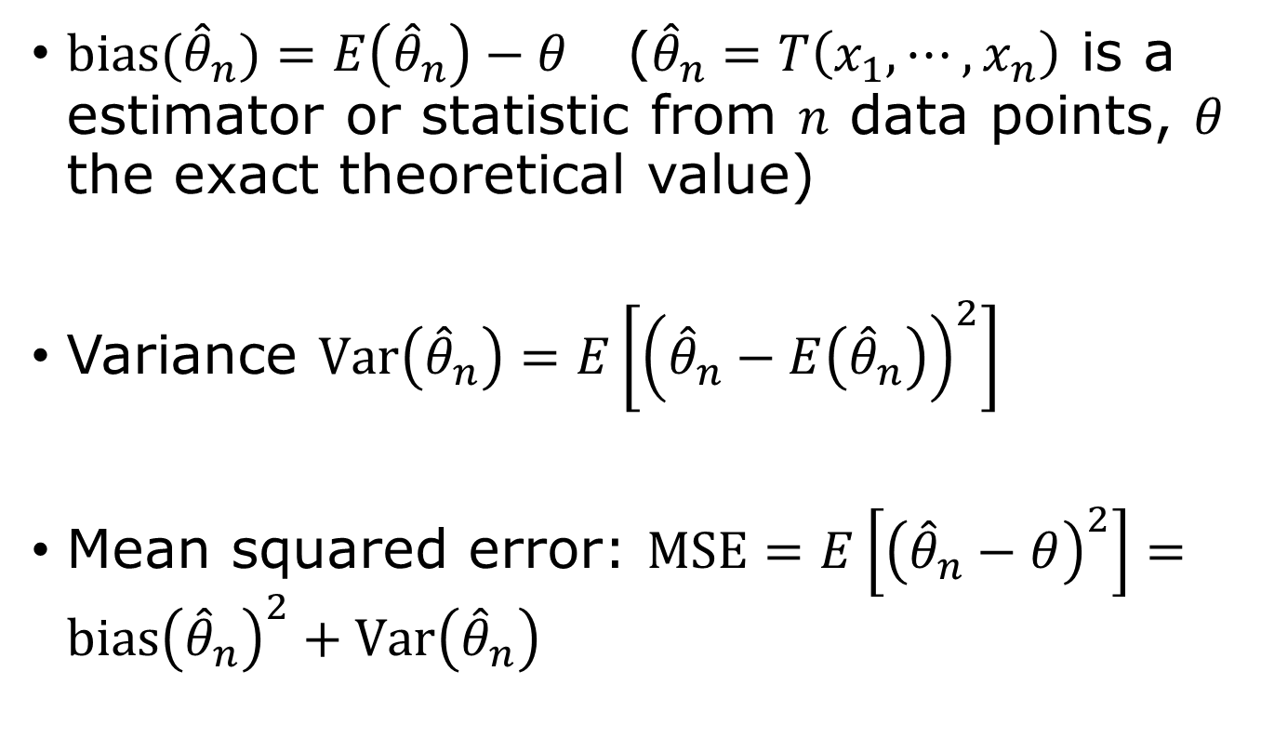
Bias, variance
$bias({\hat{θ}}_{n})=E\left({\hat{θ}}_{n}\right)−θ$ (${\hat{θ}}_{n}=T\left(x_{1},⋯, x_{n}\right)$ is a estimator or statistic from $n$ data points, $θ$ the exact theoretical value)
Variance $Var\left({\hat{θ}}_{n}\right)=E\left[{\left({\hat{θ}}_{n}−E\left({\hat{θ}}_{n}\right)\right)}^{2}\right]$
Mean squared error: $MSE=E\left[{\left({\hat{θ}}_{n}−θ\right)}^{2}\right]=bias{\left({\hat{θ}}_{n}\right)}^{2}+Var\left({\hat{θ}}_{n}\right)$

Slide 25
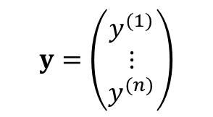
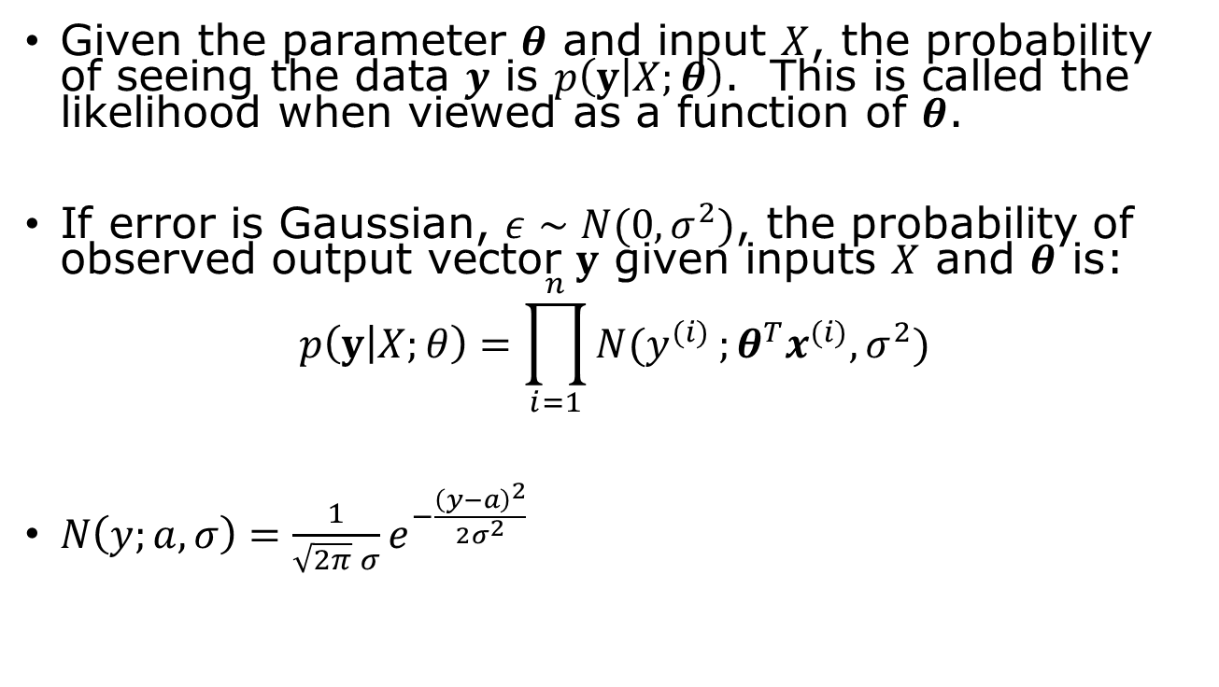
Maximum Likelihood perspective
Given the parameter $θ$ and input $X$, the probability of seeing the data $y$ is $p\left(y | X;θ\right)$. This is called the likelihood when viewed as a function of $θ$.
If error is Gaussian, $ε∼N(0,σ^{2})$, the probability of observed output vector $y$ given inputs $X$ and $θ$ is:
$$p\left(y | X;θ\right)=\prod_{i=1}^{n}{N(y^{(i)}};θ^{T}x^{(i)},σ^{2})$$
$N\left(y;a,σ\right)=\frac{1}{\sqrt{2π} σ}e^{−\frac{{\left(y−a\right)}^{2}}{2σ^{2}}}$
$$y=\left(\begin{matrix}y^{(1)} \\ ⋮ \\ y^{(n)}\end{matrix}\right)$$

Slide 26
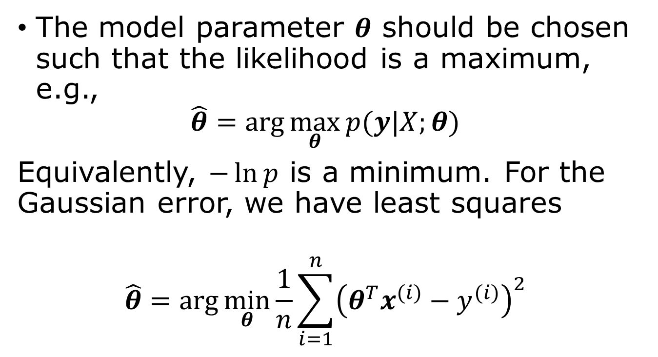
Maximum likelihood estimator
Why maximum likelihood estimator? 1) consistent, 2) lowest MSE, 3) asymptotic normality.
The model parameter $θ$ should be chosen such that the likelihood is a maximum, e.g.,
$$\hat{θ}=\arg{\max_{θ}{p(y|X;θ)}}$$
Equivalently, $−\ln{p}$ is a minimum. For the Gaussian error, we have least squares
$$\hat{θ}=\arg{\min_{θ}{\frac{1}{n}}}\sum_{i=1}^{n}{{\left(θ^{T}x^{(i)}−y^{(i)}\right)}^{2}}$$

Slide 27
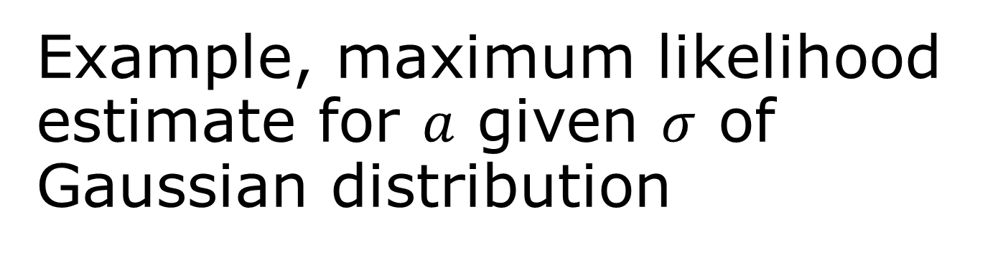
Example, maximum likelihood estimate for $a$ given $σ$ of Gaussian distribution

Slide 28
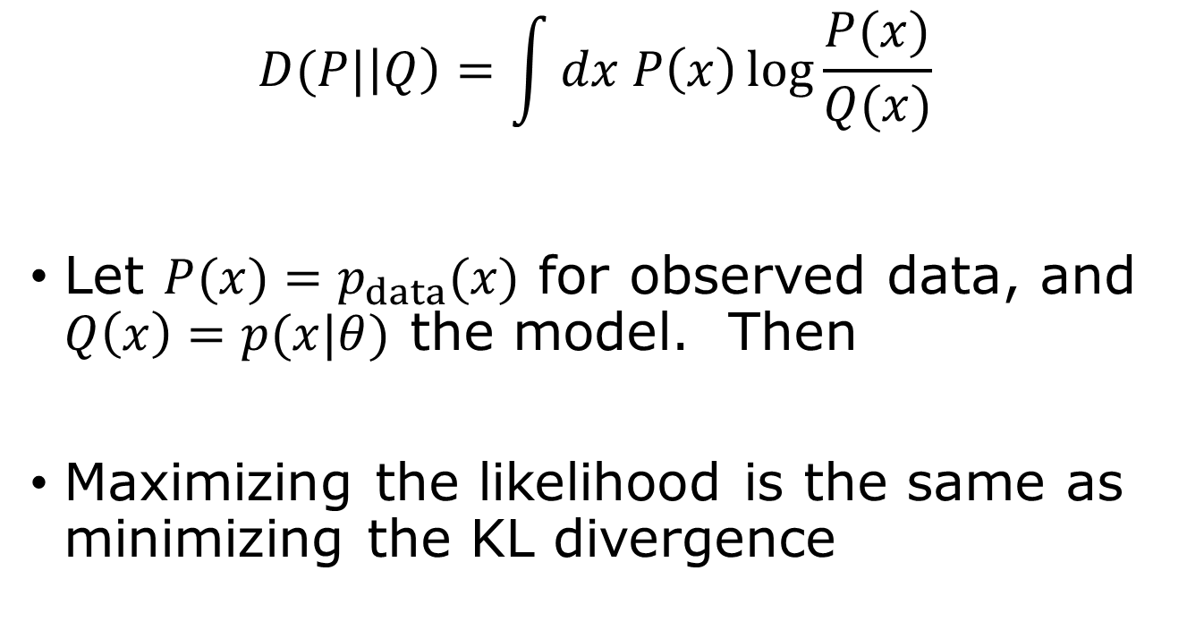
Kullback-Leibler divergence
$$D(P|\left|Q\right)=\int{dx P\left(x\right)\log{\frac{P(x)}{Q(x)}}}$$
Let $P(x)=p_{data}(x)$ for observed data, and $Q\left(x\right)=p(x|θ)$ the model. Then
Maximizing the likelihood is the same as minimizing the KL divergence
Notes:
How to show (prove) that D(P||Q) >= 0? (Hint: use Jensen’s inequality). The Jensen inequality is f(E[x]) <= E[ f(x) ].

Slide 29
Testing performance
Training error
Testing error
Generalization gap

Slide 30
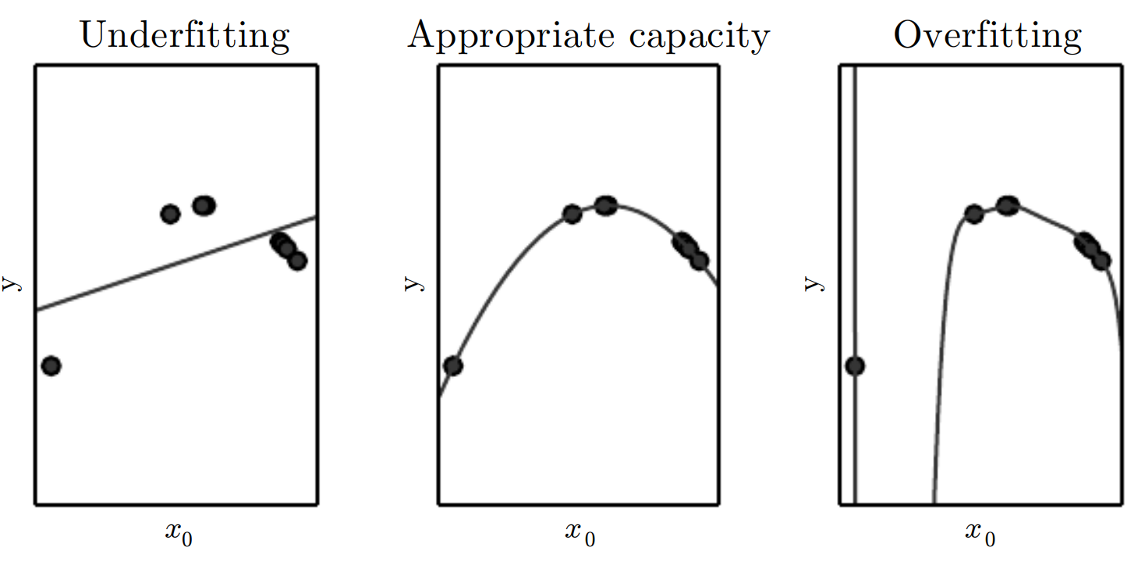
Underfit, overfit, capacity
Data follows a quadratic curve. Left: fit to a line (underfit), middle: fit to a quartic curve, right: fit to a polynomial of degree 9 (overfit). From fig 5.2 “Deep Learning,” Goodfellow, et al.

Slide 31



Performance evaluation
underfit
overfit
$$E_{new}$$
error
Generalization gap
$$E_{train}$$
Model complexity capacity (training iterations)
error is $J=E$

Slide 32
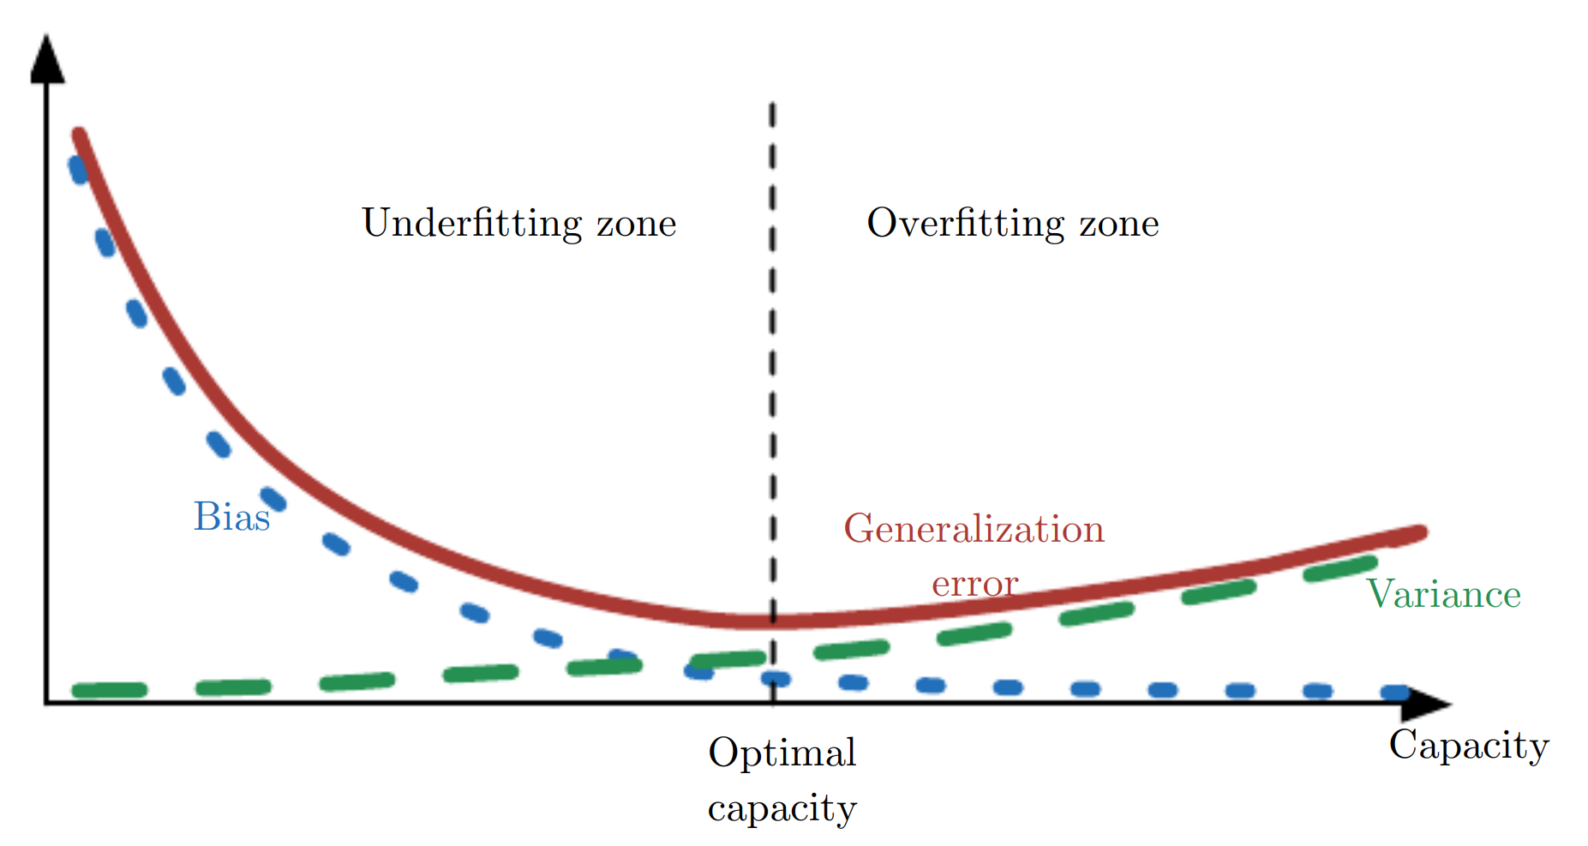
Bias-variance trade-off
MSE (generalization error) = Bias² + Variance
As capacity increases, bias (blue dotted) decreases and variance (green dashed) increases. There is an optimal model capacity. From Fig. 5.6, Goodfellow, et al.

Slide 33

Regularization
Any modification to the learning algorithm to reduce generalization error. Help to choose the capacity automatically.
$L^{2}$ regularisation $J→J+λ{\left\|θ\right\|}_{2}^{2}$
LASSO, or $L^{1}$ regularization
$$J→J+λ{\left\|θ\right\|}_{1}$$
Notes:
We learn this again in week 6.

Slide 34

$k$-fold cross-validation for error estimate $E_{new}$
all data
1
2
3
4
5
Split the data into k parts (or k-folds), use the i-th fold as testing data, the rest as training data, i = 1, 2,..., k. The final performance is the average of k cases.

Slide 35
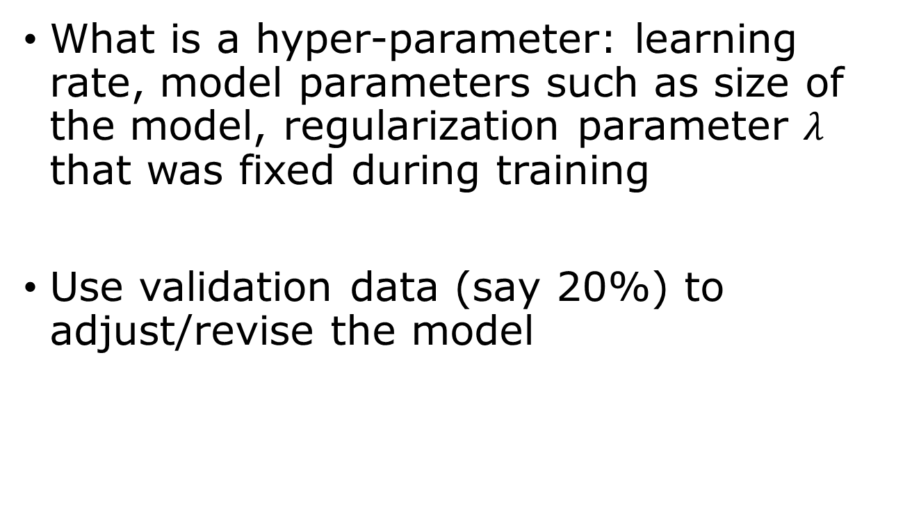
Hyper-parameter optimization
What is a hyper-parameter: learning rate, model parameters such as size of the model, regularization parameter $λ$ that was fixed during training
Use validation data (say 20%) to adjust/revise the model
Training data/validation data/testing data

Slide 36
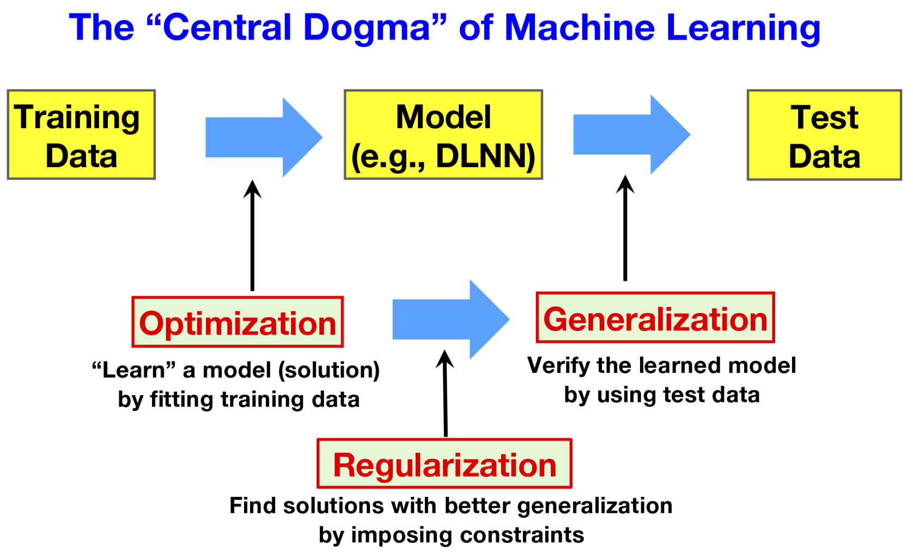
From Fig.2, Levine & Tu, PNAS, 2024.

Slide 37
Summary
Learning task: predict outputs or discover patterns from data.
Linear regression: the simplest machine learning model.
Loss function: quantify prediction errors using the mean squared error (MSE).
Optimization: minimize the loss using the normal equation or gradient descent.
Probability: provides a mathematical framework for uncertainty.
Maximum likelihood: explains why least-squares fitting is statistically justified for Gaussian noise.
KL divergence: measures the difference between probability distributions.
Generalization: good models perform well on unseen data.
Regularization and cross-validation: reduce overfitting and improve model selection.

Slide 38
Questions & Answers
1) design matrix, 2) basis function, 3) 2-norm, 4) loss function, 5) normal equation, 6) Kolmogorov definition of probability, 7) event?, 8) define conditional probability, 9) what is a likelihood function? 10) MLE? 11) statistic, 12) mean, variance, bias, MSE? 13) estimator, biased and unbiased estimator, 14) Kullerback-Leibler divergence, 15) generalization gap, 16) hyperparameters, 17) cross-validation

Slide 39
Reading (Bishop “Deep Learning”)
Probabilities, maximum likelihood: pages 23-42
KL divergence: pages 51-53
Linear model: pages 111-117

