Slide 1
Week 4, Deep Neural Networks
Notes:
Bishop, chapter 6.

Slide 2
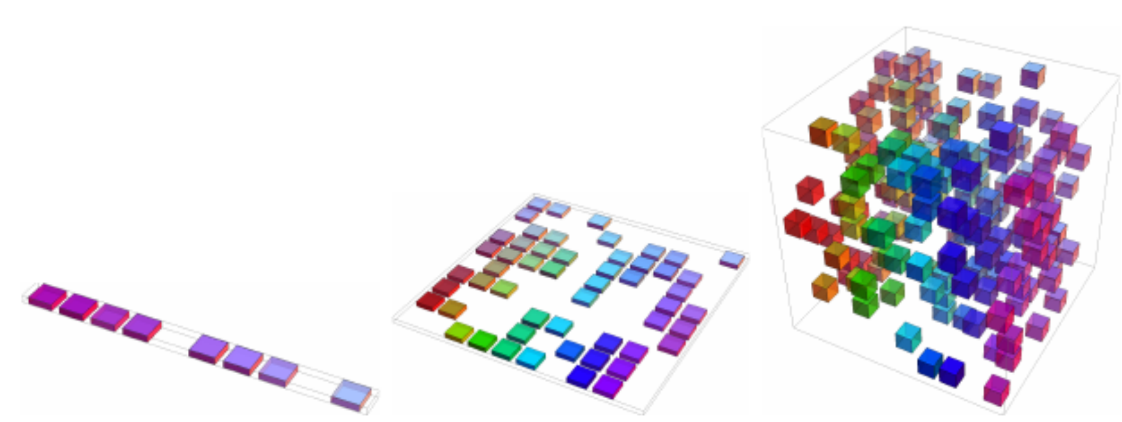
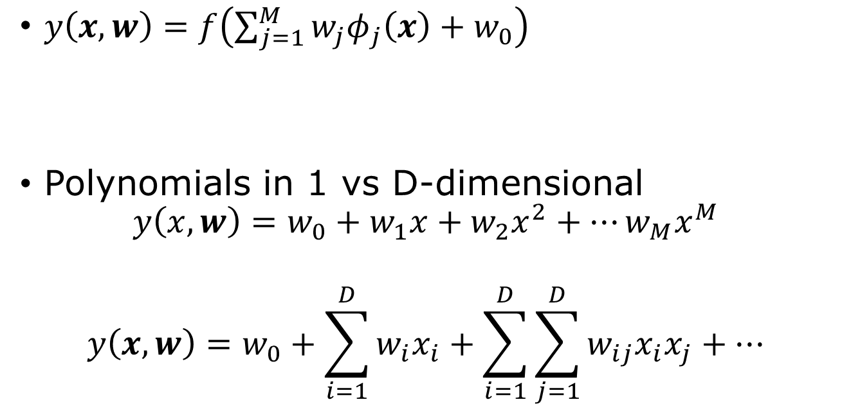
Limitations of fixed basis functions/curse of dimensionality
$y\left(x,w\right)=f\left(\sum_{j=1}^{M}{w_{j}φ_{j}\left(x\right)+w_{0}}\right)$
Polynomials in 1 vs D-dimensional
$$y\left(x,w\right)=w_{0}+w_{1}x+w_{2}x^{2}+⋯w_{M}x^{M}$$
$$y\left(x,w\right)=w_{0}+\sum_{i=1}^{D}{w_{i}x_{i}+\sum_{i=1}^{D}{\sum_{j=1}^{D}{w_{ij}x_{i}x_{j}+…}}}$$
Fig.5.9 Goodfellow, et al.
XOR problem
Notes:
Read chapter 6, Bishop, “Deep Learning”. Limitation of linear model, XOR problem, see Minsky and Papert, “Perceptrons,” (1969).

Slide 3








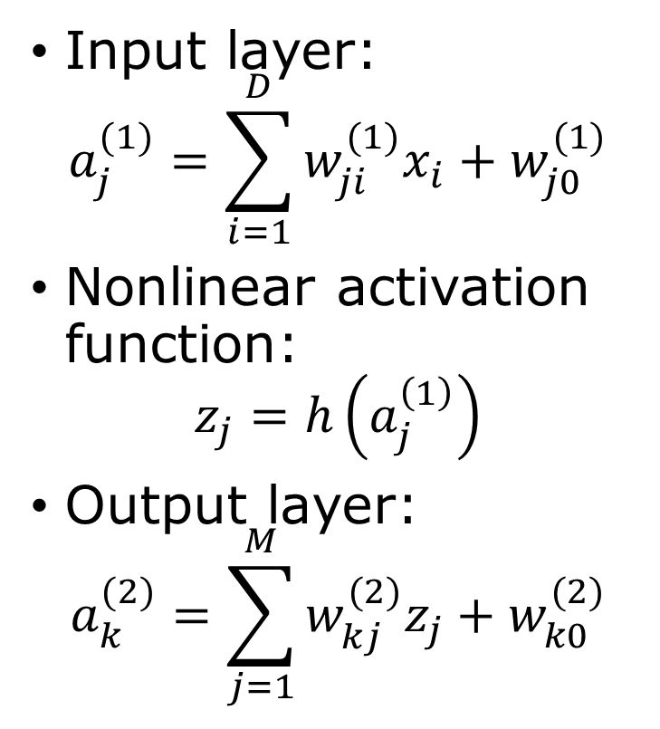














Multilayer Networks
input hidden output
$$b$$
Input layer:
$$a_{j}^{(1)}=\sum_{i=1}^{D}{w_{ji}^{(1)}x_{i}+w_{j0}^{(1)}}$$
Nonlinear activation function:
$$z_{j}=h\left(a_{j}^{\left(1\right)}\right)$$
Output layer:
$$a_{k}^{(2)}=\sum_{j=1}^{M}{w_{kj}^{(2)}z_{j}+w_{k0}^{(2)}}$$
$$w_{MD}^{\left(1\right)}$$
$$x_{D}$$
$$z_{M}$$
$$w_{KM}^{\left(2\right)}$$
$$⋮$$
$$w_{M2}^{\left(1\right)}$$
$${ y}_{K}$$
$$⋮$$
$$⋮$$
$$x_{2}$$
$$w_{M0}^{\left(1\right)}$$
$$x_{1}$$
$${ y}_{1}$$
$$z_{1}$$
$$f$$
$$x_{0}$$
$$w_{10}^{\left(2\right)}$$
$$z_{0}$$
$$x_{0}=z_{0}=1$$
$$h$$
$$y_{k}=f(a_{k}^{\left(2\right)})$$

Slide 4
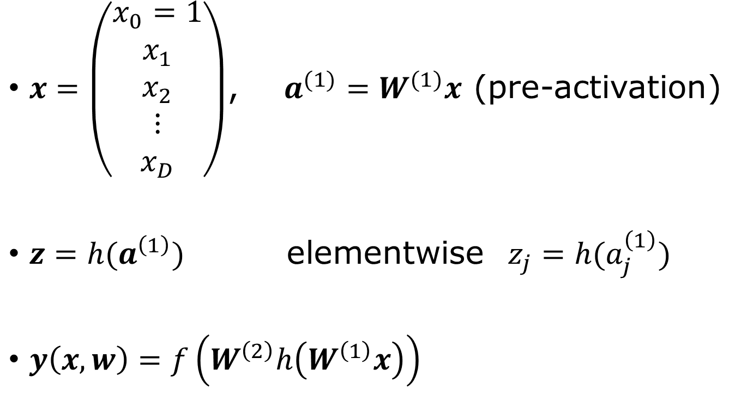

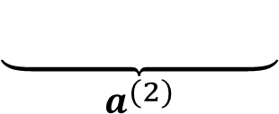
Parameters in matrix notation
$x=\left(\begin{matrix}x_{0}=1 \\ x_{1} \\ x_{2} \\ ⋮ \\ x_{D}\end{matrix}\right)$, $a^{(1)}=W^{(1)}x$ (pre-activation)
$z=h(a^{\left(1\right)})$ elementwise $z_{j}=h(a_{j}^{\left(1\right)})$
$y\left(x,w\right)=f\left(W^{\left(2\right)}h\left(W^{\left(1\right)}x\right)\right)$
$$w=\left(\begin{matrix}W^{(1)} \\ W^{(2)}\end{matrix}\right)$$
$$\underset{a^{(2)}}{\underbrace{ …………… }}$$
Notes:
Show that if f and h are identity maps, the deep network has no real advantage, why?

Slide 5




Hidden unit activation functions h(.)
Rectified linear unit ReLU
$h\left(a\right)=\max\left(0,a\right)$
Logistic sigmoid
$$σ\left(a\right)=\frac{1}{1+e^{−a}}$$
$$h(a)$$
$$a$$
$f$: softmax

Slide 6
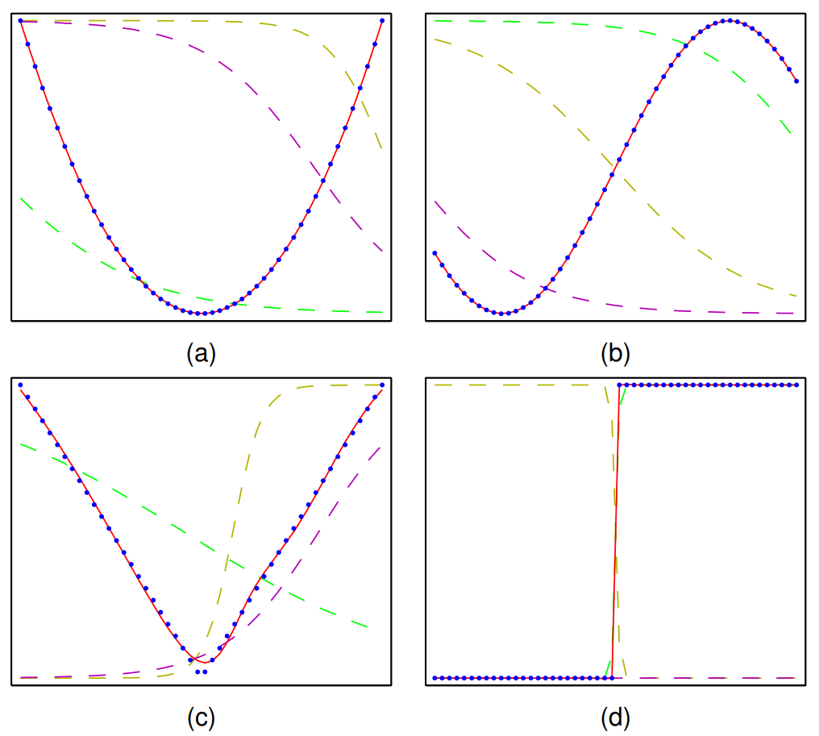

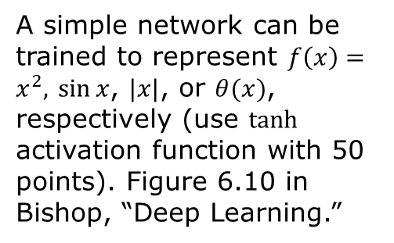




Universal approximation
For a wide range of activation functions, the two-layer network can approximate any continuous function given enough hidden layer units.
$$z_{3}$$
$$x$$
$$z_{2}$$
$$y$$
$$z_{1}$$
A simple network can be trained to represent $f\left(x\right)=x^{2},$ $\sin{x}$, $|x|$, or $θ(x)$, respectively (use $tanh$ activation function with 50 points). Figure 6.10 in Bishop, “Deep Learning.”

Slide 7
No free lunch theorem
No single optimization or machine learning algorithm is universally superior to all others across all possible problems.
“algorithm” – method of generalization given past observations.
Inductive bias

Slide 8
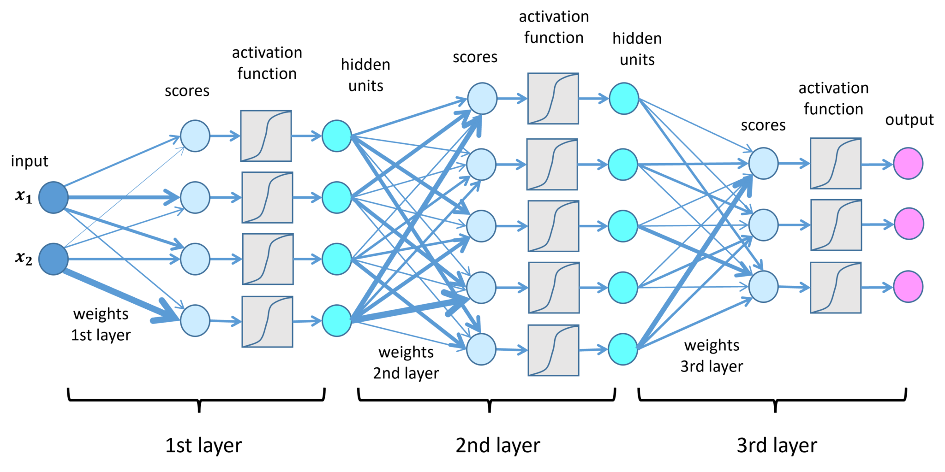
Deep network, how deep is deep?
representation learning, transfer learning, contrastive learning
https://lamarr-institute.org/blog/deep-neural-networks/

Slide 9
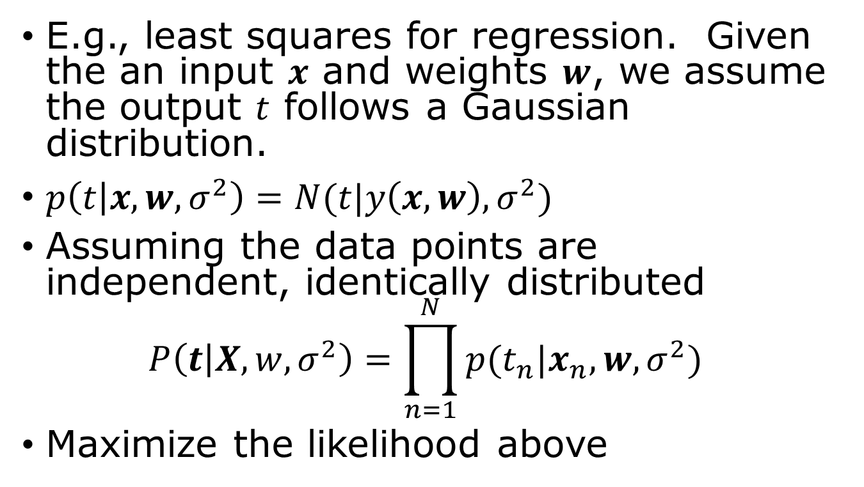
Error/loss/cost function
E.g., least squares for regression. Given the an input $x$ and weights $w$, we assume the output $t$ follows a Gaussian distribution.
$p\left(t | x,w,σ^{2}\right)=N(t|y\left(x,w\right),σ^{2})$
Assuming the data points are independent, identically distributed
$$P\left(t | X,w,σ^{2}\right)=\prod_{n=1}^{N}{p(t_{n}|x_{n},w,σ^{2})}$$
Maximize the likelihood above

Slide 10
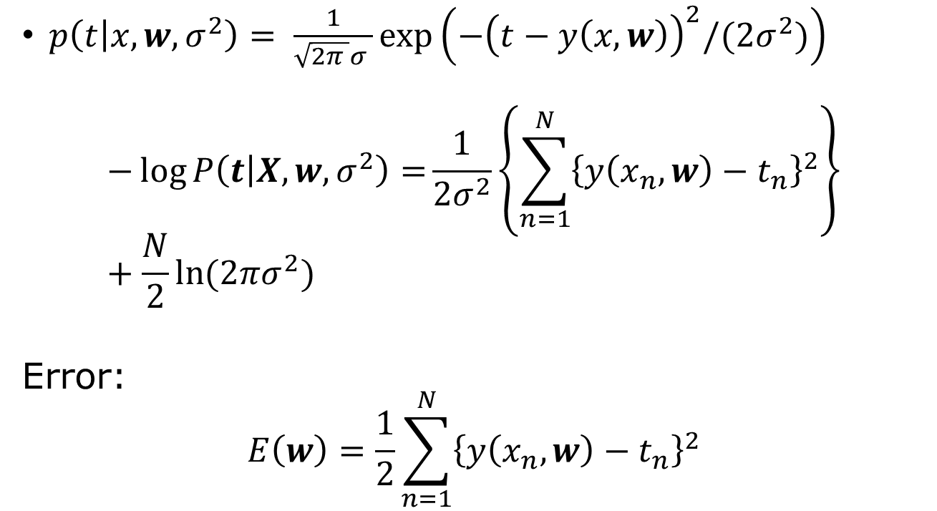
Maximize likelihood, minimize error
$p\left(t | x,w,σ^{2}\right)= \frac{1}{\sqrt{2π }σ }\exp\left(−{\left(t−y\left(x,w\right)\right)}^{2}/(2σ^{2})\right)$
$$−\log{P\left(t | X,w,σ^{2}\right)=}\frac{1}{2σ^{2}}\left\{\sum_{n=1}^{N}{{\left\{y\left(x_{n},w\right)−t_{n}\right\}}^{2}}\right\}+\frac{N}{2}\ln{(2πσ^{2}) }$$
Error:
$$E\left(w\right)=\frac{1}{2}\sum_{n=1}^{N}{{\left\{y\left(x_{n},w\right)−t_{n}\right\}}^{2}}$$
Notes:
What is the likelihood function if, 1) y and t are vectors and sigma is a matrix?

Slide 11

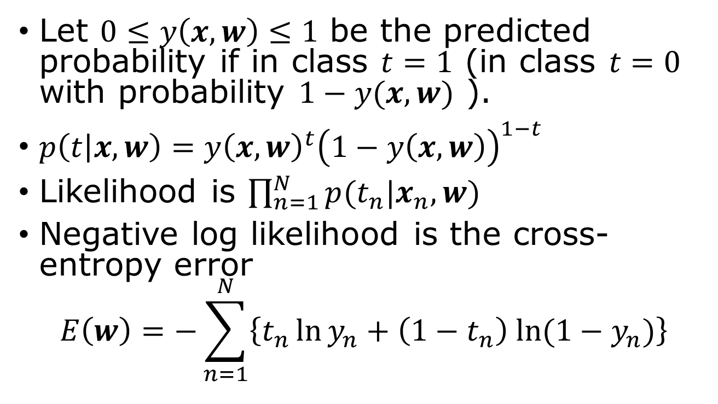
Binary classification
Let $0≤y\left(x,w\right)≤1$ be the predicted probability if in class $t=1$ (in class $t=0$ with probability $1−y(x,w)$ ).
$p\left(t | x,w\right)=y{\left(x,w\right)}^{t}{\left(1−y\left(x,w\right)\right)}^{1−t}$
Likelihood is $\prod_{n=1}^{N}{p(t_{n}|x_{n},w)}$
Negative log likelihood is the cross-entropy error
$$E\left(w\right)=−\sum_{n=1}^{N}{\left\{t_{n}\ln{y_{n}+\left(1−t_{n}\right) ln⁡(1−y_{n})}\right\}}$$
$t=0$ or $1$

Slide 12

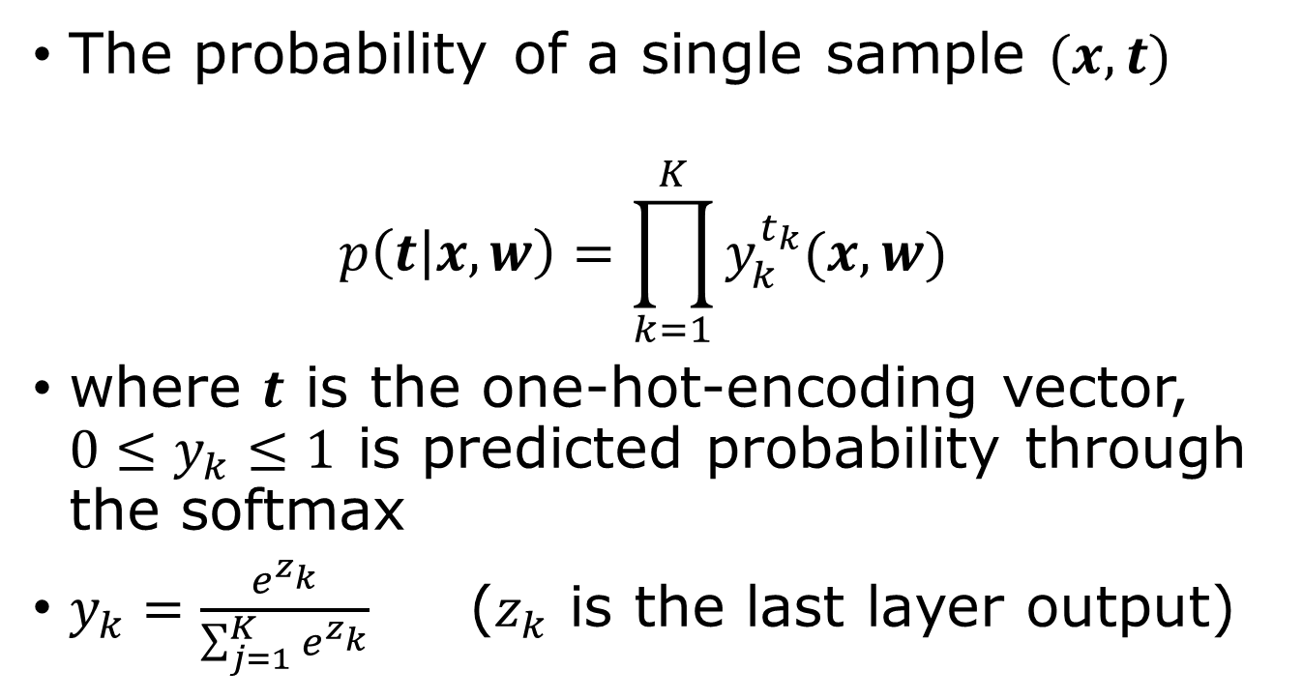
$K$-different categories, e.g., recognize the handwritten letters from 0 to 9
The probability of a single sample $(x,t)$
$$p\left(t | x,w\right)=\prod_{k=1}^{K}{y_{k}^{t_{k}}(x,w)}$$
where $t$ is the one-hot-encoding vector, $0≤y_{k}≤1$ is predicted probability through the softmax
$y_{k}=\frac{e^{z_{k}}}{\sum_{j=1}^{K}{e^{z_{k}}}}$ ($z_{k}$ is the last layer output)
Notes:
Show that this formula for p agree with the previous slide when K = 2. The likelihood is the product of p(t_n|x_n,w) over n with the same w.

Slide 13
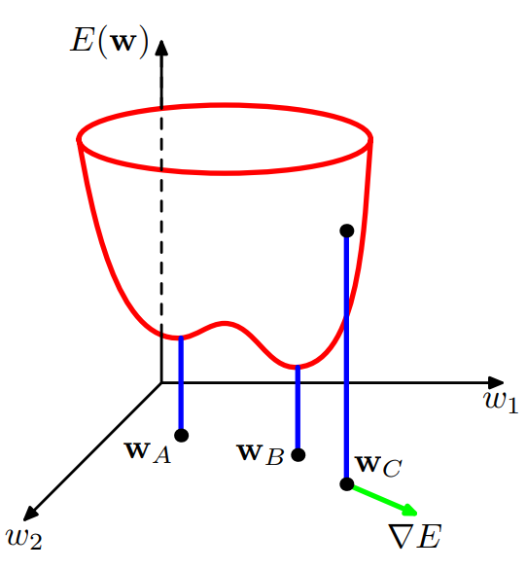

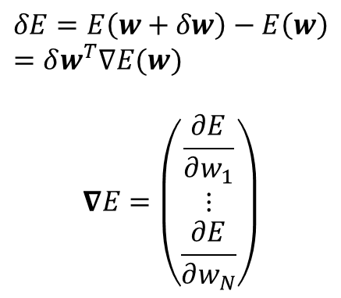


Gradient descent (find minimum of error function)
$$δE=E\left(w+δw\right)−E\left(w\right)=δw^{T}∇E(w)$$
$$∇E=\left(\begin{matrix}\frac{∂E}{∂w_{1}} \\ ⋮ \\ \frac{∂E}{∂w_{N}}\end{matrix}\right)$$
$$w_{1}$$
$$∇E$$
$$w_{2}$$

Slide 14
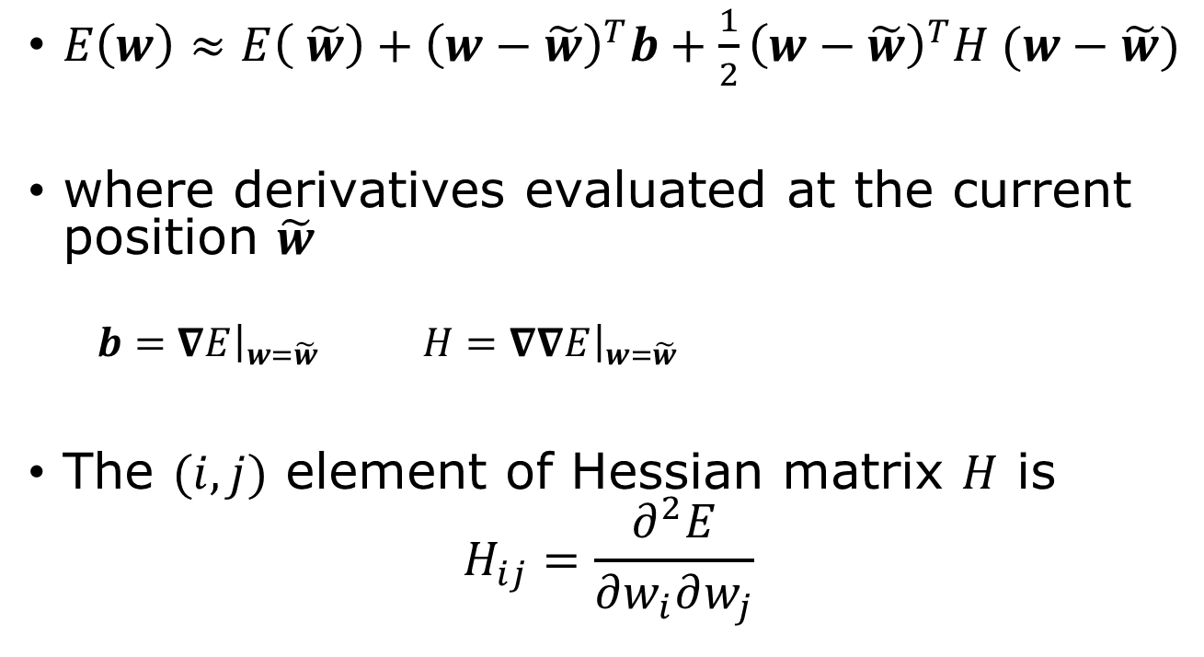
Local quadratic approximation
$E\left(w\right)≈E\left( \tilde{w}\right)+{\left(w−\tilde{w}\right)}^{T}b+\frac{1}{2}{\left(w−\tilde{w}\right)}^{T}H (w−\tilde{w})$
where derivatives evaluated at the current position $\tilde{w}$
$b={\left.∇E\right|}_{w=\tilde{w}}$ $H={\left.∇∇E\right|}_{w=\tilde{w}}$
The $(i,j)$ element of Hessian matrix $H$ is
$$H_{ij}=\frac{∂^{2}E}{∂w_{i}∂w_{j}}$$

Slide 15
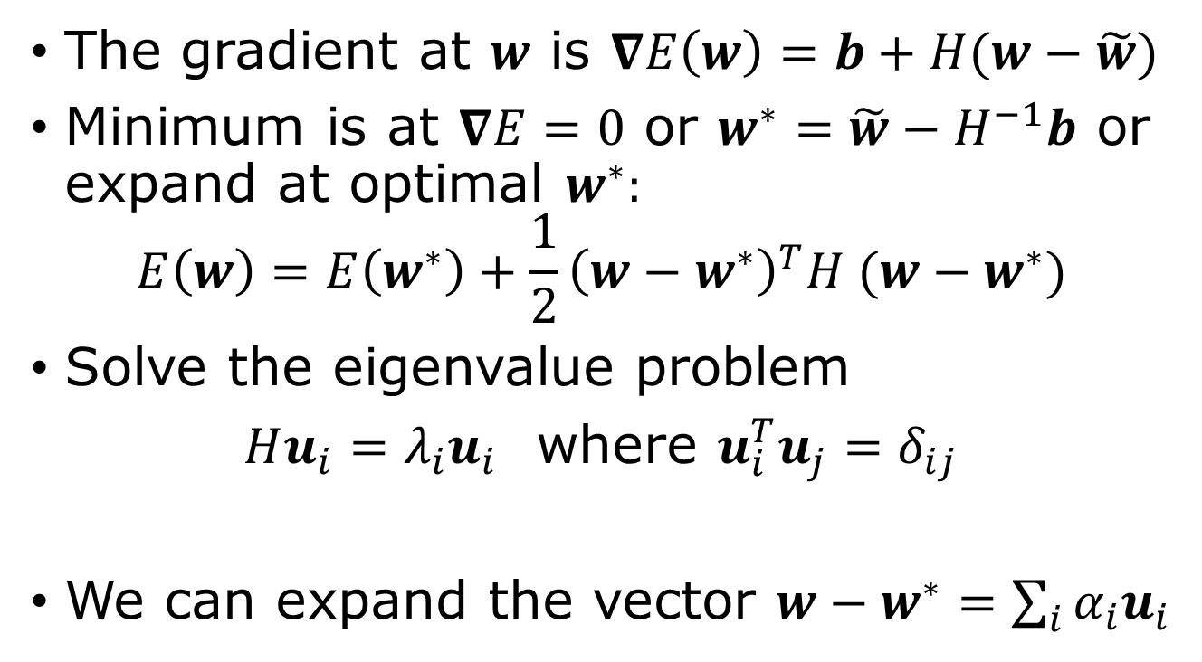
Gradient, eigen vectors
The gradient at $w$ is $∇E\left(w\right)=b+H(w−\tilde{w})$
Minimum is at $∇E=0$ or $w^{∗}=\tilde{w}−H^{−1}b$ or expand at optimal $w^{∗}:$
$$E\left(w\right)=E\left(w^{∗}\right)+\frac{1}{2}{\left(w−w^{∗}\right)}^{T}H (w−w^{∗})$$
Solve the eigenvalue problem
$Hu_{i}=λ_{i}u_{i}$ where $u_{i}^{T}u_{j}=δ_{ij}$
We can expand the vector $w−w^{∗}=\sum_{i}{α_{i}u_{i}}$
Notes:
Note u_i span the full space of w if H is not singular.

Slide 16
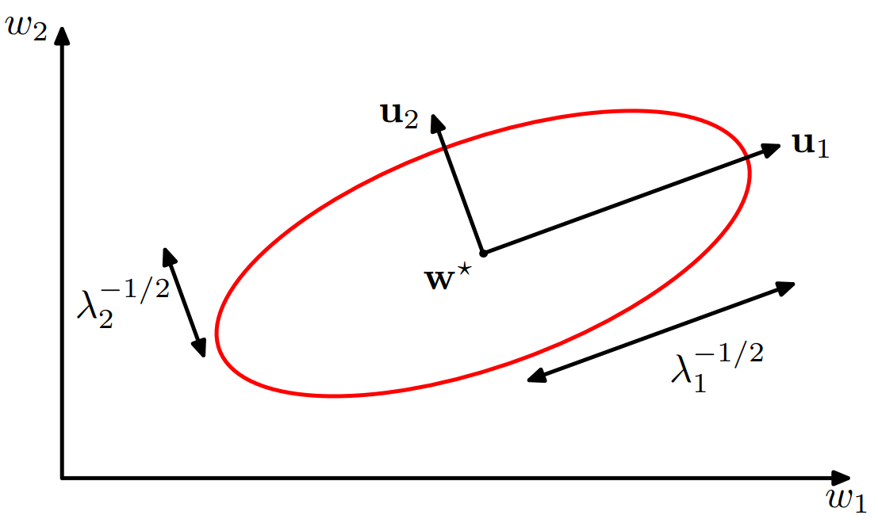

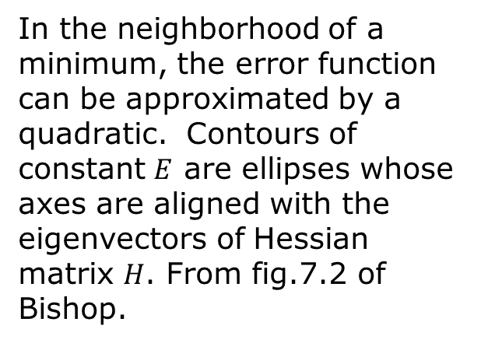
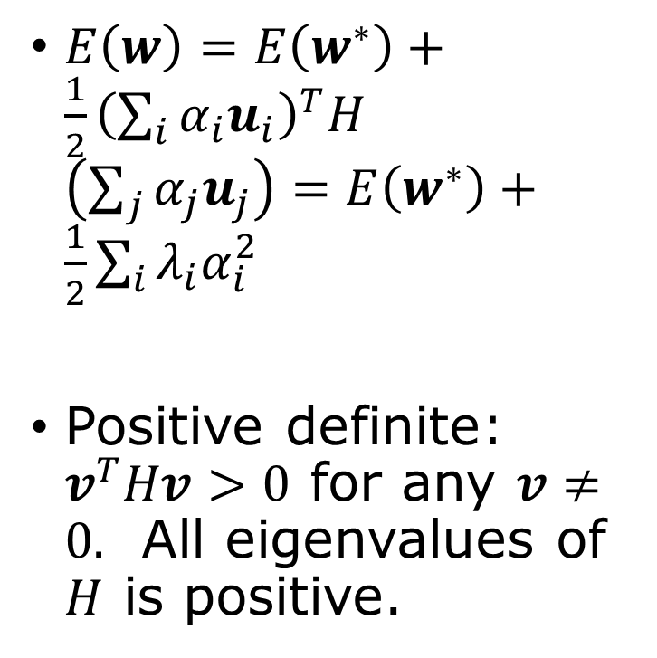
Property of $E(w)$ near a minimum
$E\left(w\right)=E\left(w^{∗}\right)+\frac{1}{2}{\left(\sum_{i}{α_{i}u_{i}}\right)}^{T}H$ $\left(\sum_{j}{α_{j}u_{j}}\right)=E\left(w^{∗}\right)+\frac{1}{2}\sum_{i}{λ_{i}α_{i}^{2}}$
Positive definite: $v^{T}Hv>0$ for any $v≠0.$ All eigenvalues of $H$ is positive.
In the neighborhood of a minimum, the error function can be approximated by a quadratic. Contours of constant $E$ are ellipses whose axes are aligned with the eigenvectors of Hessian matrix $H$. From fig.7.2 of Bishop.
Notes:
Note: E(w) is locally convex.

Slide 17
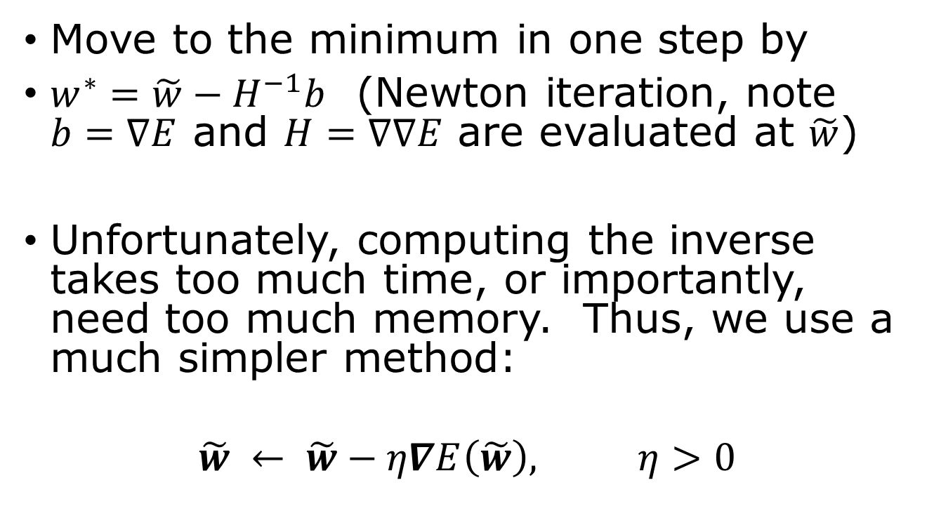
Gradient Descent Optimization
Move to the minimum in one step by
$w^{∗}=\tilde{w}−H^{−1}b$ (Newton iteration, note $b=∇E$ and $H=∇∇E$ are evaluated at $\tilde{w}$)
Unfortunately, computing the inverse takes too much time, or importantly, need too much memory. Thus, we use a much simpler method:
$$\tilde{w} ← \tilde{w}−η∇E\left(\tilde{w}\right), η>0$$
This is effectively treating $H$ as a positive constant

Slide 18





Going in the negative gradient direction
$$w_{2}$$
$E\left(w\right)=const$ contour
$$δE=δw^{T}∇E$$
$$∇E$$
$$w_{1}$$

Slide 19
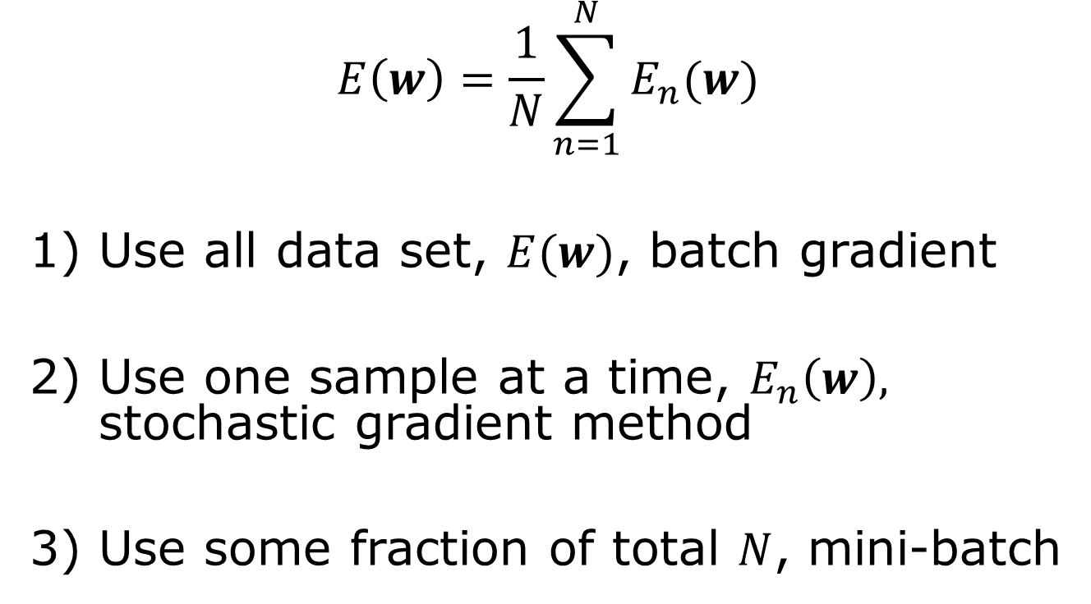
Batch gradient or stochastic gradient descent
$$E\left(w\right)=\frac{1}{N}\sum_{n=1}^{N}{E_{n}(w)}$$
Use all data set, $E(w)$, batch gradient
Use one sample at a time, $E_{n}\left(w\right),$ stochastic gradient method
Use some fraction of total $N$, mini-batch

Slide 20
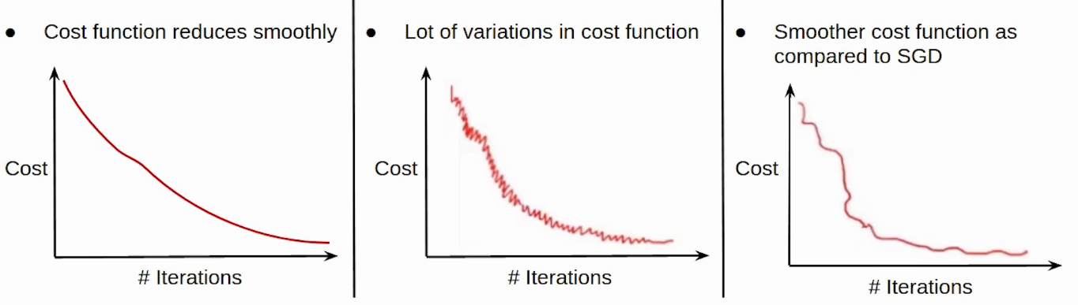
Compare batch, stochastic, and mini-batch
Epoch: an entire dataset is used
Stochastic gradient descent (SGD): faster but noisier
Mini-batch: somewhere in between
Batch: use all data, slow but smooth decrease
https://www.analyticsvidhya.com/blog/2021/03/variants-of-gradient-descent-algorithm/

Slide 21
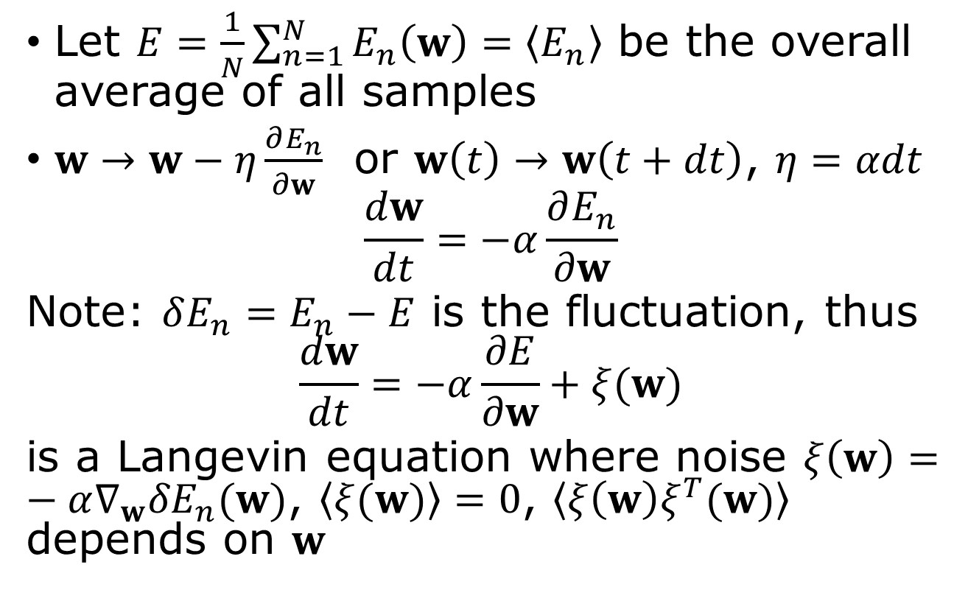
Why use one data point at a step mean “stochastic”?
Let $E=\frac{1}{N}\sum_{n=1}^{N}{E_{n}\left(w\right)=\left\langle E_{n}\right\rangle }$ be the overall average of all samples
$w→w−η\frac{∂E_{n}}{∂w}$ or $w\left(t\right)→w\left(t+dt\right)$, $η=αdt$
$$\frac{dw}{dt}=−α\frac{∂E_{n}}{∂w}$$
Note: $δE_{n}=E_{n}−E$ is the fluctuation, thus
$$\frac{dw}{dt}=−α\frac{∂E}{∂w}+ξ(w)$$
is a Langevin equation where noise $ξ\left(w\right)=−α∇_{w}{δE}_{n}(w)$, $\left\langle ξ(w)\right\rangle =0$, $\left\langle ξ{\left(w\right)ξ}^{T}(w)\right\rangle$ depends on $w$

Slide 22
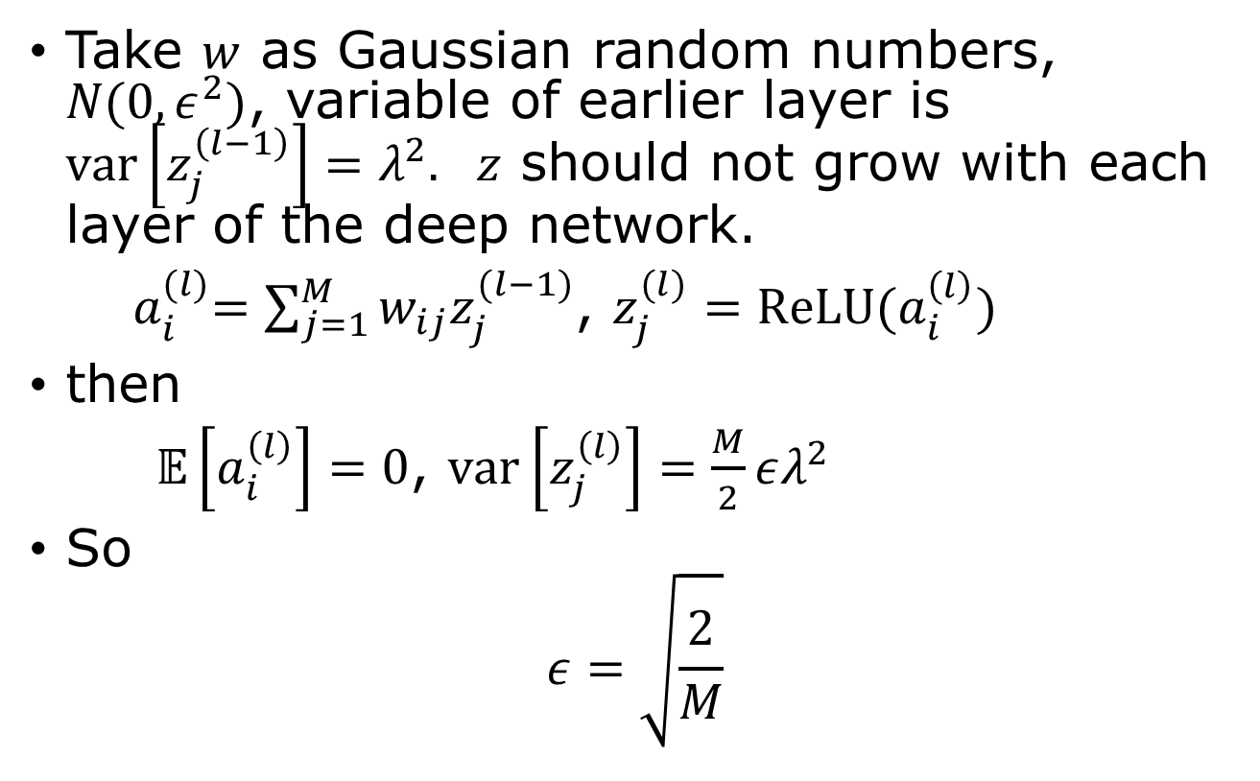

Parameter $w$ – `He’ initialization
Take $w$ as Gaussian random numbers, $N(0,ε^{2})$, variable of earlier layer is $var\left[z_{j}^{\left(l−1\right)}\right]=λ^{2}.$ $z$ should not grow with each layer of the deep network.
${ a}_{i}^{(l)}=\sum_{j=1}^{M}{w_{ij}z_{j}^{(l−1)}}$, $z_{j}^{(l)}=ReLU(a_{i}^{\left(l\right)})$
then
$𝔼\left[a_{i}^{\left(l\right)}\right]=0$, $var\left[z_{j}^{\left(l\right)}\right]=\frac{M}{2}ελ^{2}$
So
$$ε=\sqrt{\frac{2}{M}}$$

Slide 23

Linear convergence (SGD)
$ω≈\left(1−\frac{2λ_{min}}{λ_{max}}\right)=1−\frac{2}{cond(H)}$ at $η=\frac{2}{λ_{max}}$
$\left|w^{(n+1)}−w^{∗} \right|≈ω|w^{\left(n\right)}−w^{∗}|$

Slide 24
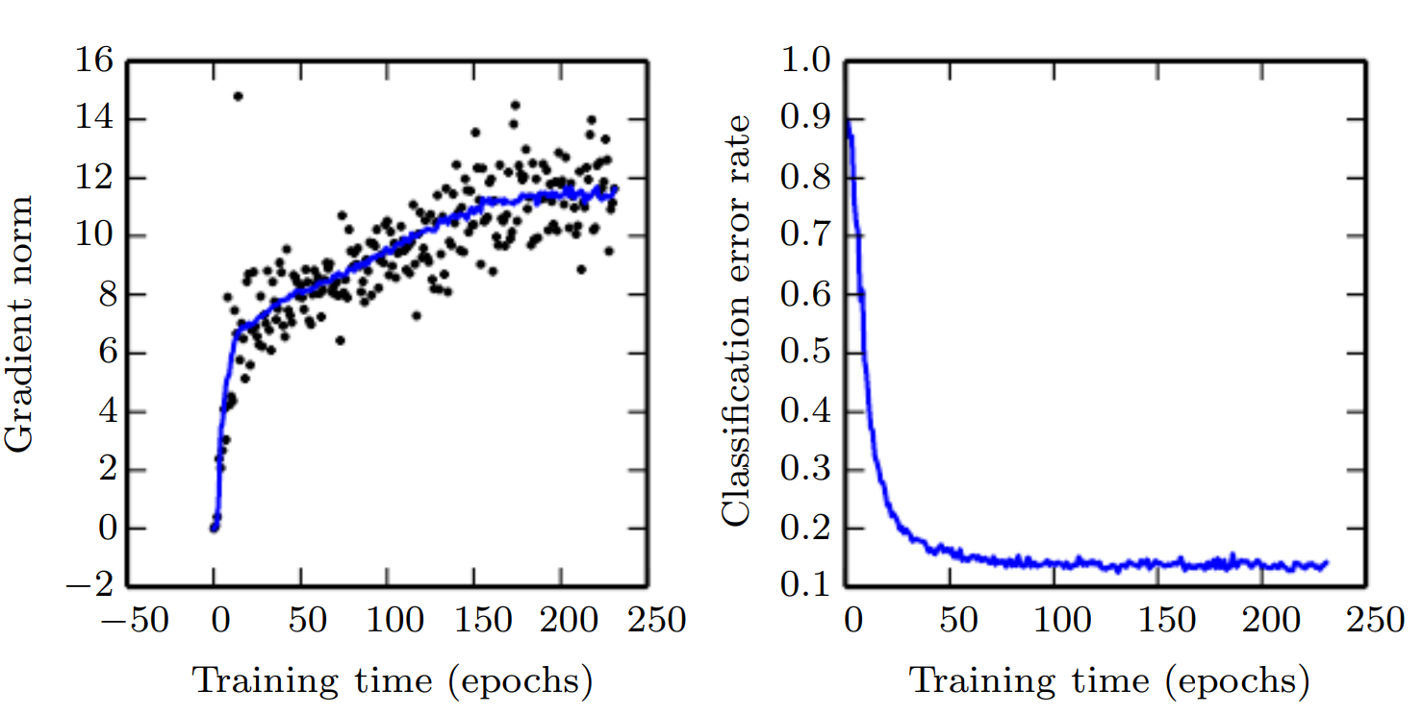
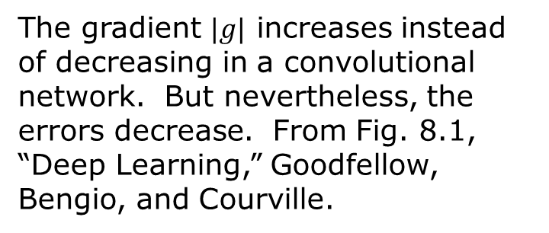
Some general comments on optimization
In a deep neural network, are we really able to find the global minimum?
There are more saddle points than the minimum in higher dimensions.
The SGD is based on the assumption of a local minimum, but why does it work at all?
Ill conditioning
The gradient $|g|$ increases instead of decreasing in a convolutional network. But nevertheless, the errors decrease. From Fig. 8.1, “Deep Learning,” Goodfellow, Bengio, and Courville.

Slide 25
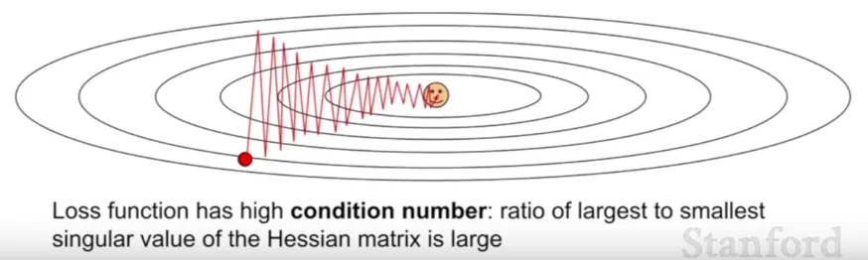
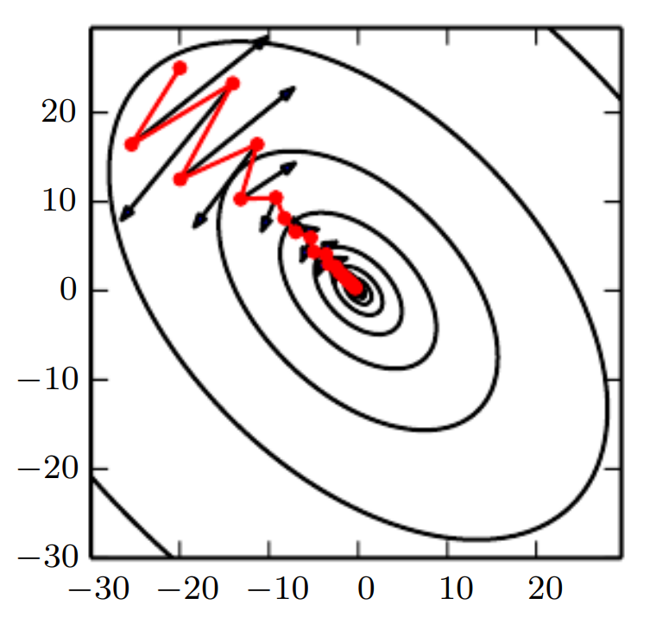
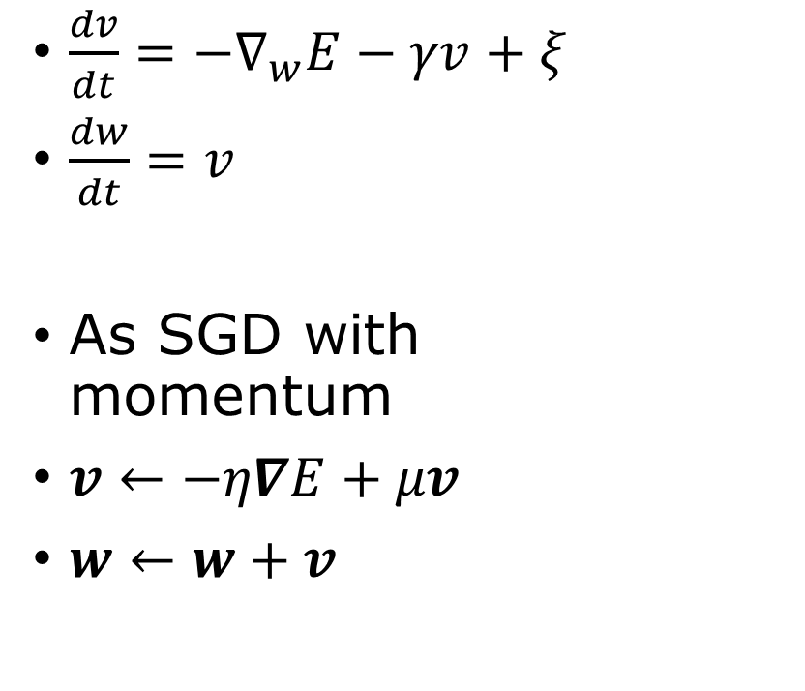
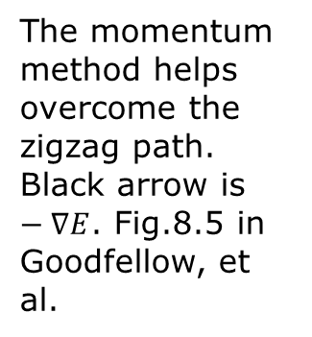
Momentum
Stochastic Langevin equation
$\frac{dv}{dt}=−∇_{w}E−γv+ξ$
$\frac{dw}{dt}=v$
As SGD with momentum
$v←−η∇E+μv$
$w←w+v$
The momentum method helps overcome the zigzag path. Black arrow is $−∇E$. Fig.8.5 in Goodfellow, et al.

Slide 26
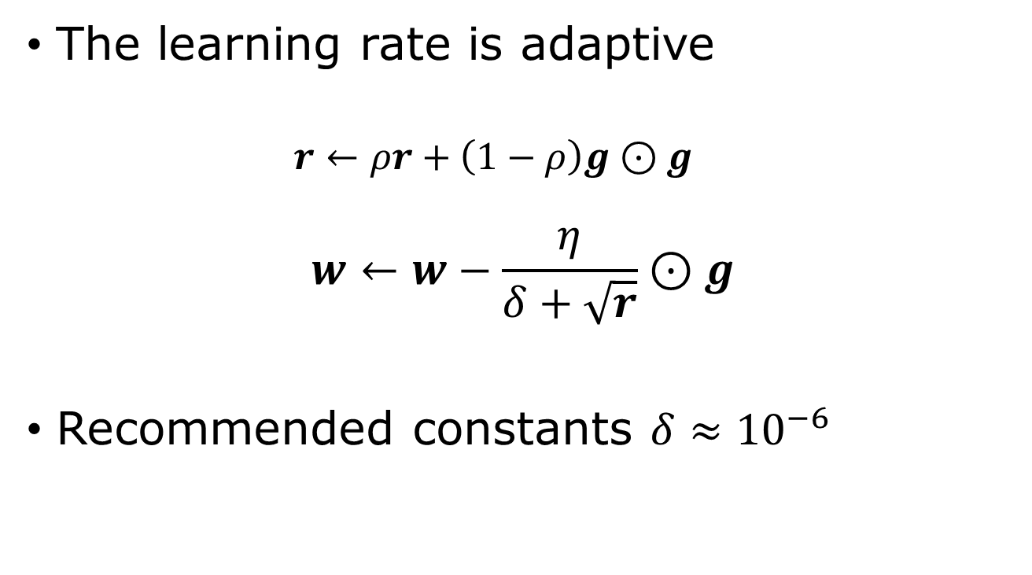



RMSProp
$⊙$ : elementwise multiplication
$$g=∇E$$
The learning rate is adaptive
$$r←ρr+\left(1−ρ\right)g⊙g$$
$$w←w−\frac{η}{δ+\sqrt{r}}⊙g$$
Recommended constants $δ≈{10}^{−6}$
$ρ$: decay rate, $η$: learning rate,
$δ$ : avoid zero denominator.
Notes:
RMSProp: root mean squared propagation.

Slide 27
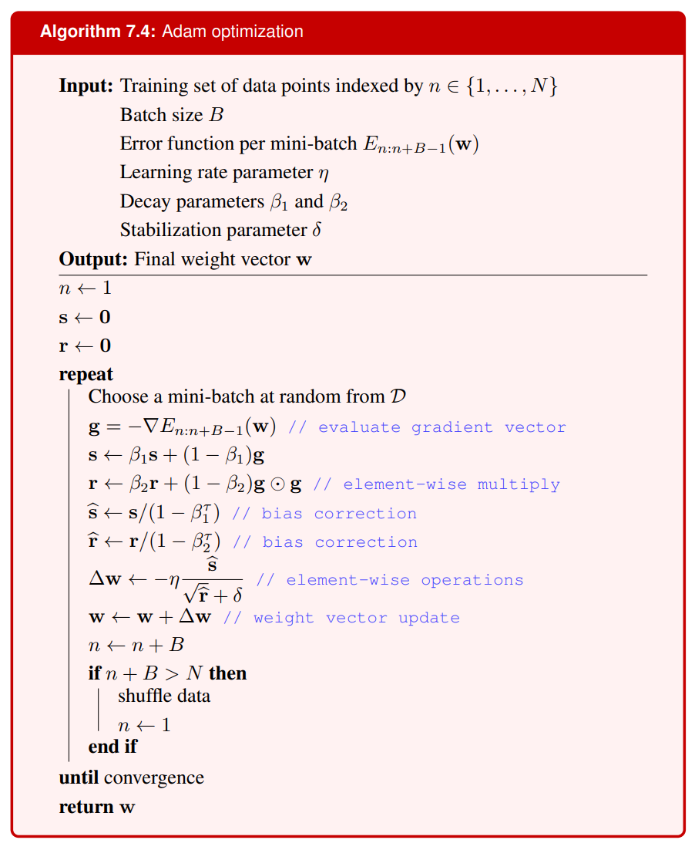
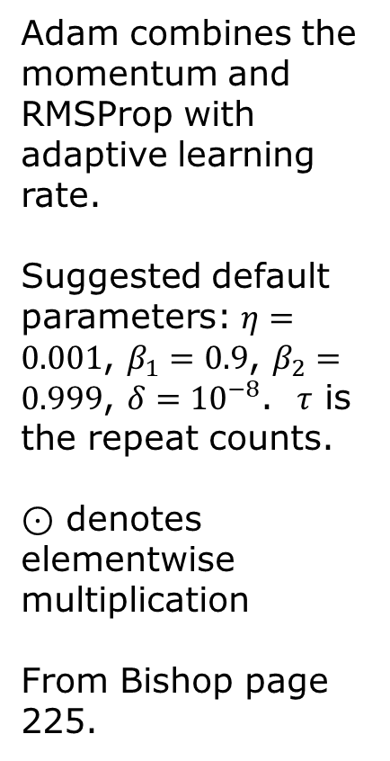

Adam
Adam combines the momentum and RMSProp with adaptive learning rate.
Suggested default parameters: $η=0.001$, $β_{1}=0.9$, $β_{2}=0.999$, $δ={10}^{−8}$. $τ$ is the repeat counts.
$⊙$ denotes elementwise multiplication
From Bishop page 225.
$$+$$

Slide 28
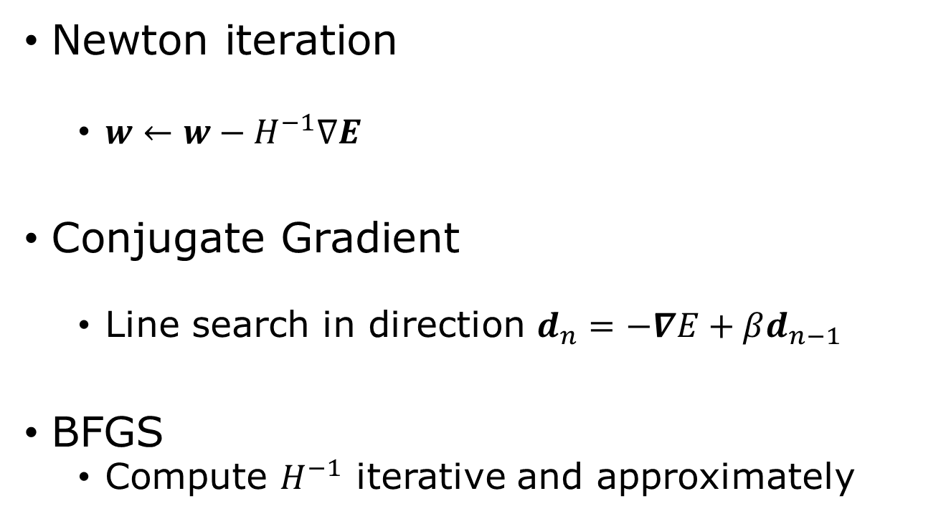
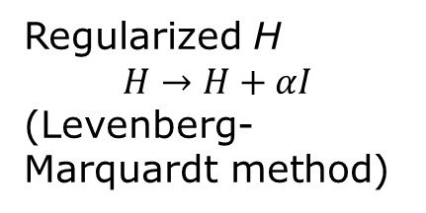
Second order methods
Newton iteration
$w←w−H^{−1}∇E$
Conjugate Gradient
Line search in direction $d_{n}=−∇E+βd_{n−1}$
BFGS
Compute $H^{−1}$ iterative and approximately
Regularized H
$$H→H+αI$$
(Levenberg-Marquardt method)
Notes:
For a deep understanding on optimization algorithms, see J. Nocedal and S. J. Wright, “Numerical Optimization”, Springer (1999).

Slide 29
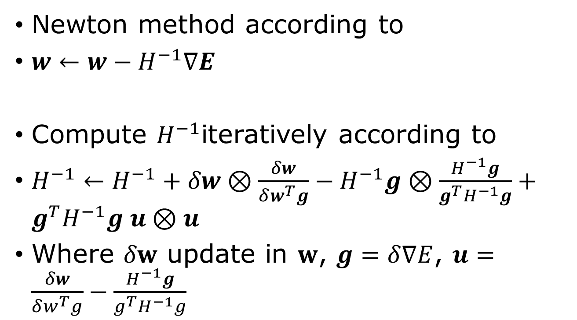

Broyden-Fletcher-Goldfarb-Shanno (BFGS)
Newton method according to
$w←w−H^{−1}∇E$
Compute $H^{−1}$iteratively according to
$H^{−1}←H^{−1}+δw⊗\frac{δw}{δw^{T}g}−H^{−1}g⊗\frac{H^{−1}g}{g^{T}H^{−1}g}+g^{T}H^{−1}g u⊗u$
Where $δw$ update in $w$, $g=δ∇E$, $u=\frac{δw}{δw^{T}g}−\frac{H^{−1}g}{g^{T}H^{−1}g}$
Outer product $a⊗b=ab^{T}$
Notes:
From Press, et al, Numerical Recipes in C, 2nd page 427

Slide 30
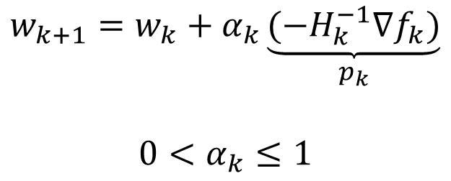
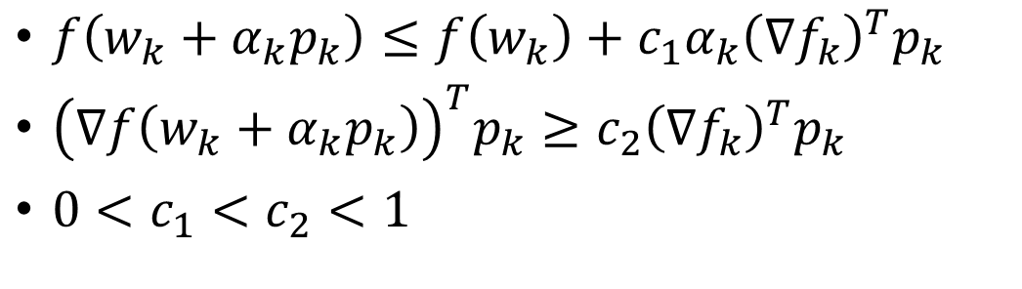

Wolfe conditions
$$f=E(w)$$
$$w_{k+1}=w_{k}+α_{k}\underset{p_{k}}{\underbrace{{(−H}_{k}^{−1}∇f_{k})}}$$
$$0<α_{k}≤1$$
$f\left(w_{k}+α_{k}p_{k}\right)≤f\left(w_{k}\right)+c_{1}α_{k}{\left(∇f_{k}\right)}^{T}p_{k}$
${\left(∇f\left(w_{k}+α_{k}p_{k}\right)\right)}^{T}p_{k}≥c_{2}{\left(∇f_{k}\right)}^{T}p_{k}$
$0<c_{1}<c_{2}<1$

Slide 31
Optimization classes in Pytorch
import torch.optim as optim
optimizer = optim.SGD(params, lr = 0.001, momentum = 0, dampening=0, weight_decay = 0, …)
Or
optimizer = optim.RMSprop([x], lr=0.3)
Or optim.Adam(param, lr=0.001) or optim.LBFGS(…)
Use optimizer.step() to call.
Notes:
The meaning of hyperparameters in SGD is by v = momentum*v + (1-dampening)*g, followed by w -= lr*v (v is velocity, and g = grad E is the gradient, lr is learning rate).

Slide 32
Example of training steps
num_epochs = 100
for epoch in range(num_epochs):
for inputs, labels in dataloader:
# Forward pass
outputs = model(inputs)
loss = criterion(outputs, labels)
# Backward and optimize
optimizer.zero_grad() # Clear gradient
loss.backward() # Compute gradients
optimizer.step() # Update weights

