Slide 1
Week 5, Backpropagation
Notes:
See Chapter 8, Bishop, “Deep Learning”.

Slide 2
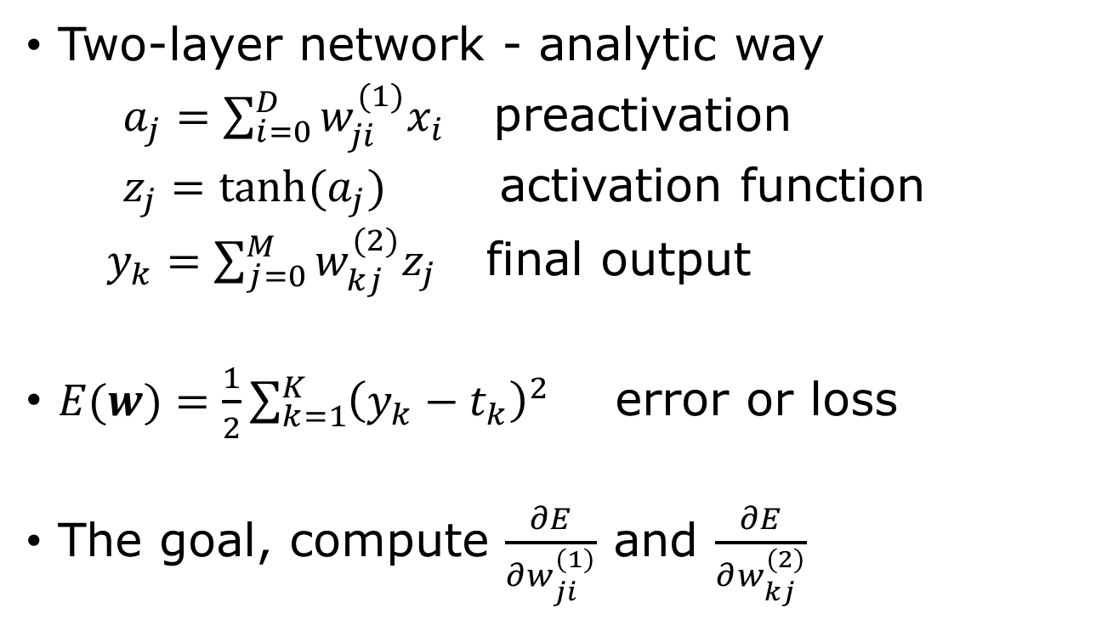

Compute the gradient $∇E$
Two-layer network - analytic way
$a_{j}=\sum_{i=0}^{D}{w_{ji}^{(1)}x_{i}}$ preactivation
$z_{j}=\tanh{(a_{j})}$ activation function
$y_{k}=\sum_{j=0}^{M}{w_{kj}^{(2)}z_{j}}$ final output
$E(w)=\frac{1}{2}\sum_{k=1}^{K}{{\left(y_{k}−t_{k}\right)}^{2}}$ error or loss
The goal, compute $\frac{∂E}{∂w_{ji}^{(1)}}$ and $\frac{∂E}{∂w_{kj}^{(2)}}$

Slide 3

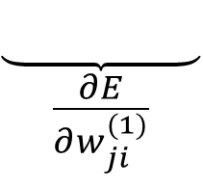
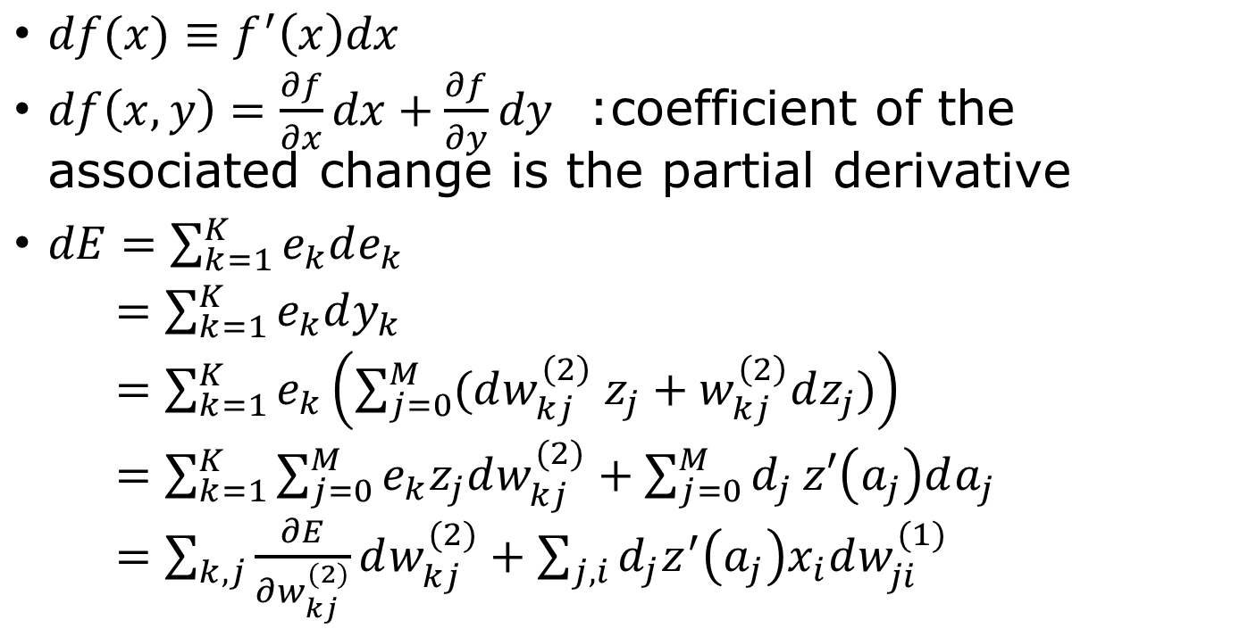


Find partial derivatives by differential
$$z=\tanh{(a)}$$
$$E=\frac{1}{2}e^{T}e$$
$df(x)≡f^{′}\left(x\right)dx$
$df\left(x,y\right)=\frac{∂f}{∂x}dx+\frac{∂f}{∂y}dy$ :coefficient of the associated change is the partial derivative
$dE=\sum_{k=1}^{K}{e_{k}de_{k}}$
$=\sum_{k=1}^{K}{e_{k}dy_{k}}$
$=\sum_{k=1}^{K}{e_{k}\left(\sum_{j=0}^{M}{(dw_{kj}^{\left(2\right)} z_{j}+w_{kj}^{\left(2\right)}dz_{j}})\right)}$
$=\sum_{k=1}^{K}{\sum_{j=0}^{M}{e_{k}z_{j}dw_{kj}^{(2)}}+\sum_{j=0}^{M}{d_{j}}z′\left(a_{j}\right)da_{j}}$
$=\sum_{k,j}{\frac{∂E}{∂w_{kj}^{(2)}}dw_{kj}^{(2)}}+\sum_{j,i}{d_{j}z^{′}\left(a_{j}\right)x_{i}dw_{ji}^{(1)}}$
$a=w^{(1)}x,$ $y=w^{(2)}z$
$$e=y−t$$
$$d^{T}=e^{T}w^{(2)}$$
$$\frac{∂E}{∂w^{(2)}}=e z^{T}$$
$$\frac{∂E}{∂w^{(1)}}=δ x^{T}$$
$$\underset{\frac{∂E}{∂w_{ji}^{(1)}}}{\underbrace{ }}$$

Slide 4



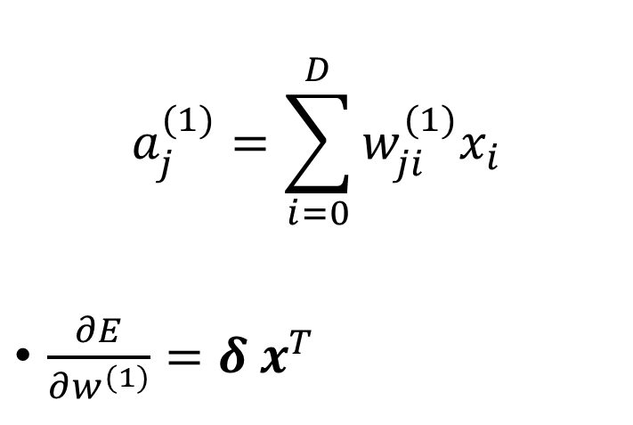
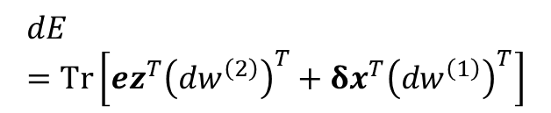






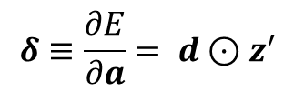



Gradient formula
Rules of differential:
$$d\left(f+g\right)= df+ dg$$
$$d\left(fg\right)=fdg+gdf$$
$$df\left(g\right)=f^{′}\left(g\right)dg$$
$$a_{j}^{(1)}=\sum_{i=0}^{D}{w_{ji}^{(1)}x_{i}}$$
$\frac{∂E}{∂w^{(1)}}=δ x^{T}$
$$w_{MD}^{\left(1\right)}$$
$$x_{D}$$
$$z_{M}$$
$$⋮$$
$$w_{M2}^{\left(1\right)}$$
$$⋮$$
Vector of input
$$x_{2}$$
$$w_{M0}^{\left(1\right)}$$
$$x_{1}$$
$$z_{1}$$
$$x_{0}$$
Error in the output
$$dE=Tr\left[ez^{T}{\left(dw^{\left(2\right)}\right)}^{T}+δx^{T}{\left(dw^{\left(1\right)}\right)}^{T}\right]$$
$$δ≡\frac{∂E}{∂a}= d⊙z′$$
Notes:
Circle with dot means elementwise multiplication, while ez^T is a matrix. The trace Tr(…) means sum over all the diagonal.

Slide 5


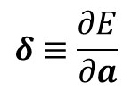




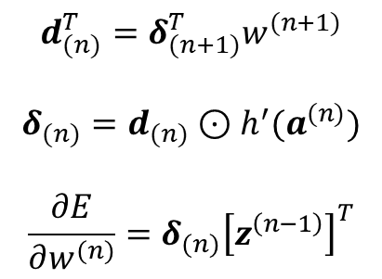





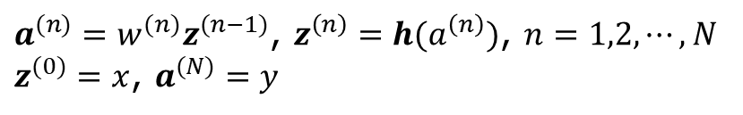
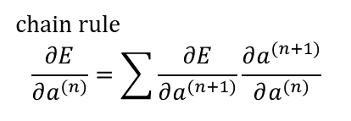





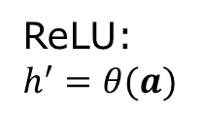
General feedforward network
${{a^{(n)}=w}^{(n)}z}^{(n−1)}$, $z^{\left(n\right)}=h(a^{\left(n\right)})$, $n=1,2,⋯, N$
$z^{(0)}=x$, $a^{(N)}=y$
$$w^{(1)}$$
$$h$$
$$w^{(2)}$$
$$h$$
$$w^{(N)}$$
$$y$$
$$x$$
$$a^{(1)}$$
$$z^{(1)}$$
$$a^{(2)}$$
$$z^{(2)}$$
$$⋯$$
$$z^{(N−1)}$$
$$δ_{(1)}$$
$$δ_{(2)}$$
$$δ_{(N)}$$
Back propagation
$$d_{(n)}^{T}=δ_{(n+1)}^{T}w^{(n+1)}$$
$$δ_{(n)}=d_{(n)}⊙h^{′}(a^{(n)})$$
$$\frac{∂E}{∂w^{(n)}}=δ_{(n)}{\left[z^{\left(n−1\right)}\right]}^{T}$$
chain rule
$$\frac{∂E}{∂a^{(n)}}=\sum{\frac{∂E}{∂a^{(n+1)}}\frac{∂a^{(n+1)}}{∂a^{(n)}}}$$
$$δ≡\frac{∂E}{∂a}$$
ReLU: $h^{′}=θ(a)$
Notes:
Here we need to use the chain rule of differentiation, see Eq.(8.12) in Bishop. Roughly speaking, delta_n = dE/da^n = dE/da^(n+1) da^(n+1)/da^n.

Slide 6
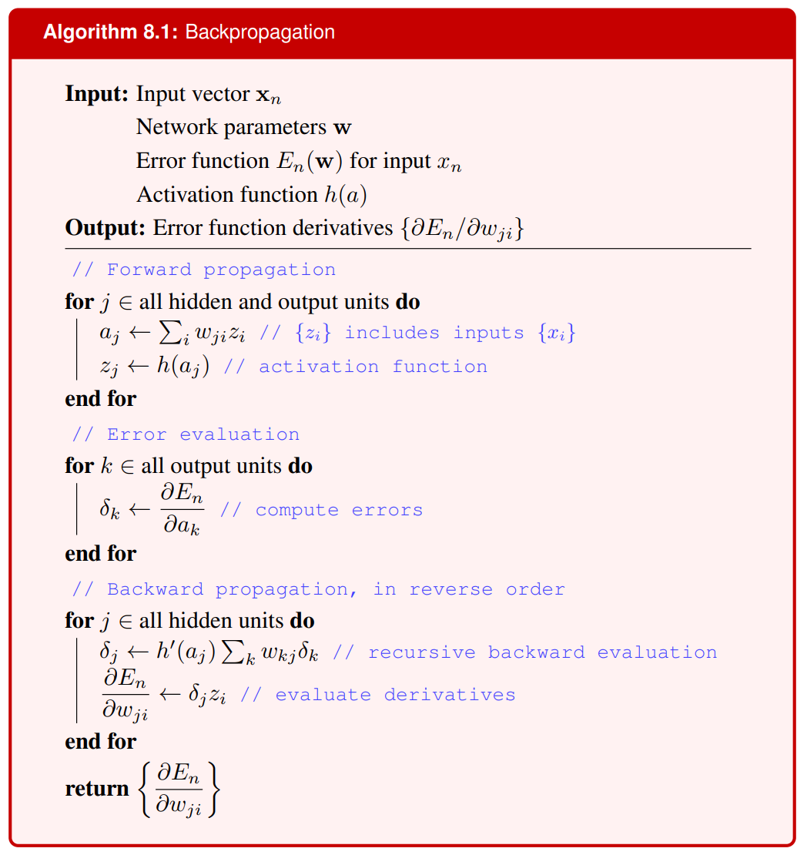
From page 237 in Bishop

Slide 7
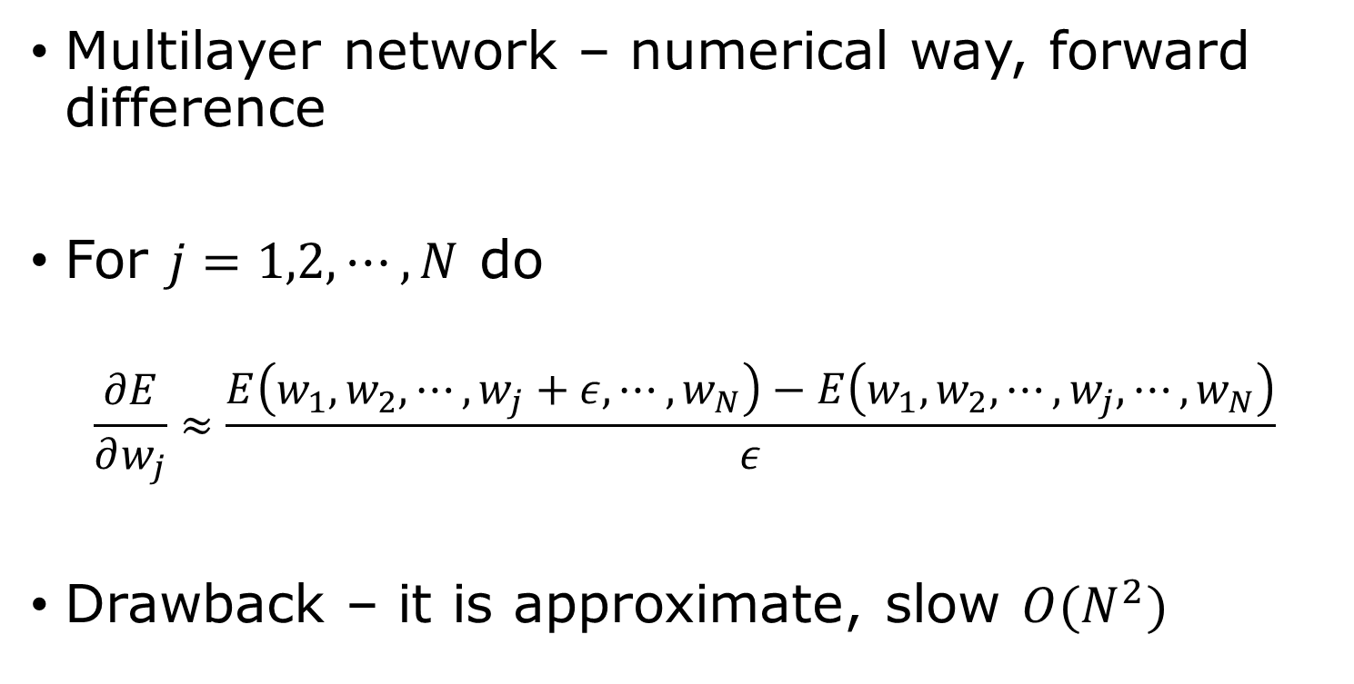
Compute the gradient $∇E$
Multilayer network – numerical way, forward difference
For $j=1,2,⋯, N$ do
$$\frac{∂E}{∂w_{j}}≈\frac{E\left(w_{1},w_{2},⋯,w_{j}+ε,⋯,w_{N}\right)−E\left(w_{1},w_{2},⋯,w_{j},⋯,w_{N}\right)}{ε}$$
Drawback – it is approximate, slow $O(N^{2})$

Slide 8
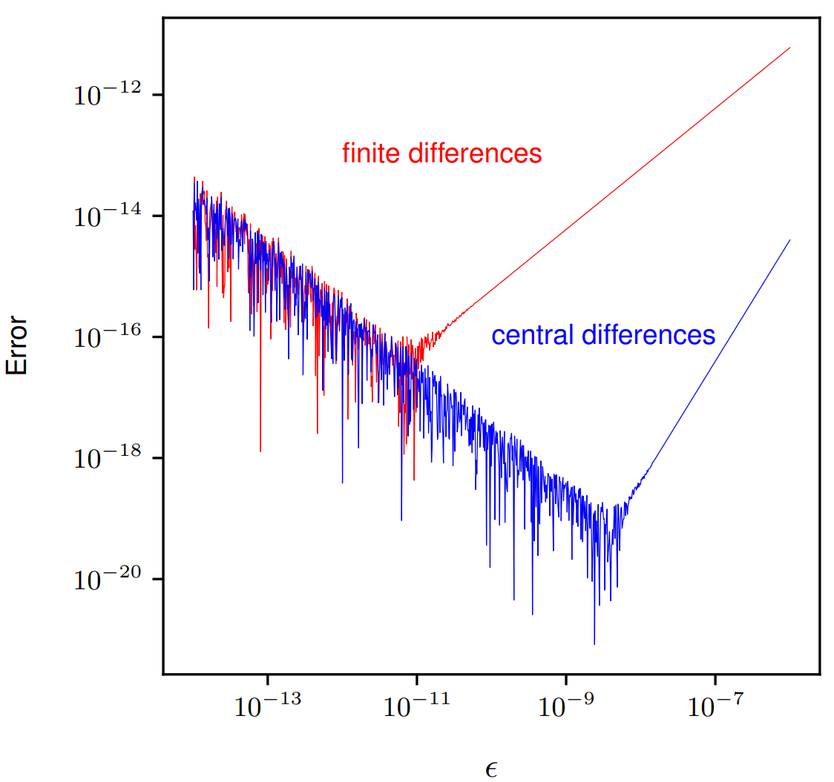
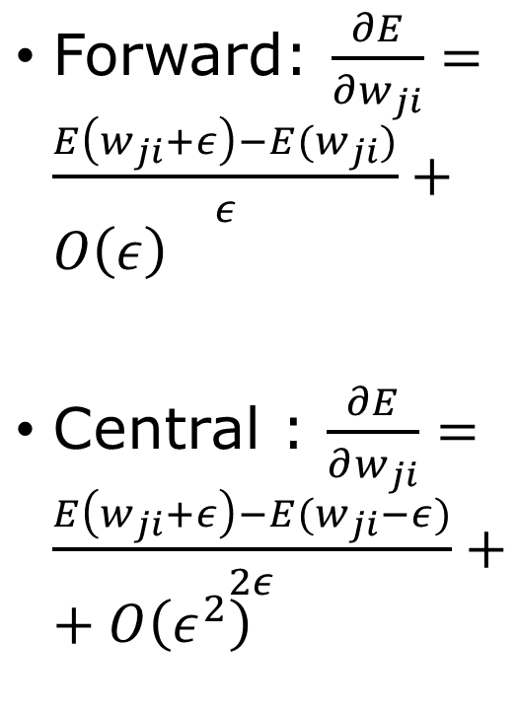
Forward difference vs central difference
Forward: $\frac{∂E}{∂w_{ji}}=\frac{E\left(w_{ji}+ε\right)−E(w_{ji})}{ε}+O\left(ε\right)$
Central : $\frac{∂E}{∂w_{ji}}=\frac{E\left(w_{ji}+ε\right)−E(w_{ji}−ε)}{2ε}++O\left(ε^{2}\right)$

Slide 9
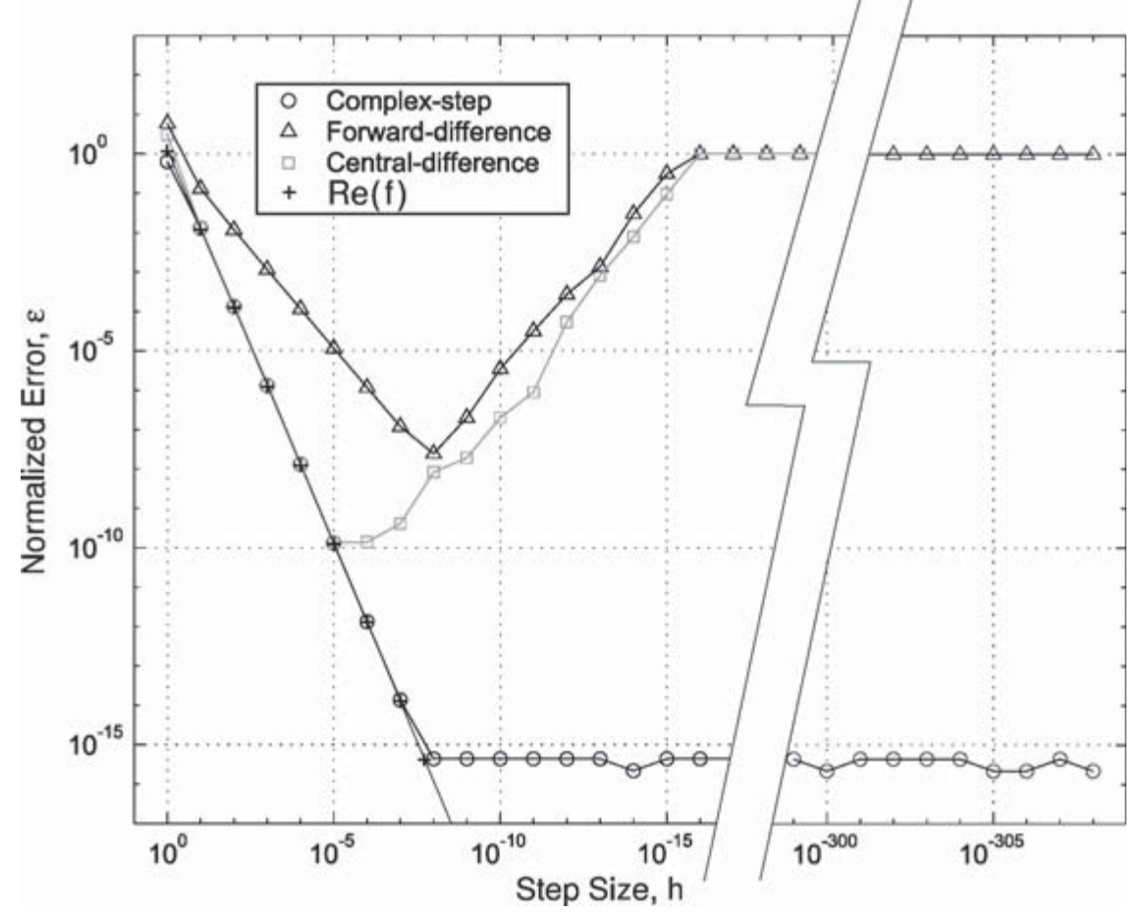
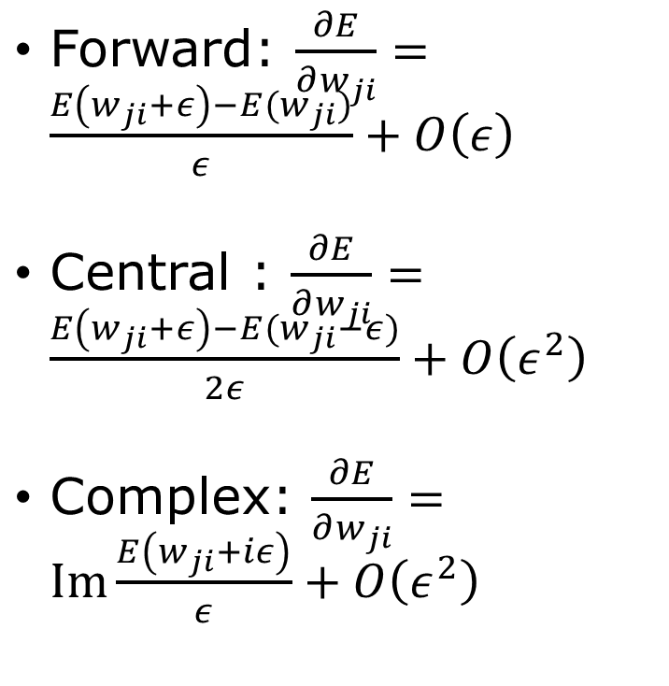

Use complex $iε$
Forward: $\frac{∂E}{∂w_{ji}}=\frac{E\left(w_{ji}+ε\right)−E(w_{ji})}{ε}+O\left(ε\right)$
Central : $\frac{∂E}{∂w_{ji}}=\frac{E\left(w_{ji}+ε\right)−E(w_{ji}−ε)}{2ε}+O\left(ε^{2}\right)$
Complex: $\frac{∂E}{∂w_{ji}}=Im\frac{E\left(w_{ji}+iε\right)}{ε}+O\left(ε^{2}\right)$
Martins, Sturdza, Alonso, ACM Transactions on Mathematical Software, 2003

Slide 10
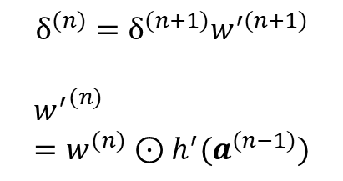
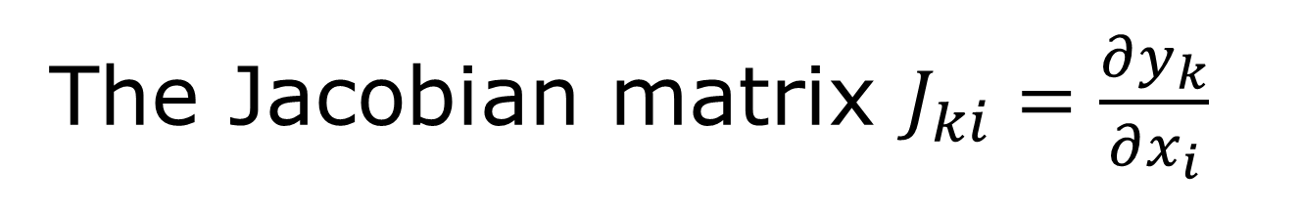




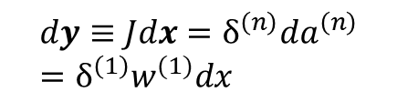
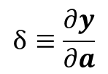

The Jacobian matrix $J_{ki}=\frac{∂y_{k}}{∂x_{i}}$
${{a^{(n)}=w}^{(n)}z}^{(n−1)}$, $z^{\left(n\right)}=h(a^{\left(n\right)})$, $n=1,2,⋯, N$
$z^{(0)}=x$, $a^{(N)}=y$
$$w^{(1)}$$
$$h$$
$$w^{(2)}$$
$$h$$
$$w^{(N)}$$
$$y$$
$$x$$
$$a^{(1)}$$
$$z^{(1)}$$
$$a^{(2)}$$
$$z^{(2)}$$
$$⋯$$
$$z^{(N−1)}$$
$$δ_{(1)}$$
$$δ_{(2)}$$
$$δ_{(N)}=I$$
$$dy≡Jdx=δ^{\left(n\right)}da^{\left(n\right)}=δ^{\left(1\right)}w^{(1)}dx$$
$$δ^{(n)}=δ^{(n+1)}w^{′(n+1)}$$
$${w^{′}}^{(n)}=w^{(n)}⊙h^{′}(a^{(n−1)})$$
$$δ≡\frac{∂y}{∂a}$$
$$δ_{kj}^{(n)}=δ_{kl}^{(n+1)}w_{lj}^{(n+1)}h′(a_{j}^{(n)})$$
$δ$ is matrix
Notes:
The Jacobian matrix is the variation of the output y with respect to the input x, keeping w fixed.

Slide 11
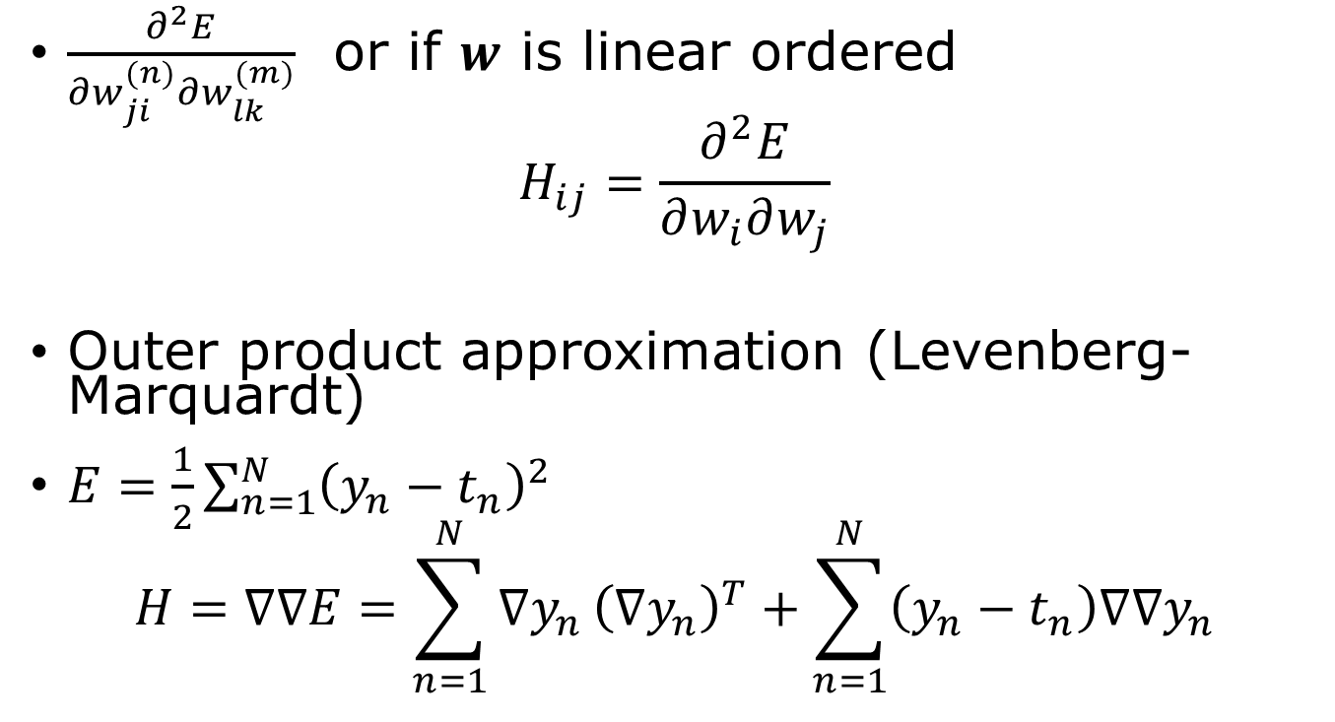
The Hessian matrix
$\frac{∂^{2}E}{∂w_{ji}^{(n)}∂w_{lk}^{(m)}}$ or if $w$ is linear ordered
$$H_{ij}=\frac{∂^{2}E}{∂w_{i}∂w_{j}}$$
Outer product approximation (Levenberg-Marquardt)
$E=\frac{1}{2}\sum_{n=1}^{N}{{\left(y_{n}−t_{n}\right)}^{2}}$
$$H=∇∇E=\sum_{n=1}^{N}{∇y_{n}}{\left(∇y_{n}\right)}^{T}+\sum_{n=1}^{N}{\left(y_{n}−t_{n}\right)∇∇y_{n}}$$

Slide 12
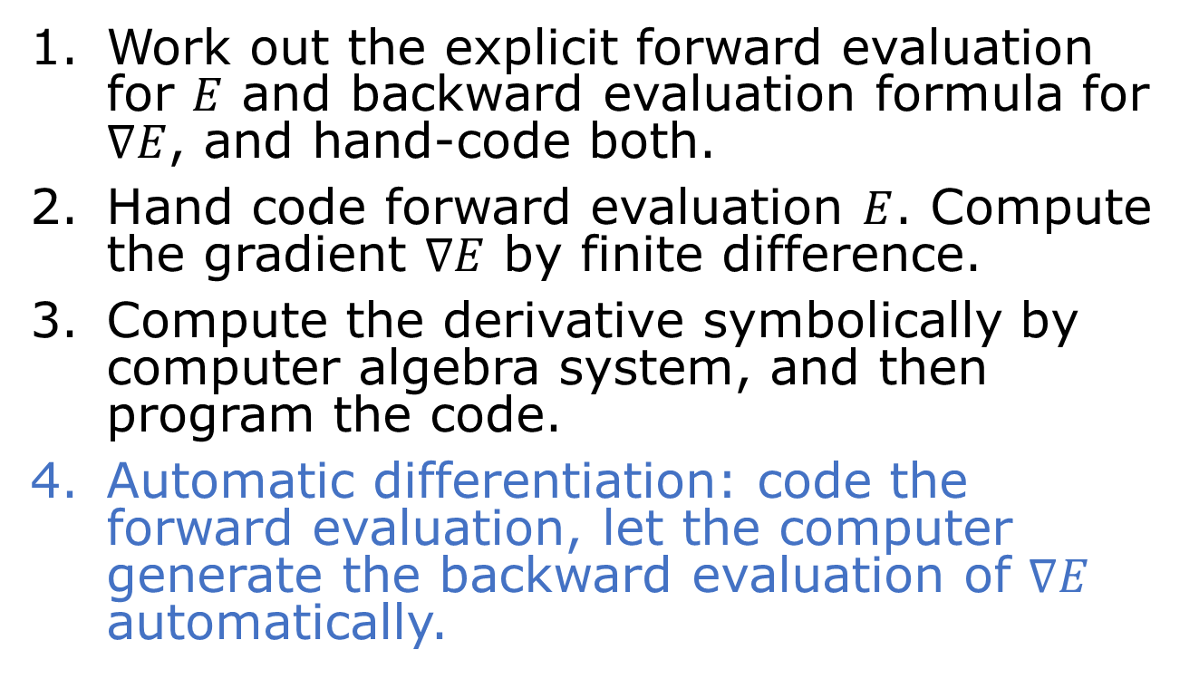

Compute gradient $∇E$
Work out the explicit forward evaluation for $E$ and backward evaluation formula for $∇E$, and hand-code both.
Hand code forward evaluation $E$. Compute the gradient $∇E$ by finite difference.
Compute the derivative symbolically by computer algebra system, and then program the code.
Automatic differentiation: code the forward evaluation, let the computer generate the backward evaluation of $∇E$ automatically.

Slide 13
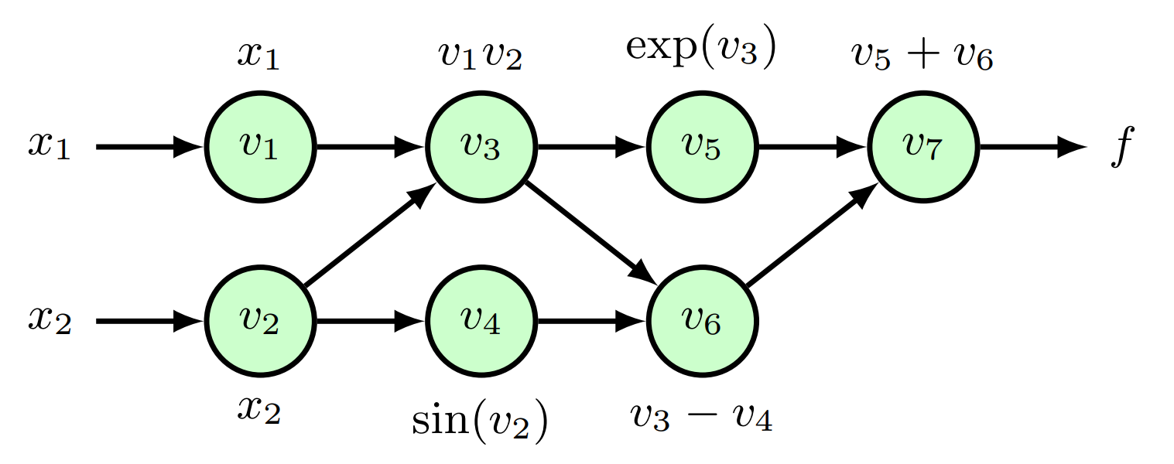



Reverse-mode automatic differentiation
$f\left(x_{1},x_{2}\right)=x_{1}x_{2}+\exp\left(x_{1}x_{2}\right)−\sin\left(x_{2}\right)$
primal variables $v_{i}$ adjunct variables ${\overline{v}}_{i}=\frac{∂f}{∂v_{i}}$
$v_{1}=x_{1}$
$v_{2}=x_{2}$
$v_{3}=v_{1}v_{2}$
$v_{4}=\sin\left(v_{2}\right)$
$v_{5}=exp⁡(v_{3})$
$v_{6}=v_{3}−v_{4}$
$v_{7}=v_{5}+v_{6}$
$f=v_{7}$
${\overline{v}}_{7}=1$
${\overline{v}}_{6}={\overline{v}}_{7}$
${\overline{v}}_{5}={\overline{v}}_{7}$
${\overline{v}}_{4}=−{\overline{v}}_{6}$
${\overline{v}}_{3}={\overline{v}}_{5}v_{5}+{\overline{v}}_{6}$
${\overline{v}}_{2}={\overline{v}}_{2}v_{1}+{\overline{v}}_{4}\cos{(v_{2})}$
${\overline{v}}_{1}={\overline{v}}_{3}v_{2}$
$${\overline{v}}_{i}=\sum_{j∈ch(i)}{{\overline{v}}_{j}\frac{∂v_{j}}{∂v_{i}}}$$
sum over the child nodes

