Slide 1
Week 6.5, Physics-Informed Neural Networks (PINN)
Notes:
For Physics Informed neural network (PINN), read M. Raissi, et al, Journal of Computational Physics, {378}, 686 (2019); and H. Baty, arXiv:2403.00599, or Humagain, et al, arXiv:2508.13216.

Slide 2




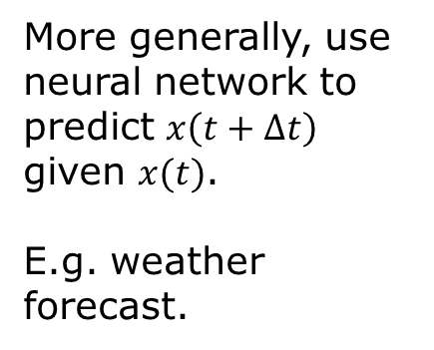
Importance of ODE
Mechanics, Newton’s law
$$a=\frac{d^{2}x}{dt^{2}}=\frac{dv}{dt}$$
$$F=ma$$
$$x_{2}$$
More generally, use neural network to predict $x\left(t+Δt\right)$ given $x(t)$.
E.g. weather forecast.
$$x_{1}$$

Slide 3

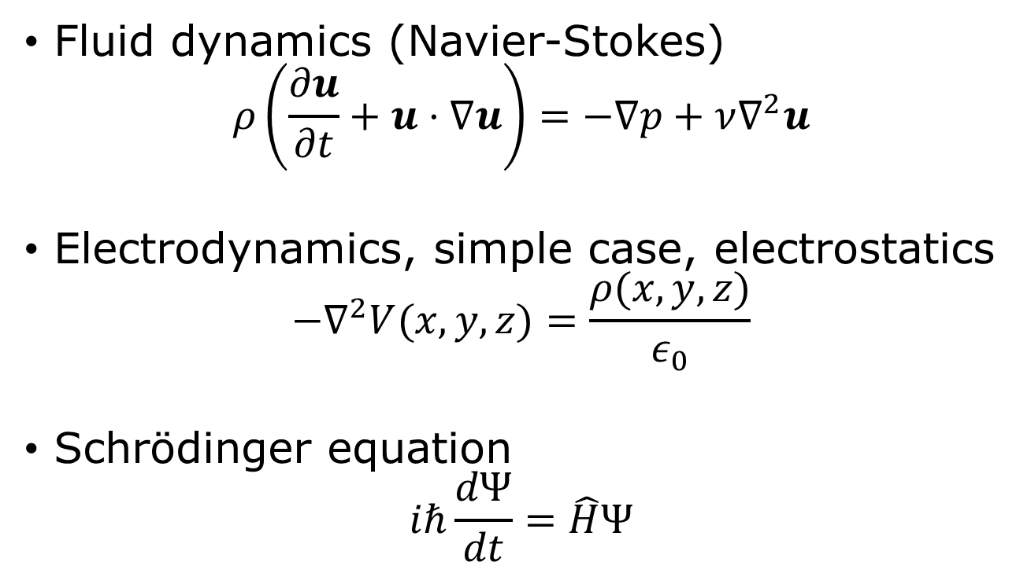
Importance of PDE
Fluid dynamics (Navier-Stokes)
$$ρ\left(\frac{∂u}{∂t}+u⋅∇u\right)=−∇p+ν∇^{2}u$$
Electrodynamics, simple case, electrostatics
$$−∇^{2}V(x,y,z)=\frac{ρ(x,y,z)}{ε_{0}}$$
Schrödinger equation
$$iℏ\frac{dΨ}{dt}=\hat{H}Ψ$$
Hamilonian
$$\hat{H}=−\frac{1}{2}∇^{2}+V$$

Slide 4
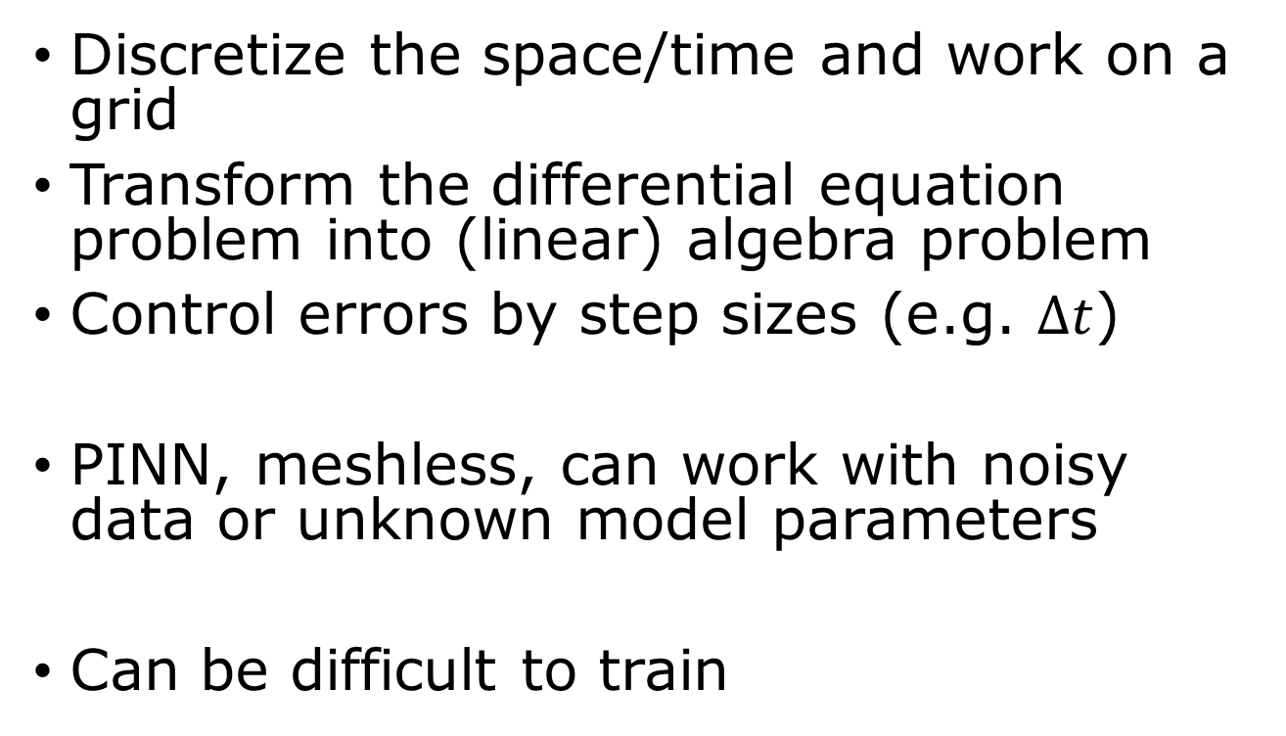
Traditional ODE/PDE solver vs PINN
Discretize the space/time and work on a grid
Transform the differential equation problem into (linear) algebra problem
Control errors by step sizes (e.g. $Δt$)
PINN, meshless, can work with noisy data or unknown model parameters
Can be difficult to train

Slide 5
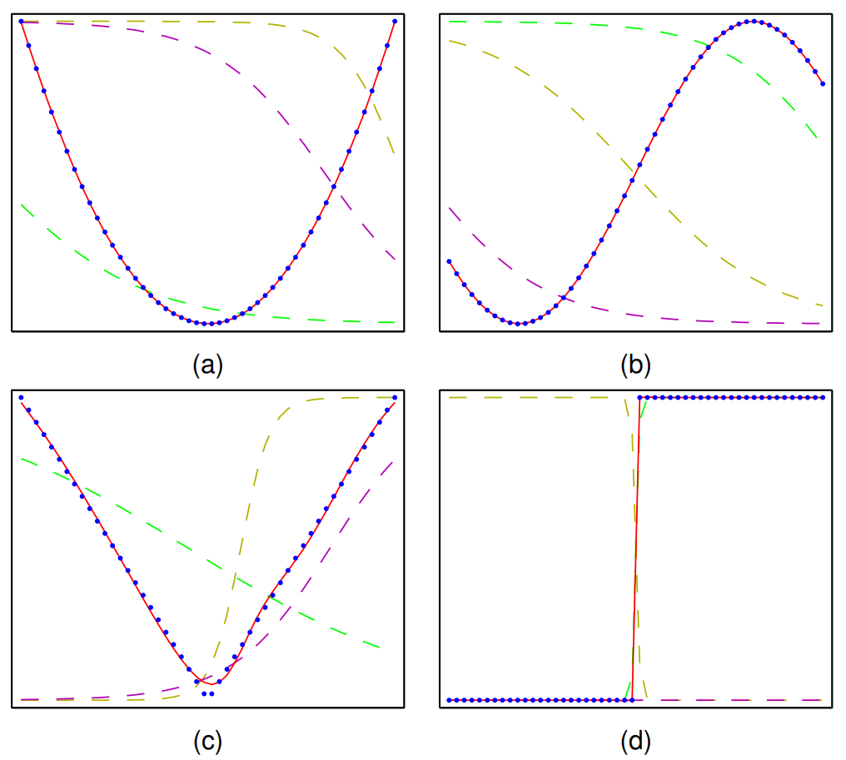

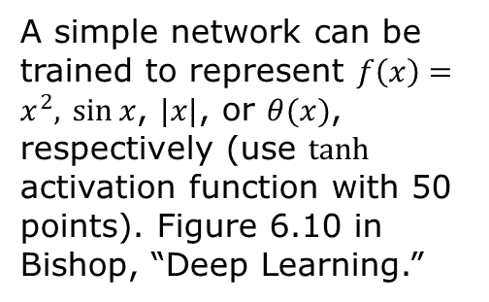




MLP as a universal approximator of any function
$$z_{3}$$
$$x$$
$$z_{2}$$
$$y$$
$$z_{1}$$
A simple network can be trained to represent $f\left(x\right)=x^{2},$ $\sin{x}$, $|x|$, or $θ(x)$, respectively (use $tanh$ activation function with 50 points). Figure 6.10 in Bishop, “Deep Learning.”
Need to work in a bounded domain

Slide 6
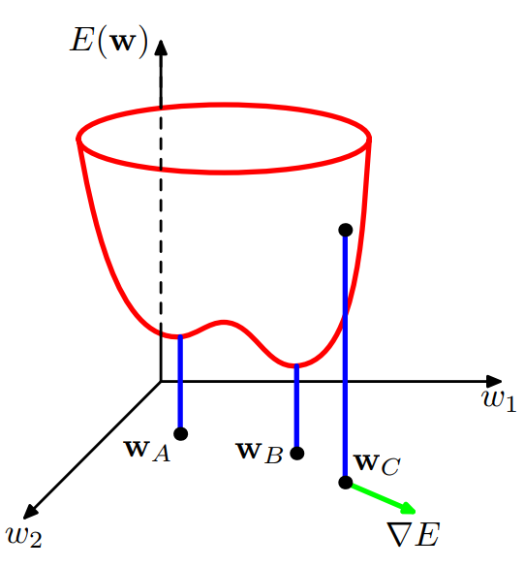
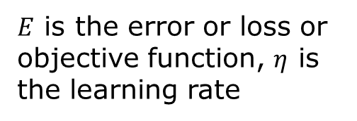


Determine network parameters by SGD
$$w←w−η∇E$$
$E$ is the error or loss or objective function, $η$ is the learning rate
$$δE=E\left(w+δw\right)−E\left(w\right)=δw^{T}∇E(w)$$
$$∇E=\left(\begin{matrix}\frac{∂E}{∂w_{1}} \\ ⋮ \\ \frac{∂E}{∂w_{N}}\end{matrix}\right)$$

Slide 7
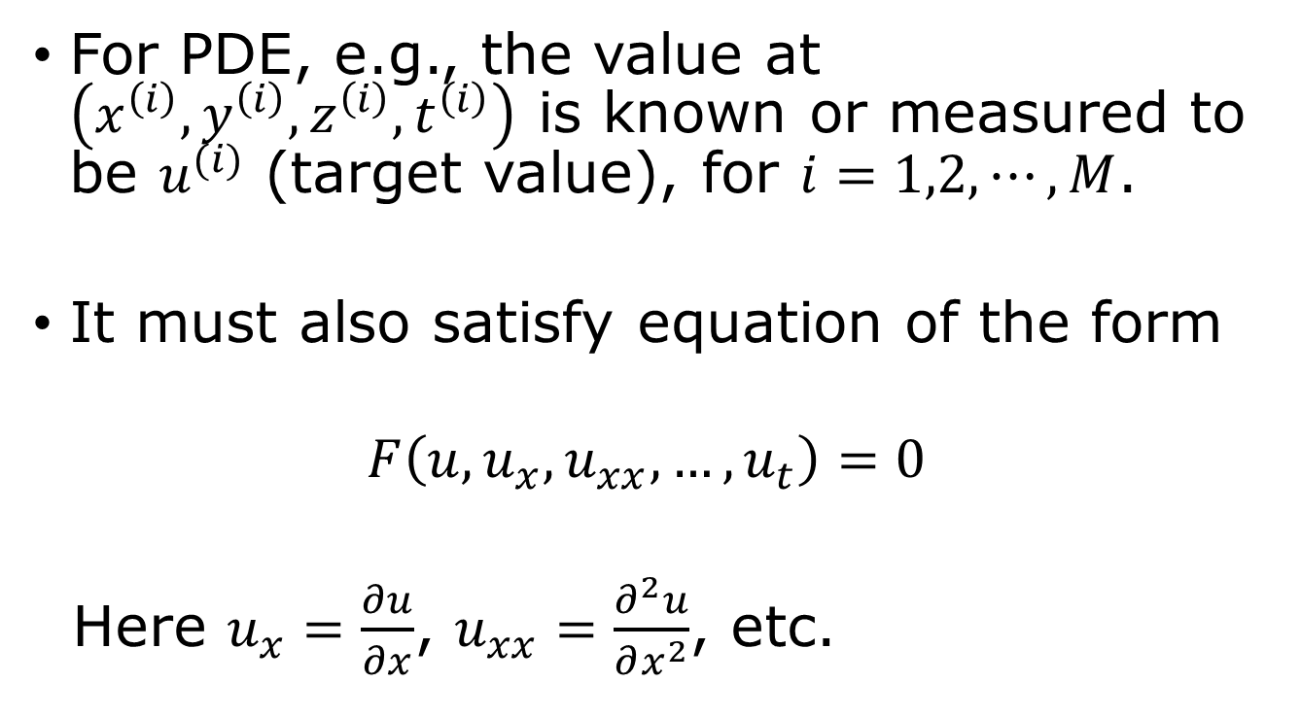
(Experimental) Data & physical constraints
For PDE, e.g., the value at $\left(x^{\left(i\right)},y^{\left(i\right)},z^{\left(i\right)},t^{\left(i\right)}\right)$ is known or measured to be $u^{(i)}$ (target value), for $i=1,2,⋯,M$.
It must also satisfy equation of the form
$$F\left(u,u_{x},u_{xx}, …, u_{t}\right)=0$$
Here $u_{x}=\frac{∂u}{∂x}$, $u_{xx}=\frac{∂^{2}u}{∂x^{2}}$, etc.
Notes:
u can be the three velocities in the Navier-Stokes equation, or the real and imaginary parts of the wave function in the Schrodinger equation, i.e., u can be a vector instead of a scalar number.

Slide 8
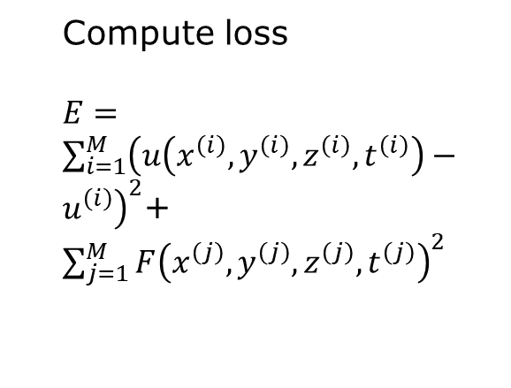

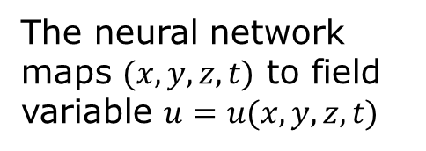




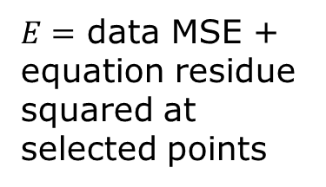
Physics-informed neural network (PINN)
Compute loss
$E=\sum_{i=1}^{M}{{\left(u\left(x^{\left(i\right)},y^{\left(i\right)},z^{\left(i\right)},t^{\left(i\right)}\right)−u^{\left(i\right)}\right)}^{2}}$+ $\sum_{j=1}^{M}{F{\left(x^{\left(j\right)},y^{\left(j\right)},z^{\left(j\right)},t^{\left(j\right)}\right)}^{2}}$
use autograd
$$(x,y,z,t)$$
$${ u}_{x}$$
x
$$u_{y}$$
y
u
$E=$ data MSE + equation residue squared at selected points
$${ u}_{z}$$
z
$${ u}_{t}$$
t
Residue evaluated at collocation points
The neural network maps $(x,y,z,t)$ to field variable $u=u(x,y,z,t)$

Slide 9
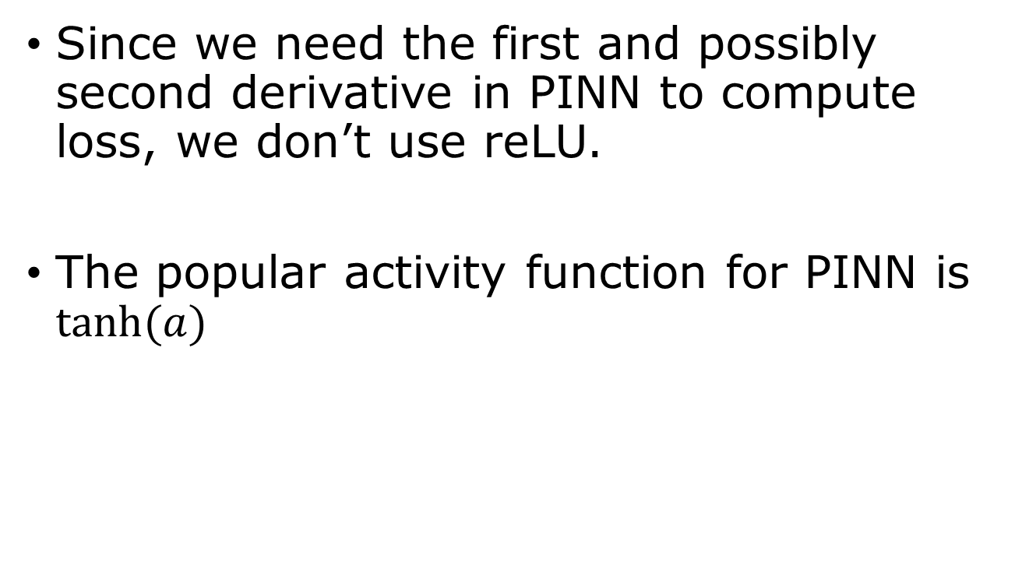


Smooth activation requirement for PINN
Since we need the first and possibly second derivative in PINN to compute loss, we don’t use reLU.
The popular activity function for PINN is $\tanh{(a)}$
$$tanh⁡(a)$$
$$a$$
Notes:
Show tanh(a) and sigmoid are equivalent.

Slide 10

How to compute derivative in pytorch?
$u=u\left(x\right),$ $u_{x}=\frac{∂u}{∂x},$ $u_{xx}=\frac{∂^{2}u}{∂x^{2}}$
u = model(x)
u_x = torch.autograd.grad(u, x, torch.ones_like(u), create_graph=True)[0]
u_xx = torch.autograd.grad(u_x, x, torch.ones_like(u_x), create_graph=True)[0]
Notes:
Note: torch.autograd.grad() returns a tuple of the partial derivatives of x with respect to u, [0] extract the numerical value and assign it to variable u_x (or u_xx). So, [0] is needed here.

Slide 11
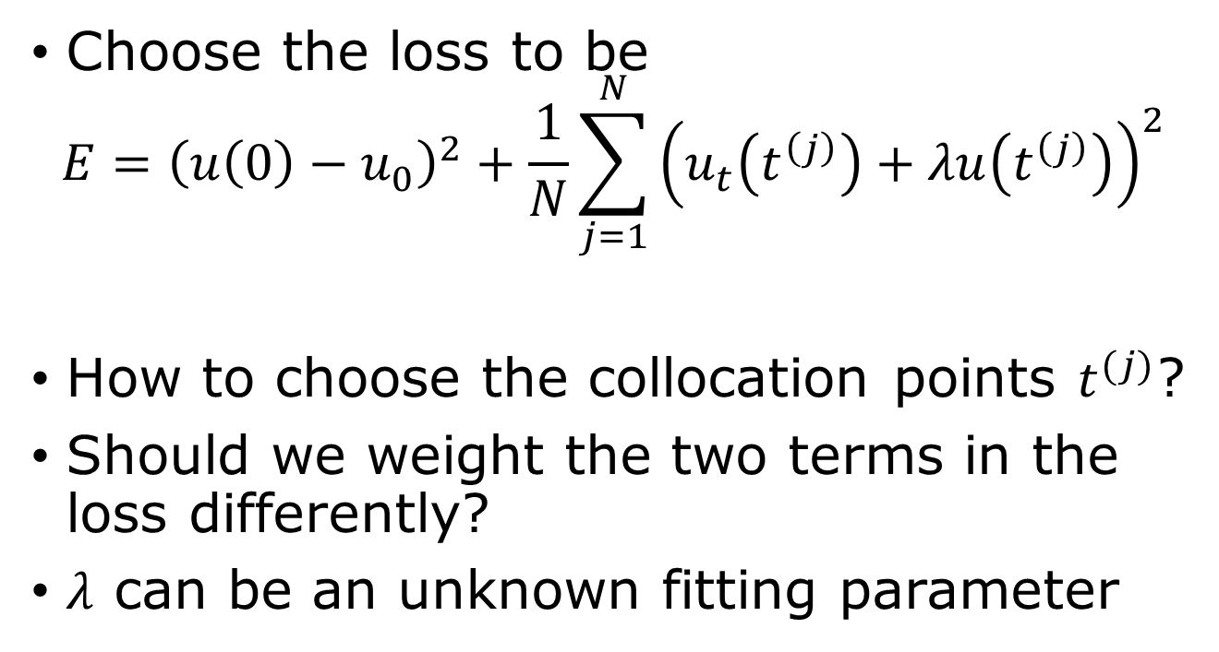
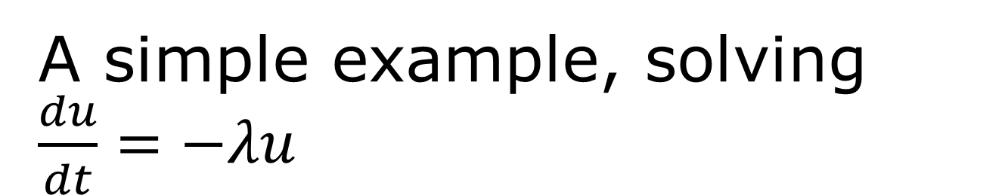
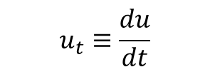
A simple example, solving $\frac{du}{dt}=−λu$
$$u_{t}≡\frac{du}{dt}$$
Choose the loss to be
$$E={\left(u\left(0\right)−u_{0}\right)}^{2}+\frac{1}{N}\sum_{j=1}^{N}{{\left(u_{t}\left(t^{\left(j\right)}\right)+λu\left(t^{\left(j\right)}\right)\right)}^{2}}$$
How to choose the collocation points $t^{(j)}$?
Should we weight the two terms in the loss differently?
$λ$ can be an unknown fitting parameter

Slide 12
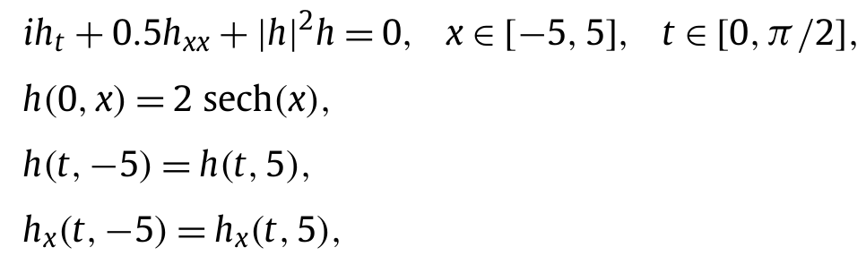
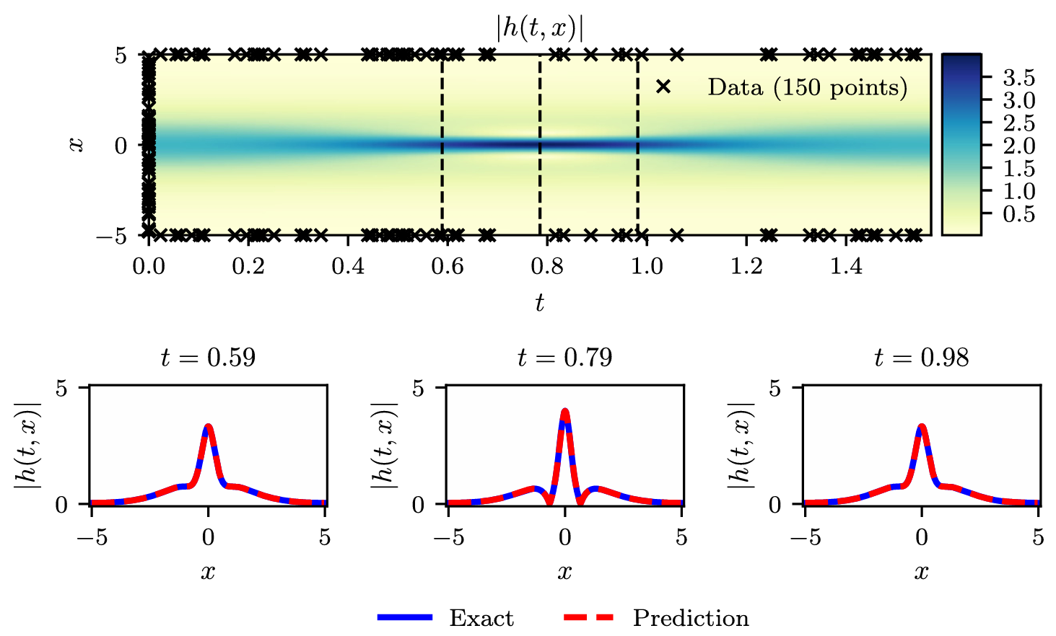
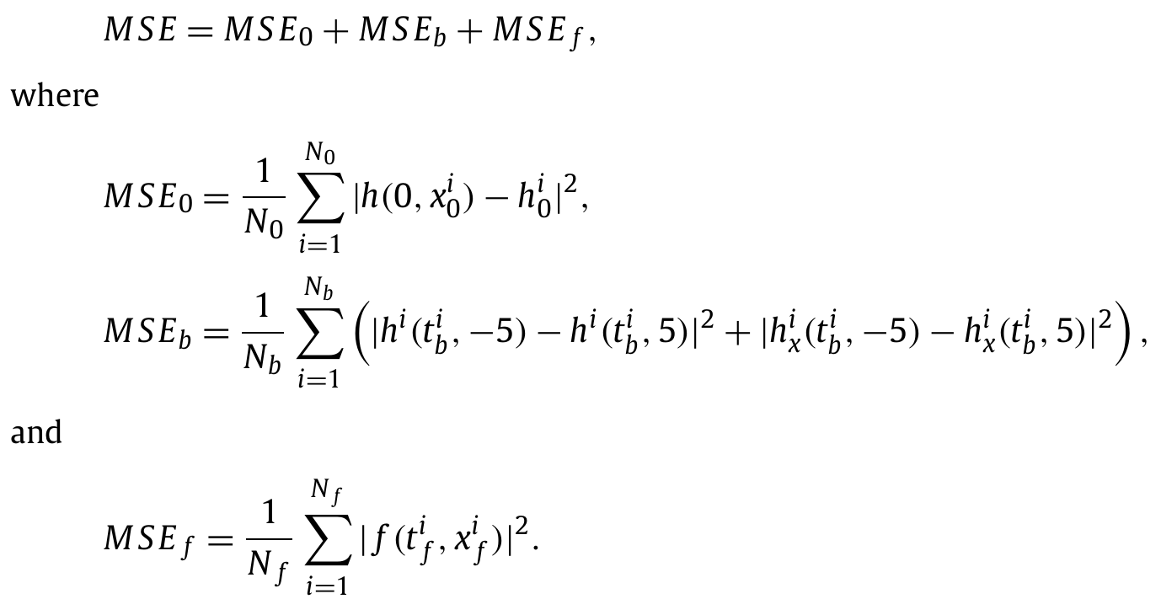

Nonlinear Schrödinger equation
From Raissi et al, JCP 2019
$f≔ih_{t}+0.5h_{xx}+{\left|h\right|}^{2}h,$ $h∈ℂ$
Notes:
From Raissi, et al, J Comp. Phys. 378 (2019) 686.

