Slide 1
Week 7, Convolutional Neural Network (CNN)
Notes:
Chapter 10, Bishop, “Deep Learning, Foundations and Concepts”.

Slide 2
What deep network can do?
Computer Vision
Classification
Detection
Segmentation
Caption generation
Large language models
Protein folding
ML-based force field, etc

Slide 3
MLP and inductive bias
In principle, with enough width and depth, the multi-layer perceptrons (MLP) can do everything
However, in practice, it is inefficient due to a larger number of parameters needed for training and inference
Thus, a strong “inductive bias” is needed for computer vision/classification. Translational equi-variance is helpful
Notes:
Question: can MLP learning every function x -> y = f(x)? No. example, a random function.

Slide 4







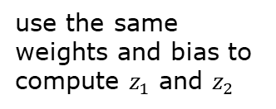
Inductive biases for image processing in CNN
Translation equivariance
Locality (sparseness)
Parameter sharing
$$f\left(g\left(x\right)\right)=g(f\left(x\right))$$
use the same weights and bias to compute $z_{1}$ and $z_{2}$
$${ x}_{1}$$
$${ z}_{1}$$
$${ x}_{2}$$
$${ x}_{3}$$
$${ z}_{2}$$
$${ x}_{4}$$

Slide 5
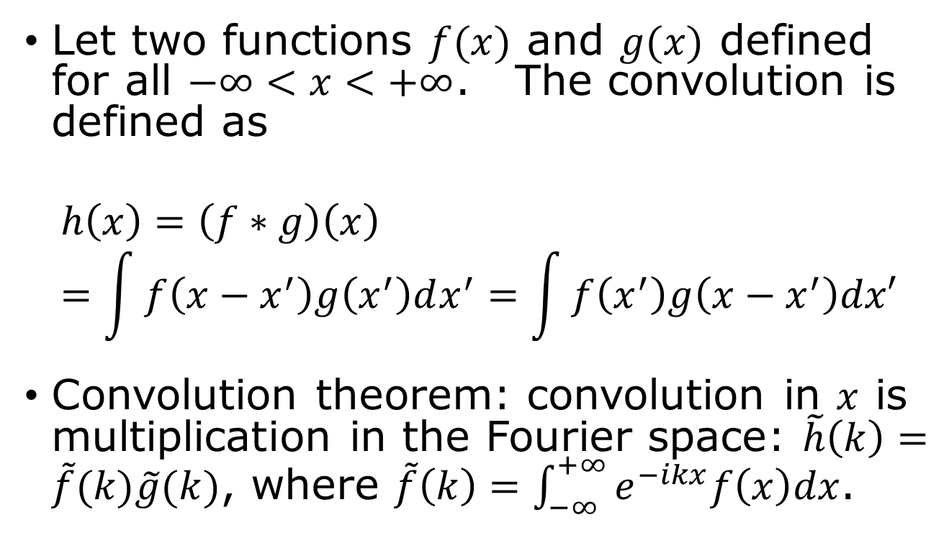
Convolution in 1D
Let two functions $f(x)$ and $g(x)$ defined for all $−∞<x<+∞$. The convolution is defined as
$$h\left(x\right)=\left(f∗g\right)\left(x\right)=\int{f\left(x−x^{′}\right)g\left(x^{′}\right)dx^{′}=\int{f\left(x^{′}\right)g\left(x−x^{′}\right)dx′}}$$
Convolution theorem: convolution in $x$ is multiplication in the Fourier space: $\tilde{h}\left(k\right)=\tilde{f}(k)\tilde{g}(k)$, where $\tilde{f}\left(k\right)=\int_{−∞}^{+∞}{e^{−ikx}f\left(x\right)dx}$.

Slide 6
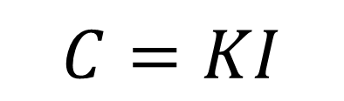



Convolution in 2D images
$$C=KI$$
Kernel $K$
1 | 0 | 1
0 | 1 | 0
1 | 0 | 1
kernel size 3, stride 1,
padding 0, channel 1
The point of CNN is to learn the kernel by training.
$$I$$
$$C$$
Notes:
The kernel K is also called filter.

Slide 7
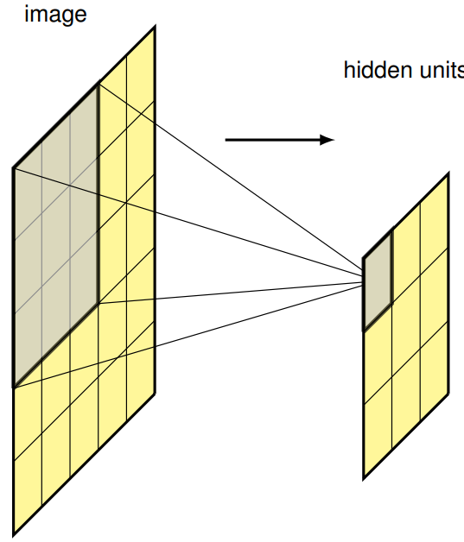
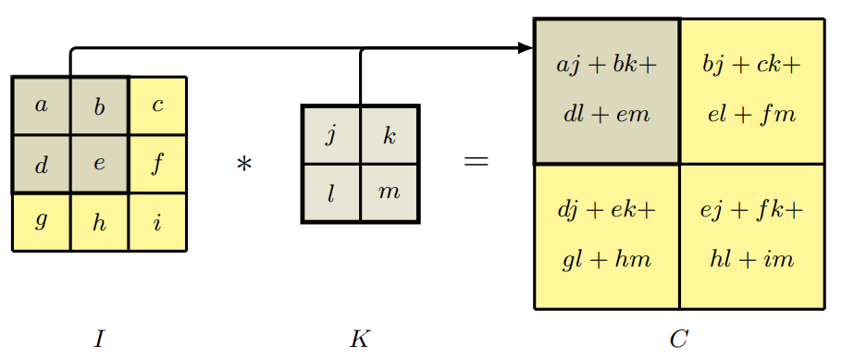

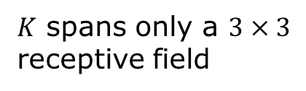
Convolution in neural network (cross correlation)
$$C\left(j,k\right)=\sum_{l}{\sum_{m}{\underset{input image}{\underbrace{I(j+l,k+m)}}\underset{kernel}{\underbrace{K(l,m)}}}}$$
output
$K$ spans only a $3×3$ receptive field

Slide 8
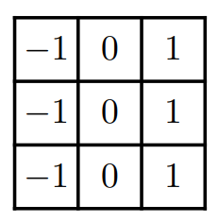
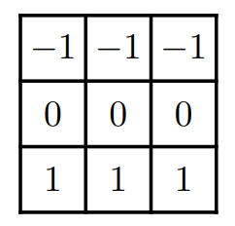
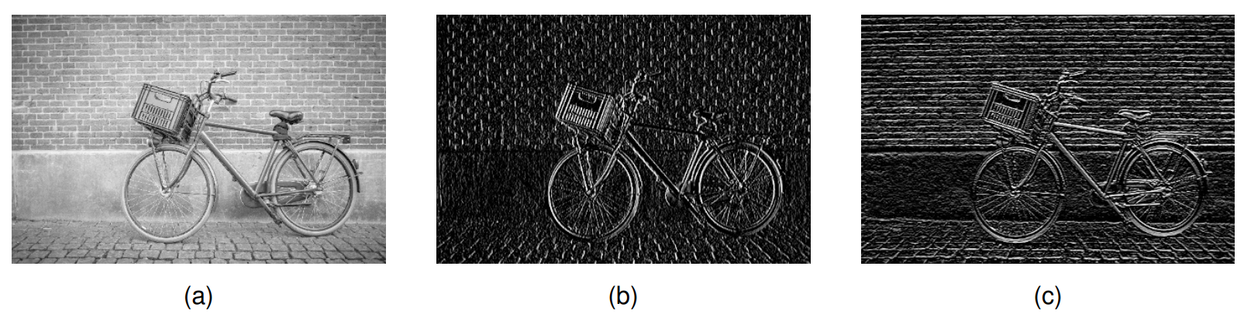

Convolution as discrete derivatives – edge detection
$3×3$ kernels
original image
Central point of CNN: Kernels are “learned”.

Slide 9
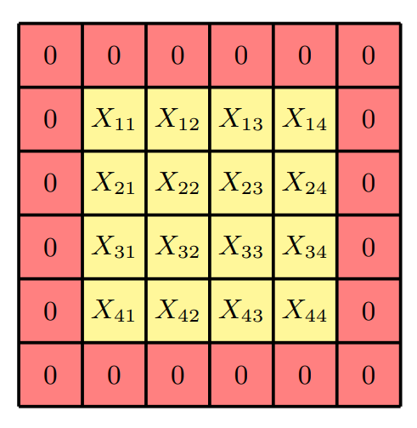
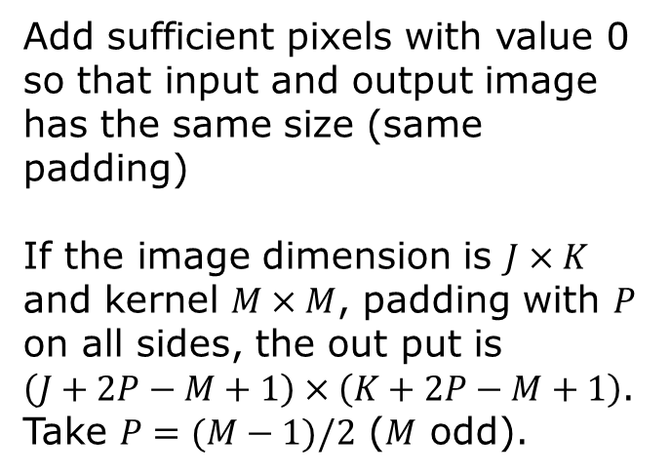

Padding and Stride
Add sufficient pixels with value 0 so that input and output image has the same size (same padding)
If the image dimension is $J×K$ and kernel $M×M$, padding with $P$ on all sides, the out put is $\left(J+2P−M+1\right)×\left(K+2P−M+1\right)$. Take $P=(M−1)/2$ ($M$ odd).
Stride: move in steps of $S$ for next output

Slide 10
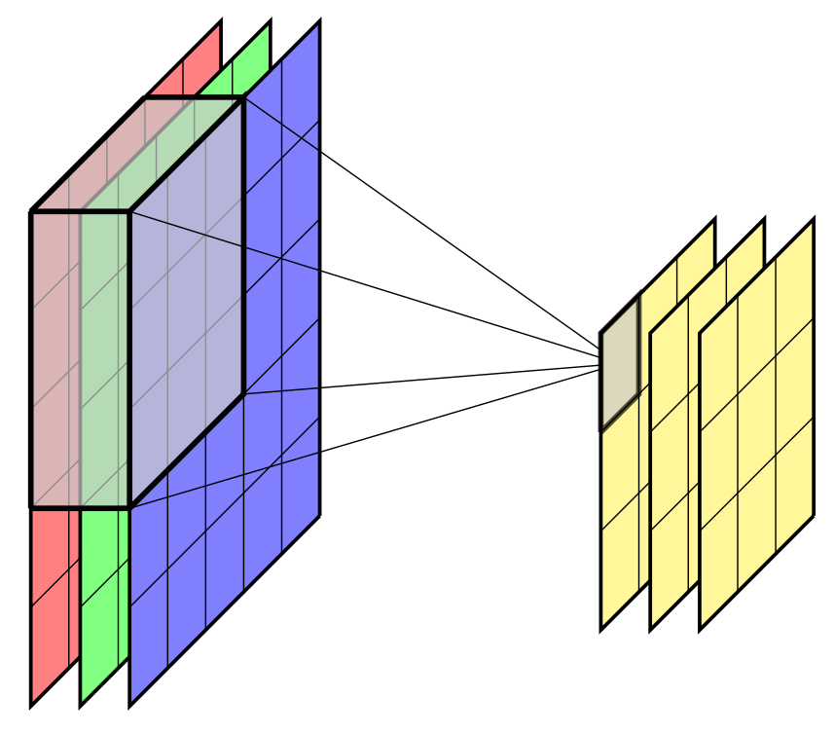
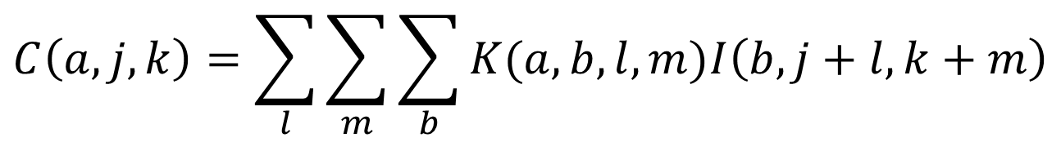
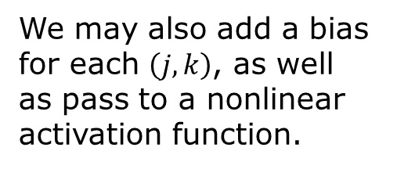
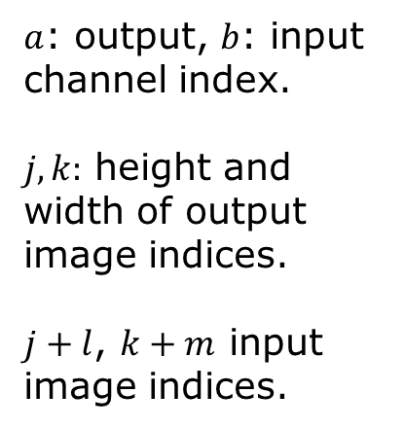
Channels
We may also add a bias for each $\left(j,k\right)$, as well as pass to a nonlinear activation function.
$$C\left(a,j,k\right)=\sum_{l}{\sum_{m}{\sum_{b}{K(a,b,l,m)I\left(b,j+l,k+m\right)}}}$$
$a$: output, $b$: input channel index.
$j,k:$ height and width of output image indices.
$j+l$, $k+m$ input image indices.
Notes:
In Pytorch, the images have for indices, imag(n,c,h,w): n is batch index, c is channel, h is height index, w is width index.

Slide 11
Convolution layer in pytorch
class torch.nn.Conv2d(in_channels, out_channels, kernel_size, stride=1, padding=0, dilation=1, groups=1, bias=True, padding_mode='zeros', device=None, dtype=None)
E.g.
conv = torch.nn.Conv2d(1,1,3)
Notes:
Dilation: if larger than 1, it skips d-1 for input, increasing the receptive field without increasing the kernel size.

Slide 12
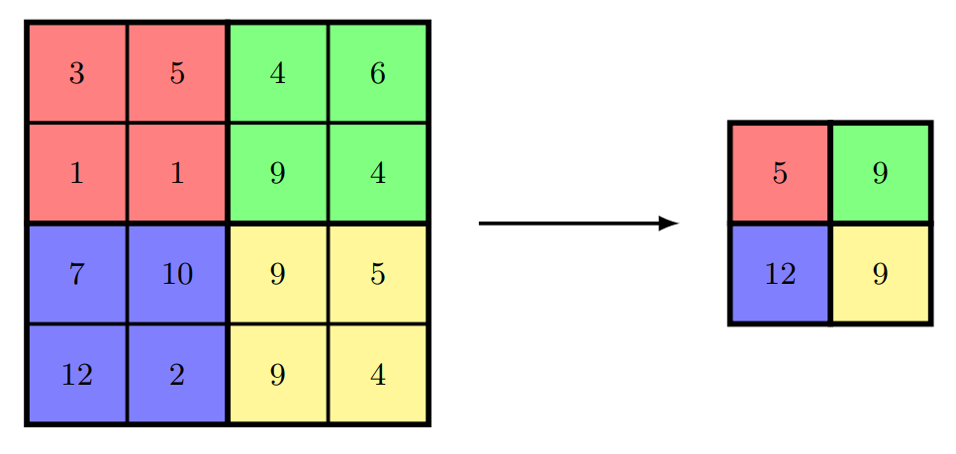
Pooling
Purpose: make output invariant with respect to small translation
max pool
Size : 2
Stride: 2
Compare: renormalization group transform

Slide 13
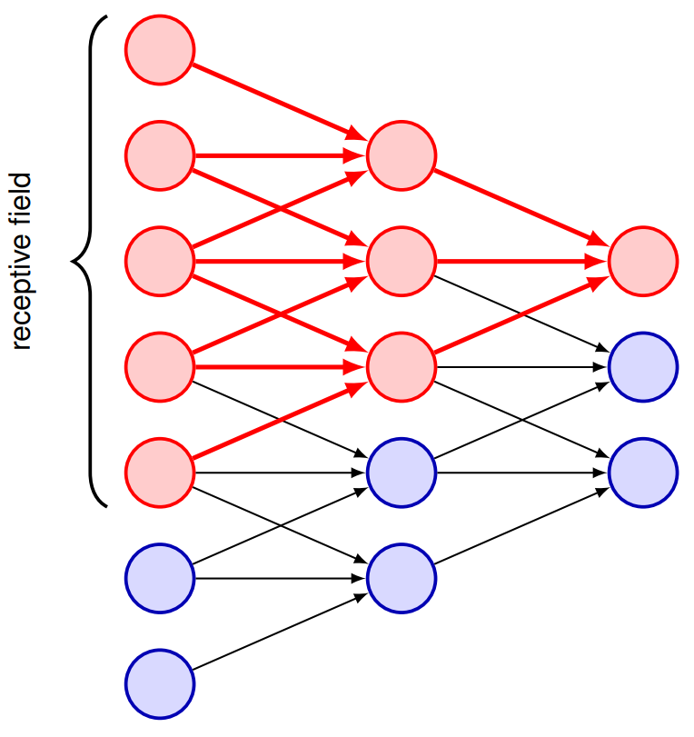
Multiple-layer convolution to increase range of locality
Effective receptive field grows with depth in a multilayer convolutional network. Increase by 2 each time we do deeper by 1 layer.

Slide 14
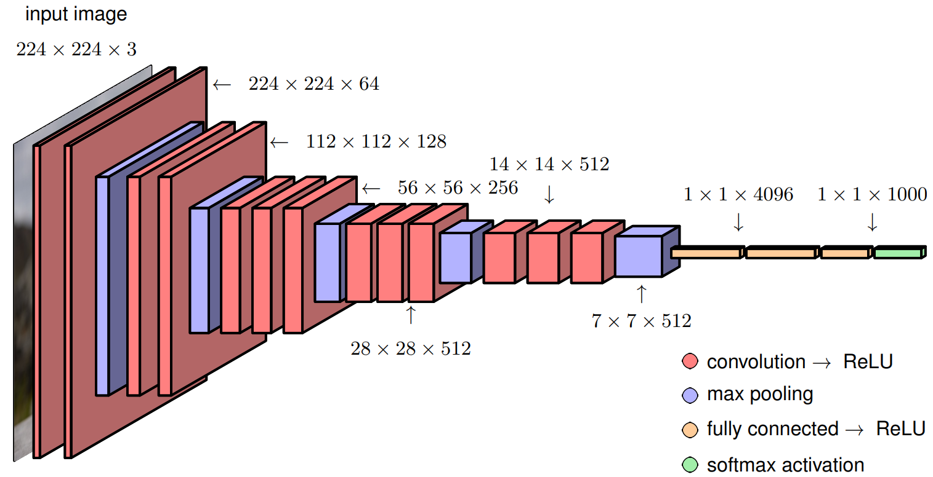
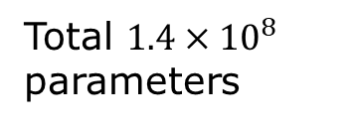
Typical CNN architecture, VGG-16
H: height
W: width
C: channel
H W C
Total $1.4×{10}^{8}$ parameters

Slide 15
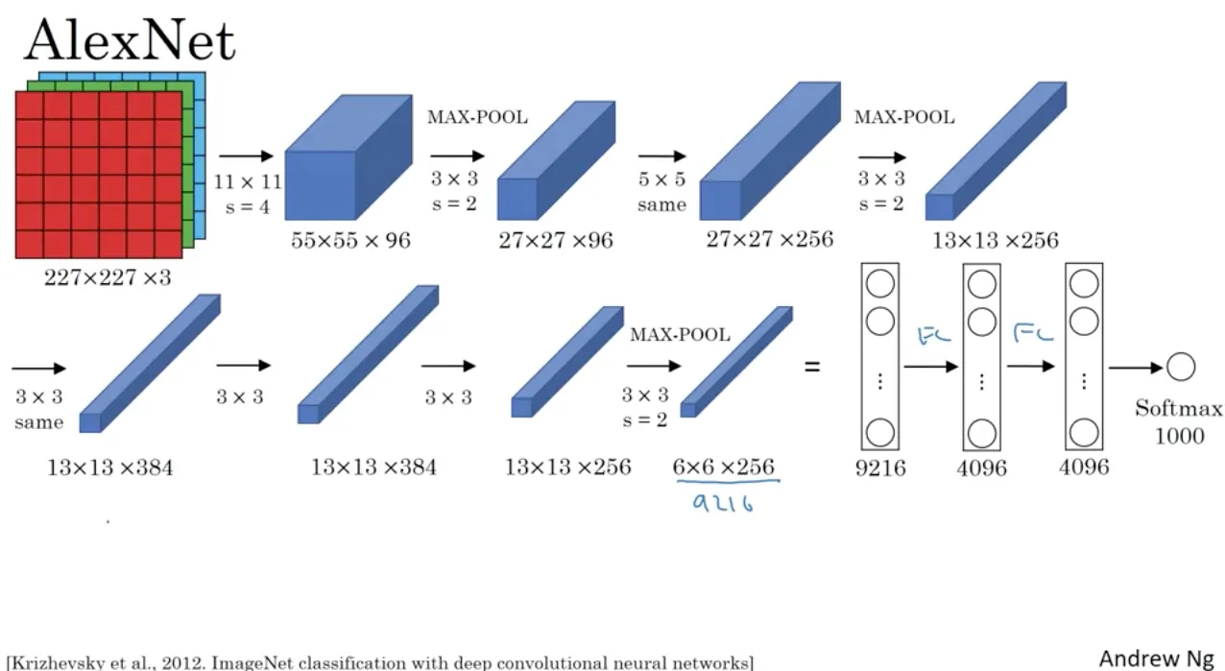
AlexNet and chatGPT
The moment we stopped understanding AI [AlexNet]
https://youtu.be/UZDiGooFs54

Slide 16
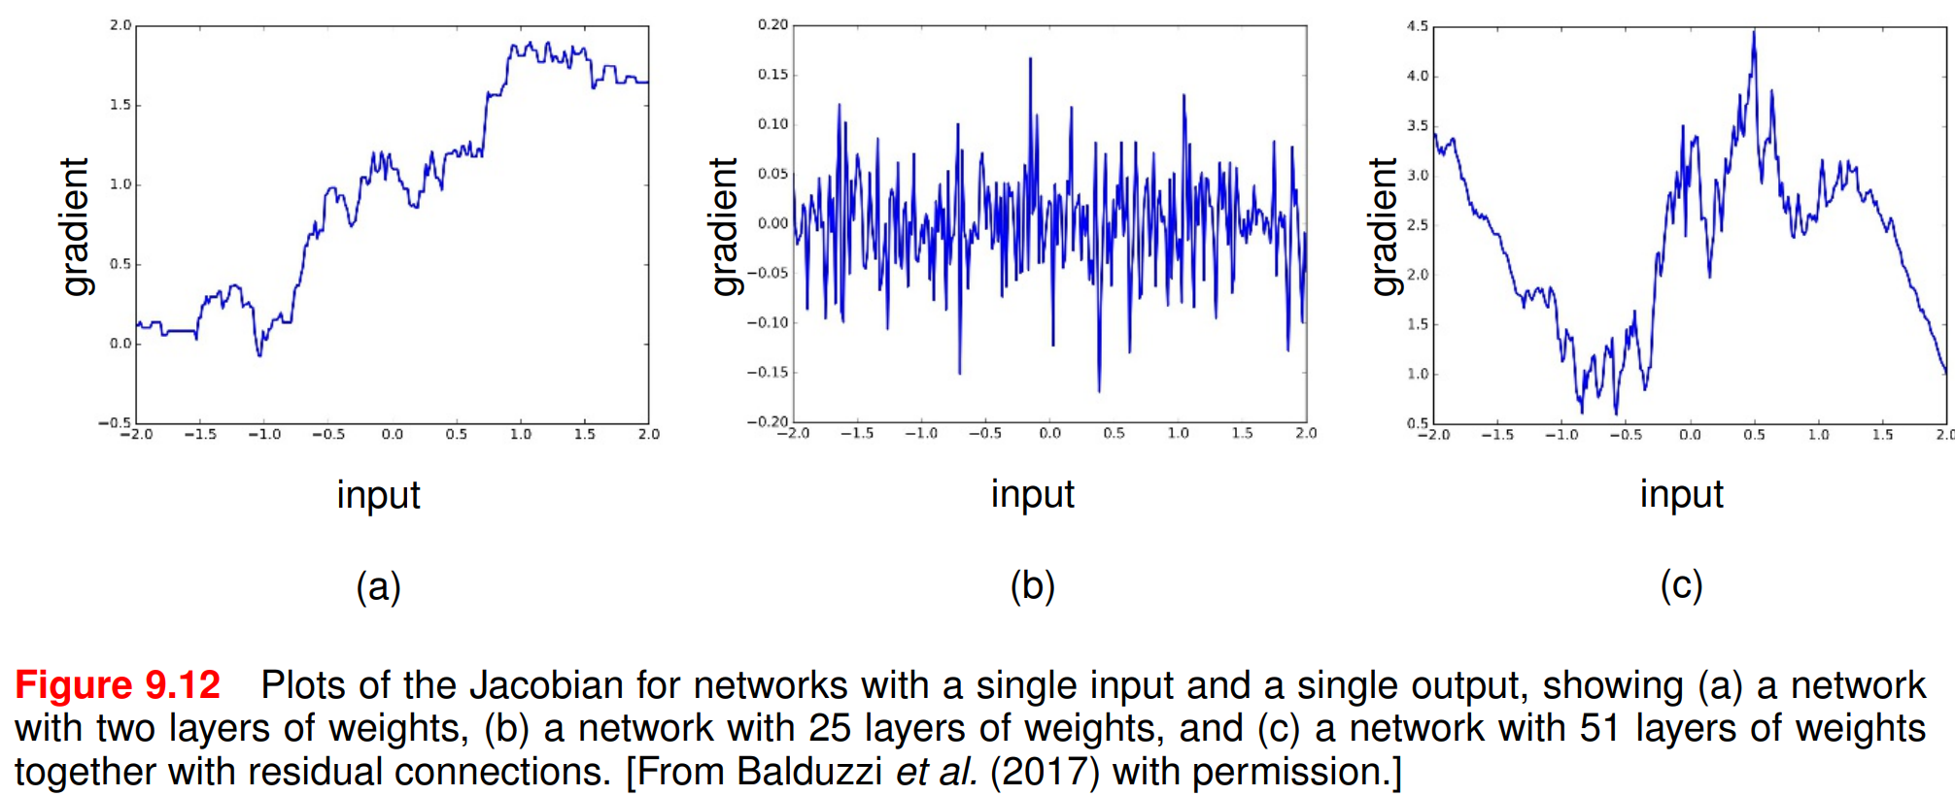
Problem with deep network
1) shattered gradients
2) vanishing or exploding gradients
From Bishop, “Deep Learning”, p. 274.

Slide 17
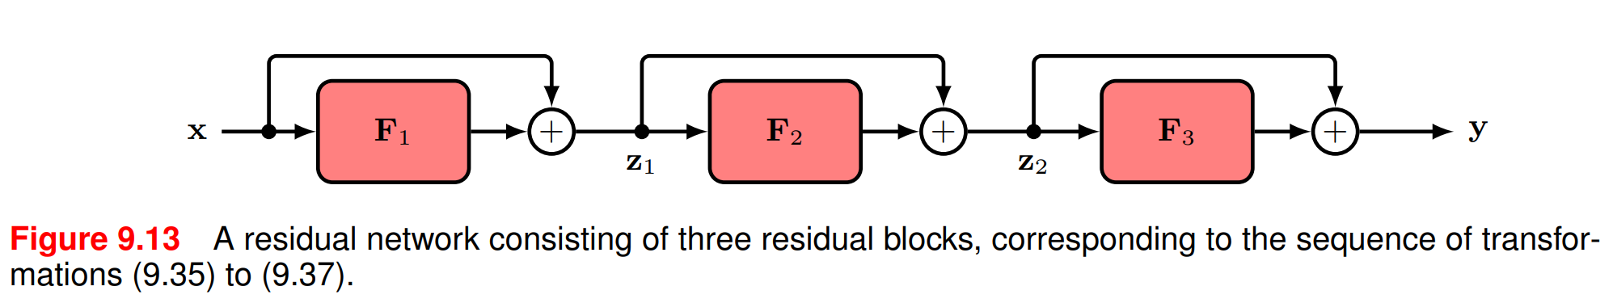

Residual connections
$$z_{1}=F_{1}\left(x\right)+x$$
$$z_{2}=F_{2}\left(z_{1}\right)+z_{1}$$
$$y=F_{3}\left(z_{2}\right)+z_{2}$$

Slide 18
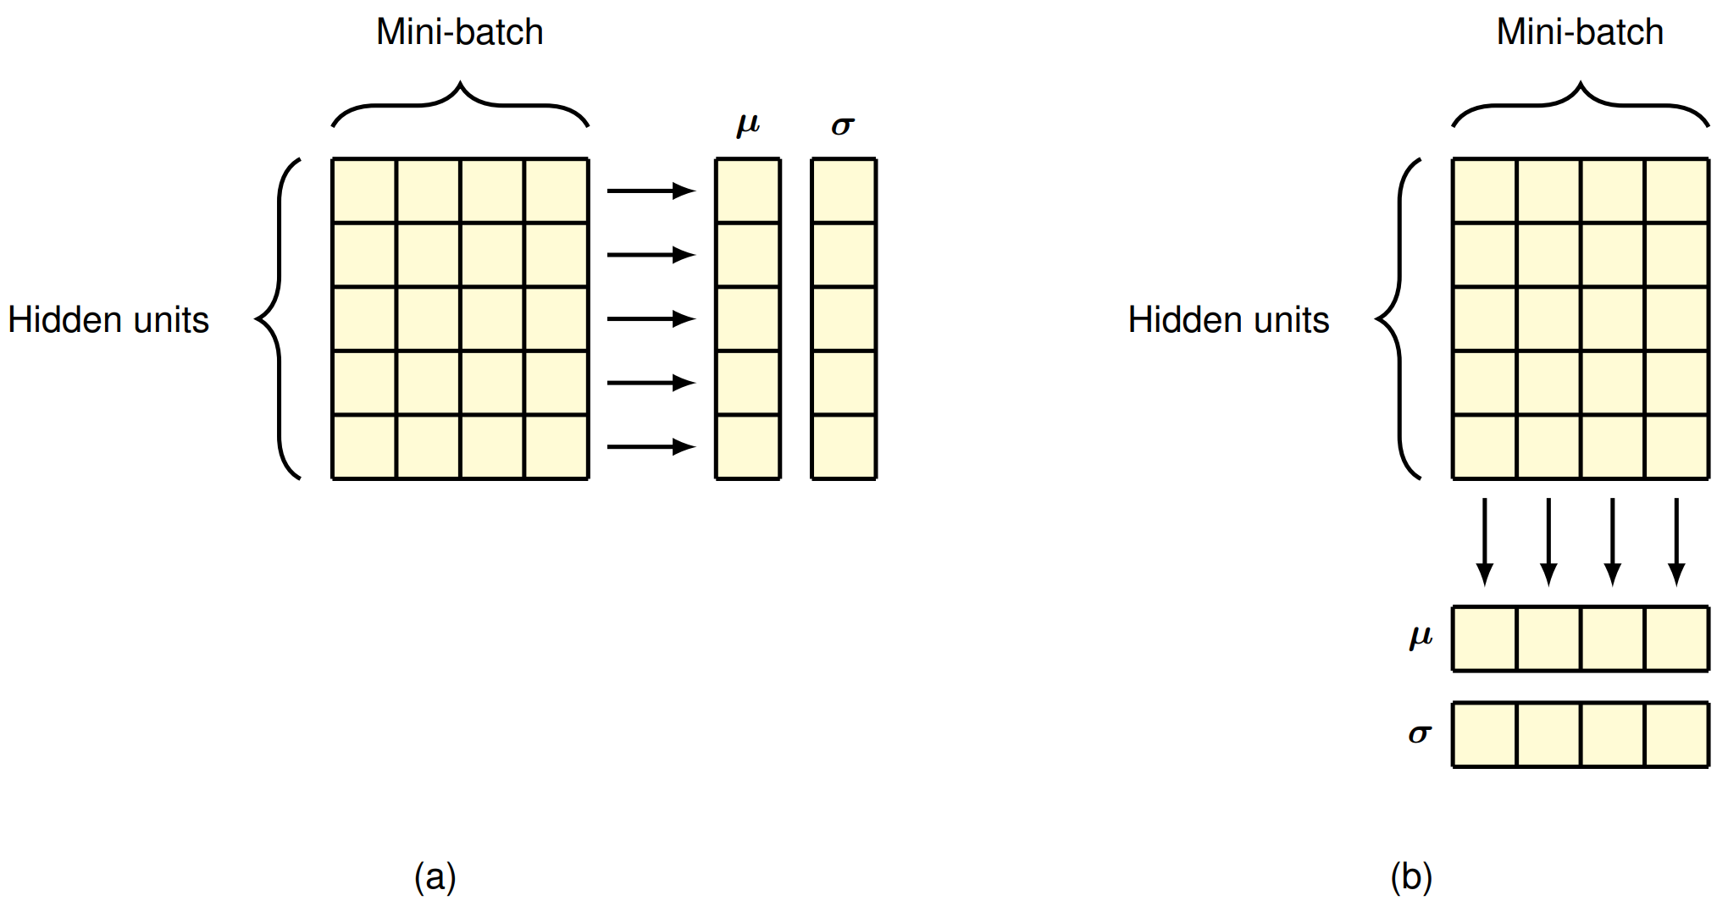
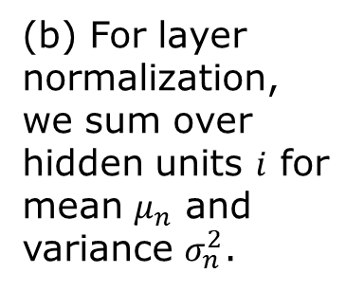


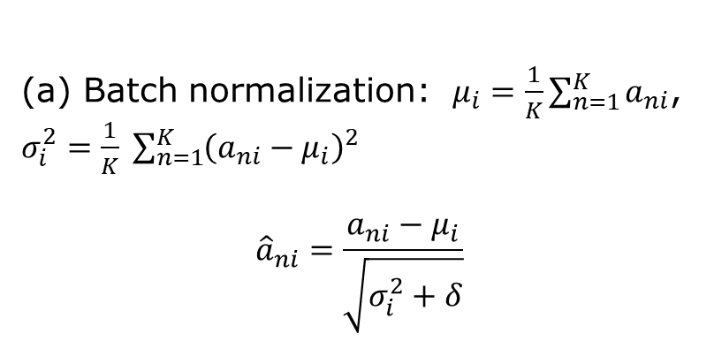


Batch normalization/Layer normalization
$$i$$
$$=X^{T}$$
$$n$$
$${\tilde{a}}_{ni}=γ_{i}{\hat{a}}_{ni}+β_{i}$$
(a) Batch normalization: $μ_{i}=\frac{1}{K}\sum_{n=1}^{K}{a_{ni}}$, $σ_{i}^{2}=\frac{1}{K} \sum_{n=1}^{K}{{\left(a_{ni}−μ_{i}\right)}^{2}}$
$${\hat{a}}_{ni}=\frac{a_{ni}−μ_{i}}{\sqrt{σ_{i}^{2}+δ}}$$
(b) For layer normalization, we sum over hidden units $i$ for mean $μ_{n}$ and variance $σ_{n}^{2}$.
Notes:
The matrix shown by the box is usually the preactivation in the form of X^T, the design matrix transposed.

