Slide 1
Week 8, Recurrent Neural Network

Slide 2
Handle sequence of data
Examples:
Time series such as music or stock market
Video
Natural language processing
etc

Slide 3
Recurrent neural network (RNN)
output output 1 output 2 output 3 …
unfold
Hidden layers
Hidden layers
Hidden layers
Hidden layers
Hidden layers
. . .
input input 1 input 2 input 3 …

Slide 4
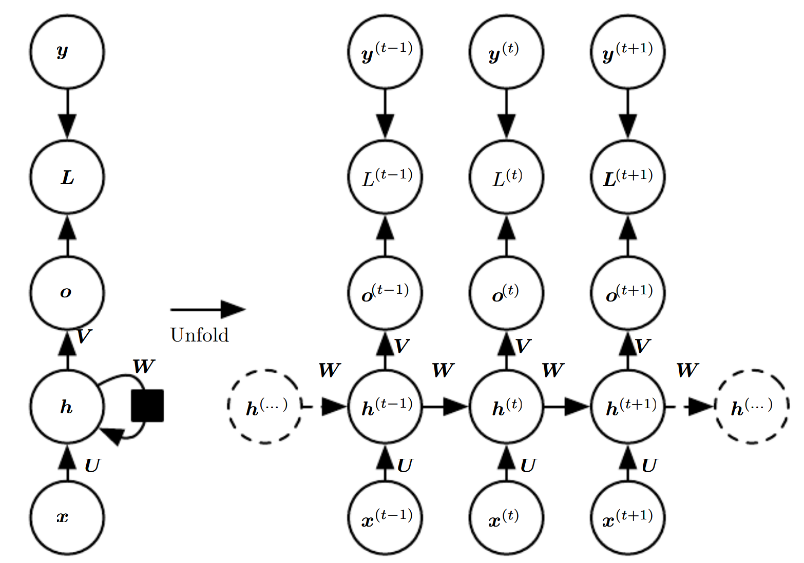
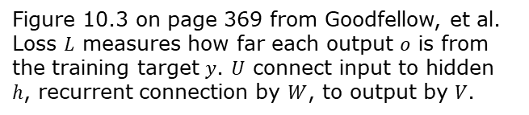
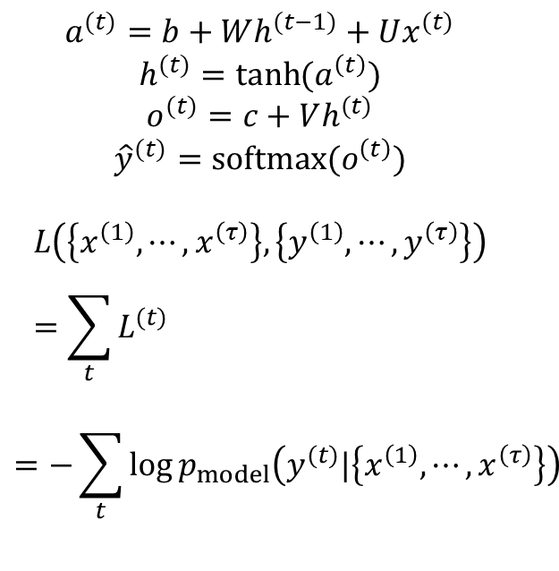
More concrete RNN and unfolding
$$a^{(t)}=b+Wh^{(t−1)}+Ux^{(t)}$$
$$h^{(t)}=\tanh{(a^{\left(t\right)})}$$
$$o^{(t)}=c+Vh^{(t)}$$
$${\hat{y}}^{(t)}=softmax(o^{\left(t\right)})$$
$$L\left(\left\{x^{\left(1\right)},⋯,x^{\left(τ\right)}\right\},\left\{y^{\left(1\right)},⋯,y^{\left(τ\right)}\right\}\right)=\sum_{t}{L^{(t)} }$$
$$=−\sum_{t}{\log{p_{model}\left(y^{(t)}|\left\{x^{\left(1\right)},⋯,x^{\left(τ\right)}\right\}\right)}}$$
Figure 10.3 on page 369 from Goodfellow, et al. Loss $L$ measures how far each output $o$ is from the training target $y$. $U$ connect input to hidden $h$, recurrent connection by $W$, to output by $V$.

Slide 5
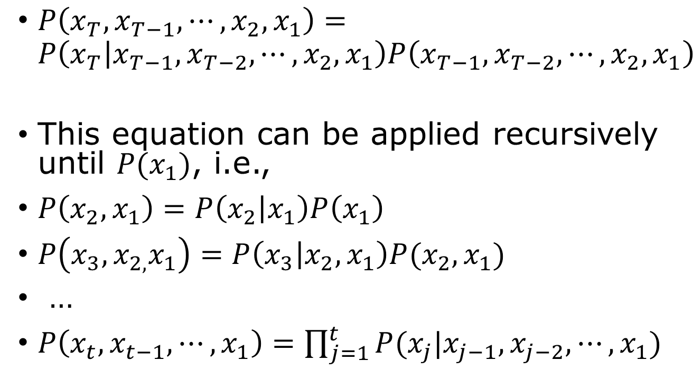
Using neural network models represent joint probabilities of sequences
$P\left(x_{T},x_{T−1},⋯,x_{2},x_{1}\right)=P\left(x_{T} | x_{T−1},x_{T−2},⋯,x_{2},x_{1}\right)P\left(x_{T−1},x_{T−2},⋯,x_{2},x_{1}\right)$
This equation can be applied recursively until $P(x_{1})$, i.e.,
$P\left(x_{2},x_{1}\right)=P\left(x_{2} | x_{1}\right)P\left(x_{1}\right)$
$P\left(x_{3},x_{2,}x_{1}\right)=P\left(x_{3} | x_{2},x_{1}\right)P(x_{2},x_{1})$
…
$P\left(x_{t},x_{t−1},⋯, x_{1}\right)=\prod_{j=1}^{t}{P(x_{j}|x_{j−1},x_{j−2},⋯,x_{1})}$

Slide 6





Markov process
Assuming the conditional probability only depends on the immediate past:
$P\left(x_{t} | x_{t−1},x_{t−2},⋯, x_{1}\right)=P(x_{t}|x_{t−1})$
$${ x}_{1}$$
$${ x}_{2}$$
$${ x}_{3}$$
$${ x}_{4}$$
?

Slide 7
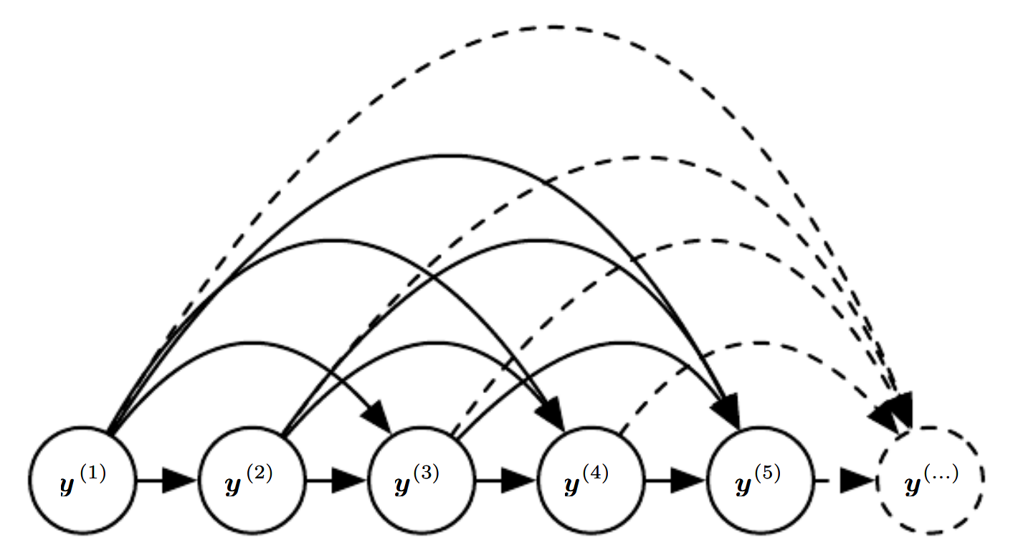
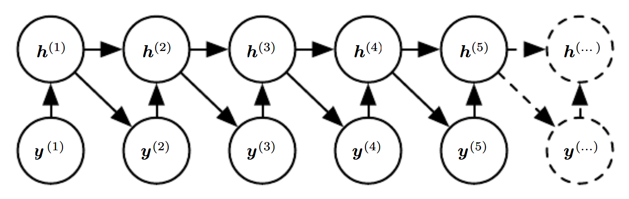
Fully connected model vs hidden Markov chain
If all connections are represented, it is very inefficient due to exponentially growing parameters.
RNN obtains the same functionality efficiently with hidden states.
Figures 10.7 & 10.8 of Goodfellow et al.

Slide 8
Compute gradient in RNN

Slide 9
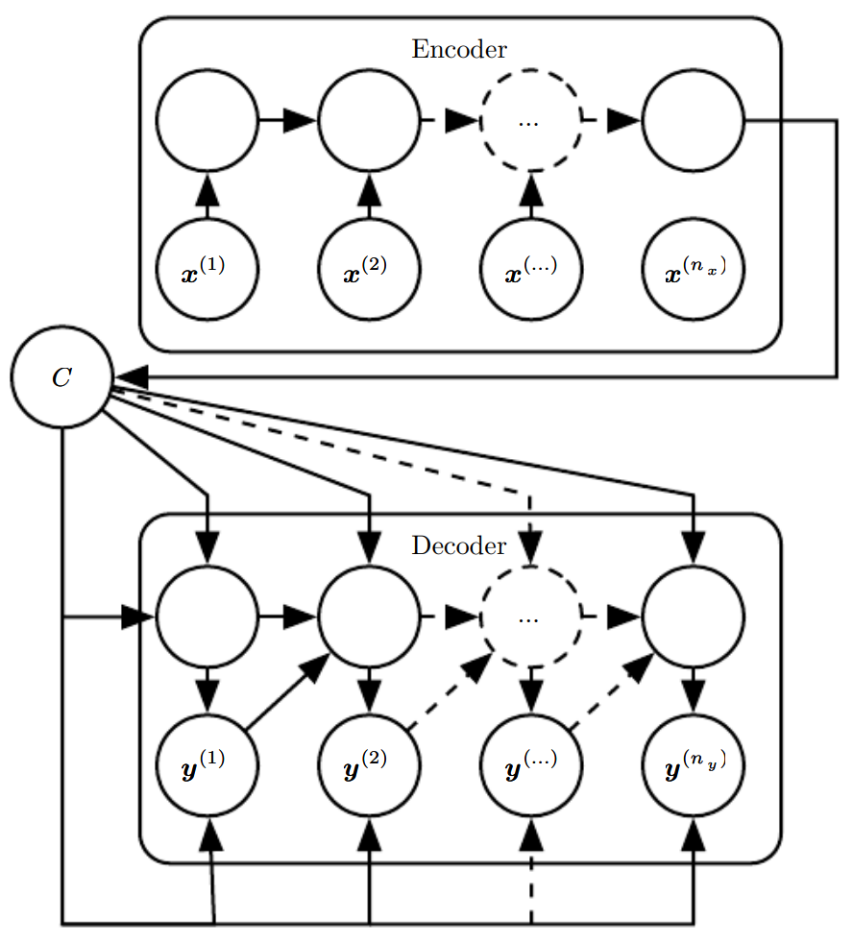
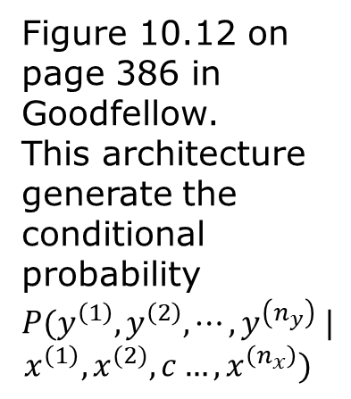
Encode-decoder sequence-to-sequence architecture
Figure 10.12 on page 386 in Goodfellow. This architecture generate the conditional probability $P(y^{\left(1\right)},y^{\left(2\right)},⋯,y^{\left(n_{y}\right)} |$
$$x^{\left(1\right)},x^{(2)},c…, x^{\left(n_{x}\right)})$$

Slide 10
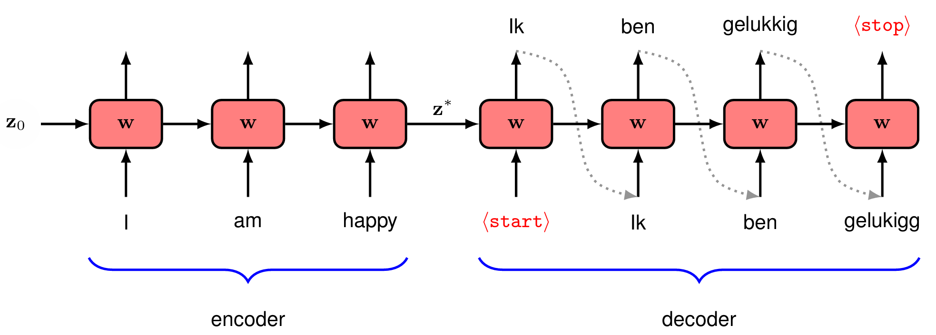
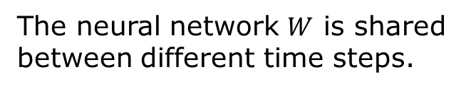
Machine translation using RNN
Fig. 12.14 from Bishop, “Deep learning.”
The neural network $W$ is shared between different time steps.

Slide 11
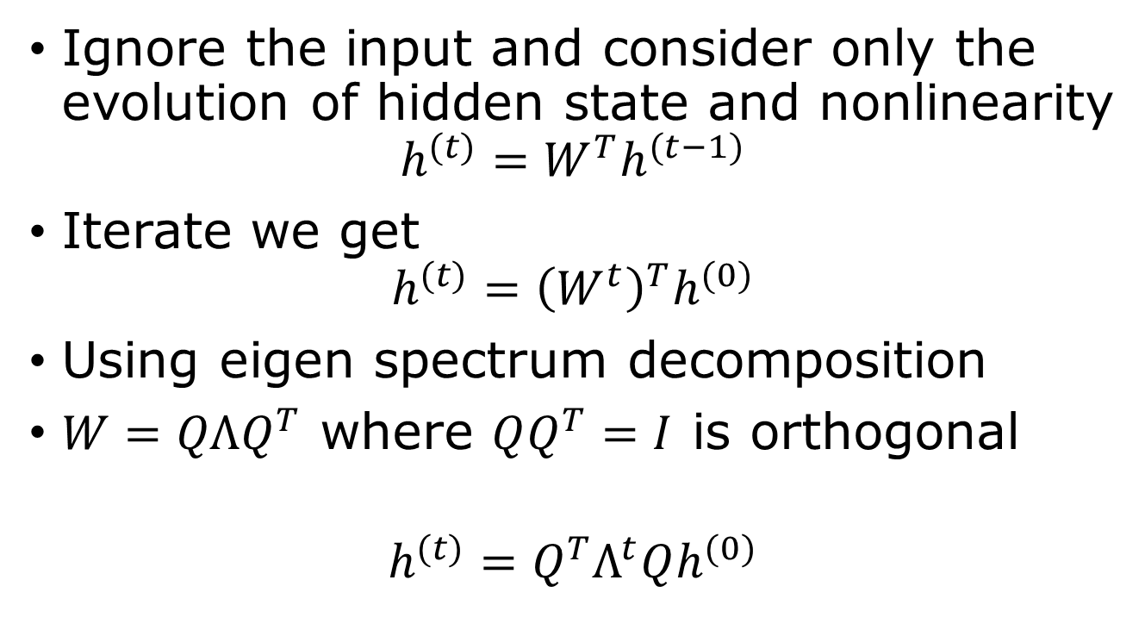
Vanishing or diverging gradient problem in RNN
Ignore the input and consider only the evolution of hidden state and nonlinearity
$$h^{(t)}=W^{T}h^{(t−1)}$$
Iterate we get
$$h^{(t)}={\left(W^{t}\right)}^{T}h^{(0)}$$
Using eigen spectrum decomposition
$W=QΛQ^{T}$ where $QQ^{T}=I$ is orthogonal
$$h^{(t)}=Q^{T}Λ^{t}Qh^{(0)}$$

Slide 12
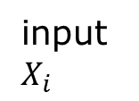
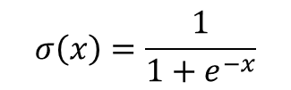


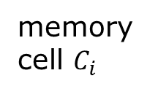

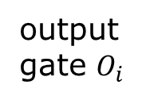

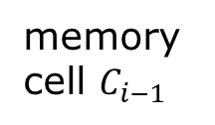

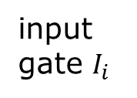
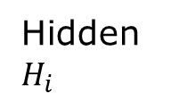

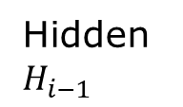
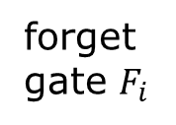
Long-short-term memory (LSTM)
memory cell $C_{i−1}$
memory cell $C_{i}$
*
+
$$tanh$$
input gate $I_{i}$
forget gate $F_{i}$
*
$$\tilde{C_{i}}$$
*
$$σ$$
$$σ$$
$$tanh$$
$$σ$$
Hidden $H_{i−1}$
Hidden $H_{i}$
output gate $O_{i}$
input $X_{i}$
$$σ\left(x\right)=\frac{1}{1+e^{−x}}$$
Notes:
See https://colah.github.io/posts/2015-08-Understanding-LSTMs/ for a nice explanation.

Slide 13
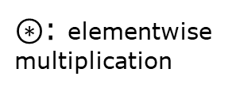
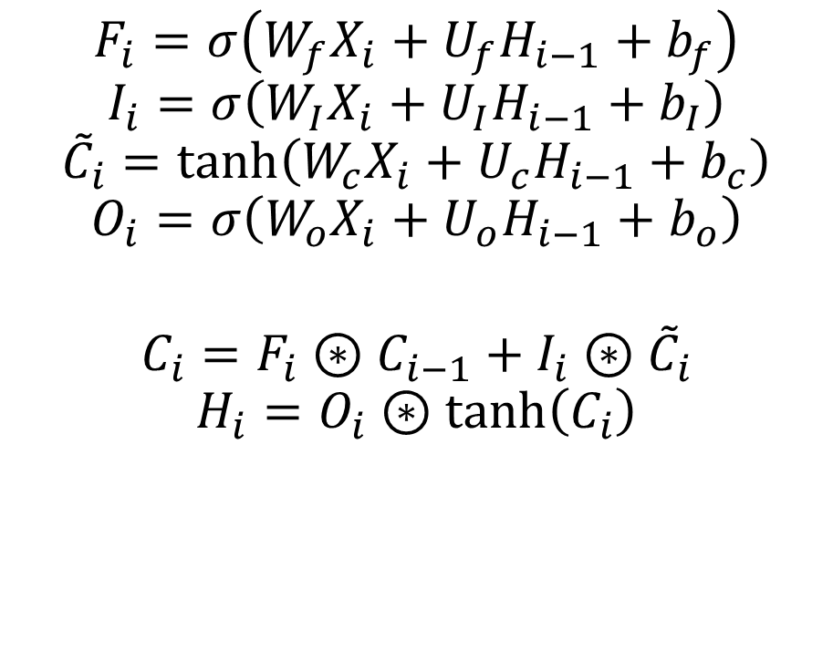
Formulas corresponding the LSTM diagram
$$F_{i}=σ\left(W_{f}X_{i}+U_{f}H_{i−1}+b_{f}\right)$$
$$I_{i}=σ\left(W_{I}X_{i}+U_{I}H_{i−1}+b_{I}\right)$$
$${\tilde{C}}_{i}=\tanh\left(W_{c}X_{i}+U_{c}H_{i−1}+b_{c}\right)$$
$$O_{i}=σ\left(W_{o}X_{i}+U_{o}H_{i−1}+b_{o}\right)$$
$$C_{i}=F_{i}⊛C_{i−1}+I_{i}⊛{\tilde{C}}_{i}$$
$$H_{i}=O_{i}⊛\tanh\left(C_{i}\right)$$
$⊛$: elementwise multiplication

