Slide 1
Welcome to this experiment

Slide 2
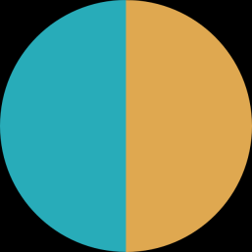
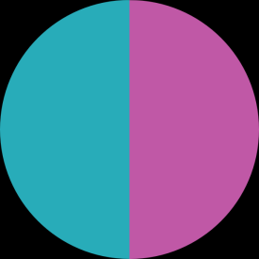
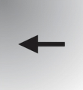
What is going to happen
1) You will see many stimuli like this one:
2) You will have to chose one color with the left and right arrows of the keyboard.
You will see another stimulus appearing on the screen. For example, this one:
3) You will again have to choose one color.
4, 5, 6, 7, 8,etc…) You will continue to see stimuli appearing on the screen and you will continue to select one color each time.
Back
Next

Slide 3
What is going to happen
You will receive more information soon, but first, you must be familiar with the basics.
Continue to perform your first trials.
Back
Next

Slide 4
Ok, let’s make a first pause here.
The principle of this experiment is that the stream of stimuli is determined by specific rules.
I/ Sometimes, your choice (i.e., the color you select) determine the next pair of color you will see. A rule like this one maybe something like: « blue selected » => « blue & yellow » in the next trial »
Here, you are the actor because your actions control the stream
II/ Sometimes, the pair of colors you see determine the next pair of color you will see. A rule like this one might be something like:
« blue & magenta » => « blue & yellow » in the next trial.
Here, you are the spectator because your actions do not control the stream
Back
next

Slide 5



Look theses 4 rules and think.
Which rules are rules the actor? For the spectator?
A
B
C
D
Back
Answer

Slide 6
Here are the answer. Make sure you understand the difference!
A & B = Actor
C & D = Actor
A
B
C
D
Back
Answer

Slide 7
First, let see whether you can detect if you have control or not.
You will play several sequences like this one:
Series + question « do you think you are the actor/spectator »,
Series + question « do you think you are the actor/spectator », etc..
It will last about 5-10 minutes. In some periods, you will be the actor, in some periods, you will be the spectator.
Your goal: try to know whether you are the actor or the spectator, in order to give as much correct answers as possible!
Back
Start

Slide 8
Ok!
Hopefully, you could « feel » the difference between periods in which you were the actor and periods in which you were the spectator.
Now, the rules will remain similar to those you’ve experienced just before, but your goal will be a bit different.
After each series of 8 trials, you will have to make predictions about the next pair of colors you may see, instead of telling directly wihether you are spectator or actor.
Back
Next

Slide 9
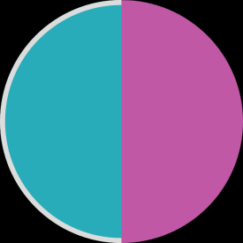
So, when you see these special screens, you should try to guess the next pair, as if you had chosen the color behind the « ? ».
You have to make a prediction for each color.
Now, think for yourself!
What should you do if you are the actor? Same or different responses?
What should you do if you are the spectator? Same or different ?
Next?
Next?
?
?
Back
Answers

Slide 10
So, when you see these special screens, you should try to guess the next pair, as if you had chosen the color behind the « ? ».
if you think you are the spectator, you should make the same prediction for and . You have no control so the consequence is the same whatever the color you chose!
if you think you are the actor, you should make different predictions for and . You have control so different actions = different consequences!
Next?
Next?
?
?
Back
Next

Slide 11
Ok, let’s pratice 3 times, with new colors.
Back
Next

Slide 12
Ok, so now, you’re finally ready for block 1.
Learn the rule!
(the block will stop when you give 4 correct answers in a row)
Back
Begin

Slide 13
Block 2
Learn the rule!
(the block will stop when you give 4 correct answers in a row)
Back
Begin

Slide 14
Block 3
Learn the rule!
(the block will stop when you give 4 correct answers in a row)
Back
Begin

Slide 15
Block 4
Learn the rule!
(the block will stop when you give 4 correct answers in a row)
Back
Begin

