Slide 1
Working memory task
In this experiment, you will see numbers appearing one by one on the screen.
Depending on the instructions given at the beginning of each block, your goal will be slightly different, but you will always have to:
« keep in mind » some of the numbers previously shown
decide whether you should press the space bar or just wait the next number without pressing any button.
Continue to see the 4 possible instructions.
Next

Slide 2
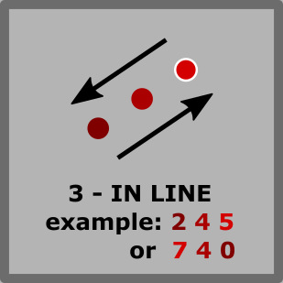
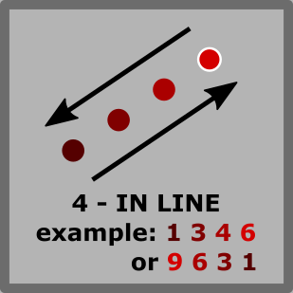
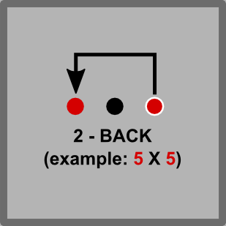
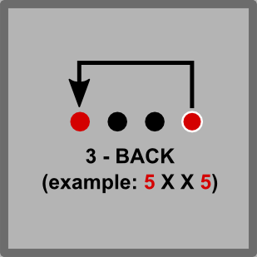
Working memory task
Before each block, you will see one of these symbols, telling you what to do.
If you see this symbol, it means that you should only press the space bar when you have seen 3 numbers strictly increasing or decreasing in a row.
Ex: if you see 2, 5 and 7, you should press when 7 appears.
If you see this symbol, same as above, except that you press the space bar only when you have seen 4 numbers strictly increasing or decreasing in a row.
Ex: if you see 1, 3, 4, and 6, you press when 6 appears.
If you see this symbol, it means that you should only press the space bar if the number you see is the same than 2 numbers before.
Ex: if you see 4, 3 and 4, you press the space bar when the second 4 appears.
If you see this symbol, same as above, except that you press the space bar only if the number you see is the same as 3 numbers before.
Ex: if you see 5, 3, 7 and 5, you press the space bar when the second 5 appears.
Next

Slide 3
Working memory task
Ok, before we start, let’s train a little with the less difficult conditions:
Important remarks :
On each trial, you can answer as long as the next number is not on the screen, but be fast if you can.
This task can be difficult, don’t blame yourself if you find it hard ☺.
Start the 2 minutes training

Slide 4
Working memory task
Training is done! It is perfectly normal if you have done errors (false alarms or misses), don’t worry.
Now you will do the real task itself. It will last around 12 minutes.
There 8 blocks of 1min30s. In each block, you will play in one of the 4 conditions:
The experiment will not give you feedback anymore (i.e. good/false alarm/miss) : it’s normal!
Easy
Difficult
Easy
Difficult
Start

