Slide 1
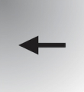
First, we are going to calibrate the eye-tracker.
You will now see white squares appearing on the screen.
Please fixate them as long as they are displayed without blinking.
Blink when they disappear.
Thank you
Calibration 1

Slide 2
You will now see the screen becoming white or black, alternatively.
Please fixate the screen without blinking.
Blink each time the screen return to gray.
Thank you
Calibration 2

