Slide 1
WORK 3 / COMPUTER ATTACKS
Padding Oracle Attack
One valid-padding bit is enough to read and rewrite encrypted state.
72
6F
6C
65
3D
75
73
65
72
CBC ciphertext block / 16 bytes
zhuhe · HDU 23320116 · 20 October 2026
REPORT + PUBLIC PRESENTATION
Notes:
Good morning. I chose the padding oracle attack because it turns a small error-handling difference into both plaintext disclosure and ciphertext forgery. The key never has to be recovered. The report models the exploit as a directed graph from an idle system to three loss states. I will cover the mechanism, the local demonstration, the graph, and the controls that break it.

Slide 2
Encryption without integrity
CBC hides the plaintext. It does not prove that the ciphertext was created by the server.
CONFIDENTIALITY
INTEGRITY
AUTHORITY
AES-CBC protects the bytes from being read directly.
No MAC or tag detects a changed predecessor block.
The server decrypts and trusts the resulting role.
The cipher is not broken. The construction is.
02
Notes:
CBC supplies confidentiality, not authenticity. If the application accepts a modified ciphertext, the change flows straight into the decrypted state. The third box is the critical design mistake: the plaintext becomes authority without a separate integrity decision.

Slide 3
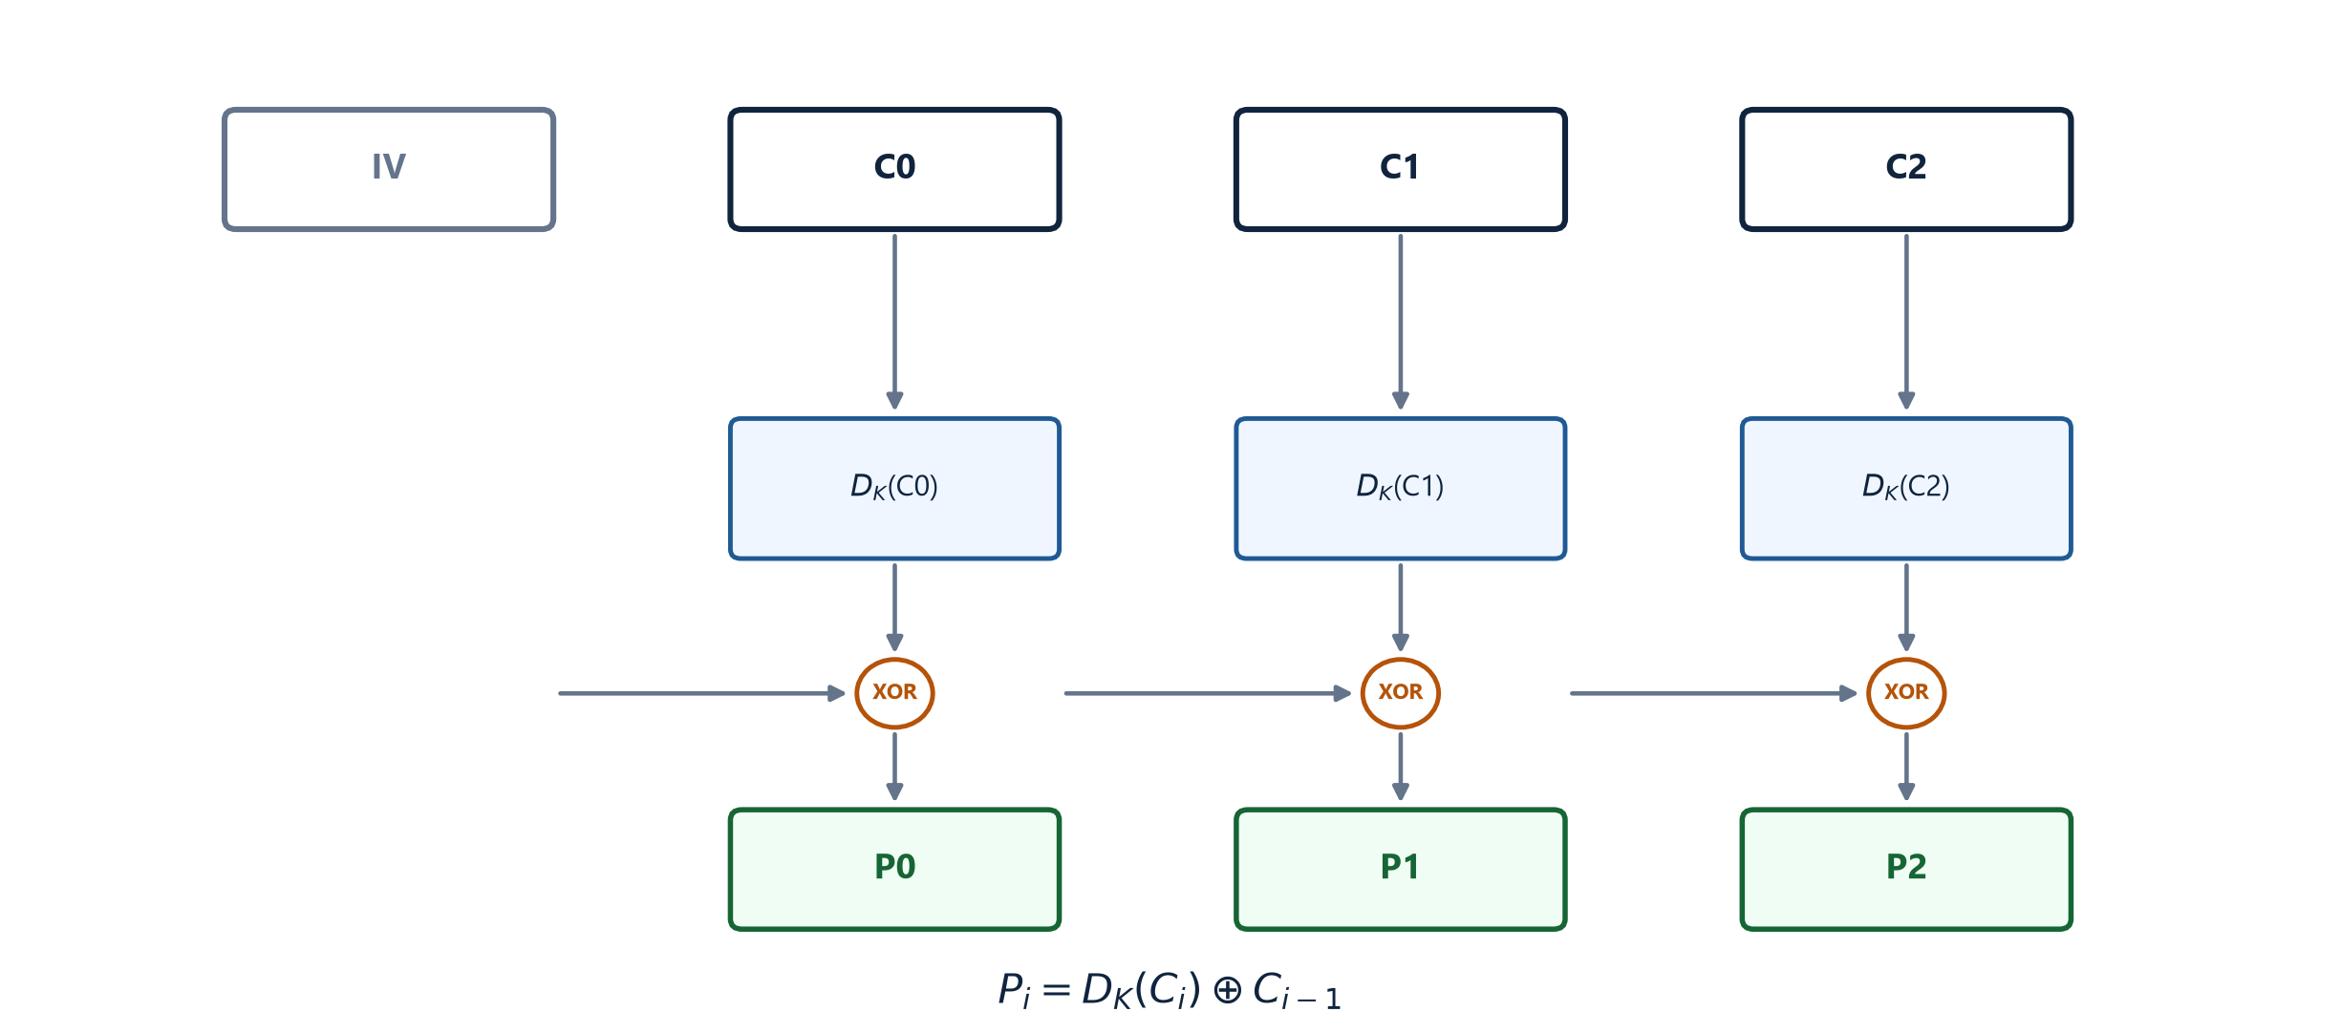
How CBC decryption chains
The attacker controls the previous block. The key stays secret.
03
Notes:
CBC decryption gives P-i equals D-K of C-i xor the previous ciphertext block. For the first block, the previous value is the IV. The attacker does not need D-K; changing the preceding block changes the plaintext in a predictable way.

Slide 4
The padding oracle
A modified predecessor block produces one of two observable outcomes.
MODIFIED CIPHERTEXT
PADDING CHECK
OBSERVABLE RESULT
C' || C
valid / invalid
one bit
The channel can be a message, status code, redirect, response length, or timing.
PKCS#7: 01 · 02 02 · 03 03 03 · ... · 10 × 16
The application reveals which branch was taken.
04
Notes:
PKCS-seven padding must end in a consistent pattern. The server only needs to reveal whether the pattern was valid. That can be an explicit error, a different status, a redirect, response length, or timing. The exact channel matters less than the reliable distinction.

Slide 5
Recover one byte
MODIFIED PREDECESSOR C'
01
g
I[15] = g xor 0x01
UNCHANGED TARGET C_i
02 02
I[14] = g xor 0x02
03 03 03
The last plaintext byte must become 01.
I[13] = g xor 0x03
Repeat for all 16 positions.
P[i] = I[i] xor C[i-1]
≤ 256 guesses / byte
4,713 requests recovered two blocks in the lab.
05
Notes:
For each position, try candidate bytes until the block ends in the desired padding. The successful guess reveals the intermediate byte, not the key. Set the next target to two bytes of 02, then three bytes of 03, and repeat. The demonstration used 4,713 requests for two blocks, consistent with the expected random search cost.

Slide 6
Forge the first block
ORIGINAL
role=user;uid=10
HTTP 200
TARGET
role=root
role=root;uid=10
admin console
The application authorizes the altered state.
IV* = I[0] xor P*[0]
Keep every ciphertext block unchanged.
Changing an inner block also corrupts its predecessor - a real attack constraint.
06
Notes:
Once the intermediate value is known, a new predecessor produces chosen plaintext. The demonstration targets the first block through the IV, so later plaintext remains intact. Changing an inner block would also corrupt the previous plaintext block, a constraint a real exploit has to handle.

Slide 7
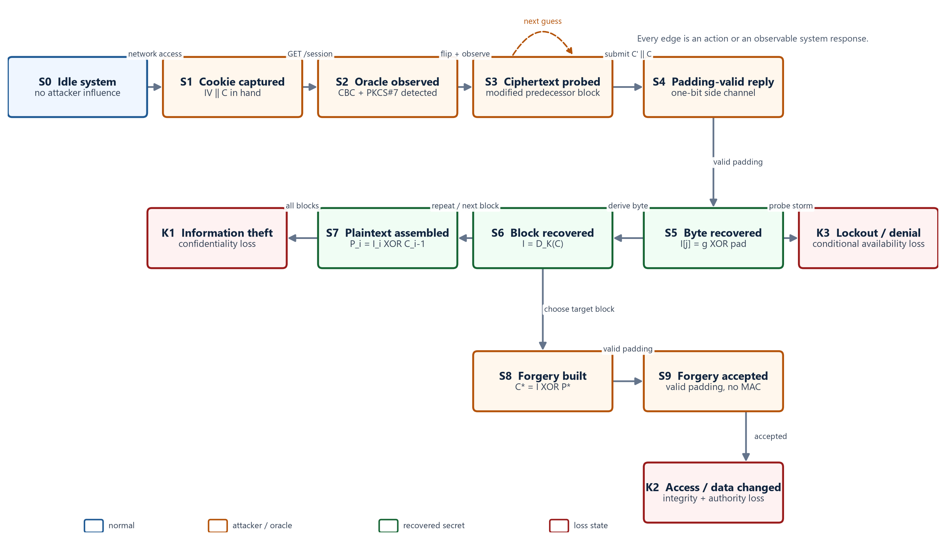
Attack graph
S0 → K1 / K2 / K3
07
Notes:
This is the main model. S0 is the idle system. The attacker captures a cookie, detects the oracle, and enters the probing loop at S3. A successful response reveals one byte; sixteen bytes recover a block. The upper path assembles plaintext and reaches K1. The lower path builds a forged predecessor, gets it accepted, and reaches K2. K3 is conditional: high-volume probing can trigger lockout or resource pressure, but the graph does not claim that every attack reaches denial of service.

Slide 8
Observed result
Synthetic localhost session / no real user data
RECOVERED
role=user;uid=1001;ok=1
2
CBC blocks recovered
FORGED BLOCK
role=root;uid=10
4,713
oracle queries
RESPONSE
HTTP 200 · role=root · admin console
0
key bytes
The forgery changes state without decrypting or re-encrypting the remaining blocks.
08
Notes:
The run recovered the complete synthetic session and then changed only the first block. Before the forgery the response was a user dashboard. After the new IV, the same service returned role equals root and the admin console. Zero key bytes were recovered; the attack abuses predictions and validity, not key recovery.

Slide 9
Root cause
The failure is a chain of three missing controls.
01
02
03
Ciphertext is modifiable
Padding is observable
Plaintext becomes authority
The client controls the IV and encrypted state.
The server separates invalid padding from other failures.
The role is parsed and accepted without integrity verification.
CWE-353 · Missing Support for Integrity Check
AES is not the failing component.
09
Notes:
The root cause is not a weak block cipher. The client can modify ciphertext, the application exposes padding validity, and the decrypted role is treated as authority. CWE-353 captures the missing integrity check. The parser is on the attack surface because only one valid-padding bit is needed.

Slide 10
Three terminal losses
STATE | LOSS | EVIDENCE
K1 | Information theft | The complete plaintext is recovered without the key.
K2 | Modification or unauthorized access | The role is forged from user to root and accepted.
K3 | Denial of service or access | Conditional: probing may trigger lockout or resource pressure.
K1 and K2 are demonstrated. K3 remains in the graph because the query loop can change availability, not because every target will experience it.
10
Notes:
The graph has three terminal loss classes. K1 is information theft. K2 is modification and unauthorized access, demonstrated by the role change. K3 is conditional availability loss. Keeping the difference explicit makes the model defensible and prevents overclaiming.

Slide 11
Countermeasures
Break the oracle edge, then remove the trust decision.
LAYER | CONTROL | EFFECT
Primary | AES-GCM or ChaCha20-Poly1305; verify the tag before parsing. | Modification becomes a hard authentication failure.
Compatibility | If CBC must stay: Encrypt-then-MAC with constant-time comparison. | Forged predecessors are rejected before the padding check.
Behavior | One generic failure path; avoid secret-dependent branches and timing. | The valid-padding distinction is no longer observable.
Operations | Rate limits, alerting, key rotation, and tamper regression tests. | Probing is contained and old captured tokens are invalidated.
verify_tag → decrypt → validate → parse
11
Notes:
The primary fix is authenticated encryption with the tag checked before any parsing. If CBC must remain, use Encrypt-then-MAC and compare in constant time. Uniform failures shrink the side channel, while rate limits and key rotation reduce the practical value of probing and previously captured cookies.

Slide 12
Authenticate before parsing
Three rules close the demonstrated path.
01
Verify authenticity before decrypting.
The attack did not break AES.
02
Never expose a padding-validity distinction.
It broke the system's decision to trust unauthenticated state.
03
Treat decrypted state as untrusted until revalidated.
Sources: Vaudenay 2002 · NVD CVE-2010-3332 · NVD CVE-2014-3566 · OWASP Cryptographic Storage Cheat Sheet
12
Notes:
To close, the attack did not break AES. It broke the system's trust decision. Verify authenticity first, never expose padding validity, and treat decrypted state as untrusted. The graph turns those principles into testable controls: remove the oracle edge, and reject the forged state before it becomes authority.

