Slide 1
MediNova-AI
A Unified AI-Powered Medical Diagnosis Platform
Three specialised AI systems — dermatology vision, radiology vision, and a bilingual clinical LLM — fused into one intelligent medical assistant.

Slide 2
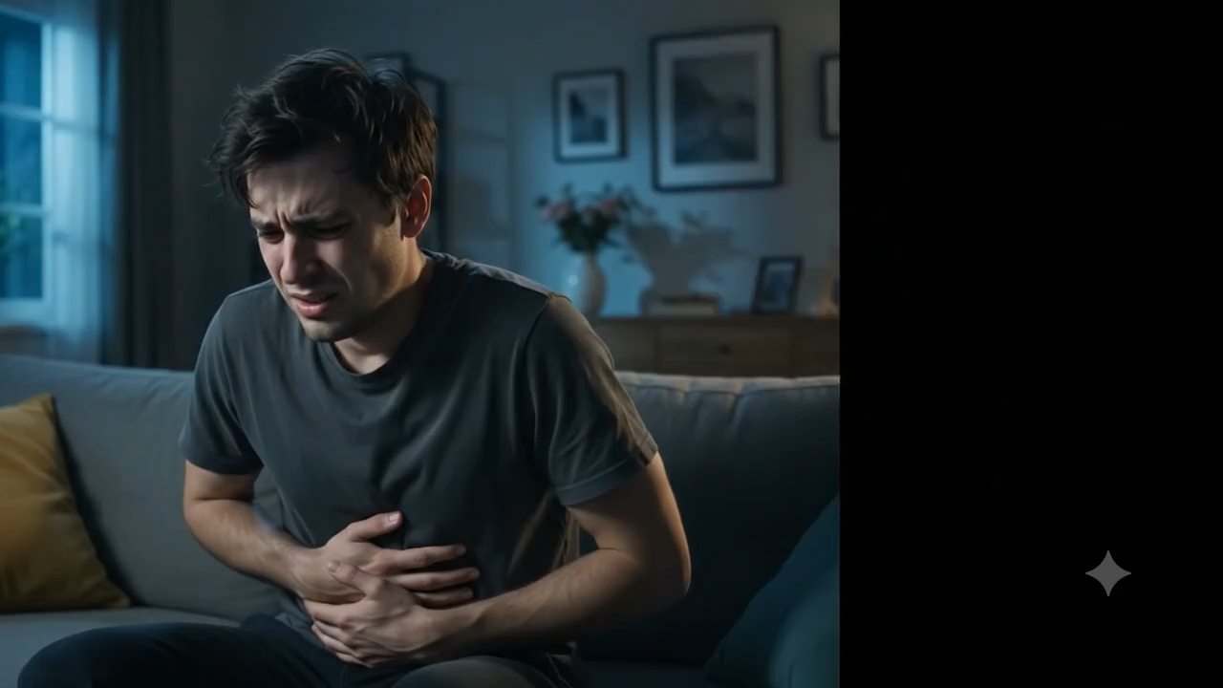

Slide 3
THE PEOPLE BEHIND IT
Project Team
⭐
LEADER
💻
🔬
Fady Yousef
Salma Samak
Rokia Hassan
⚙️
📊
🧠
Fares Waleed
Alaa Abdelhakeem
Afnan Magdy
MediNova-AI
02

Slide 4
WHY WE BUILT THIS
Project Motivation
Healthcare needs faster, more consistent, and more accessible first-line diagnostic support.
🌍
Global Shortage of Specialists
📈
Rising Diagnostic Workload
Dermatologists and radiologists are unevenly distributed — many communities wait weeks for a first read.
Imaging volumes keep growing faster than the clinical workforce that reviews them.
🗣️
Fragmented Patient Communication
🤖
Maturing AI Toolkit
Patients often need a clear, bilingual explanation of a finding, not just a raw prediction.
Transfer learning, PEFT/LoRA and instruction-tuned LLMs now make specialised, low-cost medical AI practical to build.
MediNova-AI
03

Slide 5
OUR DIFFERENTIATOR
Why MediNova-AI
One platform, three specialised models, a single bilingual clinical voice.
🔗
Unified, Not Siloed
🧠
Clinically-Aware Reasoning
Dermatology, radiology and clinical reasoning share one orchestration layer instead of separate apps.
A LangGraph multi-agent system routes cases through triage, semantic validation and emergency escalation.
🌐
Bilingual by Design
⚡
Efficient Fine-Tuning
Every structured report is generated in both English and Arabic for the patient and the clinician.
LoRA / PEFT and 4-bit quantisation keep every model small enough to fine-tune and serve on a single GPU.
MediNova-AI
06

Slide 6
WHAT WE SET OUT TO DO
Project Objectives
1
Build three clinically-grounded AI systems
Skin lesion vision, chest X-ray vision, and a medical-domain conversational LLM.
2
Reach clinical-grade accuracy
Target ≥95% headline accuracy on vision tasks and a near-zero hallucination rate on generated reports.
3
Keep training efficient & reproducible
Use PEFT/LoRA, patient-level splits and fixed seeds so every result can be reproduced on a single GPU.
4
Orchestrate, don't just predict
Route every case through a multi-agent reasoning layer that can escalate emergencies in real time.
5
Ship something deployable
Expose the whole pipeline behind a FastAPI service producing bilingual, structured clinical reports.
MediNova-AI
07

Slide 7
Skin Cancer model
Model Architecture: Custom Convolutional Neural Network (CNN)
Framework: TensorFlow Dataset: ISIC Dataset (25,000 dermoscopic images) Input: 28 × 28 RGB dermoscopic images
Accuracy: 96.2%
Classification Classes (8):
AK (Actinic Keratosis)
BCC (Basal Cell Carcinoma)
BKL (Benign Keratosis)
DF (Dermatofibroma)
MEL (Melanoma)
NV (Melanocytic Nevus)
SCC (Squamous Cell Carcinoma)
VASC (Vascular Lesion)
Training Challenges:
Class imbalance
Overfitting
Lighting variation in dermoscopic images
MediNova-AI
07

Slide 8
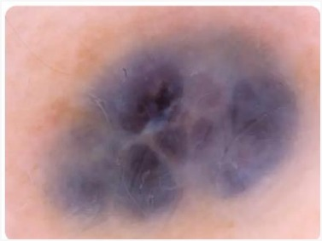
Sample of Skin Cancer dataset
MediNova-AI
07

Slide 9
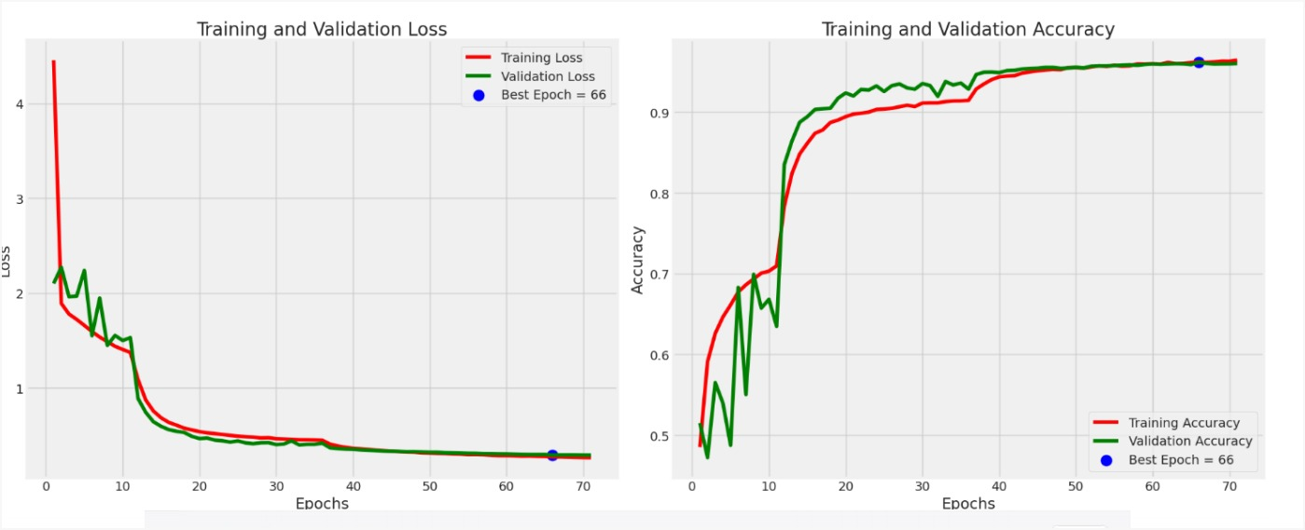
Results of Skin Cancer model
MediNova-AI
07

Slide 10
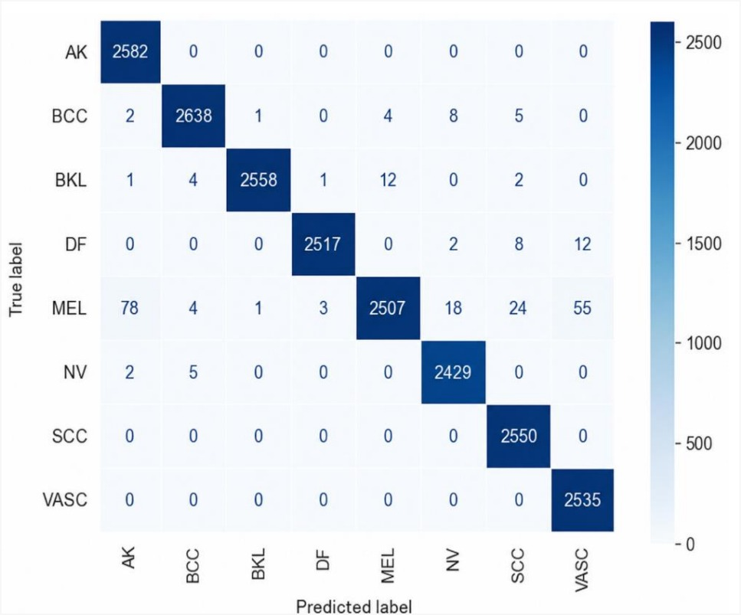
MediNova-AI
07

Slide 11
Breast Cancer Classification Model
Model Architecture: U-Net + MobileNetV2
Framework: TensorFlow Dataset: BUSI
Dataset :(15,000 ultrasound images) Input: Breast ultrasound images
Accuracy: 96.7%
Classification Classes (3):
Benign
Malignant
Normal
Training Challenges:
Accurate mask annotation
Speckle noise in ultrasound images
MediNova-AI
07

Slide 12
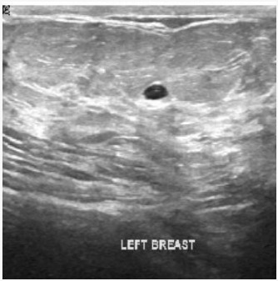
Sample of Breast Cancer Dataset
MediNova-AI
07

Slide 13
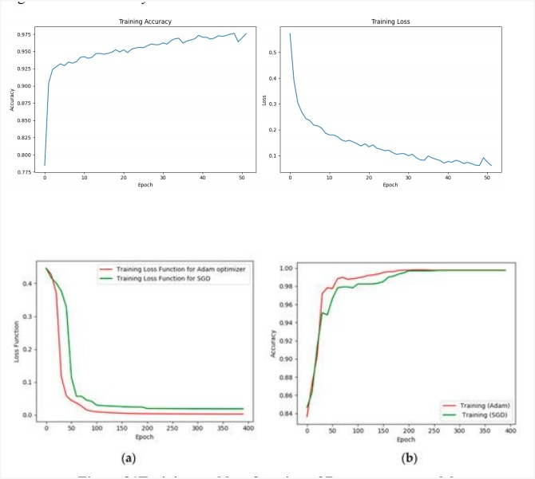
Results of Breast Cancer Dataset
MediNova-AI
07

Slide 14
Eye Disease Classification Model
Model Architecture:
EfficientNetB3
Framework: TensorFlow
Dataset: Fundus Dataset (15,000 retinal fundus images) Input: 224 × 224 fundus images
Accuracy: 97.8%
Classification Classes (4):
Cataract
Diabetic Retinopathy (DR)
Glaucoma
Normal
Training Challenges:
Variations in image quality
Reflections and illumination artifacts
Model Output:
Predicted eye disease class
Disease report with confidence score
MediNova-AI
07

Slide 15
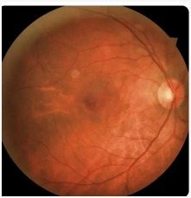
Sample of Eye Disease Dataset
MediNova-AI
07

Slide 16
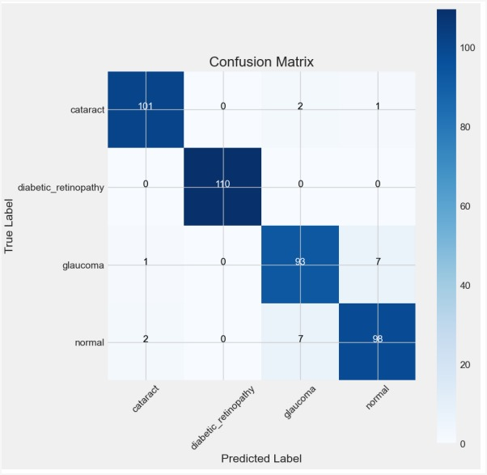
Results for Eye Disease
MediNova-AI
07

Slide 17
Brain Tumor Classification Model
Model Architecture:
VGG-like Convolutional Neural Network (CNN)
Framework: TensorFlow Dataset: MRI
Dataset (7,000 brain MRI images) Input: 224 × 224 MRI images Accuracy: 98.1% Classification Classes (4):
Glioma
Meningioma
Pituitary Tumor
No Tumor
Training Challenges:
Overfitting due to limited medical data
High memory consumption during training
MediNova-AI
07

Slide 18
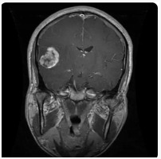
Sample of Brain Tumor Dataset
MediNova-AI
07

Slide 19
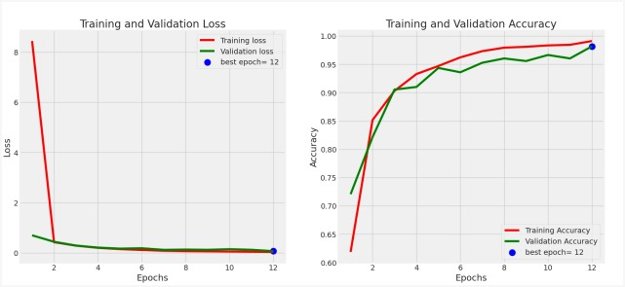
Results of Brain Tumor Dataset
MediNova-AI
07

Slide 20
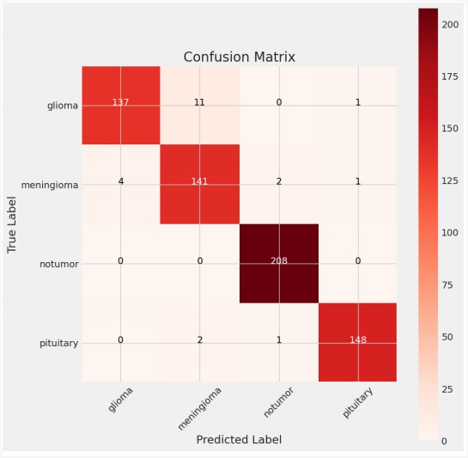
MediNova-AI
07

Slide 21
Heart Disease Analysis Model
Model Architecture: U-Net
Framework: TensorFlow
Dataset: Heart Echocardiography Dataset (13,000 images) Input: 128 × 128 echocardiography (Echo) images
Accuracy: 97.3%
Classification Classes (3):
Normal
Slightly Enlarged
Abnormal
Training Challenges:
Low image contrast
Variability in heart anatomy and image quality
MediNova-AI
07

Slide 22
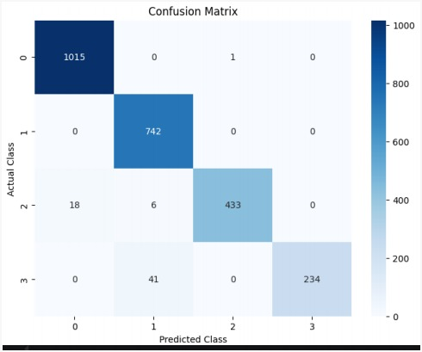
Resulte of Heart Disease dataset
MediNova-AI
07

Slide 23
Chest X-Ray Disease Classification Model
Model Architecture:
ResNet152 + EfficientNetB5 + Attention Mechanism
Framework: PyTorch
Dataset: Chest X-Ray Dataset (22,000 images) Input: 224 × 224 Chest X-ray images
Accuracy: 96.9%
Classification Classes (6):
COVID-19
Viral Pneumonia
Bacterial Pneumonia
Tuberculosis (TB)
Emphysema
Normal
Training Challenges:
Large model complexity
Class imbalance
MediNova-AI
07

Slide 24
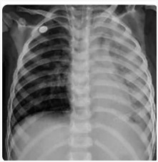
Sample Chest X-Ray of Disease Classification dataset
MediNova-AI
07

Slide 25
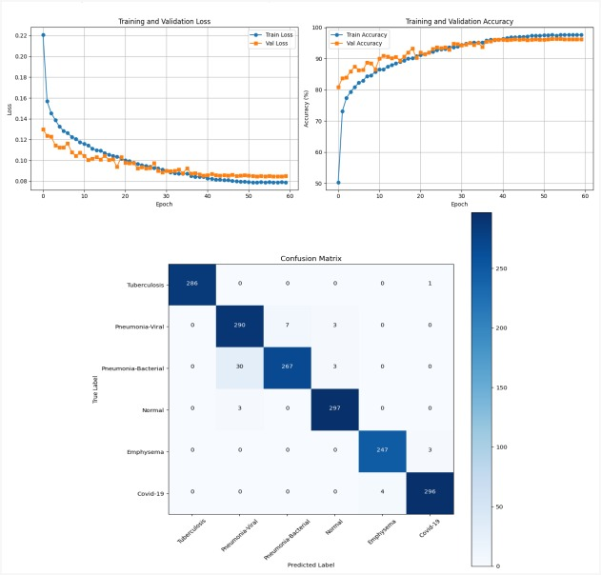
Results of Chest X-Ray Disease Classification
MediNova-AI
07

Slide 26
Kidney Disease Classification Model
Model Architecture:
Custom Convolutional Neural Network (CNN)
Framework: TensorFlow
Dataset: Kidney CT Dataset (8,000 CT images)
Input: 200 × 200 CT images
Accuracy: 97.5%
Classification Classes (4):
Cyst
Stone
Tumor
Normal
Training Challenges:
Similar appearance of different kidney abnormalities
Variations in CT image quality
MediNova-AI
07

Slide 27
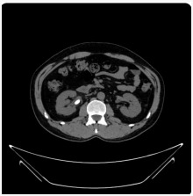
Sample of Kidney Disease dataset
MediNova-AI
07

Slide 28
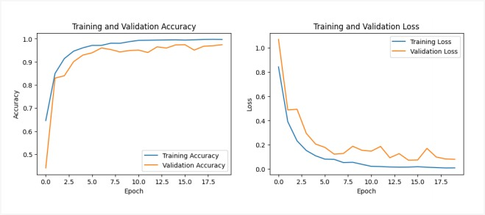
Results of Kidney Disease
MediNova-AI
07

Slide 29
MediNova-AI
07

Slide 30
WHERE MEDINOVA-AI GOES NEXT
Future Work
📱
🏥
🧩
Mobile-First Client
Clinical Validation Study
New Modalities
Ship a lightweight mobile app so patients can submit images and chat directly.
Partner with a clinical site for a prospective evaluation against specialist ground truth.
Extend the platform to additional imaging types and languages.
MediNova-AI
26

Slide 31
Conclusion
This project demonstrates the potential of Artificial Intelligence and Deep Learning in supporting the early detection of multiple diseases using medical images. By leveraging advanced CNN architectures and medical imaging datasets, the proposed models achieve high accuracy while providing fast and reliable predictions. Although AI is not a replacement for medical professionals, it can serve as an effective decision-support tool, helping improve diagnostic efficiency and patient outcomes
MediNova-AI

Slide 32
Thank You
Questions & Discussion
MediNova-AI

