Slide 2
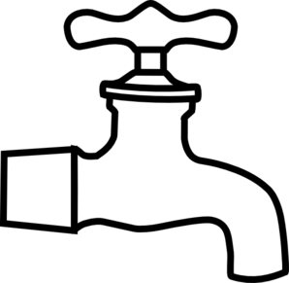


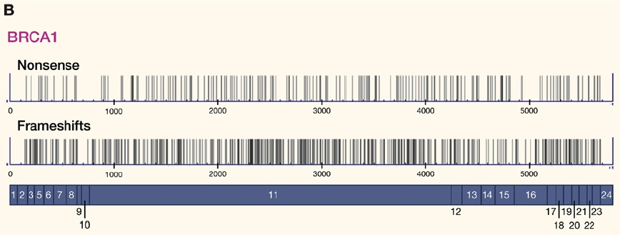
Mutation–selection balance
Mutation
Deleterious variants in the population
The gene BRCA1 is one out of about a dozen genes known to harbour loss-of-function mutations leading to breast cancer
Negative selection
At BRCA1, more than 1000 different alleles increase susceptibility to breast and ovarian cancers. The figure shows positions of frameshift and nonsense mutations along the gene, which is in blue, with exons indicated by numbers. Modified from McClellan & King (2010) Cell.

Slide 3
Mutation-Selection
Balance (MSB)
Mutation
Change due to mutation: Δq_{mut}= -Δp_{mut}=pμ
Change due to selection: Δq_{sel} = -(sh) pq
Deleterious variants in the population
These two rates of change are at equilibrium when
Δq_{mut} + Δq_{sel} =0
pμ - (sh)pq =0
We can do a similar calculation for totally
recessive mutations (h=0), and obtain
Negative selection
q_{eq} =μ/(sh)
q_{eq} = √ (μ/ s)
Haldane (1937)

Slide 4
Mutation–selection balance
s
Frequency
h
q_{e}
μ = 10⁻⁶
The more dominant a deleterious mutation is, the rarer it will be at mutation –selection balance.
Per-locus mutation rates are low and selection is effective
Notes:
There may be a huge number of loci at mutation–selection equilibrium (MSE).
MSE may be an important source of fitness variation in nature, and amount to a considerable genetic load (reduction in mean fitness).

Slide 5
Mutation–selection balance
At BRCA1, more than 1000 different alleles increase susceptibility to breast and ovarian cancers. The figure shows positions of frameshift and nonsense mutations along the gene, which is in blue, with exons indicated by numbers. Modified from McClellan & King (2010) Cell.
The frequency of frameshift and nonsense mutations at BRCA1 is about 1/1000. The BRCA1 gene has about 2500 coding bases, and the per-base pair mutation rate in humans is about 2×10^{–8} per generation. How strong is selection against an average loss-of-function mutation?
Notes:
The human mutation rate is 2x10⁻⁸ per base per generation
so the total mutation rate at BRCA1 is 5 x 10⁻⁵ (= μυ)
q = 1/1000 = μ/(sh) = 5x10⁻⁵ /(sh)
sh = 0.05

Slide 6
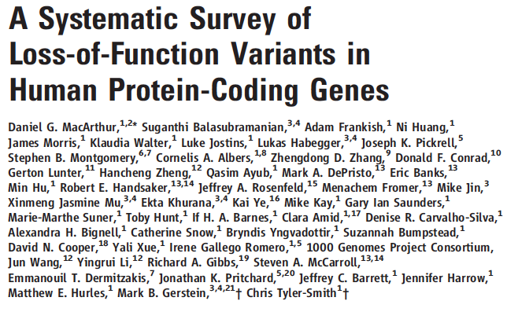
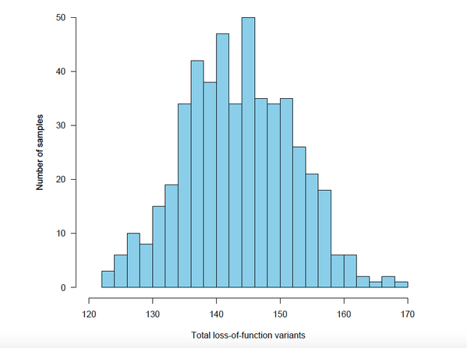
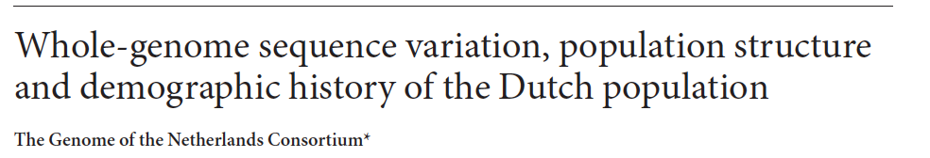
Implications
Deleterious alleles maintained at low frequencies in the population
But across the genome …
MacArthur et al. (2012 Nature) estimated that human genomes typically carry about 100 loss-of-function alleles (about 20 of them completely inactivated)
Thus, mutation–selection balance may be an important source of fitness variation in nature

Slide 7
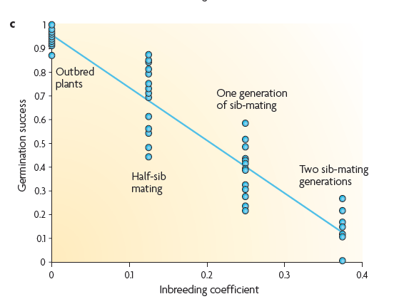
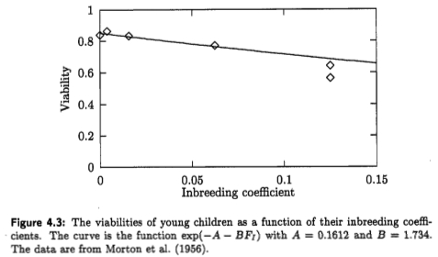
Inbreeding depression: Reduced fitness of inbred individuals (from normally outbred populations)
One of the first systematic surveys of inbreeding depression was conducted by Darwin (57 plant species)
All else being equal mutations that are more recessive
should segregate at high frequencies under mutation selection balance
Morton, Crow and Muller (1956)
First cousins
½ sibs
Silene latifolia (white campion)
from Charlesworth and Willis Nat Gen. ’09
Notes:
The Effects of Cross and Self Fertilization in the Vegetable Kingdom
Observed lower viability and fecundity of selfed offspring in nearly every case.

Slide 8
Spatially varying selection
and
migration–selection balance

Slide 9
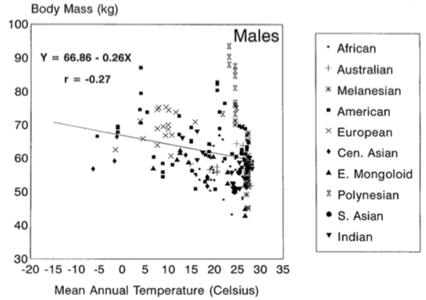
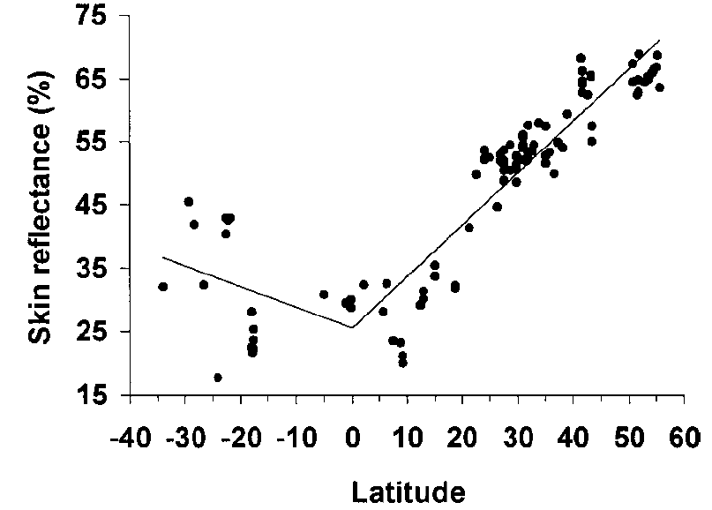
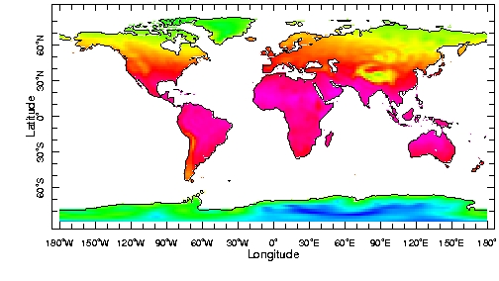
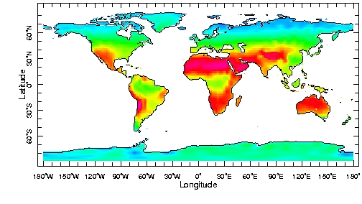
Clinal variation: local adaptation on broad scales
Human body mass and mean annual temperature
Skin reflectance and latitude
Katzmarzyk & Leonard (1998) Am J Phys Anthropol
previous study: Roberts (1953)
Relethford (1997) Am J Phys Anthropol
Mean temperature
Short-wave radiation
Notes:
Human body mass: Roberts (1953) analysed 116 male samples, and Katzmarzyk and Leonard (1998) analysed 223 male samples (as well as 154 female samples). The correlations found by Katzmarzyk and Leonard are weaker than those found 40 years earlier by Roberts. The authors explain this by secular influences; body mass and BMI have increased in tropical regions, as a consequence of increased health and wealth. Relethford’s (1997) analysis explains about 80% variation in skin reflectance.
Bergmann’s rule (body size), Allen’s rule (bpdy shape and proportions).

Slide 10
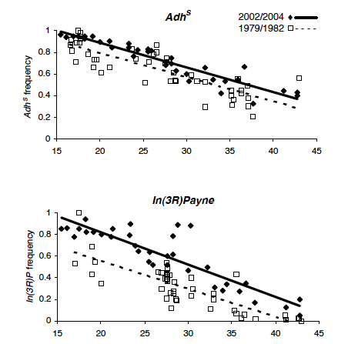
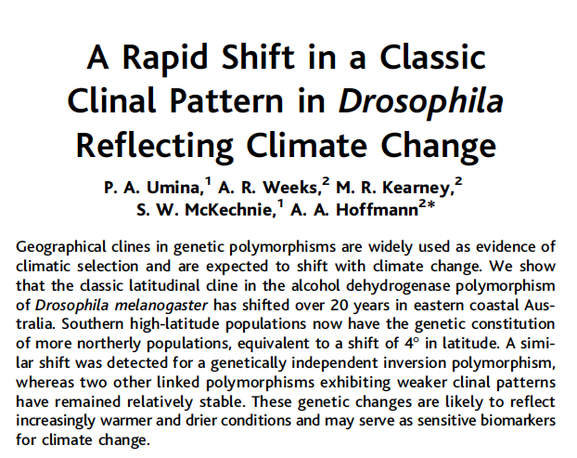
Clines in inversion frequencies in Drosophila
Latitude (degrees south)

Slide 11
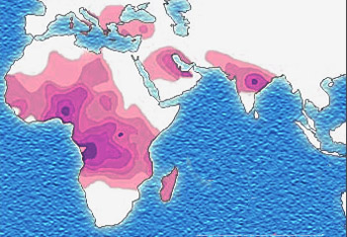
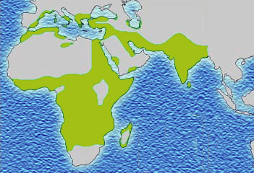
Allele-frequency clines
When selection pressures vary smoothly on a scale much greater than dispersal, and different alleles at the same locus are favoured in different environments, we observe clines in allele frequencies. These do not depend on migration.
Sickle allele distribution Malaria distribution
Notes:
11
When

Slide 12
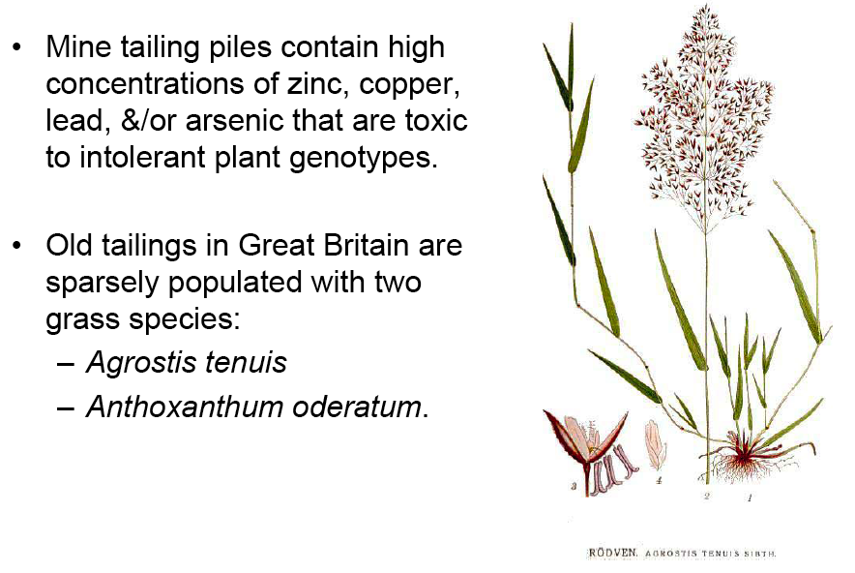
Local adaptation can occur on very short geographic scales
Macnair (1987) TREE

Slide 13
Modelling migration–selection balance
A simple haploid model
m
Population 1
Population 2
A₁ A₂
1 1 – s
m
A₁ A₂
1 – s 1

