Slide 1
Lecture 5

Slide 2
Reference Populations
Section 2.3.3 of notes
Identify origins of individuals
each with a single ancestry
Approaches: Based on Hardy-Weinberg genotype proportions
Adapted from John Novembre slide

Slide 3
Section 2.3.3 of notes
Reference Populations (known or unknown)
Identify ancestry proportions for individuals with admixed ancestry
Approaches: Structure (MCMC, Bayesian)
Or ADMIXTURE (quadratic programming)
Adapted from John Novembre slide

Slide 4
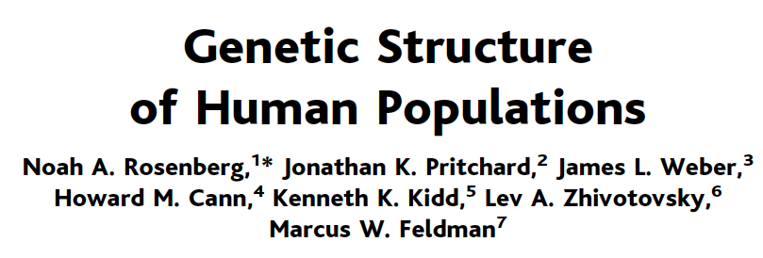
Africa Europe Middle East Central/South Asia East Asia Oceania America

Slide 5
Reference Populations
Identify origins of chromosomal segments in individuals of
admixed ancestry
Approaches: Based on Hidden Markov Models

Slide 6
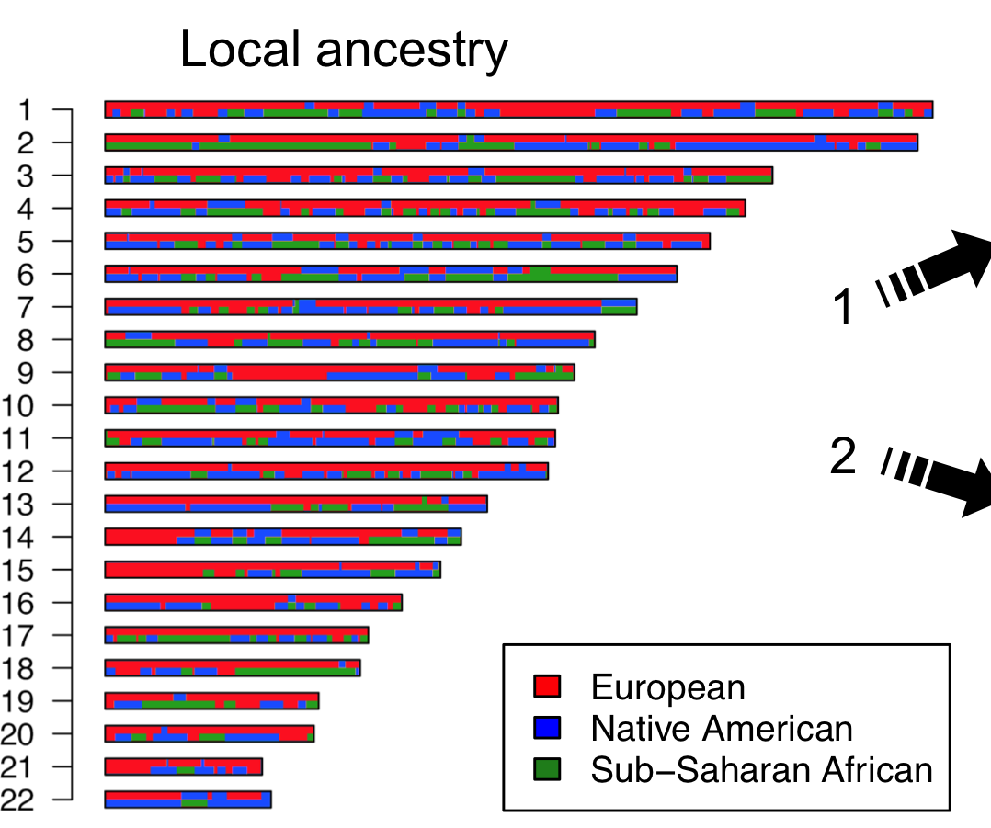
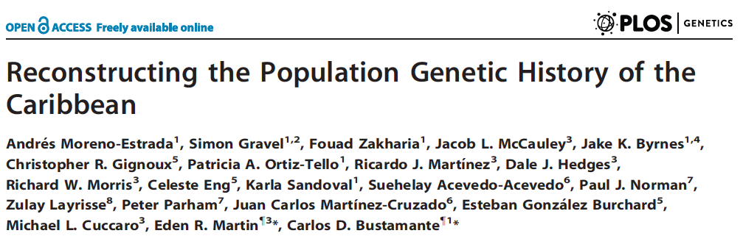

Slide 7
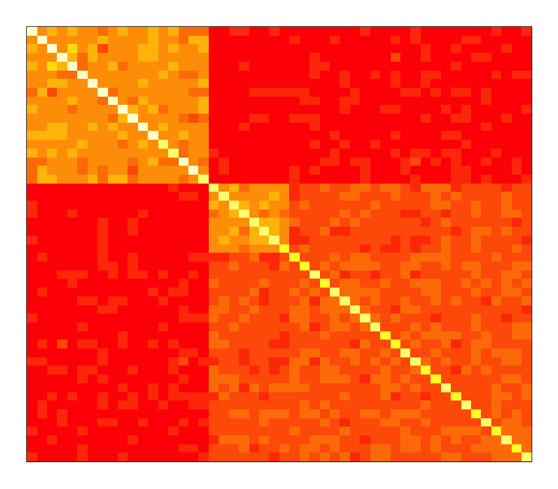
Example (Simulated data, N=50 individuals, L=1000 SNPs)
Principal components analysis
Section 2.3.4 of notes
Relatedness matrix R
20
10
30
i^{th} and j^{th} entry =average over loci (l) of (X_{li}-X_{l})(X_{lj}-X_{l})
Where X_{l} is mean freq. of the l^{th} locus.
Modified from slide by Gavin Band

Slide 8
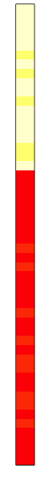
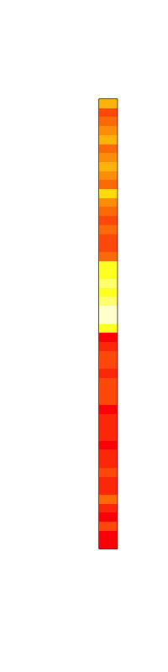
Example (Simulated data, 50 individuals, 1000 SNPs)
Principal components analysis
Principal components
Eigen-vectors)
Relatedness matrix R
v₁
v₂
Modified from slide by Gavin Band

Slide 9
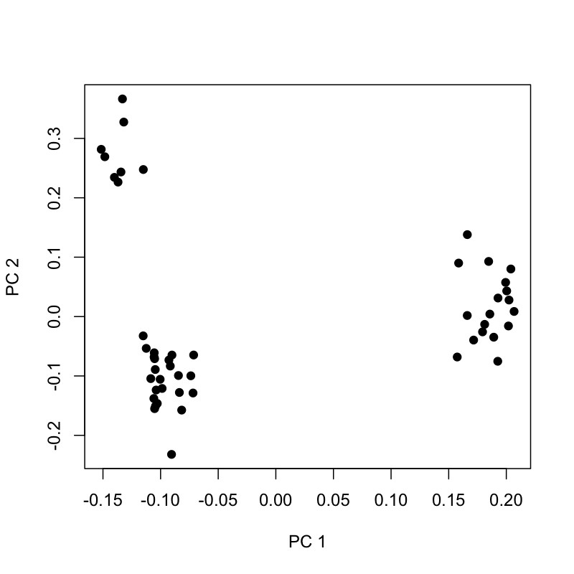
Example (Simulated data, 50 individuals, 1000 SNPs)
Principal components analysis
Eigenvectors
Relatedness matrix R
v₁
v₂
PC 1
PC 1
Modified from slide by Gavin Band

Slide 10
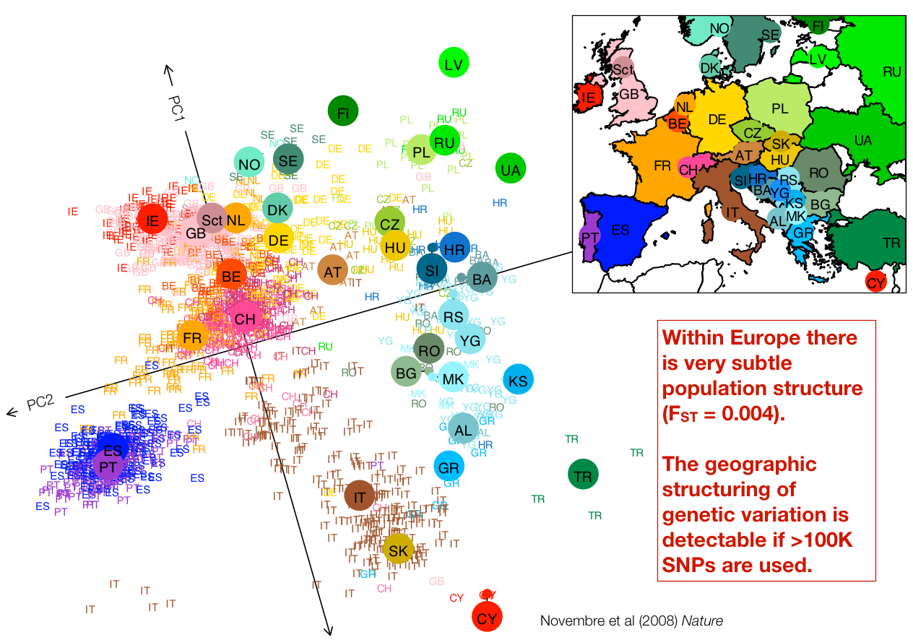
Principal Component Analysis of Europeans

