Slide 1



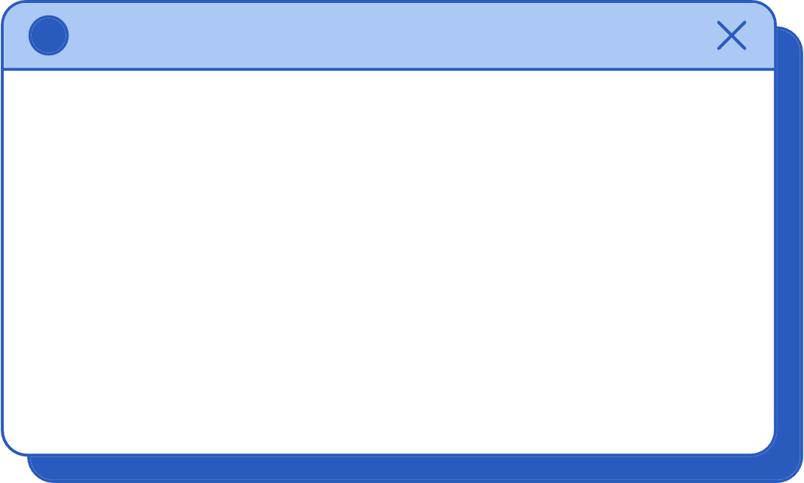


Qatar Vehicle Registration System
Team Members:
Alaa Elareer- Sara Alsada - Aisha Allenjawi

Slide 2


Qatar Vehicle Registration System: Overview and Progress
The Qatar Vehicle Registration System aims to streamline vehicle-related processes such as registration, accident reporting, ownership transfers, and payment of fines and invoices. This system is designed to benefit both car owners and regulatory authorities, offering an automated, efficient, and secure method to handle all these tasks

Slide 3


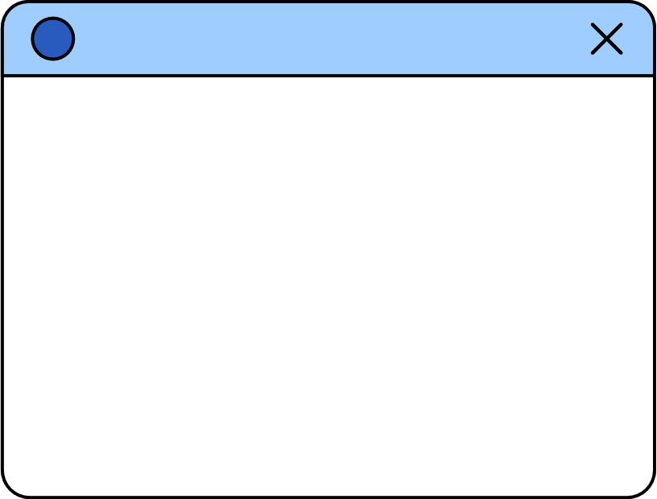


Objective
Simplify and digitize vehicle-related services for efficiency and user satisfaction

Slide 4
Technology Stack
Java, JavaFX, Scene Builder, Visual Paradigm, IntelliJ IDEA, JUnit, Pandoc.

Slide 5
Key Deliverables
Requirement Analysis and Design:
Data Flow Diagrams (DFDs).
Use Case Diagram.
Class Diagram.
Implementation:
Transfer Registered Vehicle.
Accident Reporting System.
3.User Interface Design :
JavaFX-based UI: Designed a responsive, user-friendly interface using JavaFX, integrating real-time form validation to enhance user experience and reduce input errors.

Slide 6
Key Deliverables
3. Testing and Quality Assurance:
Functional Testing:
Conducted thorough testing to ensure the core system features work as expected across various scenarios, including normal and alternative flows.
2. Non-Functional Testing: Performed tests to evaluate system performance, scalability, and security, ensuring the system meets non-functional requirements.

Slide 7
Milestone 1 - Software Requirements Analysis
In Milestone 1, the system’s requirements were analyzed and defined through key diagrams and use case specifications:
Data Flow Diagrams (DFD): Level 0 and Level 1 depict the flow of data between processes, external entities, and data stores within the system.
Use Case Diagram: Highlights core functionalities like Renew Registration, Register Vehicle, Ownership Transfer, and Pay Fines, showcasing user interactions and defining the system's scope.

Slide 8
Class Diagram
A Class Diagram represents the system's static structure, showing classes, their attributes, methods, and relationships.
Classes: Key entities like Vehicle, Owner, Accident Report, and Payment.
Attributes: Represent data (e.g., VIN, Owner’s QID).
Methods: Define operations (e.g., Transfer Ownership, Process Payment).
Relationships: Depict interactions between objects.

Slide 9
Use Case Specifications
Renew a Registered Vehicle.
Transfer Registered Vehicle:
Pay Fines and Invoices:
Transfer Unregistered Vehicle:
Each use case was analyzed and documented, defining:
1. Actors, preconditions, postconditions.
2. Normal and alternative flows.
Challenges Faced:
- Defining System Boundaries: Defining system boundaries and ensuring clear distinctions between different components (e.g., vehicle registration vs. accident reporting). - Identifying and Validating Actors and Interactions: Identifying and validating system actors and interactions.

Slide 10
Milestone 2 - Design and Implementation
Milestone 2 focused on designing and implementing core features, including:
Sequence Diagrams: For use cases like "Transfer Registered Vehicle" and "Pay Fines and Invoices.“
Class Diagram: updated.
Constraints & NFRs: Addressed performance, and Usability.
Use Case Implementation: Transfer Registered vehicle and Manage Accident.
Testing: Conducted unit, integration, and quality requirement testing.

Slide 11
The user interface (UI), built with JavaFX, emphasized ease of use and accessibility:
Key Features:
Real-time Form Validation: This ensures that users enter accurate information by immediately flagging any errors, reducing input mistakes.
Success/Error Messages: Provides clear and immediate feedback to users, confirming successful actions or guiding them to correct issues.
Responsive Layout: The UI dynamically adapts to different screen sizes,.
Implemented Use Cases:
Transfer Registered vehicle: VIN and QID form with validation.
Manage Accident Reports: Enables users to file and track accident reports for uploading details and optional payments via the qPay system.
Technologies: JavaFX, FXML, and SceneBuilder for streamlined design.
User Interface Design and Implementation

Slide 12
Testing for Core Functionalities
Unit Testing ensured core functionalities worked as expected:
testFileReport():
Verifies fileReport() initializes reports with accurate data.
Assertions: Non-null reportID, correct location, and proper vehicle assignments.
testSendToInsurance():
Verifies sendToInsurance() sets acknowledgment correctly.
Assertions: Acknowledgment includes “Acknowledged by Insurance Company.”
testStoreReport():
Verifies storeReport() saves reports to a file.
Assertions: Existence of AccidentReports.txt after saving.
Unit Testing:
All tests passed, verifying core functionalities like creating and storing reports and communicating with insurance companies.

Slide 13
Integration Test:
Integration Testing for Accident Reporting:
Test Case: testManageAccidentIntegration()
Objective: Simulate a real-world accident scenario to ensure seamless component interaction.
Process:
Initialize vehicles.
Create, acknowledge, and store an accident report.
Assertions:
Report ID is generated.
Accident location and vehicle details are captured.
Report is acknowledged and stored.
Results: Passed, confirming cohesive system functionality.

Slide 14
Non-Functional Requirement Testing
Availability Test:
Objective: Assess system efficiency under load.
Method: Simulated heavy calculations (e.g., summing numbers up to 100).
Result: The system performed without delays, confirming availability under normal usage.
Usability Test:
Objective: Ensure the system is user-friendly.
Method: Created an interactive interface for tasks like "Register Vehicle" and "Pay Fine," measuring task completion times.
Result: The system responded quickly, confirming it is intuitive and easy to use.

Slide 15
Challenges Encountered So Far
Integration Complexity: Managing interactions between components.
Performance Optimization: Handling large data efficiently.
UI/UX Design: Balancing functionality and usability.
Solutions were found through iterative development and testing.

Slide 16
Lessons Learned During the Project
System Design: Early detailed diagrams simplified development.
Decomposing Tasks: Breaking down features eased implementation.

Slide 17

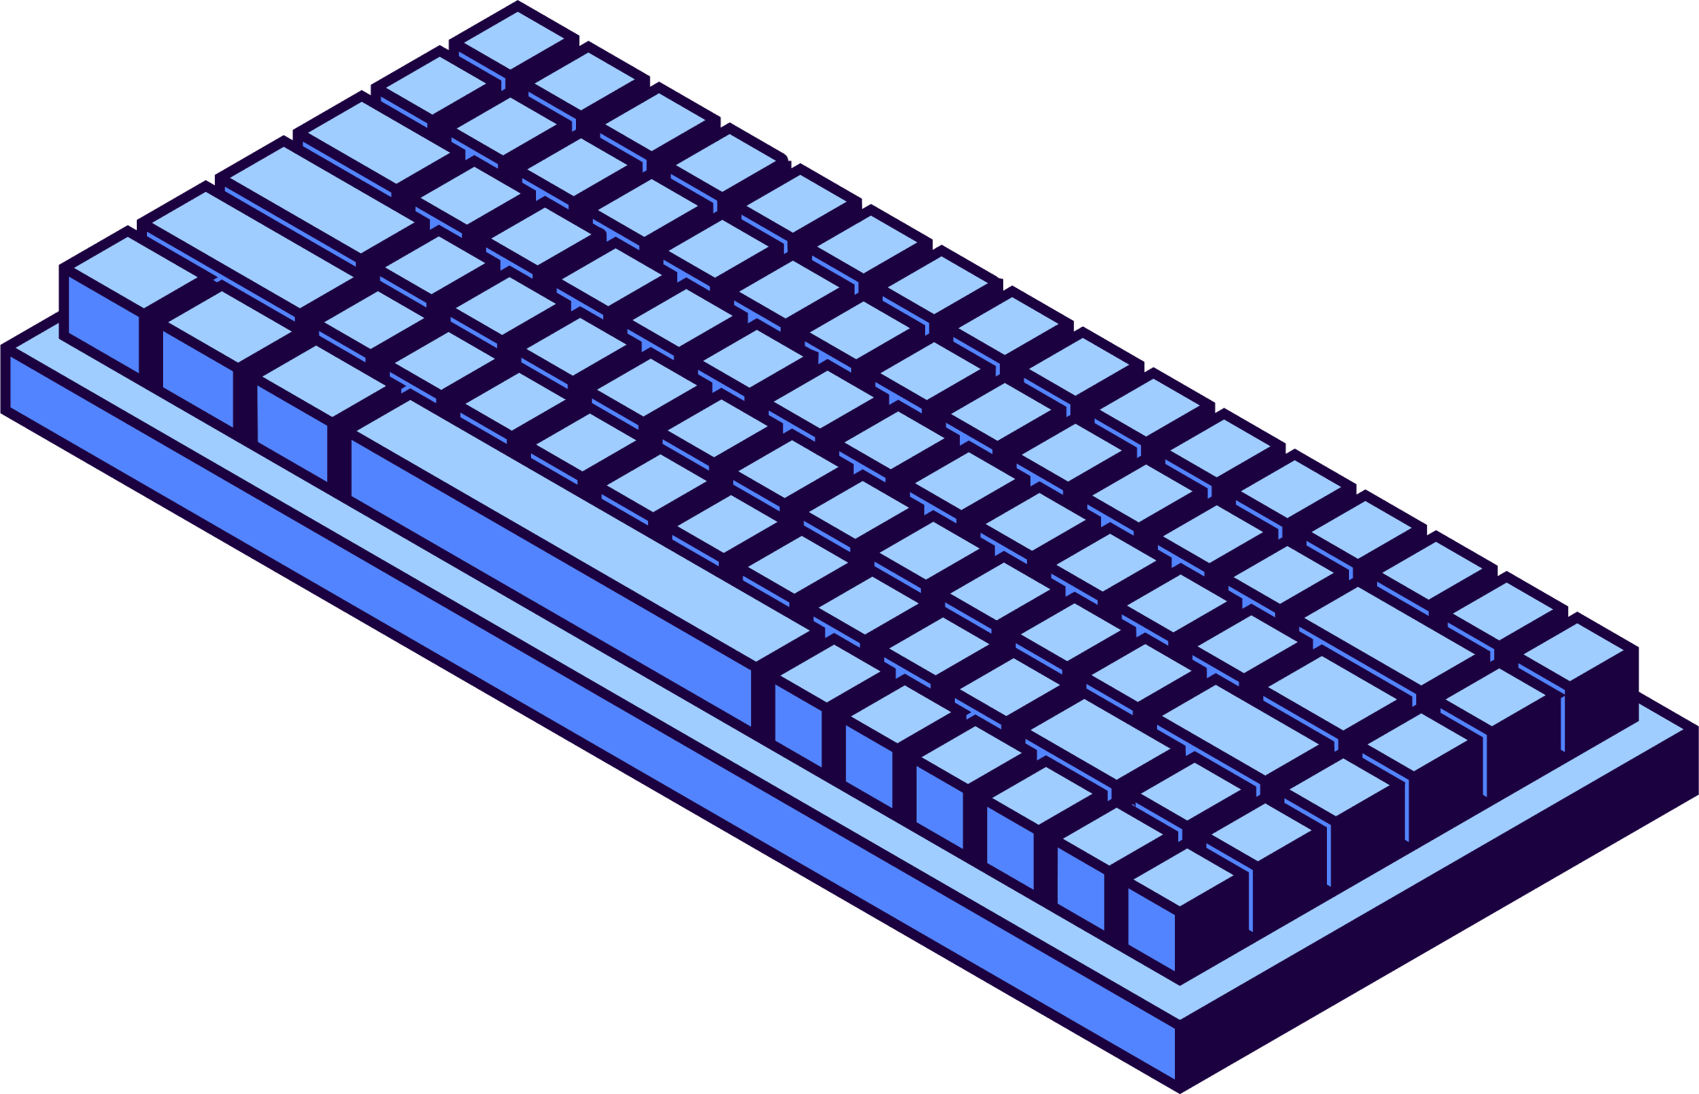
Future Work and Next Steps
Design Patterns Implementation: Apply at least two design patterns to improve architecture.
Project Management Deliverables: Create a Gantt chart and dependency graph to track progress.
Reflection and Team Evaluation: Prepare individual reflection reports on experiences, challenges, and lessons learned.

Slide 18


Conclusion
Significant progress has been made on the Qatar Vehicle Registration System. Core features such as accident reporting, ownership transfer, and payment processing have been successfully implemented and tested.
This project has provided valuable insights into system design, integration, and user-centered development. We look forward to finalizing the remaining tasks and delivering a robust, user-friendly solution

Slide 19


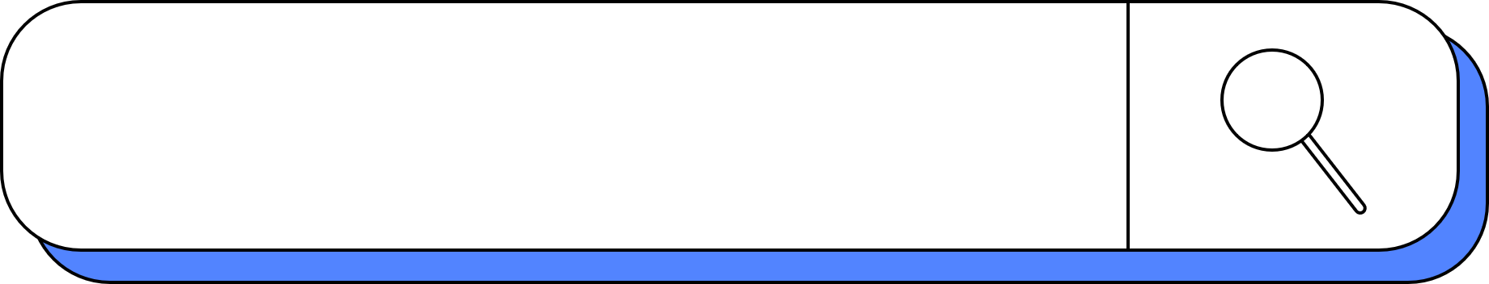
We Appreciate your Attention!
Any Questions?

