Slide 1
Body language presentation

Slide 2
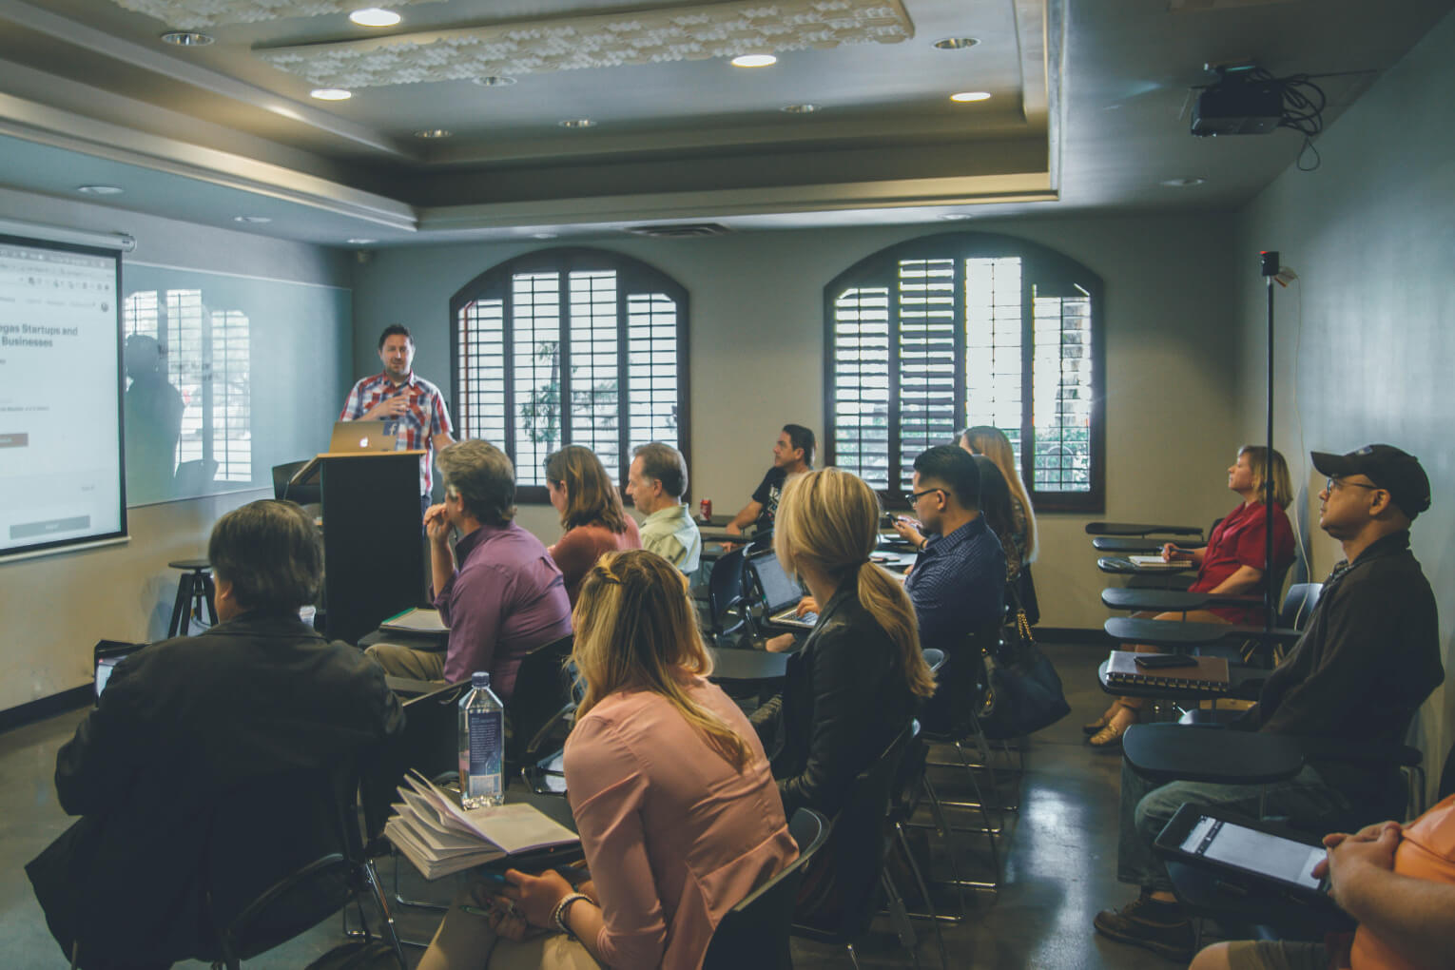
Seating Arrangements

Slide 3
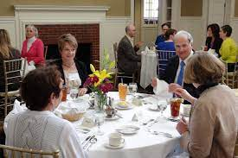
Seating Arrangments

Slide 4

Arm Signals

Slide 5
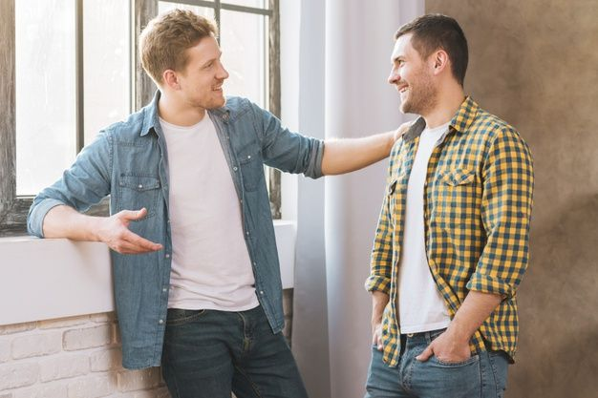
Arm Signals

Slide 6

Eye signals

Slide 7
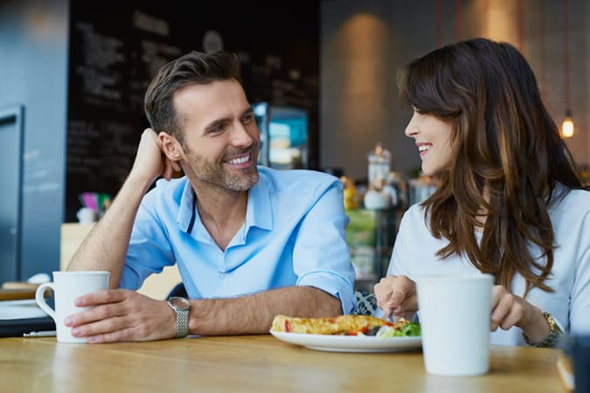
Eye signals

Slide 8
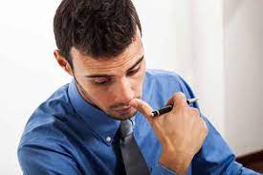
The head nod

Slide 9
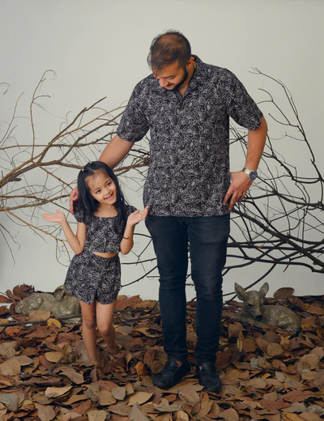
The head nod

Slide 10

Facial expression , smile

Slide 11
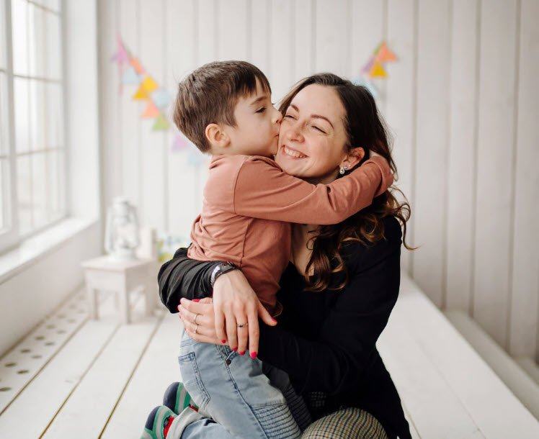
Facial expression , smile

