Slide 1

Brain
2025
Wave
ALI JAAFAR 6411
ALAA YEHIA 6432
PRESENTED TO
dr mohamad aoude

Slide 2

What is Brainwave?
01
A cutting-edge web platform designed to revolutionize summer school programs.
CLASS MANAGEMENT
TEACHER PROFILES & ANNOUNCEMENTS
AI CHAT ASSISTANT

Slide 3
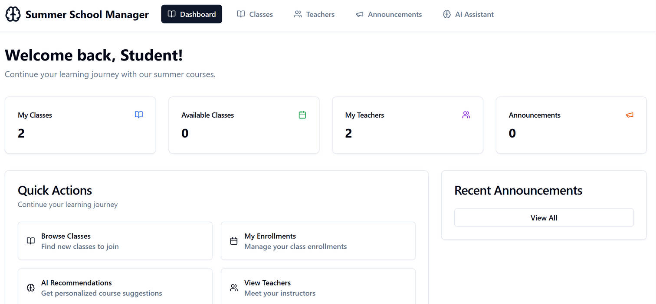
Key Features
02
Class Listings: Browse, enroll, and manage your summer schedule
Teacher Directory: View bios, experience, and expertise
Announcements: Stay up-to-date with instant school-wide updates
AI Chat Assistant: Personalized course suggestions, instant academic help

Slide 4




Tech Stack
03
LLAMA3
REACT
POSTGRESQL
NODE JS
LLM
FRONTEND
DATABASE
BACKEND

Slide 5

Data
Integration
04
Why we migrated from mock data:
Realism → Test with actual scenarios
Scalability → Future-proofing
Persistence → Data doesn't vanish on reload
Classes
Teachers
Announcements

Slide 6
Announcements
CLASSES
TEACHERS
ID
Title
Content
Priority
Category
ID
Name
Desc
Teacher
Schedule
Capacity
Enrolled
Category
Level
ID
Name
Bio
Specialities
Rating
Experience

Slide 7

Rule Based Assistant
04
MULTI-STEP FORM COLLECTS GRADES, INTERESTS, HOBBIES, AND LEARNING PREFERENCES.
STATE IS MANAGED WITH USESTATE TO TRACK FORM DATA AND CURRENT STEP.
A RULE-BASED ENGINE GENERATES UP TO 4 COURSE RECOMMENDATIONS.
FINAL SCREEN DISPLAYS PERSONALIZED COURSE CARDS WITH REASONS AND DIFFICULTY.

Slide 8
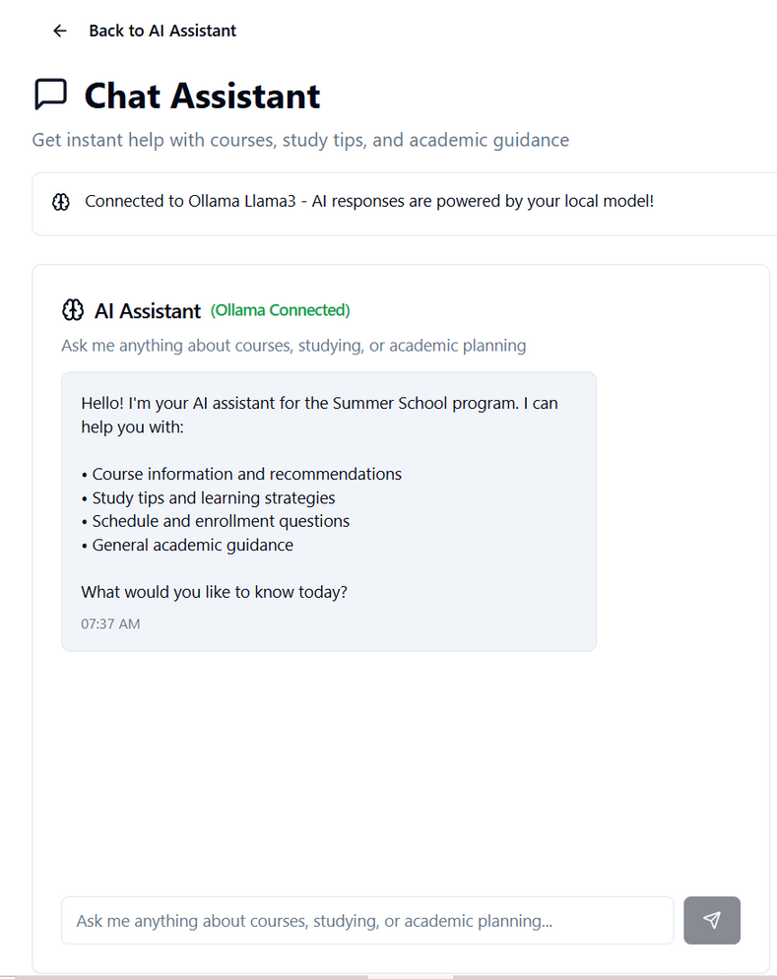
AI Assistant
02
Dynamic Prompting: The assistant uses top 5 fetched classes to build a strict system prompt ensuring only valid suggestions.
Live Chat UI: Users can ask questions; responses come from a TinyLlama model via a backend service.
Fallback Logic: If the AI response doesn't mention actual classes, it uses keyword-based matching to suggest relevant classes.

Slide 9
Challenges
07
Shifting from hardcoded to live database content
Large model sizes (Ollama download pains)
Handling API errors & edge cases

Slide 10



Future Work
06
MANAGER DASHBOARD
USER AUTHENTICATION
CALENDER

Slide 11
2025
Demonstration

