Slide 1


Khotwh website

Slide 2
Group names:
1-Alaa Ibrahim Mohamed
2-Heba Adel Saber
3-Ibrahim Ali Ibrahim(project leader)
Track:
Web Development Using(CMS)
supervisor: Eng/ Noha
Date:29-1-2022

Slide 3
Outlines: ▪ Background on the problem ▪ Competitors & Customers Analysis ▪ Proposed solution ▪ Stakeholders/Beneficiaries ▪ Tools & Technologies ▪ System Architecture ▪ Project Demo ▪ Presenting our project

Slide 4
Background on the problem
After we conducted an opinion poll, we found that 50% of people prefer to buy online via the Internet for several reasons, the first of which is due to the spread of the Corona virus and their fear of gatherings. Secondly, to gain time and reduce effort, and for several other reasons.

Slide 5


Competitors
features | khotwh | coctail | bambie | Lc waikiki
Mobile friendly
Rating system
Multi language
Size guide
Clear
Ease of use
Order tracking

Slide 6
Customer analysis the customer we target women and men at a different ages and their needs to buy clothes and find variety in our store.

Slide 7
Proposed solution The goal of the project is to facilitate the process of buying for people from anywhere in the world while they are in their home without the need to go to the store and waste a lot of time and help the elderly and people with special needs to meet their needs with ease Also, our project helps the business owner to spread in many places, increase his profits, increase his sale of products, and increase his spread in the market because it meets all desires in a wide range and competes with many international brands.

Slide 8
Stakeholders: owner of the project customers admin
“
”

Slide 9
Tools & Technologies:
using wordpress
Basel theme and plugins(All-in-One WP Migration for Backup, Contact Form 7 for forms , Elementor for design, WooCommerce for products , all in one SEO)
Using php and css

Slide 10
Plan for project launch
Deploy strategic networks with compelling e-business needs5
Planning
Synergize scalable e-commerce
Marketing
Disseminate standardized metrics
Design
Coordinate
Launch
e-business applications
1
2
3
4

Slide 11
Timeline
Upload the project to github
& check every thing is done
7 Jan 2023
Our work plan
10 Jan 2023
We search about
Hosting website
12 Jan 2023
We determined what each
One will do and help each
other
20 Jan 20XX
We are shared for making
29 Jan 2023
A documentation and presentation

Slide 12
demo Video

Slide 13
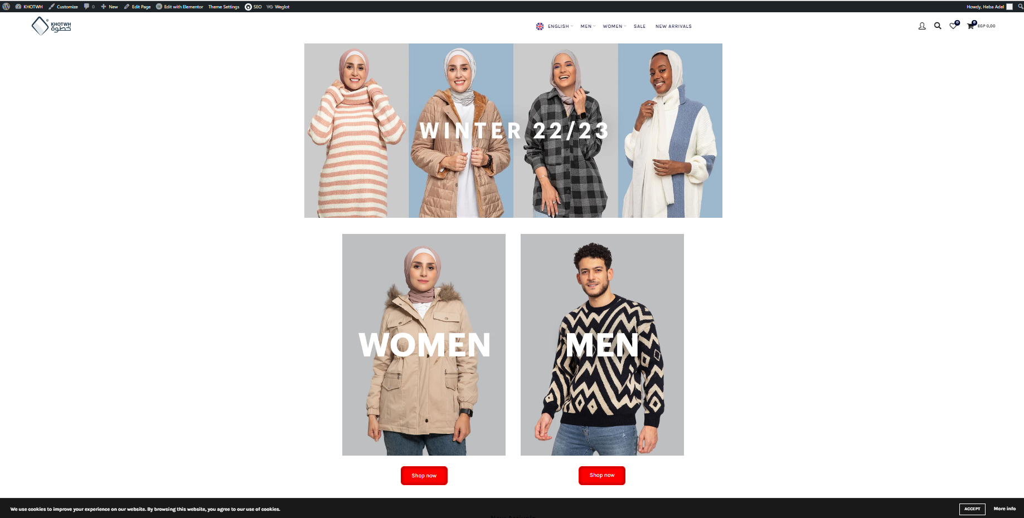
land page

Slide 14
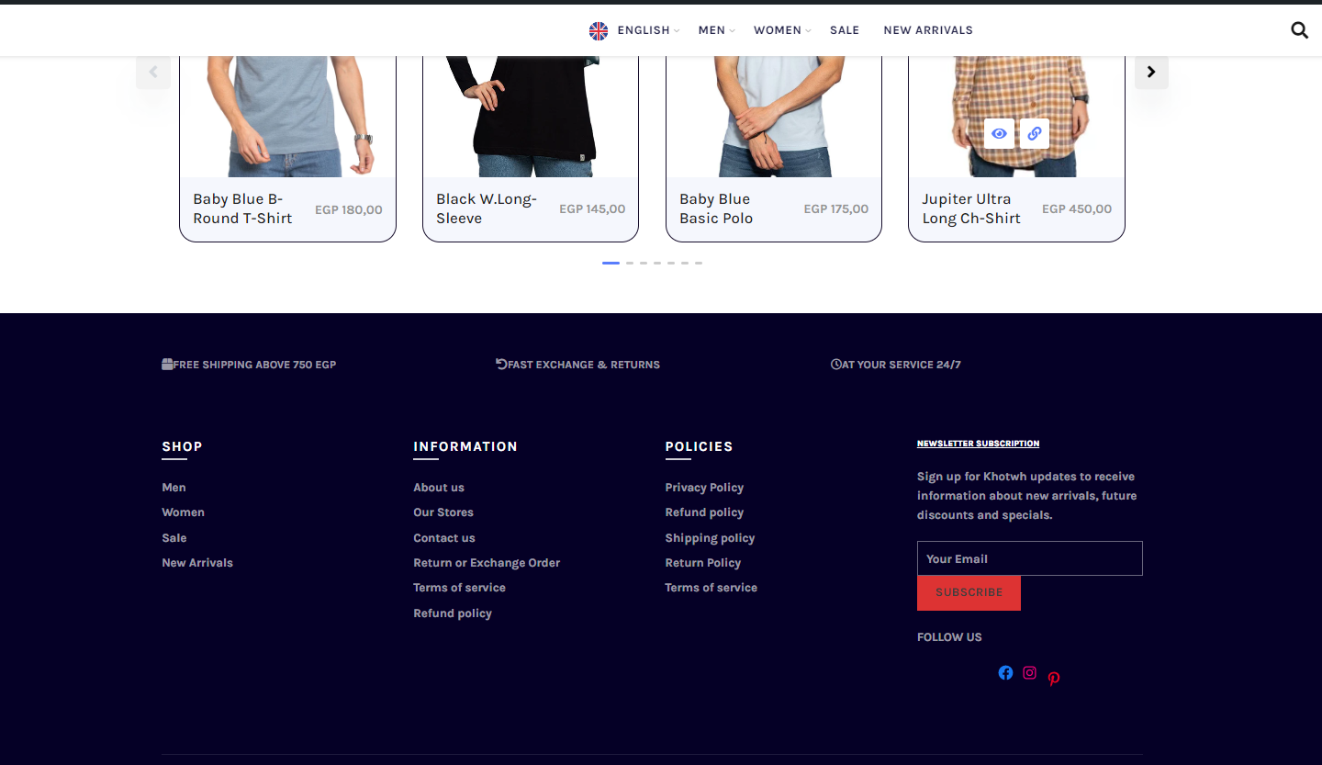

Slide 15
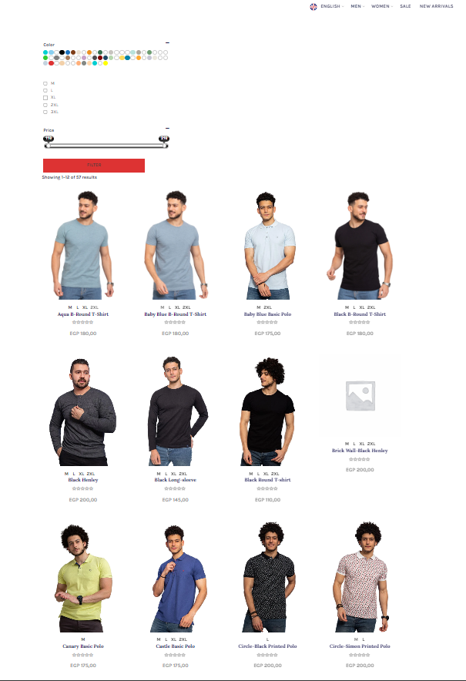

Slide 16
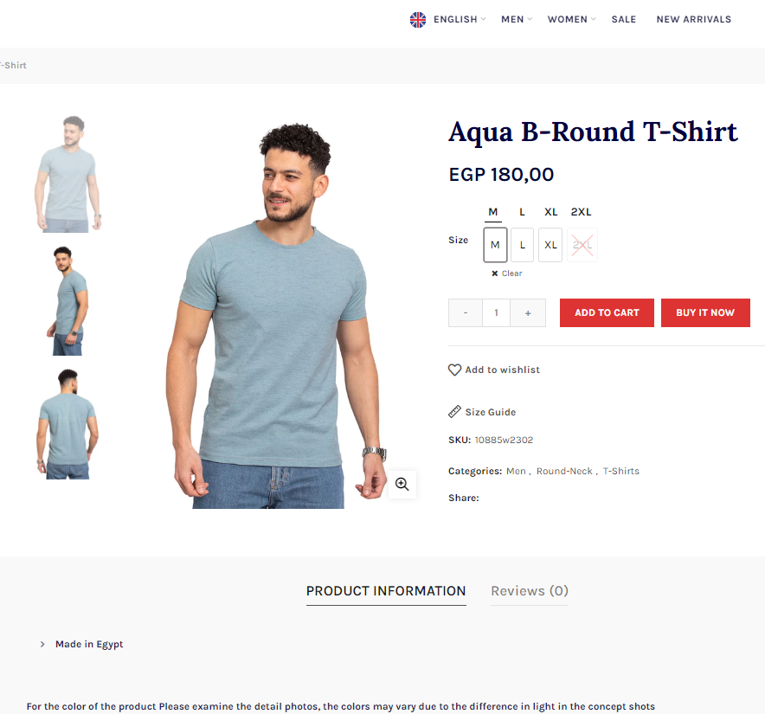

Slide 17
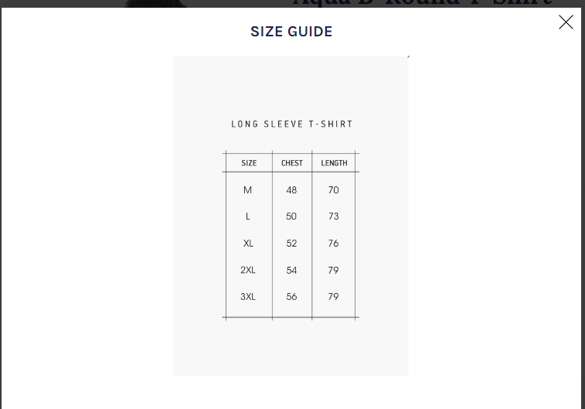

Slide 18
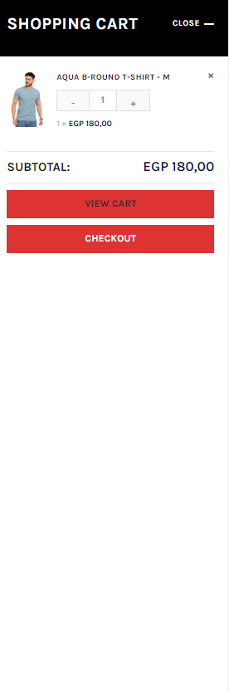

Slide 19
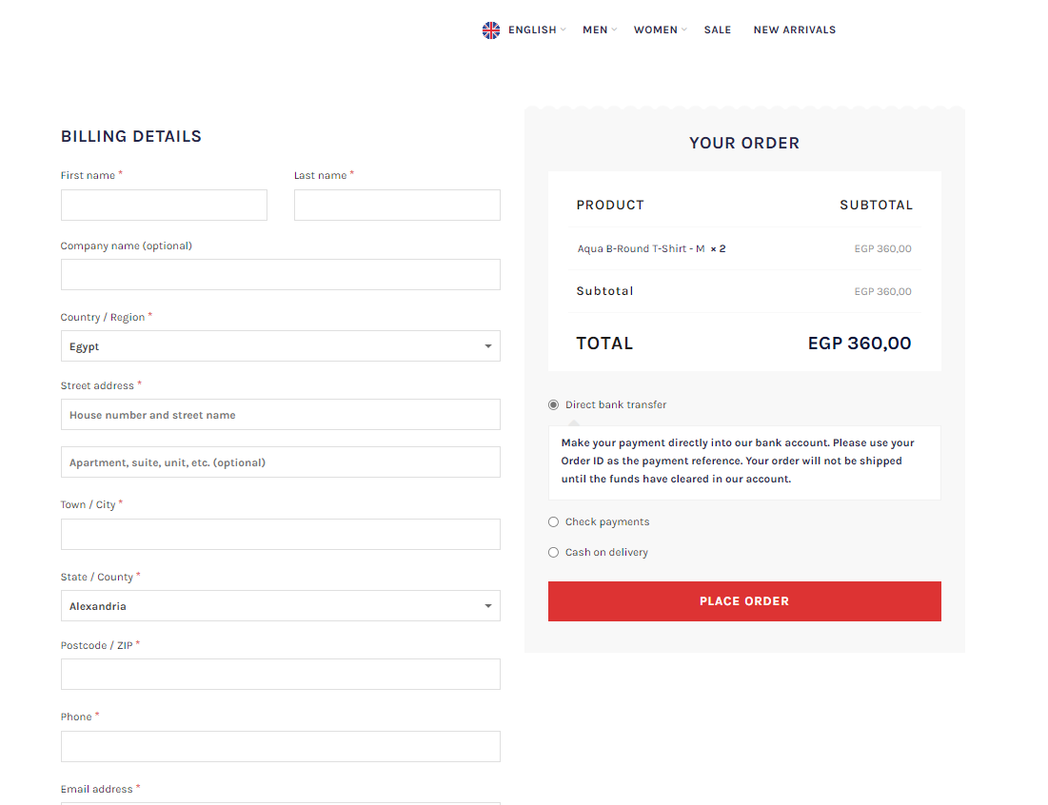

Slide 20
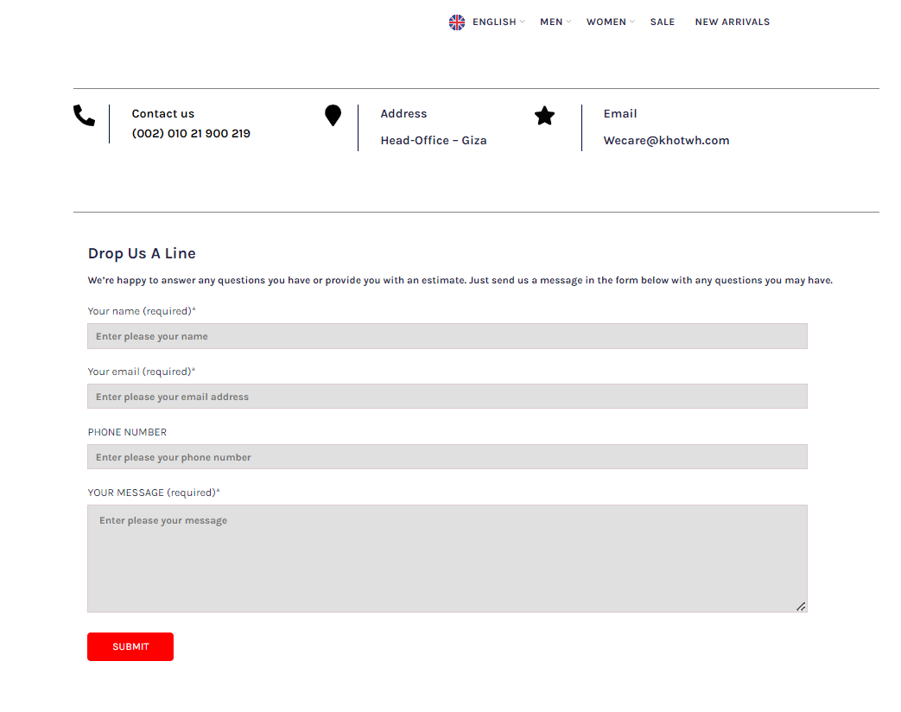

Slide 21
Thank you

