Slide 1
Mobile Robots Final Presentation
Group 17 Ahmed Saadallah
Alaa Maghrabi
Grégoire Ferracci
Hala Khodr

Slide 2
Introduction
Calibration
Positioning
Triangulation
Odometry
Kalman

Slide 3
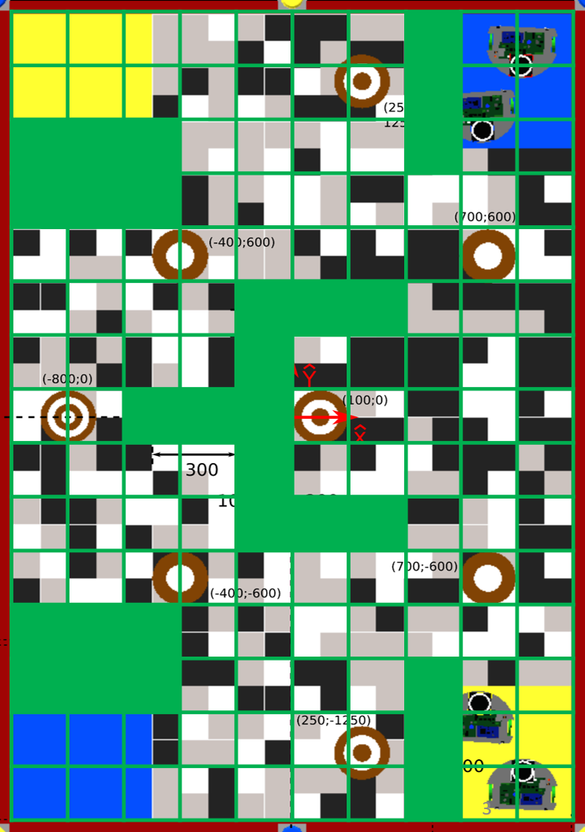
Path Planning
MAP: Divided into 200x200 mm²
A* heuristic function: euclidian distance
•Why?
•Optimal since our heuristic is admissible
•Complete
•No local minima
Opponent detection:
The opponent detection gives back a boolean -> redo the path
planning but with adding the opponent position + a safe
area around him as an obstacle

Slide 4
Path regulation
Based on odometry
Smooth PD regulator on speed and angular speed to make curves
Limited acceleration
Deceleration phase
Stop the robot at each end of path
Safety

Slide 5
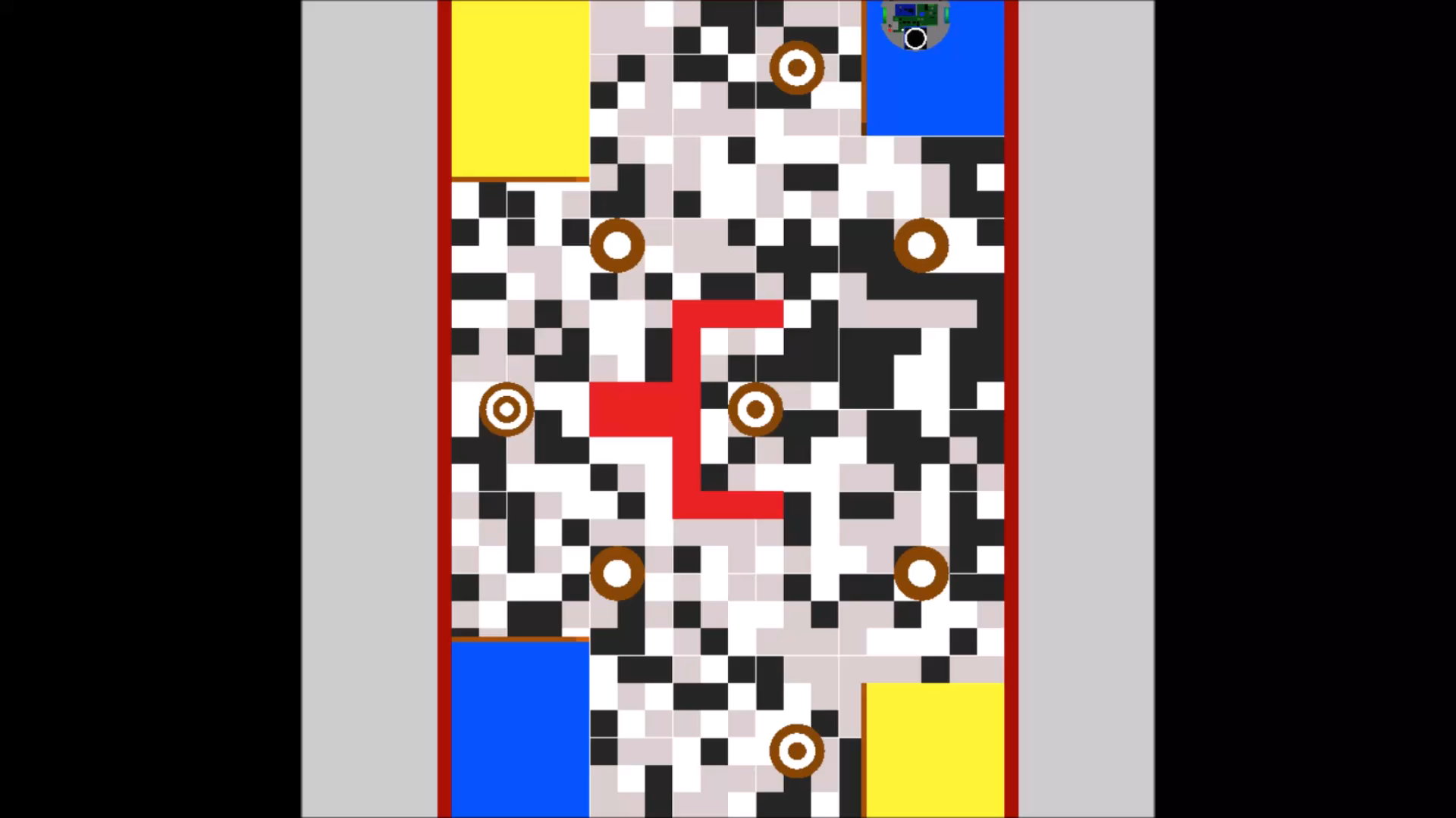
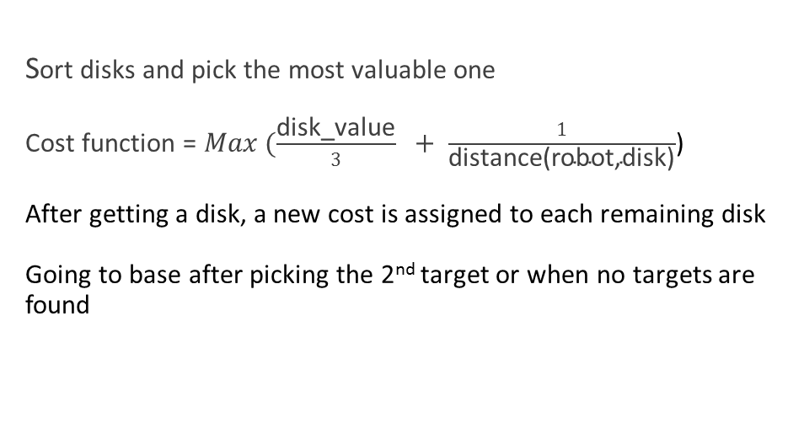
Strategy
General plan

Slide 6
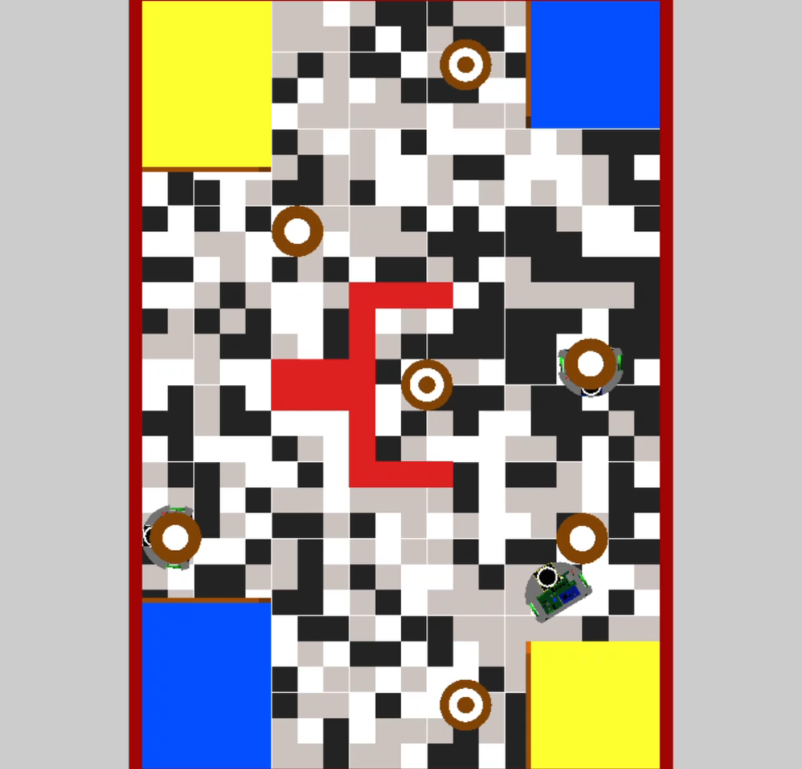
Different scenarios
Getting in the way of the robot:
use of opponents avoidance
keep searching for an alternative path

Slide 7
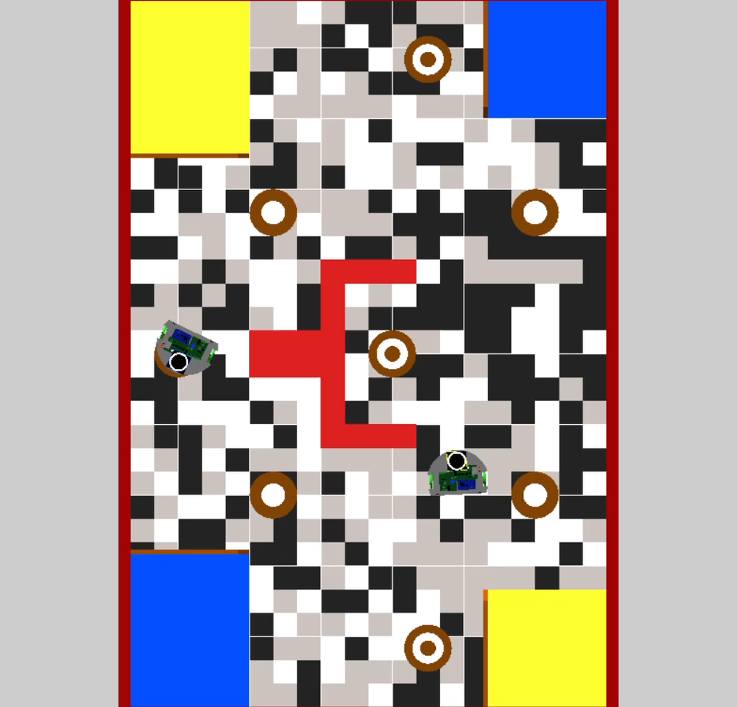
Taking a target Removing target taken from the list of disks sort disks and pick which to pursue Initiate a new path plan

Slide 8
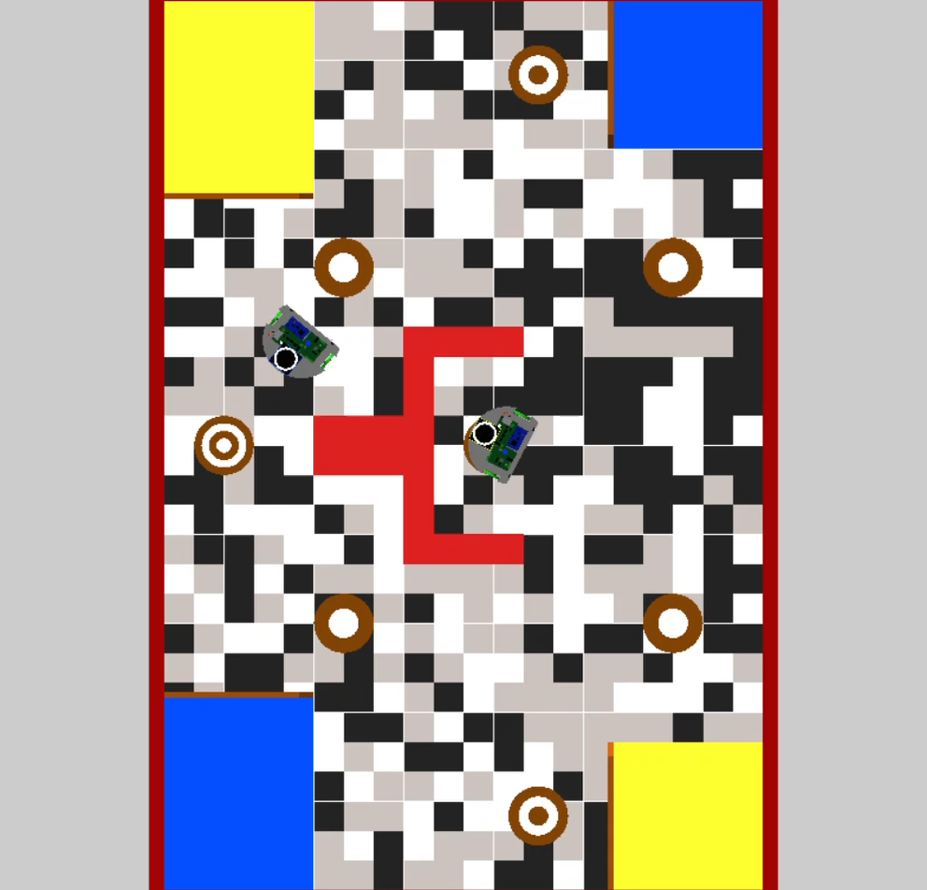
Taking a targeted disk
remove taken disk
initiate a new disk and path search
Failing to get the targeted disk
reconsider other targets and start a new path

Slide 9
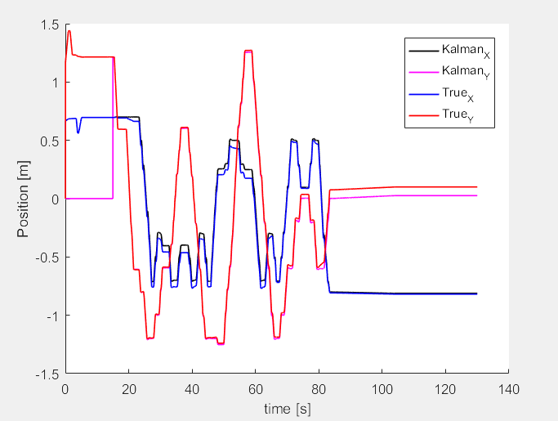
Drawbacks
Odometry inaccuracy :
Hitting walls and missing disks.
failing to detect the opponent.
Sometimes the disks are placed at the
limit of the base and not accounted for
Avoid 2 opponents :
Detection problems with two opponents : noisy signal
Replacing the disks : Failing to detect them

Slide 10
Thank you for your attention!

